Slide 1



Nb₃Sn growth by sequential sputtering: film morphology and its RF properties
Md Nizam Sayeed, Hani E. Elsayed-Ali (Old Dominion University)
Uttar Pudasaini, Charles E. Reece (Jefferson Lab)
Grigory V. Eremeev (Fermilab)
Frank Batten College of
Engineering & Technology
Old Dominion University: www.eng.odu.edu

Slide 2
Outline
Research motivation
Research approach
Characterization results
Summary
Frank Batten College of
Engineering & Technology
Old Dominion University: www.eng.odu.edu

Slide 3
Research motivation
Why Nb₃Sn and why magnetron sputtering?
Nb cavities are approaching the intrinsic material limit.
Higher T_{c} and H_{sh} of Nb₃Sn promise potential cavity operation at higher temperatures and higher E_{acc}.
Disadvantage- brittle structure and lower thermal conductivity.
Phase | T_{c} (K) | H_{sh} (mT)
Nb | 9.25 | 200
Nb₃Sn | 18.3 | 400
Frank Batten College of
Engineering & Technology
Old Dominion University: www.eng.odu.edu

Slide 4
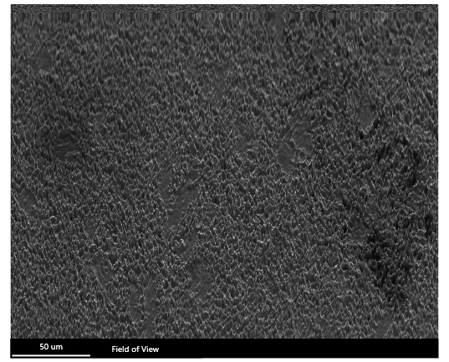
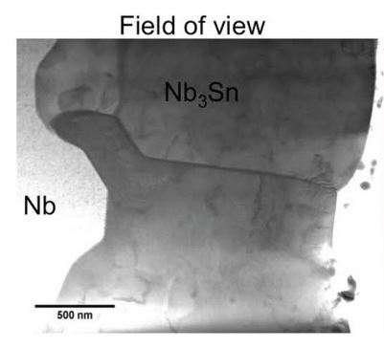
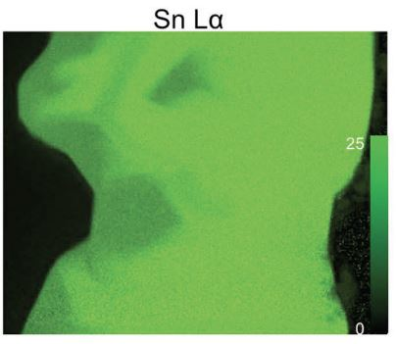
Research motivation
Why Nb₃Sn and why magnetron sputtering?
Limitation of vapor diffused film:
Patchy regions with low Sn composition
Stoichiometry control
Thin patchy region with lower Sn concentration
Advantages of magnetron sputtering:
Stoichiometry of Nb and Sn can be controlled.
Relatively less annealing temperature is required- possible to use in copper cavities.
Figure: SEM image of vapor diffused Nb₃Sn film [1].
Figure: Sn concentration gradient on vapor diffused Nb₃Sn film [2].
[1] U. Pudasaini, contribution at The 8th Thin films and new ideas for SRF Workshop, 2018.
[2] Becker, Chaoyue, et al. Applied Physics Letters 106.8 (2015): 082602.
Frank Batten College of
Engineering & Technology
Old Dominion University: www.eng.odu.edu

Slide 5
Research goals
Growth technique of Nb₃Sn by magnetron sputtering.
Measurement of RF superconducting properties of the fabricated films.
Design of a magnetron sputtering system of single-cell cavity coating.
Frank Batten College of
Engineering & Technology
Old Dominion University: www.eng.odu.edu

Slide 6
Nb₃Sn by multilayer sequential sputtering
Multilple layers of Nb and Sn sputter sequentially.
Deposition rate: 1 Å/s.
Sputtering pressure: 3 mTorr 20 SCCM.
Substrate rotation: 30 rpm.
Multilayers annealed: 850- 1200 °C, 1- 12 h.
Substrate
Ar gas
Vacuum pump
Ar⁺
Nb target
Sn target
DC
RF
Nb film
Sn film
Figure: Schematic diagram of the sequential sputter deposition.
Frank Batten College of
Engineering & Technology
Old Dominion University: www.eng.odu.edu

Slide 7
Nb₃Sn by multilayer sequential sputtering
Parameters to optimize
  Effect of annealing temperature and time,
  Effect of thickness,
  Effect of substrate temperature,
  Effect of annealing ramp rate.
Frank Batten College of
Engineering & Technology
Old Dominion University: www.eng.odu.edu

Slide 8
Effect of annealing temperature
1 µm thick multilayer of Nb (20 nm thick) and Sn (10 nm thick) deposited.
Annealed temperature: 850, 950, 1000, 1100, and 1200 °C for 3 h.
Frank Batten College of
Engineering & Technology
Old Dominion University: www.eng.odu.edu

Slide 9
Structural properties
As-deposited film
Annealed film at 950 °C
Figure: X-ray diffraction pattern of as-deposited and annealed films.
Frank Batten College of
Engineering & Technology
Old Dominion University: www.eng.odu.edu

Slide 10
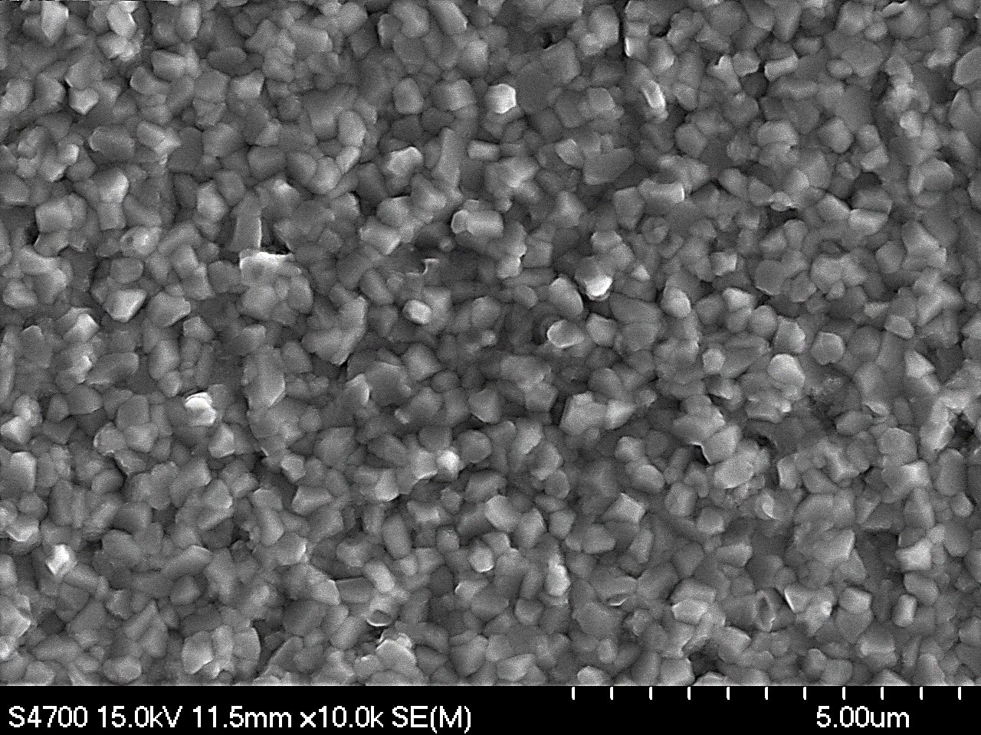
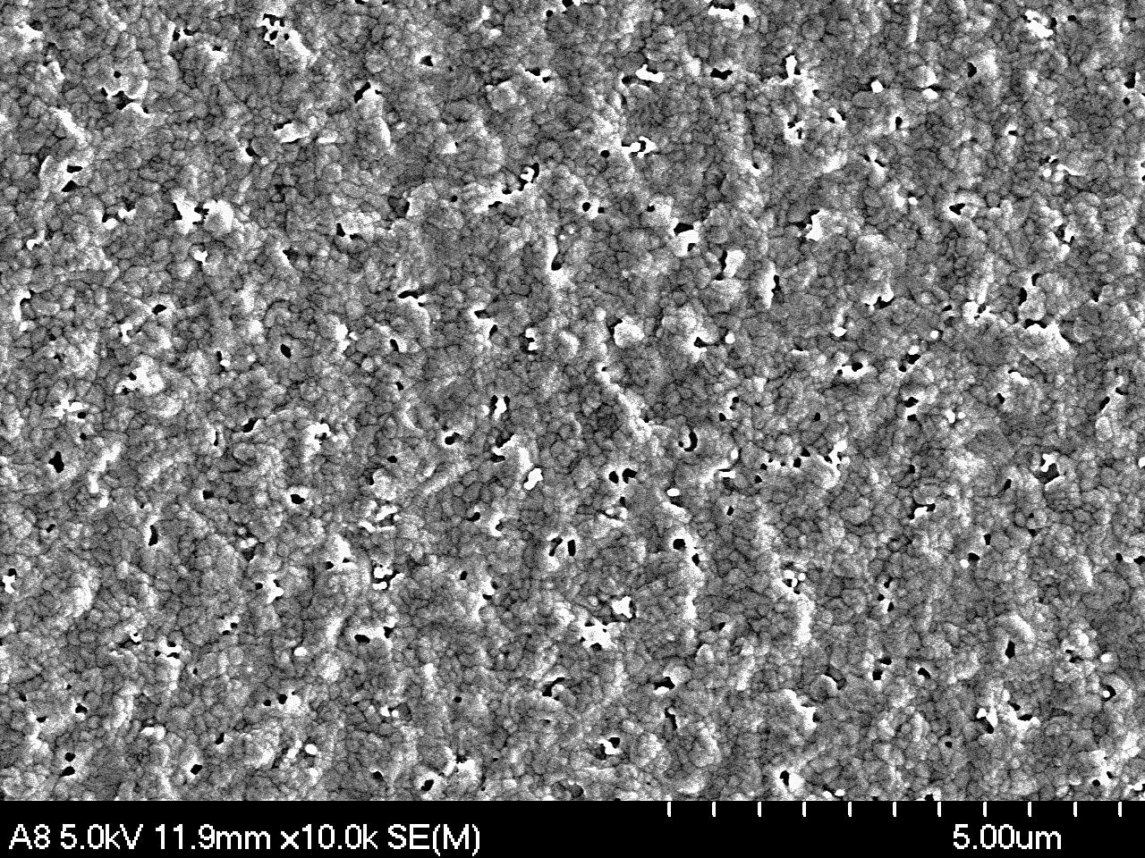
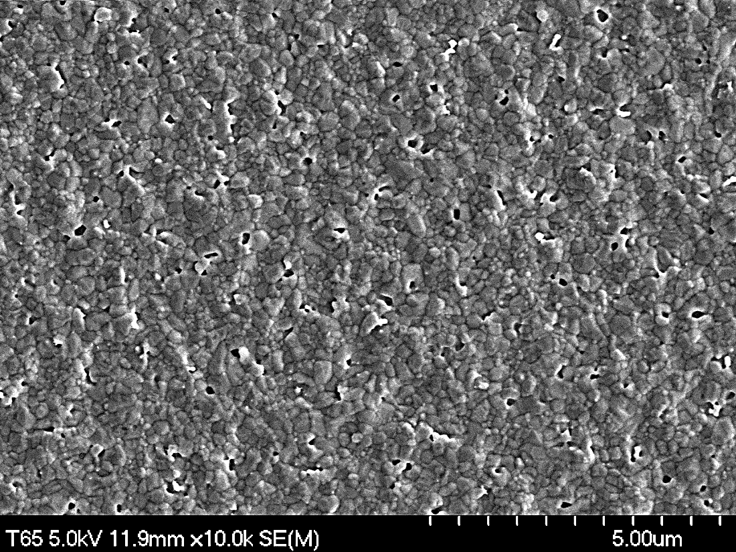
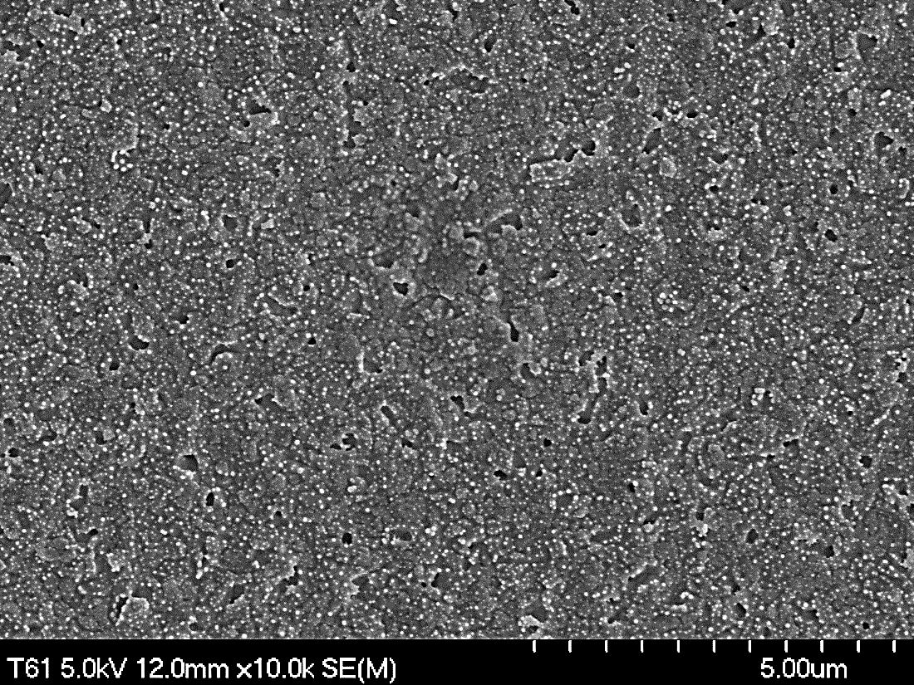
Effect of annealing temperature
As-deposited
Annealed- 850 °C 3 h
Annealed- 950 °C 3 h
Annealed- 1000 °C 3 h
Annealed- 1100 °C 3 h
Annealed- 1200 °C 3 h
Frank Batten College of
Engineering & Technology
Old Dominion University: www.eng.odu.edu

Slide 11
Effect of annealing temperature
As-deposited
Annealed- 850 °C 3 h
Annealed- 950 °C 3 h
Sn ~ 23.2 %
Sn ~ 21.6 %
Sn ~ 21.6 %
T_{c} 17.61 K
T_{c} 17.63 K
Annealed- 1000 °C 3 h
Annealed- 1100 °C 3 h
Annealed- 1200 °C 3 h
Sn ~ 19.6 %
Sn ~ 6.1 %
Sn ~ 0.8 %
Figure: Resistivity vs temperature.
T_{c} 17.66 K
T_{c} 17.53 K
T_{c} 7.9 K
M.N. Sayeed et al. https://doi.org/10.1016/j.jallcom.2019.06.017
Frank Batten College of
Engineering & Technology
Old Dominion University: www.eng.odu.edu

Slide 12
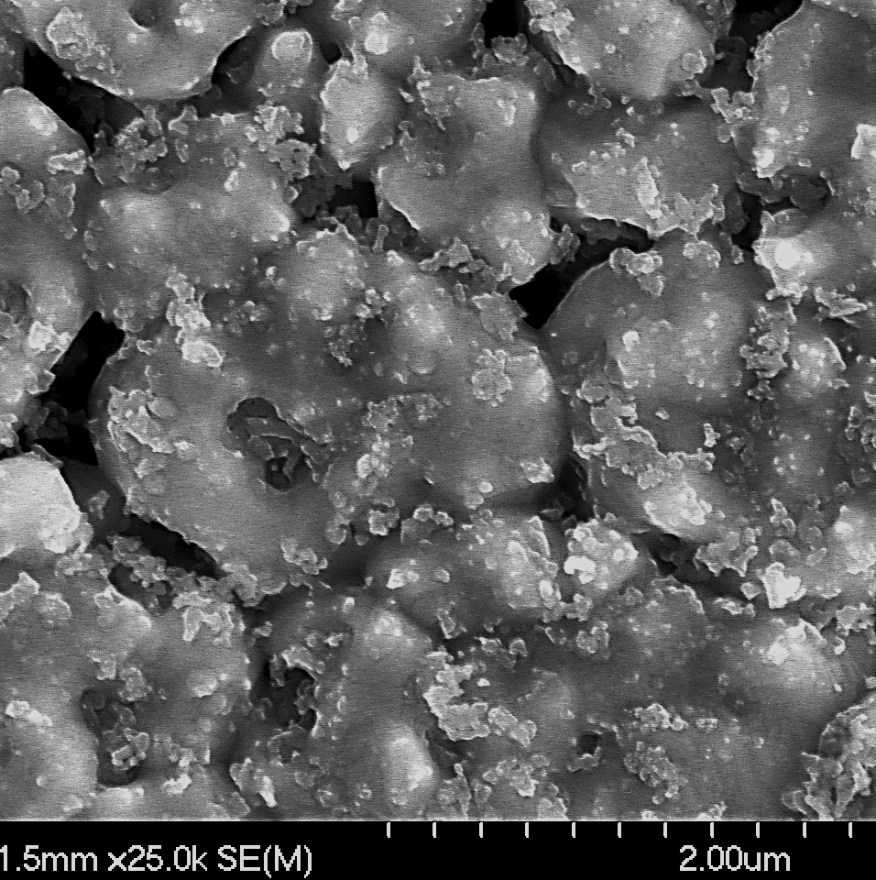
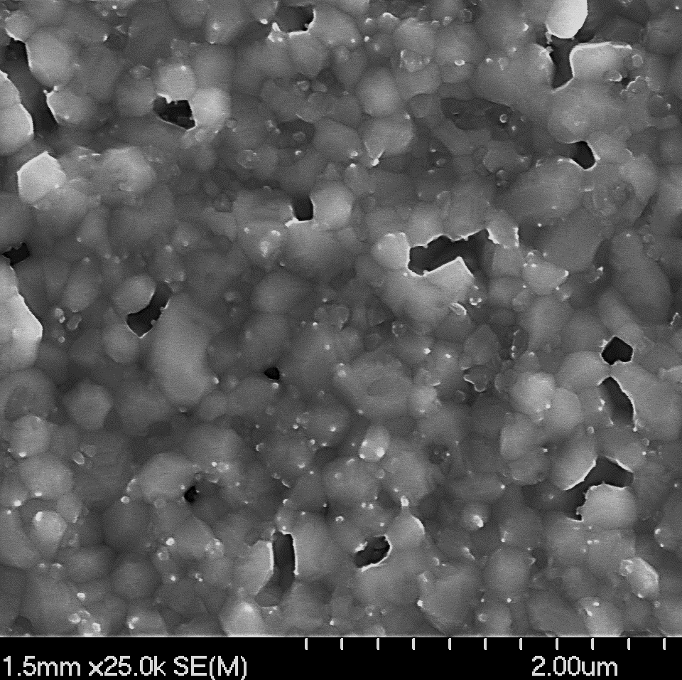
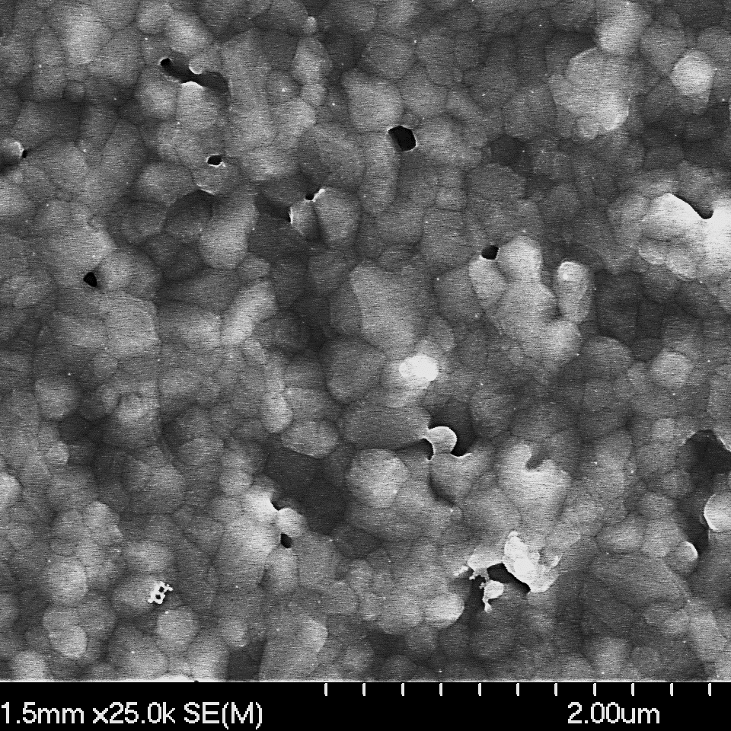
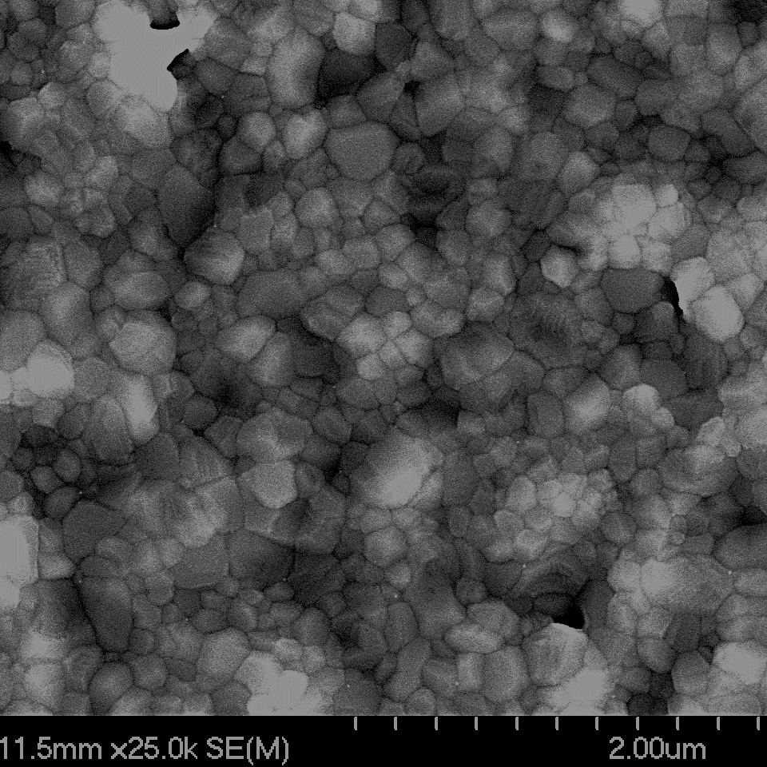
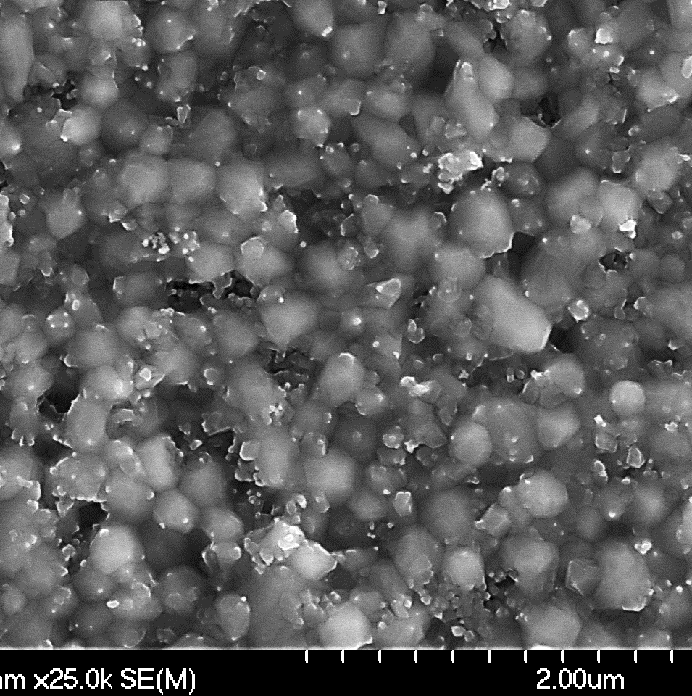
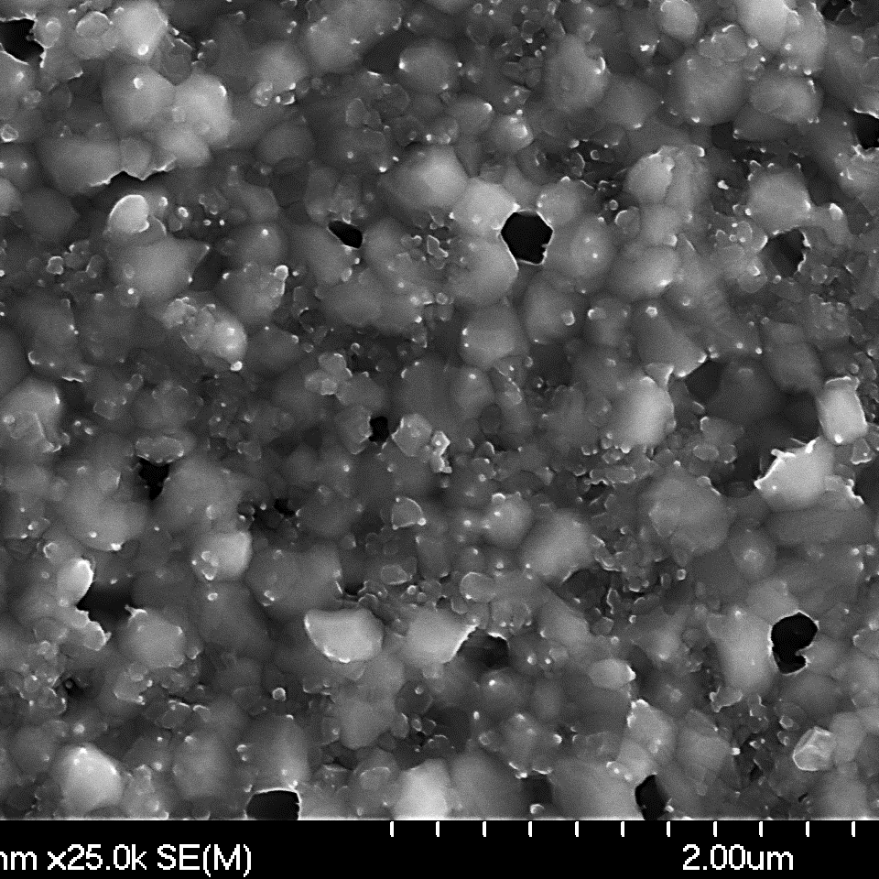
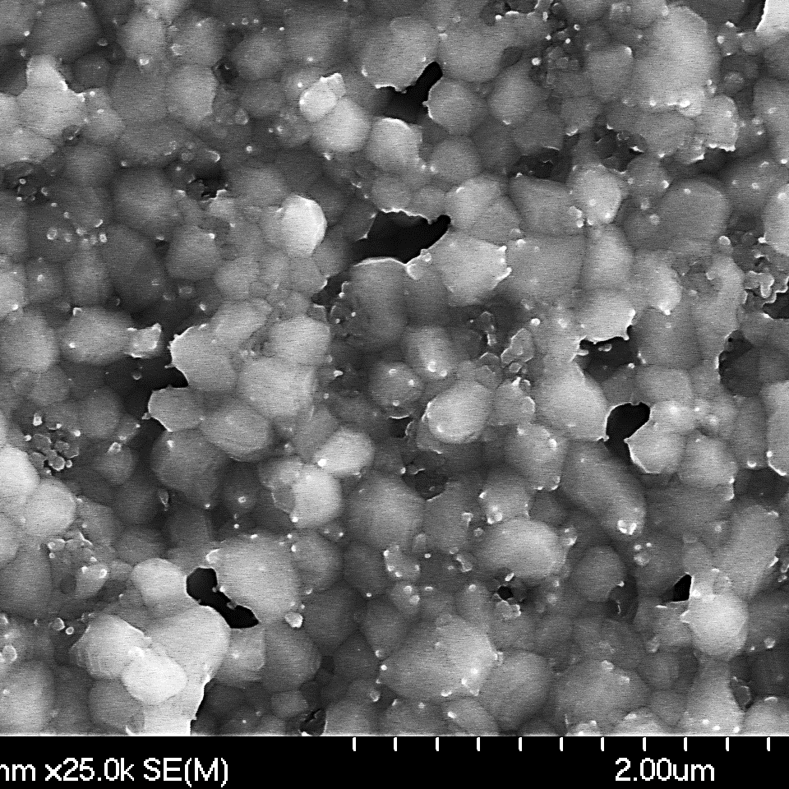
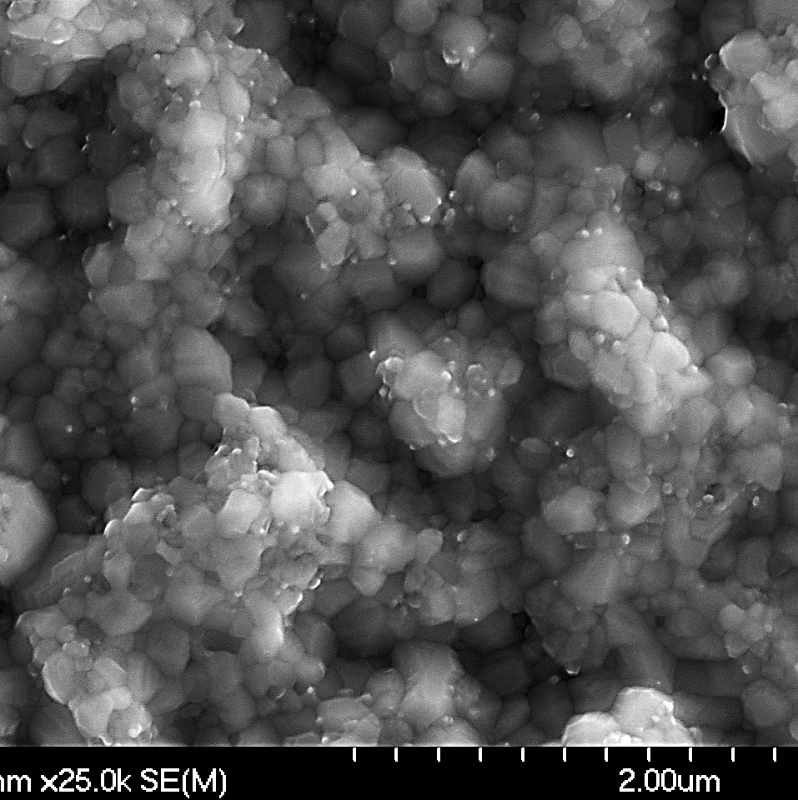
Effect of thickness
Nb:Sn 10 nm:10 nm
Nb:Sn 20 nm:10 nm
Nb:Sn 30 nm:10 nm
Nb:Sn 40 nm:10 nm
As-deposited Sn ~ 43.6 %
As-deposited Sn ~ 28.4 %
As-deposited Sn ~ 20.3 %
As-deposited Sn ~ 16 %
Annealed Sn ~ 23.8 %
T_{c} 17.93 K
Annealed Sn ~ 23 %
T_{c} 17.84 K
Annealed Sn ~ 21.4 %
T_{c} 17.56 K
Annealed Sn ~ 20.2 %
T_{c} 17.54 K
Nb:Sn 10 nm:5 nm
Nb:Sn 20 nm:10 nm
Nb:Sn 50 nm:25 nm
Nb:Sn 200 nm:100 nm
As-deposited Sn ~ 29.5 %
As-deposited Sn ~ 28.9 %
As-deposited Sn ~ 27.2 %
As-deposited Sn ~ 20 %
Annealed Sn ~ 23.1 %
T_{c} 17.82 K
Annealed Sn ~ 21.7 %
T_{c} 17.83 K
Annealed Sn ~ 22.4 %
T_{c} 17.83 K
Annealed Sn ~ 21.4 %
T_{c} 17.84 K
Frank Batten College of
Engineering & Technology
Old Dominion University: www.eng.odu.edu

Slide 13
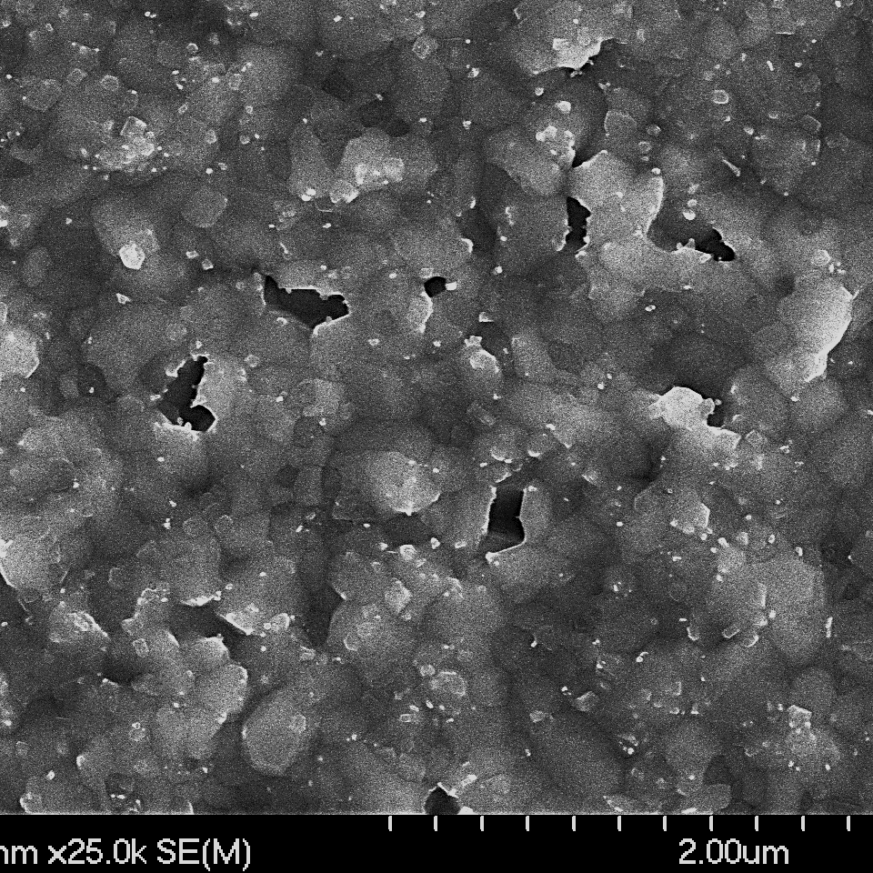
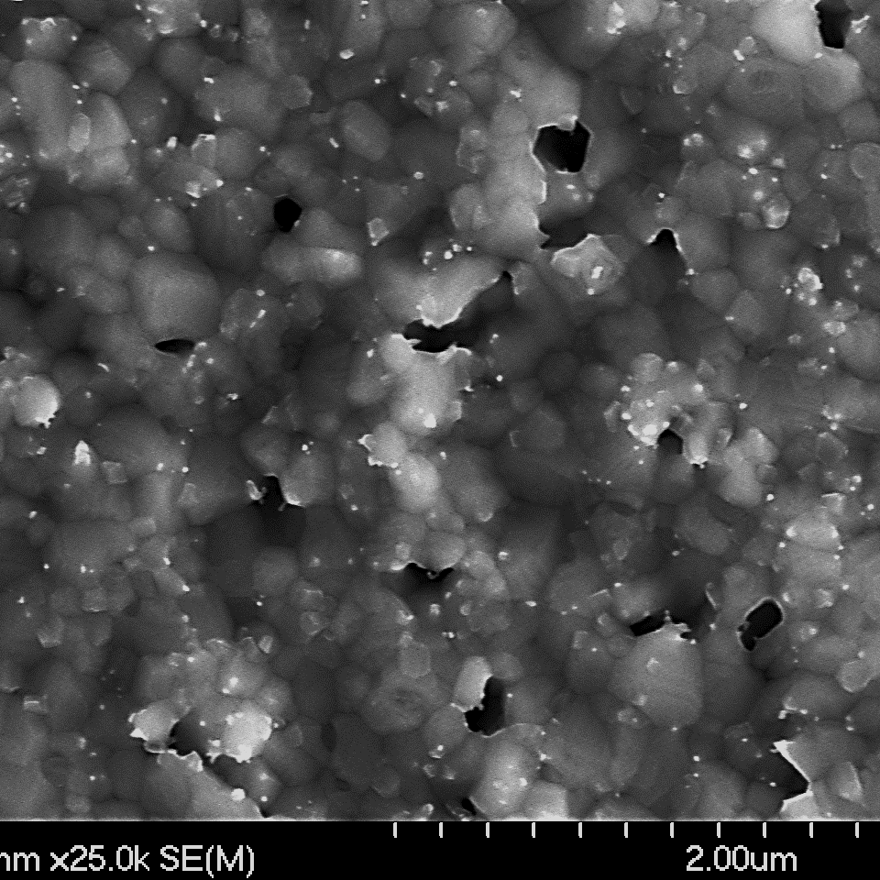
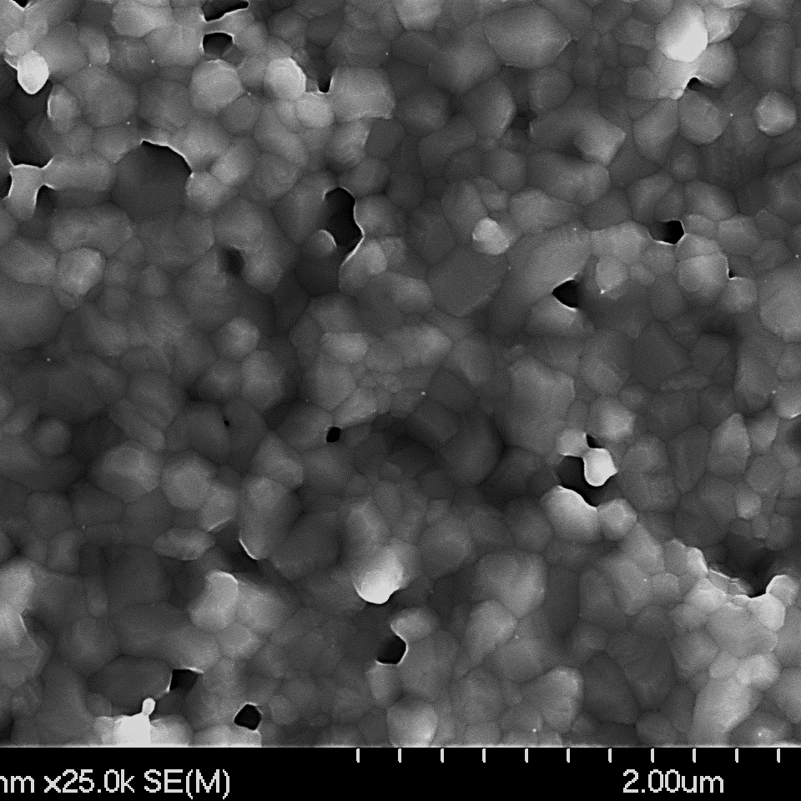
Effect of Nb buffer layer thickness
Sn ~22 %
Sn ~22 %
Sn ~23 %
T_{c} 17.82 K
T_{c} 17.81 K
T_{c} 17.75 K
No buffer layer
20 nm buffer layer
100 nm buffer layer
Figure: SEM images of the annealed films with different buffer layer thicknesses.
M.N. Sayeed et al. https://doi.org/10.18429/JACoW-SRF2019-TUP079
Frank Batten College of
Engineering & Technology
Old Dominion University: www.eng.odu.edu

Slide 14
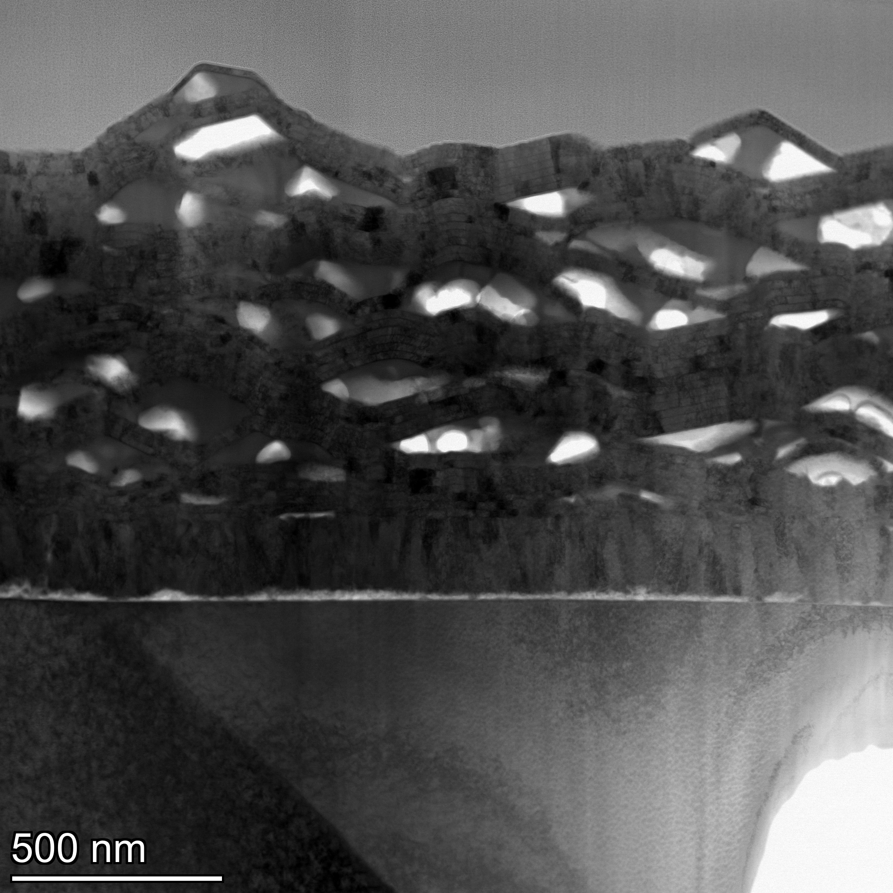
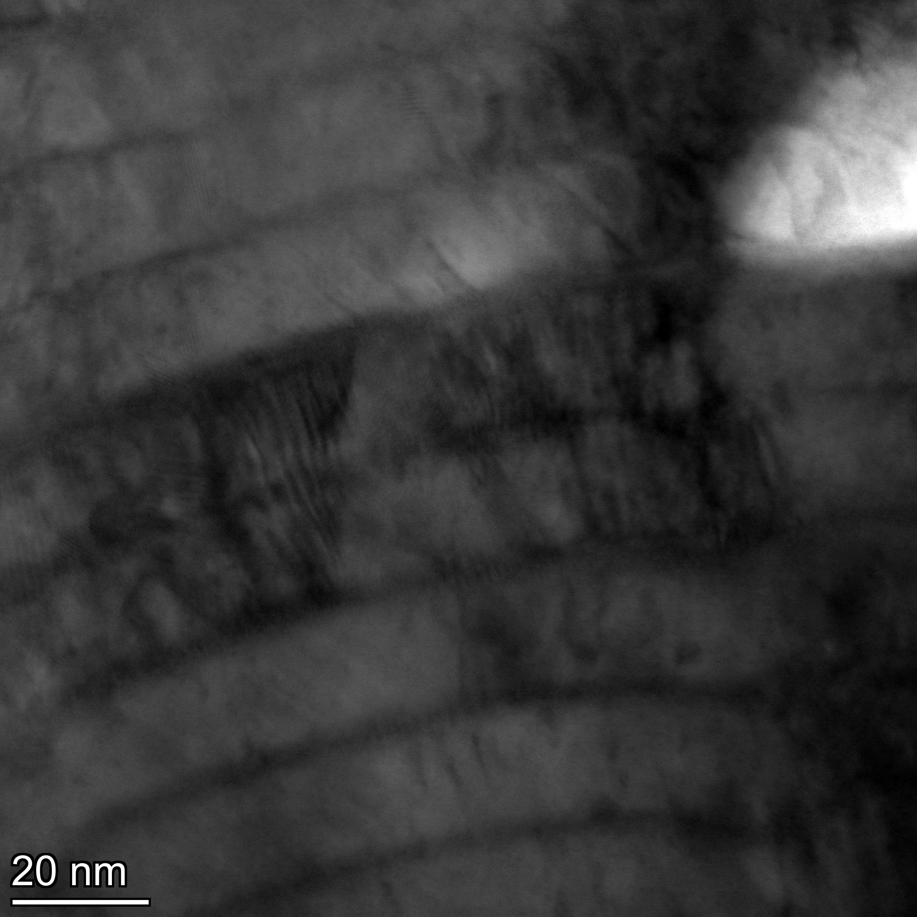
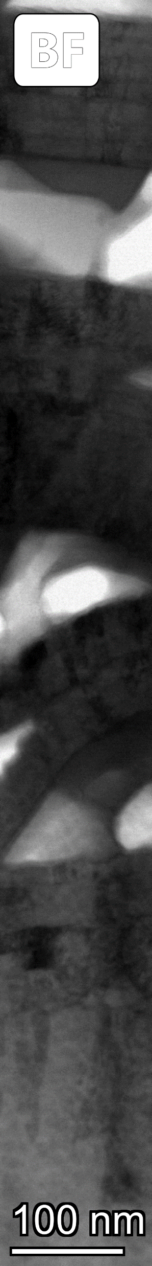
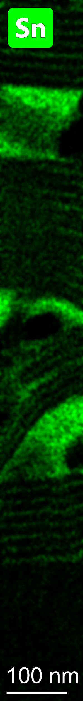
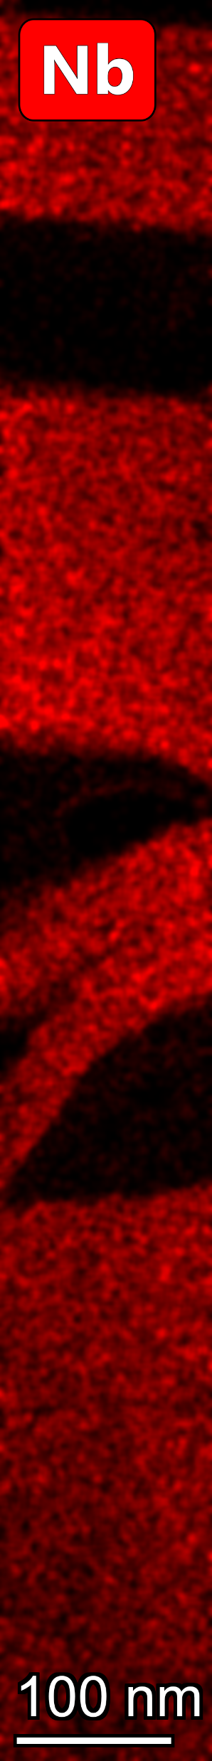
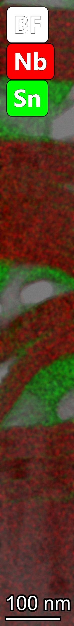
Origin of voids- TEM analysis
Frank Batten College of
Engineering & Technology
Old Dominion University: www.eng.odu.edu

Slide 15
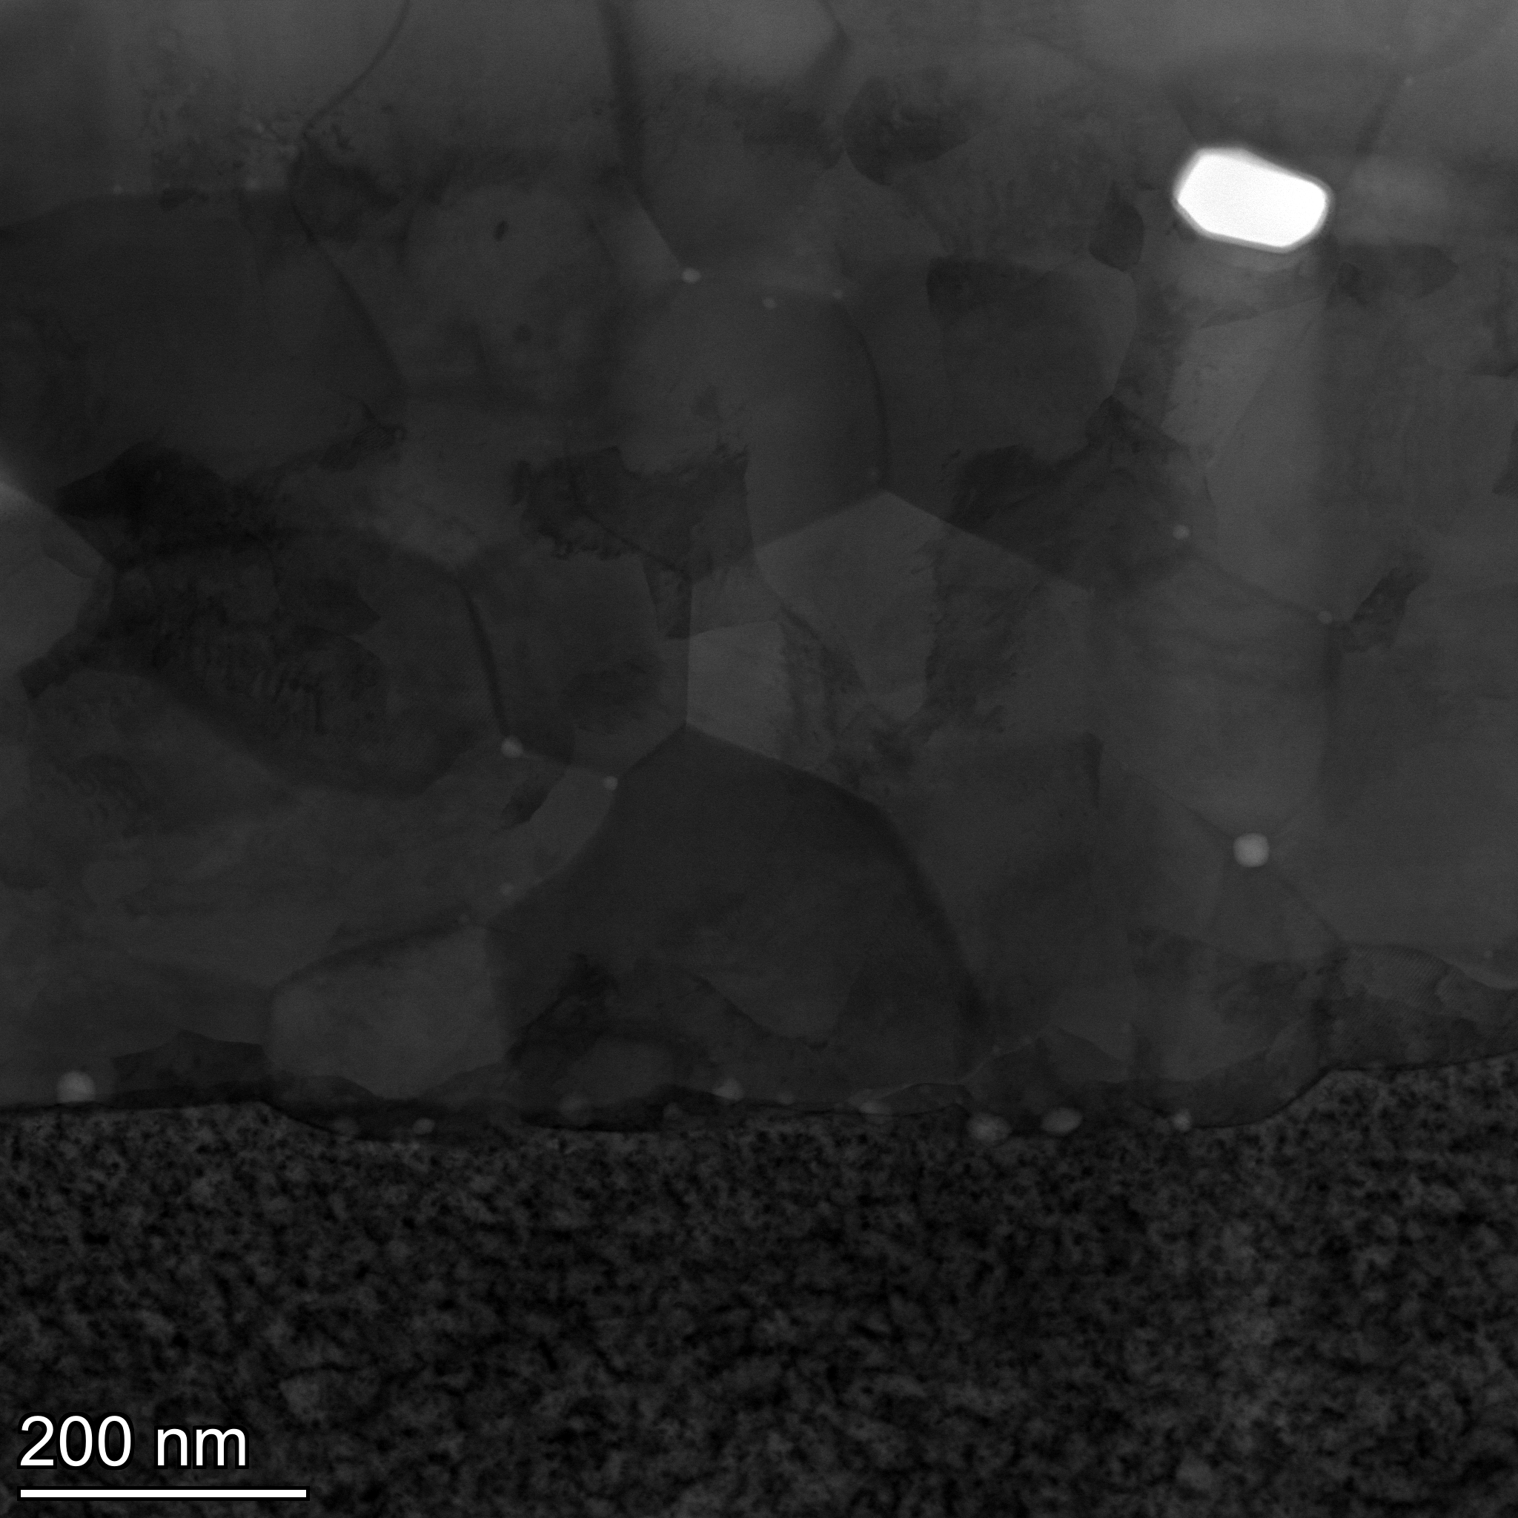
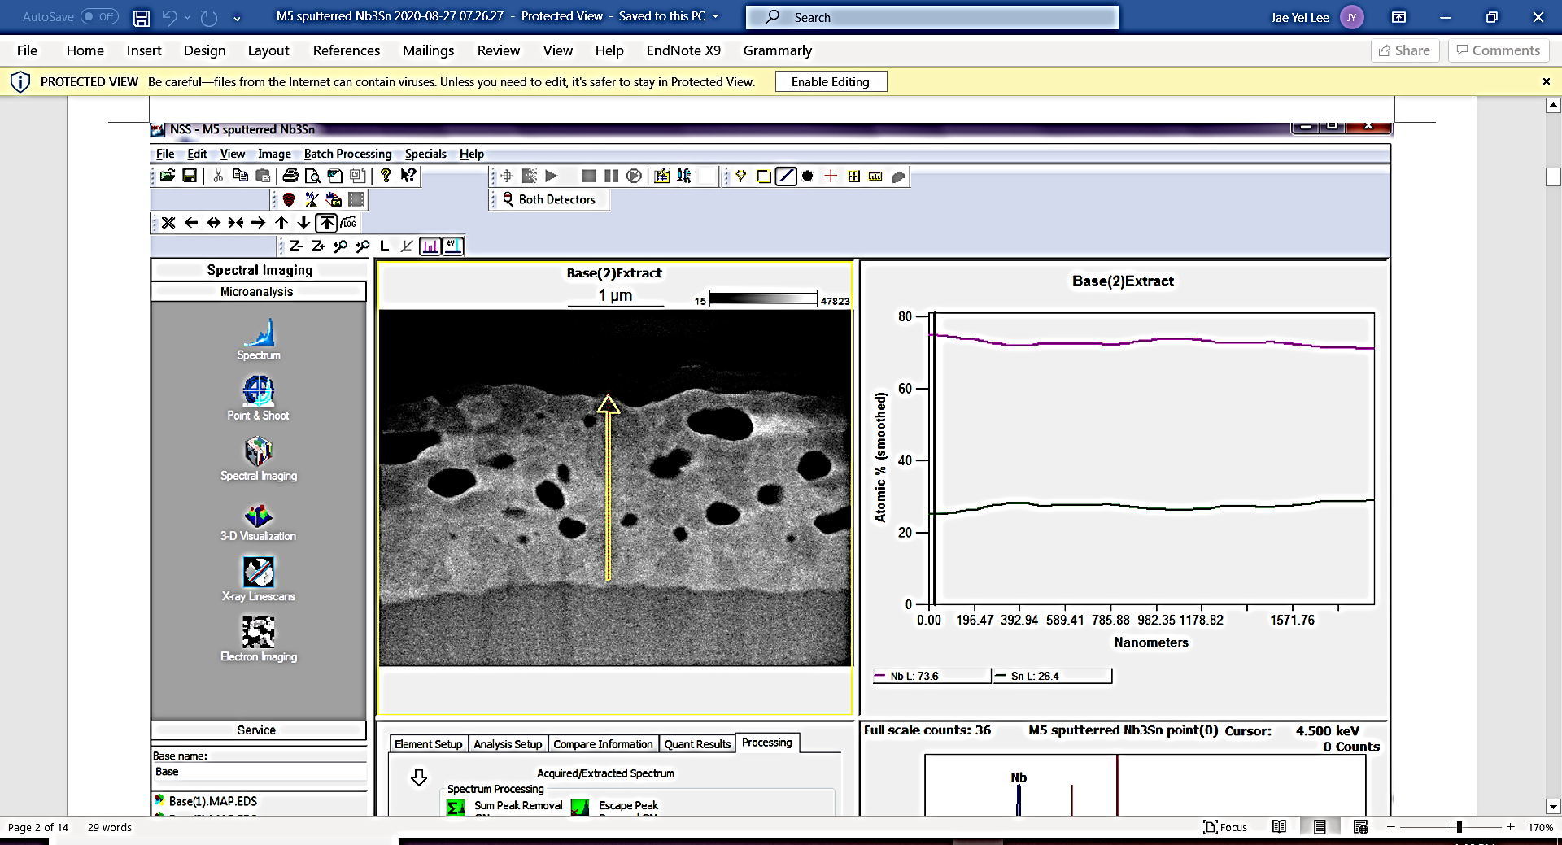
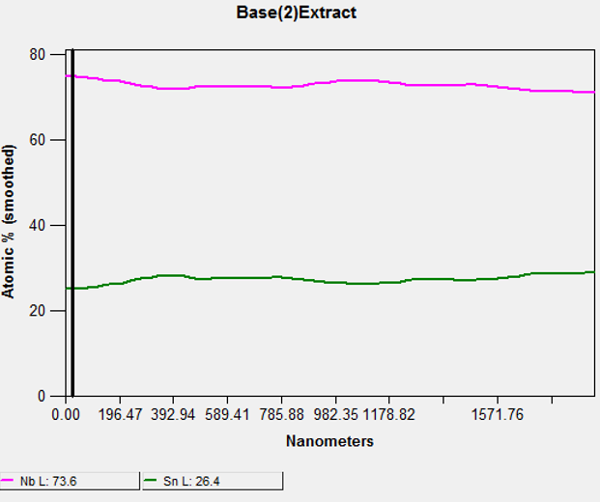
Origin of voids- TEM analysis
Frank Batten College of
Engineering & Technology
Old Dominion University: www.eng.odu.edu

Slide 16
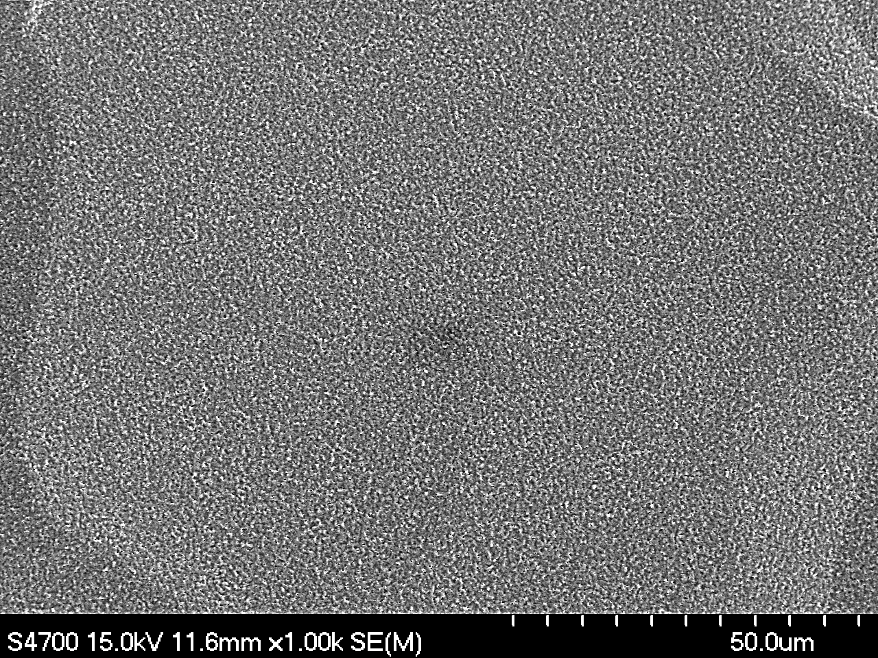
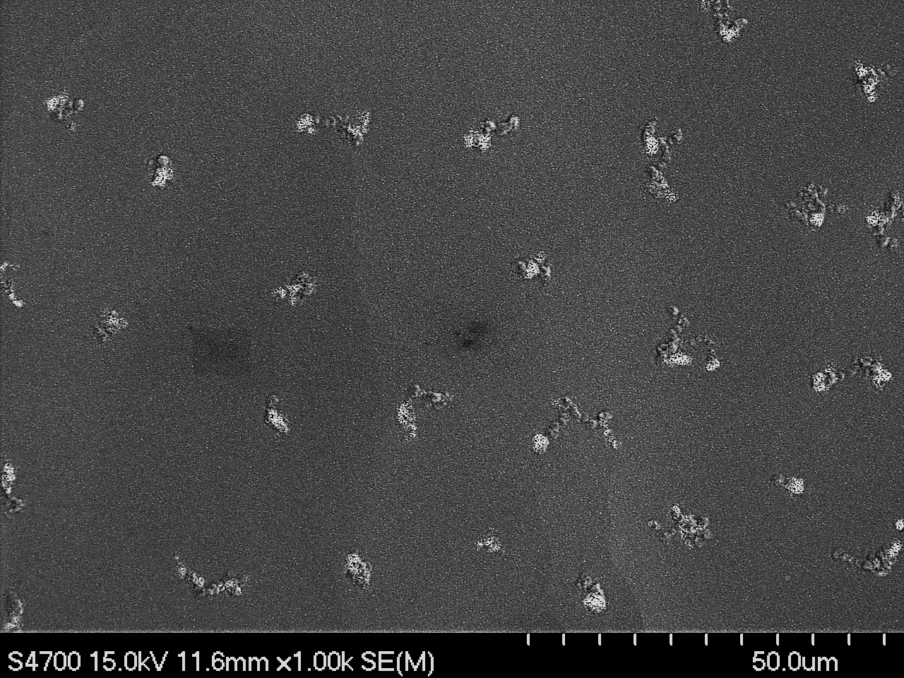
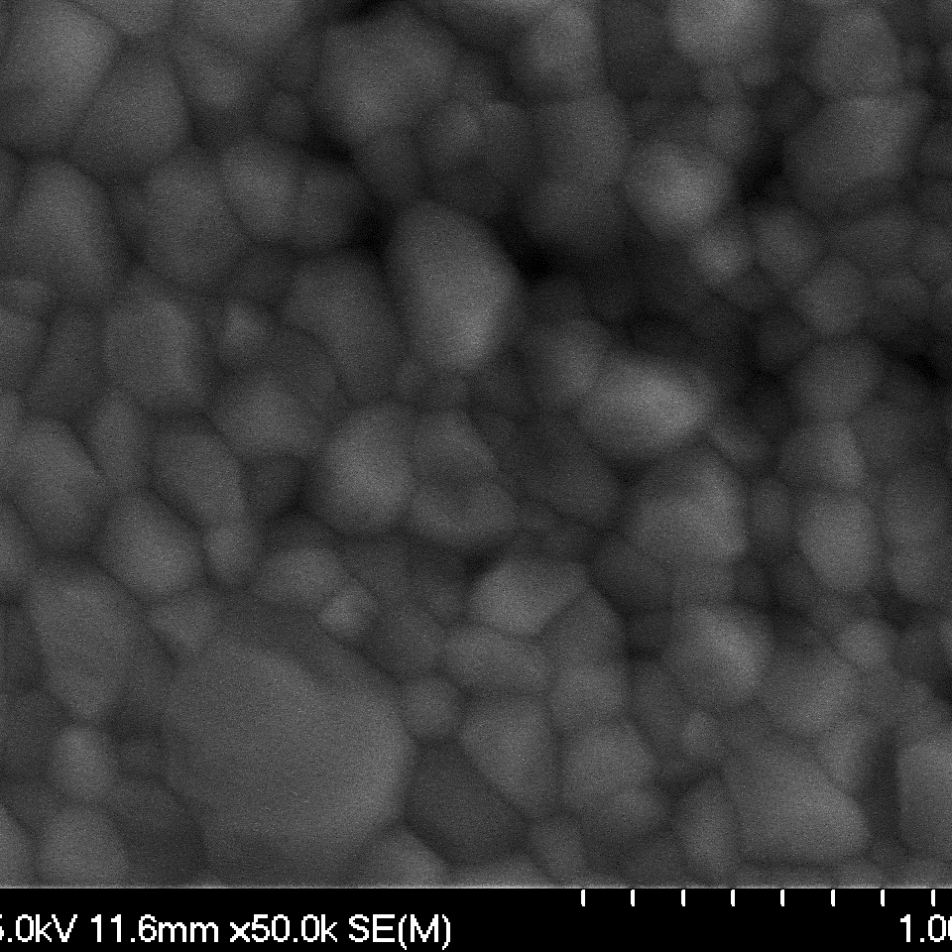
Effect of substrate temperature
Room temperature
250 °C
1 µm
Frank Batten College of
Engineering & Technology
Old Dominion University: www.eng.odu.edu

Slide 17
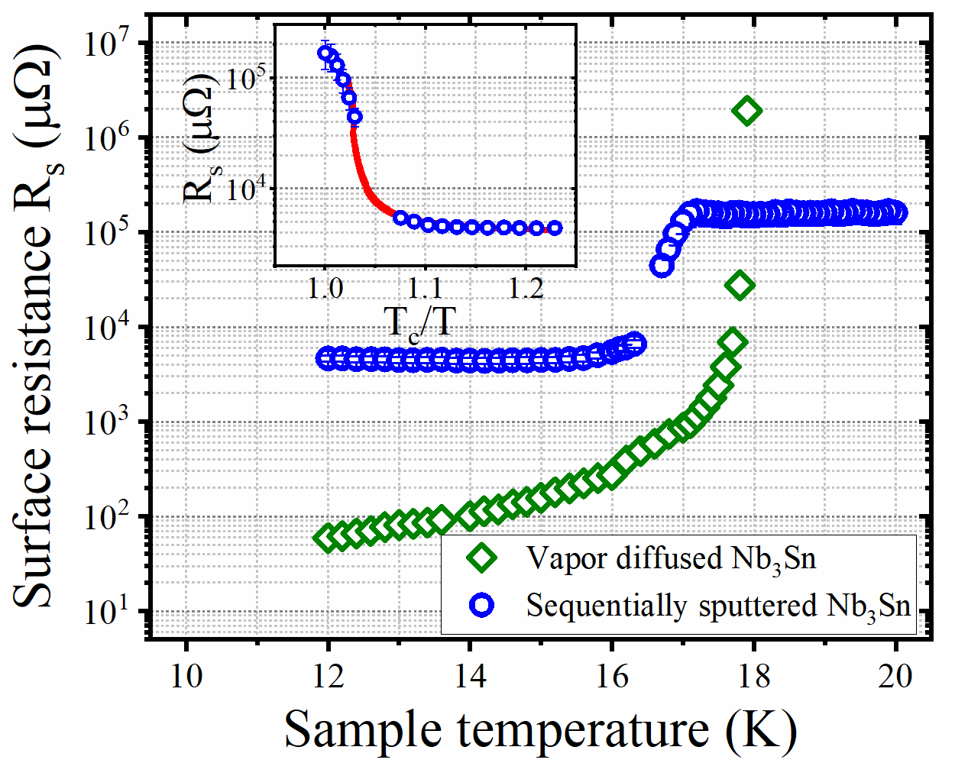
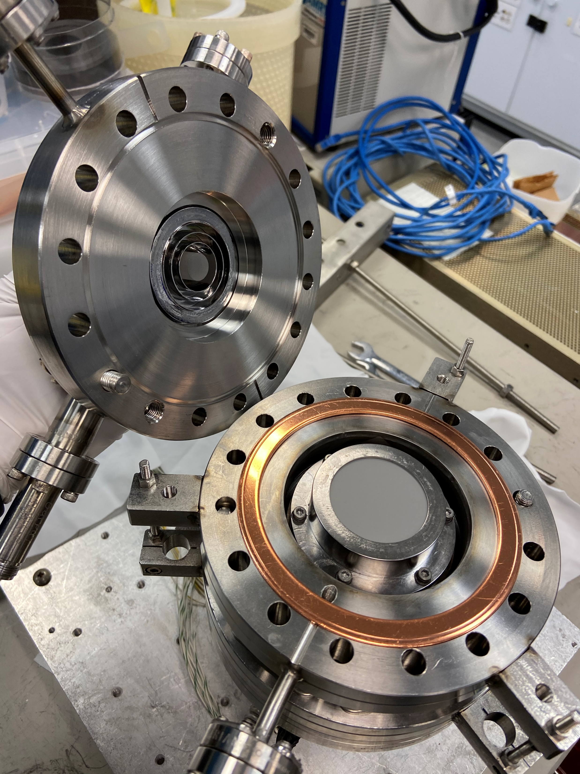
RF surface resistant measurement
Residual resistance: 3.87 ± 0.28 mΩ
Gap: 2.519 ± 0.963 meV
Critical temperature: 17.2 K
Frank Batten College of
Engineering & Technology
Old Dominion University: www.eng.odu.edu

Slide 18
Summary- Sequential sputtering
Superconducting Nb₃Sn with a T_{c} up to 17.93 K have been achieved.
Film morphology modified with niobium buffer layer and increased substrate temperature.
Significant Sn evaporation above 950 °C.
Sn evaporation was not affected much by varied thickness.
Layer thickness should be thin to avoid delamination.
Problem to solve- voids on the surface, Sn composition control.
Frank Batten College of
Engineering & Technology
Old Dominion University: www.eng.odu.edu

Slide 19
Acknowledgement
This material is based upon work supported by the U.S. Department of Energy, Office of Science, Office of Nuclear Physics.
Drs. Michael Kelley, Anne-Marie Valente-Feliciano, Gianluigi Ciovati, Pashupati Dhakal, Jae-Yel Lee.
Jefferson Lab technical staffs- Peter Owen, Pete Kushnick, Joshua Spradlin.
Frank Batten College of
Engineering & Technology
Old Dominion University: www.eng.odu.edu

Slide 20
THANK YOU!
Frank Batten College of
Engineering & Technology
Old Dominion University: www.eng.odu.edu

