Slide 1

Optimization of Vortex Pinning by Nanoparticles
Using Large-Scale Simulations of
Time-Dependent Ginzburg-Landau Equations
Virtual International Workshop on Nb3Sn SRF
Science, Technology, and Applications (Nb3SnSRF’20)
10 November 2020
Alexei Koshelev¹, Roland Willa^{1,2}, Ivan Sadovskyy^{1,3},
Andreas Glatz^{1,4}
¹ Materials science division, Argonne National Laboratory, USA
² Karlsruhe Inst. of technology, Germany
³ Station Q, Microsoft, Santa Barbara, USA
⁴ Department of Physics, Northern Illinois Univ., USA
Phys. Rev. B 93, 060508(R) (2016)
Phys. Rev. B, 98, 054517 (2018)
Sup. Sci. Techn., 31, 014001(2018)

Slide 2
Strong Pinning by inclusions in REBCO films
Best practical way to enhance critical currents
Platform for 2G HTS cables
REBCO=REBa₂Cu₃O_{7+δ}
RE = Y, Dy, Er …
BZO=BaZrO₃, BHO=BaHfO₃
Isolated particles (BZO, BHO, BSO, …)
MacManus-Driscoll et al., APL 2004
Song et al., APL 2006
Gutiérrez et al., Nat. Mat. 2007, APL 2007,
Obradors et al., SuST 2008
Kim et al., APL 2007
Yamasaki et al., SuST 2008
Polat et al., PR B 2011
Miura et al., PR B 2011, SUST 2013, NPG Asia Mat. 2017
Nanorods; Nanorods + Particles
Kang et al., Science 2006
Varanasi et al., SuST 2007, JAP 2007, APL 2008
Maiorov et al., Nat. Mat. 2009
Selvamanickam et al., APL 2015
Notes:
1. The best superconductor for power application at liquid nitrogen at present is YBCO
2. Significant progress has been achieved in enhancing its critical current
3. The best practical way to enhance pinning is to introduce nanoscale inclusions: platform for 2G HTS cables

Slide 3
Exploration of pinning using time-dependent Ginzburg-landau model
GOAL: Quantify pinning by large-size defects
OUTLINE:
TDGL model
Single inclusion
          Single vortex: anisotropy and size dependence of pin-breaking force
          Vortex lattice: Transitions between different occupation states
Finite inclusion density
          Critical current vs Magnetic field
          Pinning regimes
Optimal particle density and diameter for fixed magnetic field

Slide 4
Time-dependent Ginzburg-Landau (TDGL) model
Dynamics of superconducting order parameter ψ(r,t)
For ε(r)=1:
Units:
Length | Magn. Field | Current density
ξ_{ab}(T) | H_{c2}(T) | J₀
Total current:
ξ_{x,y}=1, ξ_{z}=1/γ
Infinite-λ approximation (high magnetic fields), A=x(0,B_{z},-B_{y})
ε(r) ⟶ pinning potential
ζ(r,t ) = Langevin noise
J_{dp} ≈ 0.385 J₀
Static model:
Valid near T_{c}
Can be derived microscopically (Gor’kov 1959)
Dynamics almost never realistic
Not crucial for pinning problems (quasistatic)
GPU code details: Sadovskyy et al., Journ. Comp. Phys. 294, 639 (2015)
Notes:
TDGL= Very efficient way to optimize pinning
Dynamics of the order parameter. Not realistic – not very crucial for pinning
Infinite-lambda approximation - large fields

Slide 5
Individual pinning site
Parameters:
Pinning energy U_{p}
Pin-breaking force f_{p}
f_{p}
Small defects, a<ξ: f_{p}= U_{p} /ξ
Large defects , a>ξ:
f_{L}
Vortex line energy scale
a

Slide 6
Individual pinning site
Parameters:
Pinning energy U_{p}
Pin-breaking force f_{p}
f_{p}
Small defects, a<ξ: f_{p}= U_{p} /ξ
Large defects , a>ξ:
f_{L}
Vortex line energy scale
a
Naively f_{p} = U_{p} /a
not correct

Slide 7
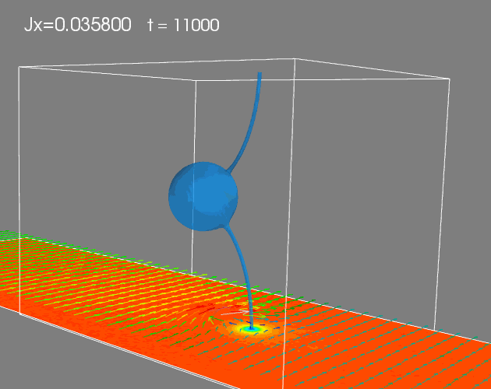
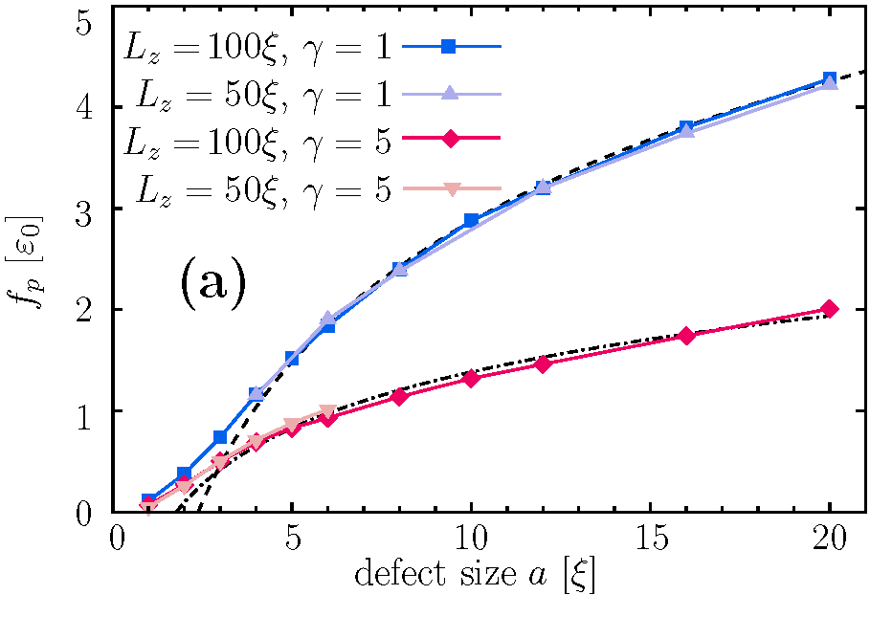
Depinning from large particle
a=16 ξ, L_{z}=50 ξ, γ=1
B
J
Pin breaking force
Notes:
Depinning from large-size defect is instability event mostly determined by properties of vortex line

Slide 8
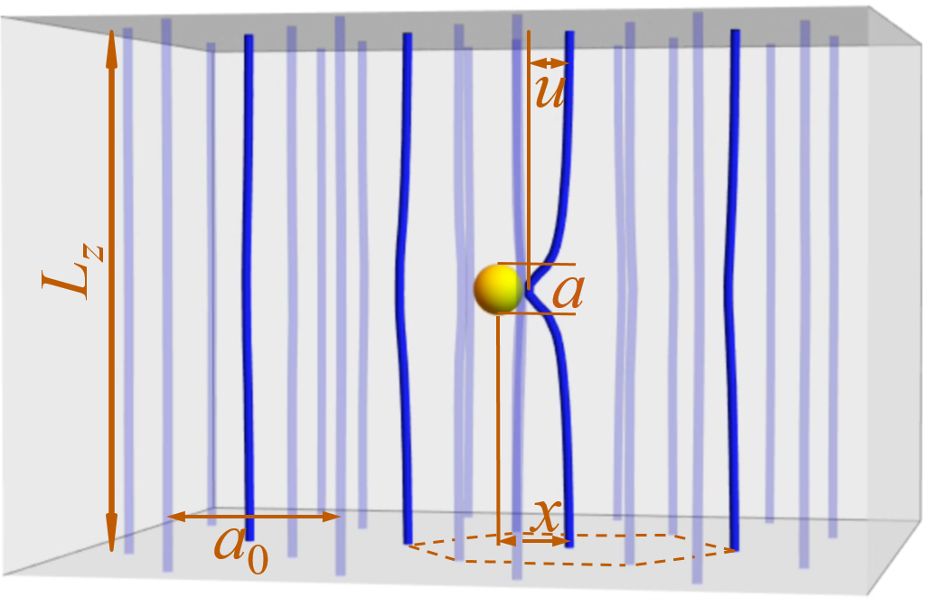
Single inclusion interacting with vortex lattice
Setup:
N_{v} = 36 vortex lines
single inclusion with diameter a
anisotropy γ = 5
L_{z}=50-100ξ, L_{x}=(3/4)^{1/2}L_{y}=6a₀
Protocol:
Prepare pinned state
Increase current j
Monitor electric field E(t)
and lattice displacement x(t)
Extract f_{p} from critical current j_{c}
f_{p}=N_{v} L_{z}Φ₀ j_{c}/c
Willa et al.,Phys. Rev. B, 98, 054517 (2018)

Slide 9
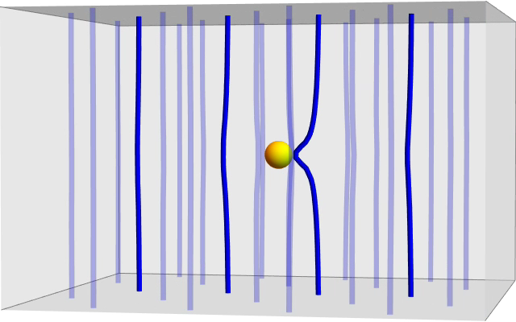
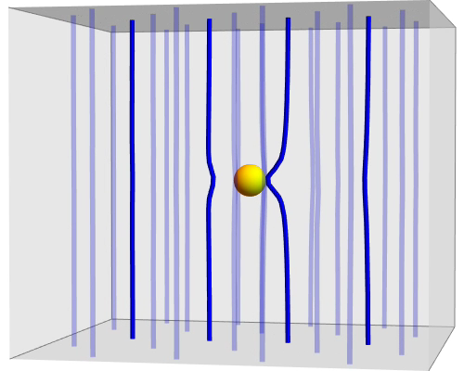
Single Defect:
Depinning Process
1-0-1 scenario
Depinning process is strongly affected
by next approaching vortex
1-1 scenario
Enhanced by large anisotropy, γ = 5

Slide 10
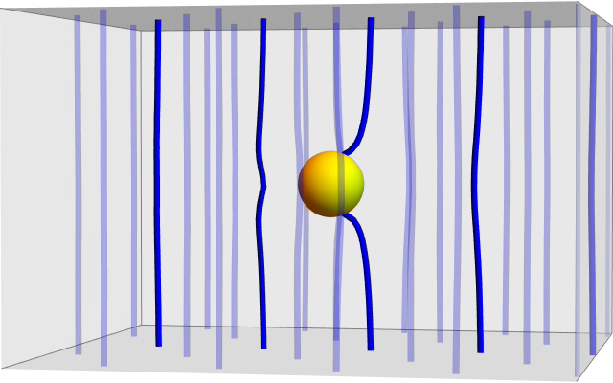
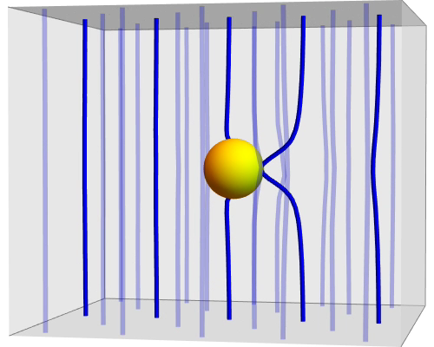
Single large Defect:
Depinning Process
1-1 scenario
1-2-1 scenario

Slide 11
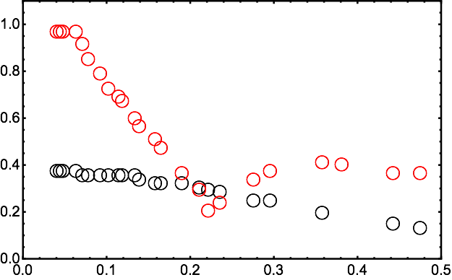
Pin-Beaking Force vs magnetic field
First-order transition in the ground state

Slide 12
Different defect sizes

Slide 13
Finite defect density
Field dependences of the critical current and pinning regimes
j_{c}
System size: 100x100x50 ξ³
[256x256x128 mesh points]
γ = 5
10⁵ steps/current
10⁶ steps/current
Sup. Sci. Techn., 31, 014001(2018)

Slide 14
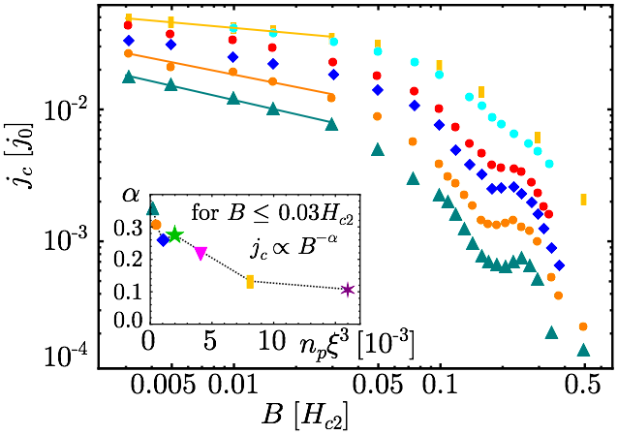
Field Dependence of critical current
large inclusions: a = 4ξ
16
1.8
8
1
4.8
0.5
4
0.25
2
Several regimes:
Power law at low fields with a smaller power than expected from strong pinning theory, α_{max}~0.3
Rapid drop followed by peak/plateau
Typical fields are not sensitive to density

Slide 15
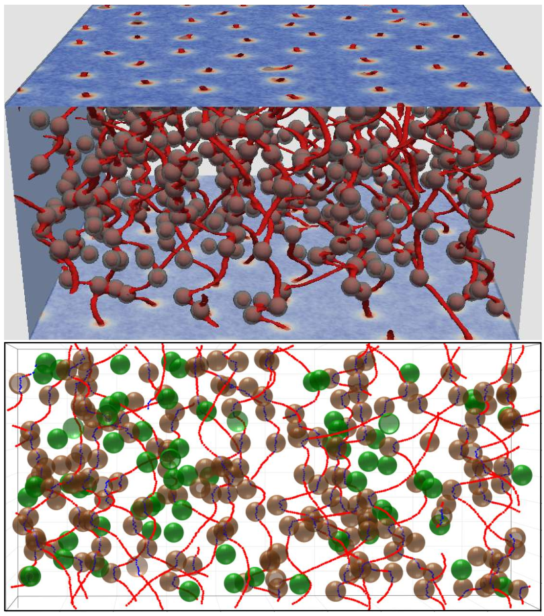
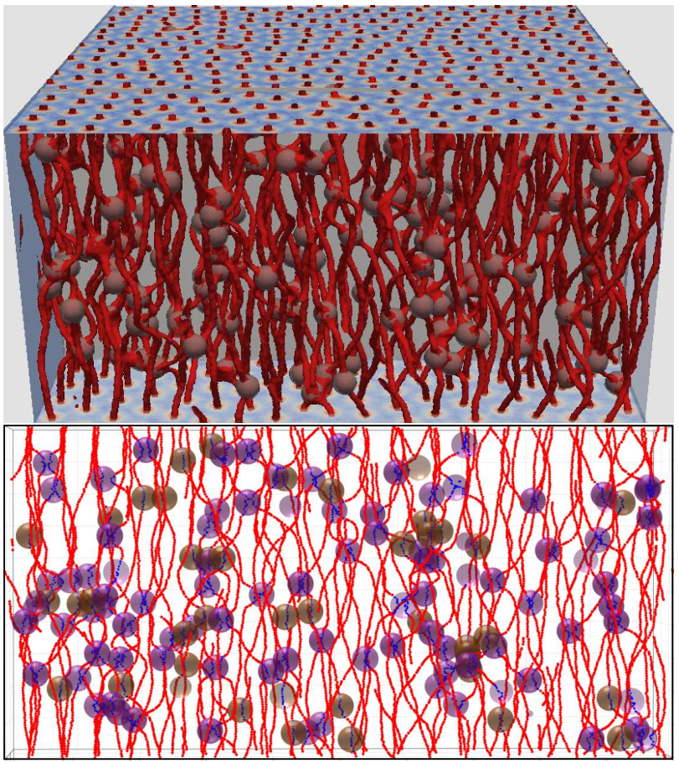
Pin occupation
B=0.03H_{c2}
B=0.2H_{c2}
unoccupied
single-occupied
double-occupied

Slide 16
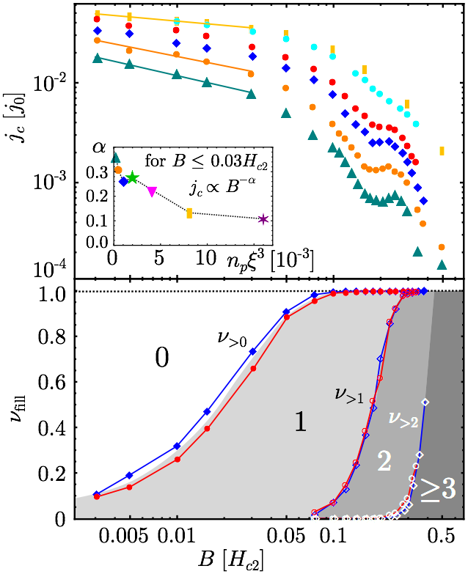
large inclusions:
Field Dependence of critical current
16
1.8
8
1
4.8
0.5
4
0.25
2
  May pin multiple vortices
  at the same time
  The double-occupancy is accompanied by a peak in the critical current

Slide 17
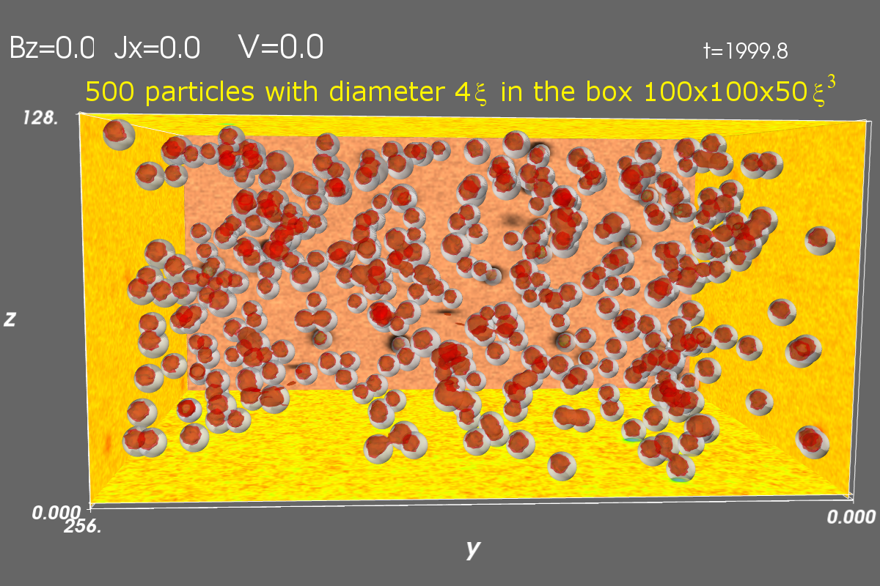
Optimal particle Size and density at fixed magnetic field
Phys. Rev. B 93, 060508(R) (2016)
diameter a and density n_{p}
Occupied volume fraction f ≈ n_{p}V_{p}
Overlap: f → f − f²/2
System size: 100x100x50 ξ³
[256x256x128 mesh points]
Simulation time=10⁵ per current

Slide 18
Evolution of critical current with increasing density
IVs for different numbers of particles (occupied volume fractions)
Mechanisms of maximum:
Reducing cross section for current flow
Vortex hoping between particles
Maximum shifts to higher density
for higher field

Slide 19
Optimal parameters
Critical current vs particle density
for different particle sizes
Global maximum for B=0.05H_{c2}: a ≈ 4.2ξ, volume fraction ≈ 0.19

Slide 20
Compare optimal configurations
For B = 0.1H_{c2}
Limitations
Parallel walls J_{c}= 0.4J_{dp}
Hexagonal lattice columns || H, J_{c} = 0.32J_{dp}
Random columns || H, J_{c} = 0.091J_{dp}
Random spheres, J_{c} of 0.061J_{dp}
J,H || walls
H || columns, single field
H || columns
none
Kimmel et al., Phys. Rev. E 96, 013318 (2017)
Sadovskyy et al., PNAS 116 (21) 10291 (2019)
Optimal pinning depends on application
Notes:
walls: b=2, l=9; hex columns d=3
Random columns; a=3, f=0.2

Slide 21
Summary
Pinning by spherical inclusions
Single inclusion:
  Pin-breaking force depends on magnetic field
  Change to pin occupation states ⟶ Dips in the pin-breaking force
Finite density:
  Pinning regimes ⟷ average occupation numbers of inclusions
  Peak effects at small densities
Optimal size and density depend on B

