Slide 1
Electrochemical deposition for generating Nb₃Sn films with low surface roughness and stoichiometry
Zeming Sun, Ryan D. Porter, Katrina Howard, Thomas Oseroff, Mingqi Ge, Matthias U. Liepe (CLASSE)
Zhaslan Baraissov, Nathan Sitaraman, Michelle Kelly, James Sethna, Tomas Arias, David Muller (Cornell Physics)
Kevin D. Dobson (Institute of Energy Conversion)
Xiaoyu Deng (UVA)
Ajinkya Hire, Richard Hennig (UFlorida MSE)
Aine Connolly, Michael O. Thompson (Cornell MSE)
Nb3SnSRF’20
11/2020

Slide 2
Use of Nb3Sn in SRF cavity
Nb3Sn vs. state-of-the-art Nb
Doubled superheating field
Nb3Sn: ~400 mT vs. Nb: ~200 mT
High Tc
Nb3Sn: 18 K vs. Nb: 9.2 K
High accelerating gradient as 100 MV/m
Increased operation temperature
2 K to 4 K
Lower cryogenic cost
Current RF performance
Nb3Sn theoretical
Nb3Sn cavity measured at 4K
[MV/m]

Slide 3
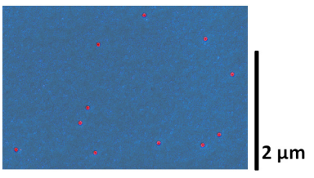
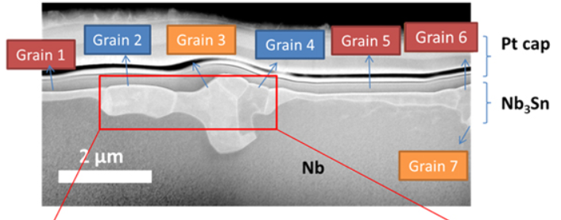
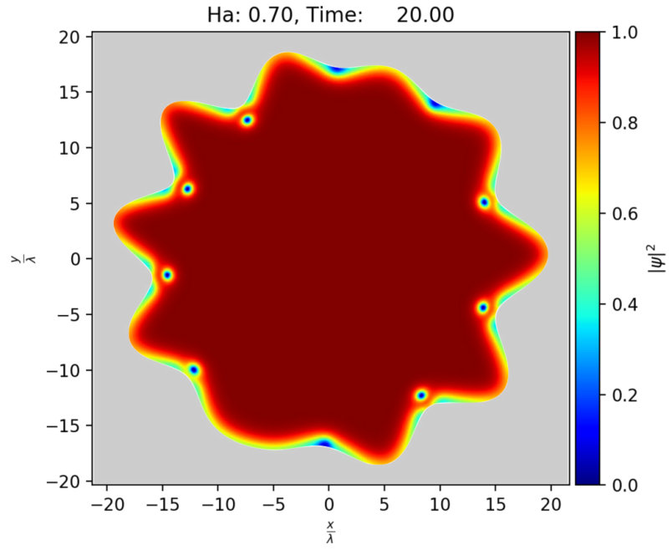
Issues in vapor diffusion – surface roughness
Large surface roughness
Sn vapor
Nb
500 C
(Ryan Porter, et al., LINAC’19)
Conventional Sn vapor diffusion method for generating Nb3Sn
Nb
Sn
(Jaeyel Lee, et al., Supercond. Sci. Technol., 2018)
Non-uniform nucleation events
Source of surface roughness: large variation in grains
Impact on the RF performance
Vortex nucleation for rough surface
(Alden Pack, et al., PRB, 2020)
Notes:
Lower cost
High RRR Nb ≈ 10x price of Cu
Can avoid expensive electron beam welding
Increased thermal stability
Nb: 75 W/(m∙ K) -> Cu: 300-2000 W/(m∙K)
Can avoid inclusions caused by machining
Can coat Nb-layer on complex shaped parts.

Slide 4
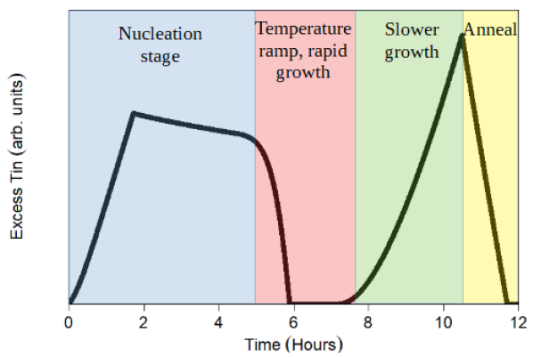
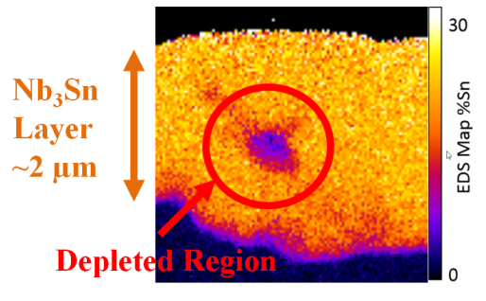
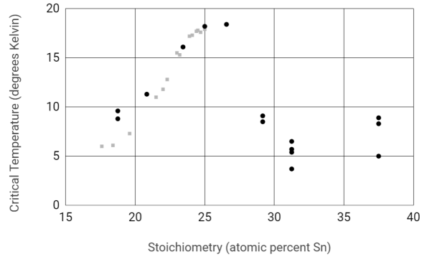
Issues in vapor diffusion – Sn depletion
Sn depletion region/stoichiometry
Insufficient Sn supply
(Nathan Sitaraman, et al. arXiv:1912.07576 [cond-mat.supr-con])
(Ryan Porter, et al., LINAC’19)
Impact on the RF performance
(Nathan Sitaraman, et al. arXiv:1912.07576 [cond-mat.supr-con])
Notes:
Lower cost
High RRR Nb ≈ 10x price of Cu
Can avoid expensive electron beam welding
Increased thermal stability
Nb: 75 W/(m∙ K) -> Cu: 300-2000 W/(m∙K)
Can avoid inclusions caused by machining
Can coat Nb-layer on complex shaped parts.

Slide 5
Our strategy
Pre-deposition of a uniform smooth Sn layer on Nb
Thermal conversion to Nb3Sn
Advantages:
Promote uniform distribution of nucleation to lower the surface roughness
Excess Sn supply to satisfy the kinetic requirement for Nb3Sn stoichiometry
Possible application of Nb3Sn on Cu cavity (better heat conduction, low cost)
Notes:
Lower cost
High RRR Nb ≈ 10x price of Cu
Can avoid expensive electron beam welding
Increased thermal stability
Nb: 75 W/(m∙ K) -> Cu: 300-2000 W/(m∙K)
Can avoid inclusions caused by machining
Can coat Nb-layer on complex shaped parts.

Slide 6
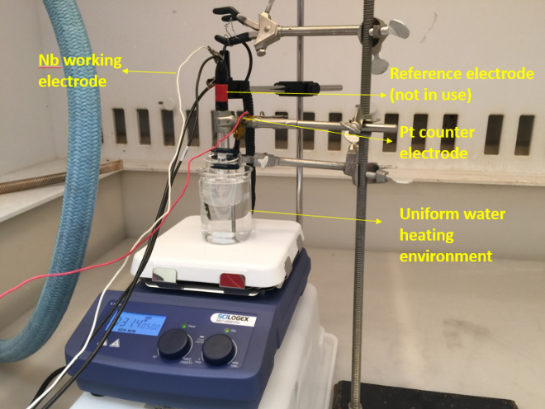
Enable Sn electrochemical deposition on Nb surface
Challenges
Low lateral surface diffusion
Dendrite formation --- Large initial surface roughness
Poor adhesion at Sn/Nb interface --- Peel-off issue
Control of impurity concentration
Methods
A three-electrode deposition system
Optimization of temperature, solution chemistry, plating potential, ph-values, and stirring conditions
Notes:
Lower cost
High RRR Nb ≈ 10x price of Cu
Can avoid expensive electron beam welding
Increased thermal stability
Nb: 75 W/(m∙ K) -> Cu: 300-2000 W/(m∙K)
Can avoid inclusions caused by machining
Can coat Nb-layer on complex shaped parts.

Slide 7
Demonstration of uniform, smooth Sn films on Nb
Uniform surface morphology
(some embedded grains)
Low surface roughness on the flat region
(Ra= 65 nm, AFM)
Cross-section SEM shows smooth surface and thickness of ~3 um.
Notes:
Lower cost
High RRR Nb ≈ 10x price of Cu
Can avoid expensive electron beam welding
Increased thermal stability
Nb: 75 W/(m∙ K) -> Cu: 300-2000 W/(m∙K)
Can avoid inclusions caused by machining
Can coat Nb-layer on complex shaped parts.

Slide 8
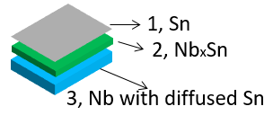
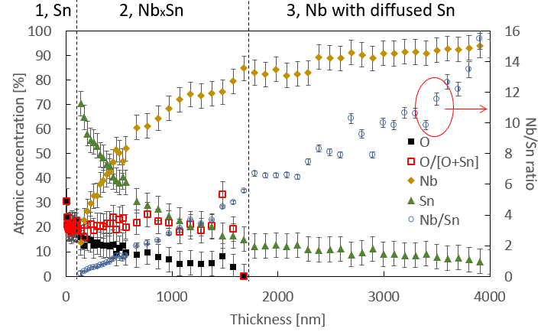
Characterization of electroplated Sn film
Low impurity concentration: C & N in surface monolayer; O exists in the film
XPS
Without any sputter etching
EDS
XRD
A critical NbxSn structure
NbxSn generation using fast ion transport
[SnTFSI]
Sn²⁺ + 2e⁻ → Sn (-0.14 V)
Nb → Nb³⁺ + 3e⁻ (1.099 V)
(Zeming Sun, et al., NAPAC’19)
Notes:
Lower cost
High RRR Nb ≈ 10x price of Cu
Can avoid expensive electron beam welding
Increased thermal stability
Nb: 75 W/(m∙ K) -> Cu: 300-2000 W/(m∙K)
Can avoid inclusions caused by machining
Can coat Nb-layer on complex shaped parts.

Slide 9
Post annealing of electroplated films
Notes:
Lower cost
High RRR Nb ≈ 10x price of Cu
Can avoid expensive electron beam welding
Increased thermal stability
Nb: 75 W/(m∙ K) -> Cu: 300-2000 W/(m∙K)
Can avoid inclusions caused by machining
Can coat Nb-layer on complex shaped parts.

Slide 10
Successful conversion to stoichiometric Nb3Sn
Stoichiometric Nb3Sn with Tc of 18 K and low concentration of impurity (O may be a concern)
Uniform film, relative small grain size
v
v
XRD
Nb/Sn =3
EDS
STEM-EWPC
SEM
v
v
Nb/Sn =3
XPS
Tc = 18K
Cross-section STEM & SEM shows smooth surface and 2.4 um thickness
Multiple grains in the depth direction
Notes:
EWPC transformation

Slide 11
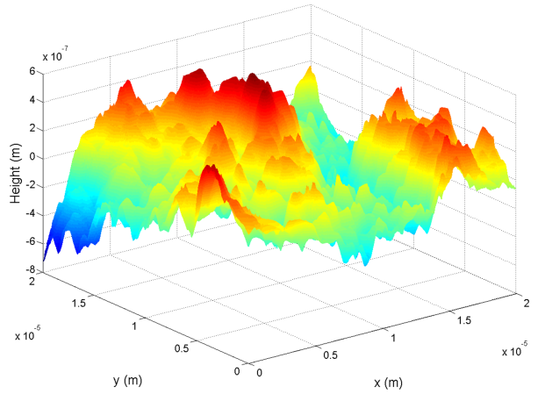
Record-low surface roughness
Comparison between vapor diffused sample and plated-Sn converted sample
AFM image of plated-Sn converted Nb3Sn
4 – 5 times reduction in surface roughness
AFM mapping of vapor diffused Nb3Sn
* Note that Fermi Lab and KEK both report ~100 nm Ra on their new “shiny” coatings in this workshop
0.6 um
-0.8 um
Ryan Porter, et al. LINAC’16
Vapor diffused Nb3Sn
Plated-Sn converted Nb3Sn
Notes:
Lower cost
High RRR Nb ≈ 10x price of Cu
Can avoid expensive electron beam welding
Increased thermal stability
Nb: 75 W/(m∙ K) -> Cu: 300-2000 W/(m∙K)
Can avoid inclusions caused by machining
Can coat Nb-layer on complex shaped parts.

Slide 12
Effect of Sn thickness and fast Fourier transform
Dendrite formation
Vapor diffused Nb3Sn
Electroplated Sn
Plated-Sn converted Nb3Sn
No clear dependence on initial Sn thickness
All film roughness are controlled to ~100 nm
Their power spectral densities are reduced by one order of magnitude
Roughness increases once dendrites are formed
Notes:
Lower cost
High RRR Nb ≈ 10x price of Cu
Can avoid expensive electron beam welding
Increased thermal stability
Nb: 75 W/(m∙ K) -> Cu: 300-2000 W/(m∙K)
Can avoid inclusions caused by machining
Can coat Nb-layer on complex shaped parts.

Slide 13
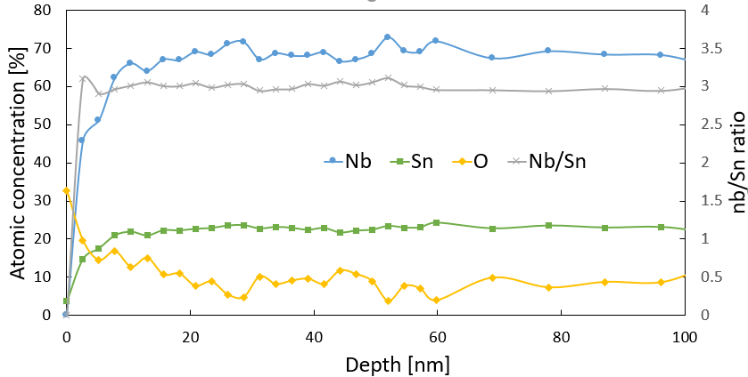
Stoichiometry depth profiling
XPS on plated-Sn converted Nb3Sn
XPS on vapor diffused Nb3Sn
Sn depletion/excess regions
Constant 3:1 ratio in plated sample (STEM imaging is being performed to confirm the local stoichiometry)
Sn depletion/excess regions in vapor diffused sample
O concentration is high at the surface ~10 nm region for both samples
Different growth mechanisms (top-down vs. bottom-up)
Data acquisition may be affected by the surface roughness

Slide 14
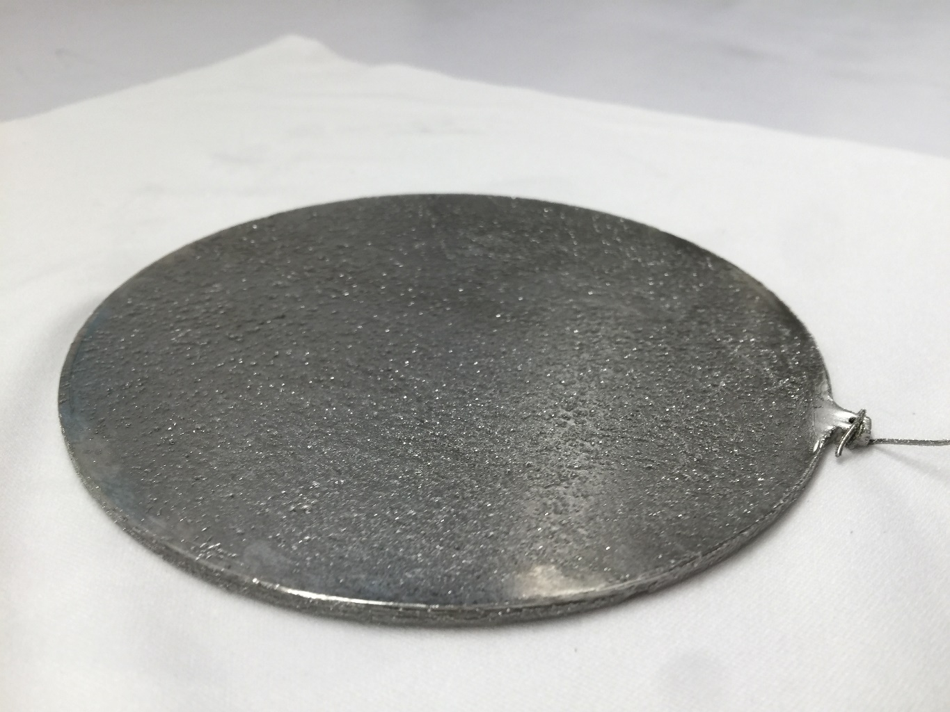
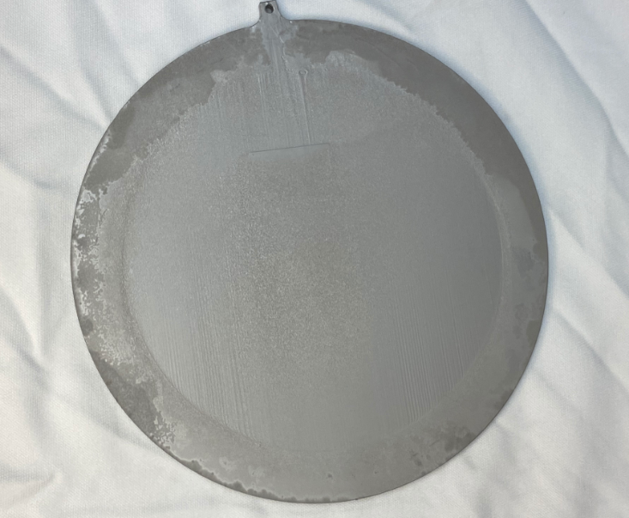
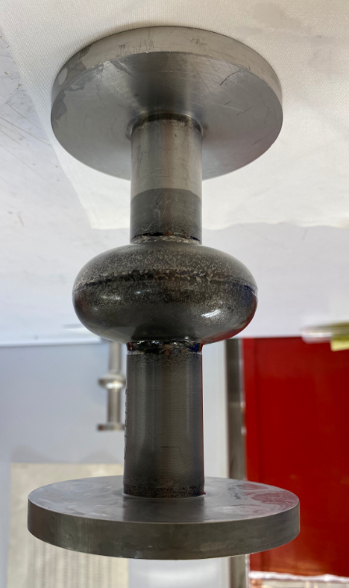
Scale up to 5” plate and 3.9 GHz cavity (Preliminary)
5” Nb plate
After Sn electroplating
After thermal conversion
Uncoated edge
Sn film with crystals
Nb3Sn film
3.9 GHz cavity
The scale-up process is under optimization
No RF test yet…
Plating solution surface
Sn film on the outside surface

Slide 15
Conclusions and Future work
Enabled Sn plating on Nb surface and achieved uniform, low-impurity, good-adhesion Sn films
Demonstrated stoichiometric Nb3Sn with low surface roughness via Sn electrochemical deposition and thermal conversion
Resolved the Sn-depletion and large-surface-roughness issues in vapor diffused samples (Atomic STEM imaging is ongoing)
Achieved Nb3Sn films with low impurities concentration and some surface oxides
Process is scaled up to 5” Nb plate and 3.9 GHz cavity (Optimization is ongoing)
Electroplating of Nb and Sn films on Cu substrate are being developed (Ongoing)

Slide 16
Acknowledgements
This work is supported by Center of Bright Beams from the National Science Foundation under Grant No. PHY-1549132.
This work made use of the Cornell Center for Materials Research Shared Facilities which are supported through the NSF MRSEC program (DMR-1719875).
This work was performed in part at the Cornell NanoScale Facility, a member of the National Nanotechnology Coordinated Infrastructure (NNCI), which is supported by the National Science Foundation (Grant NNCI-2025233).
Thank you for your attention!

