Slide 1
Conduction cooled SRF photogun for UEM/UED applications
Roman Kostin, Chunguang Jing, Pavel Avrakhov, Yubin Zhao, Ao Liu
Euclid BeamLabs, 365 Remington Blvd., Bolingbrook, IL 60440, USA
Nb3SnSRF’20, November 10-13, 2020

Slide 2
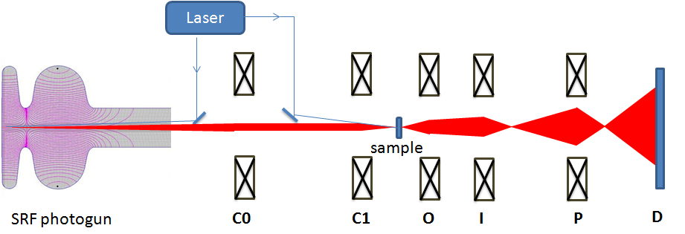
Outline:
Introduction to UEM/UED and requirements
SRF gun optimization studies
Cryomodule design
Current status
Plans and conclusions
Outline

Slide 3
Outline:
Introduction to UEM/UED and requirements
SRF gun optimization studies
Cryomodule design
Current status
Plans and conclusions
Outline

Slide 4
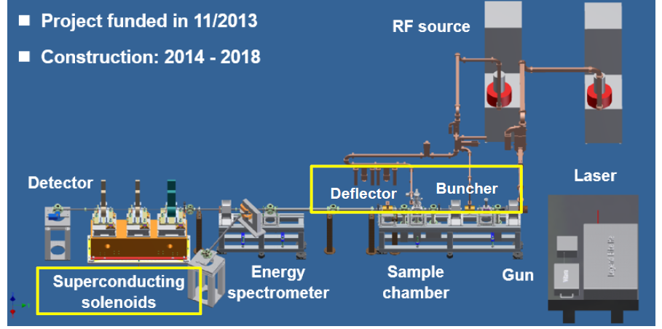
Introduction:
Ultra-fast electron diffraction/microscopy stands for time resolved phenomena, where a bunched beam required
Standard approach is the use of laser generated photoemission beam (see A)
MeV beam is required to reduce space charge effects
UED usually based on NC gun, which can operate with 100’s Hz rep rate and requires MW’s of RF power (see B)
The proposed here L-band SRF photogun can work in CW mode powered by only 10W solid state amplifier, which can provide an order of magnitude higher stability. It can also reduce the footprint by 2/3
A
Courtesy of Dao Xiang, talk at IPAC19
B
Introduction to UEM/UED

Slide 5
Outline:
Introduction to UEM/UED and requirements
SRF gun optimization studies
Cryomodule design
Current status
Plans and conclusions
SRF gun optimization studies

Slide 6
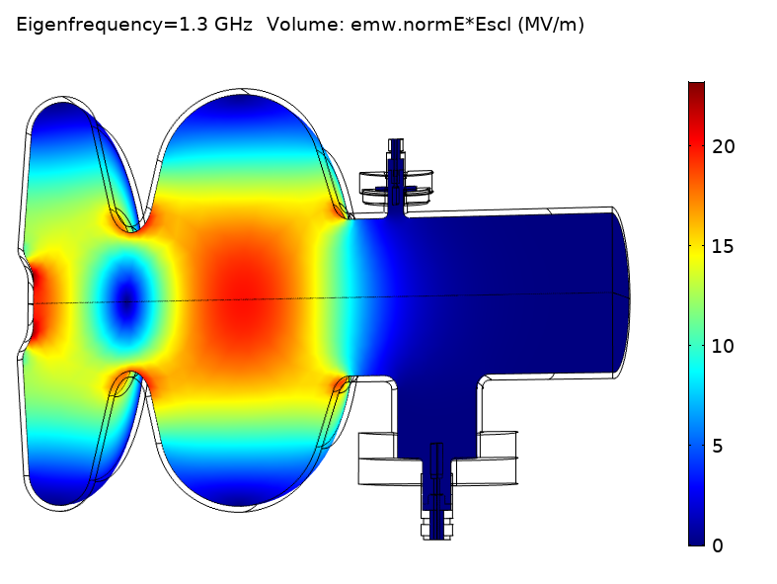
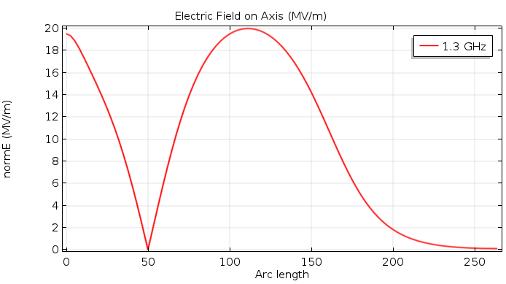
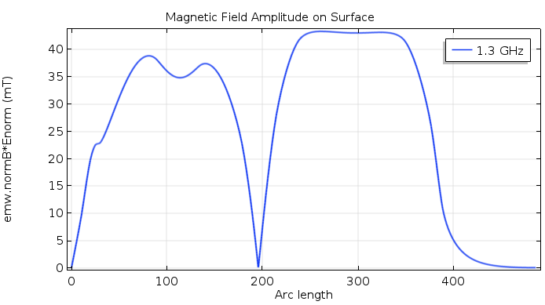
RF Design
Maximum energy gain and min energy spread of the beam corresponds to different RF phases
Cavity nose section was optimized to minimize the spread while keeping acceptable energy gain.
E-field
Table 1. RF parameters
Parameter | Value
Frequency, | 1.3 GHz
Length | 1.45cell (160mm)
Q₀ at 4°K (Rs = 20 nΩ ) | 1.16×10¹⁰
R/Q (critical coupling) | 176.9 Ω
Geometry factor | 232 Ω
Wall Power dissipation | 0.9 W
E_{on axis} | 20 MV/m
E_{max} | 23.5 MV/m
B_{max} | 43.3 mT
E_{acc} | 10MV/m
Beam energy | 1.6MeV
E-field along axis
H-field on surface
SRF gun optimization studies

Slide 7
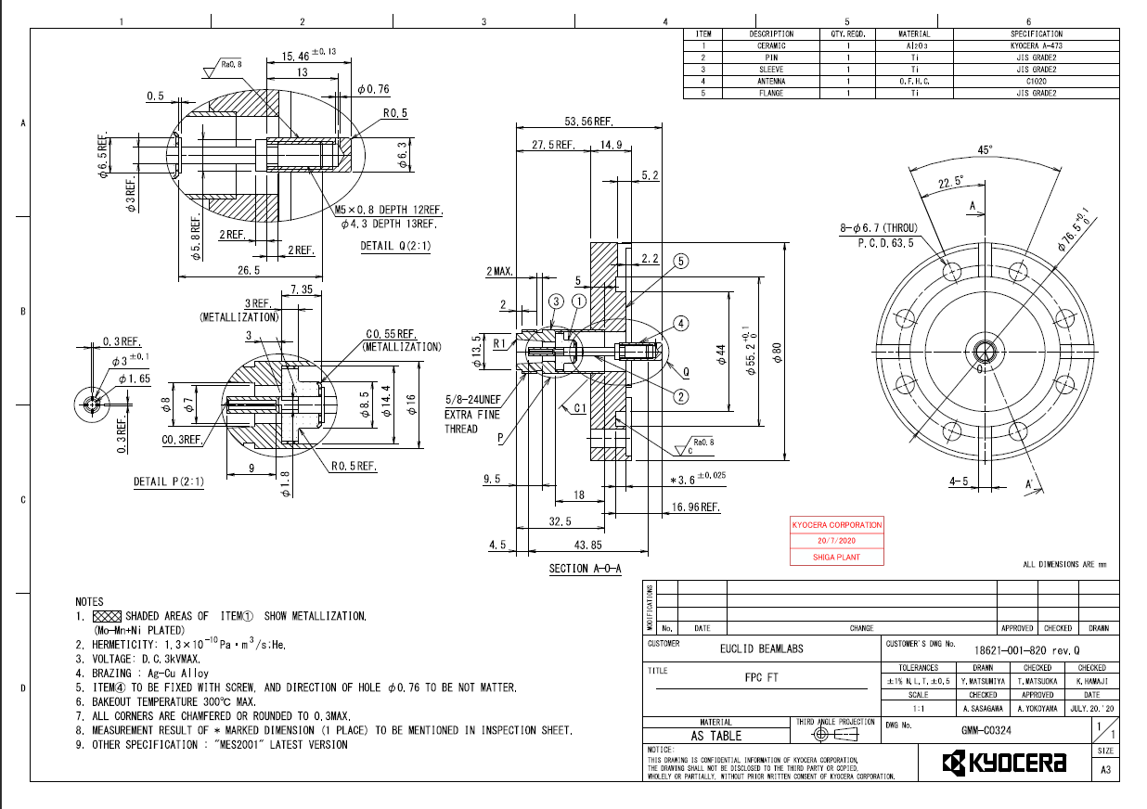
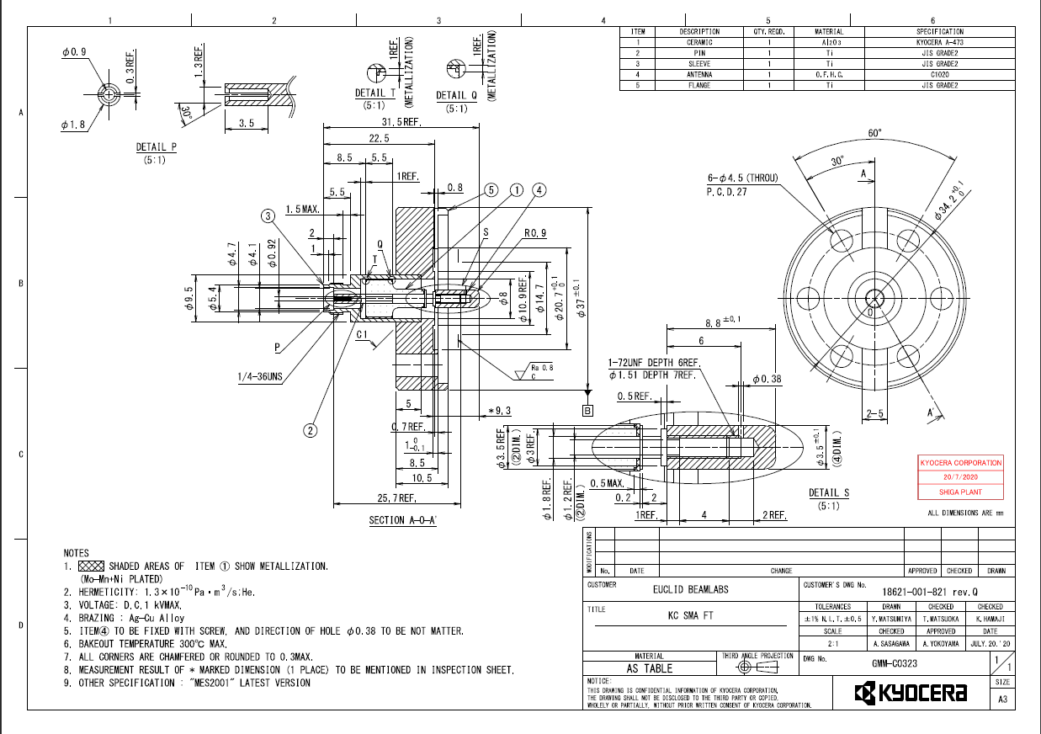
RF Design
FPC and Pick-up couplers were optimized
FPC coupler is based on an N-type feedthrough.
Pick-up coupler is based on an SMA-type feedthrough.
Both couplers have a screw-on antenna which can be easily tuned if needed.
The couplers are ordered from Kyocera, blueprints were generated.
FPC
Pick-UP
SRF gun optimization studies

Slide 8
Beam dynamics
Beam Simulation (UED Application, 5fC)
Beam Simulation (UEM Application, 0.5pC)
Parameter | Value
Application | UED | UEM
Beam energy | 1.655MeV | 1.655MeV
Charge | 5fC | 0.5pC
Laser pulse length, rms | 6.4fs | 6.4fs
Laser spot size | 36um | 180um
Beam bunch length, rms | 167fs | 741fs
Beam emittance | 6.6nm | 39nm
Energy spread (relative) | 1.3e-5 | 6.4e-5
SRF gun optimization studies

Slide 9
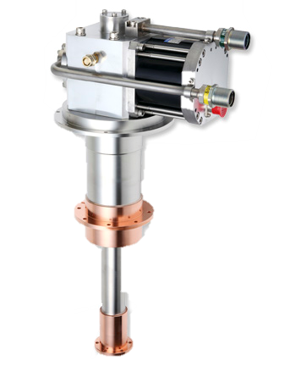
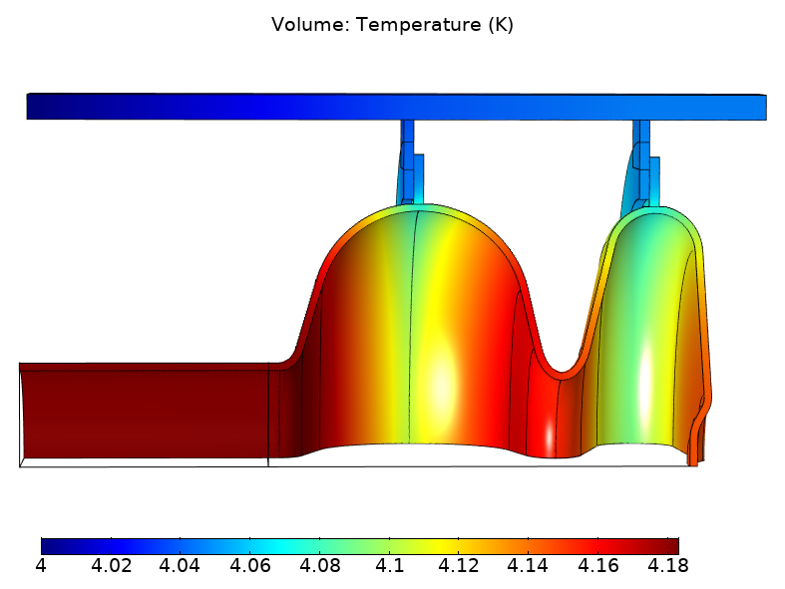
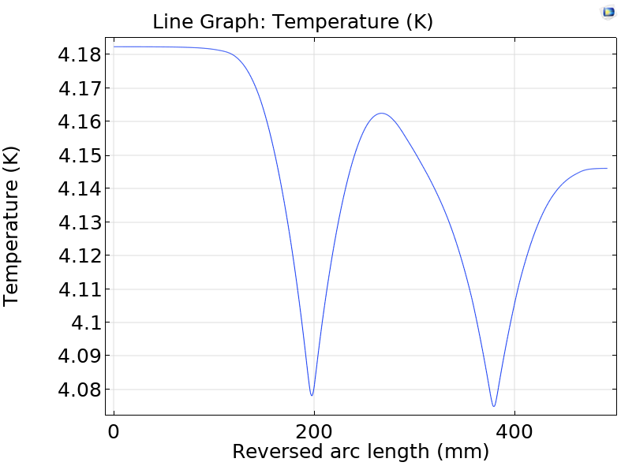
Thermal Analsys and Conduction Cooling
Cryo-cooler
5N pure AL buses are used for conduction cooling
Cryocooler is connected to the end of the of the AL bus
Thermal contact resistance is included in the model between AL-AL, AL-Nb and Nb-Nb.
Temperature dependent surface resistance Rbcs was used
Temperature difference in the cavity is 0.1K at 4K temperature of the cryocooler
Stable operation regions for Eacc=10MV/m found and presented on the next slide
SRF gun optimization studies

Slide 10
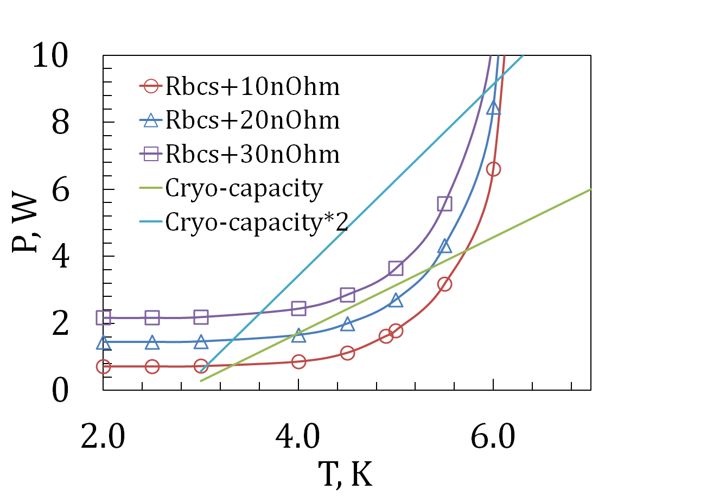
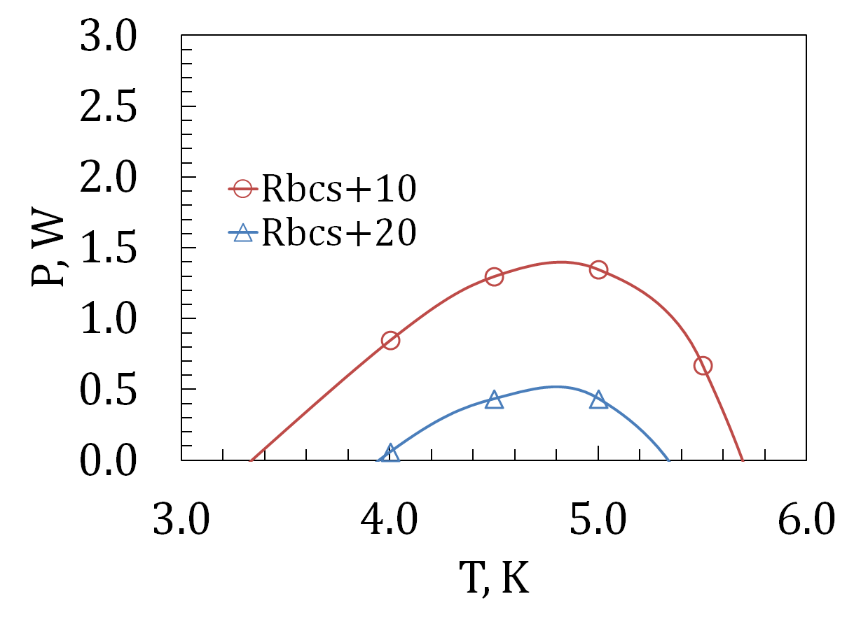
Thermal Analsys and Conduction Cooling
Thermal modeling was done for different cryocooler temperatures to find stable operation regimes for the case of Eacc=10MV/m (1.6MeV beam)
Dissipated power in the gun along with the capacity of the cryocooler are presented below.
In the ideal case (Rbcs+10nOhm) with no additional heat from radiation or conduction the gun will stabilize at 3.5K. 1.5W of cryocooler capacity is still available to accommodate the other sources of heat
In the case of Rbcs+20nOhm, the gun will stabilize at 4K with additional cryocooler capacity of 0.5W.
Excessive Power by a single Cryo-cooler
SRF gun optimization studies

Slide 11
Outline:
Introduction to UEM/UED and requirements
SRF gun optimization studies
Cryomodule design
Current status
Plans and conclusions
Cryomodule design

Slide 12
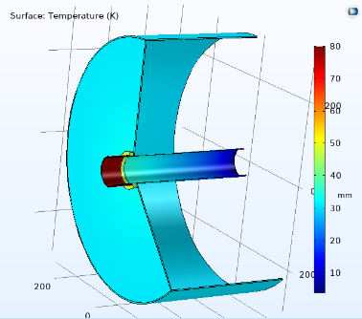
Cryomodule design
Cryomodule was developed to host the photogun
It is based on conduction cooling approach and is cooled by one Sumitomo cryocooler (CC)
1st stage of the CC is used as a thermal intercept and cools down a copper thermal radiation screen.
There is a 1mm thick magnetic screen (A4K) on top of the radiation screen
The cavity is supported by 8 Kevlar strips (k=0.05W/m/K)
The total power to the cavity is less than 0.2W, while the intercept has a heat flow of 20W
Temperature distribution in the copper thermal shield connected to the beam pipe.
Table 1. Static heat load to 30K and 4K zones in UEM cryomodule.
 | Radiation | Beam pipe | Suspension | RF cables | Total
30K zone | 2 W | 17 W | NA | 0.8 W | 20 W
4K zone | 0.01 W | 0.03 W | 0.05 W | 0.05 W | 0.14 W
Cryomodule design

Slide 13
Outline:
Introduction to UEM/UED and requirements
SRF gun optimization studies
Cryomodule design
Current status
Plans and conclusions
Current status

Slide 14
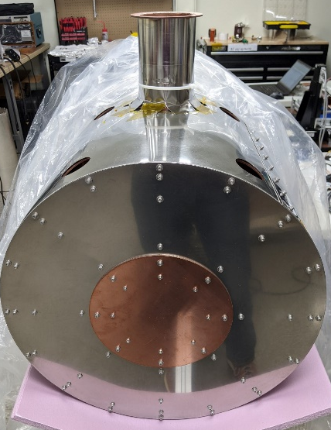
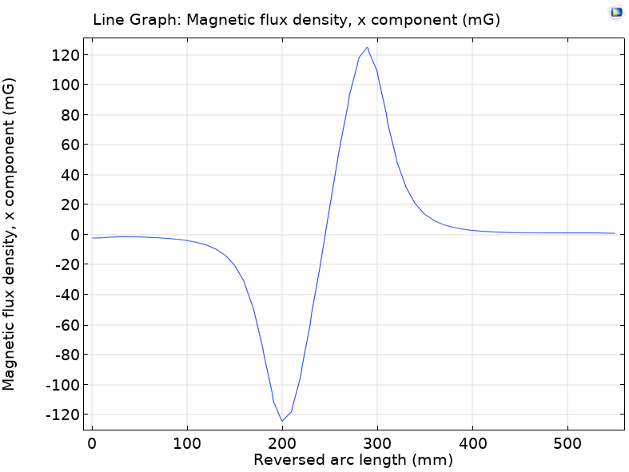
Magnetic shield in the cryomodule
A
B
C
Initial magnetic field measurements identified a gap in the magnetic shielding (see B) between the chimney and the cylindrical body (see A and B).
The results correlates with Comsol model (see C).
Nevertheless, the field in the cavity region (R=110mm, Z=(250;500)) is below 10mG at room temperature for A4K screen (See B).
A patch from Mu-metal foil (see C) reduced the field penetration at R=220mm down to 10mG (D).
Cryogenic performance measurement is ongoing.
Thanks to Y.Tereshkin for helpful discussions
D
Current status

Slide 15
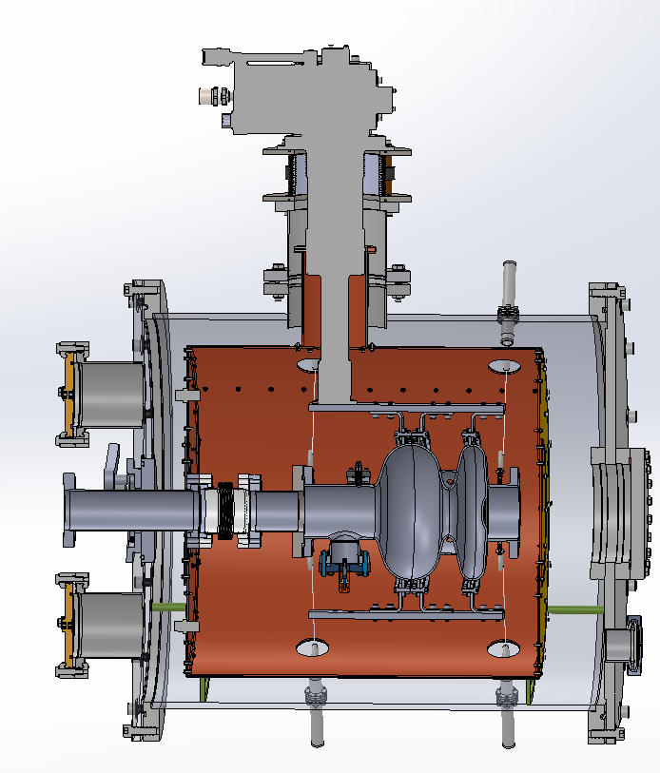
Cryomodule cool down (no cavity)
The cryomodule was assembled and successfully cooled down.
Aluminum foil was taped to the vacuum chamber walls to reduce heat radiation for the initial cool down studies. MLI is waiting to be installed.
The vacuum level was low E-5Torr went down to high E-8 Torr once cooled down.
Apiezon-N was applied on Cernox thermal sensors for better thermal contact.
Temperature of the 1st stage reached 28K in 24hrs while the 2nd stage cooled down to 2.5K and are within the expected values.
C1 and C2 temperatures corresponds to ~10W and ~0W to the 1st and the 2nd stages according to the provided by Sumitomo capacity map.
20K difference is observed between the 1st stage and the thermal screen, which demonstrates a poor thermal contact
A
C1
C2
C3
D
B
C
C3
C1
C2
Current status

Slide 16
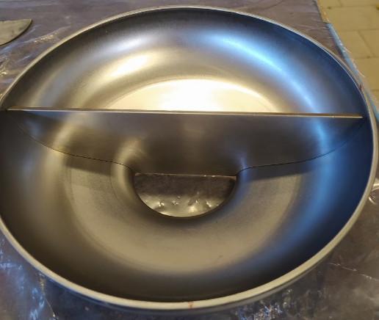
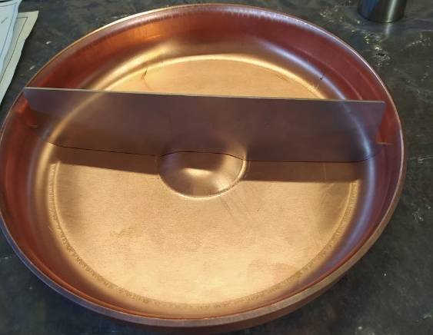
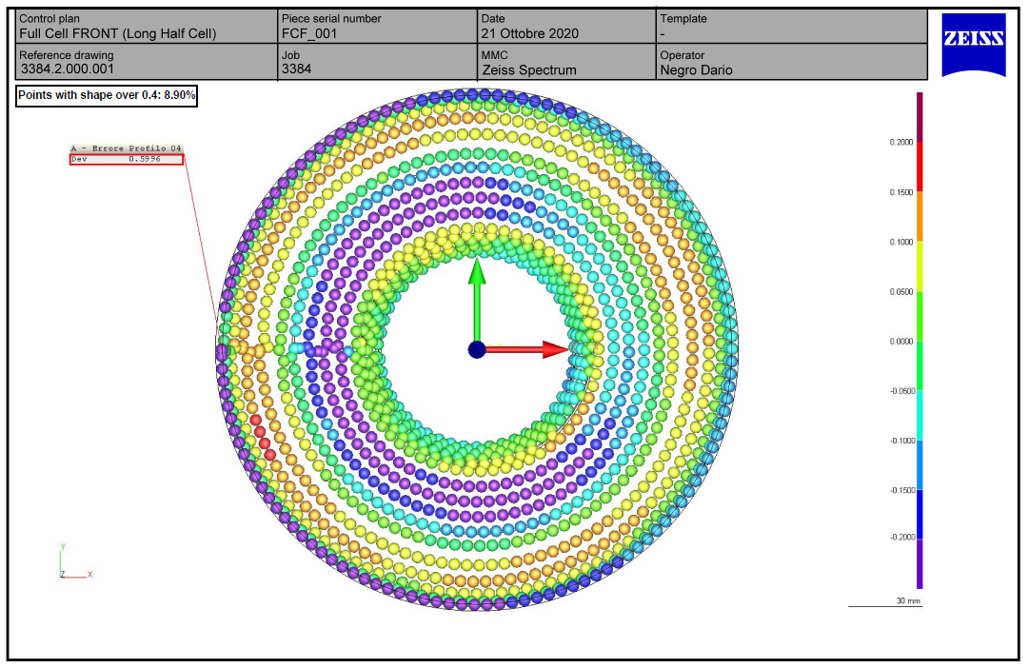
SRF GUN Status
Conduction cooled SRF photogun drawings were produced (see A)
The gun is being manufactured by Zanon
Half cells were die-pressed from copper first (see B), then from pure RRR300 Niobium (see C)
The Half cells were inspected by CMM and are within the tolerances (see D)
The cavity is at the EB welding stage now
The target delivery date of the gun is mid December 2020
A
D
C
B

Slide 17
Outline:
Introduction to UEM/UED and requirements
SRF gun optimization studies
Cryomodule design
Current status
Plans and conclusions
Plans and conclusions

Slide 18
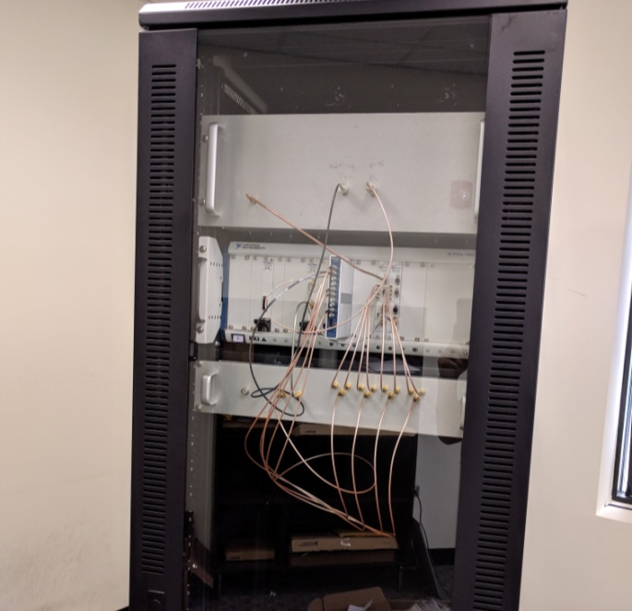
Conclusions
The cryomodule was assembled and successfully cooled down.
Magnetic field insulation inside the shielding was measured at room temperature and is below 10mG
SRF gun is under manufacturing. The half cells were die-pressed and are within the tolerances (see B).
All of the components are acquired.
LLRF control similar to one delivered to Fnal-IARC (see C) is developed.
The cryomodule is in the commissioning stage and will be ready soon to host the cavity
Capacity map of the cryocooler and cryogenic magnetic shielding performance is ongoing.
A
C
B
Plans and conclusions

Slide 19
Future plans
Zanon will deliver the cavity to Euclid Dec 2020
Nb3Sn deposition will be carried out by Fnal. The agreement is signed. The preparation work has been already initiated.
Test of the bare Nb gun in vertical test stand (VTS) to benchmark the performance
Nb3Sn deposition followed by the test in VTS
Test of the Nb3Sn gun at Euclid using conduction cooling cryomodule
Demonstration of 10MV/m of accelerating gradient as required to get 1.6MeV beam
Delivery the system to BNL for beam generation by UV laser and beam quality studies.
Plans and conclusions

Slide 20
Collaborators and Acknowledgements
Illinois Accelerator Research Center and Technical Division:
Sam Posen, V.Yakovlev, R.Pilipenko, Ch. Thangaraj, R,Dhuley, I.Tereshkin (retired)
Condensed Matter Physics and Material Science Division:
Yimei Zhu, Erdong Wang
Work supported by the U.S. Department of Energy Contract No. DoE SBIR Grant DE-SC0018621.
SRF gun optimization studies

