Slide 1
Temperature-Dependent Characteristics of Sputtered Nb3Sn Thin Films (for Accelerator Applications)
Katrina Howard, Zeming Sun, Matthias Liepe
(Cornell Laboratory for Accelerator-Based Sciences and Education)
Nb3SnSRF’20 11/12/20

Slide 2
Overview
Outline of Talk
Experimental Parameters
Data
Discussion of Results
Conclusions and Questions
Goals of Project
To establish a sputtering technique for Nb3Sn thin films that is promising for use inside Nb or Cu SRF cavities
To study the annealing behavior of these sputtered Nb3Sn thin films

Slide 3
Experimental Setup
DC power
Argon gas
Bulk Nb3Sn target
Substrates:
~1 cm x 1 cm x 3 mm Nb
~1 cm x 1 cm x 2 mm Cu
Substrate holders:
Rotating stage
Heated stage
Sputtering Deposition System
Image source: http://www.semicore.com/what-is-sputtering

Slide 4
Overview of Project
Variables we are testing:
Film thickness
Nb vs. Cu substrates
Effect of controlled heating in situ during sputtering
Effect of different annealing temperatures in high vacuum furnace
Analysis includes:
Scanning Electron Microscope (SEM): grain structure and size
Energy Dispersive X-Ray Spectroscopy (EDS): atomic composition and ratios
X-Ray Diffraction (XRD): characteristics of films in comparison to known material parameters

Slide 5
Sample Details
100 nm Nb3Sn film on Nb substrate
rotating stage at room temperature
2 um Nb3Sn film on Nb substrate
rotating stage at mystery temperature
300 nm Nb3Sn film on Cu substrate
heated stage at 550 C
Use Lindberg High Vacuum Furnace to heat samples to 600 C, 700 C, 800 C, and 950 C for 6 hours anneal time, conducting analysis between heatings to characterize films

Slide 6
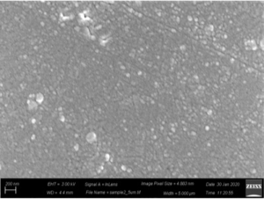
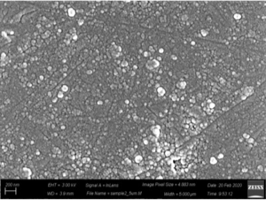
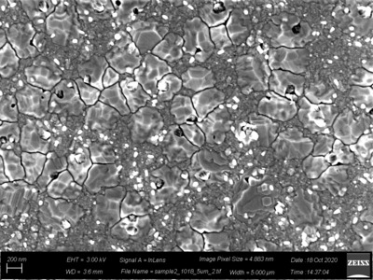
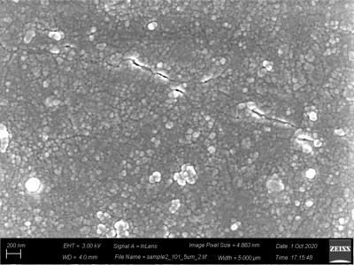
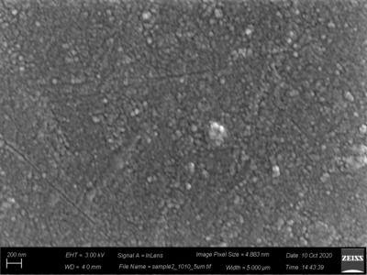
100 nm film on Nb substrate (room temp) SEM
initial
600 C
950C
images are 5 um wide
1 um
1 um
700 C
800 C
Observe recrystallization at 950 C with larger grain size at about 300 nm

Slide 7
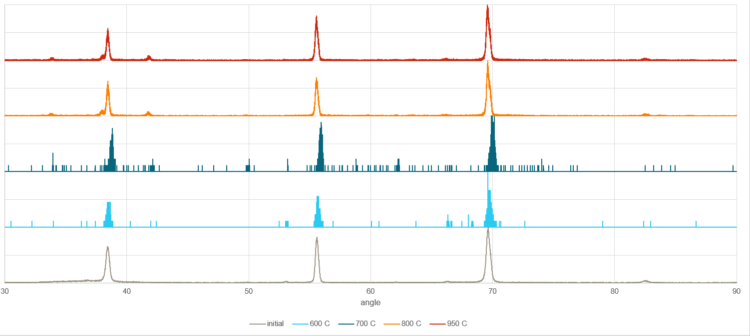
100 nm film on Nb substrate (room temp) XRD
Nb3Sn
(200)@33.6
(210)@37.7
Nb3Sn
(320)@62.8
(321)@65.6
Nb3Sn
(400)@70.6
Nb3Sn
(211)@41.5
Nb3Sn
(421)@82.9
950 C
800 C
intensity
700 C
600 C
initial
Nb (110)
@38.4
Nb (200)
@53.3
Nb (211)
@69.3

Slide 8
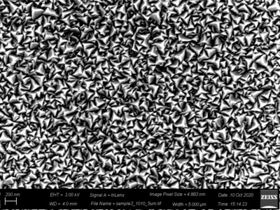
2 um film on Nb substrate (mystery temp) SEM
initial (mystery)
600 C
950 C
images are 5 um wide
1 um
1 um
700 C
800 C
Observe consistent triangular grains at 5um image width but significant cracking at low resolution

Slide 9
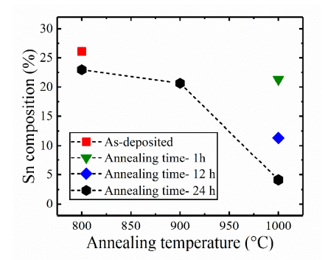
2 um film on Nb substrate (mystery temp) EDS
Jefferson Lab Result
Annealing time = 6 hours
Source: Sayeed, Md. Nizam & Pudasaini, Uttar & Reece, Charles & Eremeev, Grigory & Elsayed-Ali, Hani. (2020). Properties of Nb3Sn films fabricated by magnetron sputtering from a single target.
Observe loss of tin starting at 700 C and nearly gone at 950 C

Slide 10
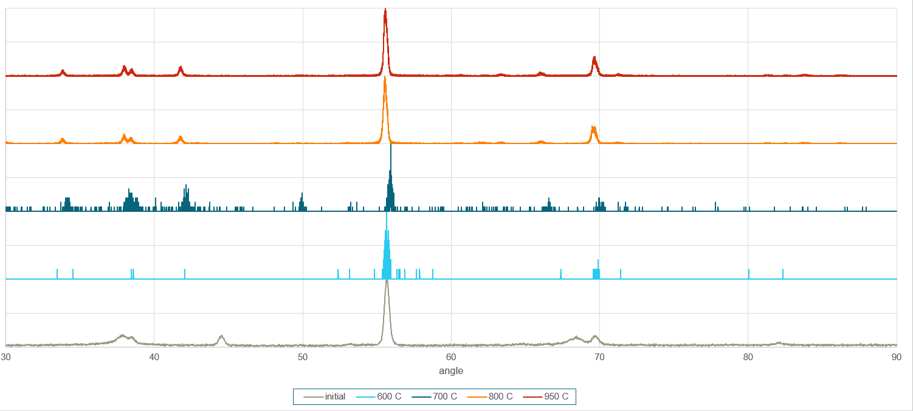
2 um film on Nb substrate (mystery temp) XRD
Nb3Sn
(200)@33.6
(210)@37.7
Nb3Sn
(320)@62.8
(321)@65.6
Nb3Sn
(400)@70.6
Nb3Sn
(420)@80.5
(421)@82.9
(322)@85.9
Nb3Sn
(211)@41.5
950 C
800 C
intensity
700 C
600 C
initial
Nb (200)
@53.3
Nb (211)
@69.3
Nb (110)
@38.4
Nb (220)
@82.1

Slide 11
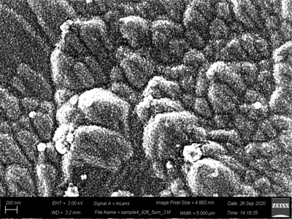
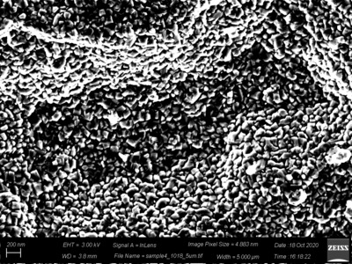
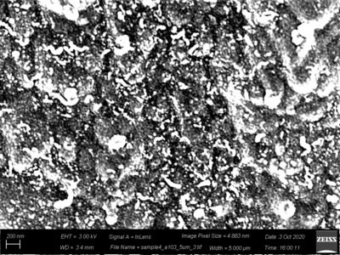
300 nm film on Cu substrate (550 C) SEM
initial (550 C)
600 C
950 C
images are 5 um wide
1 um
1 um
700 C
800 C
Observe remelting from initial finger-like grains to smaller angular grains

Slide 12
300 nm film on Cu substrate (550 C) EDS
Annealing time = 6 hours
Temperature | Atomic % Sn | Atomic % Nb | Atomic % Cu
Initial (550 C) | 19 | 74 | 8
600 C | 17 | 73 | 10
700 C | 6 | 72 | 22
800 C | 1 | 78 | 21
950 C | 0 | 83 | 17
Observe decrease in tin and increase in copper starting at 700 C
Tin undetectable by 950 C

Slide 13
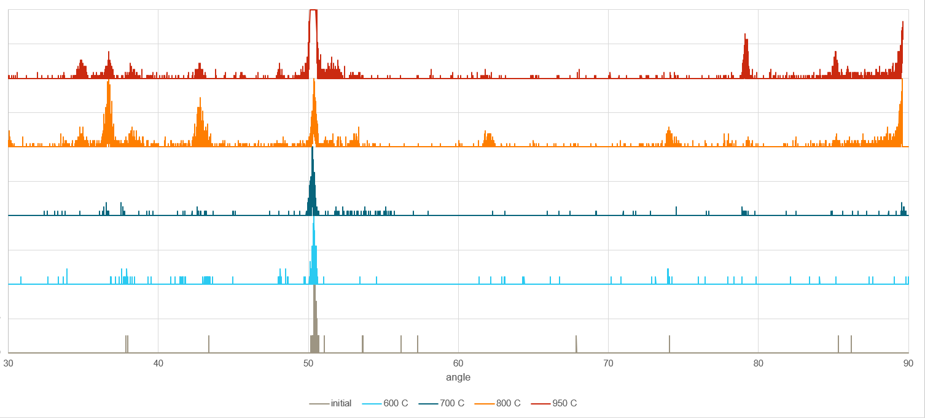
300 nm film on Cu substrate (550 C) XRD
Nb3Sn
(200)@33.6
(210)@37.7
Nb3Sn
(322)@85.9
Nb3Sn
(320)@62.8
950 C
800 C
intensity
700 C
600 C
initial
Nb (110)
@38.4
Cu (111)
@42.3
Nb (200)
@53.3
Cu (220)
@74.0
Cu (311)
@89.8
Cu (200)
@50.4

Slide 14
Summary of Results
100 nm on Nb at room temp:
Observe recrystallization at 950 C with larger grain size at around 300 nm
Observe Nb3Sn peaks emerge at 800 C
Shows annealing is required to obtain this phase
2 um on Nb at mystery temp:
Observe tin loss above on EDS results starting at 700 C
Some Nb3Sn diffraction peaks remain through 950 C
Observe significant cracking and decrease in triangular grain surface area, but uniform tin loss
300 nm on Cu at 550 C:
Observe tin loss above on EDS results starting at 700 C
Some Nb3Sn diffraction peaks remain through 950 C
Observe change in grain shape from finger-like to more angular shape, but not quite triangular
Observe increase in atomic % Cu at increasing temperature

Slide 15
Conclusions and Questions
Evidence of Nb3Sn in all samples
Why do EDS results show complete tin loss while XRD results show new Nb3Sn peaks at increasing temperature?
Increased strain in thicker films (possibly made worse by uncontrolled temperature during sputtering)
What is ideal thickness to obtain benefits of Nb3Sn thin films while avoiding cracking?
Tin loss (through evaporation?) above 700 C
How do we protect tin during annealing? What is being left over?
Change in grain shape in thinner films with increasing temperature to be more angular
Is angular shape good or a sign of tin loss?
Increased detection of Cu with increased temperature
How to avoid negative effects of annealing films on Cu substrate?

Slide 16
Acknowledgements
This work was supported by the U.S. National Science Foundation under Award PHY-1549132, the Center for Bright Beams.
This work made use of the Cornell Center for Materials Research Shared Facilities which are supported through the NSF MRSEC program (DMR-1719875). Thank you, Mick, Steve, and Mark for the training and support!
This work used the Materials Project as a resource for XRD data analysis:
A. Jain*, S.P. Ong*, G. Hautier, W. Chen, W.D. Richards, S. Dacek, S. Cholia, D. Gunter, D. Skinner, G. Ceder, K.A. Persson (*=equal contributions) The Materials Project: A materials genome approach to accelerating materials innovation APL Materials, 2013, 1(1), 011002. doi:10.1063/1.4812323

