Slide 1


Northern Illinois Center for Accelerator
and Detector Development
Field-Emission Cathodes on Niobium Conduction-Cooled SRF Cavity
Daniel Mihalcea,
Department of Physics, Northern Illinois University
Nb₃SnSRF’20, Nov. 10-13, 2020

Slide 2
Outline:
Conduction-cooling of RF cavities
Cathode holder & Electron source
Thermal studies
Expected performances
First experimental results
Plans & Conclusions

Slide 3
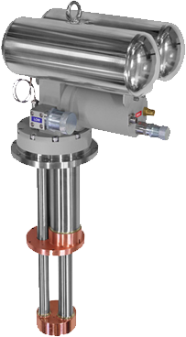
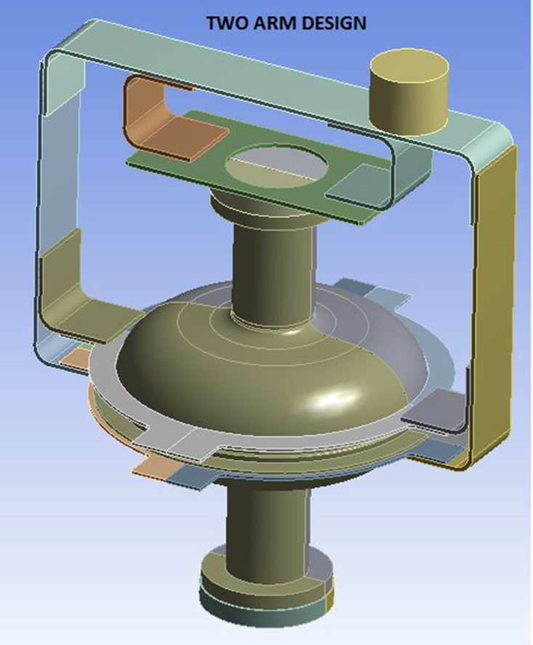
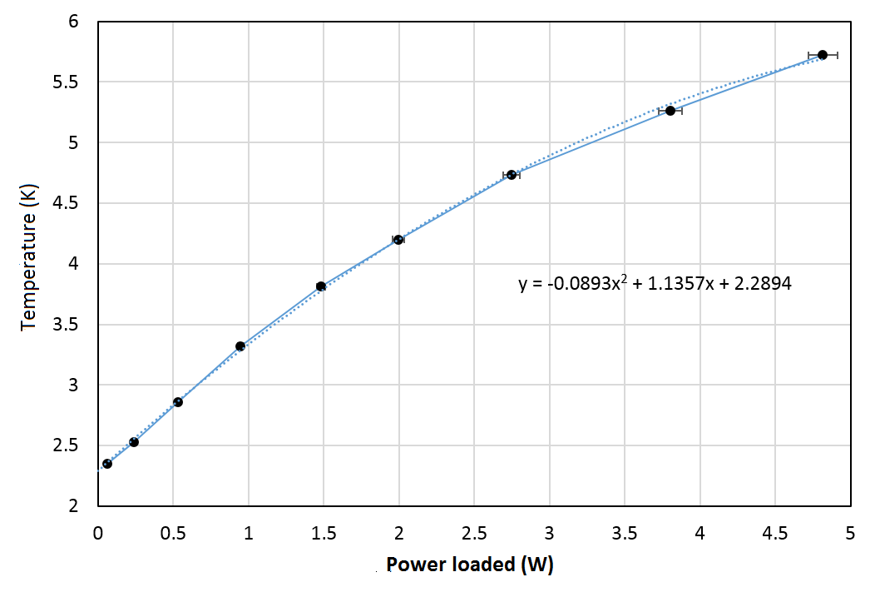
Conduction Cooling
Cryomech PT-440
Cryocooler adapter
T = 4.2K
2W@4.2K
Input flange (stainless steel)
Aluminum link
650 MHz Nb superconducting RF cavity
T ≈ 4.7K
Output flange (stainless steel)
Power loaded = Power dissipated (cavity) + Power loss (cryostat)

Slide 4
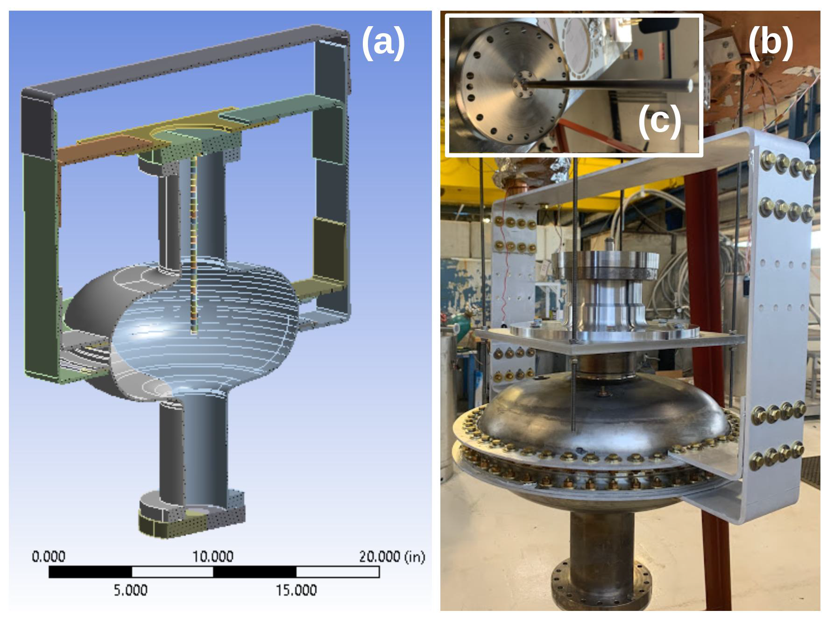
Cathode Holder
Superconducting cylindrical niobium rod is attached to the input flange.
Rod length (220 mm) and radius (5 mm) were determined from EM simulations and temperature studies.
Cathode can be attached at the open end of the rod.
Cathode consists of an array of field-emitters or a more standard photo-emissive deposition.
Insert cavity into cryostat.
Advantages:
field increase at rod tip.
impressive rep. rate (FE).
Disadvantages:
large EM fields around rod and upper flange.
hard to control pulse duration (FE).

Slide 5
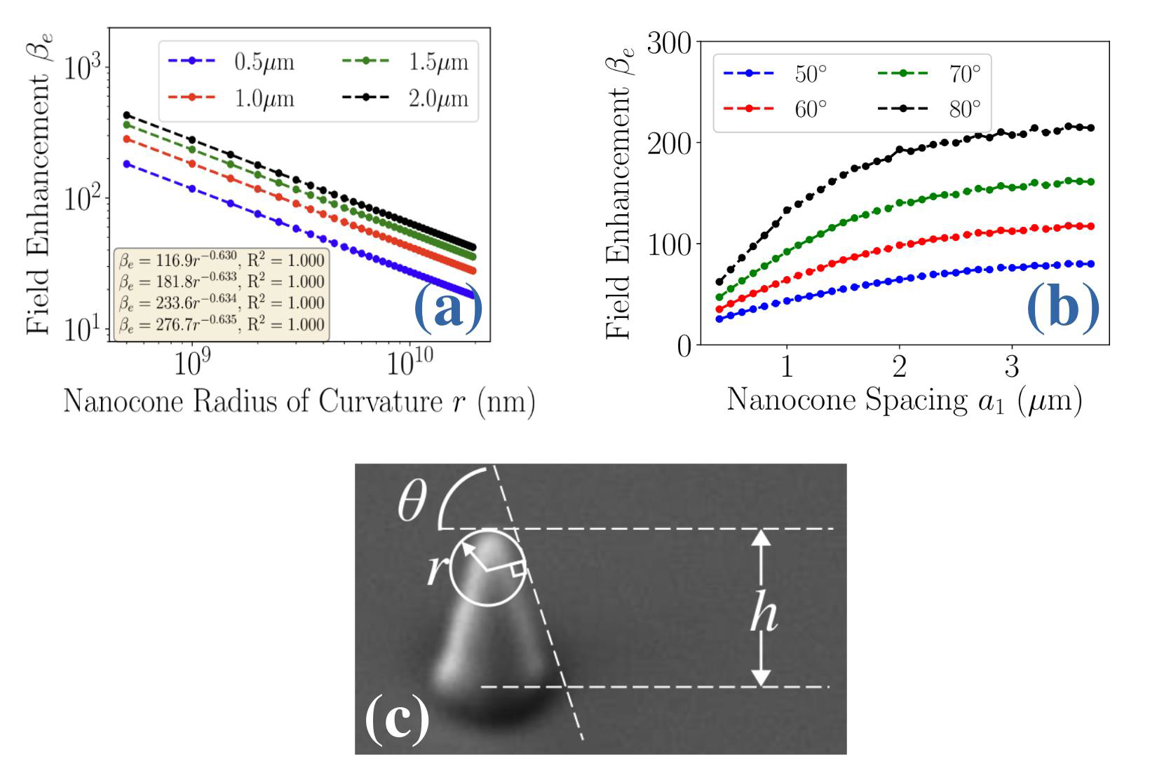
Field-Emission Cathodes
Fowler-Nordheim:
Ultra-nanocrystaline diamond (UNCD) tips. Ultra-sharp (r < 2 nm) high aspect ratio, adjustable spacing.
Manufactured at NIU Engineering Dept.
Tested on DC stand at NIU Physics Dept.
Enhancement factor: can reach a few hundreds.
Need to study how to deposit on Nb.

Slide 6
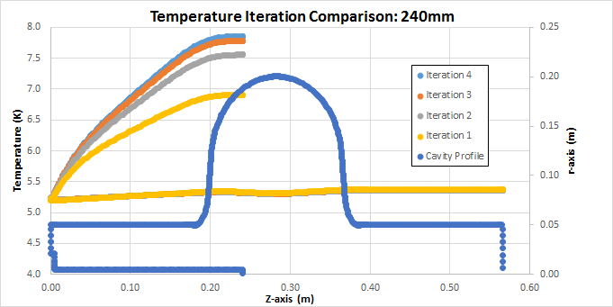
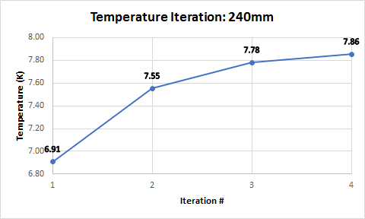
Thermal Studies
Iterative method with ANSYS:
Convergence must be achieved and T < T_{C} at any position.
Typically up to 10 iterations would suffice to obtain convergence (if it exists).
In the case of rod length L = 240 mm T_{max} ≈ 8K; Our choice was L = 220 mm when T_{max} < 7K

Slide 7
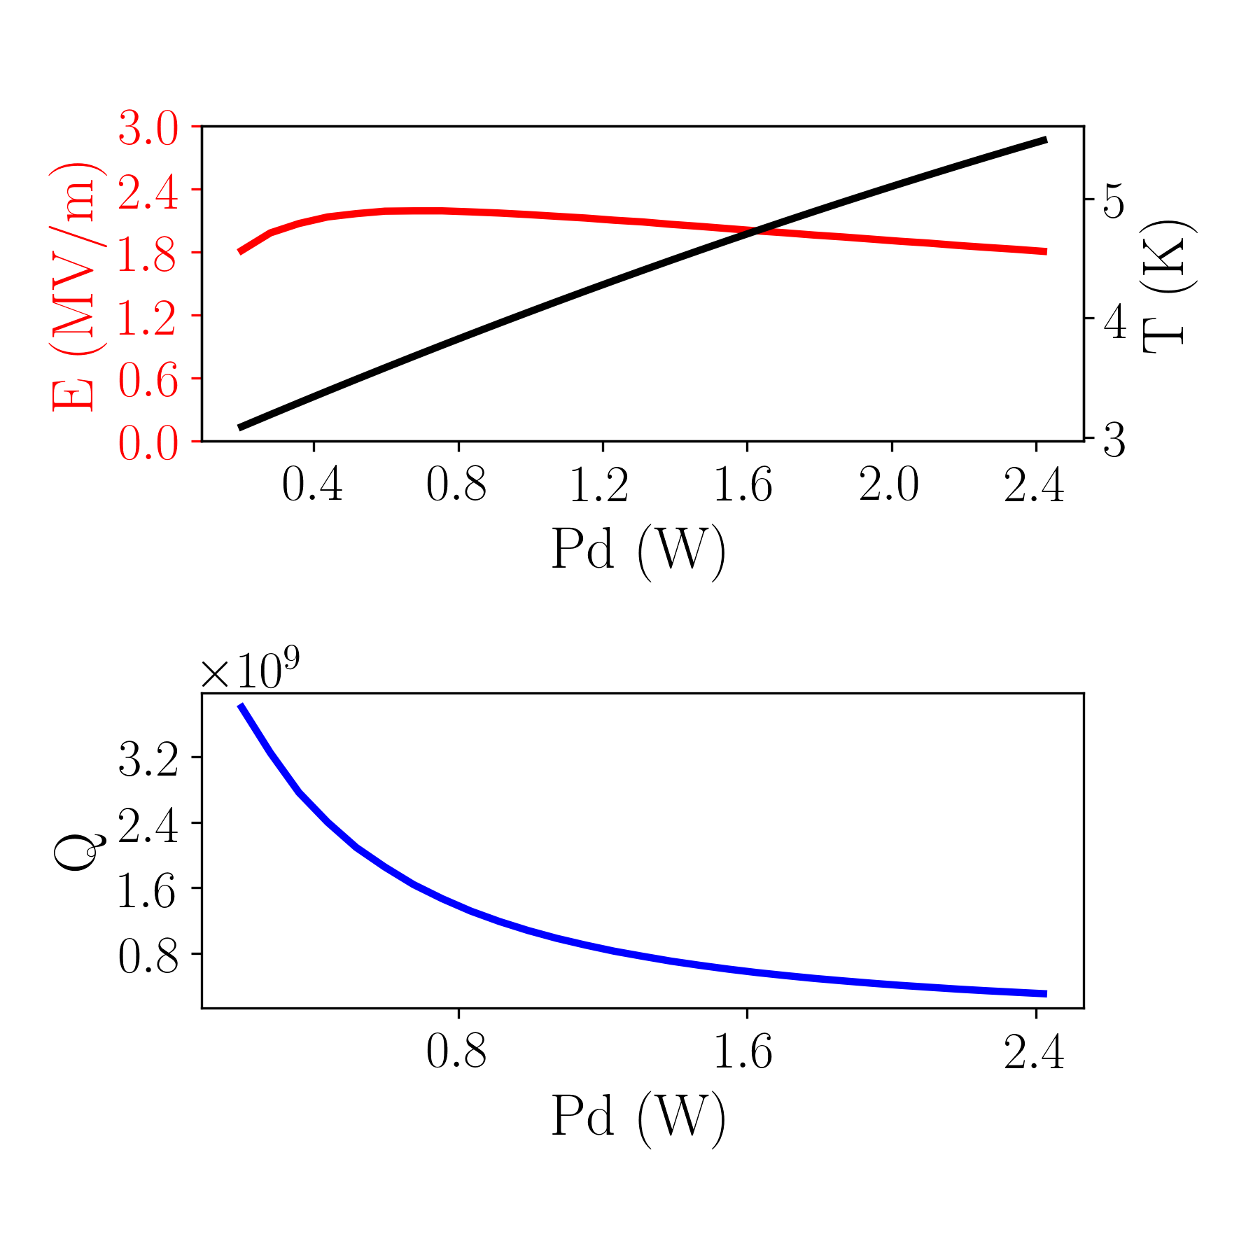
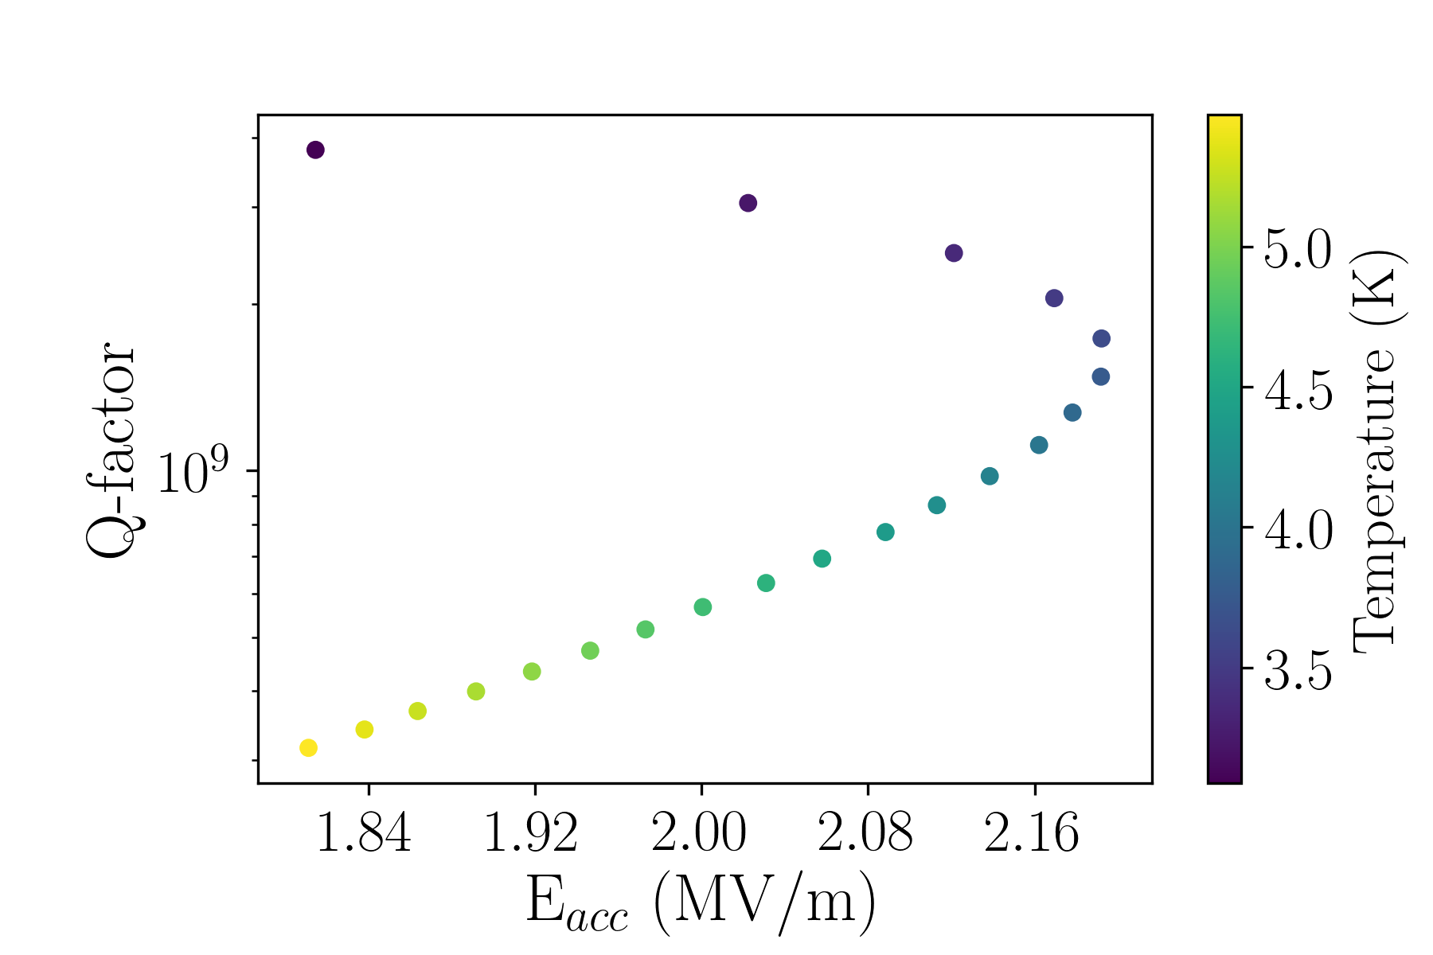
Expected Acceleration Field & Quality Factor
Cavity dissipated power P_{d}
Expect average E-field ≈ 2.0 MV/m
Peak field at cathode ≈ 8.8 MV/m
Q in the range 10⁸ – 10⁹
Beam current: ~ 0.1 – 1.0 mA
Energy gain: ≈ 30 kEV

Slide 8
First Experimental Results
Assembled cavity inserted into the cryostat.
Cryostat vacuumed to about 10⁻⁷ torr.
Cryocooler turned on.
In day 4 temperature reached the plateau at all measuring points.
As expected temperature was about 4.2K at the cryocooler adapter.
Upper flange temperature (4.3K) only slightly above the minimum.
The largest measured temperature is at cavity equator (4.7K) in agreement with our expectations based on measured thermal conductance of about 4.0 W/K
No direct temperature measurement at rod tip.

Slide 9
First Experimental Results (2)
T = 293K Q = 9.1×10³
T = 4.12K Q = 6.0×10⁵
Input flange exposed to large fields needs to be superconducting too.
Redesign the input coupler to minimize energy dissipation.
Fields by a factor 10 lower than expected.
Q-factor lower by a factor of about 100 lower.

Slide 10
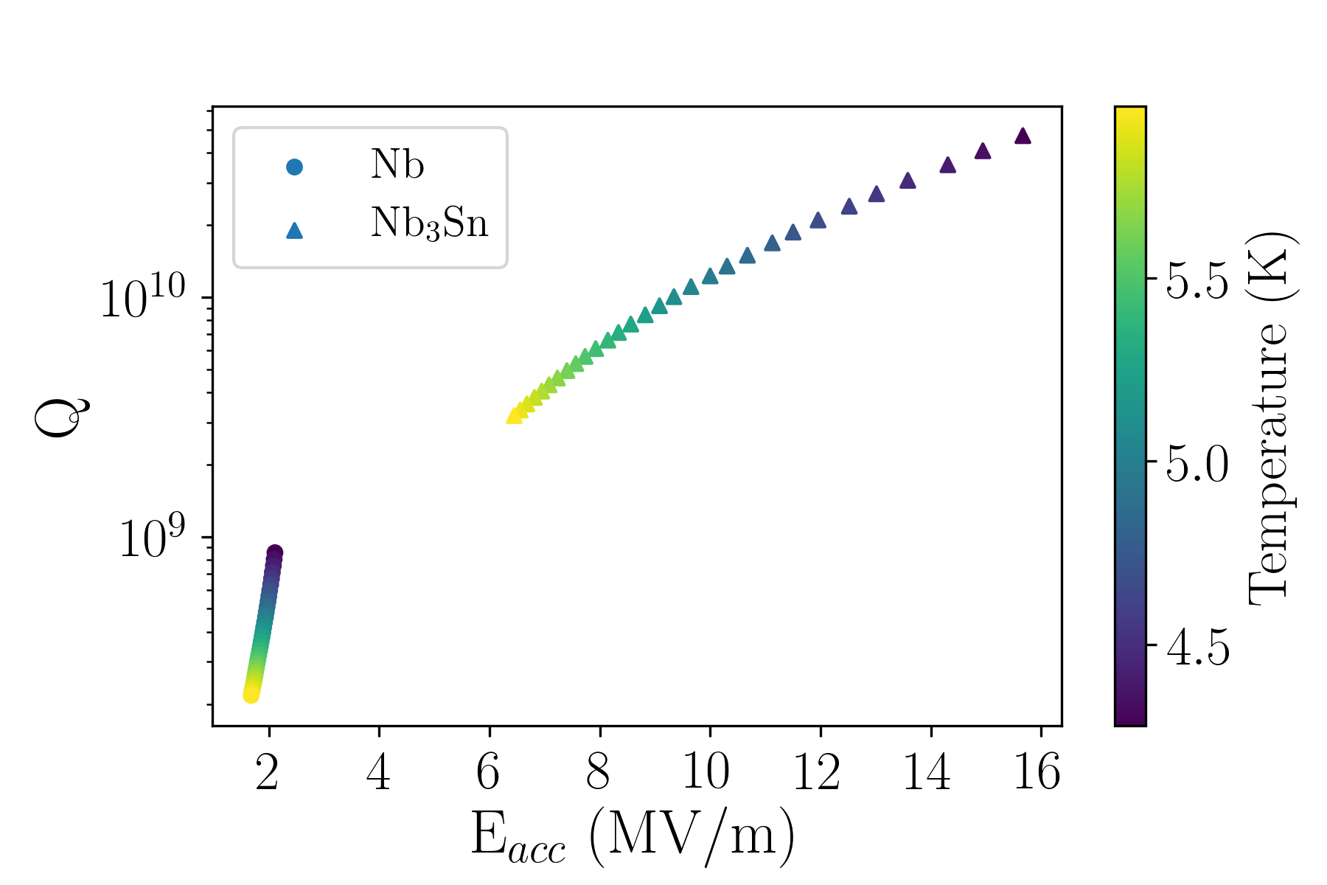
Plans & Conclusions
Plans
Replace the normal conducting input flange with a superconducting one.
Replace redesigned input coupler.
Improve the quality of the field-emitters to obtain enhancement factors β > 500.
Switch from pure Nb to Nb₃Sn
Conclusions
Conduction cooling achieved superconducting temperatures.
With redesigned flanges and couplers we should achieve E_{acc} ≈ 1.5 MV/m and Q = 10⁸ - 10⁹

Slide 11

Collaborators @ Acknowledgments
Northern Illinois Center for Accelerator
and Detector Development
Charles Thangaraj
Ram Dhuley
Michael Geelhoed
Philippe Piot
Daniel Mihalcea
Osama Mohsen
This research used resources of the National Energy Scientific Computing Center which is supported by the Office of Science of the U. S. DOE, Contract No. DE-AC02-05CH11231.

