Slide 1
Dinner Cruise
Tonight (Wednesday, 6 p):
Dinner cruise on the Cayuga lake
Please go to the Clark Hall Entrance (east)
Two busses will bring us to the boat landing
Boarding is 5:30 p
There will be a dinner and you have 2 vouchers for drinks (CW dollars), cash bar available
Cruise ends at 9 p, busses will bring you back to the downtown hotels and campus
Bags may be left in the busses

Slide 2
Boat Landing
Boat departs 6p sharp!

Slide 3
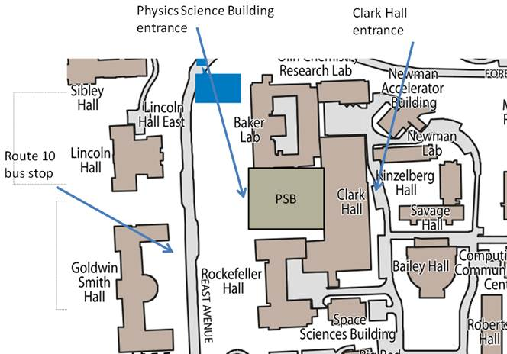
The day after…
Sessions will begin 8:30 a
Today and Friday in Clark700
Thursday in PSB 401
Signage will guide you

