Slide 1
SRF Cavities Resonance Control. CW mode of operation (FNAL’s experience).
Yu. Pischalnikov W. Schappert
FNAL
TTC CW SRF Meeting, Cornell University, 12June, 2013

Slide 2
Microphonics for CW SRF machine
dF/dP: cryo-plant OR/AND cavity system (cavity/HeVessel/tuner) design (see T. Khabiboulline – FNAL’s design of 650MHz &325MHz design);
External vibration: design of cryo-module & vacuum/cryo infrastructure around machine;
Active compensation of the microphonics /challenges/:
Accuracy of detuning measurements
Slow feed-back compensation (slow dF/dP compensation )
Fast feed-back compensation (external vibration; mechanical model of cavity)
Long Term stability of active compensation (one trip/per cavity/500Hours operation)
Tuners coarse(slow)& fine(fast)
Design & Reliabilities (piezo reliability)

Slide 3
Active control of SRF cavities resonance
 | operation mode
algorithm | CW | RF pulse
Feed-forward
Slow Feedback (He pressure fluctuation & cavities dF/dP)
Fast Feedback (vibrations)

Slide 4
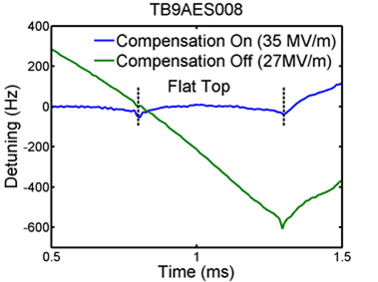
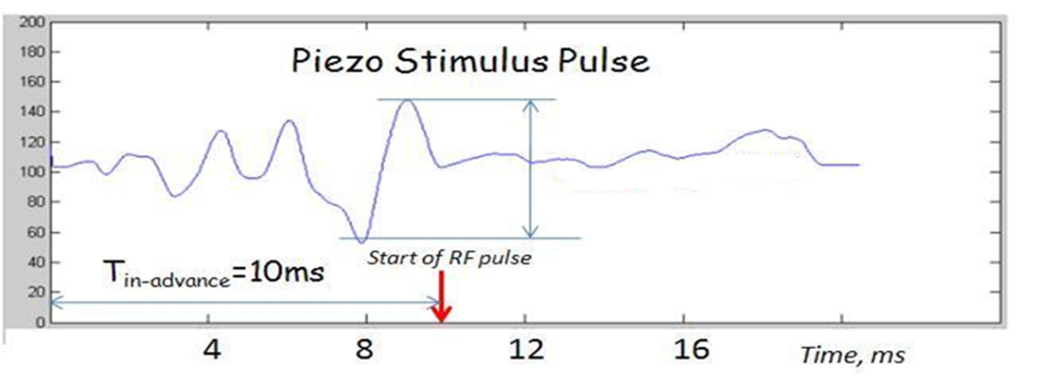
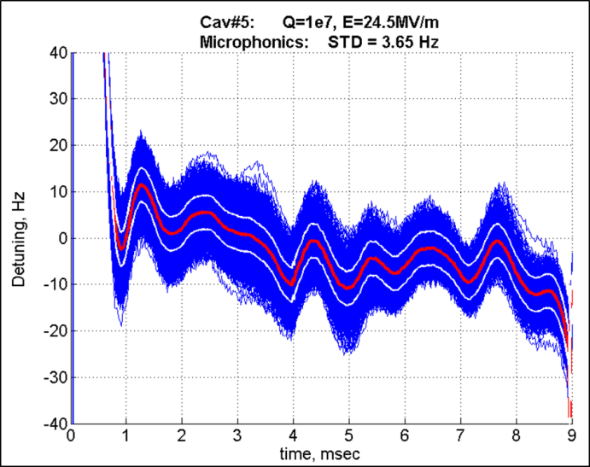
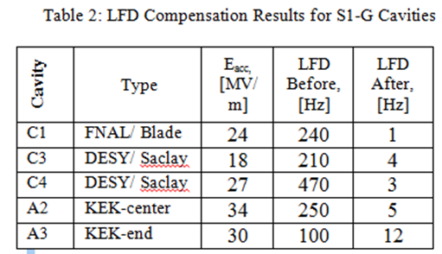
Adaptive Feed-forward algorithm for LFD compensation for 1-10ms (and longer) pulse.
Accurate measurements of the detuning due to Lorentz force
Accurate characterization of the detuning response to piezo impulses at various delays
Use least-squares to determine the combination of piezo impulses required to cancel out the Lorentz force detuning
1ms RF pulse
Lorentz Force Detuning Before and After Compensation for one 9-cell cavity equipped with blade tuner
10ms RF pulse
Flat top

Slide 5
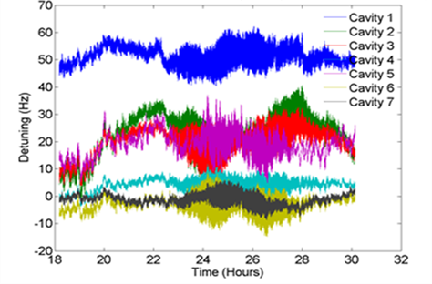
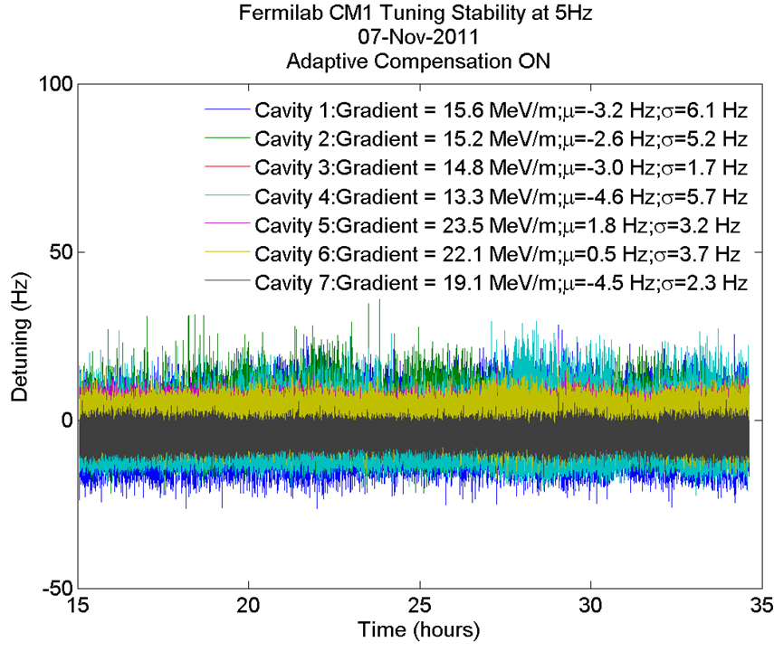
Adaptive Feed-forward @RF pulse mode CM1 NML (He pressure & dF/dp)
20 hours
Frequency stability of the CM1 cavities over the course of 12 hours with non-adaptive LFD compensation. The cavity resonance frequencies can drift by several tens of Hz.
Fermilab CM1 tuning stability with adaptive feed-forward LFD compensation ON. CM1 operated at 5Hz repetition rate. Adaptive feed forward (adjusting piezo bias for next RF pulse) can limit the drift to ~1 Hz.

Slide 6
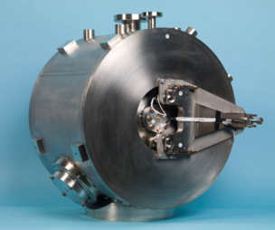
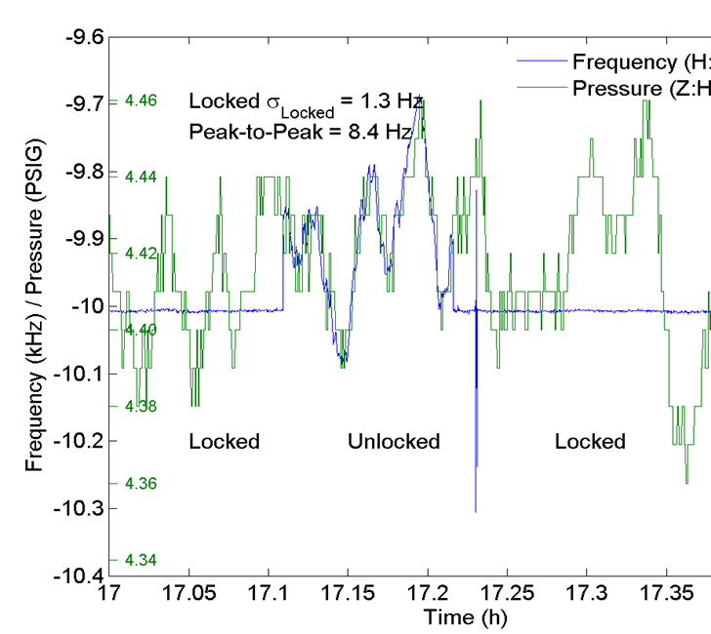
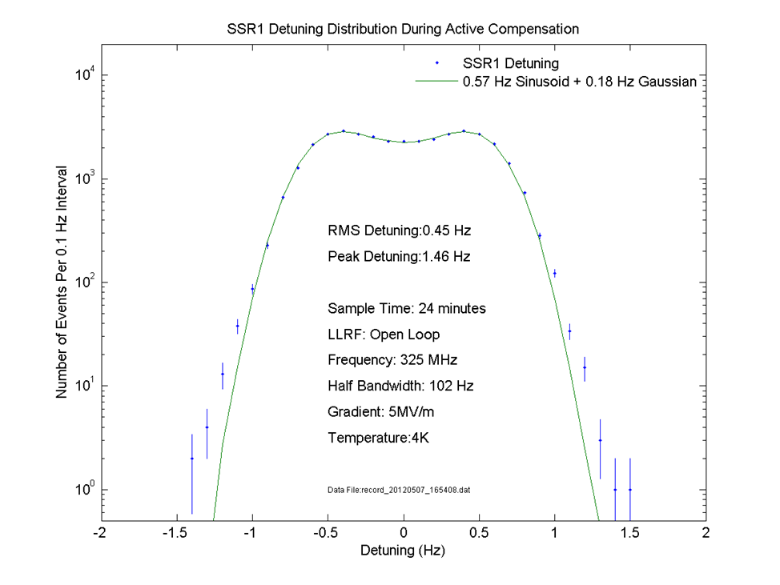
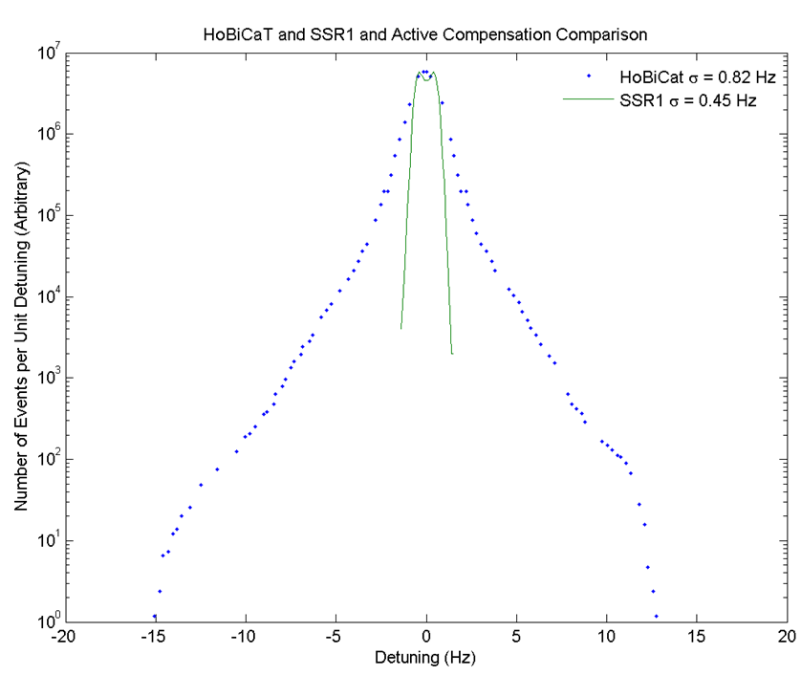
Slow Feed-back to compensate microphonics (as a results of He pressure fluctuation ( dP~5torr @4.5k) and cavity’s dF/P ~140Hz/torr )
σ=1.3Hz
σ=0.45Hz
Half Bandwith:1-2Hz
Active Compensation of Microphonics in the SSR1 Cavity. The green curve shows the pressure of the helium bath. The blue curve shows cavity detuning. The cavity was operating with a bandwidth of ~1.5Hz at the temperature 4.5K and Eacc=5MV/m.
FPGA fed Δf (detuning) back to fast tuner.
Simple simulations indicated that limit may be 100kHz ADC
Upgraded hardware: Used ADC14-bit, 100MS/s
SSR1 cavity was operated with bandwidth of ~102Hz
Goal was to see ultimate level of compensation

Slide 7
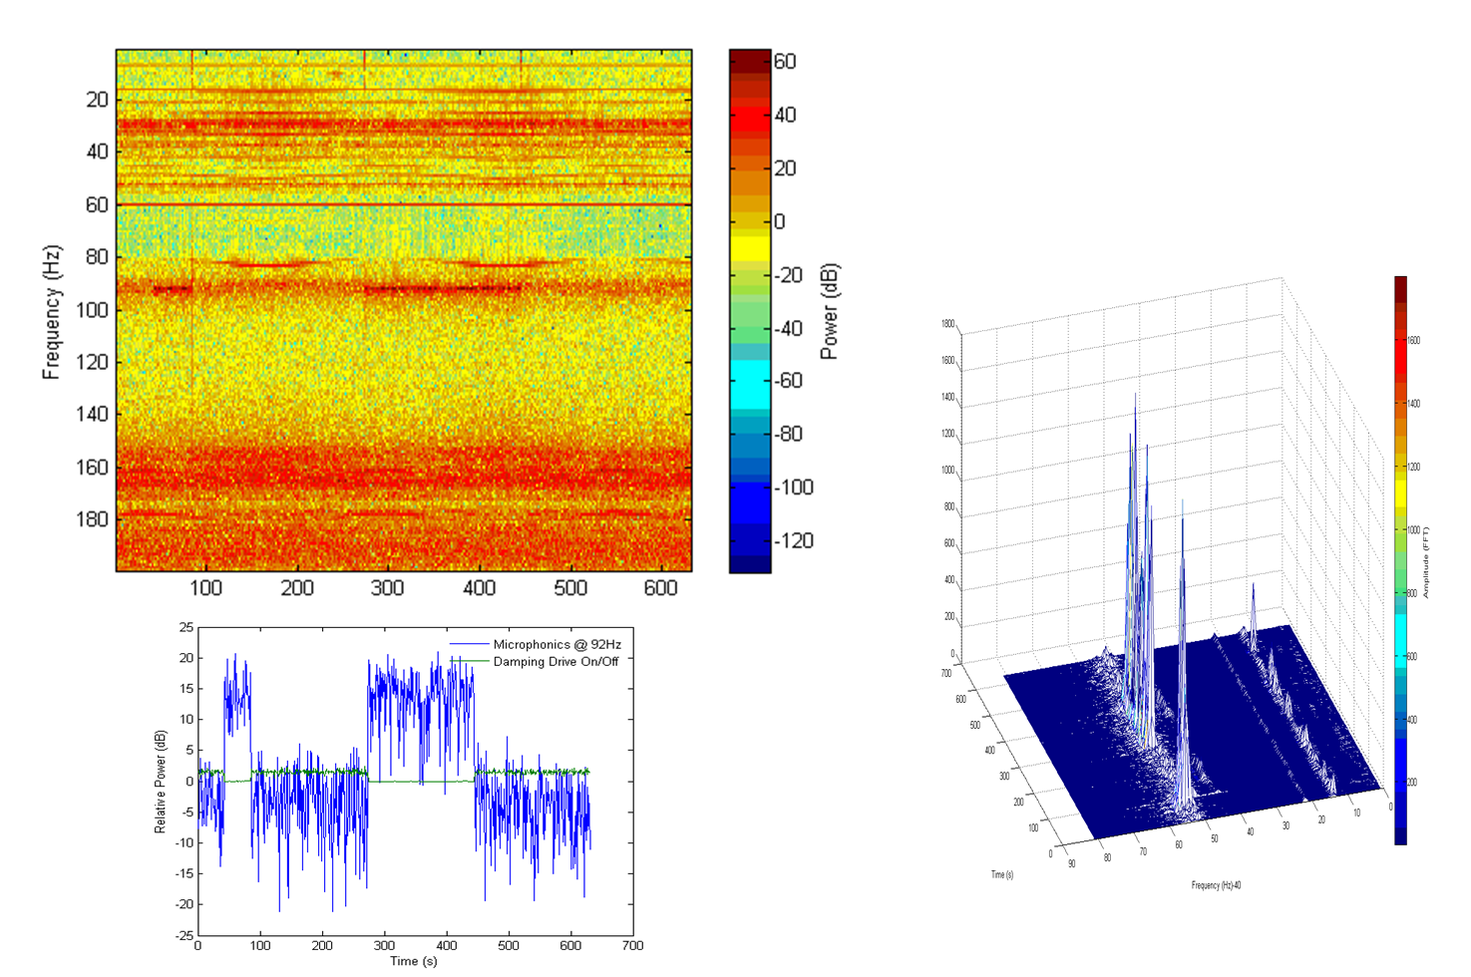
Fast Feed-back @CW
9cell 1.3GHz “tesla style cavity (CC2)
Now is part of FNAL’s NML photo-injector
Single Narrow Resonance (F=92Hz; T=2K)
The Piezo tuner actively damped vibrations induced by external sources. An IIR filter bank was used to isolate and reverse the phase of the particular spectral line. The phase reversed signal then fed back to the piezo tuner.
CC2 (analog phase detector) & filter bank
Amplitude (FFT)
Time (s)
Time (s)
Active damping reduces the vibration at this frequency
by 15 dB.
Frequency(Hz)

Slide 8
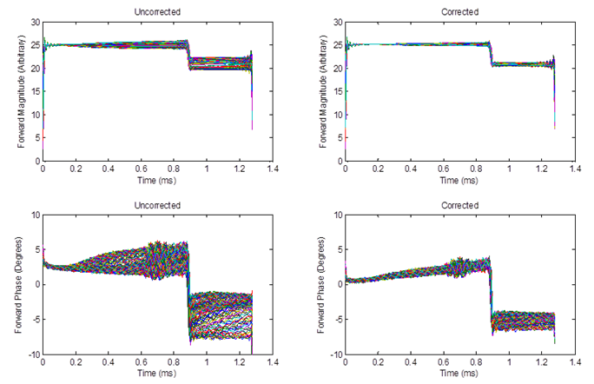
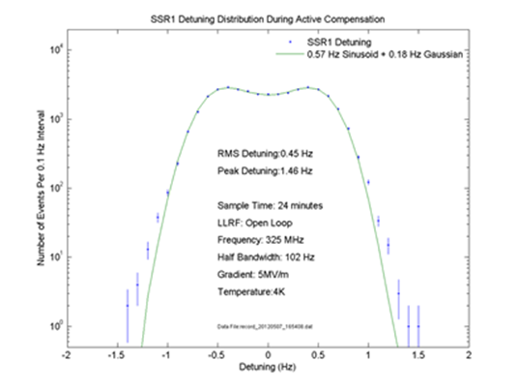
Plans at FNAL related to microphonics work
Calculate detuning from RF signals using the same detuning formula used for LFD compensation
Directional Coupler issues: Contamination of P_{forw} with P_{refl}
Quality of RF receivers and digital filtering→ contamination of our baseband signal
Cavity’s mechanical model to feed into FPGA system
LLRF
Directional coupler
P_{refl}
P_{forw}
Detuning calculation
P_{probe}
Piezo
Δf(detuning)
Cavity mech.model
FPGA
/algorithm
/Piezo_amp
Correction used at FNAL for RF-pulse
mode LFD compensation
Piezo stimulus
1(a)
Uncorrected
Corrected
B
1(b)
magnitude
phase
Assumption (likely only partially true) that forward tail is due exclusively to cross-contamination by reflected signal.
Correction reduces the amplitude and phase variation and forward signal from 5-15% to a few percent.
Double structure distribution… 0.5Hz resolution instead of 0.18Hz

Slide 9
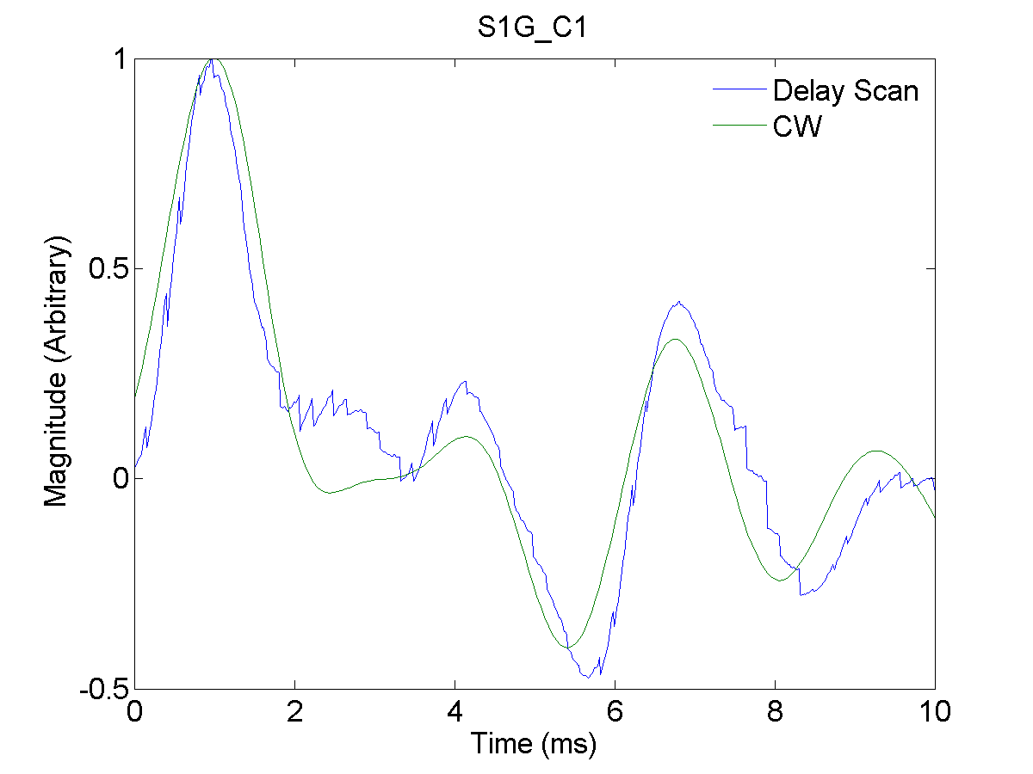
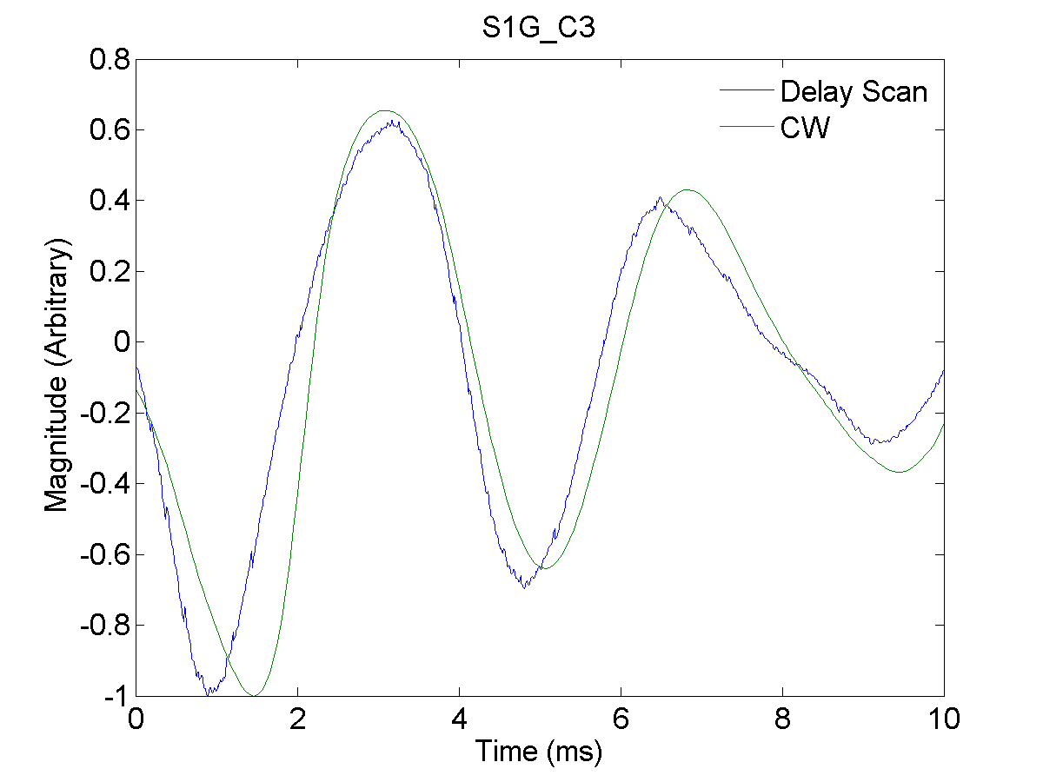
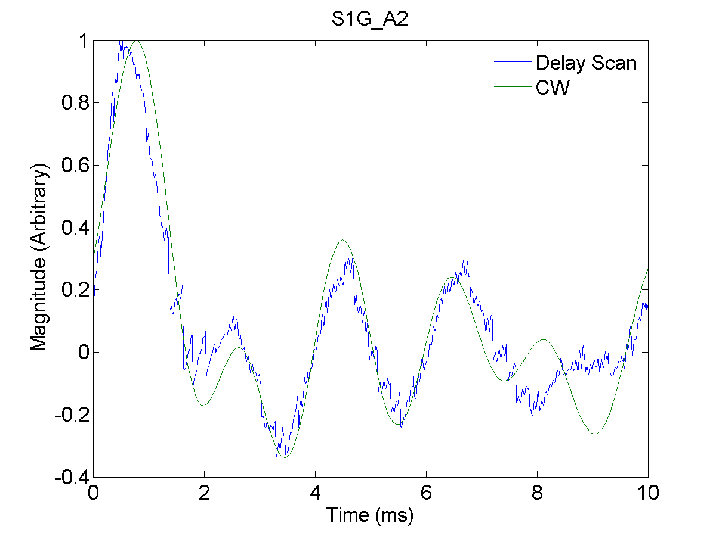
Measuring the Mechanical Transfer Function in Pulsed-Mode (opportunity to do it at S1-Global)
Blade/FNAL
DESY/Saclay
Excite the piezo with a series of impulses and sweep the impulse-to-RF delay
Equivalent to measuring the piezo-to-detuning transfer function using CW
Delay-Scan used to determine optimal waveform
KEK cavity

Slide 10
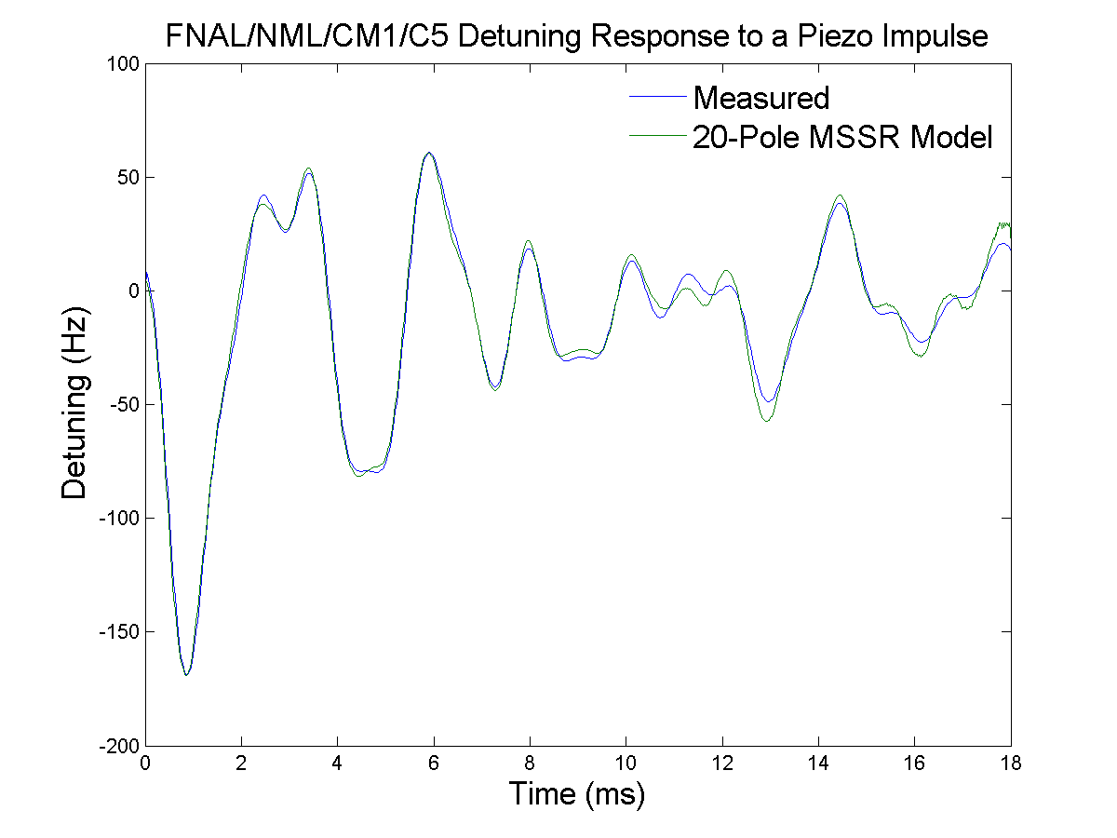
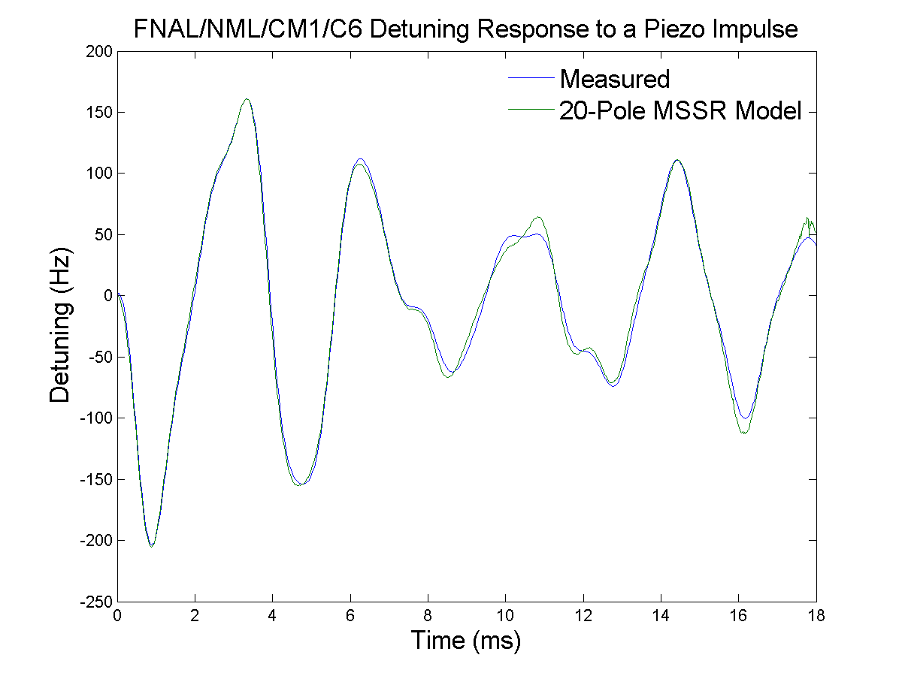
CM1 Cavities (#5&#6 of NML cryomodule#1) measurements and 20-Pole MSSR Model

Slide 11
Summary
FNAL focus is changed from RF-pulse machine (ILC) on CW machine (Project X)
Development of expertise in active compensation of the mircophonics is important goal for FNAL’s team
We are interesting to collaborate with experts in SRF community:
exchanges ideas; software codes; joint work at existing facilities; tuner’s reliabilities study; etc…

Slide 12
Additional Slides

Slide 13
Fast Feed-back @CW
Single Wide Resonance (F=155Hz; T=2K)

Slide 14
Measuring LFD
Complex envelope of the probe signal described by 1st order ODE
Rearrange terms to extract the width and the dynamic detuning from the probe and forward IF signals

Slide 15
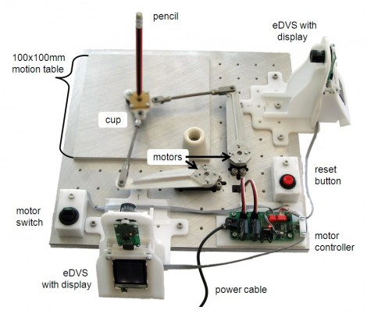
Long Term Stability

