Slide 1
CW Cryomodules;
KEK injector cryomodule
Eiji Kako (KEK, Japan)

Slide 2
OUTLINE
cERL injector cryomodule
Cryomodule assembly in clean room
Cryomodule assembly in clean booth
Installation in beam line
Low power RF tests
High power RF tests
Static and dynamic heat loads
Beam operation
Summary

Slide 3
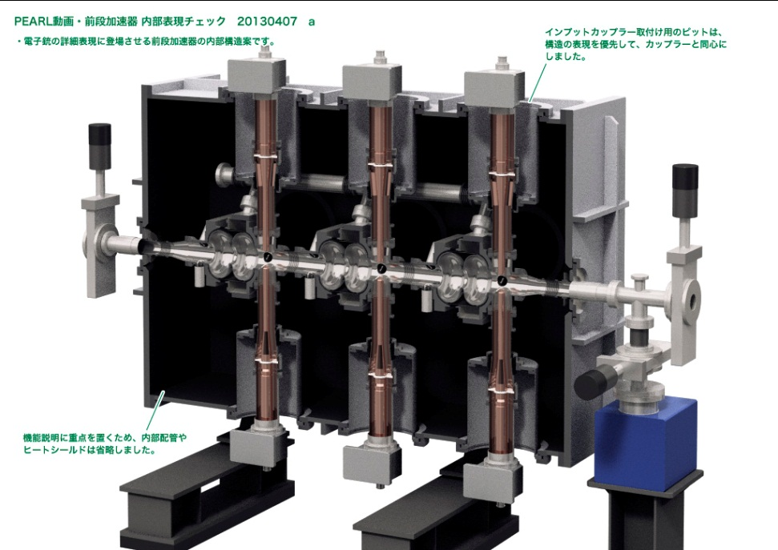
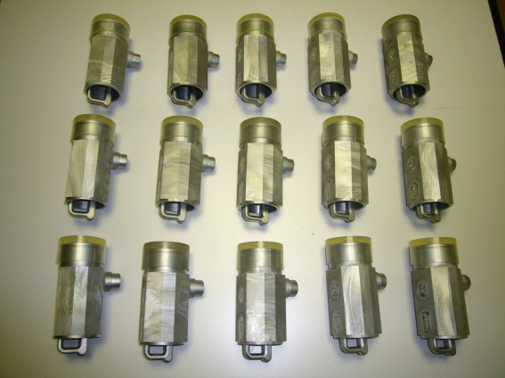
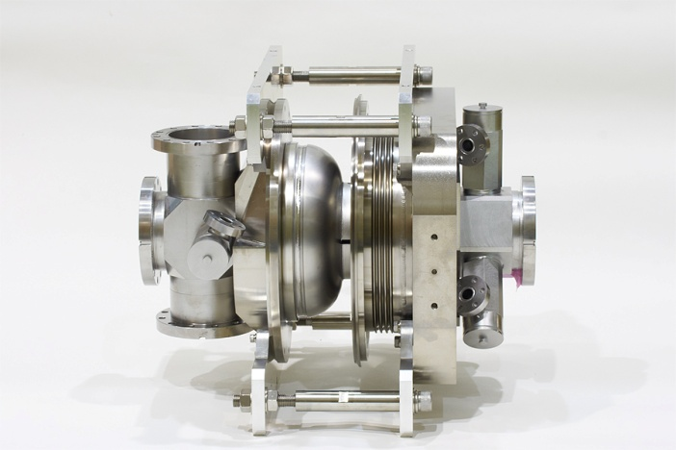
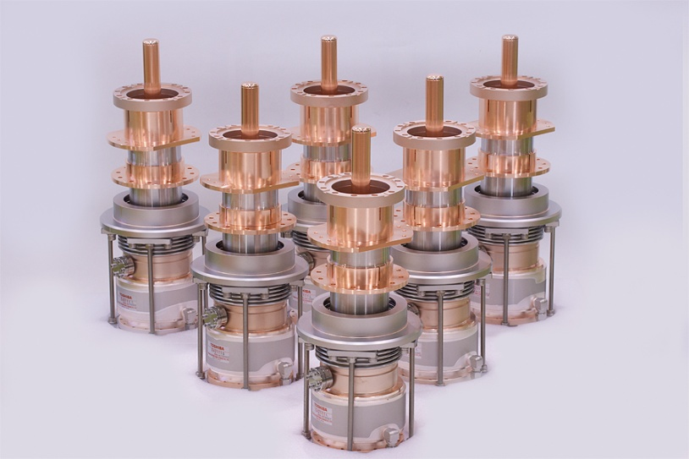
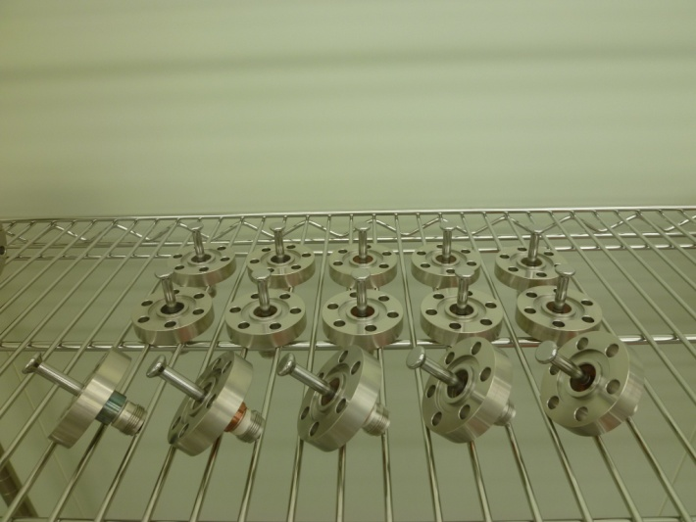
cERL Injector Cryomdule
e⁻ beam
0.5 → 5.5 MeV
10 mA

Slide 4
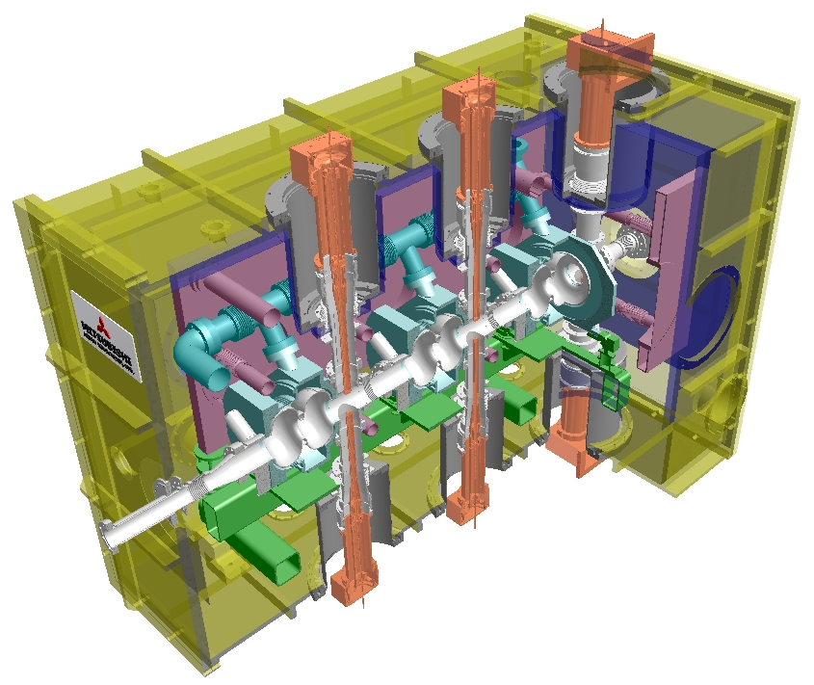
cERL Injector Cryomdule
Vacuum Vessel
5K Duct
5K Panel
5K Panel
80K Shield
2K He Jacket
2K Gas
Return Pipe
5K Support
Input Coupler
e⁻
80K Base-plate
Magnetic shield
2-cell Cavity
10 mA
0.5 → 5.5 MeV
HOM Coupler &
RF Feedthrough
4

Slide 5
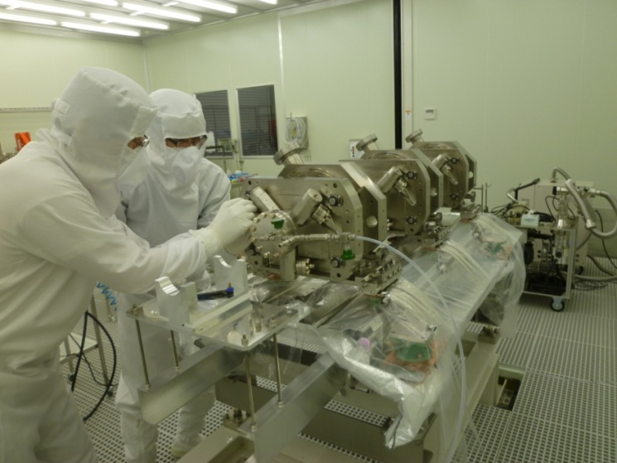
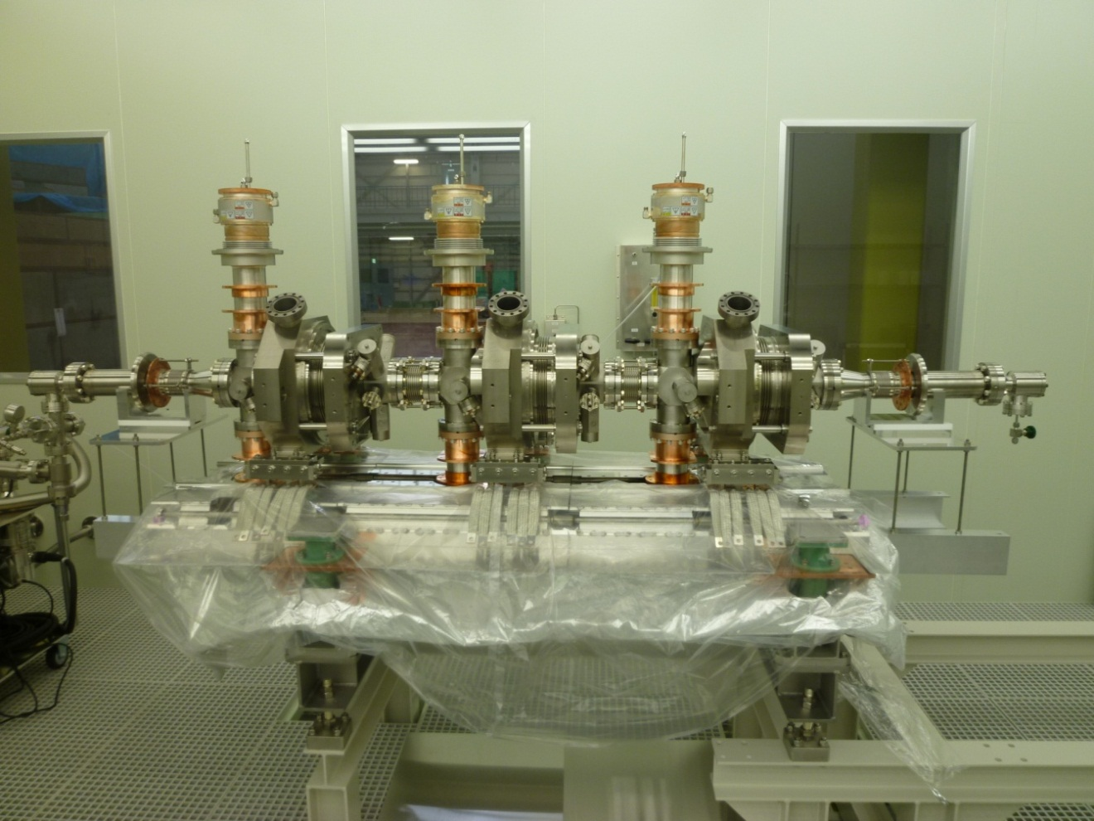
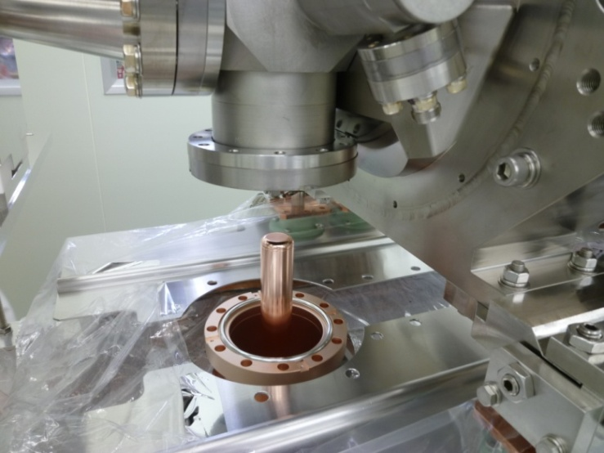
Cryomdule Assembly in Clean Room
April 25th, 2012
Exchange of RF feedthroughs
Cavity string assembly in clean room
Attachment of input couplers

Slide 6
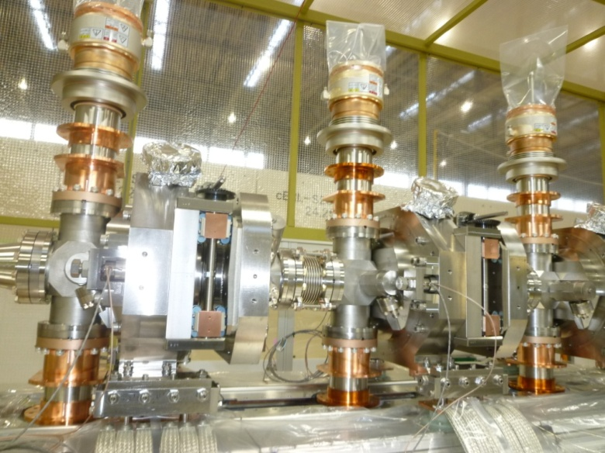
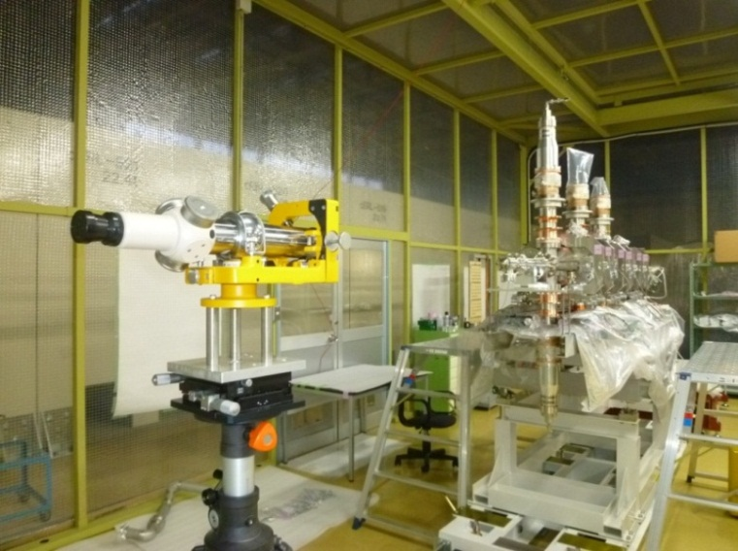
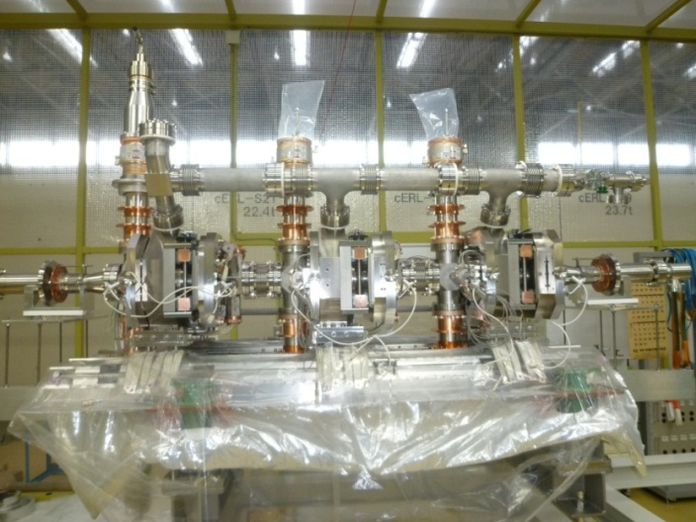
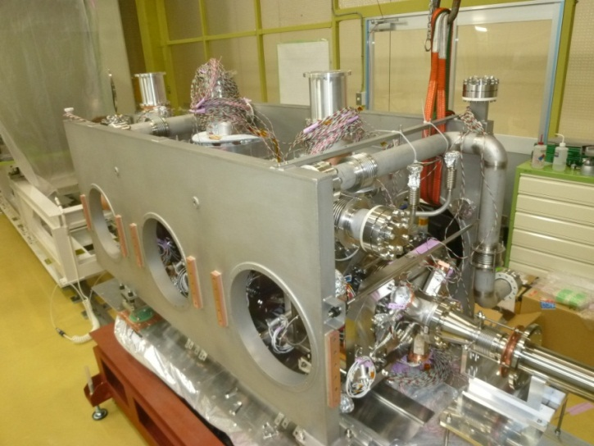
Cryomdule Assembly in Clean Booth
Assembly of slide-jack tuner system
Alignment of three cavities
Assembly of 2K-He line
Installation of 5K-He panels

Slide 7
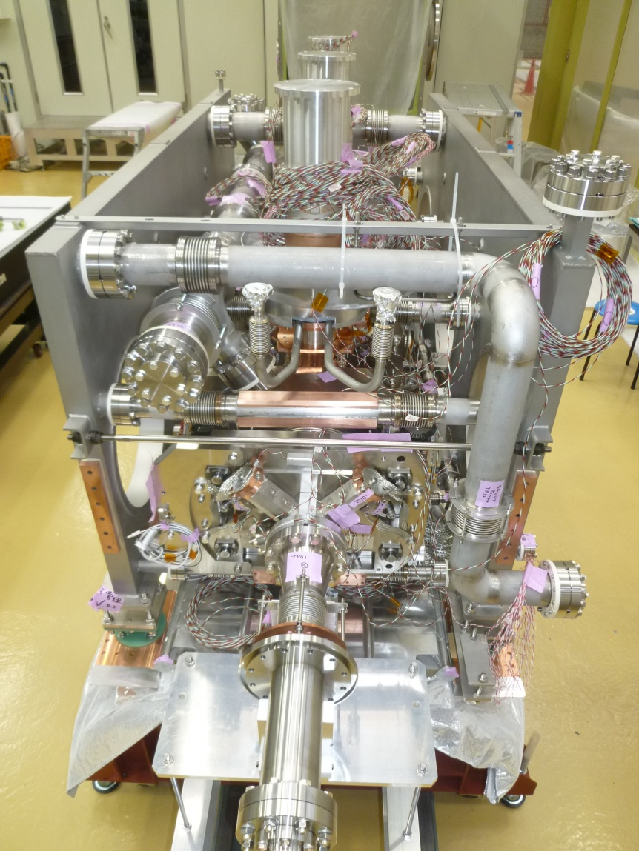
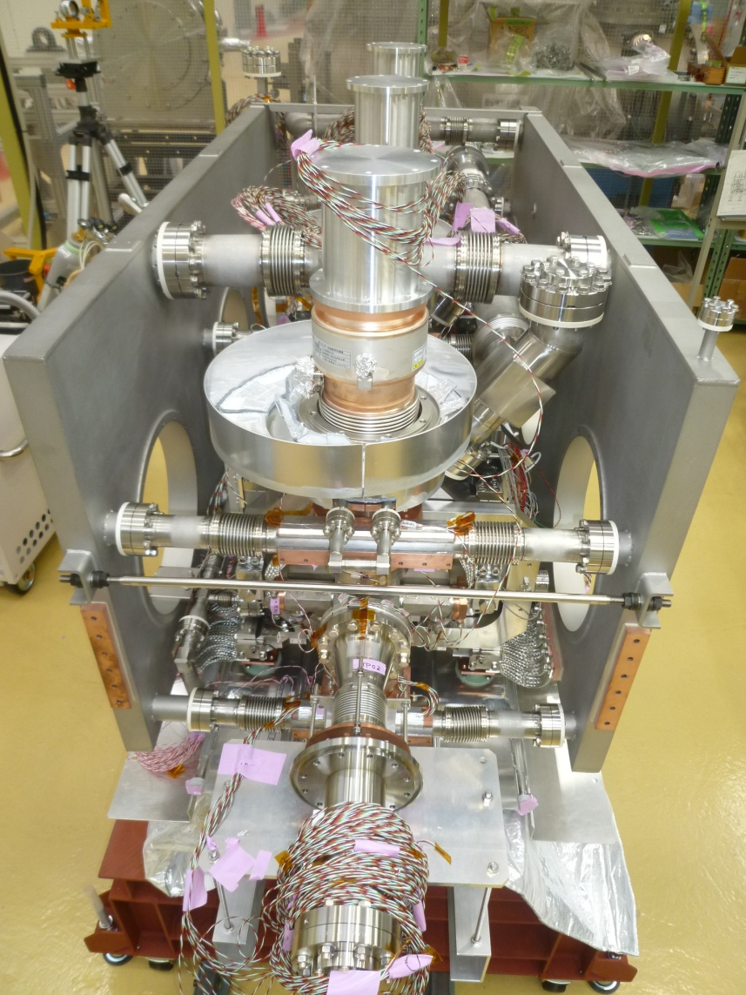
Cold-mass Assembly
2K-He, 5K-He, 80K-N₂ Cooling Line
May 23rd, 2012
2K-He Gas
Return Line
Liq. 2K-He
Supply Line
Liq. 80K-N₂
Liq. 5K-He
Supply Line
5K-He Gas
Return Line

Slide 8
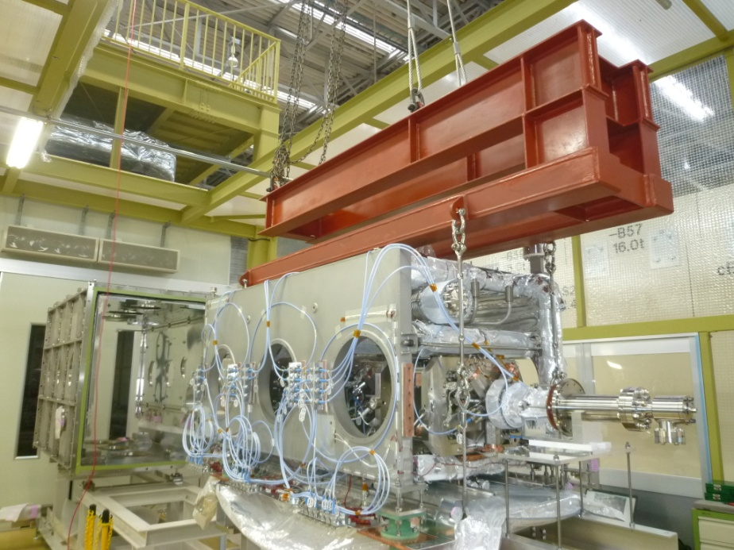
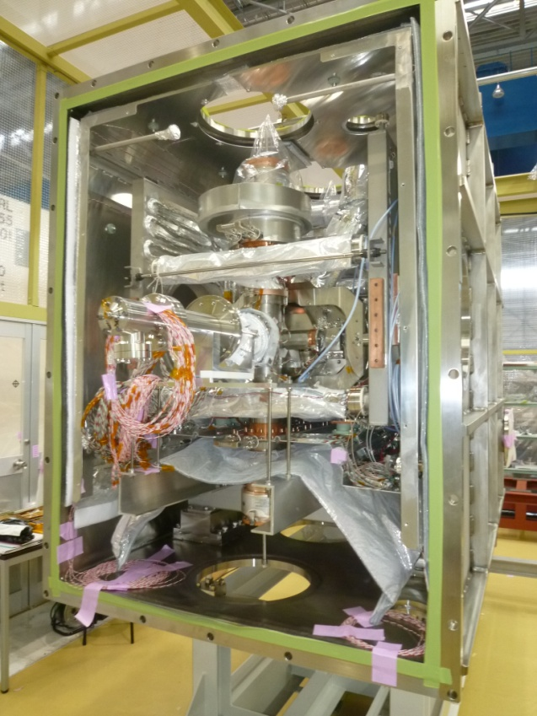
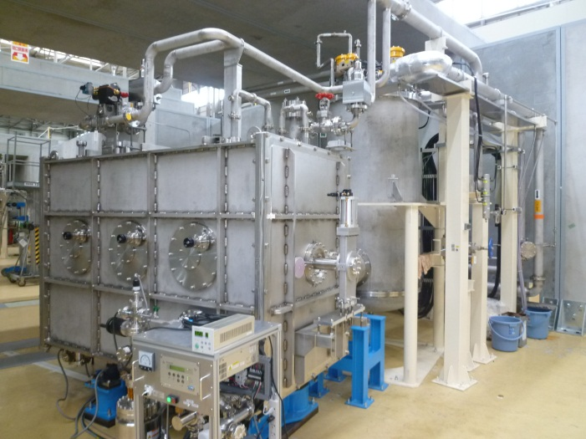
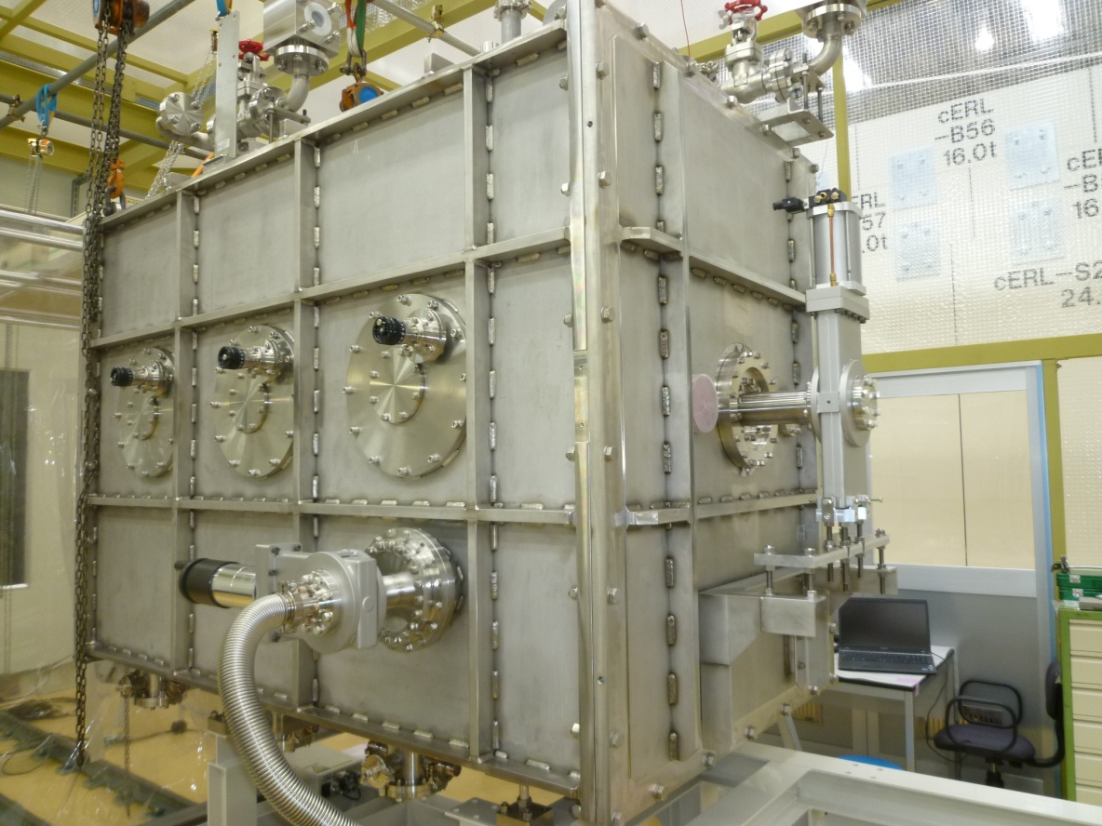
Assembly of Injector Cryomodule
Insertion into vacuum vessel
Installation in the beam line

Slide 9
Cool-down Tests

Slide 10
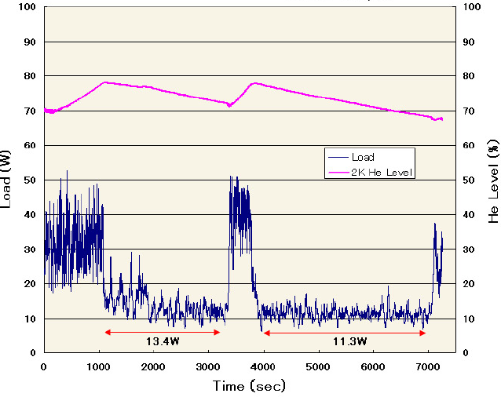
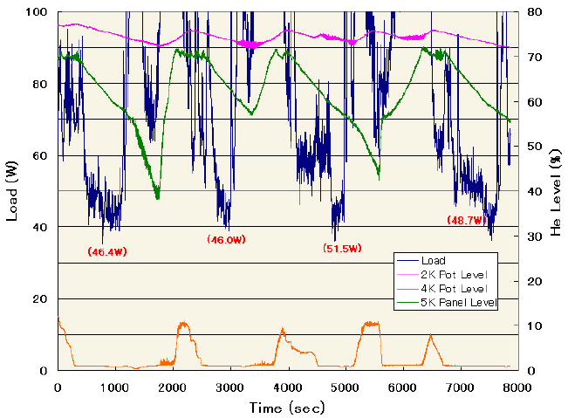
Static Heat Loads
Static heat load ; 2K
Static heat load ; 4.2K
ave. 2K heat load = 12 W
(including 2K cold-box = 1 W)
Cryomodule = 11 W at 2K
Estimation = 14 W,
including 1 W/coupler (x6),
0.2 W/HOM-cable (x15) and others.
ave. 4.2K heat load = 48 W
(including 2K heat load = 12 W)
Cryomodule = 36 W at 4.2K
Estimation = 33 W,
including 3 W/coupler (x6),
1 W/HOM-cable (x15).

Slide 11
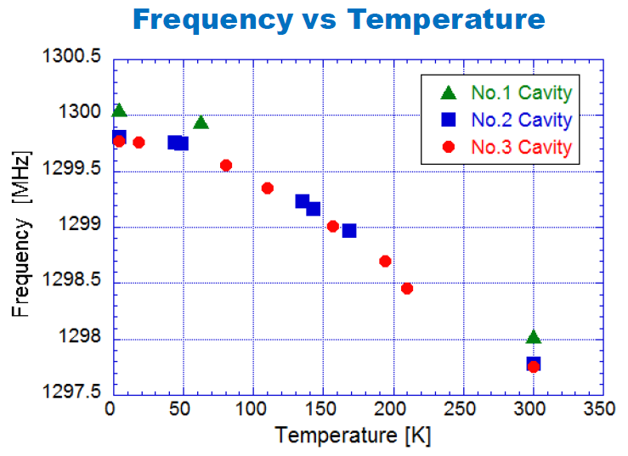
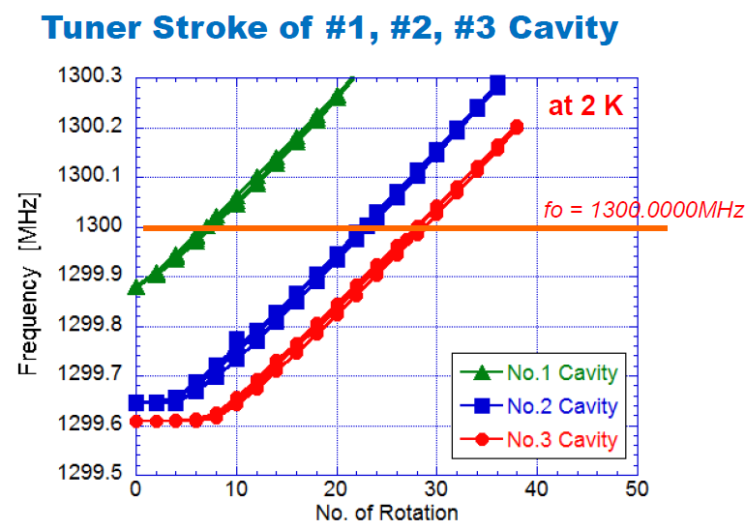
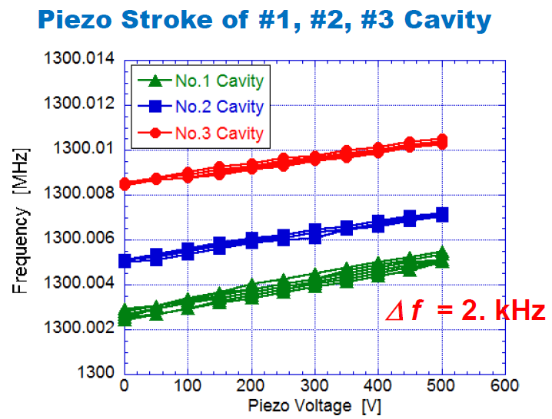
Low Power RF Tests

Slide 12
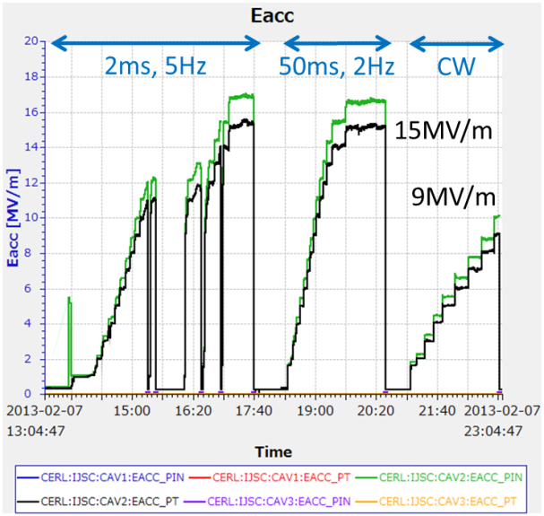
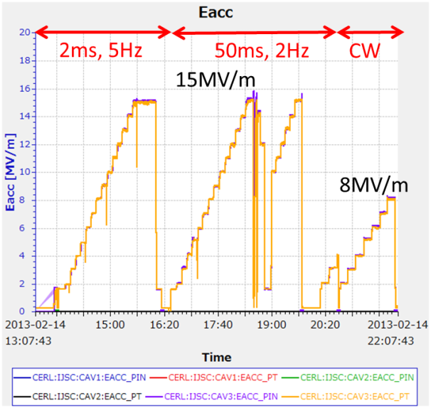
High Power RF Tests
Cavity-2
Cavity-3

Slide 13
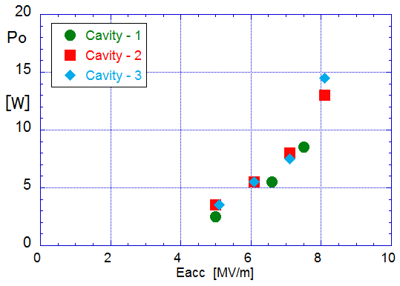
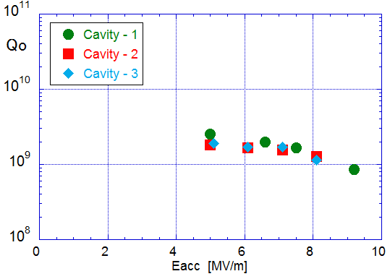
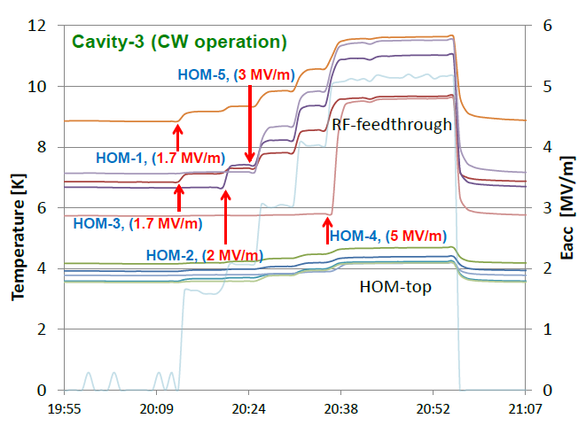
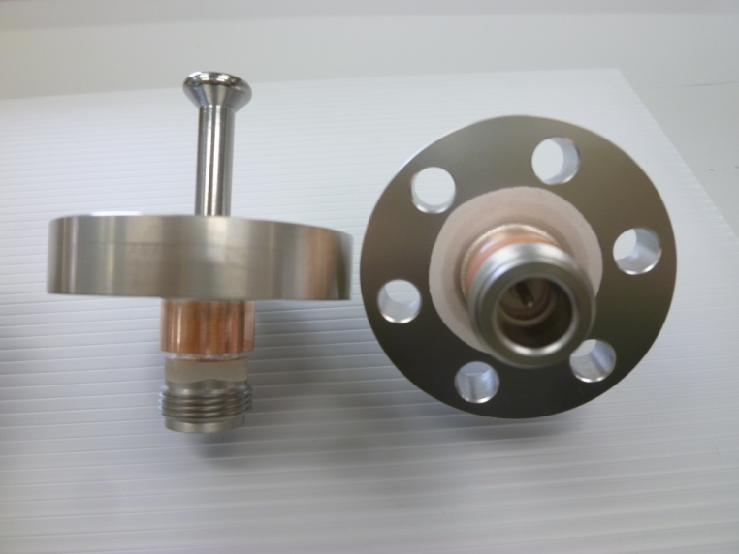
Dynamic Heat Loads
Cavity dynamic heat load at 2K
Qo vs. Eacc at 2K
Po = 8 W (at 7.5 MV/m)
Qo = 2 x 10⁹ (at 7.5 MV/m)

Slide 14
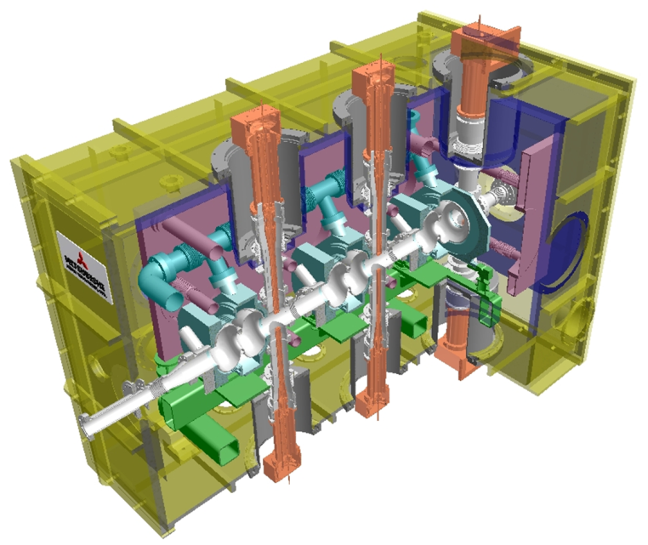
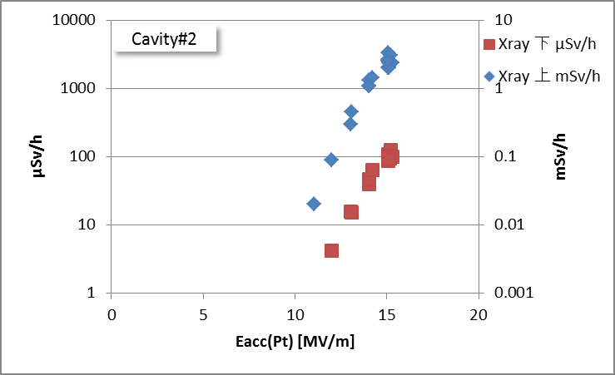
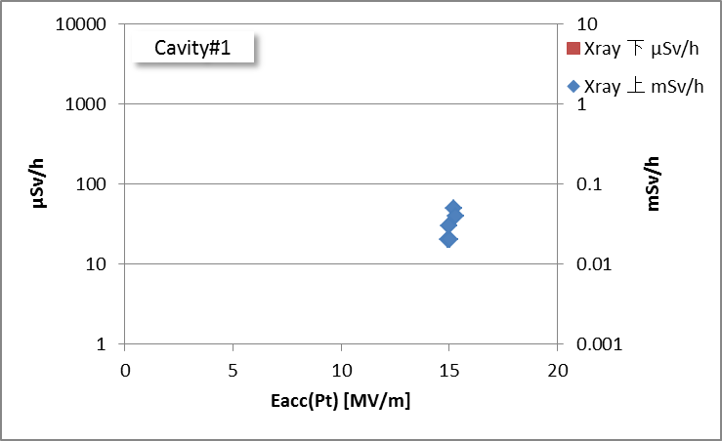
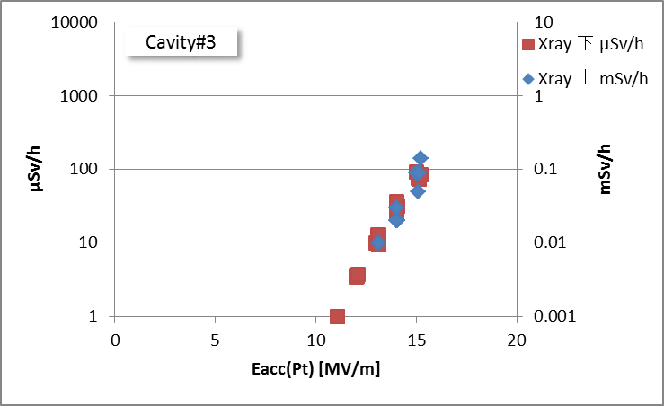
Observation of x-ray radiation level
down-stream
μSv/h
50ms, 2Hz (10% duty)
up-stream
mSv/h
No.3 Cavity
No.2 Cavity
no x-ray
< 10 MV/m
No.1 Cavity
50ms, 2Hz (10% duty)
50ms, 2Hz (10% duty)

Slide 15
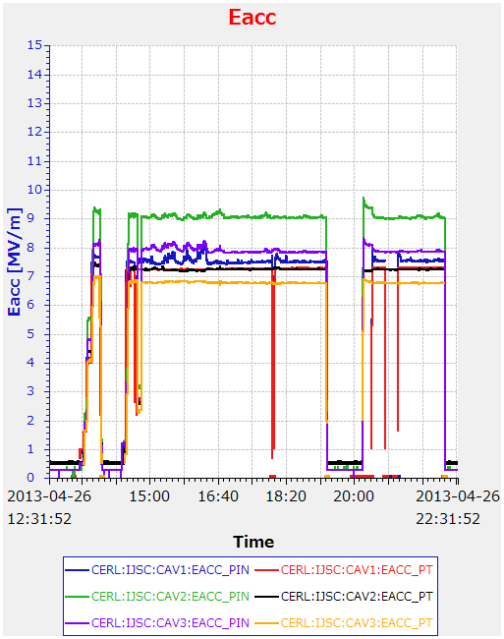
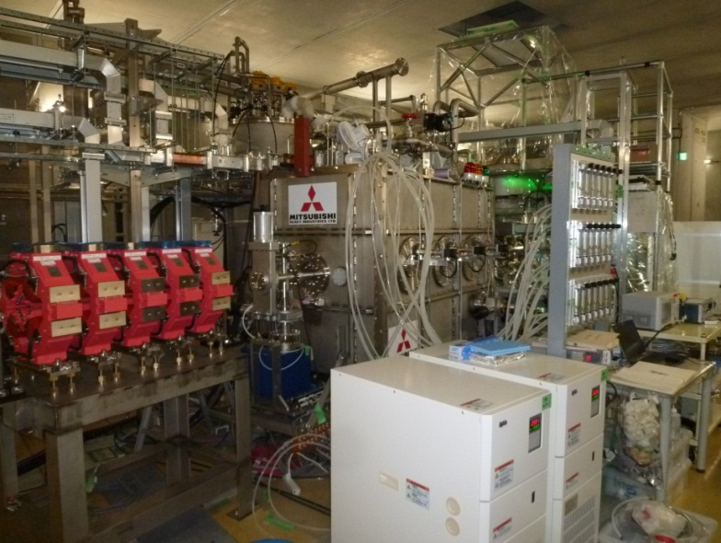
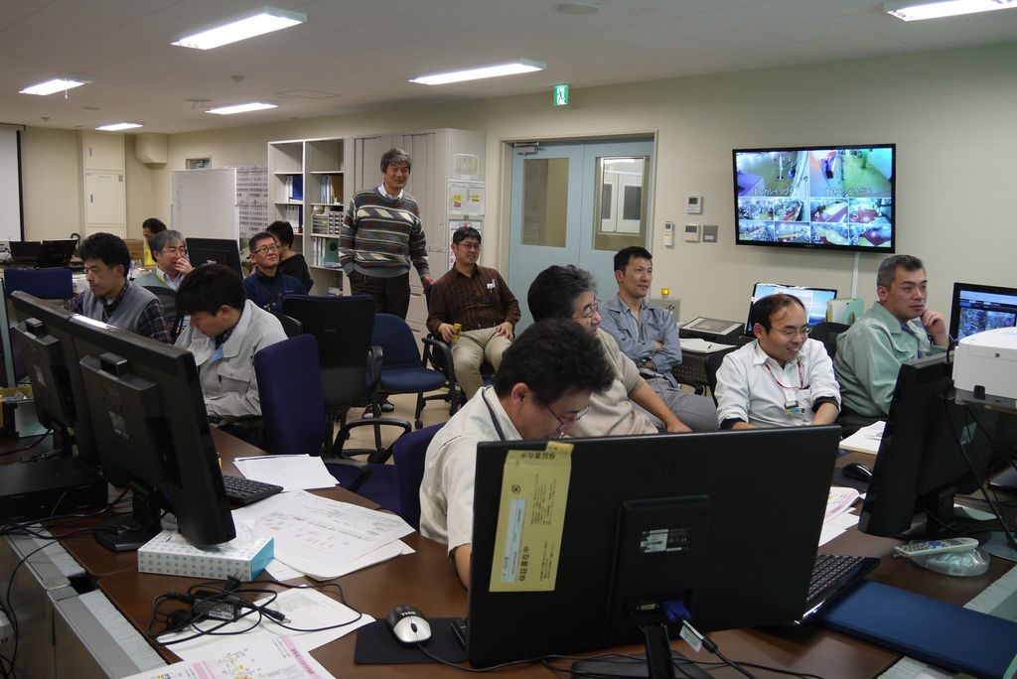
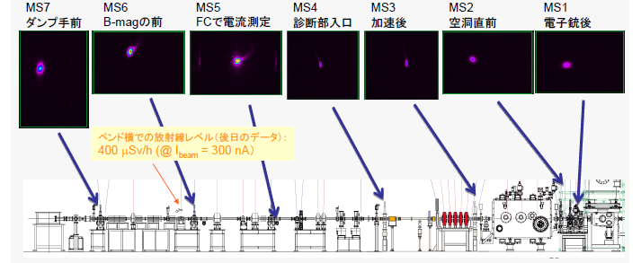
Beam Operation of Injector Section
Vc = 5 MeV operation
(3 cavities)

Slide 16
SUMMARY
Cryomodule assembly (April-June, 2012)
First cool-down tests (Sept., 2012)
Low and high power RF tests (Jan.-Feb., 2013)
Beam operation (April, 2013)
Heat loads at 2K of three 2-cell cavities were ten
times larger than the expectation due to heating-up
at the antenna tip of HOM feedthroughs.
Stable beam operation at 5 MeV was successfully
demonstrated in the cERL injector cryomodule.

Slide 17
END
Thank you for your attentions.

