Slide 1
Experience with high loaded Q cavity operation at Cornell
Matthias Liepe

Slide 2
Outline
Requirements for the Cornell ERL
High loaded Q cavity operation:
  Cavity turn on / field ramp up
  Frequency tuner and slow frequency control
  Microphonics
  RF power
  LLRF and field stability
Conclusions

Slide 3
Requirements for the Cornell ERL

Slide 4
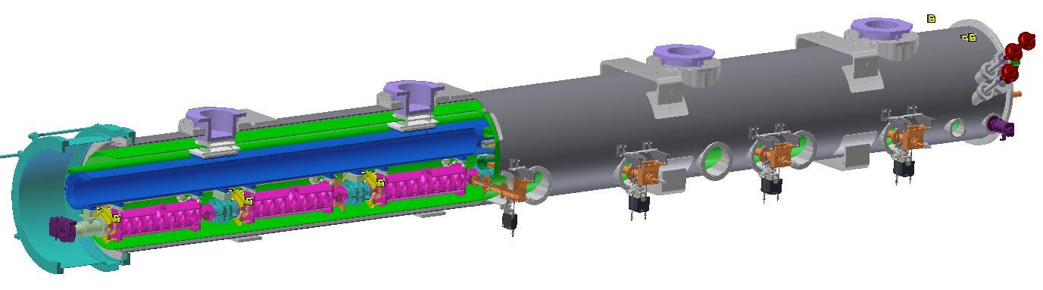
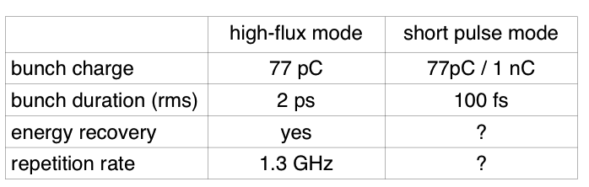
ERL Main Linac SRF
HGRP support post
Helium-gas return pipe
~40K thermal shield
Cryogenic control valves
Beamline HOM absorber
Gate valve
7-cell cavity
Acceleration gradient 16.2 MV/m
Q_{ext} 6.5×10⁷
RF power per cavity 5 kW
Amplitude stability 2x10⁻⁴ (rms)
Phase stability 0.1° (rms)

Slide 5
RF Power Requirements: Optimal Q_{L}
10
At 16.2 MV/m
8
0 Hz
6
10 Hz
RF power [W]
4
20 Hz
30 Hz
2
40 Hz
0
10
6
10
7
10
8
10
9
Q
L
Q_{L}=6.5⋅10⁷
Assume optimistic 10 Hz as typical detuning and < 20 Hz as peak.

Slide 6
Peak Power (Q_{L}=2· 10 ⁷ … 1· 10 ⁸)
60
7
8
9
10
4
5
6
Required power [kW]
50
7
8
9
10
40
3
4
5
6
peak detuning [Hz]
30
8
9
10
2
7
3
4
5
6
20
7
2
4
5
6
1
3
10
2
3
1
2
1
0
10
15
20
25
gradient [MV/m]
5 kW gives sufficient overhead, and allows operation up to 20 MV/m (for Δf<20 Hz)

Slide 7
Cavity turn on / initial field ramp up
=> Show that cavity resonance is easy to find

Slide 8
Frequency Search / Cavity Turn On
Cavity field signal has >10⁴ dynamic range (16 bit ADC)
Conclusion: LLRF system can detect fields with cavity detuned by >10,000 bandwidths (100 kHz)!

Slide 9
  Frequency tuner and slow frequency control
  => Show that frequency tuner behaves linearly with small hysteresis to allow for compensation of slow frequency drifts and Lorentz-force detuning

Slide 10
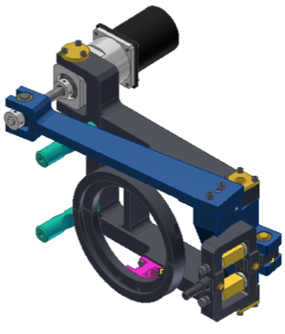
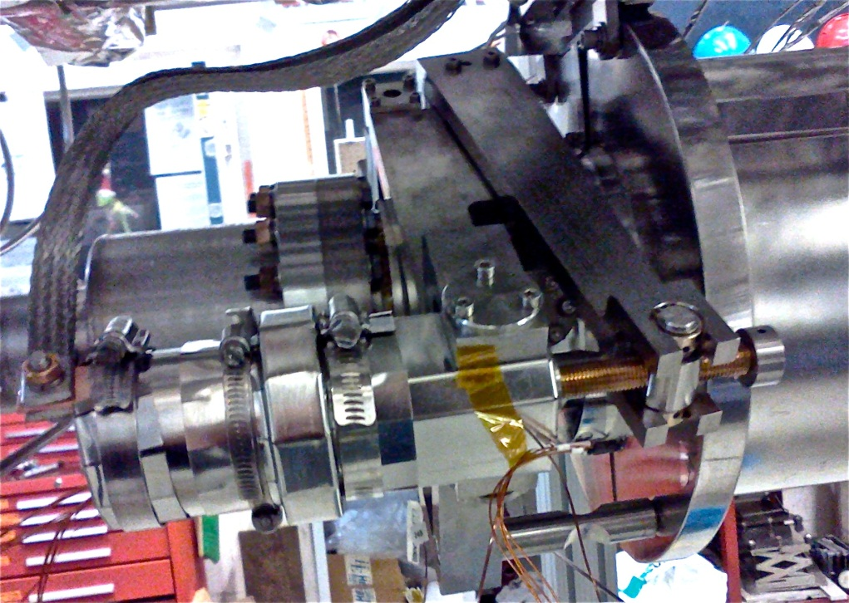
Cornell ERL Frequency Tuner (I)
Design optimized for CW cavity operation with very high loaded quality factor
  High stiffness
  Fast piezo actuators for fast control of cavity frequency
Stepper motor for slow control
Piezoelectric actuators for fast control

Slide 11
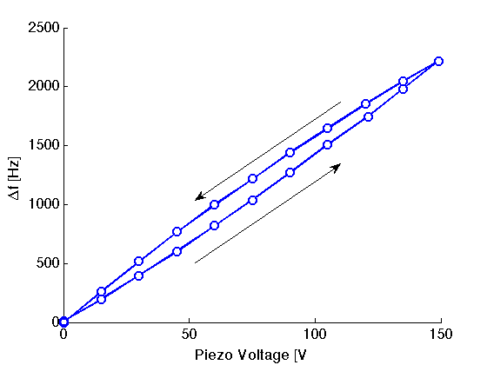
Cornell ERL Frequency Tuner (II)
  Excellent stiffness and linearity with very small hysteresis (< 10 Hz)
  >400 kHz slow tuning range
  2 kHz fast piezo tuning range

Slide 12
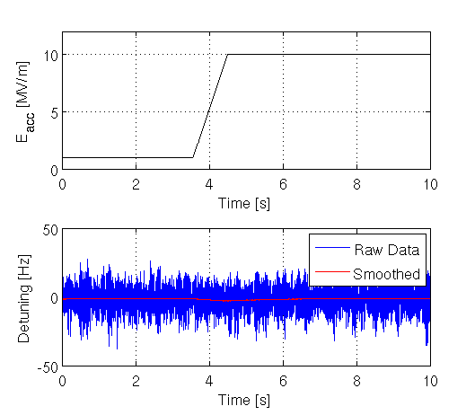
Lorentz-Force Detuning Compensation
Piezo based feed-forward to compensate LF-detuning
Allow fast changes in cavity field
Works very well and reliably

Slide 13
  Microphonics
  Show that microphonics level is low (goal: < 20 Hz peak)
  Explore active microphonics compensation

Slide 14
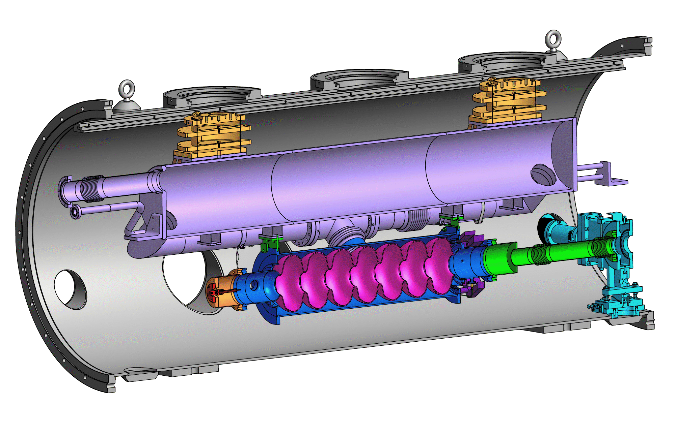
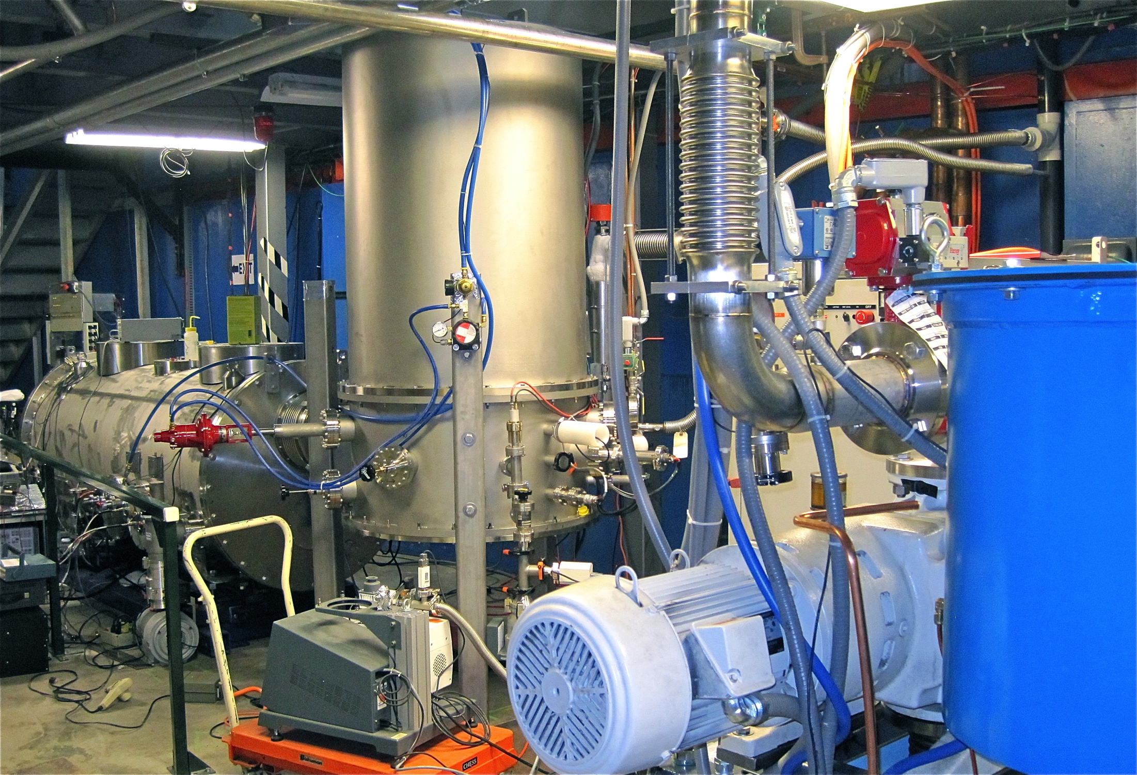
Microphonics Measurements (I)
Measurement on ERL main linac cavity in horizontal test cryostat, 1st assembly (HTC I), very noisy area:
At 1.8K
Sigma = 4.6 Hz
Peak = 18 Hz

Slide 15
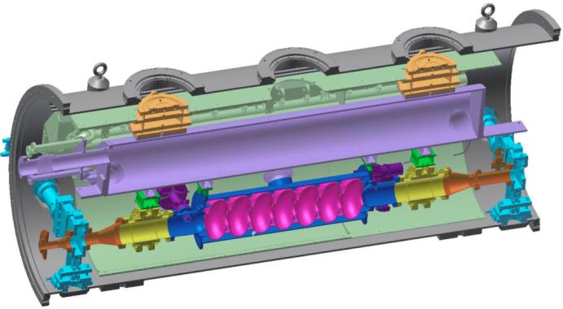
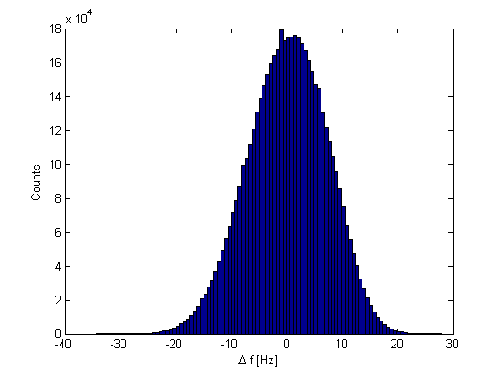
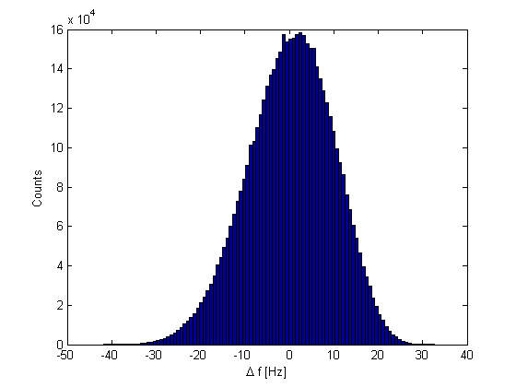
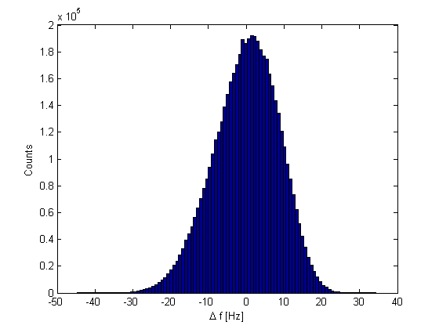
Microphonics Measurements (II)
Measurement on ERL main linac cavity in horizontal test cryostat, 3rd assembly (HTC III):
At 1.6K: σ = 7 Hz, peak ~ 30 Hz
At 1.8K: σ = 10 Hz, peak ~ 40 Hz
At 2K: σ = 9 Hz, peak ~ 40 Hz
Module placed in noisy area with cryo-pumps right next to it…
80K shield
HGRP
HOM load
cavity
HOM load
Gate valve
1.6 K 1.8 K 2 K

Slide 16
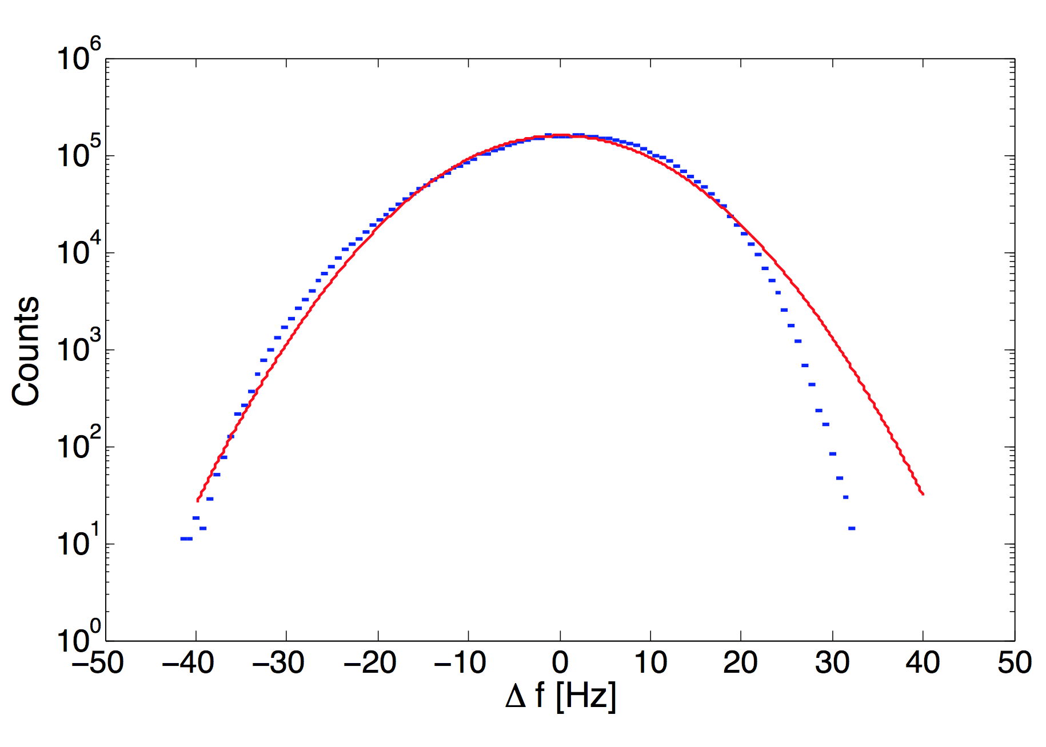
Microphonics Measurements (III)
At 1.8 K:
Gaussian function
data
=> No long, non-Gaussian tails at large detunings (large detuning events)!

Slide 17
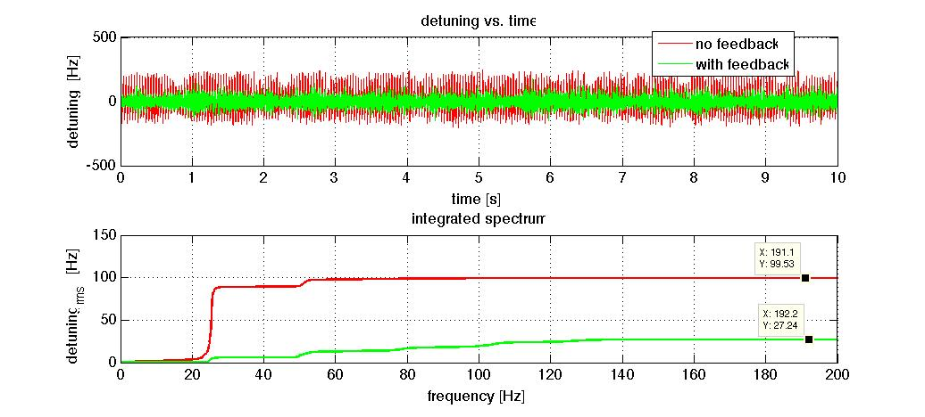
Microphonics Compensation (I)
Piezo Feedback on Tuning Angle/Cavity Frequency:
  Reduced rms microphonics by up to 70% (ERL injector cavity with strong microphonics)!
  But: Does not always work that well…

Slide 18
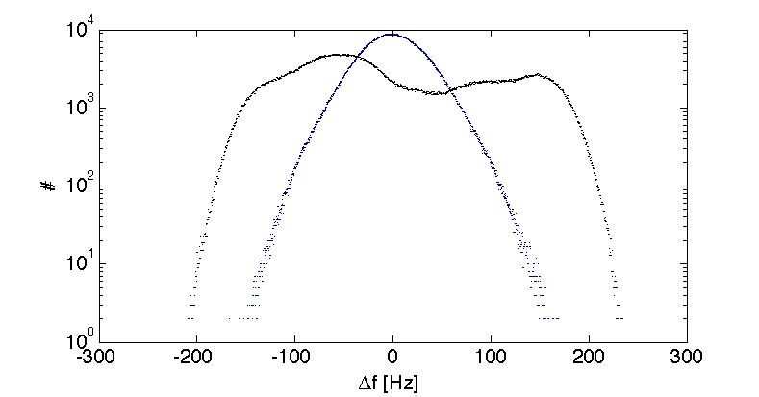
Microphonics Compensation (II)
Feedback off
Feedback on

Slide 19
  PF Power
  => Show stable and efficient operation of a 5kW RF power source

Slide 20
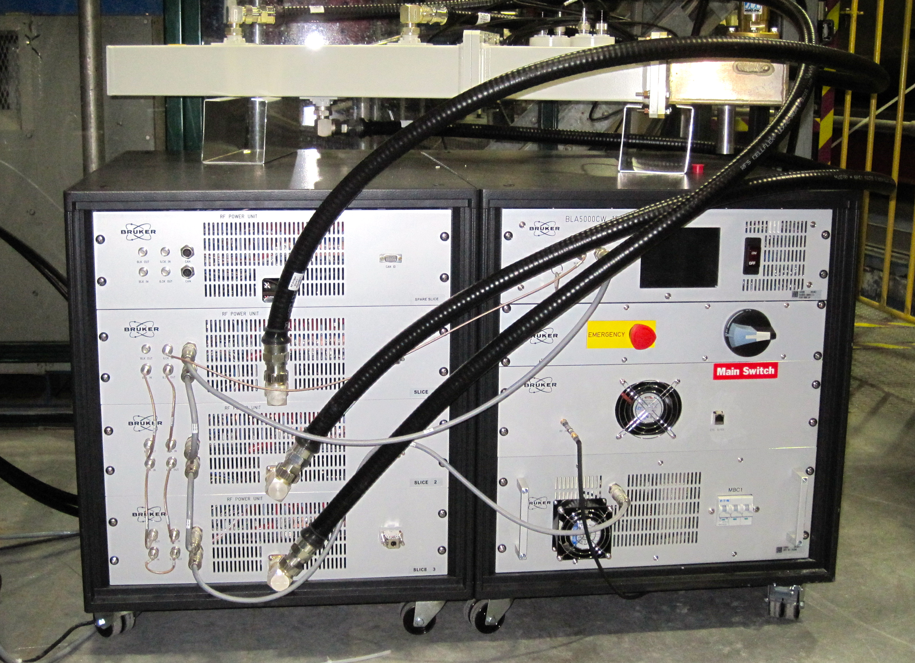
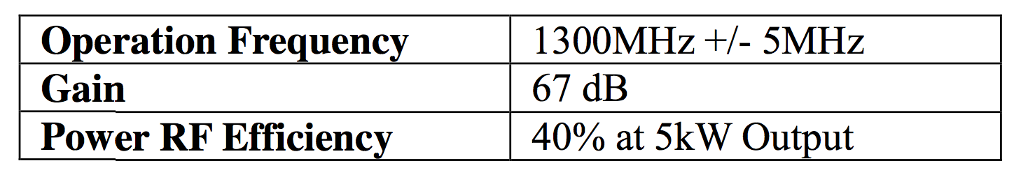
5 kW Solid State RF Amp
Many advantages: compact, modular design, good maintainability….
Competitive cost (<15$/W) for low power CW applications
High overall system efficiency
Good linearity
Stable operation after initial problems with overheating of transistors (resolved) ; occasional trips likely due to overdriving the amp

Slide 21
  LLRF and field stability
  => Show that high field stability can be achieved at high loaded Q even in the presence of strong microphonics

Slide 22
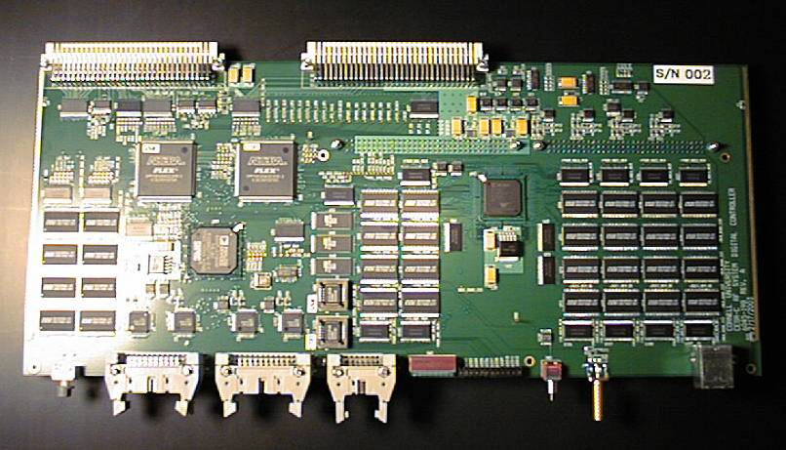
Cornell’s RF Field Control System
Fast digital components
Low noise field detection
Advanced and fast feedback and feedforward control loops
Fast cavity frequency control (piezo cavity frequency tuner)
Designed in house
Designed to deal with large amplitude and phase field perturbations (I-Q control)
DSP
Virtex II FPGA

Slide 23
Cornell LLRF Test at the JLAB ERL at Q_{L}=1x10⁸
Operated 1.5 GHz JLAB ERL cavity with Cornell LLRF system with
  Q_{L} up to 1.2·10⁸ (6 Hz half bandwidth)
  5 mA energy recovered beam
Result:
  Excellent field stability
  Very efficient cavity operation (few 100 W)
  Very stable operation (no trips over hours of operation)
12.4
σ_{A}/A ≈ 1·10 ⁻ ⁴
accelerating field [MV/m]
12.3
12.2
12.1
0
time [sec]
1
11
10.5
σ_{ϕ} ≈ 0.02 deg
phase [deg]
10
9.5
Cornell LLRF Test at the JLAB FEL
9
0
time [sec]
1
1
5.0 mA recirculated beam
beam takes 43 kW of RF power
and recovers 43 kW of RF power!
5.5 mA
0.8
4 mA
2.5 mA
0.6
0 mA
klystron power [kW]
0.4
0.2
0
0
0.2
0.4
0.6
0.8
1
time [sec]

Slide 24
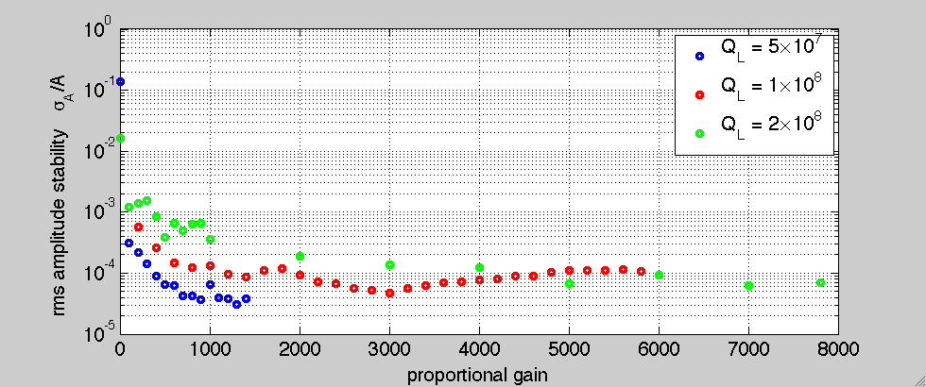
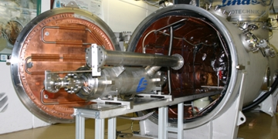
Cornell LLRF Test at HZB at Q_{L}=2x10⁸
Demonstrated highly efficient operation of a full 9-cell cavity at very high loaded quality factors up to 2⋅10⁸ (3 Hz bandwidth) (Test of Cornell’s LLRF system at HoBiCaT at HZB)
  Exceptional field stability: σ_{A}/A < 1⋅10⁻⁴, σ_{ϕ} ~ 0.01° even peak microphonics of many bandwidths
  Fast RF field ramp up in 0.5 s to high fields with piezo tuner frequency control
Half bandwidth = 3.35 Hz
Peak microphonics: ~ 30 Hz!

Slide 25
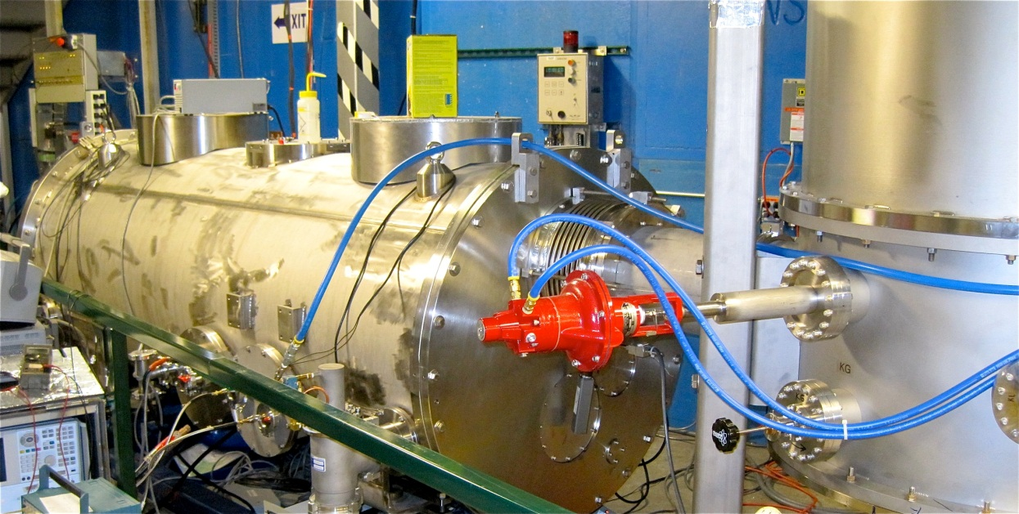
Cornell LLRF Test at HZB at Q_{L}=5x10⁷
Measurement on ERL main linac cavity in horizontal test cryostat
  Q_{L} ~ 5·10⁷ (13 Hz half bandwidth)
  5 kW solid state RF amp
  40 Hz peak microphonics
80K shield
HGRP
HOM load
cavity
HOM load
Gate valve

Slide 26
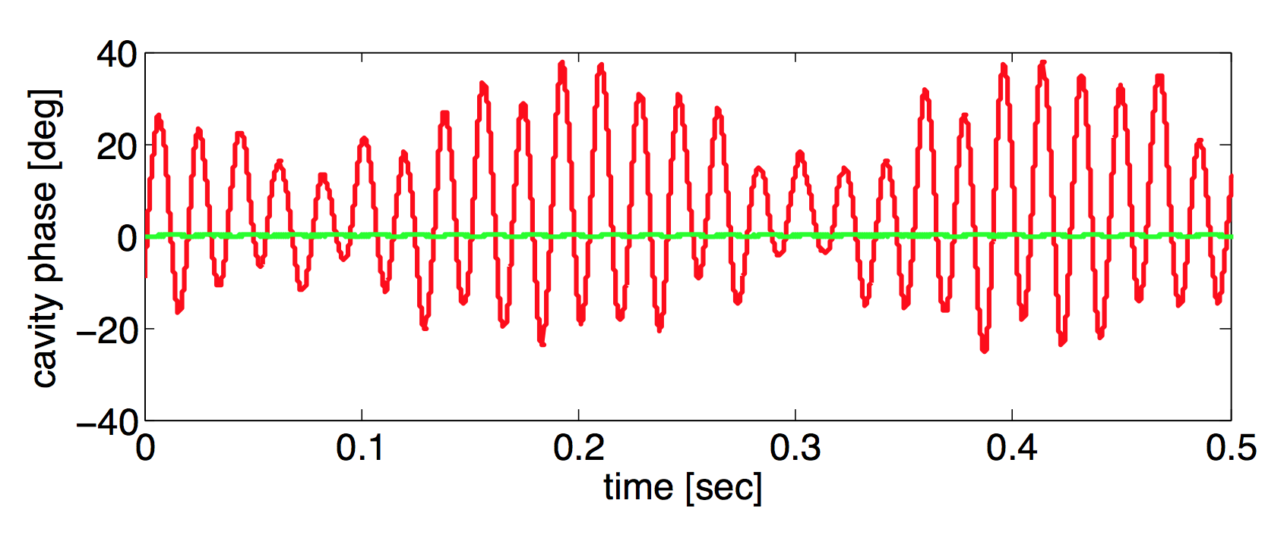
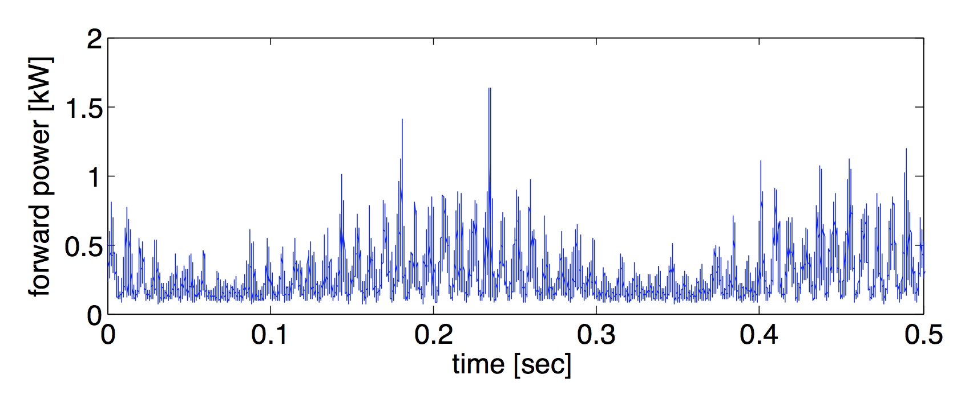
Cornell LLRF Test at HZB at Q_{L}=5x10⁷ (II)
Open loop:
Large phase fluctuation due to strong microphonics
Closed loop:
Very stable phase even with strong microphonics

Slide 27
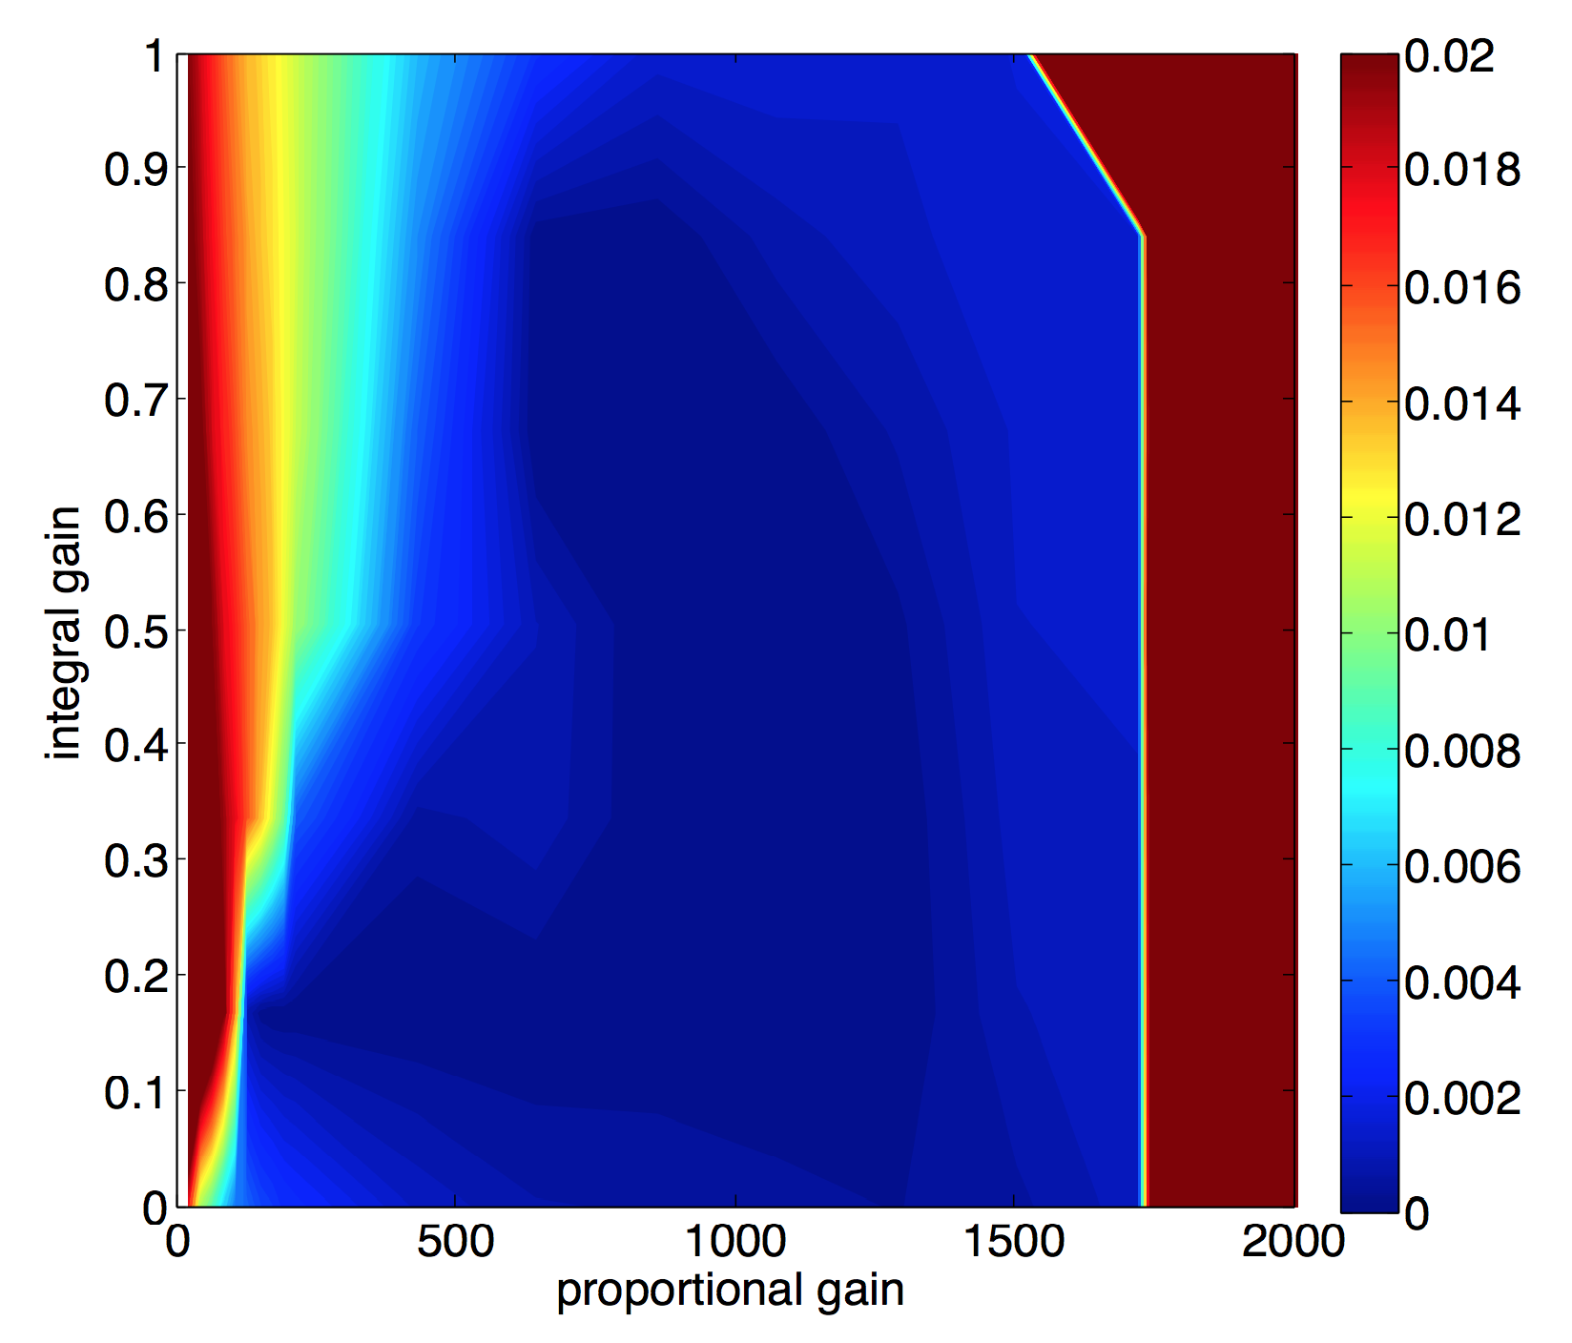
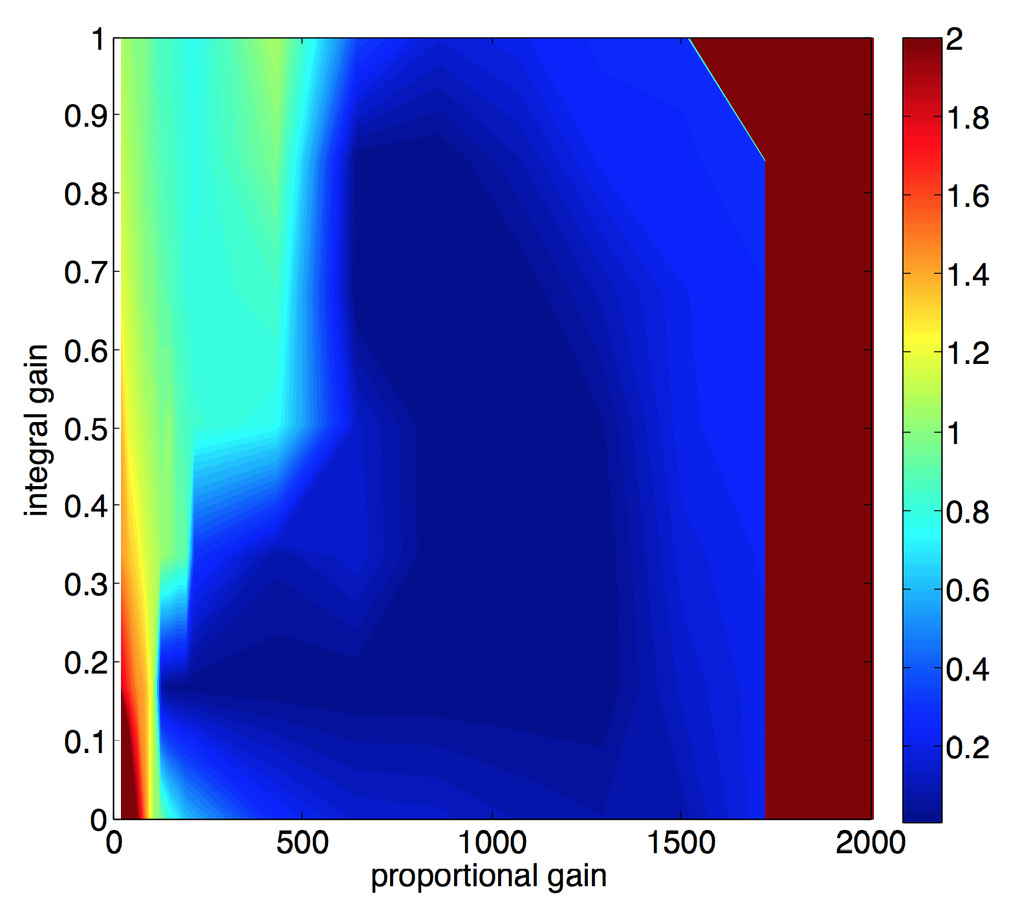
Cornell LLRF Test at HZB at Q_{L}=5x10⁷ (III)
Relative amplitude stability: σ_{A}/A
Relative phase stability: σ_{ϕ} [deg]
Field stability at optimal gains (proportional gain =860, integral gain =0.5):
σ_{A}/A = 6.5x10⁻⁵, σ_{ϕ} = 0.01 deg

Slide 28
  Conclusions
  => What you should remember from this talk…

Slide 29
Conclusions
Demonstrated stable and efficient high load Q cavity operation multiple times with Q_{L}=5x10⁷ to 2x10⁸:
  Initial frequency “hunting” and tuning is easy, even with generator driven system
  Tuner with excellent linearity and small hysteresis supports high loaded Q cavity operation
  Piezo tuner based Lorentz-force and slow frequency drift compensation (<few Hz bandwidth) works reliably
  Cornell LLRF system achieves excellent field stability, even at very high loaded Q with strong microphonics of several bandwidths:
    σ_{A}/A < 1⋅10⁻⁴, σ_{ϕ} ~ 0.01°
Biggest unknown: Microphonics level

