Slide 1
High Q₀ preservation
Andy Hocker
Fermilab
TTC CW Workshop, 13-JUN-2013

Slide 2
Introduction
How well does Q₀ survive from a vertical test to a CM?
Survey the landscape of VT and CM Q₀ data from modern cryomodules from various labs
Quickly discovered that it’s tough to capture Q₀ evolution succinctly in a paper (as opposed to E_{max})
Nevertheless, here are some examples from the last few years’ literature
(What follows is my own gloss of data produced by others, apologies for oversimplifications, datedness, etc.)
You will get details in other talks this workshop

Slide 3
Where we’re at
Cornell ERL injector CM (M. Liepe - LINAC ’10 - TU303)
VT: ~1.6e+10 @ 15 MV/m, CM: 0.5-1.0e+10 @ 10 MV/m
Cornell ERL main linac cav (N. Valles - IPAC ’12 - WEPPC075, M. Liepe, IPAC ‘12, WEPPC07)
VT: “met 2e+10 spec”, HT: 3e+10 @ 16.2 MV/m
KEK cERL injector CM (E. Kako - IPAC ‘12 – WEPPC015, E. Kako – IPAC ’13 – WEPWO013)
VT: 0.7-0.9e+10 @ 5-10 MV/m, CM: 0.1-0.3e+10 @ 5-10 MV/m
KEK S1G CM (N. Ohuchi – IPAC ‘11 – WEPO035)
VT: probably ~1e+10, CM: 0.4-0.9e+10 @ 25-38 MV/m
JLab C100 CMs (A. Reilly – SRF ‘11 – TUPO061, M. Drury – LINAC ‘12 – MOPB30)
VT: 0.8-1.2e+10 @ 20-25 MV/m, CM: 0.5-1.0e+10 @ 20-25 MV/m
Takeaway: not unheard of to lose up to a factor of 2 in Q₀ from VT->CM

Slide 4
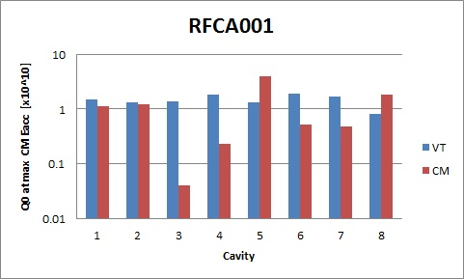
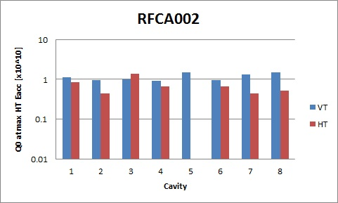
Add’l data points from FNAL
TESLA-style CMs
RFCA002 not tested yet, shown are horizontal test results
All HT and CM facilities at FNAL are limited to pulsed operation (for now)
< 1% DF

Slide 5
Measuring heat loads
Cavities are strongly overcoupled in CMs, Q₀ measured from 2K dynamic heat loads
At FNAL the low DF means we’re struggling to measure fractions of a watt --- this is hard
I suspect CW life is easier with heat loads of tens of watts
Different labs use different methods
He mass flow (steady-state or supply closed)
Boil-off rate (liquid level)
Rate-of-rise
I think there is a useful discussion to be had here about pros/cons of these techniques, associated uncertainties, tricks of the trade, etc.

Slide 6
Q₀ degradation mechanisms
From VT to CM, one pays attention to residual resistance
FE-loading: quest for ever-cleaner assembly
Trapped magnetic flux
Thermal currents (see Neumann’s talk)
Sources of remanent field in CM
Efficacy of magnetic shielding
FNAL study: what field does a cavity see inside the mag shielding and inside a CM vacuum vessel
Measure at room temperature
Several groups have measured Cryoperm permeability cold and found that it doesn’t differ much from RT permeability (despite manufacturer claims)

Slide 7
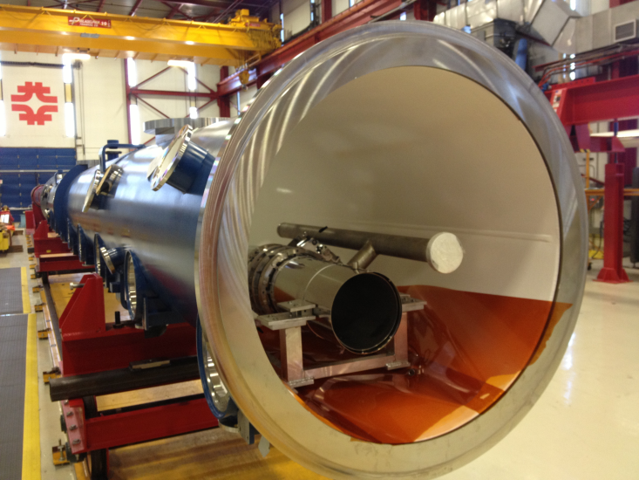
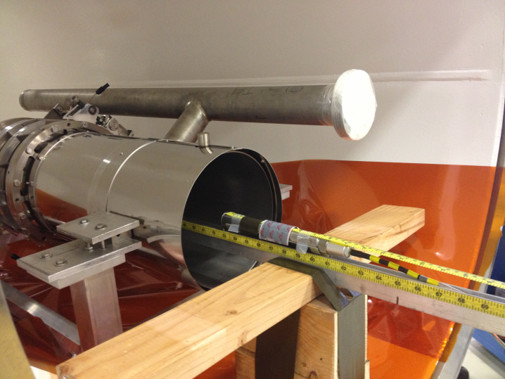
Measurement setup
Empty helium vessel and Cryoperm shielding in CM
3-axis magnetic field sensor (Bartington Instrum.)

Slide 8
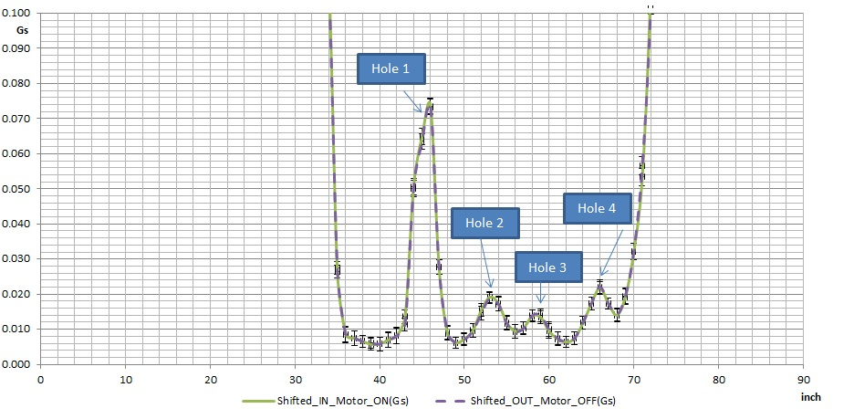
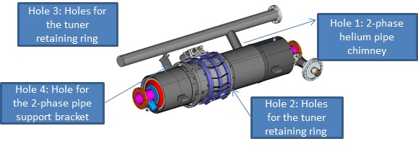
Field measurements
Probe roughly at location of cell equators
Along “beamline,” no effect from holes -> measured field was 4 mG

Slide 9
Effect of imperfect shielding
Assuming Cryoperm μ does increase as advertised (2.5x)
Using R_{s} =ηH (η=1.9x10⁻⁴√(f/RRR) (BUT… see next slide)
4 mG contributes 0.70 nOhm to R_{s} (1.3 GHz, RRR=250)
Integrated effect of holes contributes an additional 0.77 nOhm
Total of 1.47 nOhm
Typical R_{s} in VT at FNAL (2 K, B_{pk} = 70 mT) about 13.6 nOhm, with about 0.35 nOhm from remanent field
Can expect a degradation in CM of
If μ doesn’t increase, F = -17%

Slide 10
Trapped flux: field dependence
A. Grassellino and A. Romanenko
Measure R_{res} before/after quench, difference is purely trapped flux effect
Observe effect has linear dependence on cavity field
If trapped flux dominates R_{s} in CM, can expect higher Q-degradation at higher fields

Slide 11
Conclusions
It’s currently rare for Q₀ to pass from VT to CM completely unscathed
But recent results from some labs are encouraging
FNAL work on this topic has only just started
Providing guidance for our dressed cavity designs
To chase down subtle Q₀ effects in CMs (NOT horizontal tests) requires robust measurements of heat loads
THANKS to
Curtis Crawford, Tug Arkan, Anna Grassellino, Alex Romanenko, Elvin Harms for data and discussion

Slide 12
Backup

Slide 13
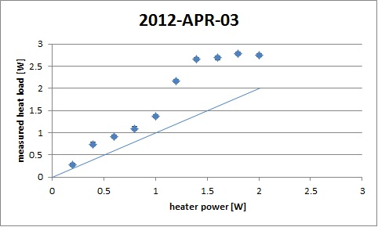
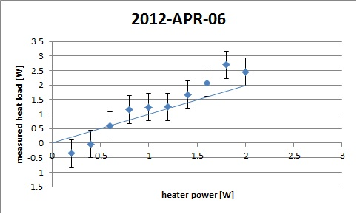
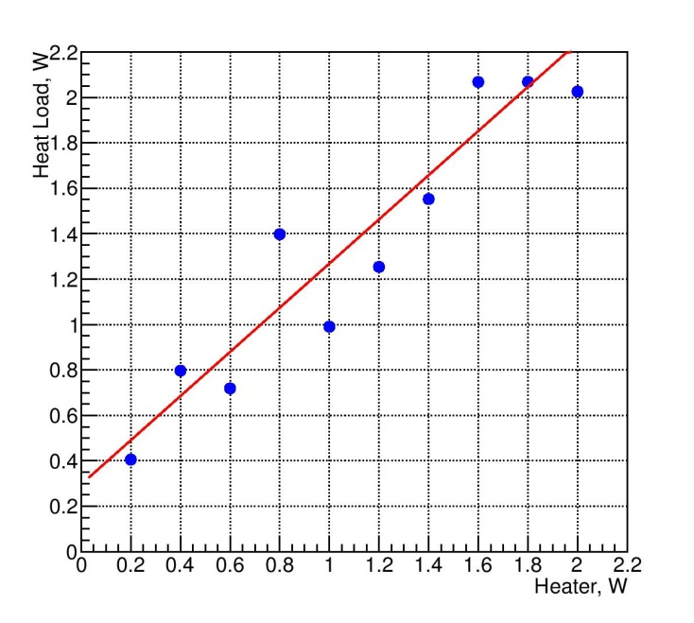
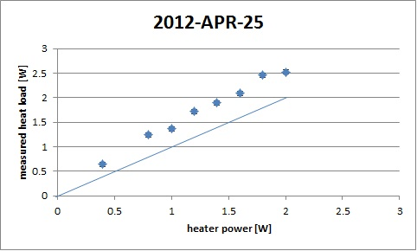
Mass flow: checks: not good
2012-APR-13

Slide 14
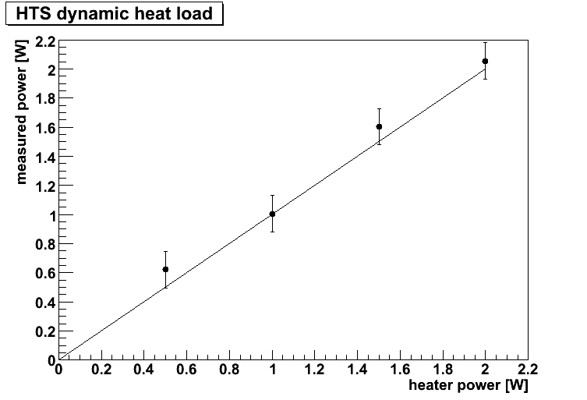
Rate-of-rise: check: better

