Slide 1
High Q R&D at Cornell
Fumio Furuta
Cornell University
TTC topical-meeting on CW SRF 2013
Ithaca, NY, 13June2013

Slide 2
What are the best surface treatment?

Slide 3
Required cavity specs
Cornell ERL
XFEL
ILC, BCD& ACD
KEK ERL
Jlab upgrade

Slide 4
Surface treatments
Material | Bulk removal | Degassing | Light removal | 120C Bake | Additional
Fine grain Large grain | BCP EP CBP Mirror finish CBP | 600C 650C 750C 800C >800C | BCP EP | 24hrs 48hrs | HF rinse
ILC, KEK-ERL
XFEL
Jlab upgrade
Cornell ERL
Many R&Ds on parameter optimization are done and on going.
-How much removal?
-How long bake?

Slide 5
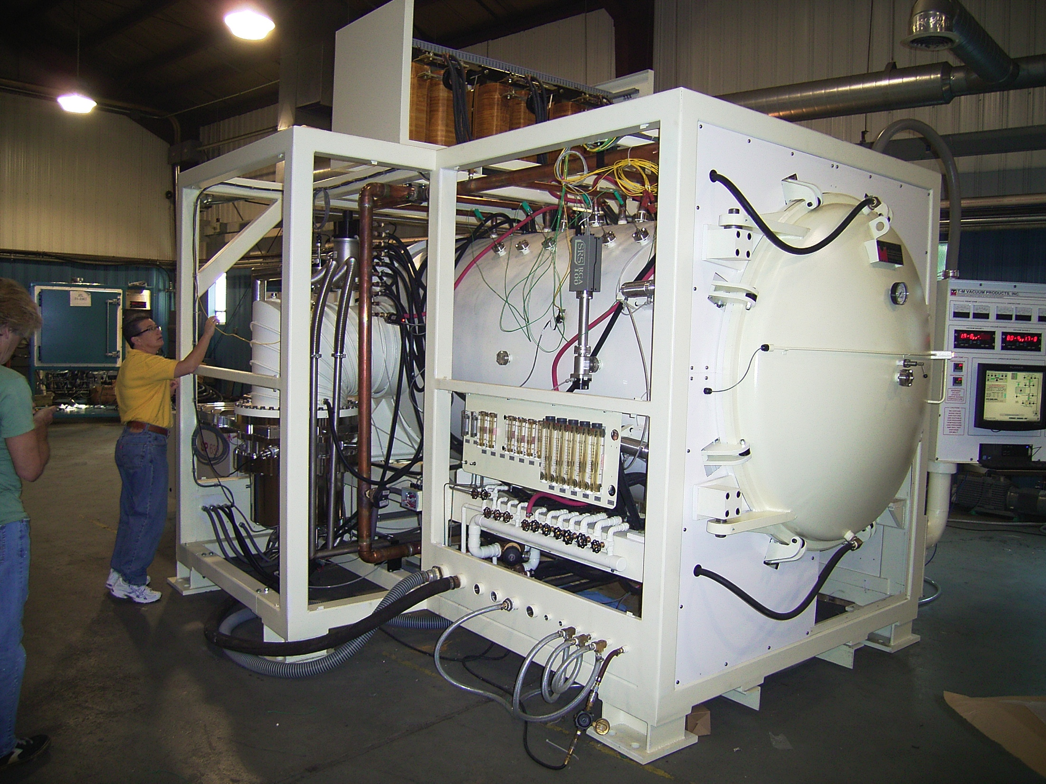
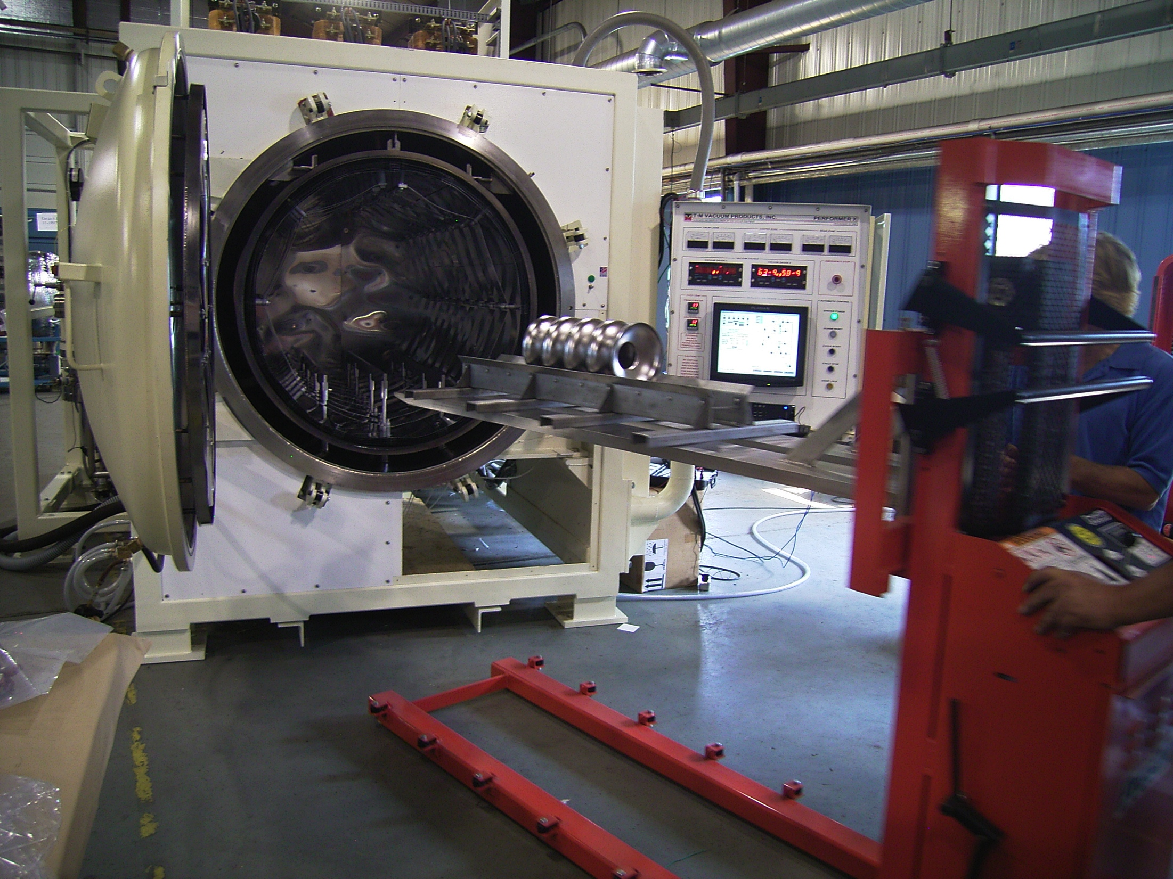
Degassing in TM-furnace
T-M Vacuum furnace at Newman lab.
Design
Max Temp. 1450C
Vac. 1.0e-8 Torr

Slide 6
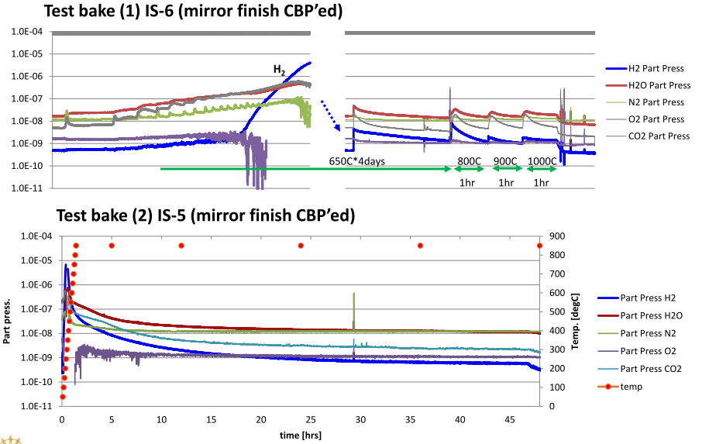
TM-Furnace qualification

Slide 7
Series test of IS-5
IS-5 series test
Limited by Q-slope, no detectable radiation
2K meas.

Slide 8
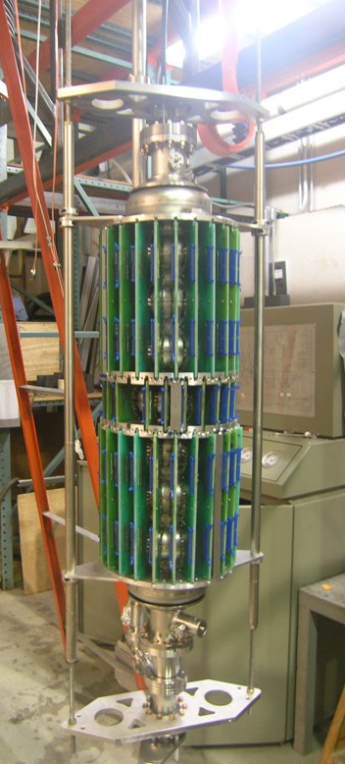
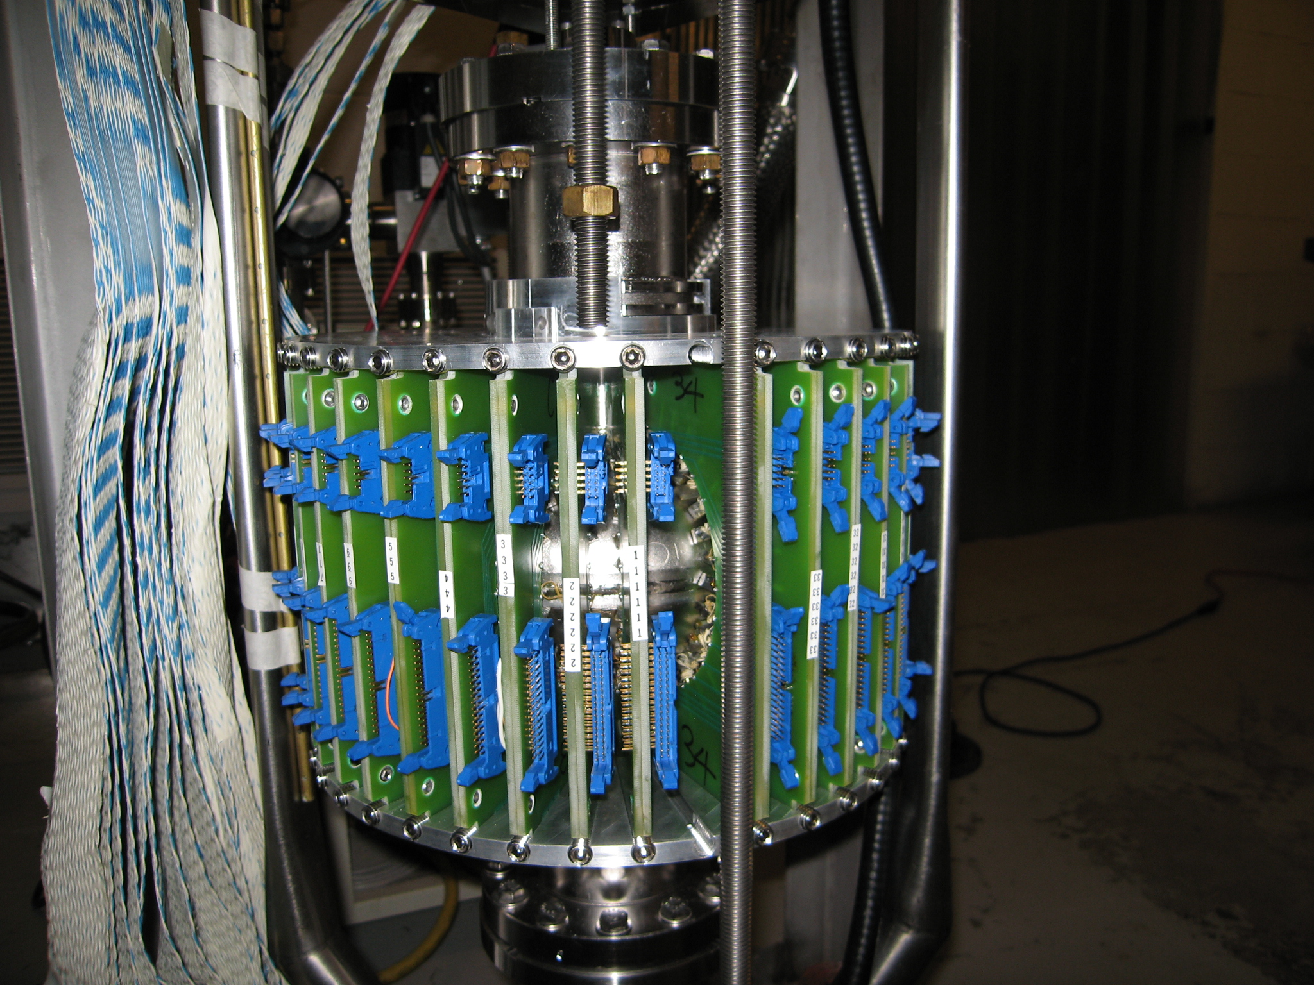
T-map for single/multi-cell
17 [sensors/board] *38 [boards/cell]
= 646 [sensors /cell]
11 [sensors/board]x 24 [boards/cell]
= 264 [sensors/cell]
x 7 [cell/cavity]
=1,848 [sensors
8

Slide 9
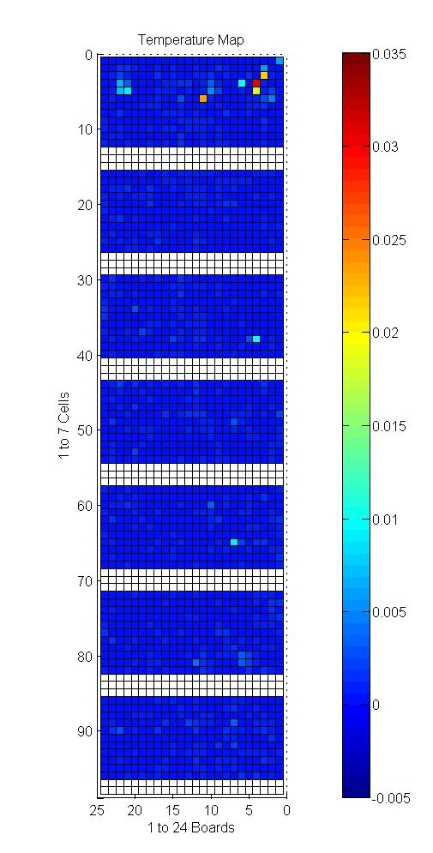
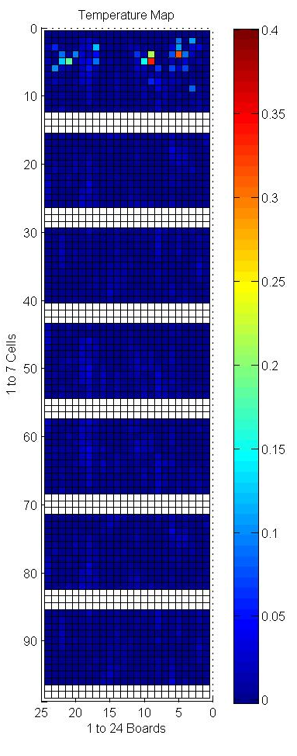
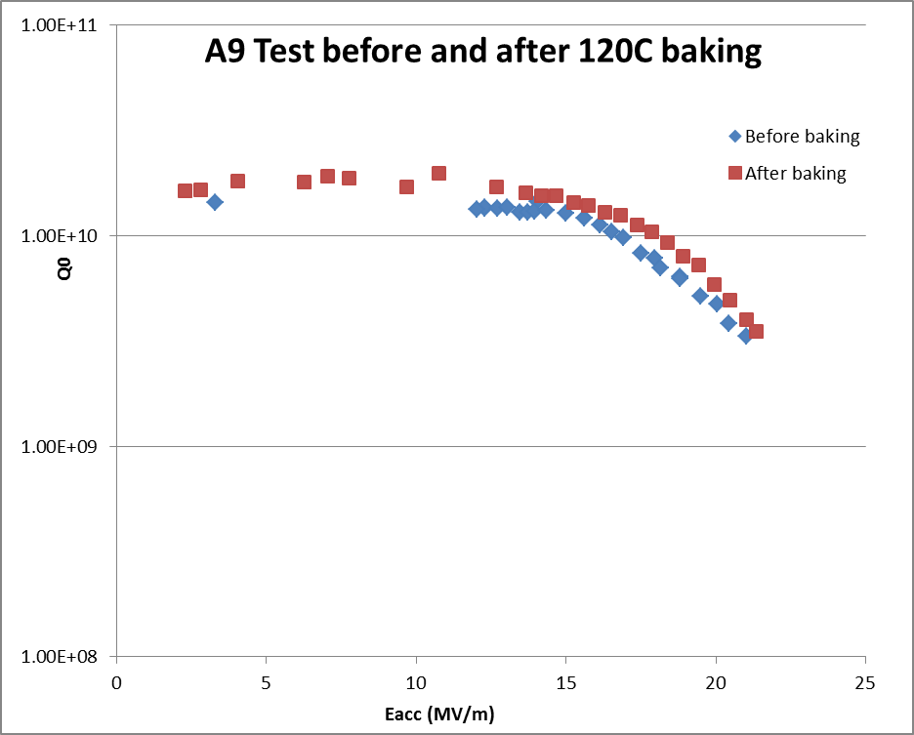
Multi-cell T-map
before
after
@20MV/m

Slide 10
Coupon study
Process coupon (φ11mm) with VEP.

Slide 11
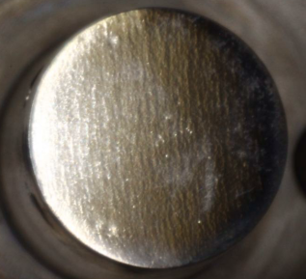
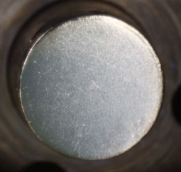
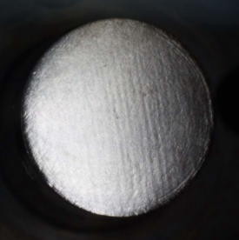
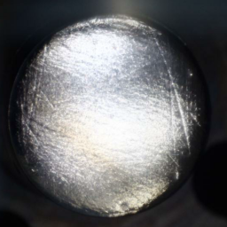
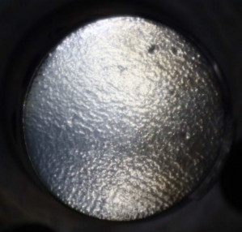
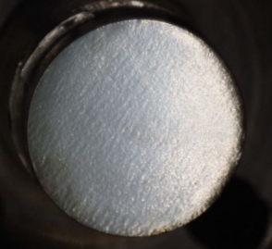
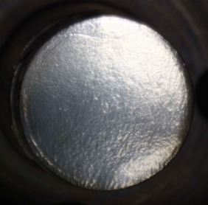
Coupon image
equator
iris
11mA/cm²
15mA/cm²
28mA/cm²
37mA/cm²
Surface roughness analysis is on going.

Slide 12
What are the best surface treatment?
High Qo
Large grain?
HF rinse?
120C bake
BCP
EP
Alternative shape,
(LL, RE, LSF)
TESLA shape
High gradient
12

Slide 13
Summary
Systematic high Qo study on surface treatments are on going at Cornell SRF group, such as parameter optimization of BCP, VEP, CBP and furnace bake with T-map or Coupon analysis.
High Qo specs of Cornell ERL cavity has been demonstrated with simple recipe. Next step is demonstration of high yield with this simple recipe.

