Slide 1

CORNELL ERL COUPLERS:
2. COUPLER FOR ERL INJECTOR
V. Veshcherevich
Cornell University

Slide 2
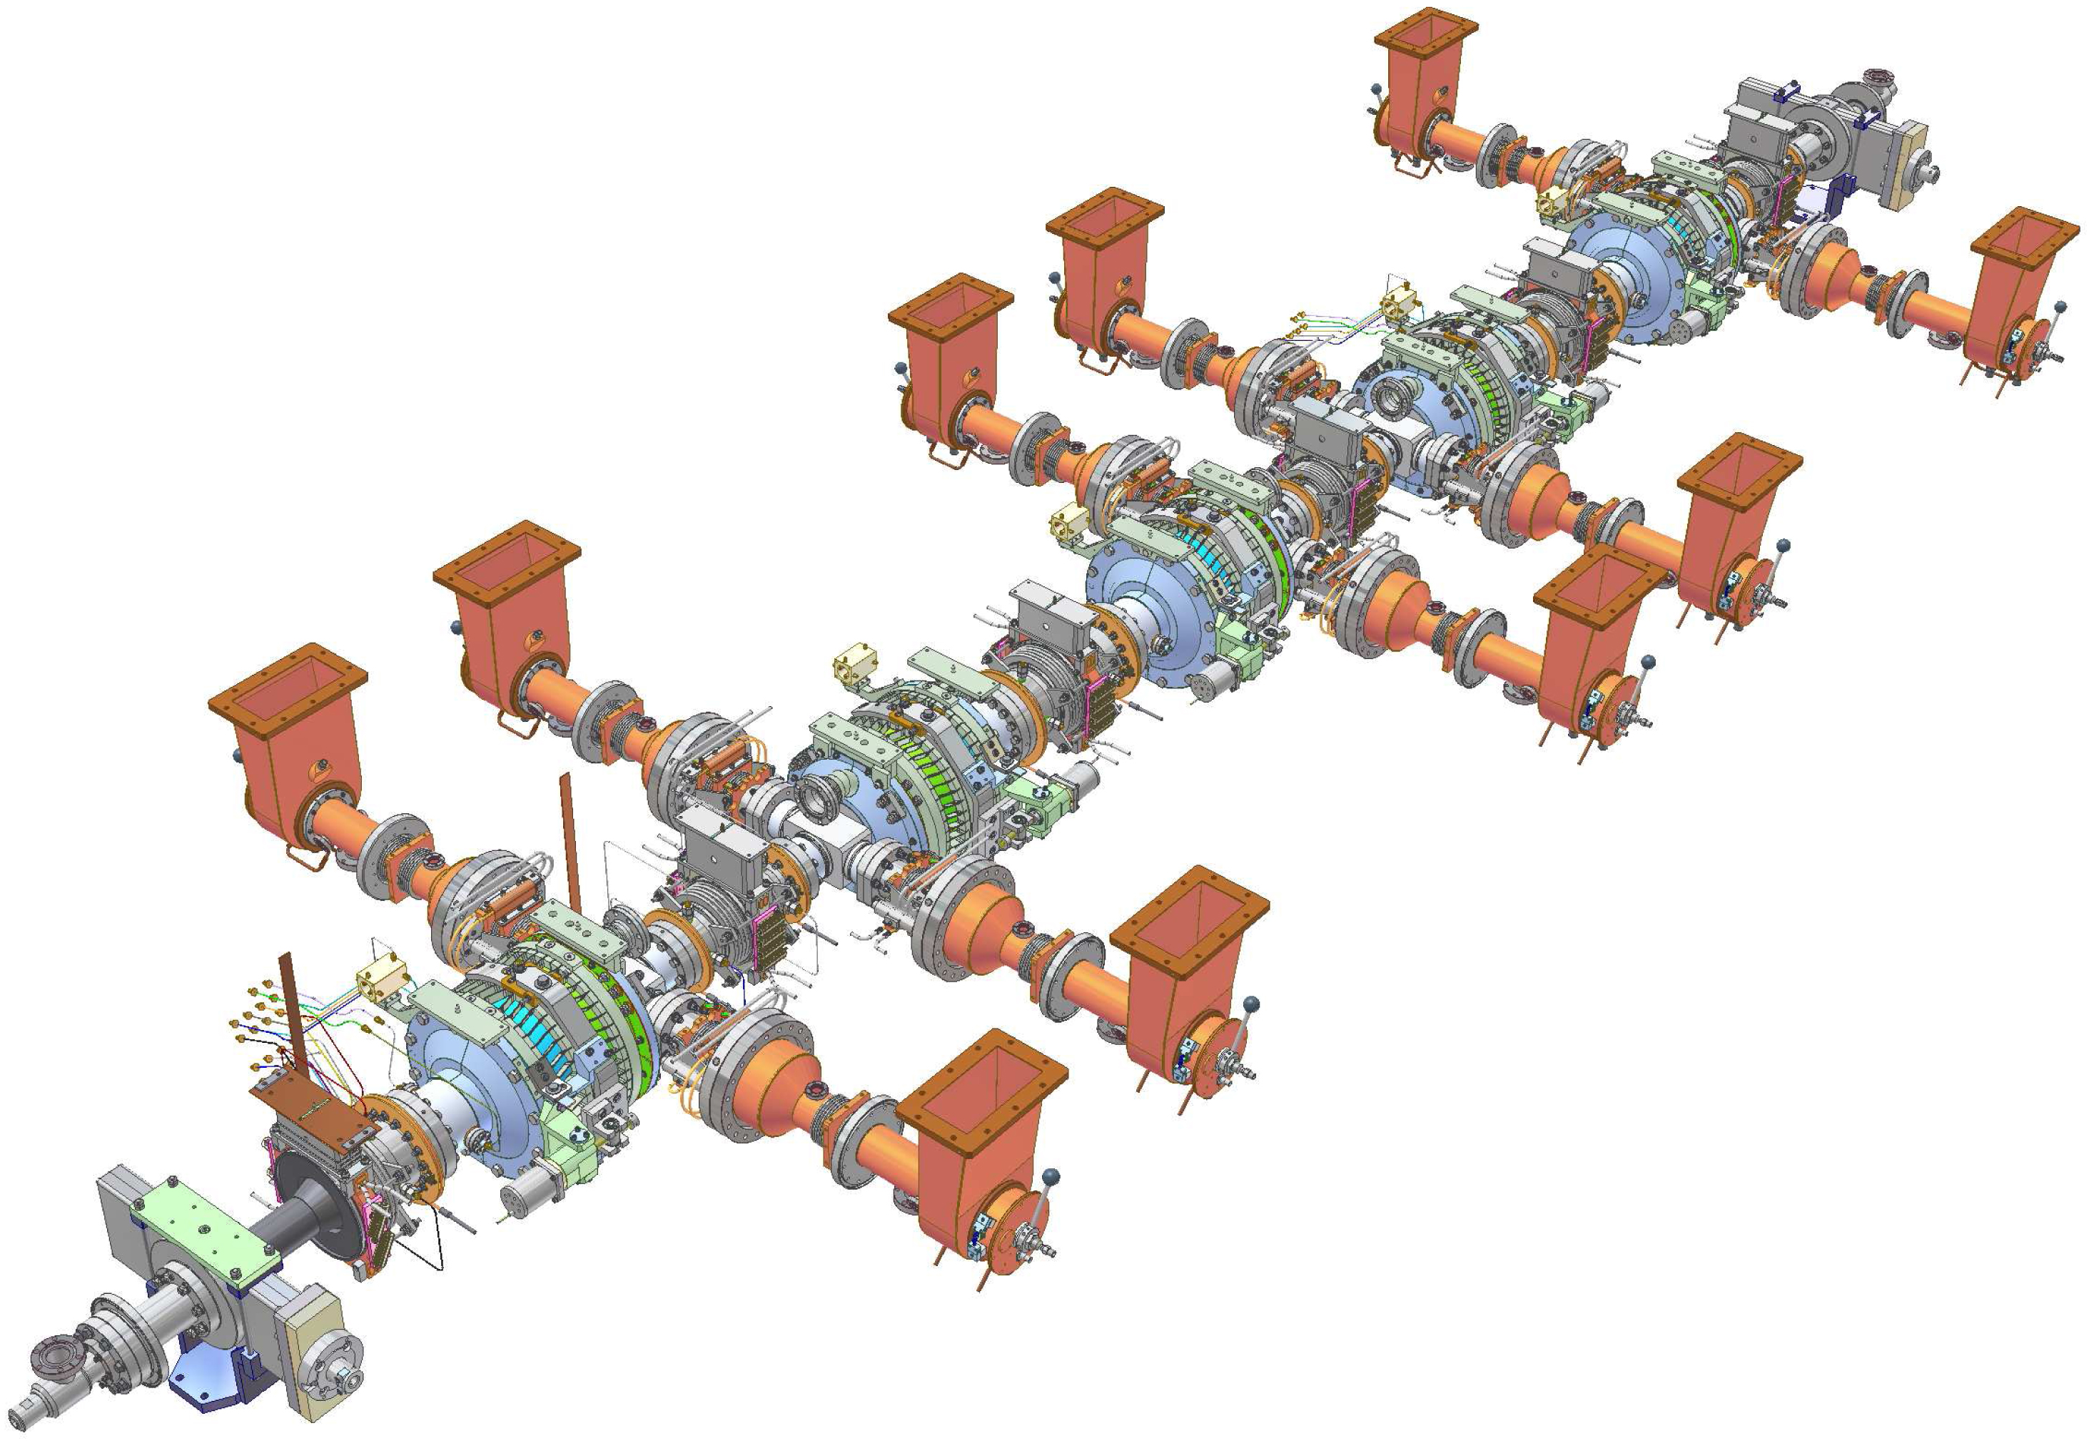
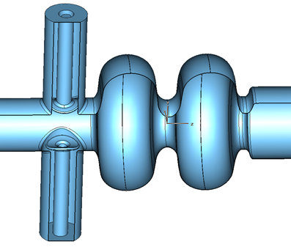
Cornell ERL Injector
Each cavity of the Cornell ERL Injector (5 MeV, 100 mA) has two couplers for minimizing the transverse kick. Another benefit of this scheme is reduced RF power per coupler.

Slide 3
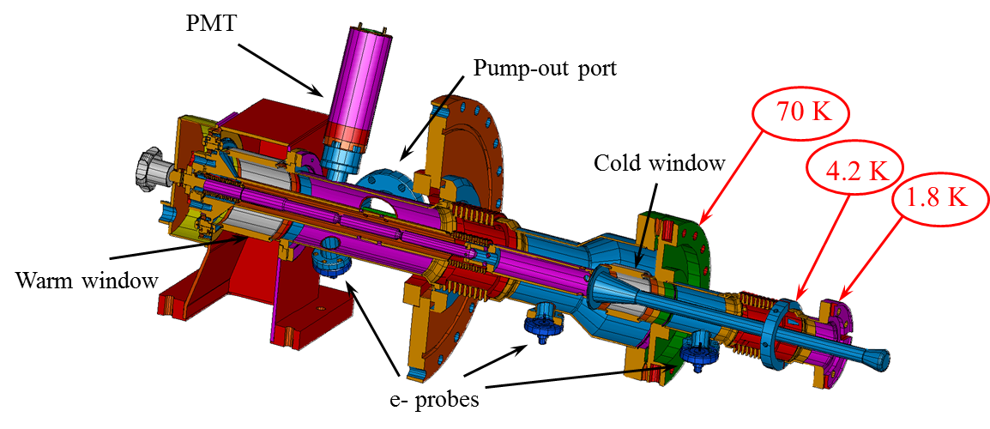
TTF-III Coupler as Prototype
The design of the ERL Injector coupler is based on the design of classic TTF-III input coupler

Slide 4
Parameters of ERL Injector Coupler

Slide 5
Injector Coupler Challenges
Main challenges for the injector coupler:
Strong coupling
Wide range of coupling adjustment
High RF power and due to that:
  Risk of bellows overheating
  Risk of ceramic window overheating

Slide 6
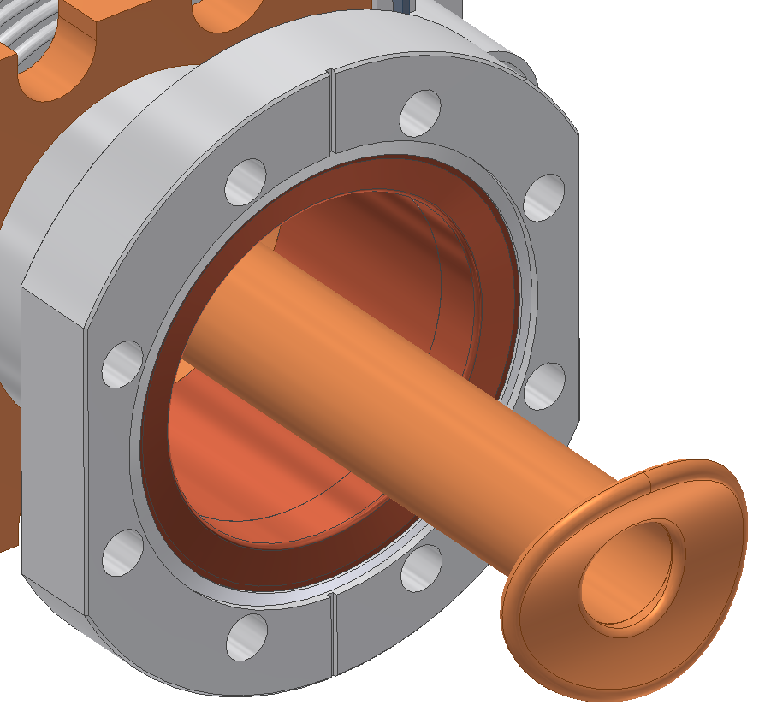
Large Antenna
A need for strong coupling
(Q _{ext} = 9 × 10 ⁴) leads
to a large antenna tip and a large diameter of cold coaxial line

Slide 7
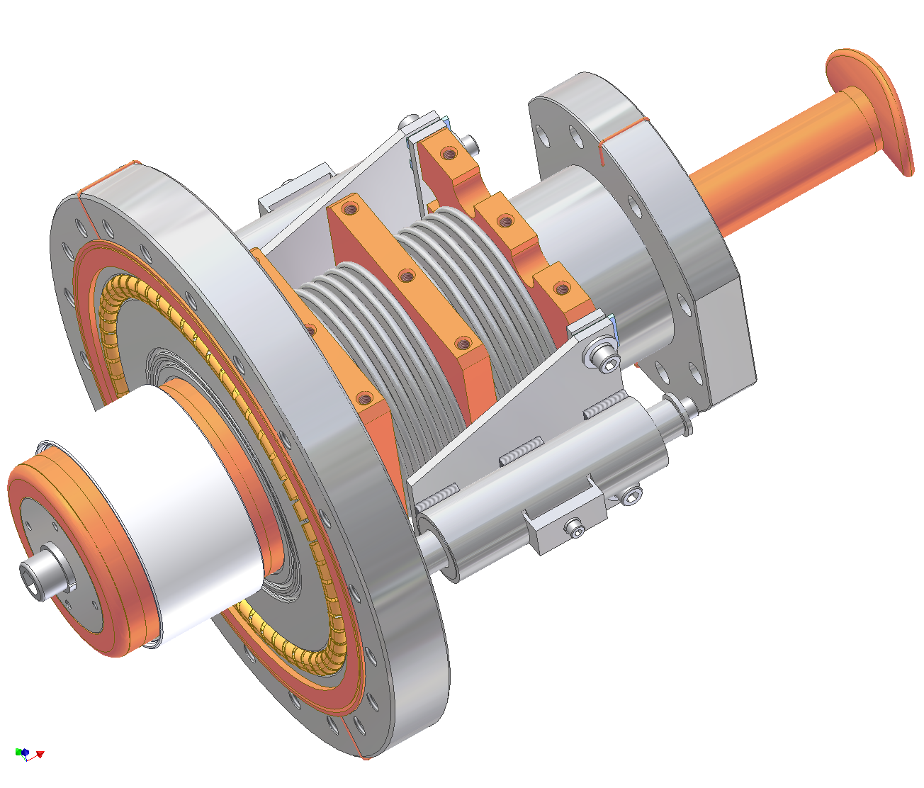
Large Cold Window
Cold window was enlarged to the size of warm window

Slide 8
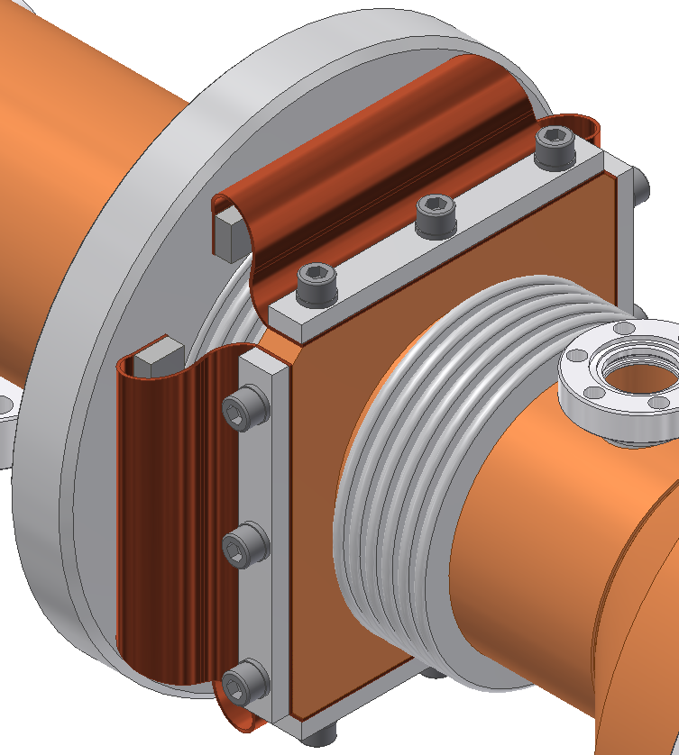
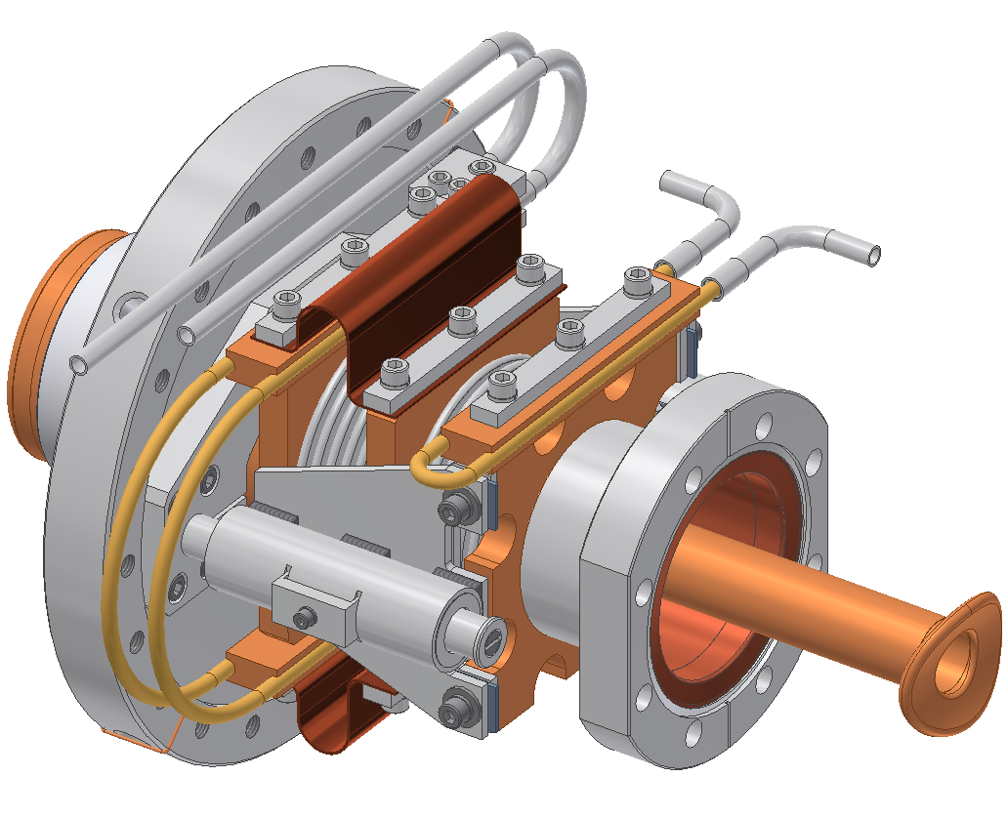
Sectioned Bellows
Outer bellows are subdivided in two sections with 80 K and 300 K intercepts between sections
300 K Port Flange
80 K Intercept
80 K He Gas Cooling
5 K He Gas Cooling
300 K Intercept

Slide 9
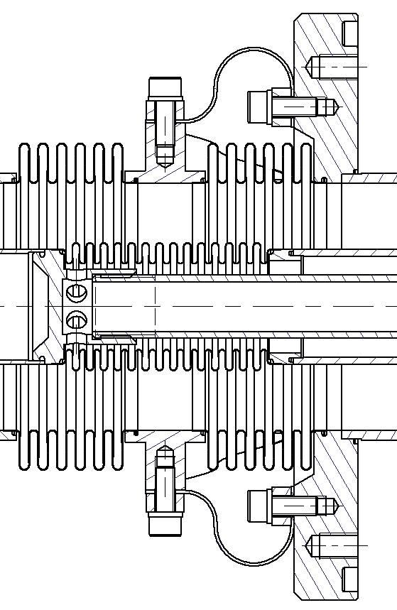
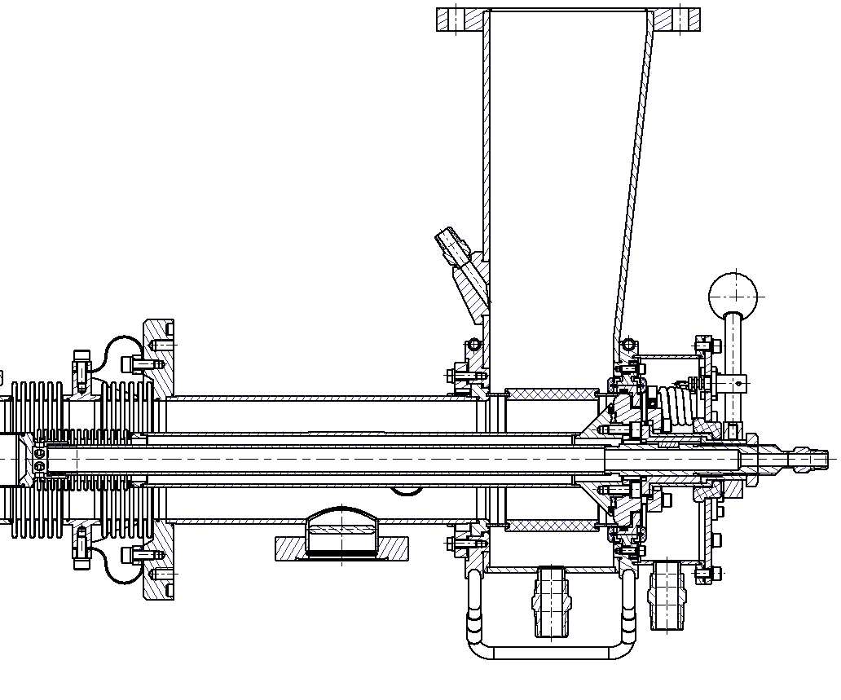
Air Cooling of Bellows
Air cooling is applied to inner bellows and to whole warm inner conductor
Compressed
Air

Slide 10
Bellows Temperature
Outer Warm Bellows
Maximum temperature is 100 K on the cold bellows and 90‒100 °C on warm bellows
Cold Bellows
Inner Warm Bellows

Slide 11
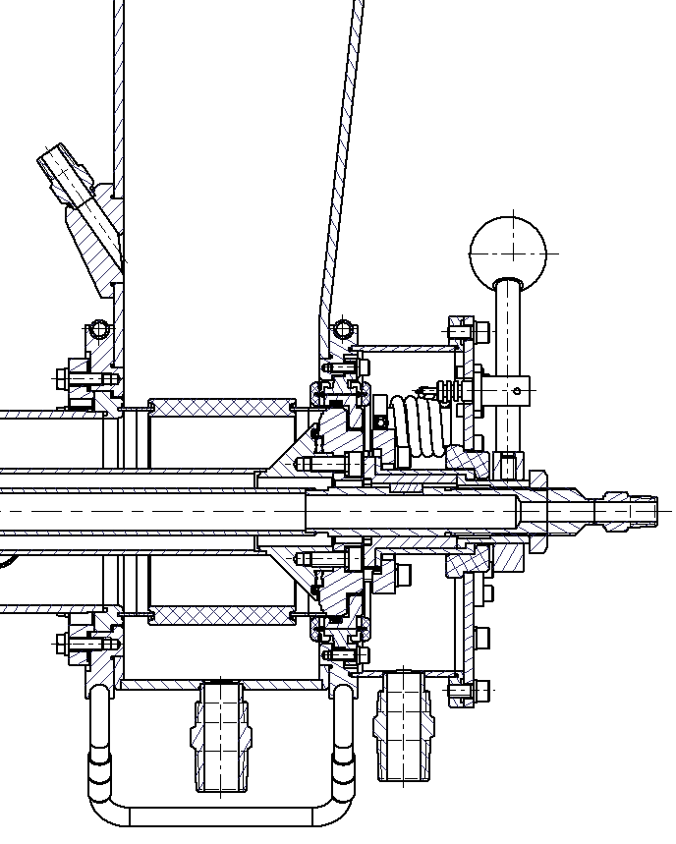
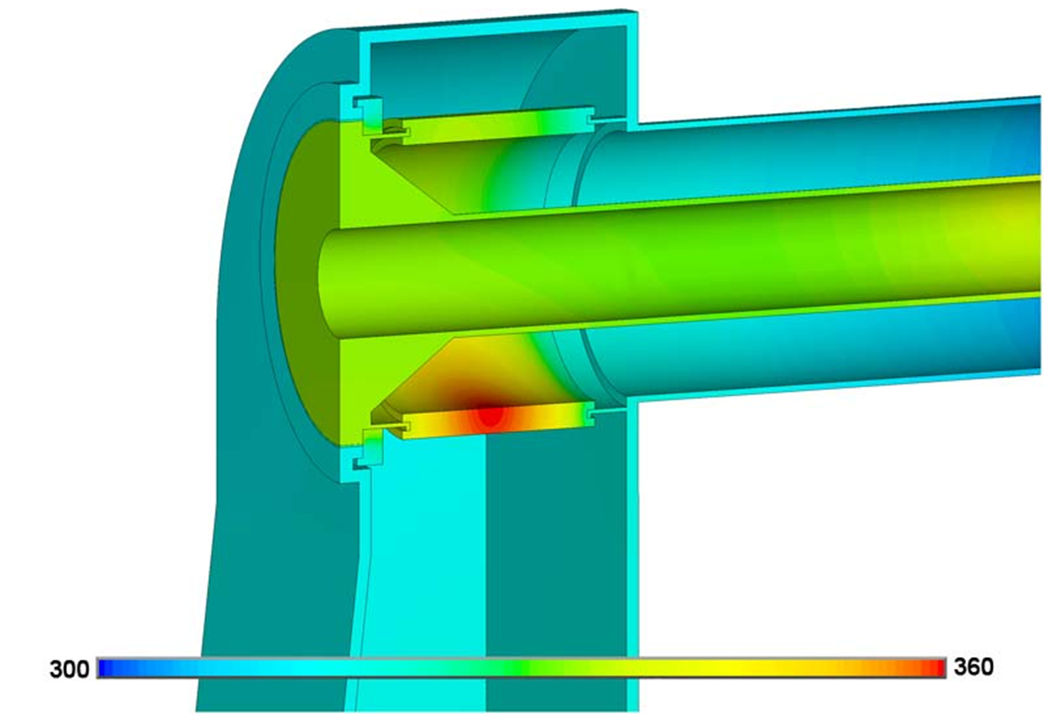
Air Cooling of Ceramic
Heating of warm ceramic
window is non-uniform.
Local cooling by compressed
air is applied.
Compressed
Air

Slide 12
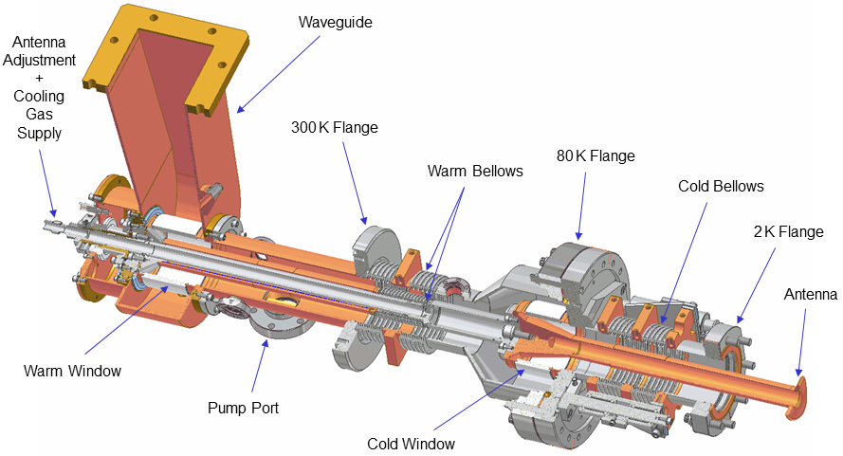
ERL Injector Coupler

Slide 13
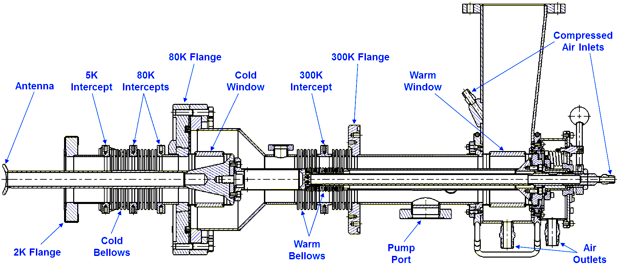
ERL Injector Coupler
Coupling adjustment screw
Water Cooling

Slide 14
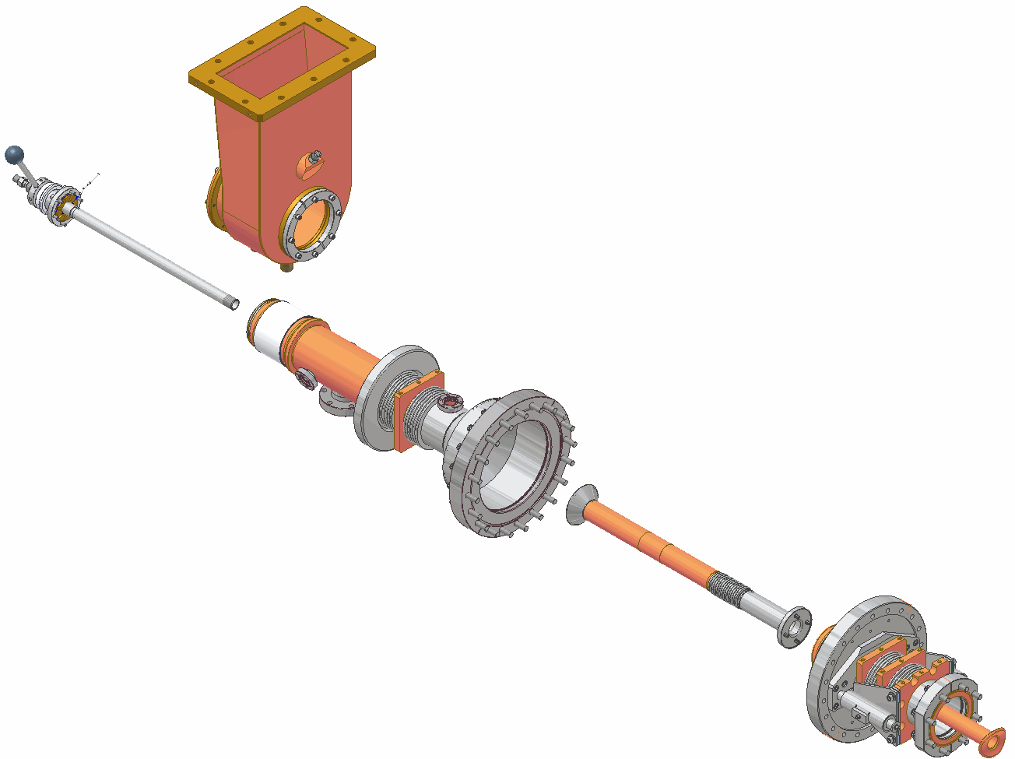
ERL Injector Coupler: Main Parts
Waveguide Box
Antenna
Adjustment
+
Cooling Gas
Supply
Warm Part,
Inner Assembly
Cold Part
Warm Part,
Outer Assembly

Slide 15
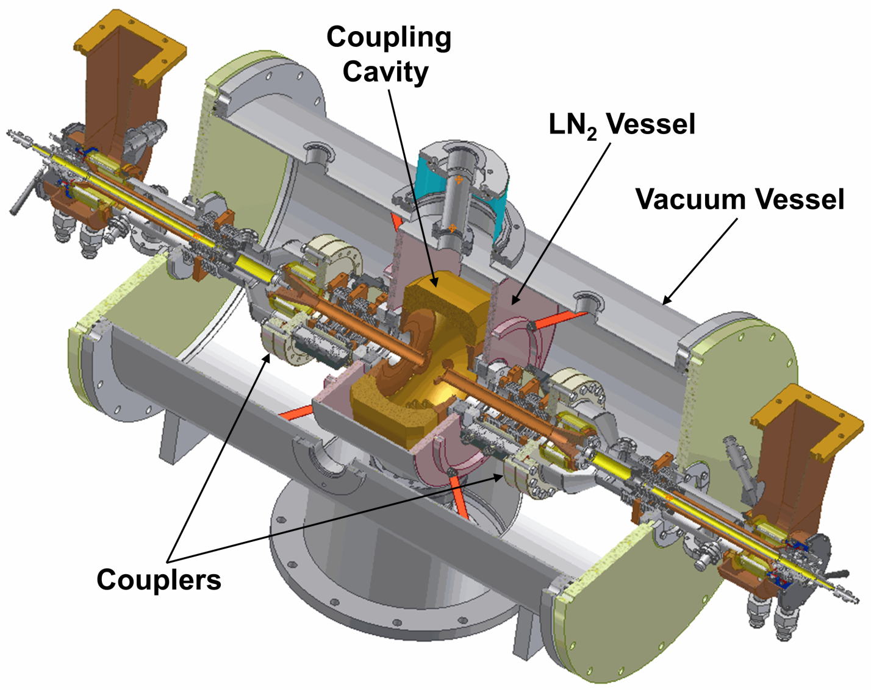
Coupler Test Stand

Slide 16
CW Power Test Performance
RF Power
Cold Bellows Area Temperatures
Vacuum
Warm Bellows Area Temperatures

Slide 17
Coupler Pulse Processing
Pulse processing (1.5 msec, 50 Hz) of new couplers
installed in the injector cryomodule
Processing history
Time required to reach 50 kW

Slide 18
Injector Coupler Performance
Summary of the injector coupler performance:
Two prototype couplers were made (by CPI, Beverly) and tested at Cornell. After that the design was improved.
10 more couplers were fabricated and installed in the ERL Injector Cryomodule in 2008.
Two of ten couplers were tested on the test stand up to
61 kW CW.
In the cryomodule, couplers were processed in pulse and CW modes w/o beam; finally processing is going on during high current beam operation.
RF power up to 40 kW CW per coupler was applied so far during beam operation.
Beam current up to 75 mA was accelerated in the ERL Injector.
High current beam operation will be continued.

