Slide 1
High Q R&D at Fermilab
Anna Grassellino
TTC Topical Meeting on CW SCRF
Cornell University, June 13th 2013

Slide 2
Outline
What is typical Q and, in particular, residual and BCS resistance for standard treatments, as a function of field? (study performed at 1.3 GHz)
New processing techniques for Q maximization (studies performed at 1.3 GHz)
Transferring high Q recipes to 650 MHz cavities for PX

Slide 3
What is Q and Rs(B) for standard treatments?

Slide 4
Field Dependence of Surface Resistance for typical treatments
Q = G/R_{s}, where Rs = R_{BCS}(T) + R_{s}
Crucial question – how does medium field Q-slope emerge from its components R_{BCS} (B) and R_{s} (B)?
Answering allows:
  Obtain Rs(B,T) predictions for any standard treatment (EP, BCP, mild bake, anneal…) to design accelerators -> missing input for optimization
  Baseline for comparison with new, innovative treatments
  Fundamental understanding of “Q-slopes”

Slide 5
Approach
A. Romanenko and A.Grassellino
http://arxiv.org/abs/1304.4516
Obtain as many Q(B,T) measurements as practical at ALL fields (not only at a single low field as is customary)
At each fixed field fit corresponding Q(T) to extract Rres
  Also gives Rbcs(T) = Rs(T)-Rres
Bath temperature

Slide 6
Results (1.3 GHz)
A. Romanenko and A.Grassellino
http://arxiv.org/abs/1304.4516
Medium field Q slope is a combination of both R₀(B) and R_{BCS}(B)
R_{BCS} decreases but becomes strongly field dependent after 120C
Medium field Q slope is NOT due to thermal feedback
Stronger R₀(B) for BCP vs EP

Slide 7
New surface processing techniques
for Q maximization

Slide 8
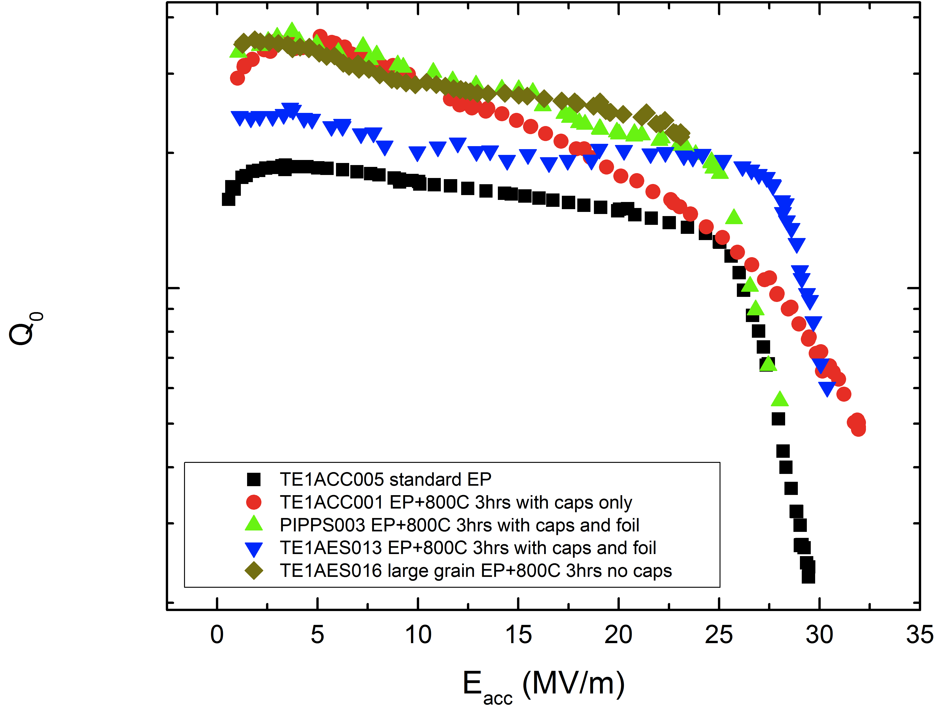
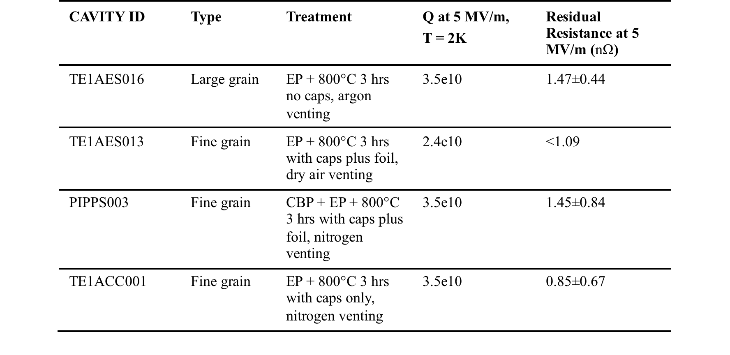
Annealing with caps+ no chemistry produces extra-low residual resistance
1.3 GHz, 2K
A.Grassellino et al, http://arxiv.org/abs/1305.2182
Systematically low R₀
Extra cost savings from skipping the post furnace chemical processing
See also G. Ciovati, Phys. Rev. ST Accel. Beams 13, 022002 (2010)

Slide 9
Long annealing produces extra-low R₀(B)

Slide 10
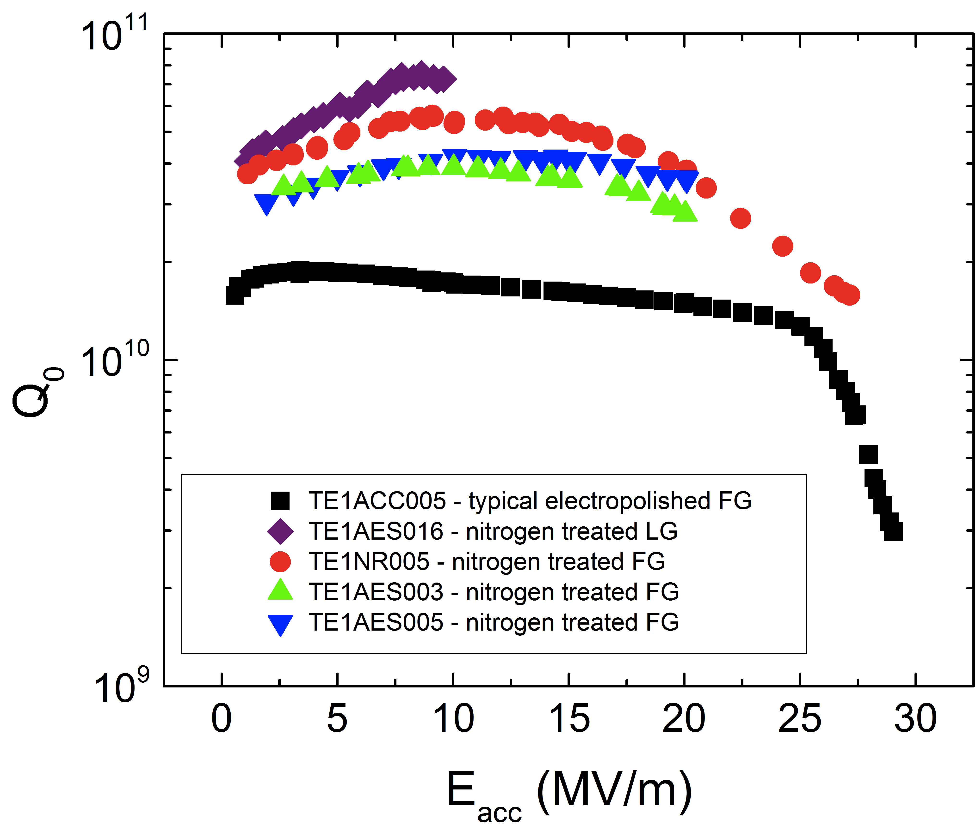
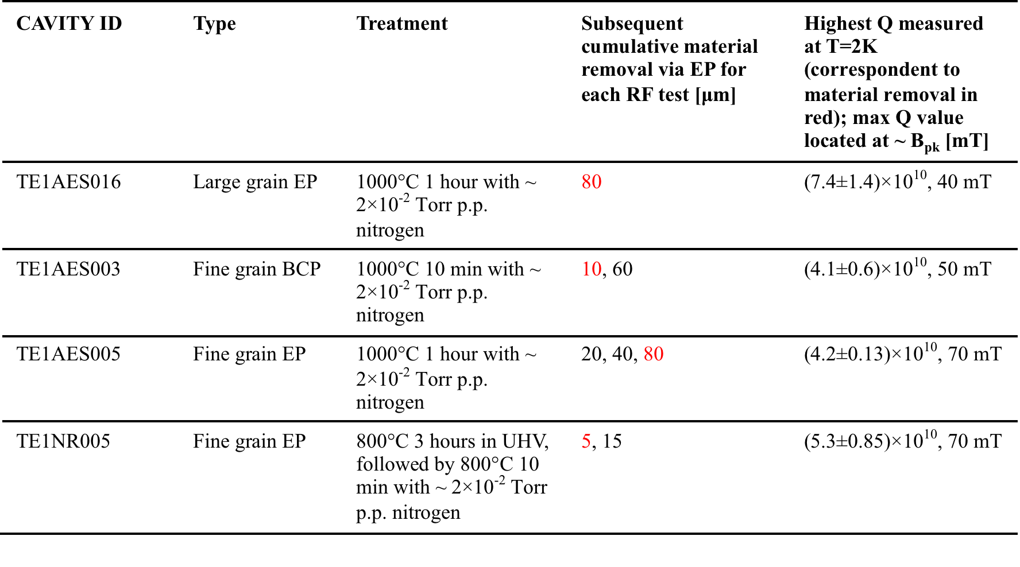
Heat treatments in nitrogen produce unprecedented values of R_{BCS}(B)
1.3 GHz, 2K
A.Grassellino et al,
http://arxiv.org/abs/1306.0288

Slide 11
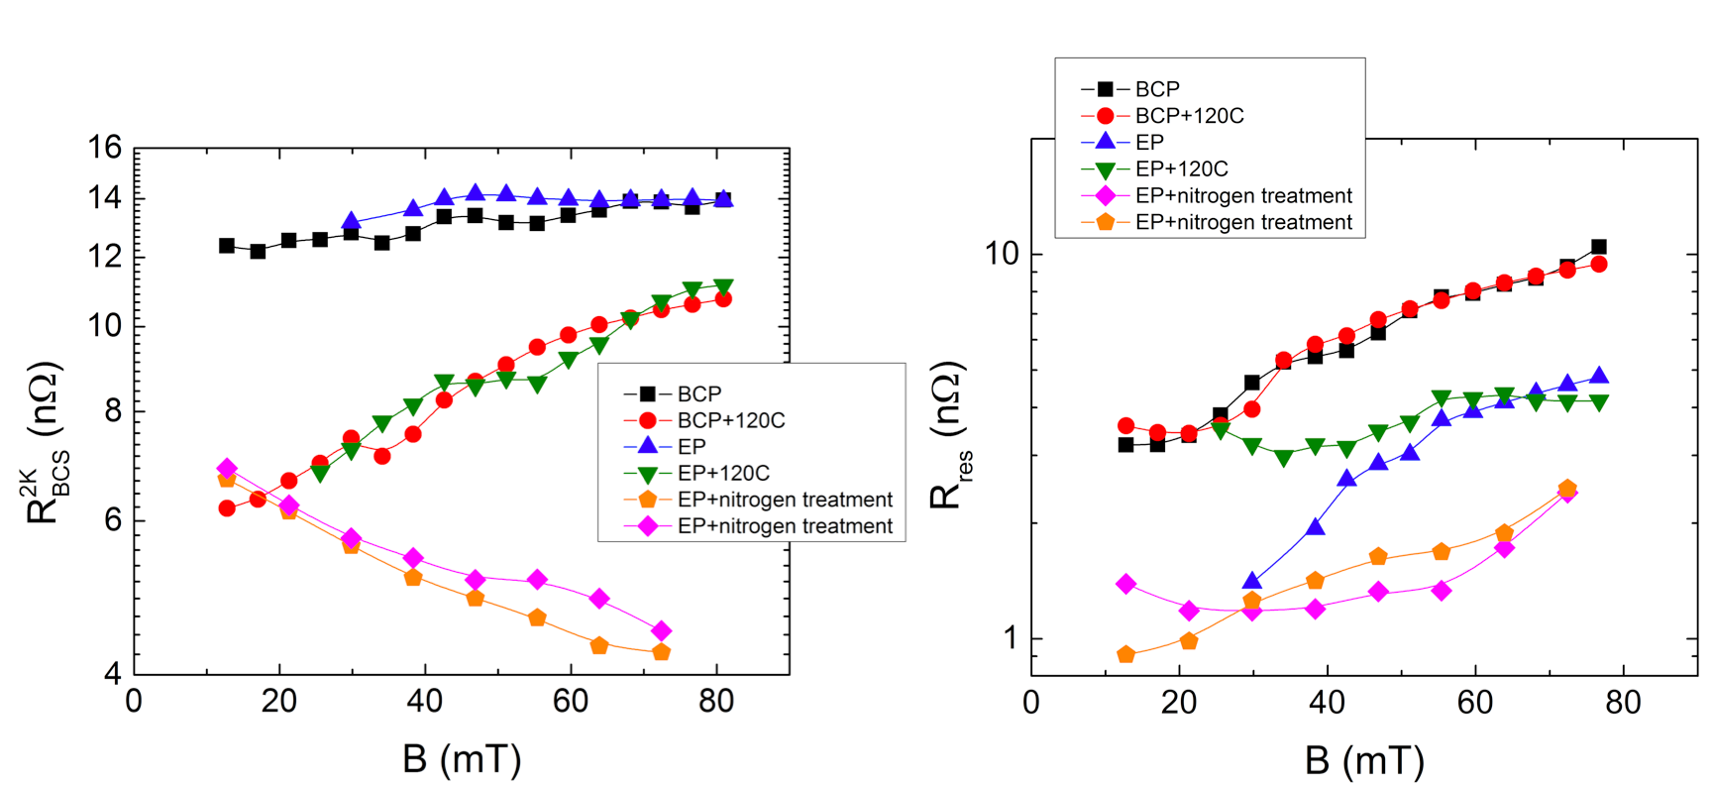
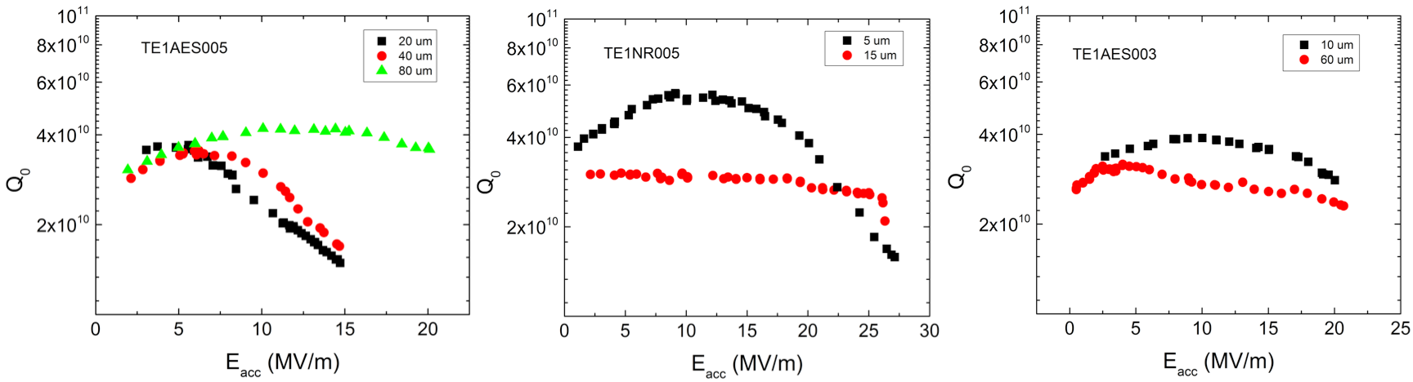
Heat treatments in nitrogen produce unprecedented values of BCS
Q curves as a function of material removal via EP post-nitrogen treatment:
1.3 GHz, 2K
1.3 GHz, 2K
1.3 GHz, 2K

Slide 12
Is doping with interstitial impurities a long sought solution to the medium field Q-slope?

Slide 13
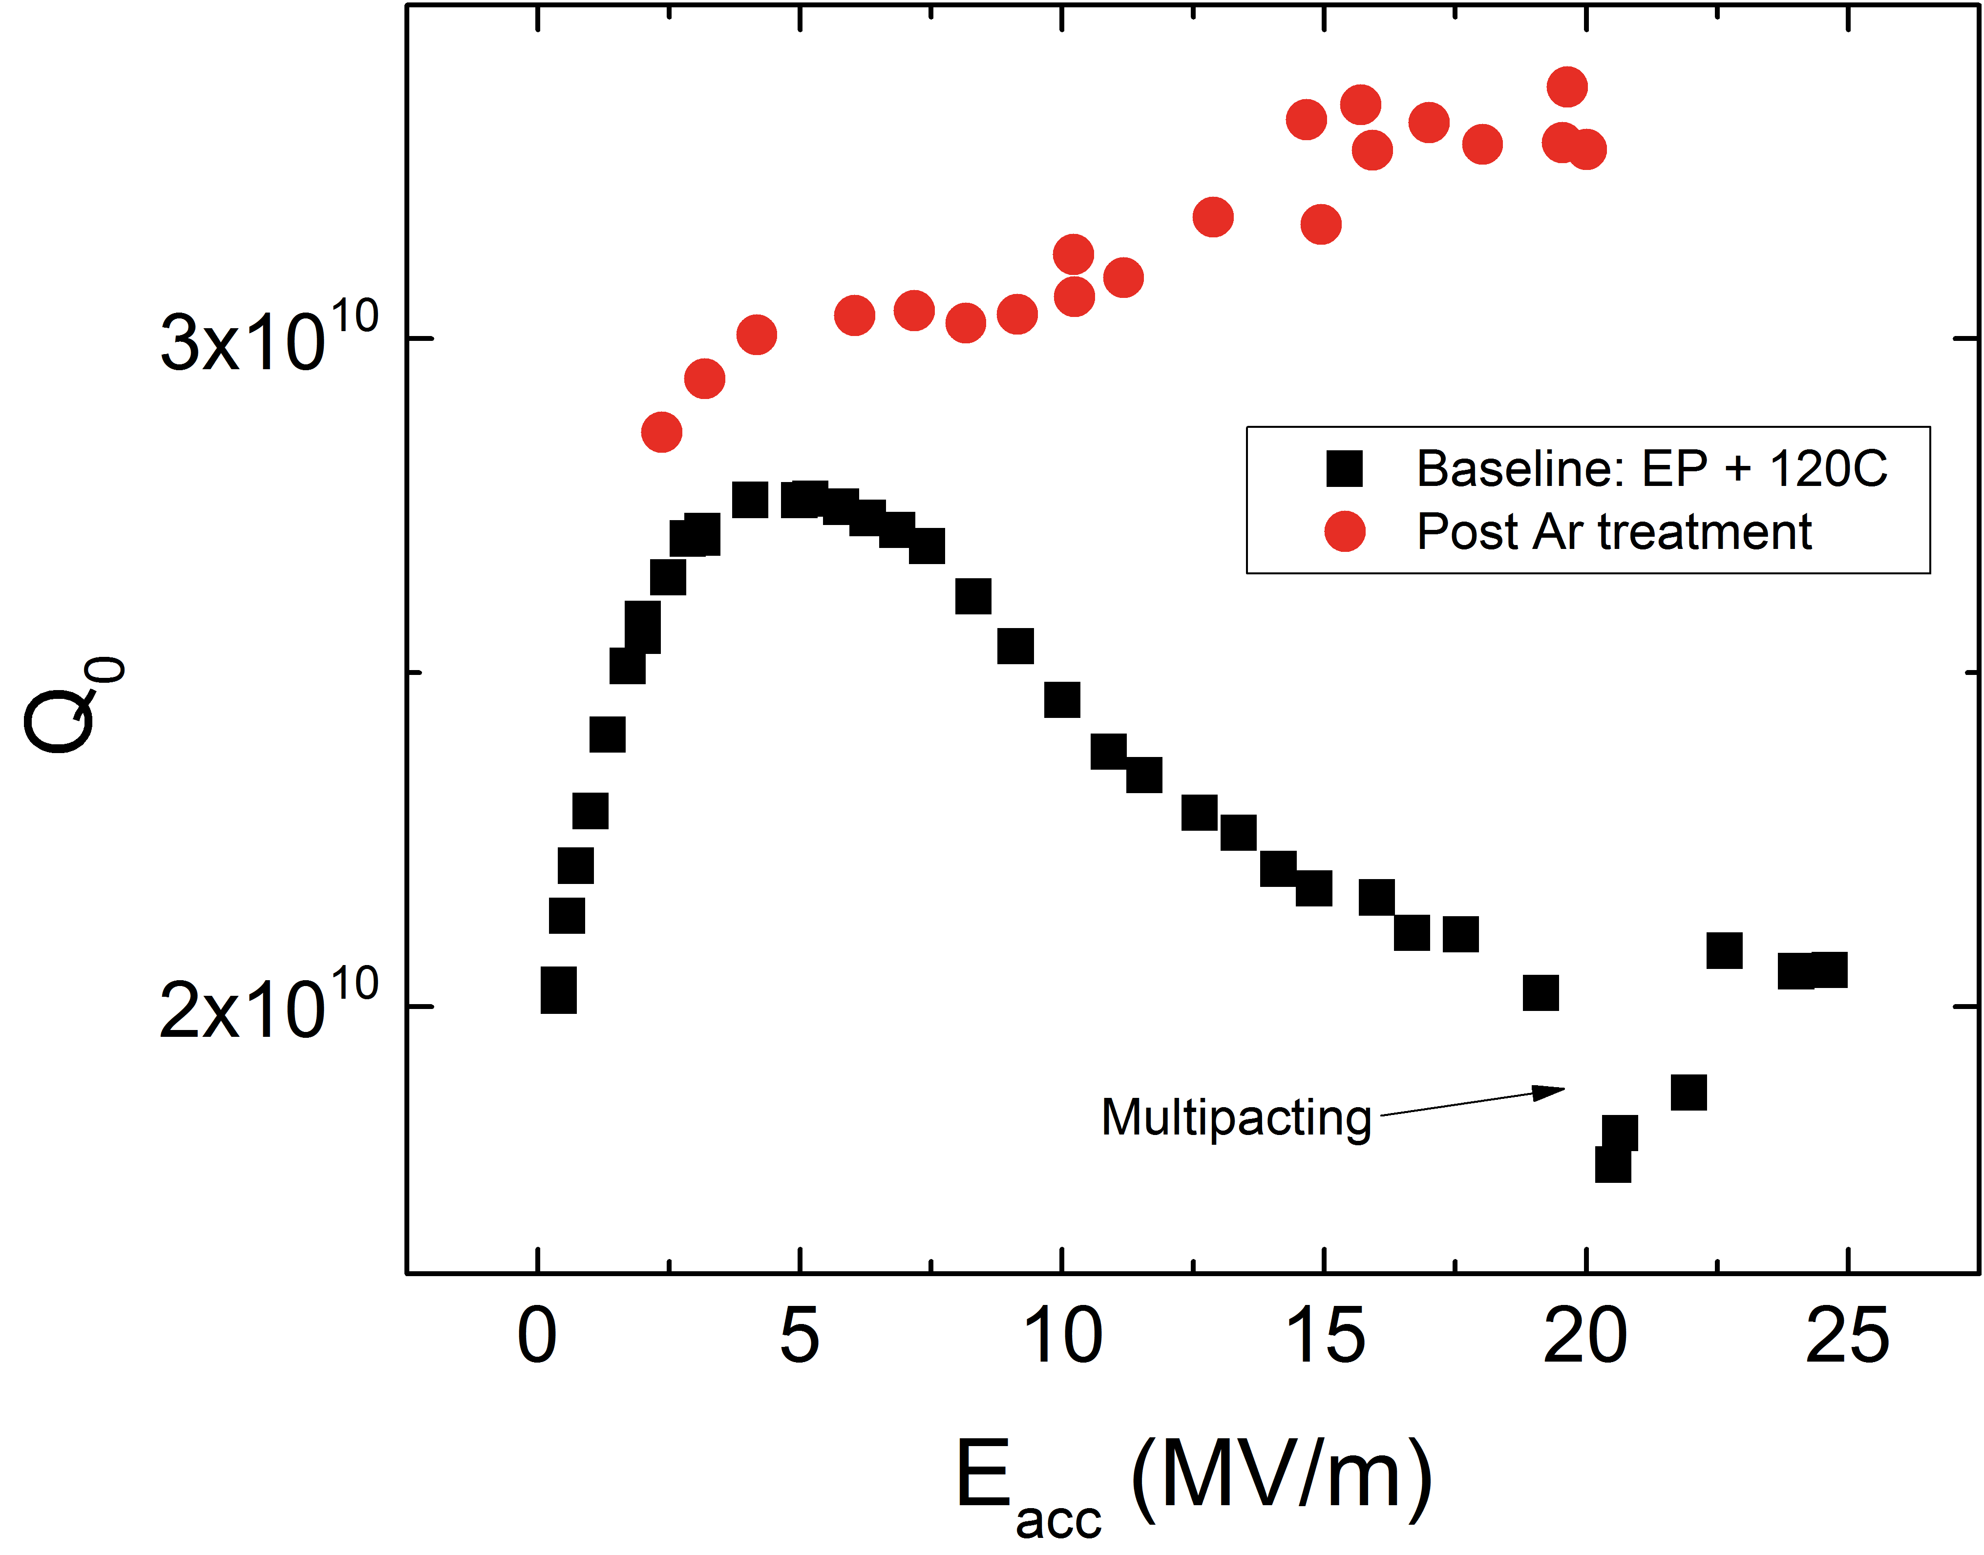
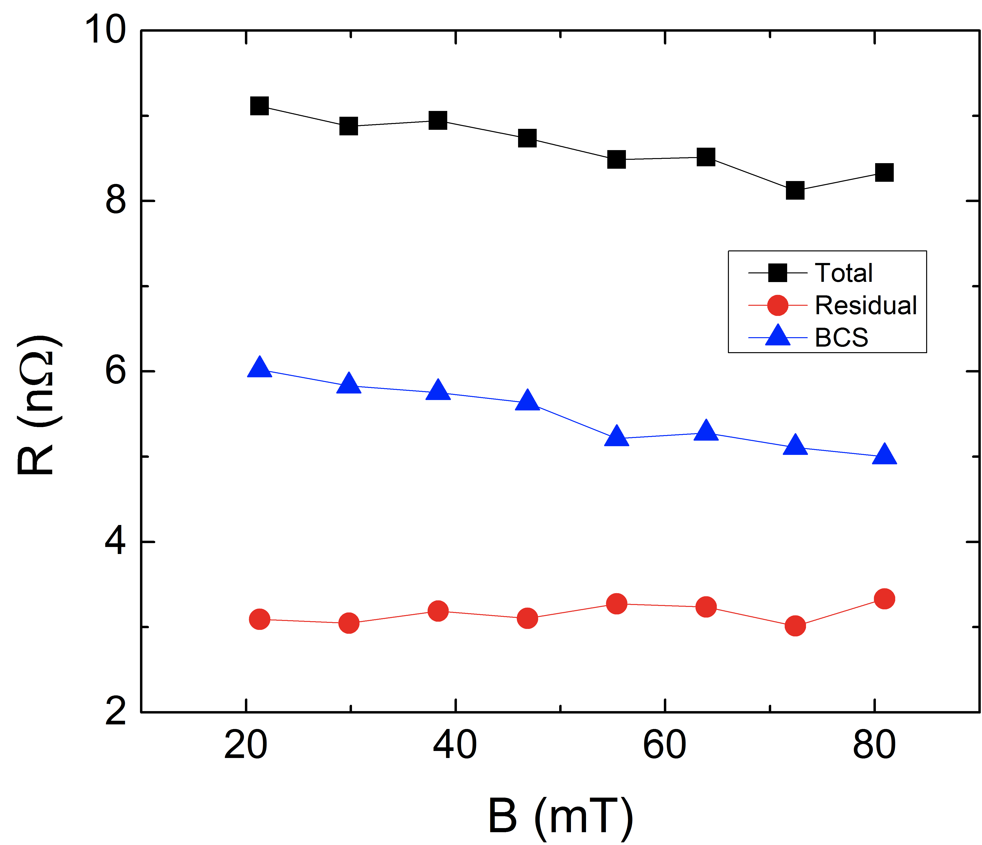
Doping with interstitial impurities: a solution for MFQS?
The cavity baked with argon
Cavity baked at 800C for an hour in UHV, followed by an hour at 800C in partial pressure ~2x10⁻² T of Argon → Q ~1x10⁷
Then ~ 7 micron removal via EP → again anti-Qslope!
Interesting note: anti-Q-slope result recently reported by Jlab also has argon injection at high T in the preparation steps
Interstial impurities doping may be the common root of the anti-slope results
1.3 GHz, 2K
A.Grassellino et al,
http://arxiv.org/abs/1306.0288

Slide 14
Applying the high Q recipes
to 650 MHz cavities for PX (first results)

Slide 15
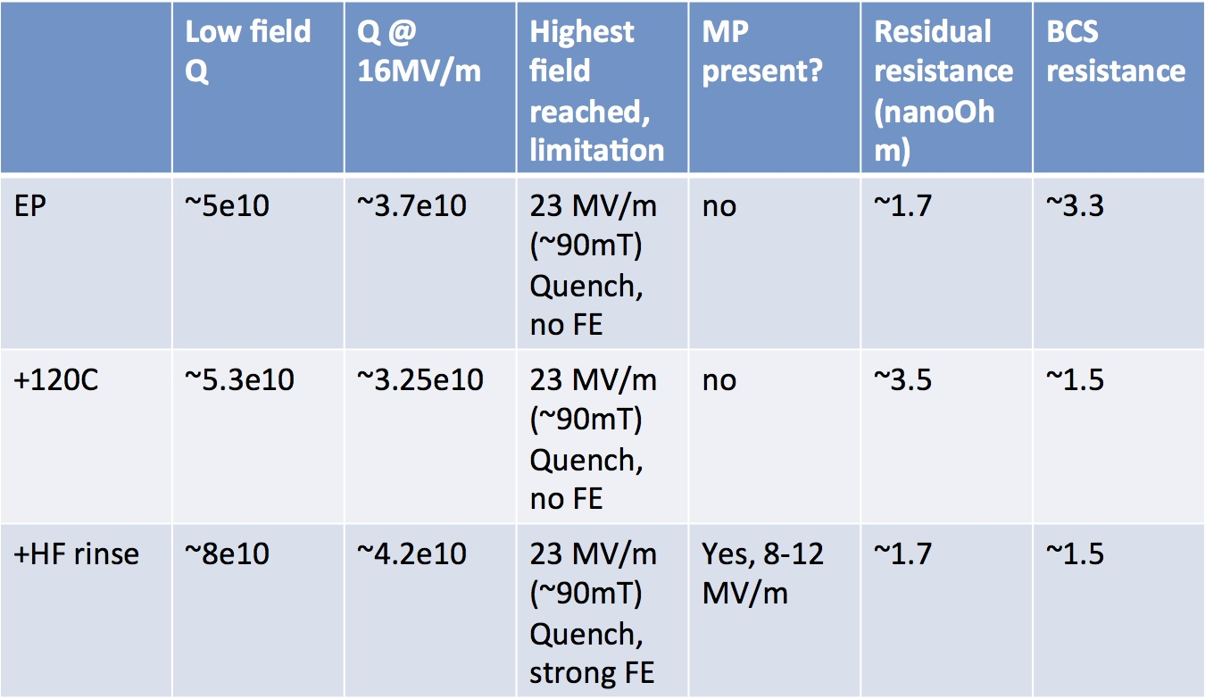
Applying the findings to 650 MHz PX cavities
Very low residual resistance (~2 nΩ) even with just baseline EP or BCP (indication of frequency dependence of residual resistance?)
Cavities have not been high temperature baked yet
HF rinse successful in raising Q! ~ 40%
Slope due to both residual and BCS
Will try annealing with caps and nitrogen/argon treatments next

Slide 16
Conclusions
Different recipes found for Q maximization for different applications
  For applications requiring extra high Q, no operating T constraints (ie cavity QED): anneal followed by no chemistry, long anneals
  For large CW machines, where operating T range is constrained to above 1.8K: two new surface treatments have been found which:
    Reverse medium field Q-slope!
    Up to 150% gain in Q in the T range of interest for CW accelerators
Recipes are extremely simple, can be replicated at any lab with access to a standard hydrogen degassing furnace
FNAL will try soon interstitial doping on 3.9 GHz cavity: potential for even larger gains!
An improvement in BCS has the advantage to be “robust” and fully maintained in cryomodule

Slide 17
The work presented comes from a team effort:
A.Grassellino, A.Romanenko, O.Melnychuk, A.Crawford, A.Rowe, M.Wong, D.Sergatskov, T.Khabiboulline, A. Sukhanov, Y.Trenikhina, F.Barkov, D.Bice, B.Stone, C.Baker, Y. Pischalnikov, C. Ginsburg, V.Yakovlev, R.D.Kephart

Slide 18
 | N total | Mean | sigma | Minimum | Median | Maximum
Not tumbled | 11 | 2.6 | 0.50796 | 1.43 | 2.73 | 3.14
Tumbled | 11 | 2.69273 | 0.71337 | 1.53 | 2.51 | 4.24
 | N total | Mean | sigma | Minimum | Median | Maximum
Not tumbled | 10 | 1.777 | 0.39556 | 1.16 | 1.95 | 2.17
Tumbled | 11 | 1.89182 | 0.52759 | 0.99 | 1.98 | 2.87

Slide 19
From combined T-map/RF measurements
Heating is negligible, Rbcs increase with field is a genuine effect
Thermal feedback does not explain the medium field Q slope

Slide 20
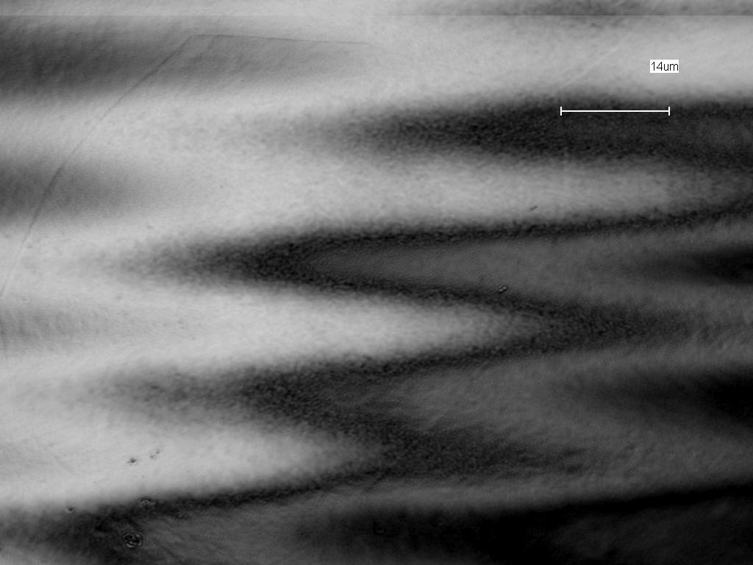
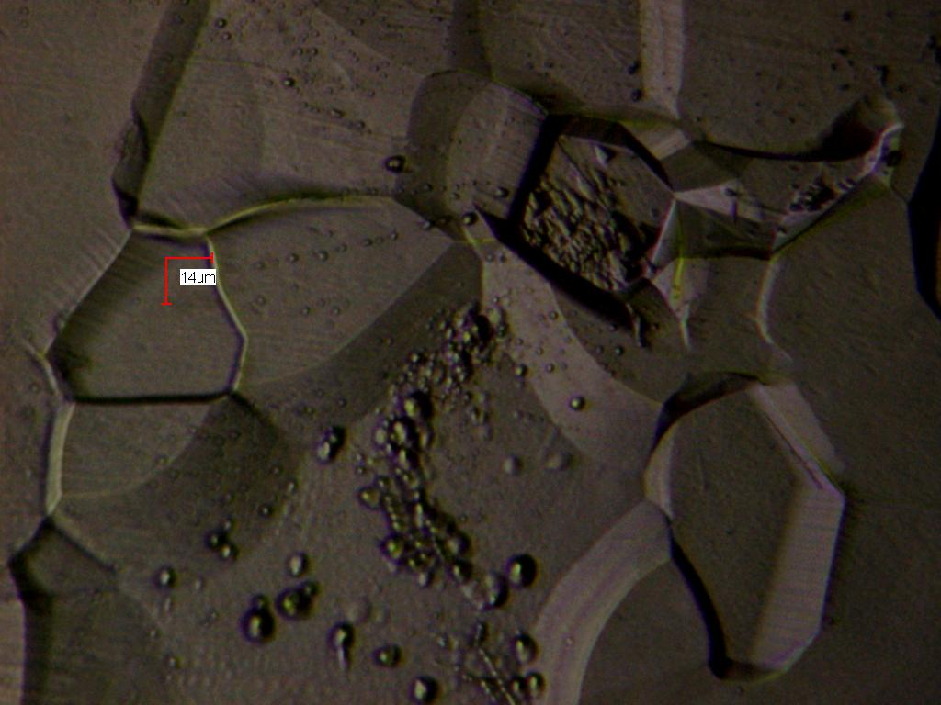
After 800C 10 min with N plus 5 micron EP
(perfectly smooth, nothing noticeable)
After 800C 10 min with N plus 5 micron EP
plus 15 micron BCP, signs of preferential etching

Slide 21
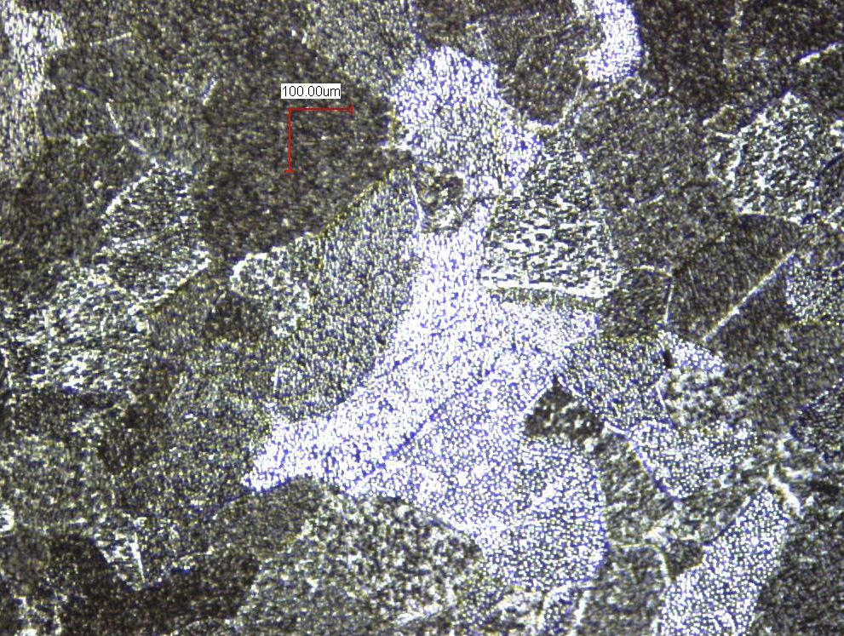
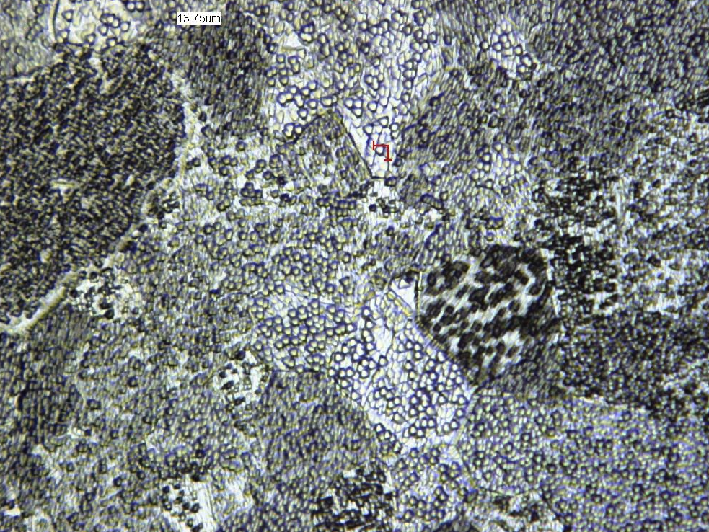
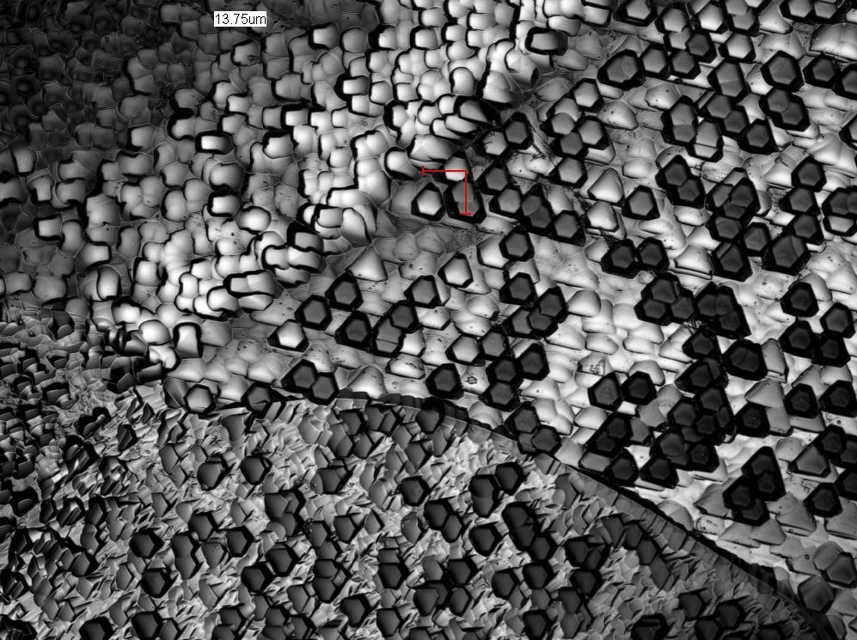
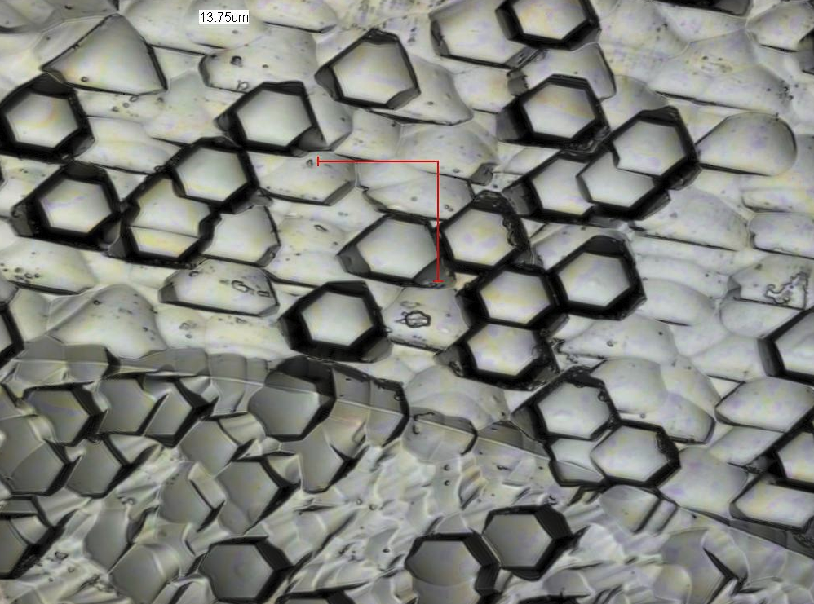
Nitrided surfaces: laser microscopy – post chemistry
(10 minutes nitridization plus 10 microns BCP)
10x
20x
50x
100x

Slide 22
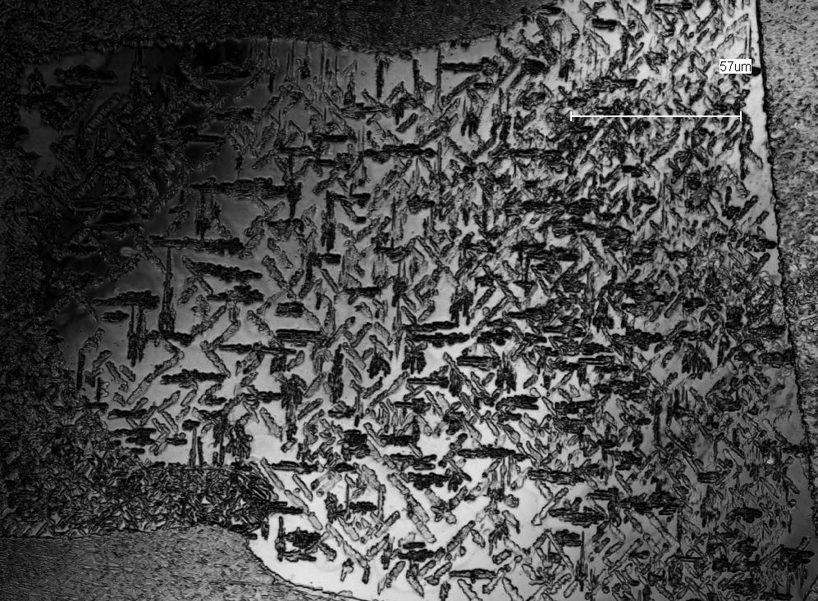

Slide 23
