Slide 1
Cornell’s Main Linac Module (MLC)
Ralf Eichhorn
CLASSE, Cornell University

Slide 2
Not an Outline
I will not talk about:
Cavities (Nick and Sam did this)
HOM absorbers (did that yesterday)
Power couplers (see Vadim’s talk)
SC-Magnet & BPM section (design is halted)
But I will try to review
Choices we made
Questions we are working on

Slide 3
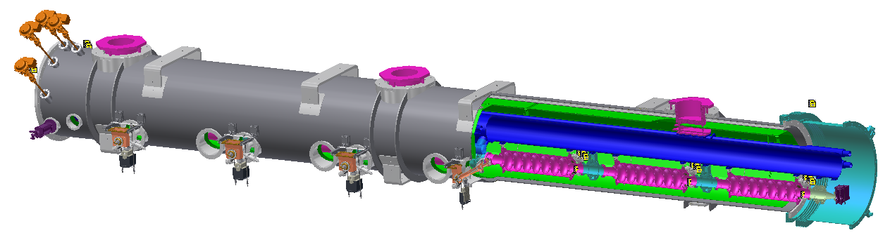
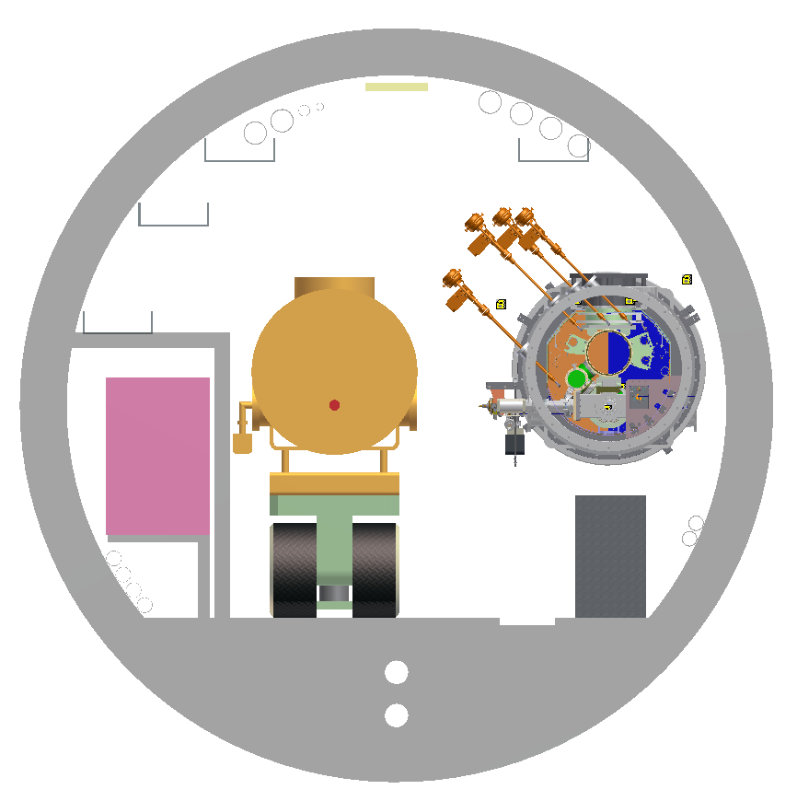
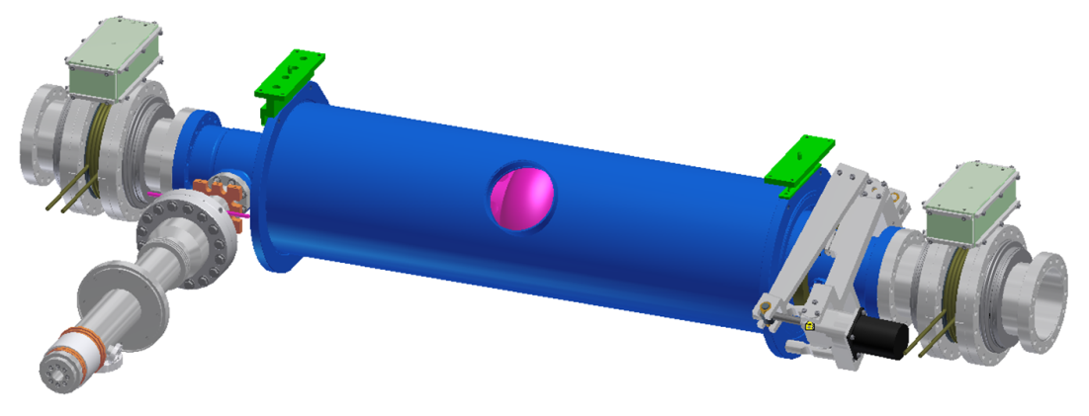
Cryomodule unit
Cryogenic valves
Beamline string supported by HGRP via three posts
Beam
Pneumatic gate valve
Manual gate valve
All ports are on aisle side in the tunnel
Coupler downstream of cavity
SC magnets downstream of cavities
Cavity package

Slide 4
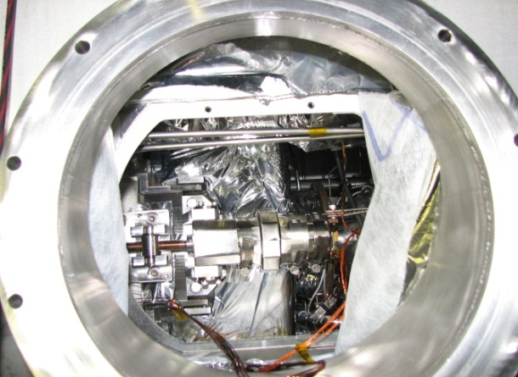
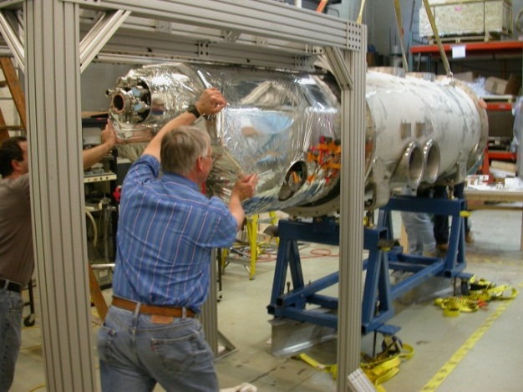
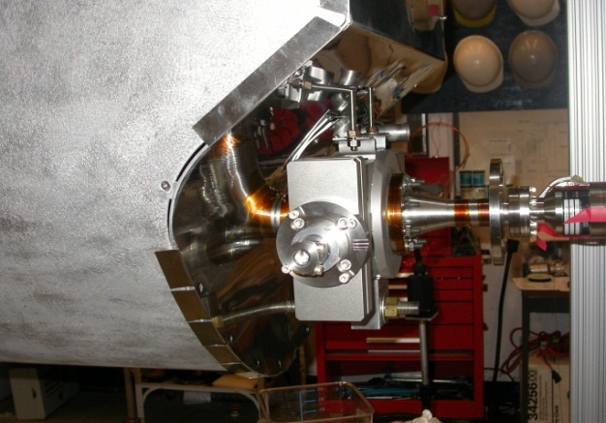
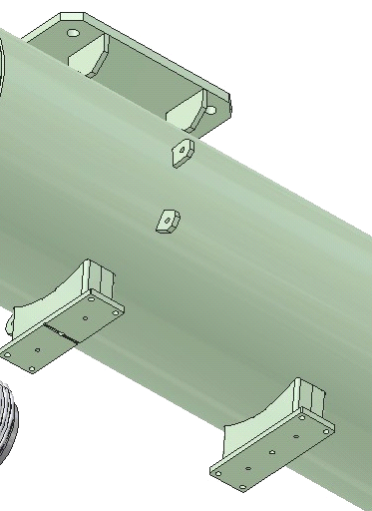
Cornell Specifics
Tuner stepper replaceable while string is in cryomodule
Rail system for cold mass insertion
Gate valve inside of module with outside drive
Precision fixed cavity support surfaces between the beamline components and the
HGRP -> easy “self”
alignment

Slide 5
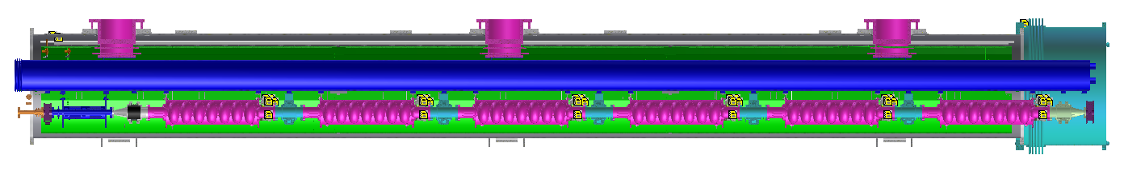
Cool-Down shrinkage
Axial displacement due to thermal contractions of materials at cold
Components | Material | Temperature | ∆L/L | ∆L
HGRP | Ti | 300K-2K | 0.172% | 17 mm
Thermal shield | Al 1100 | 300K-40K | 0.350% | 34.5 mm
Beamline (cavity) | Nb | 300K-2K | 0.146% | 14.5 mm
Sliding post
Fixed point
Sliding post
9.8 m, vacuum vessel at room temperature
7.5 mm -- HGRP
Axial displacement is allowed by:
Sliding post
Cavity flexible support
Key alignment of component supports
Coupler design allows an offset of 10 mm
Bellows in HOMs
9.5 mm -- HGRP
15.5 mm – thermal shield
19 mm – thermal shield
6.5 mm – beamline
8 mm – beamline
1 mm – cavity LHe vessel

Slide 6
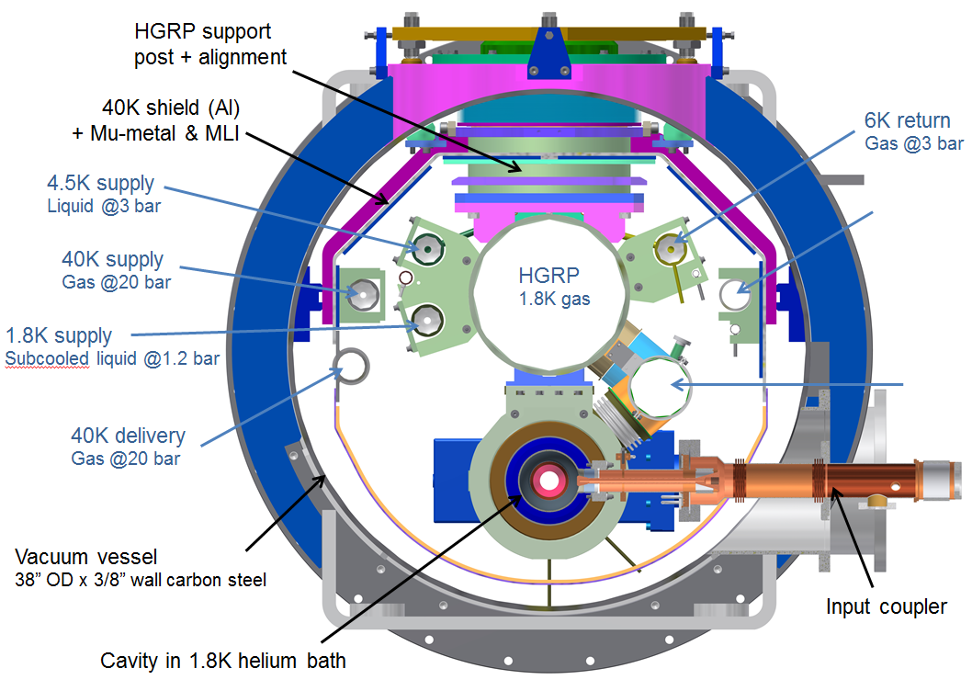
Cryogenic manifolds: six lines
1 line for 2K supply | subcooled liquid @1.2 bar | 2K helium bath for cavities via 2K-2 phase line pre-cool gas for cool-down 90% heat load from RF losses in the cavities
2 lines for 4.5-6K | 3.0 bar He liquid Single phase flow | Thermal intercept for HOM absorbers and couplers 2/3 dynamic heat load
3 lines for 40-80K | 20 bar He gas | Thermal intercept for HOM absorbers and couplers 40K thermal shield, low thermal expansion rate over 40-120K range 90% heat load from HOM

Slide 7
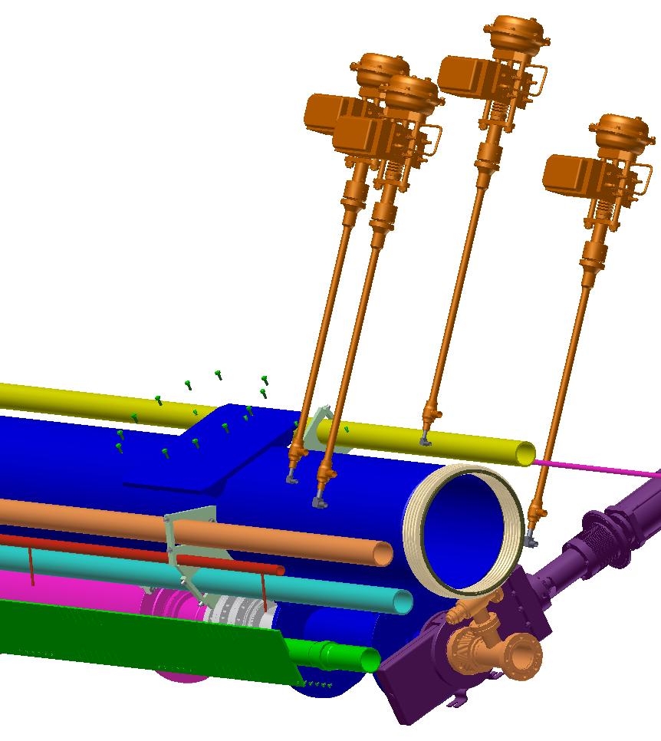
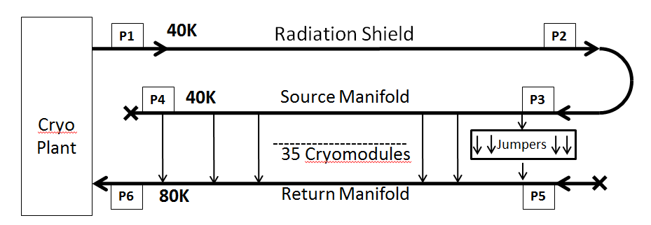
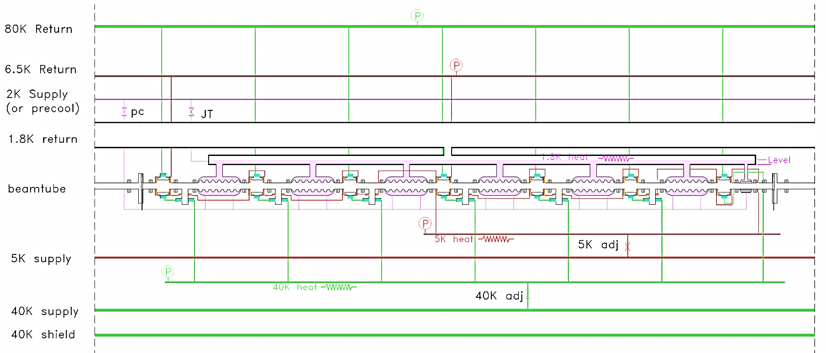
Cryogenic sketch of one Module
(as of Sep 2012)
2K, 5K and 40K supply pipes run for the entire half linac
4 Valves control flow into local distribution lines:
1.8 K
Pre-cool
5 K
40 K
Inside each cryomodule

Slide 8
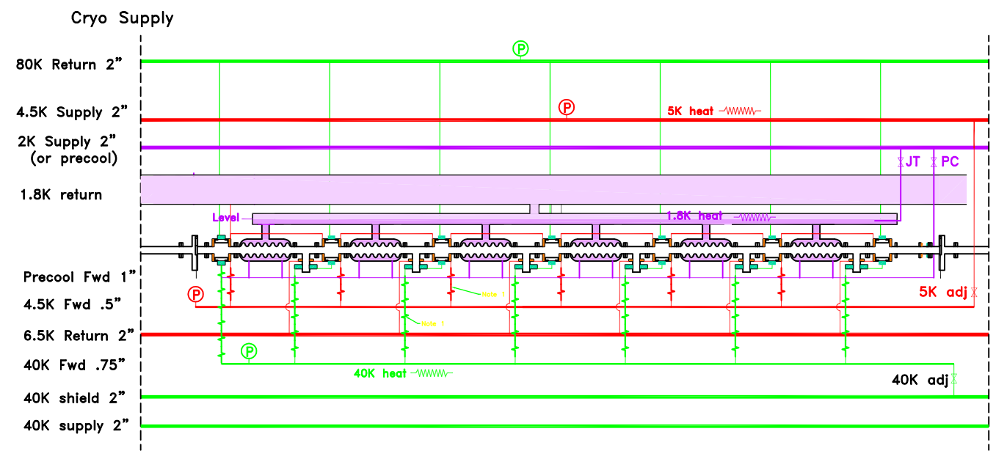
Cryogenic sketch of one Module
(as of today)

Slide 9
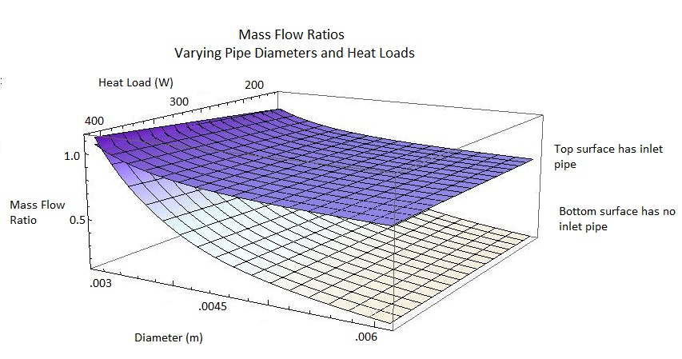
Investigation of Parallel Flows
Q₂
Q₁

Slide 10
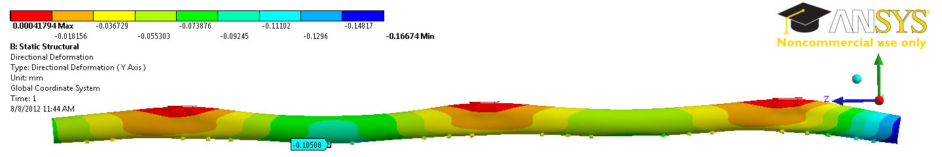
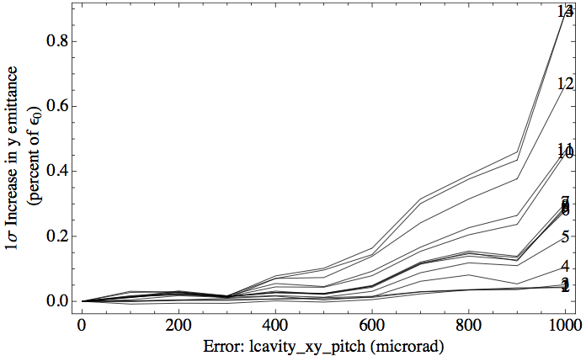
Structural analysis (II)
Max. 0.1 mm displacement
Cavity Alignment:
  Transverse offset (x,y)
    Baseline (1-σ): 0.5 mm
    Allowable (1-σ): 2 mm
  Pitch
    Baseline (1-σ): 1 mrad
    (0.8 mm over length of cavity)
    Allowable (1-σ): 1.5 mrad
    (1.2 mm over length of cavity)
Emittance growth due to cavity misalignment

Slide 11
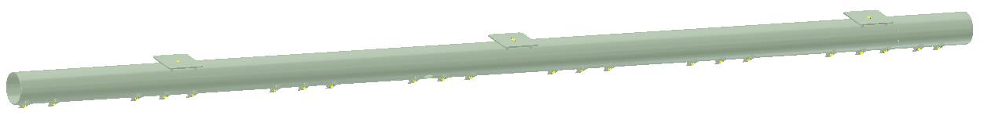
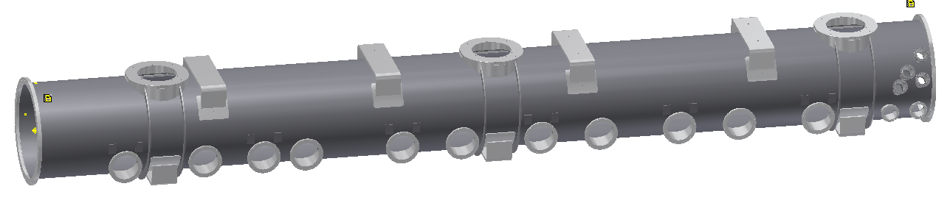
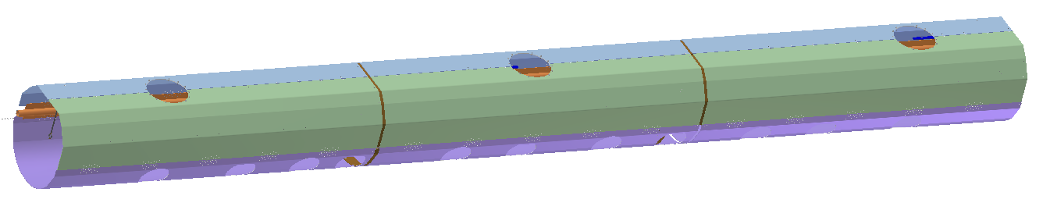
Structural analysis
1). Deformation/stress of HGRP under 1 ton beamline weight
2). Deformation/stress of vacuum vessel with 4 ton cold mass weight on 3 support posts
3). Mechanical stresses during cool-down process

Slide 12
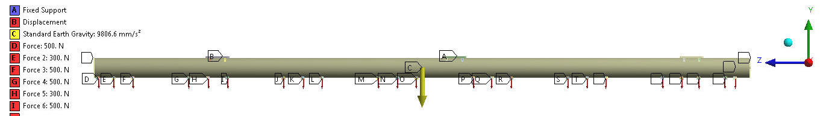
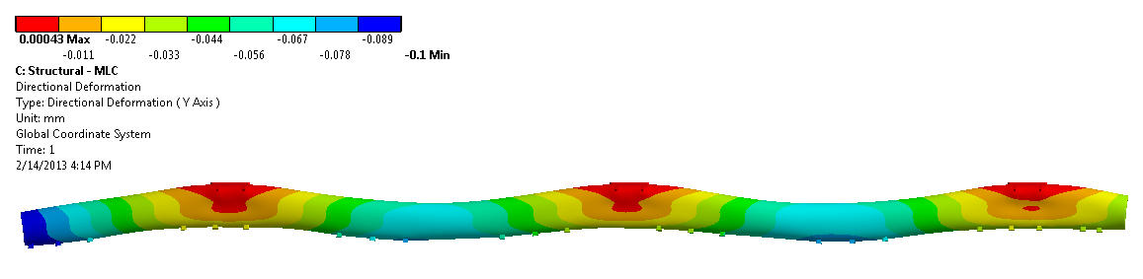
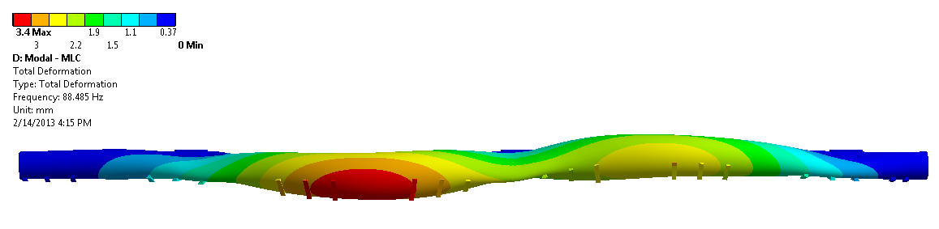
Structural Analysis of HGRP
∆Y = 0
Fixed
∆Y = 0
Beamline weight total 1 Ton
Max. displacement = 0.1 mm
Natural frequency ~ 88 Hz
Conclusion: enough supports

Slide 13
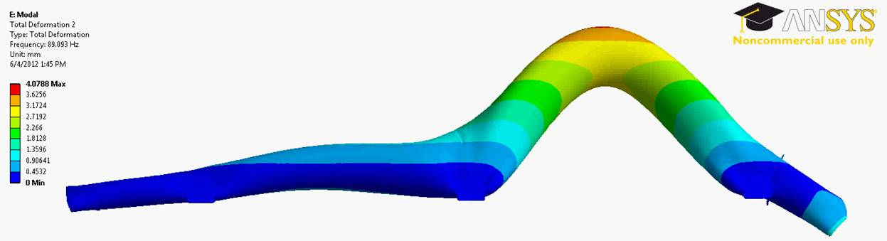
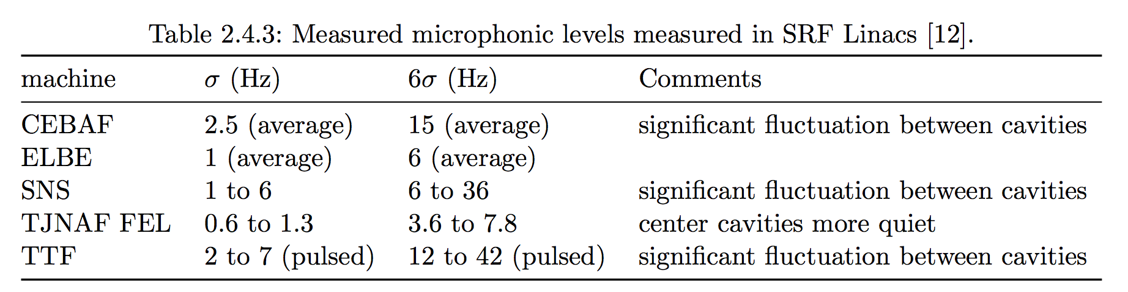
Structural Analysis
Natural frequency ~ 88 Hz
RF Power vs. detuning
(16.2 MV/m, Q_{ext}= 6.5e7)

Slide 14
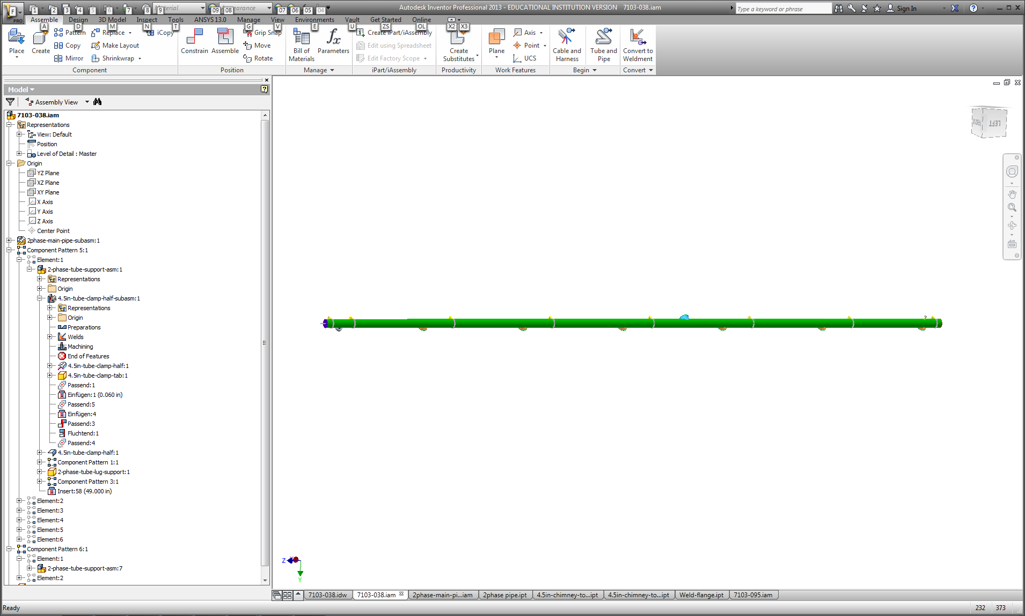
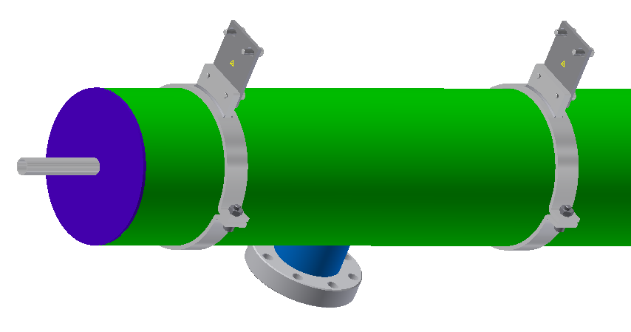
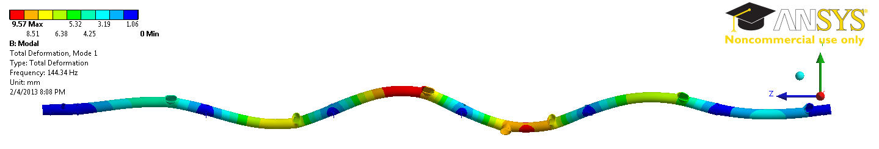
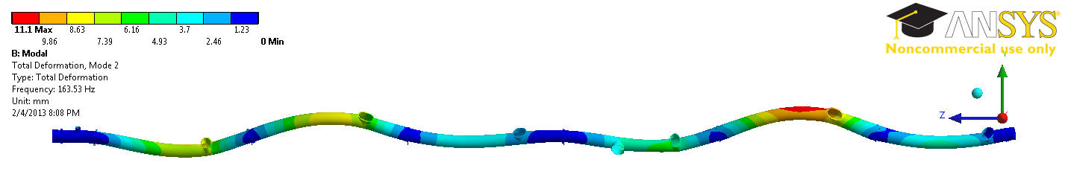
Modal Analysis of 2-Phase Pipe
Fixed supports (Qty. 8)
Material Ti Grade 2
Modulus of Elasticity: 102 GPa
Mode 1 @ 144 Hz
Mode 2 @ 164 Hz
Conclusion: enough supports

Slide 15
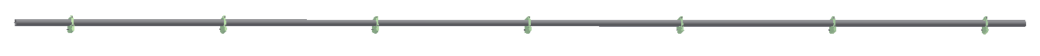
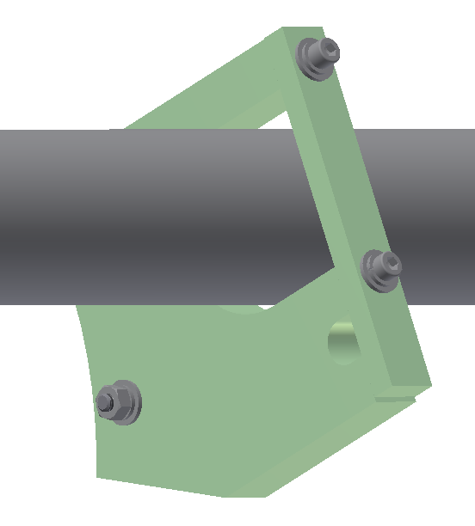
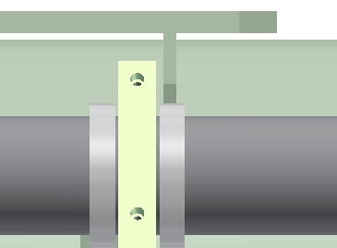
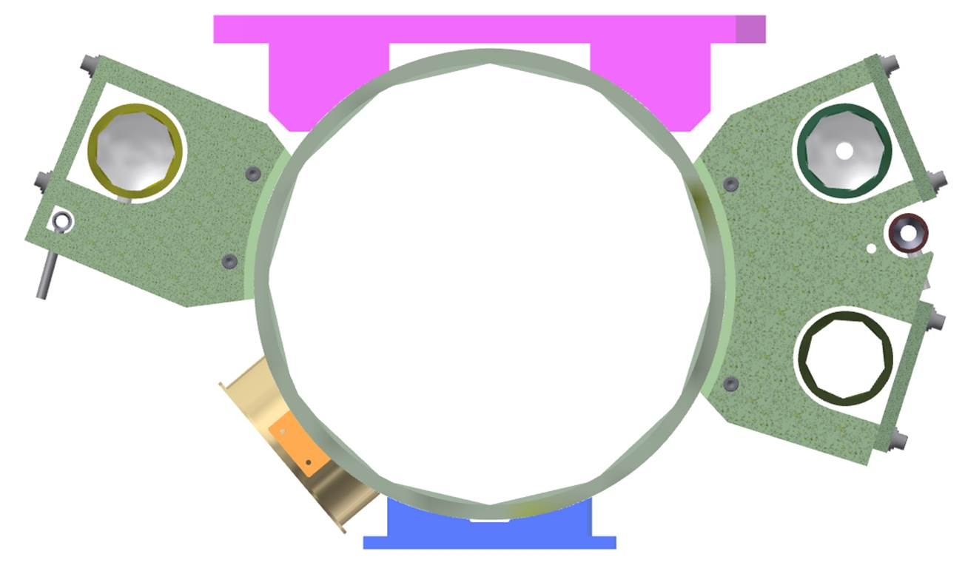
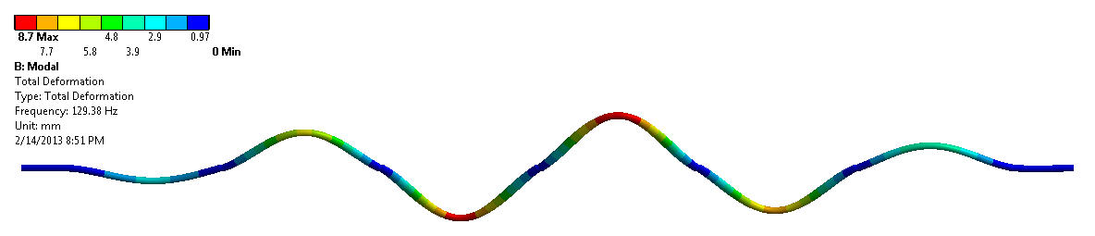
Modal Analysis of 4.5K Cooling Pipe
Fixed pipe support near cryo-valve
Six cylindrical supports
Fixed radial & tangential
Free axial
Natural frequency ~ 129 Hz
Fixed support near cryo-valve
of adjacent MLC
Same situation for 2K & 6K pipes

Slide 16
You name it
Which specific part of the CM should be analyzed for mechanical eigenmodes?
Strategies to minimize microphonics, do they come via the cryolines?
HGRP (Ti) tolerances is a cost driver
Best and cheapest way to stress-relief?
Experience of weld cracking during cooldown?
Carbon steel vessel demagnetization?
Managing parallel cryogenic flows (expected heat-load for HOMs is 0-400 W, cooling is in parallel)?

