Slide 1
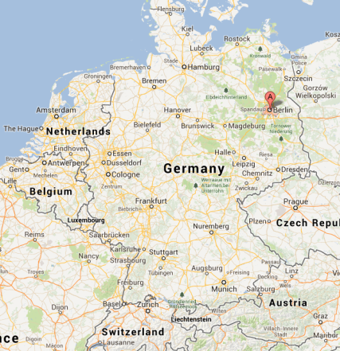
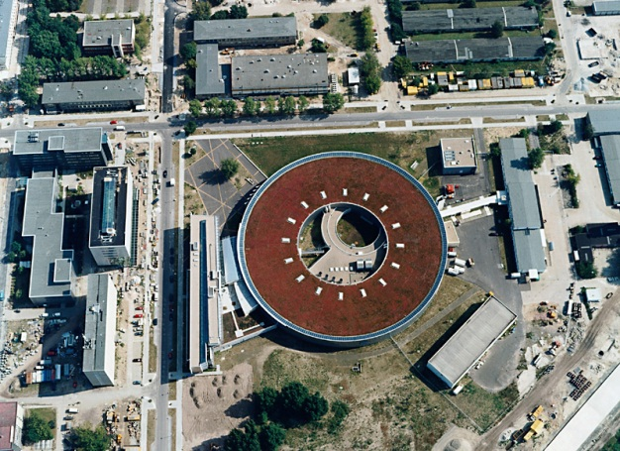
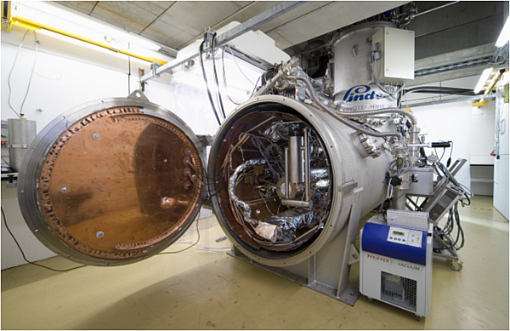
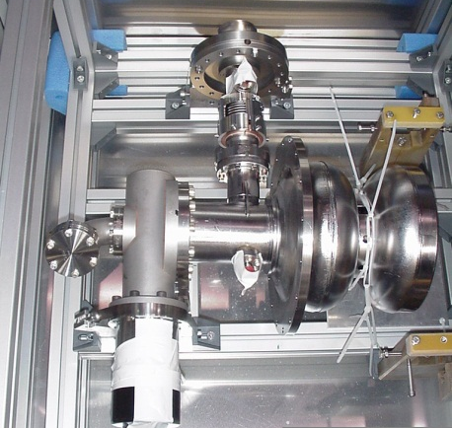
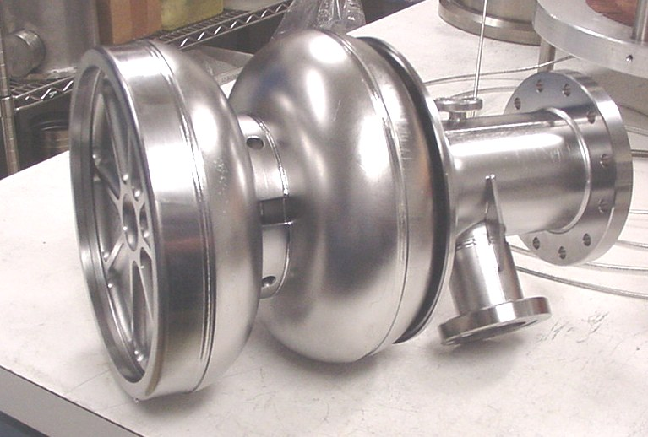
CW SRF Photoinjector Experience at HZB
Andrew Burrill for the HZB Team

Slide 2
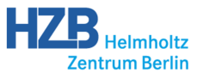
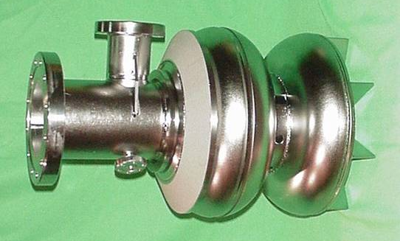
Motivation
HZB is building a 50 MeV, 100 mA c.w. ERL that will utilize a SRF photoinjector with a CsK₂Sb photocathode.
How do we try to ensure success?
A multi-stage SRF photoinjector development program.
  4 x 1.3 GHz SRF photoinjectors will be tested
  Gun 0.1 and Gun 0.2 are 1.5 cell 1.3 GHz guns utilizing a Pb photocathode
    Gun 0.1 – back wall Pb coated
    Gun 0.2 – removable Nb plug Pb coated
    Collaboration with DESY, JLab, BNL, NCBJ
  Gun 1 (1.4 cell 1.3 GHz – CsK₂Sb photocathode) –in fabrication
  Gun 2 (1.X cell 1.3 GHz – CsK₂Sb photocathode) –in design
    Addition of 115 kW input couplers

Slide 3
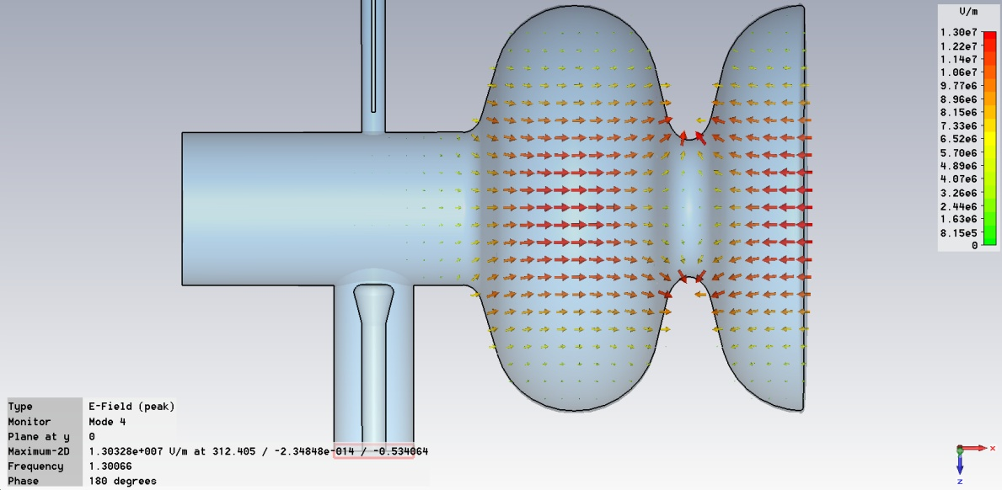
First step: SC RF Gun0
Pick-up probe
Excited π-TM₀₁₀ mode
Original design by
Jacek Sekutowicz
Lead cathode,
T_{c}= 7.2 K
TTF-III FPC: Q_{L}= 1.10⁹-6.10⁶
including 3-stub tuner
Input coupler
EM design: Highest fields at
cathode region
SC lead cathode on half-
cell backwall: QE_{Pb}~10.QE_{Nb}
Study beam dynamics at short
pulses, ERL parameter range
Frequency π-mode | 1300 MHz
E_{peak}/E_{acc} | 1.86
H_{peak}/E_{acc} | 4.4 mT/(MV/m)
Geometry factor | 212.2 W
R/Q (linac, b=1) | 190 W
Sekutowicz et al., Proc. PAC 2009

Slide 4
Gun 0 - Test Plan
Install the photoinjector in HoBiCaT
  study RF properties, Q vs. E, LLRF, microphonics, operation with TTF-III coupler, SC solenoid, steering magnet
Connect a diagnostic beamline
  Stripline BPM, 2 Faraday Cups, viewscreens and THZ diagnostics
Study the cathode
  measure QE, QE map, emission surface, thermal emittance and dark current before and after laser cleaning
Learn how all the systems work
Determine what needs improvement for Gun 1 & 2
Repeat

Slide 5
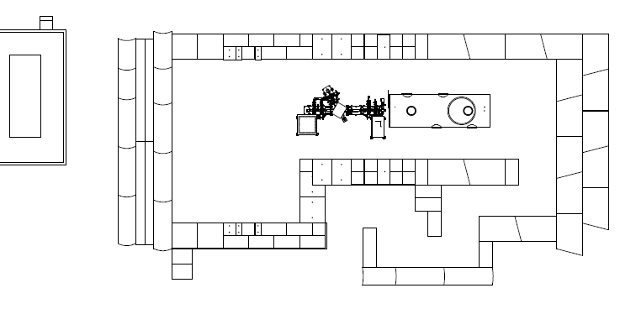
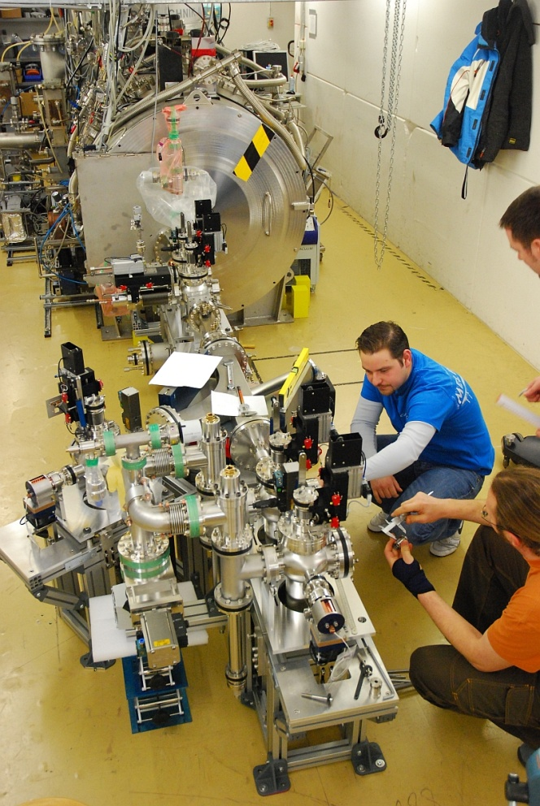
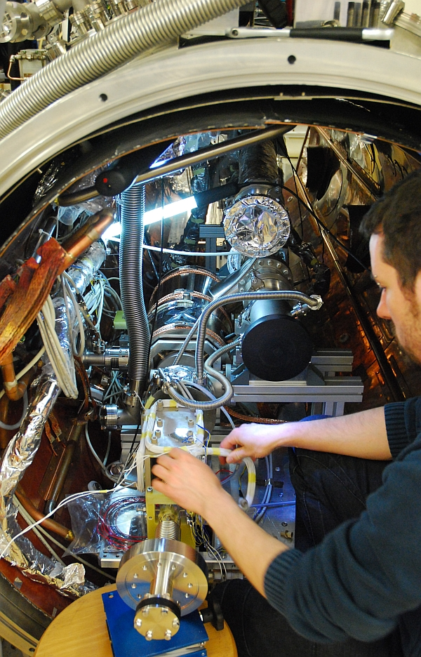

Extension of the HoBiCaT Cavity Test Facility
Laser
hut
Laser beamline
C
o
n
t
r
o
l
ro
o
m
HoBiCaT cryostat
Diagnostic
e- beamline

Slide 6
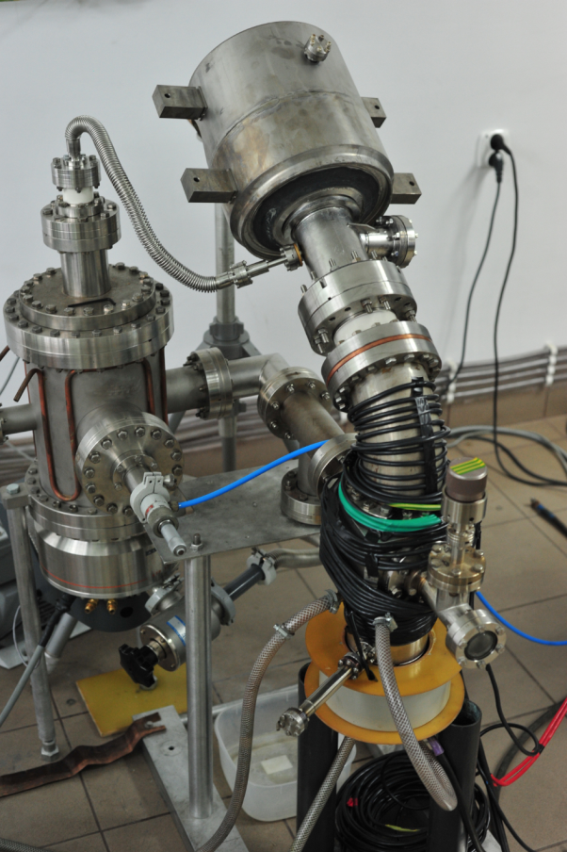
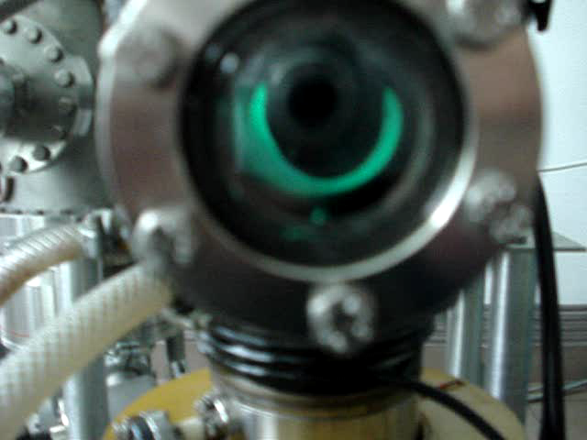
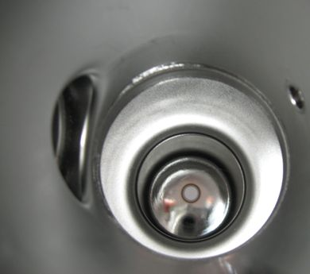
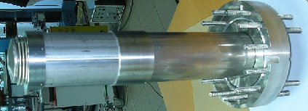
Cathode deposition at NCBJ (formerly IPJ Andre Soltan Swierk)
Cavity without helium vessel
Plasma arc
depositon setup
in 30° configuration
16 x 5min depositions result
in a few hundred nm thick
Pb cathode film
P. Strzyzewski et al.,
Phys. Scr. T123 (2006)
Cavity with helium vessel
Pb cathode film
Final diameter
by BCP + special
mask: 5 mm
Mask to protect cavity
R. Nietubyc

Slide 7
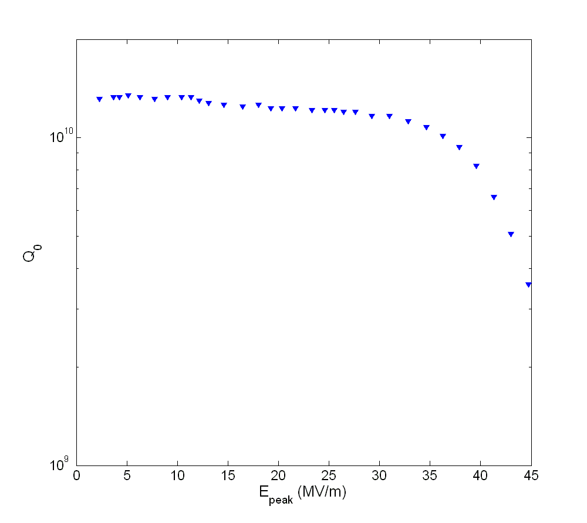
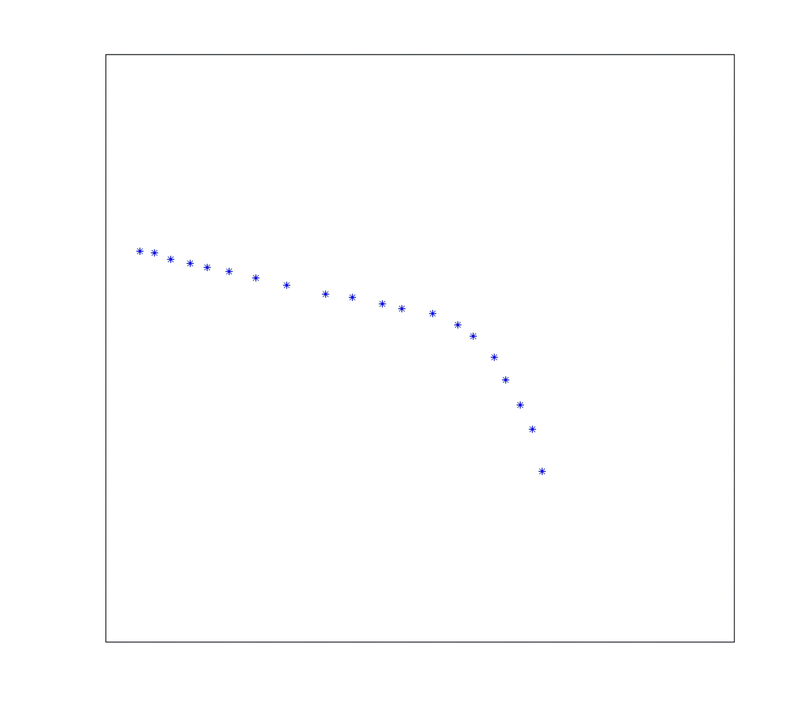
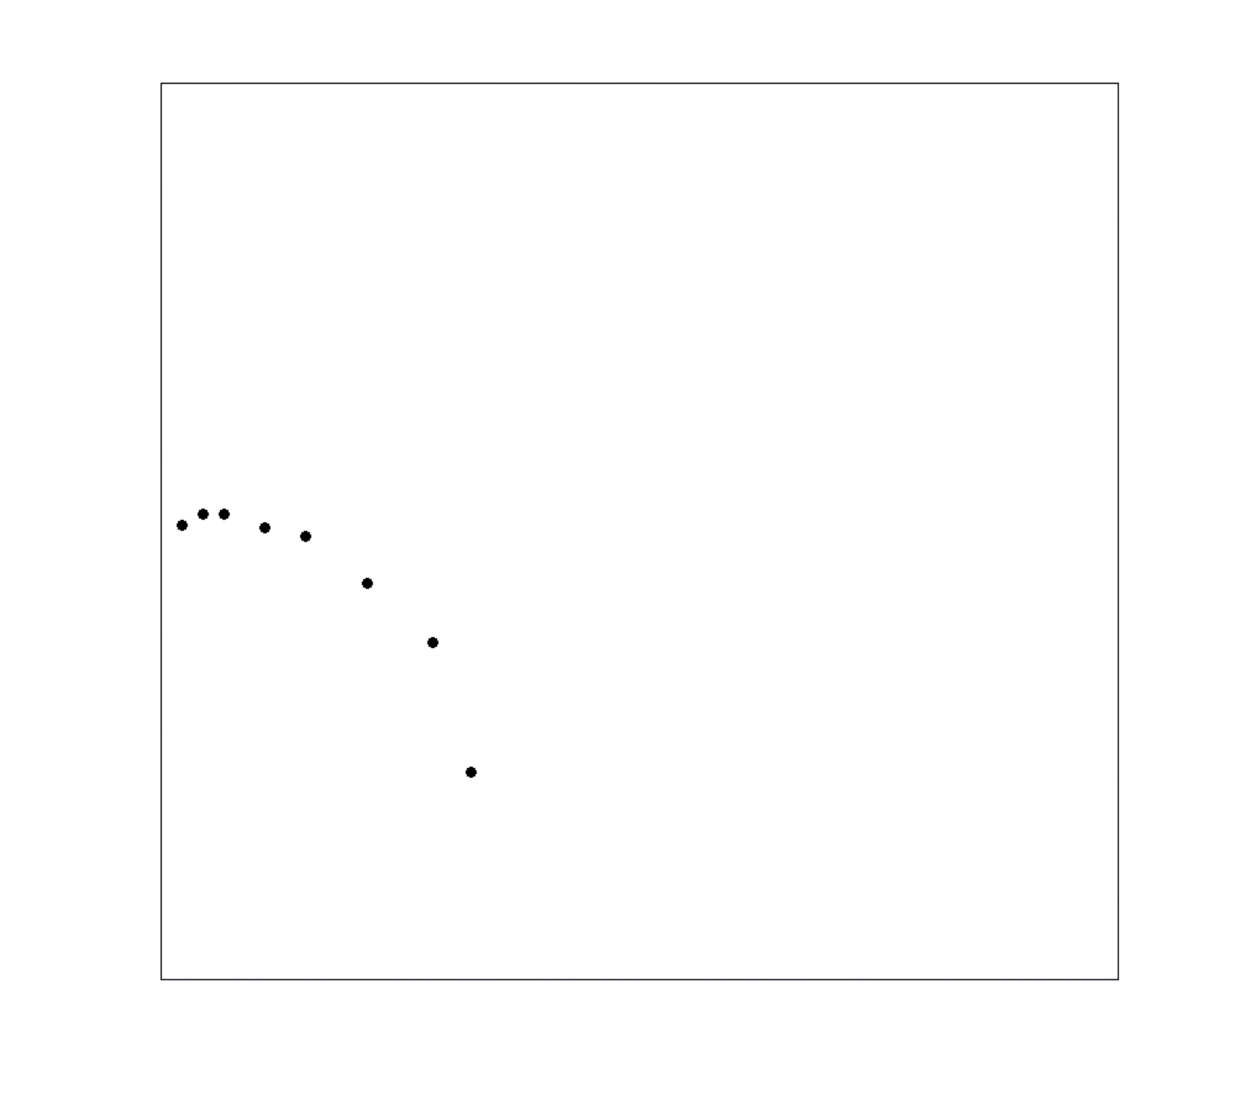
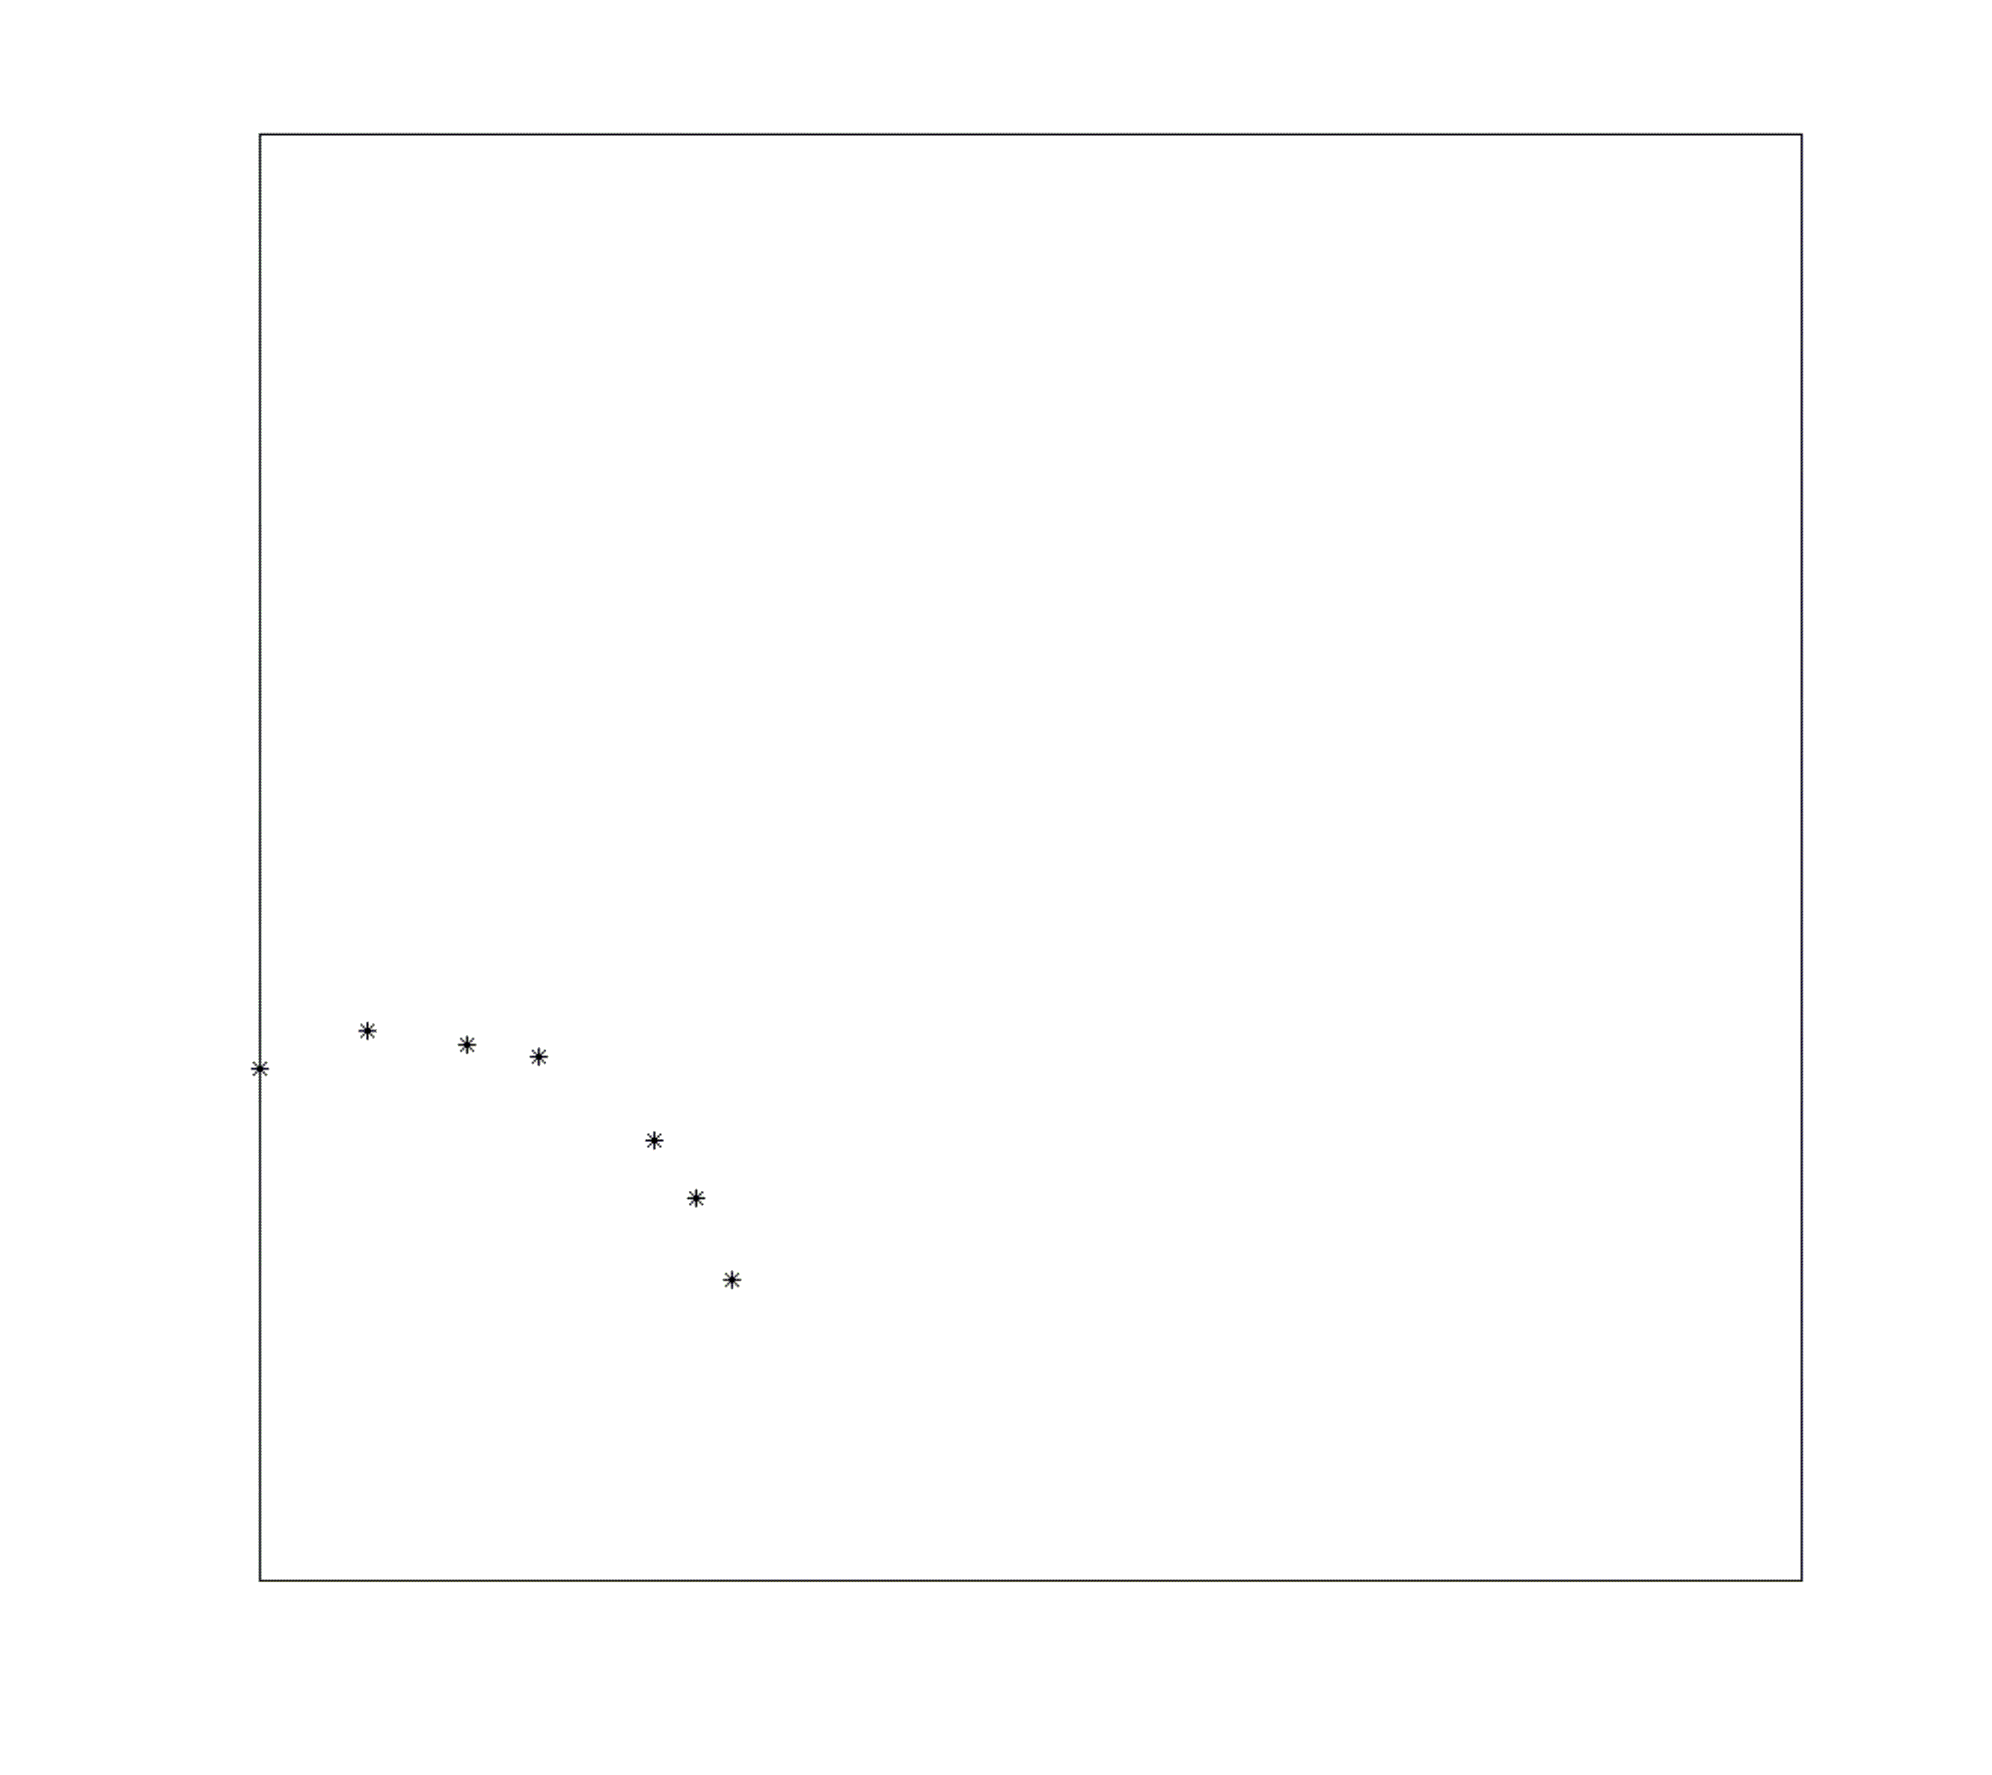
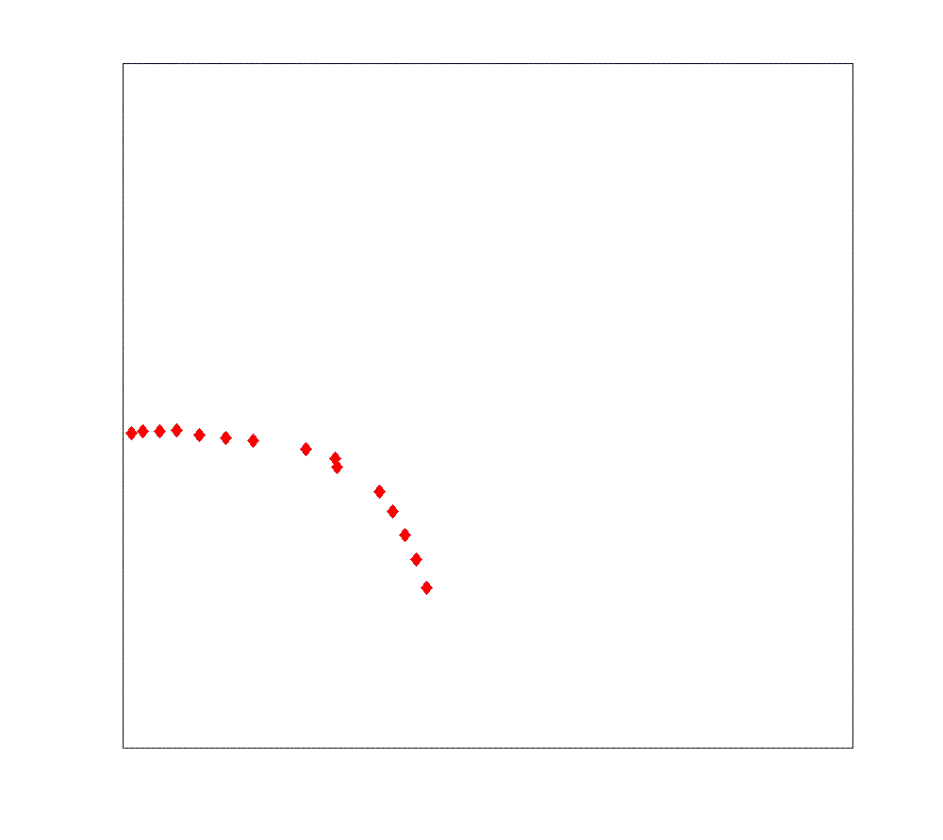
Gun 0.1 RF measurements: Vertical and Horizontal tests (JLab and HZB)
Vertical test after fabrication,
treatment and mounting Q₀>1.10¹⁰
for E_{peak}<35 MV/m
w/o cathode
After lead deposition Q drops
significantly and field emission (FE)
onset lowered
+ cathode
Cavity was then vented, assembled
with TTF-III coupler and sent to HZB
Installation in HoBiCaT further
Q degradation, FE onset 12 MV/m
After additional cooldown cycle
even worse, cavity collects residual
gases?
horizontal
Excimer Laser cleaning
of lead cathode
increased onset of FE to 15 MV/m
Note: Horizontal RF tests at β_{c}~3-4, error bar!
A. Neumann et al., SRF 2011

Slide 8
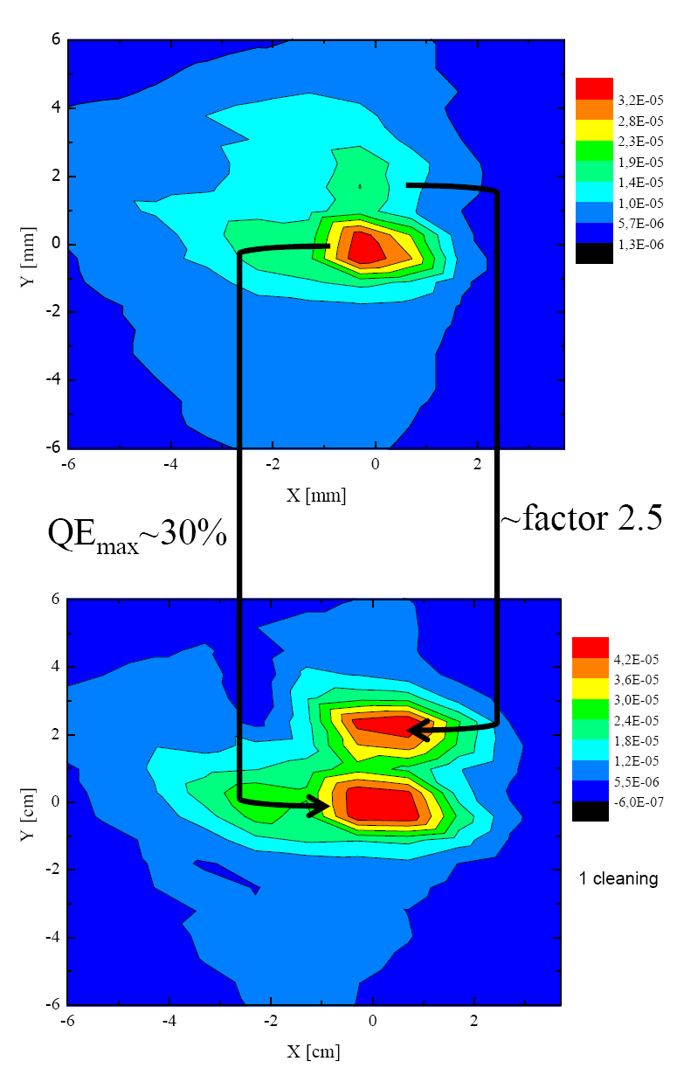
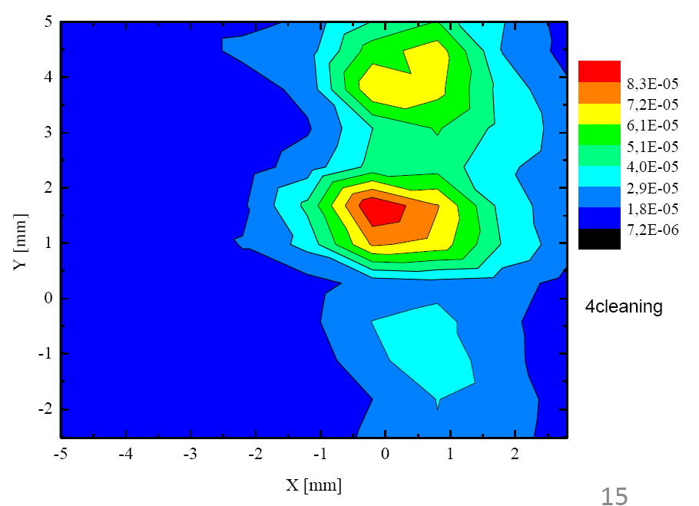
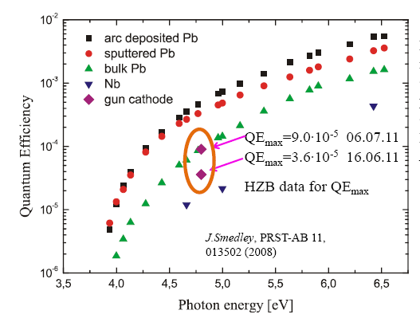
Improvement of QE after laser cleaning and RF processing.
Laser cleaning required to control state of the cathode surface, as contaminants increase work function and lower QE
KrF excimer laser at 248 nm with 0.045 mJ/mm² to 0.23 mJ/mm². Each round consisted of 300.000 shots in 10 min.
Found that laser cleaning improves QE, lowers workfunction and moves dark current onset to higher gradients
pre
cleaning
after
4th round
10⁻⁵
after
1st round
R. Barday et al., Proc. of PSTP 2011

Slide 9
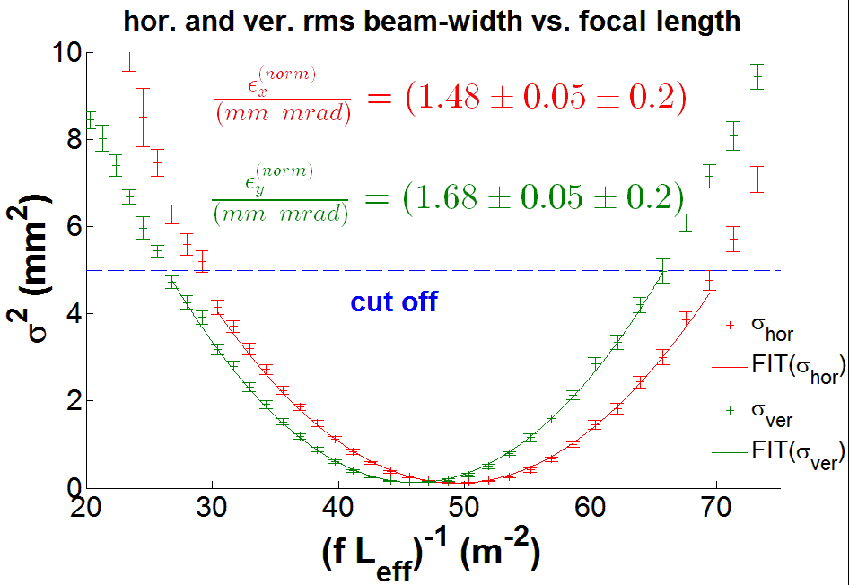
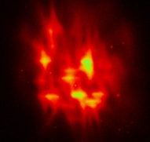
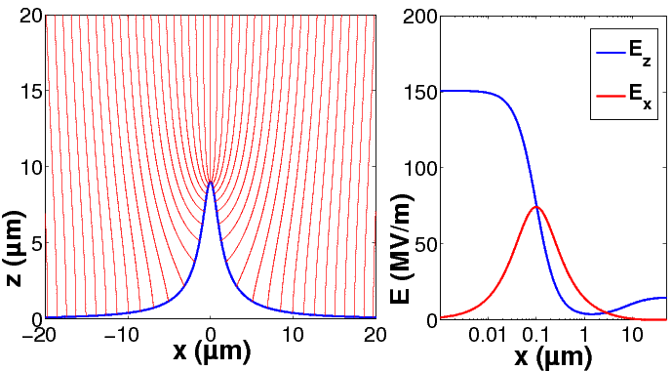
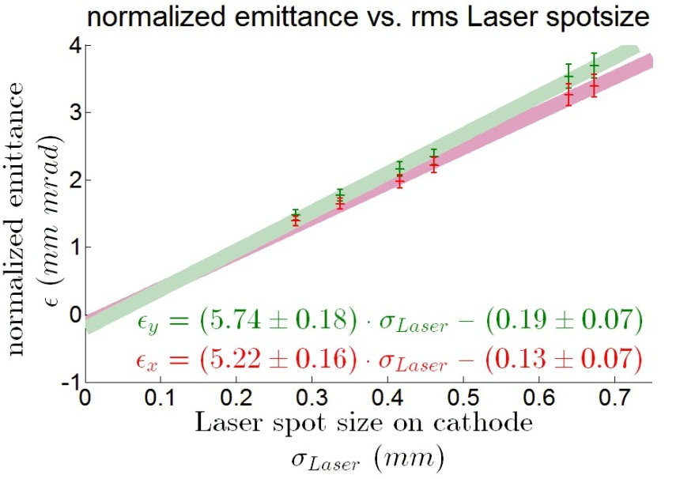
Results from emittance measurements
Measured emittance scaling with laser spot size by solenoid scan technique.
Emittance contributions from space charge, aberrations, & astigmatism.
Setup model to estimate effect of irregular surface: local QE variation and presence of droplets and protrusions.
Protrusions cause longitudinal field enhancement and transverse defocusing field.
Findings: Emittance is dominated by beam expansion due to transverse field of these protrusions.
Emission spot imaged with solenoid on first view screen
J. Völker, Master thesis, HU Berlin, 2012

Slide 10
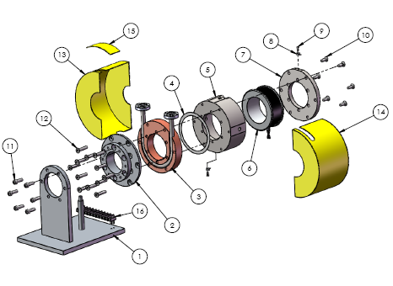
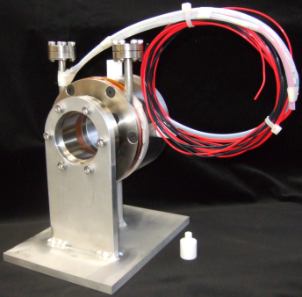
Superconducting Solenoid Experience
Conduction Cooled by 1.8K
Fixed position (no mover for Gun0.1)
Lessons learnt from Gun0.1
  Cooling issues: solenoid got warm for current I > 5 A, OK for operation between 2…3 A – due to incoming leads in vacuum with poor heat intercept.
  Field shape: rather short effective length (low L/R) → spherical aberrations.
  Alignment issues: Solenoid movers required for beam based alignment

Slide 11
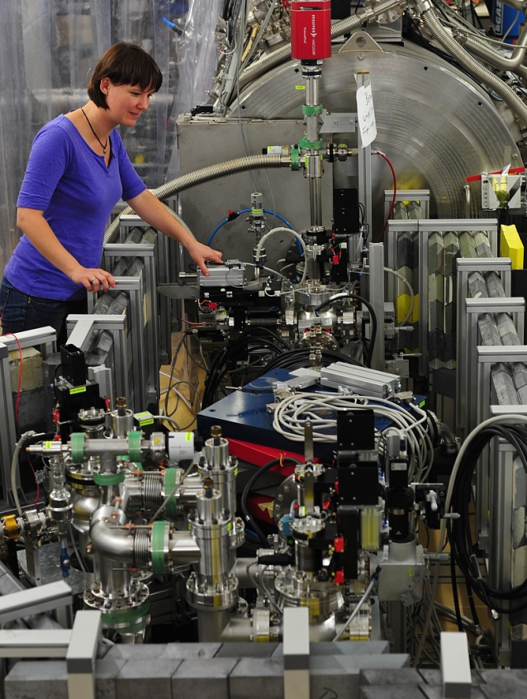
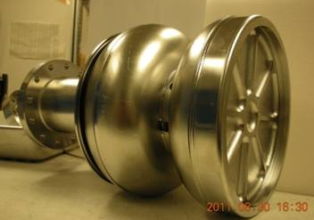
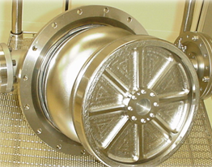
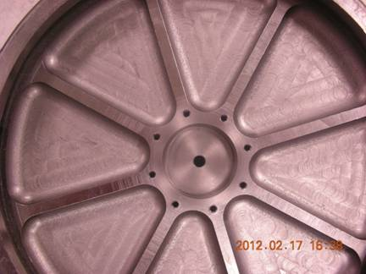
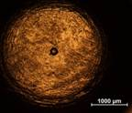
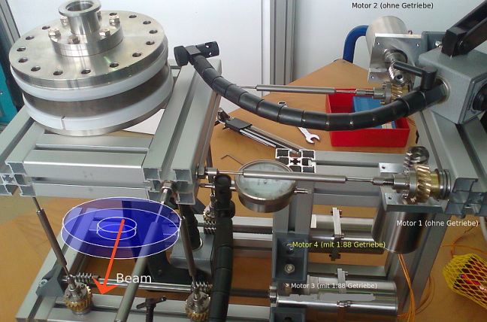
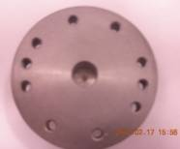
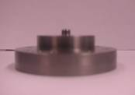
Gun0.2: Upgrades and modifications
Modifications cavity 0.1 → 0.2
Introduce Stiff back plate (30 mm thick) with opening for Nb cathode plug.
LHe vessel demountable.
Saclay-style tuner push/pull rear wall.
JLab
NCBJ
back wall
Upgrade beamline:
Installed solenoid mover allowing beam based alignment.
Replaced uncoated Ce:YAG screens with ITO coated Ce:YAG to avoid charging up phenomena.
Included slit mask in first cross for phase space measurements.
Put in segmented Faraday cup in dispersive arm to improve energy resolution.
Sol mover
A. Frahm
plug

Slide 12
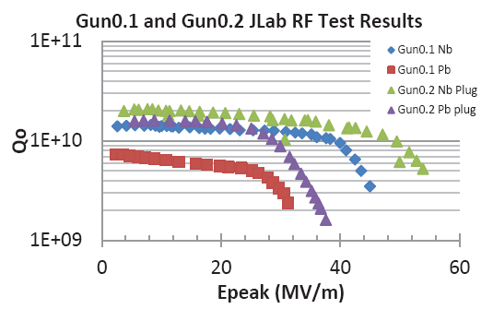
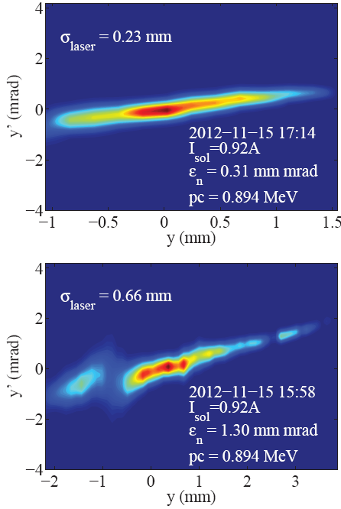
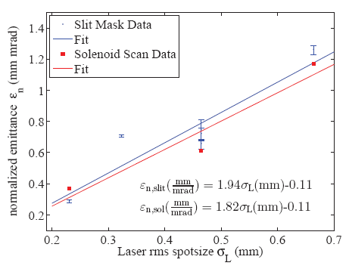
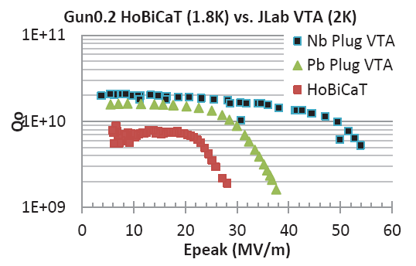
Gun0.2 RF and beam measurement results
Removable cathode plug helps decoupling cavity treatment (HPR, BCP) and cathode preparation.
RF processing increased achievable peak field from 20 to 28 MV/m, limited by field emission and quench.
Qo performance decrease at HoBiCaT due to lack of magnetic shielding and cold leak.
Measured emittance with solenoid scan and slit mask, phase space with slit mask.
Emittance of 0.2 three times lower than 0.1, improved cathode surface with less protrusions. Shorter arc and slit aperture avoid formation and reach of micro-droplets
A. Burrill, et al., Proc. of IPAC 2013, WEPWO002
M. Schmeißer, et al., Proc. of IPAC 2013, MOPFI002

Slide 13
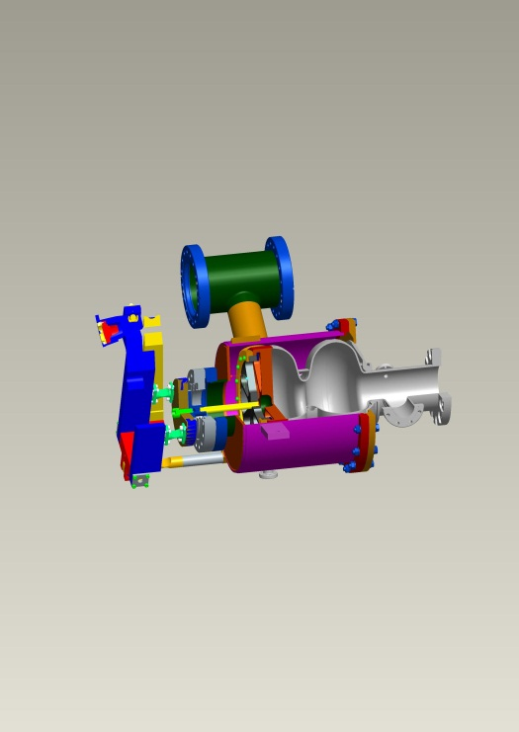
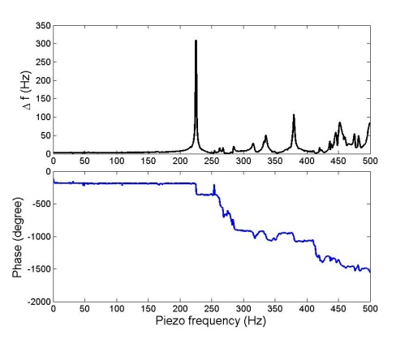
Gun0.2 Tuner and microphonics
By adding a Saclay style tuner to Gun0.2 we were better able to lock the laser to the LLRF and cavity.
Tuner range was found to be linear
Transfer functions measured at various power levels, cavity appears very stable.

Slide 14
Operating Experience Summary
Several successful and insightful runs have been carried out with the Pb/Nb gun
Cavity RF performance suffers compared to VTA
  Magnetic shielding
  Cold leak
  Contamination
Beamline diagnostics worked very well
Solenoid mover helps with beam based alignment
  Care needs to be taken in solenoid design and heat intercepts
  Steering magnet also critical to getting beam out of gun
Pb cathode demonstrated and results closely match those from the cathode test system
  Laser cleaning works as expected, QE slightly lower than the bench measurements
  Cathode surface critical to emittance and dark current minimization
  Cathode plug greatly improves cleaning and sputtering processes.
Cavity tuner works well, LLRF control of cavity functioned as expected.
By addressing these items this Gun could be used as a long term electron source for a low average current application

Slide 15




Acknowledgments
Thanks to our collaborators
Thanks to A. Neumann and T. Kamps for their slides
Thank you.
The End!

Slide 16
Extra Slides

Slide 17
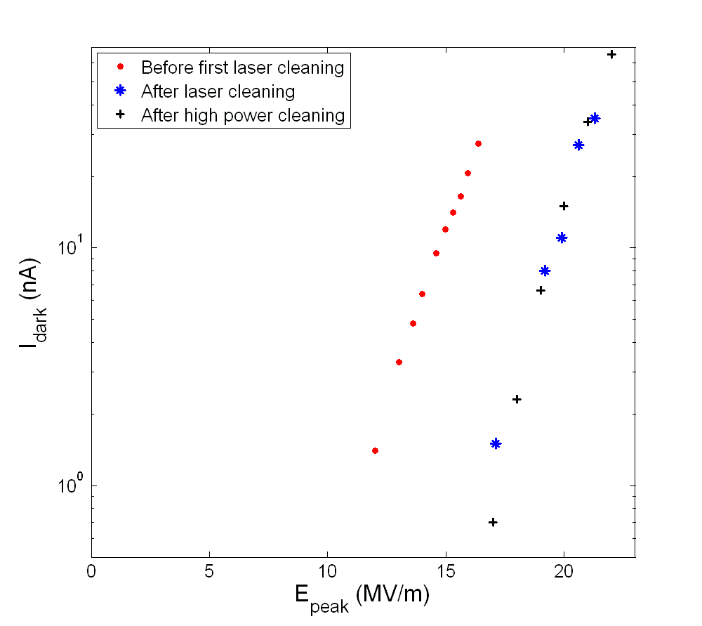
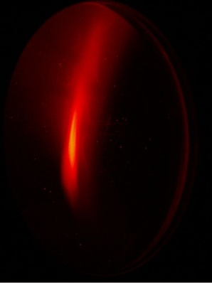
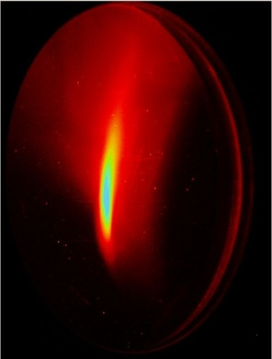
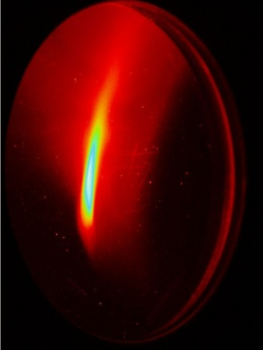
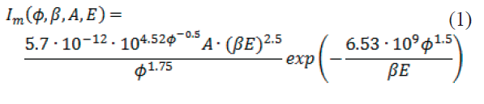
Gun 0.1 Dark current studies
14.6 MV/m
15.0 MV/m
15.6 MV/m
Dark current focussed by SC solenoid before laser cleaning
15.9 MV/m
16.4 MV/m
First laser cleaning treatment of cathode
increased onset level of field emission!
Fowler-Nordheim fit of dark current/field emission shows reduction of field enhancement factor β_{NF}.
Effectively emitting tip area, A_{e,} increases

