Slide 1
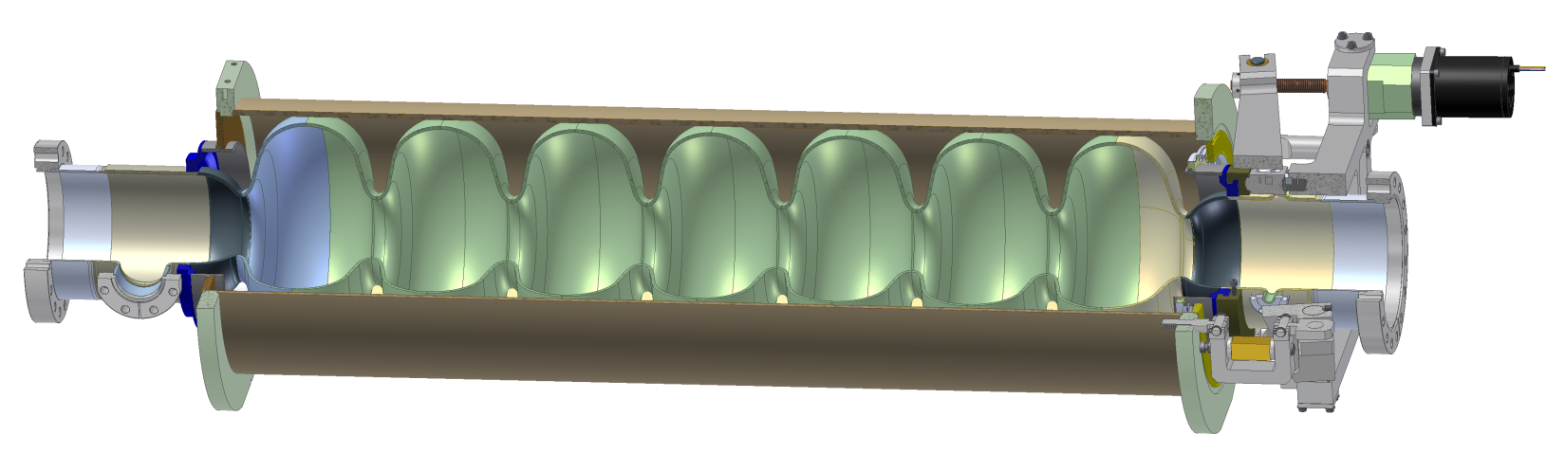
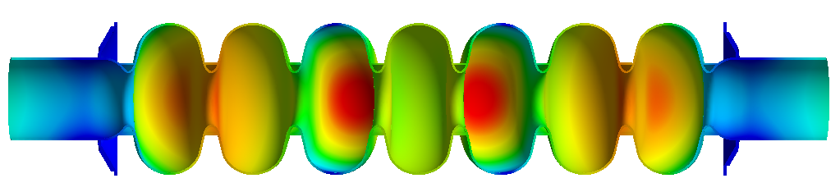
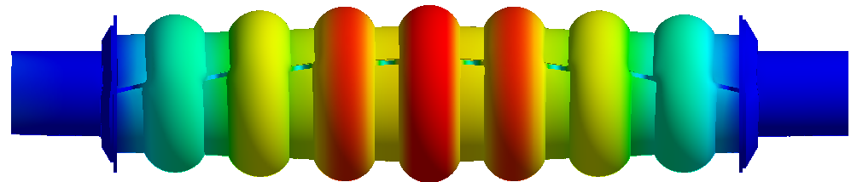
Cornell Main Linac Cavity Mechanical Optimization
S. Posen and M. Liepe, Cornell University
CW TTC Meeting 2013, Ithaca, NY
12 June 2013
S. Posen and M. Liepe. “Mechanical optimization of superconducting cavities in continuous wave operation,” PRST-AB, 15, 022002 (2012). http://prst-ab.aps.org/abstract/PRSTAB/v15/i2/e022002

Slide 2
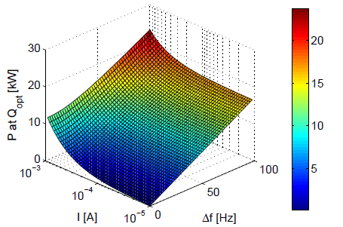
Consequences of Microphonics
In high Q_{L} CW SRF linacs, small pressure variations in He bath can detune cavity on the order of the loaded bandwidth
The cavity requires more power from RF source when detuned
RMS detuning determines wall power
Peak detuning determines required RF source size: if not enough power is available, cavity trips 50% of time (LFD compensates one way)
Power to maintain design gradient for Cornell ERL main linac cavity

Slide 3
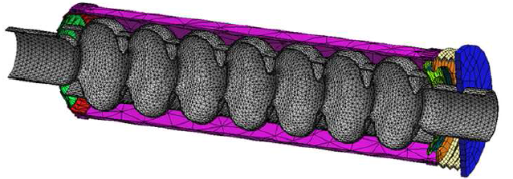
Microphonics Simulations
Using ANSYS, small pressure variations were simulated and resulting Δf found
Next slide: plot of Δf for Cornell ERL main linac cavity for various stiffening ring radii, tuner stiffnesses, and wall thicknesses

Slide 4
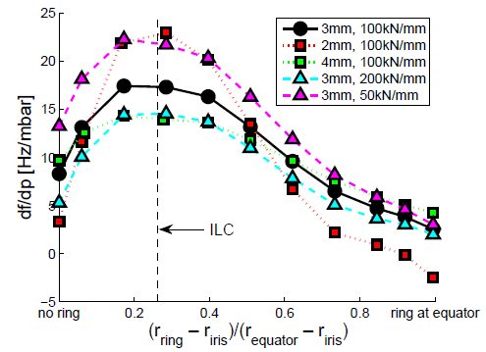
Microphonics Simulations
ILC: restricting iris movement good for LFD, bad for df/dp
For very thin walls, df/dp = 0 conceivable
Stiffer tuner is better
stiffening ring radius, presented as a fraction of the iris-equator distance
Large diameter rings or no rings -> smallest df/dp

Slide 5
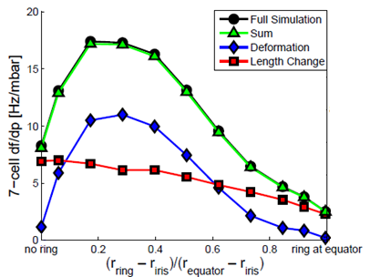
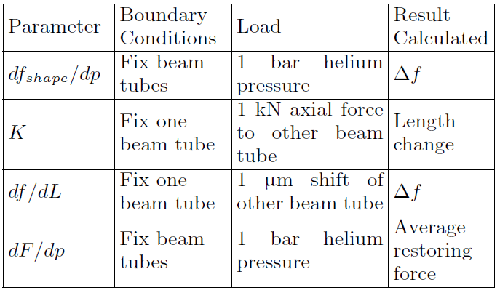
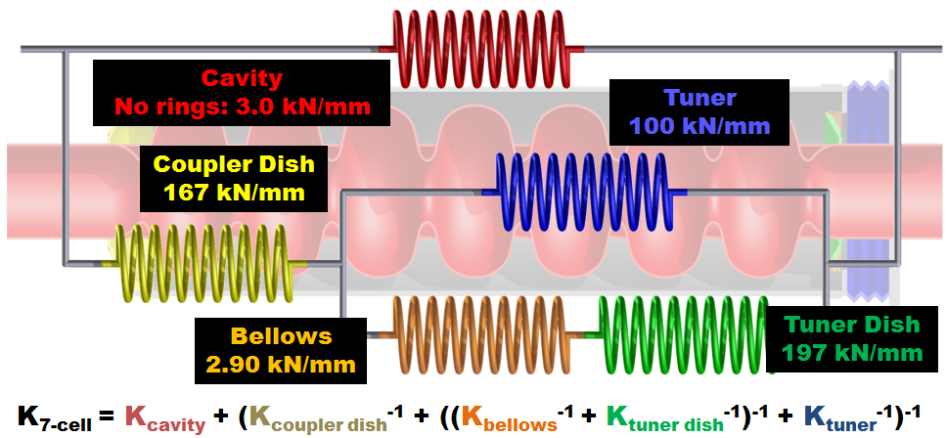
Components of df/dp
Spilt df/dp into two parts:
Expand second term:
Breakdown agrees with full simulation
ANSYS simulations can give all these parameters!

Slide 6
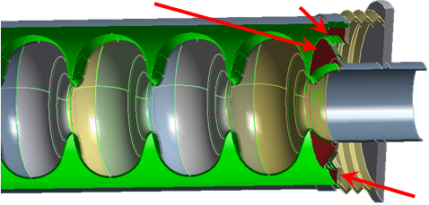
Components of df/dp
Length change component can be understood as follows:
  dF/dp: pressure on ends of He vessel creates force pulling cavity apart
  K: System stiffness determines cavity length change
  df/dL: Change in frequency is linear with length
Simluations show p on cavity does not contribute strongly to dF/dp—endwalls biggest effect
Enddish
Bellow
Helium Tank Ring
Stiffness of tuner and opposite endwall are especially important!
If df/dp_{shape} is negative, can cancel with length term. Otherwise, must minimize these terms!

Slide 7
Designing an Elliptical Cavity / He Tank / Tuner Assembly for High QL CW Applications
Assuming df/dp_{shape} is positive (or negative but small compared to df/dp_{length}):
Consider choosing a tuner that sits at the end of the helium vessel (next slide)
Try to minimize diameter of helium tank bellows (next slide also)
Use simulation to determine effect of endwall stiffness → tradeoff between df/dp and ease/cost of construction
Optimize stiffening ring radius via simulation
Plan welding carefully

Slide 8
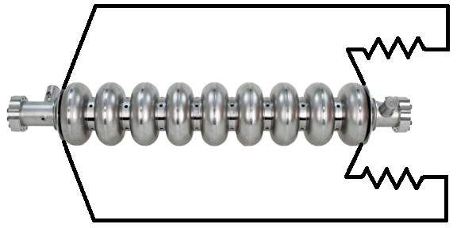
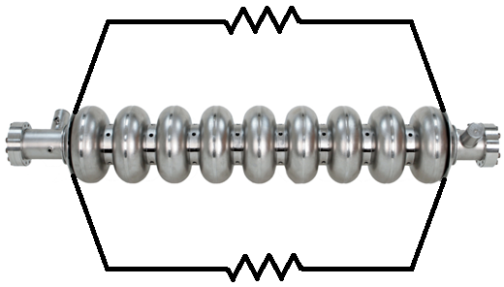
P_{He} produces force on He-vessel
Assumptions
  Same diameter He vessel
  He vessel is stiffer than the tuner
End type will generate less force on the tuner than center type → smaller df/dp
Smaller bellows enhances effect
Bellows diameter
P_{He} produces force on tuner
End Type Tuner, e.g. Saclay
Center Type Tuner, e.g. Blade
P_{He} produces force on tuner

Slide 9
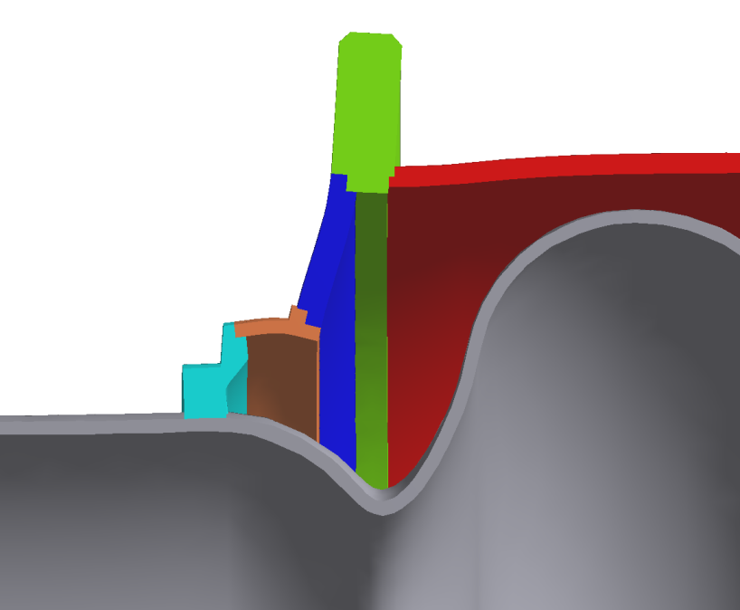
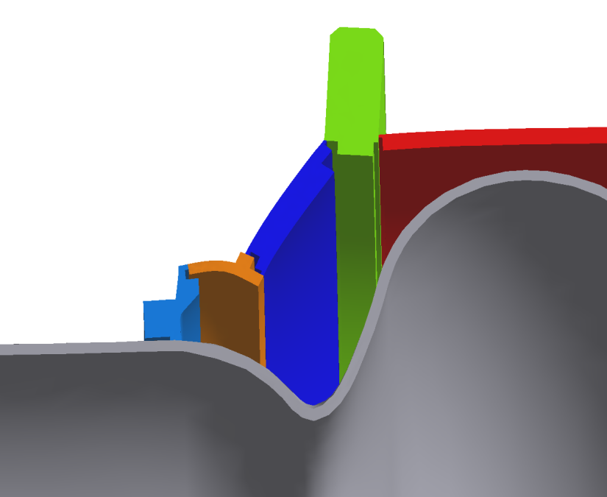
Pay Attention to Key Welds
Oversimplifying model can cause underestimate of df/dp
If weld is done only on outside of He-vessel, stiffness will be less than simulation with surface bonded constraint
Ideal Welds
df/dp = 8 Hz/mbar
Realistic Welds
df/dp = 24 Hz/mbar

Slide 10
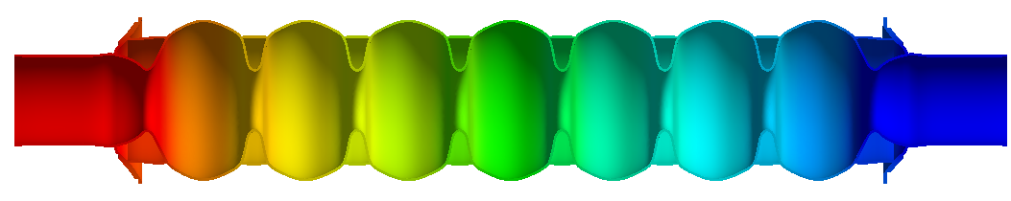
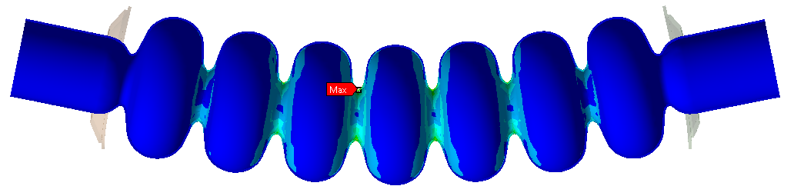
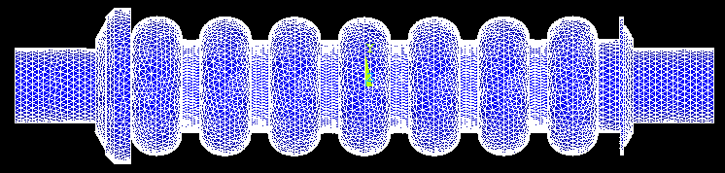
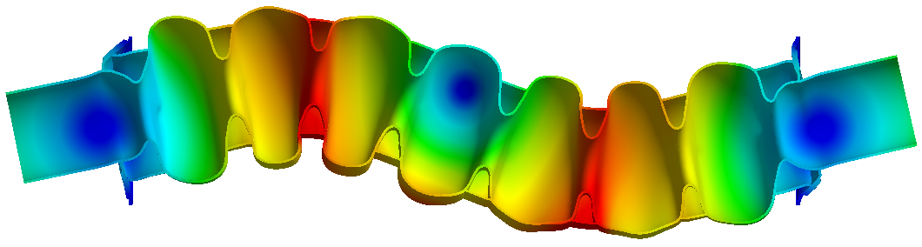
Other Considerations
Required force from cold tuner (no rings: smaller F)
Vulnerability to deformation during handling (large rings: less vulnerable)
Mechanical resonance frequencies and their effect on active microphonics compensation (large rings: higher frequencies)
Cost of fabrication (no rings less expensive)
Lorentz force detuning

Slide 11
Conclusions
No rings and large rings have similar df/dp, and no clear winner based on other considerations
For Cornell ERL, we have built prototype cavities of both types! We will study if advantages of rings are worth cost
With careful mechanical design, df/dp can be minimized, but details are important!
  Entire system is important, not just cavity
  Size of stiffening rings, position and diameter of tuner bellows are important
  Welds!

Slide 12
Acknowledgements
Special thanks to Vadim Veshcherevich, Roger Kaplan, John Dobbins, Peter Quigley (Cornell), Rick Fisher (ANL)
Authors of previous work on low-beta cavities, for example: J. Holzbauer, E. Zaplatin, L. Ristori, Z. Conway, A. Facco

