Slide 1
Cornell ERL Main Linac
Cavity RF Design
N. Valles, M. Liepe, V. Shemelin
Cornell University

Slide 2

Cornell ERL Overview
ERL@CESR, Cornell
5 GeV, 100 mA CW beam
  8 pm emittance, 2 ps bunch length
Stable operation
  Strong HOMs can cause beam breakup
  ~200 W HOM power in beamline loads/cavity
CW operation
  Q(1.8 K) = 2x10¹⁰ @ 16.2 MV/m
    10 W cryogenic loss from fundamental/cavity
    ~4 MW wall power
Cornell Energy Recovery Linac Project Design Report
Editors: G. Hoffstaetter, S. Gruner, M. Tigner

Slide 3
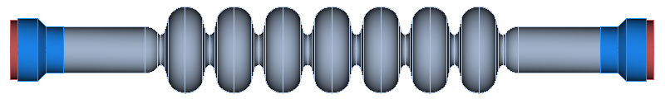
Cavity Design Overview
Goal: Maximize I_{th} > 100 mA (under constraints)
Notes:
Cavity design began from a design that minimized the cryogenic load due to the fundamental mode of the cavity.
As always however the main goal to keep in mind is to maximize Ith, under constraints
1st step is to parameterize the model. If we model each half cell by 4 ellipse parameters and an aperture parameter, the 14 half cells would be described by 70 parameters, then adding in 5 parameters to describe the beam tubes and transistion to the cavity would result in a 80 parameter optimization. This would be hard and mean that most of our time would be spent changing variables that don’t matter. So instead of taking a brute force approach, we attacked the problem more intelligently.
Center cells
Geometries are (nominally) identical
Responsible for general properties of HOM spectrum
Controls frequencies of HOM passbands and dispersion relations
Iris aperture determines cell-to-cell coupling and how sensitive HOM spectrum is to variation in cell shape
End cells
Assymetric design allows RF power to flow out to loads
Responsible for effectively coupling HOMs to HOM load
Directly controls quality factors of HOMs
Beam Pipe
Should be short enough to strongly couple to HOMs but long enough to avoid dissipating too much power from the fundamental mode
HOM load
Absorber material properties determine specific mode losses.

Slide 4
Cavity Design Overview
Goal: Maximize I_{th} > 100 mA (under constraints)
Center cells
  Geometries are (nominally) identical
  Responsible for general properties of HOM spectrum
    Controls frequencies of HOM passbands and dispersion relations
    Determines cell-to-cell coupling and how sensitive HOM spectrum is to variation in cell shape
Notes:
Cavity design began from a design that minimized the cryogenic load due to the fundamental mode of the cavity.
As always however the main goal to keep in mind is to maximize Ith!
Center cells
Geometries are (nominally) identical
Responsible for general properties of HOM spectrum
Controls frequencies of HOM passbands and dispersion relations
Iris aperture determines cell-to-cell coupling and how sensitive HOM spectrum is to variation in cell shape
End cells
Assymetric design allows RF power to flow out to loads
Responsible for effectively coupling HOMs to HOM load
Directly controls quality factors of HOMs
Beam Pipe
Should be short enough to strongly couple to HOMs but long enough to avoid dissipating too much power from the fundamental mode
HOM load
Absorber material properties determine specific mode losses.

Slide 5
Cavity Design Overview
Goal: Maximize I_{th} > 100 mA (under constraints)
Center cells
  Geometries are (nominally) identical
  Responsible for general properties of HOM spectrum
    Controls frequencies of HOM passbands and dispersion relations
    Determines cell-to-cell coupling and how sensitive HOM spectrum is to variation in cell shape
End cells
  Asymetric design helps prevent trapped modes
  Responsible for coupling HOMs to HOM absorber
    Directly controls quality factors of HOMs
Notes:
Cavity design began from a design that minimized the cryogenic load due to the fundamental mode of the cavity.
As always however the main goal to keep in mind is to maximize Ith!
Center cells
Geometries are (nominally) identical
Responsible for general properties of HOM spectrum
Controls frequencies of HOM passbands and dispersion relations
Iris aperture determines cell-to-cell coupling and how sensitive HOM spectrum is to variation in cell shape
End cells
Assymetric design allows RF power to flow out to loads
Responsible for effectively coupling HOMs to HOM load
Directly controls quality factors of HOMs
Beam Pipe
Should be short enough to strongly couple to HOMs but long enough to avoid dissipating too much power from the fundamental mode
HOM load
Absorber material properties determine specific mode losses.

Slide 6
Cavity Design Overview
Goal: Maximize I_{th} > 100 mA (under constraints)
Center cells
  Geometries are (nominally) identical
  Responsible for general properties of HOM spectrum
    Controls frequencies of HOM passbands and dispersion relations
    Determines cell-to-cell coupling and how sensitive HOM spectrum is to variation in cell shape
End cells
  Asymetric design helps prevent trapped modes
  Responsible for coupling HOMs to HOM absorber
    Directly controls quality factors of HOMs
Beam Pipe
  Should be short to improve linac fill factor but long enough to avoid dissipating too much power from the fundamental mode in the HOM load
Notes:
Cavity design began from a design that minimized the cryogenic load due to the fundamental mode of the cavity.
As always however the main goal to keep in mind is to maximize Ith!
Center cells
Geometries are (nominally) identical
Responsible for general properties of HOM spectrum
Controls frequencies of HOM passbands and dispersion relations
Iris aperture determines cell-to-cell coupling and how sensitive HOM spectrum is to variation in cell shape
End cells
Assymetric design allows RF power to flow out to loads
Responsible for effectively coupling HOMs to HOM load
Directly controls quality factors of HOMs
Beam Pipe
Should be short enough to strongly couple to HOMs but long enough to avoid dissipating too much power from the fundamental mode
HOM load
Absorber material properties determine specific mode losses.

Slide 7
Cavity Design Overview
Goal: Maximize I_{th} > 100 mA (under constraints)
Center cells
  Geometries are (nominally) identical
  Responsible for general properties of HOM spectrum
    Controls frequencies of HOM passbands and dispersion relations
    Determines cell-to-cell coupling and how sensitive HOM spectrum is to variation in cell shape
End cells
  Asymmetric design helps prevent trapped modes
  Responsible for coupling HOMs to HOM absorber
    Directly controls quality factors of HOMs
Beam Pipe
  Should be short to improve linac fill factor but long enough to avoid dissipating too much power from the fundamental mode
HOM load
  Absorber material properties determine specific mode losses.
  Also serves as bellows connecting cavities
Notes:
Cavity design began from a design that minimized the cryogenic load due to the fundamental mode of the cavity.
As always however the main goal to keep in mind is to maximize Ith!
Center cells
Geometries are (nominally) identical
Responsible for general properties of HOM spectrum
Controls frequencies of HOM passbands and dispersion relations
Iris aperture determines cell-to-cell coupling and how sensitive HOM spectrum is to variation in cell shape
End cells
Assymetric design allows RF power to flow out to loads
Responsible for effectively coupling HOMs to HOM load
Directly controls quality factors of HOMs
Beam Pipe
Should be short enough to strongly couple to HOMs but long enough to avoid dissipating too much power from the fundamental mode
HOM load
Absorber material properties determine specific mode losses.

Slide 8
Center Cell Design
Center Cell Optimization

Slide 9
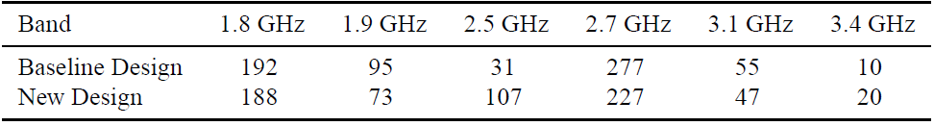
Fabrication Variation
Seven-Cell Cavity Optimization for Cornell’s Energy Recovery Linac N. Valles and M. Liepe; Proceedings of the 2009 International Workshop of RF Superconductivity, Berlin, Germany (2009)
Baseline Center Cells
Enhanced cell-to-cell coupling
BBU Parameter
BBU Parameter
o HOM properties with no fabrication variation x HOM properties with 1/16 mm variation
Notes:
Increasing cell-to-cell coupling results in less variation
of HOM properties for a given dimensional error, leading
to increased threshold current through the linac.
Wall angle 85 -> 77 degrees

Slide 10
Center Cell Design
End Cell Optimization

Slide 11
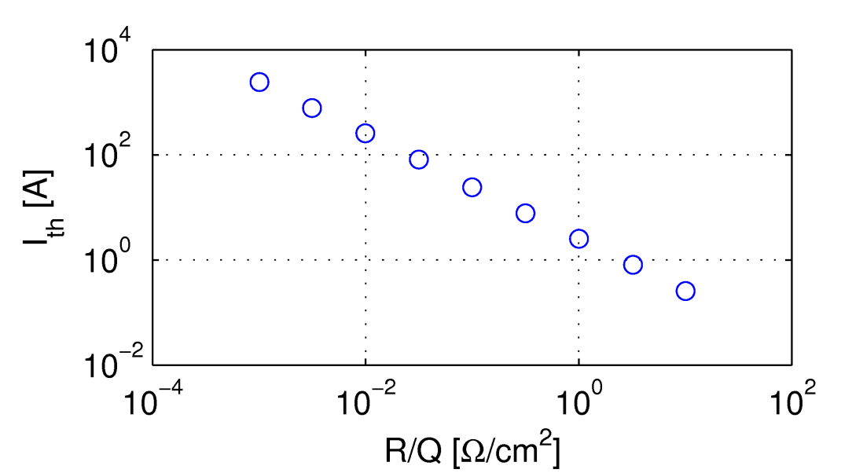
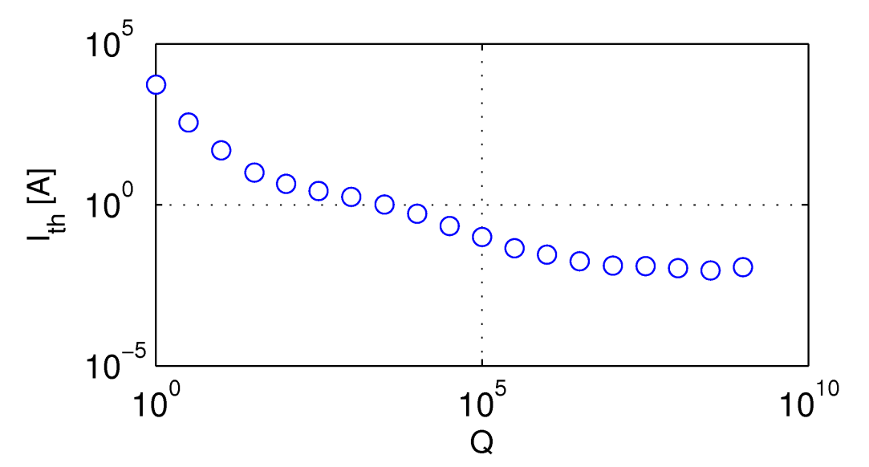
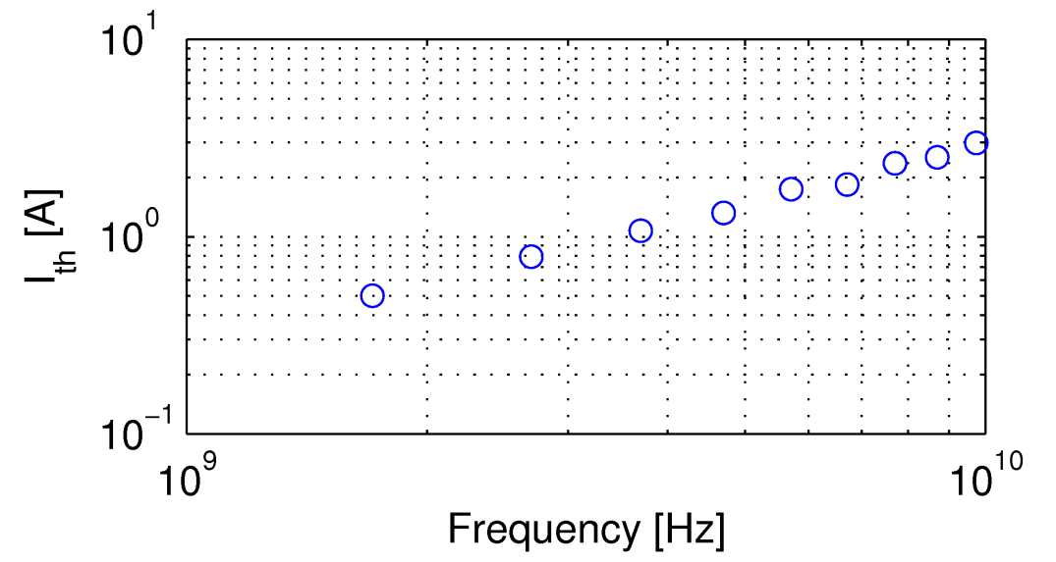
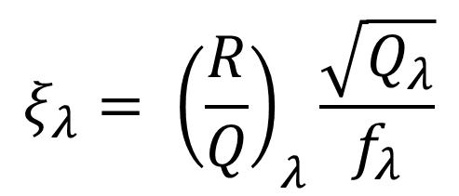
Cavity Design–End Cell Optimization
Obtaining Goal Function from Scaling Laws
$$ξ_{λ}= {\left(\frac{R}{Q}\right)}_{λ}\frac{\sqrt{Q_{λ}}}{f_{λ}}$$
Notes:
Threshold current from BMAD for a mode at 1.7 GHz, and varying HOM properties
Relative cavity-to-cavity frequency spread of 5e-3.
Single cavity would have the strength given by R/Q* Q. Coherent effects introduced by relative cavity to cavity frequency spread.
We optimized the seven cell geometry on a parallel computing cluster, solving 1692 modes at each point.

Slide 12

Cavity Design–End Cell Optimization
Optimization Problem Formulation
$$ξ_{λ}= {\left(\frac{R}{Q}\right)}_{λ}\frac{\sqrt{Q_{λ}}}{f_{λ}}$$
Minimize the worst value of over all dipole HOM passbands up to 10 GHz (worst mode matters!)
Constraints
  Maintain Epk/Eacc < 2.1
  Keep Hpk/Eacc < 4.2 mT/(MV/m)
  Limit wall angle to 85º
  Limit radius of curvature to 6 mm
  Maintain high fundamental mode R/Q x G (Decrease < 5%)
Design Validation
  Cavity’s optimized properties should be preserved for realistically shaped cavities (machining variation)

Slide 13
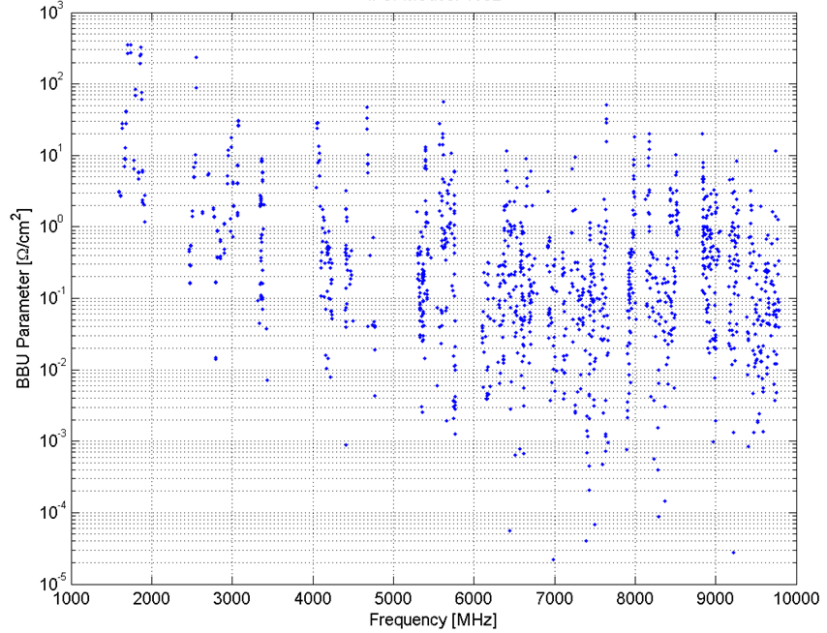
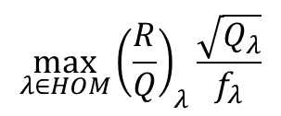
End Cell Optimization Algorithm
$$\max_{λ∈HOM}{{\left(\frac{R}{Q}\right)}_{λ}\frac{\sqrt{Q_{λ}}}{f_{λ}}}$$
12-parameter optimization minimizes
Intrinsically a non-analytic problem

Slide 14
End Cell Optimization Algorithm
Optimization implemented in MatLab and CLANS
  MatLab code generates geometry files for CLANS/CLANS2
  Minimization run on 256 core cluster at Cornell Center for Advanced Computing
Intrinsically a non-analytic problem
  Decompose hard problem into an analytic problem with a non-analytic constraint
    Example: Optimize BBU parameter of 1 mode until another mode becomes worse, then optimize new mode
BBU Parameter
Iteration Number

Slide 15
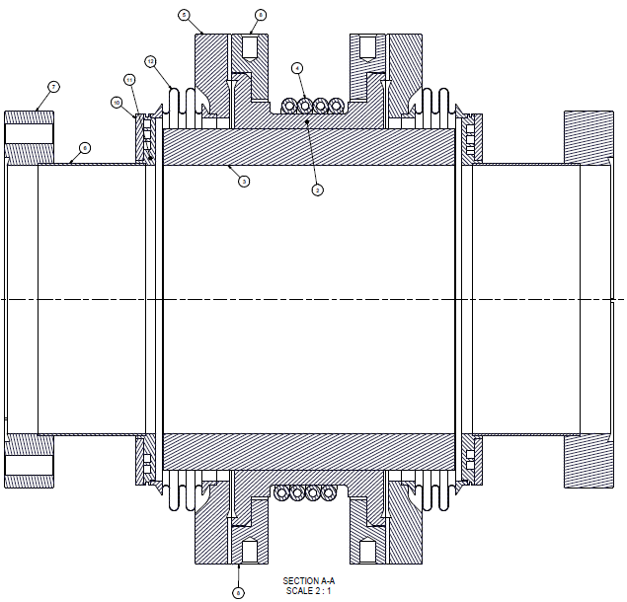
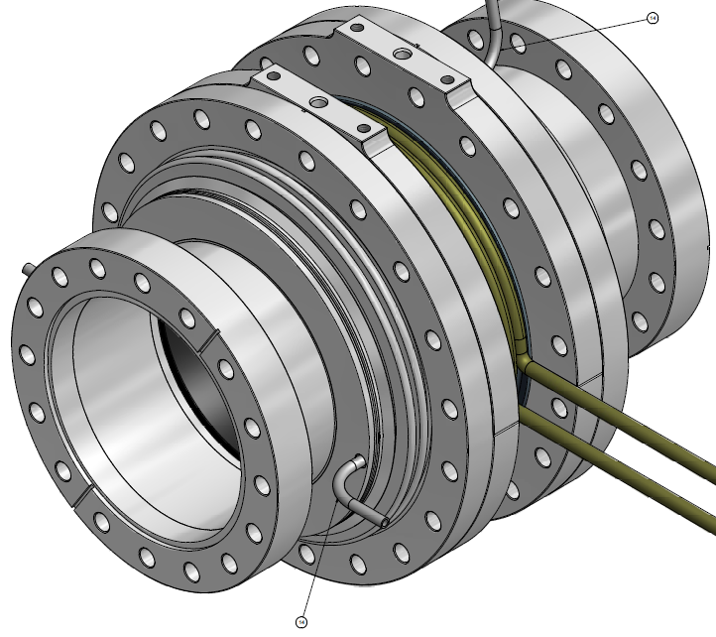
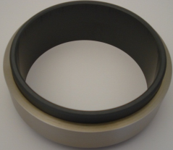
Higher-Order Mode Loads
HOM absorber load is responsible for absorbing HOM power and acting as bellows connecting cavities
Permittivity (ε) and permeability (μ) of absorber material determine load effectiveness
Used realistic properties of lossy dielectrics (SiC loaded graphite)
Computed HOMs with four boundary conditions: EE, EM, ME, MM

Slide 16
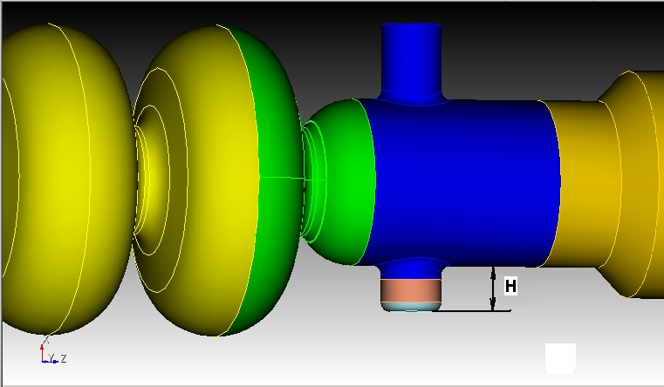
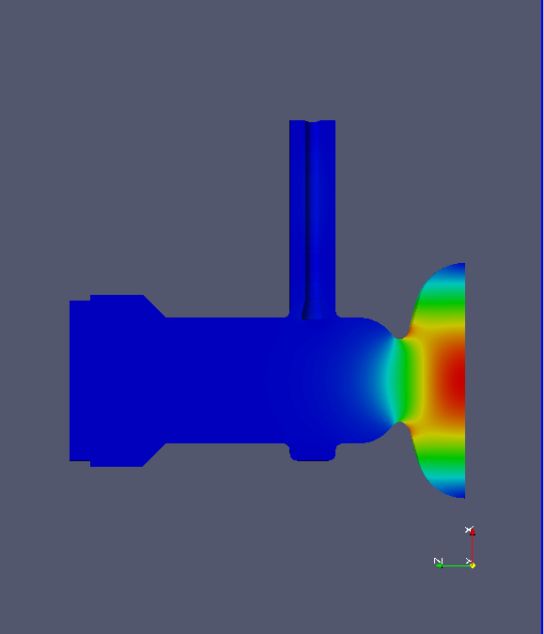
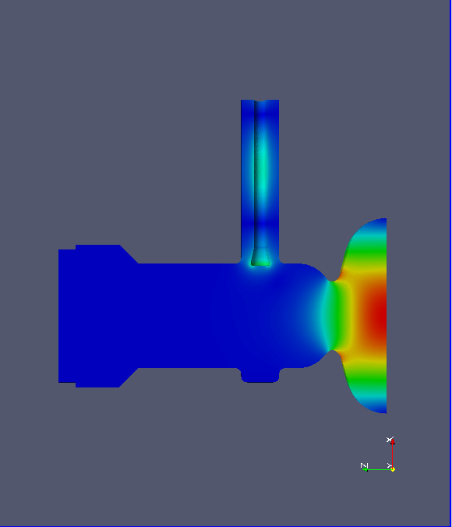
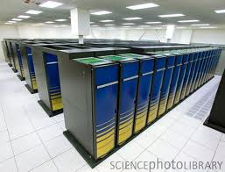
Power Coupler Design
On resonance
Resonance + 14 kHz
S3P calculations performed on NERSC cluster.
Further studies should investigate HOM interactions with coupler

Slide 17
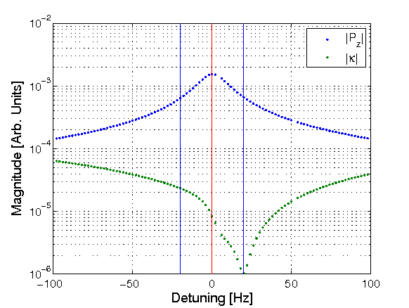
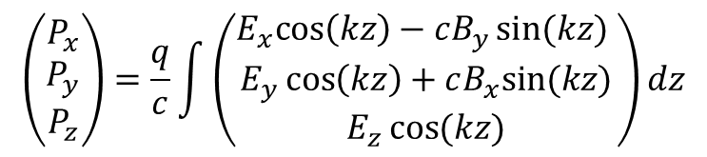
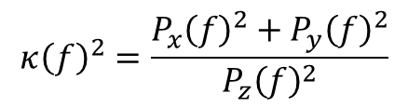
Coupler Kick vs Frequency
$$\left(\begin{matrix}P_{x} \\ P_{y} \\ P_{z}\end{matrix}\right)=\frac{q}{c}\int{\left(\begin{matrix}E_{x}cos\left(kz\right)−cB_{y}\sin{(kz)} \\ E_{y}\cos\left(kz\right)+cB_{x}sin⁡(kz) \\ E_{z}\cos{(kz)}\end{matrix}\right)}dz$$
$$κ{\left(f\right)}^{2}=\frac{P_{x}{\left(f\right)}^{2}+P_{y}{\left(f\right)}^{2}}{P_{z}{\left(f\right)}^{2}}$$
Computed coupler kick as a function of detuning frequency
Minimal kick does not occur on resonance
Microphonics should be confined to < 20 Hz peak detuning to keep coupler kicks manageable

Slide 18
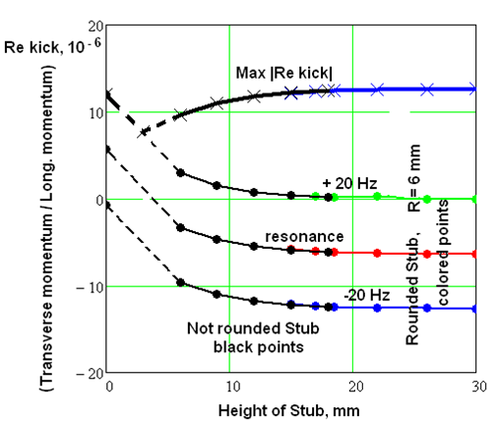
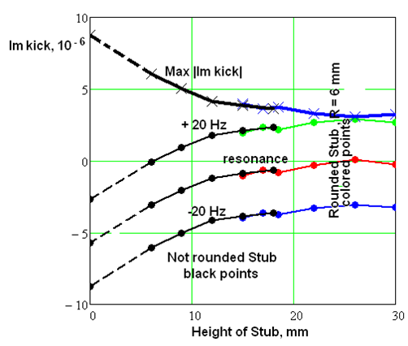
Coupler Kick
Real part of coupler kick related to time dependent kick of electron bunch
Imaginary part of coupler kick related to emittance dilution
Coupler kick effects are smaller than potential microphonic effects
No compensation stub necessary

Slide 19
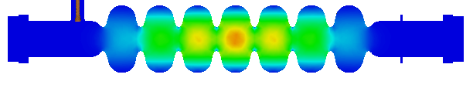
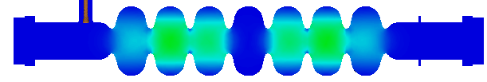
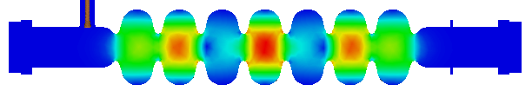
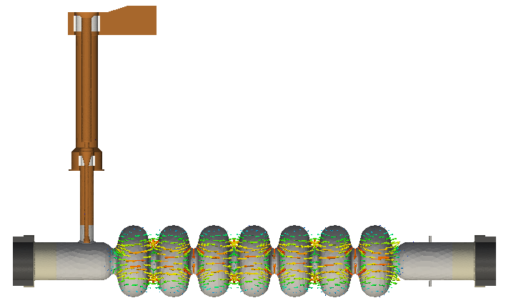
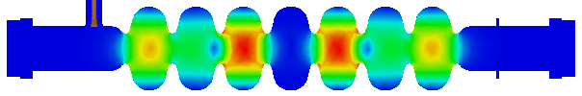

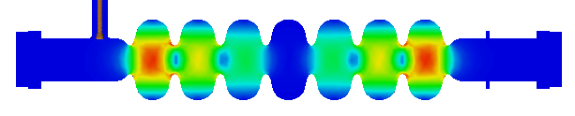
Final Accelerating Structure
Optimized 2D geometry modeled in 3D to incorporate full power coupler
Fundamental mode passband & HOMs computed with ACE3P
Waveguide RF input
Alumina
windows
HOM absorbers
RF HOM absorbers

Slide 20
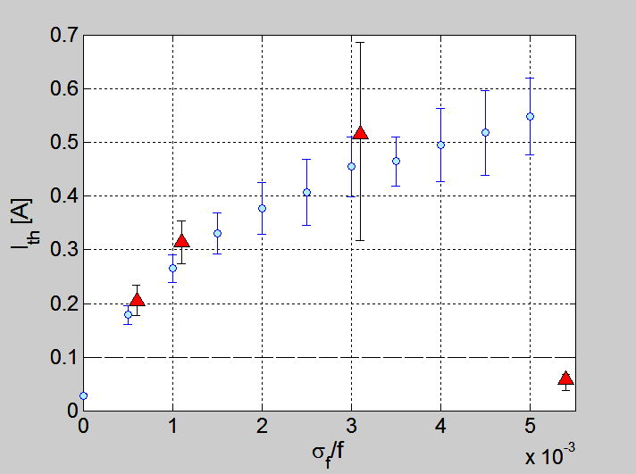
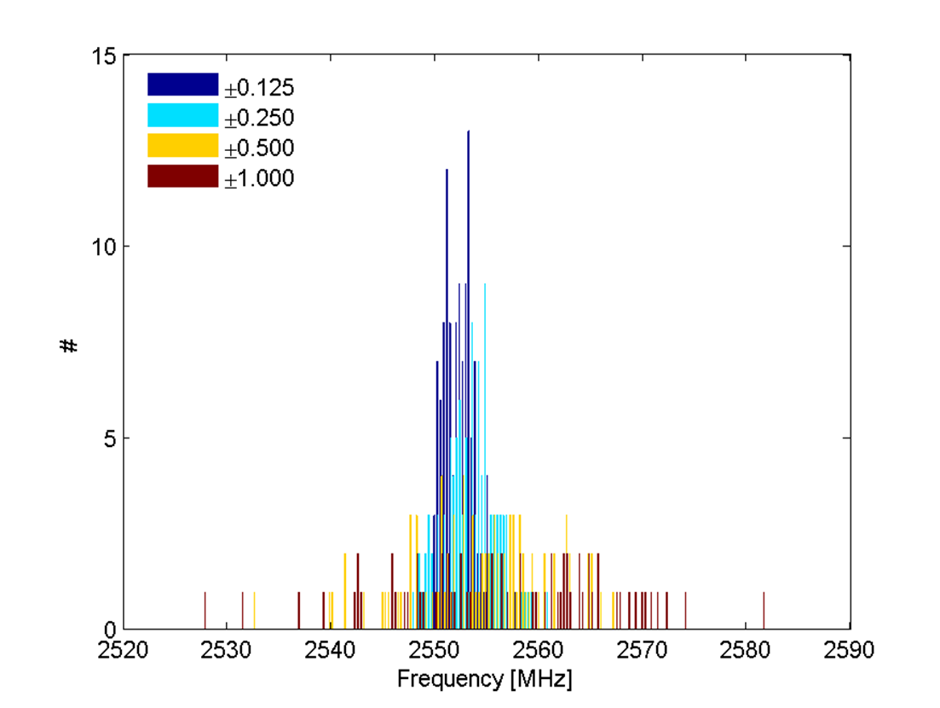
Fabrication Variation (2D)
Optimize Cavity
W.R.T. BBU parameter
Introduce realistic shape variations
(x400/error)
Compute dipole HOMs to 10 GHz
(1692 modes /cavity)
Generate realistic ERL
(x100)
Compute BBU current
±0.125 mm
±0.250 mm
±1.000 mm
±0.500 mm
Loosened machining tolerances
increase relative cavity-to-cavity
HOM frequency spread
(good!)

Slide 21
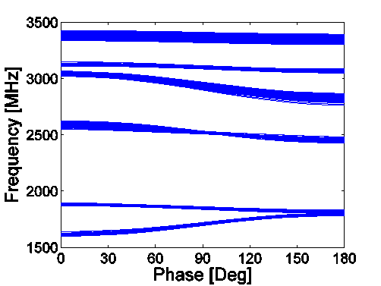
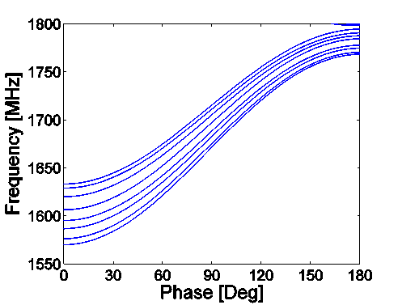
Cavity Classes
Cavity Classes
  Introduce controlled frequency spread to further increase BBU current
  Choose (N-different) center cell geometries to occupy a larger region of HOM frequency space
  Optimize end cells to minimize BBU parameter as before (N-optimizations)
  Results in N optimized cavity classes
I_{th} from expected cavity variation
I_{th} with multiple cavity classes

Slide 22
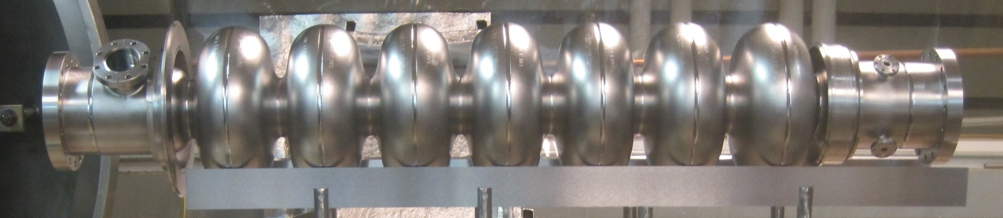
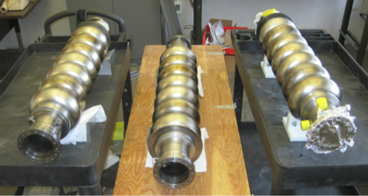
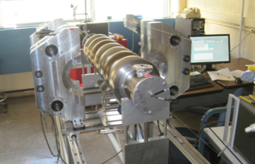
Fabricated Structures
Fabricated with 85% field flatness
CMM results show that we achieved ¼ mm shape precision after welding
Tuned to 95% field flatness
Received BCP, 120 C bake
Successfully horizontal tests
Six additional cavities have been fabricated
  - 3 with stiffening rings, 3 without.

Slide 23
Conclusions
The main linac cavity for the Cornell ERL has been successfully optimized.
2D and 3D simulations show the design is robust under machining perturbations
  Machining tolerances must be < 0.5 mm to ensure dipole HOMs are sufficiently damped.
Prototype cavity has been fabricated & tested in horizontal test cryomodule
Six additional cavities have been fabricated.

