Slide 1
CEBAF Upgrade cavity
G. Ciovati for the JLab SRF Group
TTC Topical Meeting on CW SRF
Cornell Univ., June 12th-14th, 2013

Slide 2
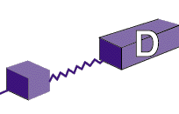
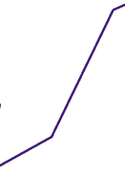
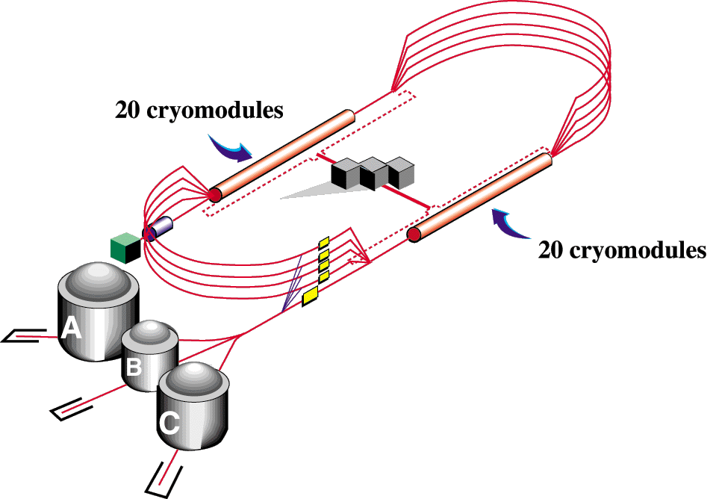
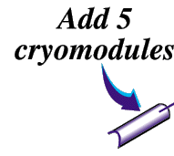

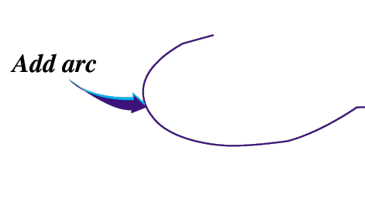

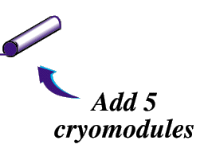
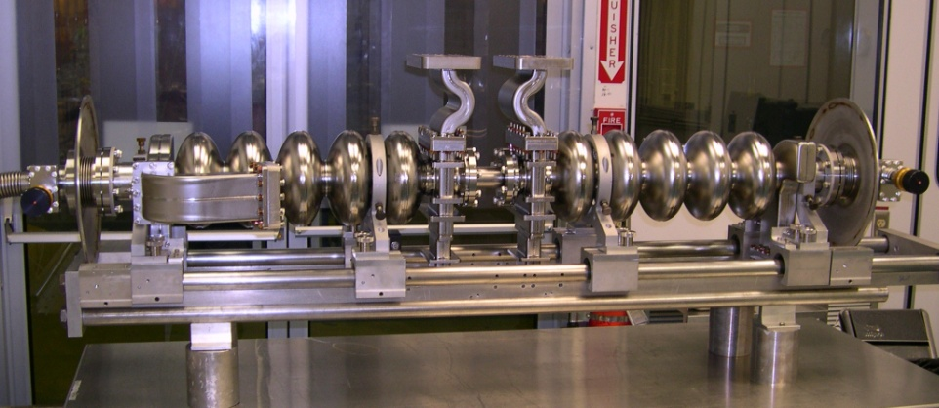
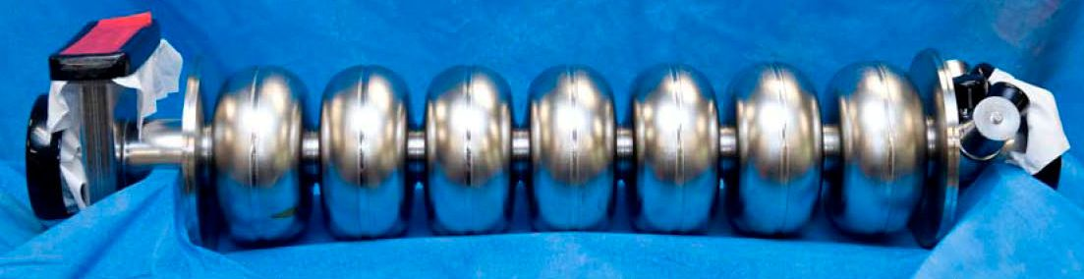
CEBAF’s Evolution to 12 GeV
42 1st -generation SRF cryomodules ‘91-’93 -- ≥ 25 MV
10 reprocessed ’06-’09 -- 50 MV
4 2nd-generation cryomodules – ’11-’12
6 2nd-generation cryomodules – ’13
  ≥ 108 MV avg.
300 W @ 2.07K
Upgrade magnets and power supplies
CHL-2
Pair of 0.5 m cavities:, “Original” cell shape 1.497 GHz, 8 cavities/cryomodule
All cavities made from “RRR-grade”
sheet metal niobium
2nd generation cavity: 0.7 m, “Low loss” cell shape, 1.497 GHz, 8 cavities/cryomodule

Slide 3
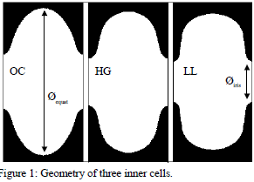
Cavity Designs
HG shape was optimized to lower E_{p}/E_{acc}, reducing the risk of FE
LL shape was optimized to lower the wall loss [(R/Q)G]
J. Sekutowicz et al., PAC’03, p. 1395.
Four 7-cell Nb cavities of each shape were built, tested and installed in a prototype cryomodule (Renascence)
Both types of cavities performed well w.r.t.:
  Susceptibility to FE and MP
  Adequacy of HOM damping
  Stability of field flatness
The LL-shape was chosen because of ~20% lower P_{wall} than HG-shape

Slide 4
Prototype cavities – VT results
Cavities treated by BCP
C. Reece et al., PAC’05, TPPT081.

Slide 5
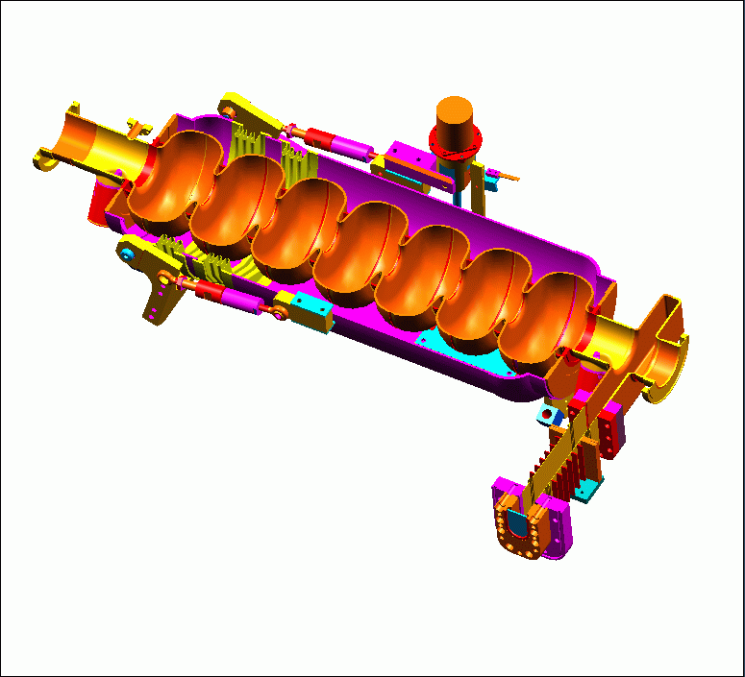
Upgrade cavity – Initial Configuration
RF reference probe
Stepper motor tuner drive
Thermal problem area
λ/4 waveguide RF input coupler
HOM coupler (4)
Fundamental Power Coupler (FPC)
Piezo element (2)
Titanium helium vessel
Cu-plated waveguide between RT and 2 K
1 m
Warm ceramic RF window

Slide 6
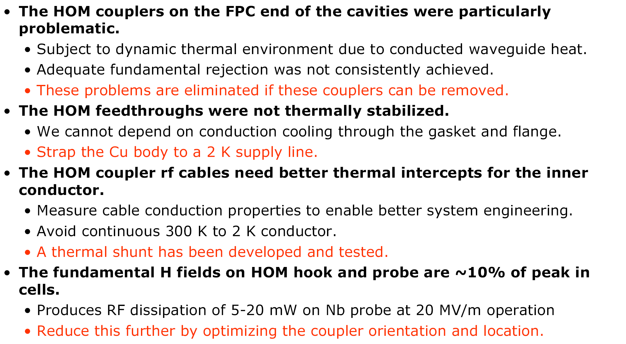
Issues and Solutions
C. Reece et al., SRF’07, p. 540.

Slide 7
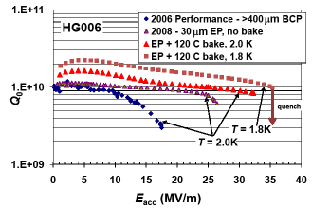
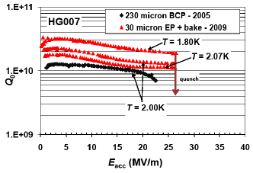
Updated cavity treatment: “light” EP+120°C bake
30 μm EP: increase gradient
HPR
120°C bake: increase Q₀
Adopted as final surface treatment of Upgrade cavities
C. Reece et al., PAC’09, p. 2126.

Slide 8
Cavity treatments – Production process
  160 µm BCP and pre-tuned by vendor
  Receipt inspection – mechanical and rf
  US >> Bake: 600 C, 10 hrs
  US >> EP: 30 µm, @20°C regulated by external water spray
  US >> Tune
  Helium vessel welding
  Flange lapping
  HPR
  Partial assembly
  HPR >> dry in Class 10 cleanroom
  Final assembly, leak check
  Bake: 120° C, 24 hrs
  Vertical test @ 2.07 K
  HPR >> dry in Class 10
  String assembly
A. Reilly et al., SRF’11, TUPO061.

Slide 9
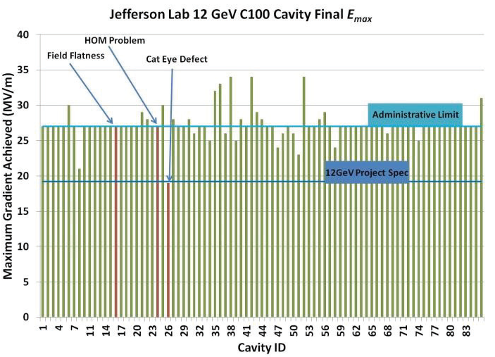
Cavities Vertical Test results
A. Burrill et al., IPAC’12, p. 2423.
96% of the cavities were qualified (61% with a single RF test)

Slide 10
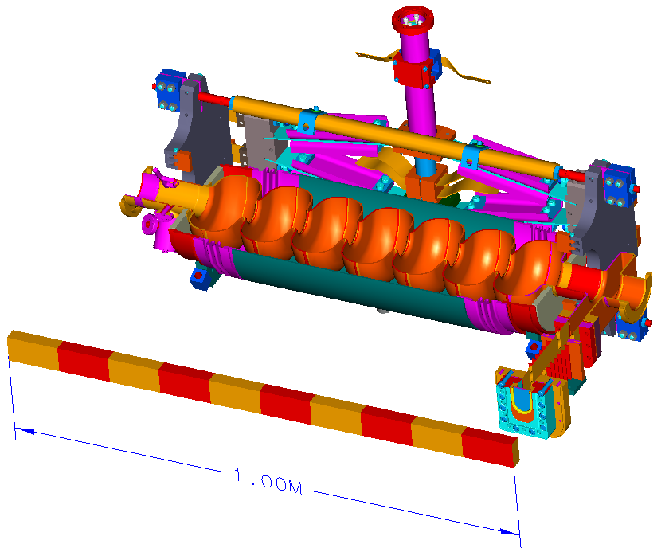
Upgrade cavity – Optimized Configuration
Warm tuner actuator not shown
RF reference probe
λ/4 waveguide RF input coupler
HOM coupler (2)
Fundamental Power Coupler (FPC)
SST helium vessel
Warm ceramic RF window
Cu-plated waveguide between RT and 2 K

Slide 11
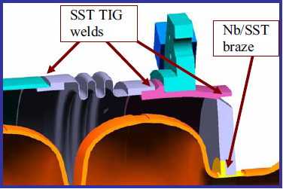
Integrated Cavity - Features (1)
No stiffening rings, to increase tunability
New helium vessel design, to replace titanium with stainless steel for cost and joint reliability
New tuner interface, mounts to stainless steel helium vessel endplates and allows use of proven scissor-jack tuner
C. Reece et al., SRF’07, p. 536.

Slide 12
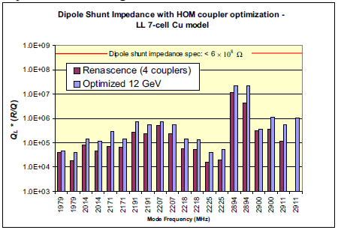
Integrated Cavity - Features (2)
Optimized waveguide input coupler geometry for Q_{ext} = 3.2×10⁷
Nb HOM coupler probes confidently cooled
Optimized position and orientation of HOM couplers (now only on “field probe” side) for HOM damping

Slide 13
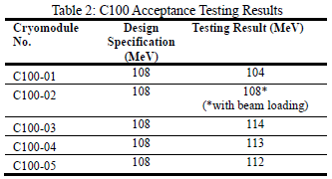
C100 Cryomodules
Each cavity is powered individually to determine its maximum gradient while measuring the corresponding heat load
All the other operational systems such as tuners, HOM couplers, valves and instrumentation are qualified.
J. Hogan et al., IPAC’12, p. 2429.
Pressure sensitivity: ~220 Hz/Torr
Lorentz force detuning: ~ -1.6 Hz/(MV/m)²

Slide 14
2 K Dynamic Heat Load vs. Cavity Gradients in CEBAF
0.7 m cavities
0.5 m cavities

Slide 15
Bang for the Cryo Buck
2.07 K

Slide 16
Conclusions
JLab has successfully developed a multi-cell SRF cavity for the 12 GeV Upgrade of CEBAF
The cavities meet the project specification of E_{acc}=19.2 MV/m with Q₀ ≥ 8×10⁹ at 2.07 K in CW operation
During the prototyping phase, improvements of cavity surface treatment methods lead to a change in the processing procedures initially envisioned.
Changes to multiples components of the “integrated” cavity assembly resulted from testing of prototypes in a cryomodule
JLab has accrued a broad experience on the design of cavities and components for CW applications
There is room for improvement, particularly on lowering the cryogenic losses.

Slide 17
Acknwoledgments
C. E. Reece for providing some of the slides for this presentation

