Slide 1






international ERL Cryomodule
A. Wheelhouse
ASTeC, STFC Daresbury Laboratory
TTC Topical Workshop - CW SRF,
Cornell 12th – 14th June 2013
On behalf of
ERL Cryomodule Collaboration

Slide 2
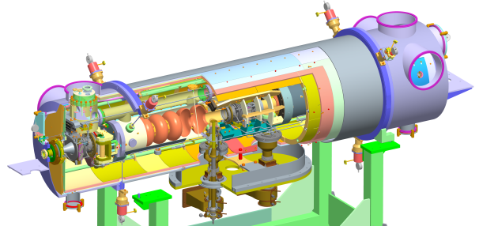
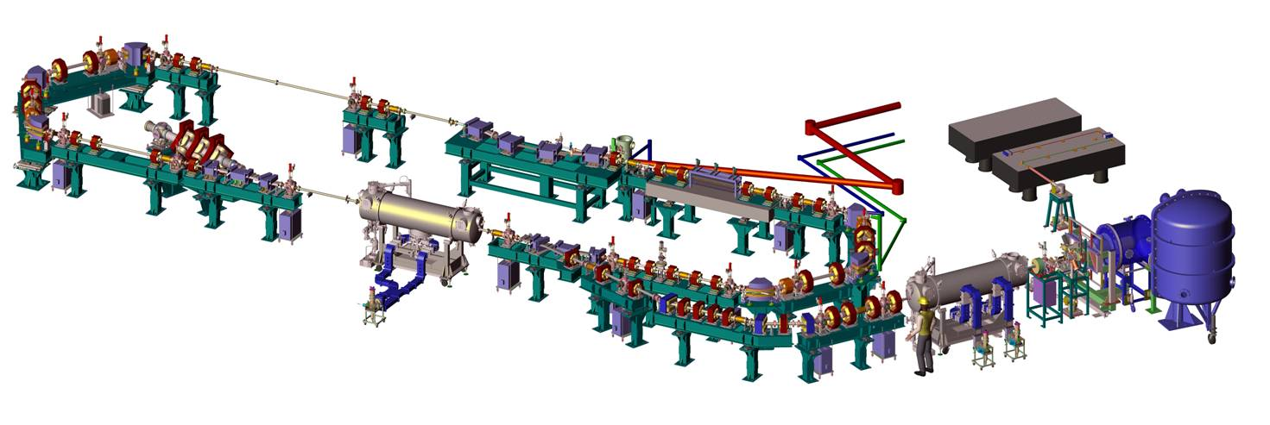
Outline
Project Overview
Installation
Cryogenic Commissioning
Low Level RF Tests
Future Plans
ALICE
14th June 2013
TTC Workshop A Wheelhouse

Slide 3
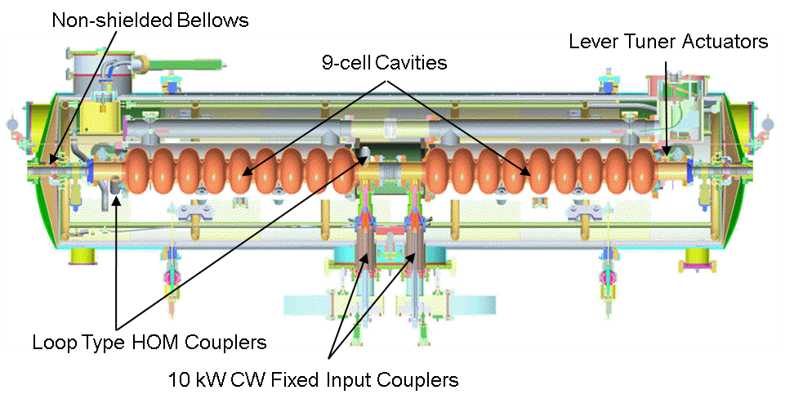
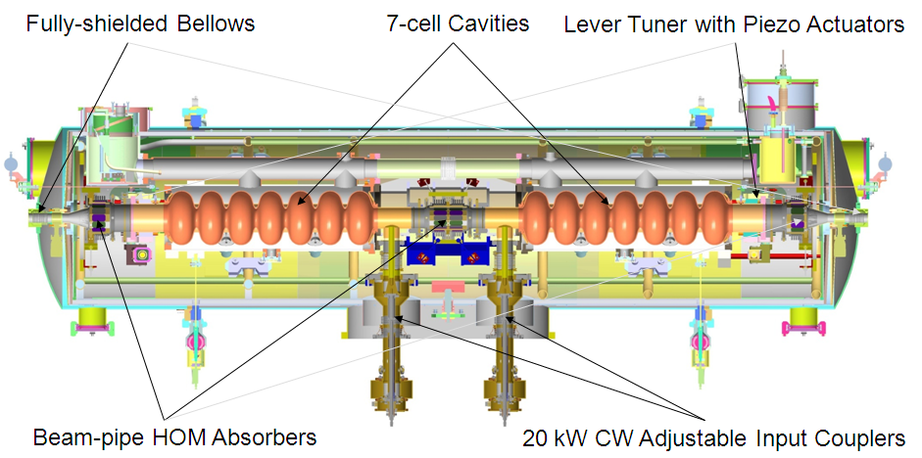
SRF Cryomodule
International collaboration initiated in early 2006:
  ASTeC (STFC)
  Cornell University
  DESY
  FZD-Rossendorf
  LBNL
  Stanford University
  TRIUMF (2009)
Fabricate new cryomodule and validate with beam.
Dimensioned to fit on ALICE:
  Same CM footprint
  Same cryo/RF interconnects
  ‘Plug Compatible’
Original Cryomodule on ALICE
New ERL Cryomodule
14th June 2013
TTC Workshop A Wheelhouse

Slide 4
SRF Cryomodule
Parameter | ALICE | Target
Frequency (GHz) | 1.3 | 1.3
Number of cavities | 2 | 2
Number of Cells per Cavity | 9 | 7
Cavity Length (m) | 1.038 | 0.807
Cryomodule Length (m) | 3.6 | 3.6
R/Q (Ω) | 1036 | 762
E_{acc} (MV/m) | 12 - 15 | >20
CM Energy Gain (MeV) | 27 | >32
Q_{o} | <5 x10⁹ | >1x10¹⁰
Q_{ext} | 4 x 10⁶ | 4 x10⁶ – 10⁸
Max Cavity Fwd Power (kW) | 10 SW | 20 SW
Original Cryomodule on ALICE
New ERL Cryomodule
14th June 2013
TTC Workshop A Wheelhouse

Slide 5
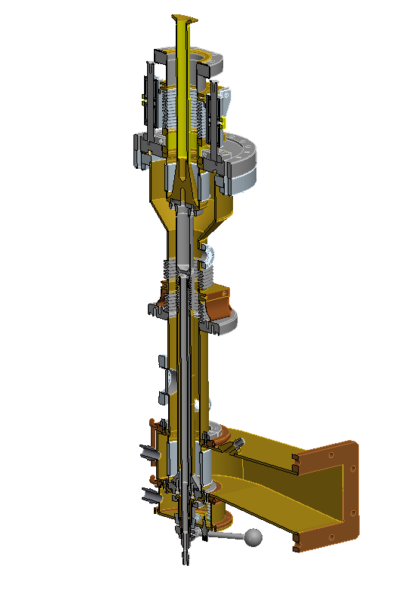
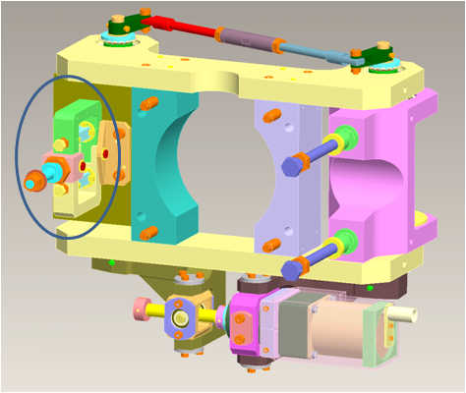
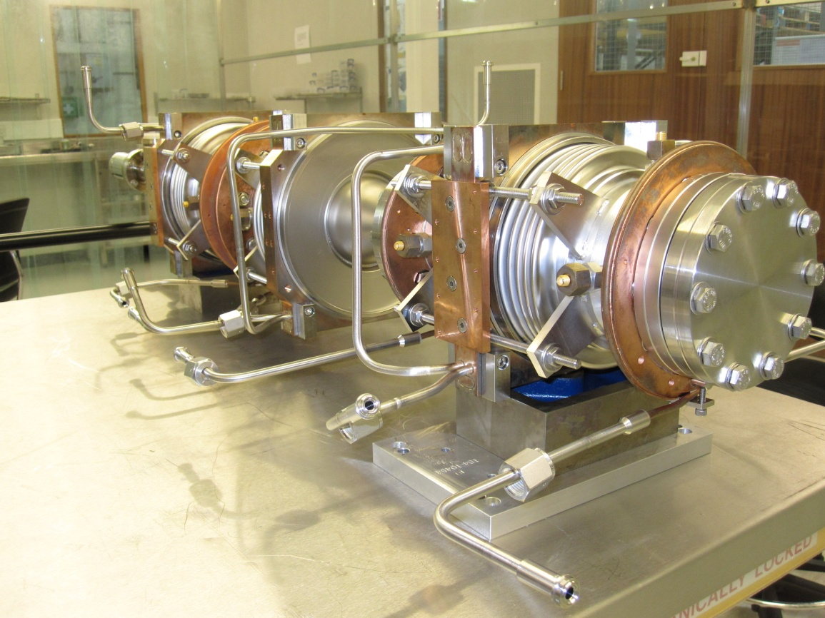
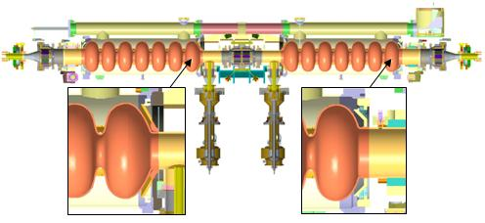
Major Variations in the Design
High power input couplers
Saclay II tuners
HOM absorbers
Several thermal transitions
80K-5K-2K
2K-5K-80K-5K-2K
2K-5K-80K
2K
5K
80K
14th June 2013
TTC Workshop A Wheelhouse

Slide 6
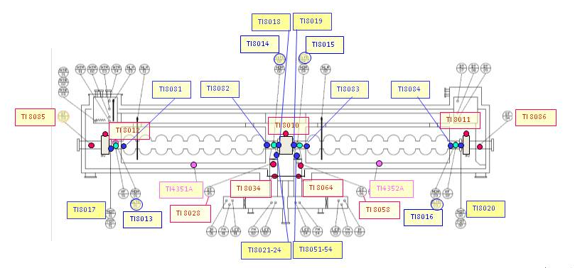
Major Variations in the Design
Radiation shield, HOMs and thermal intercepts cooled with GHe
Additional thermal management scheme
Additional instrumentation
14th June 2013
TTC Workshop A Wheelhouse

Slide 7
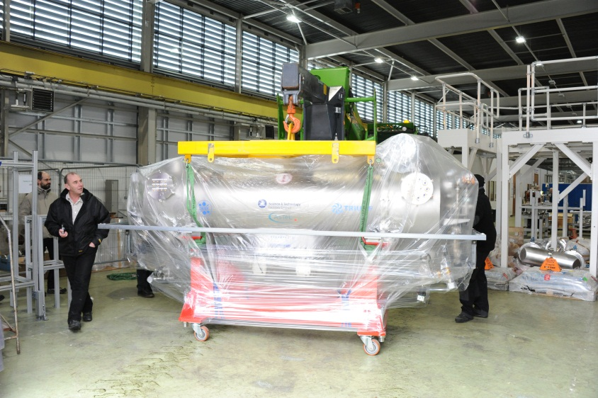
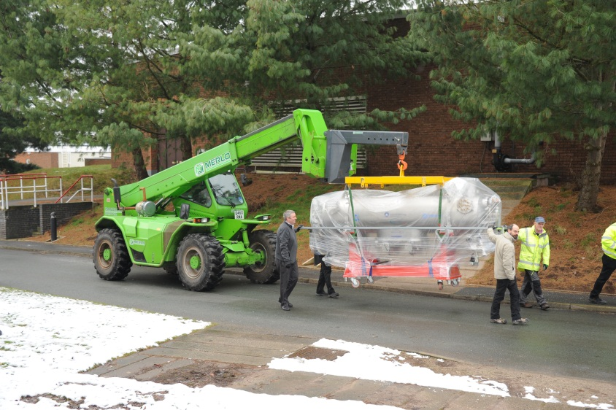
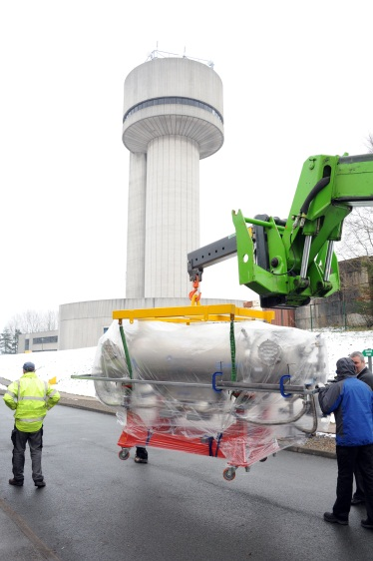
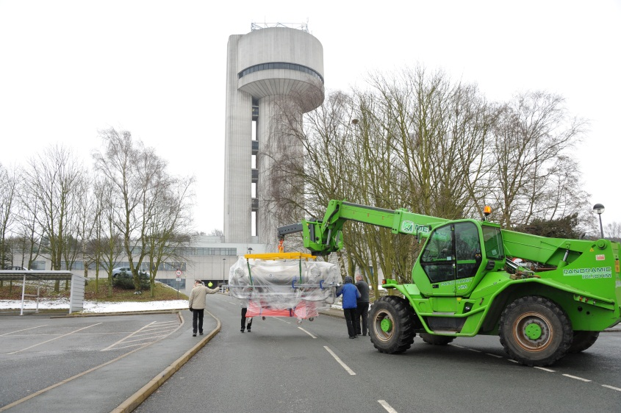
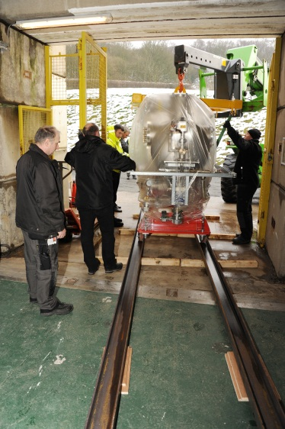
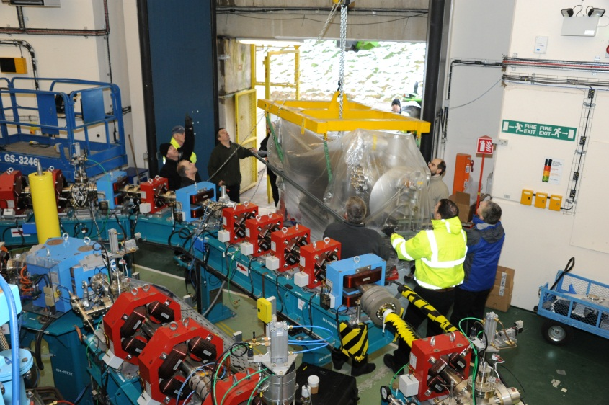
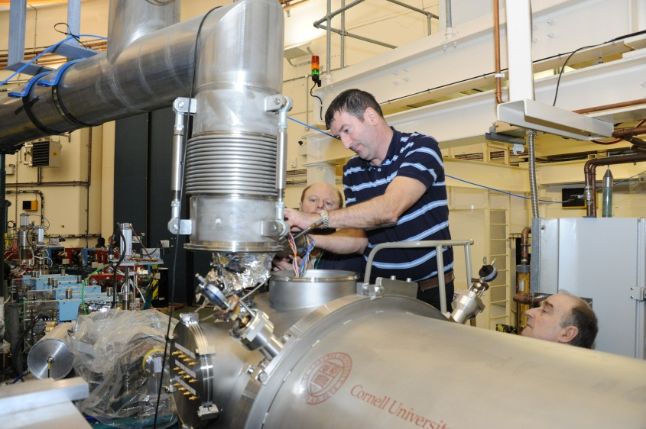
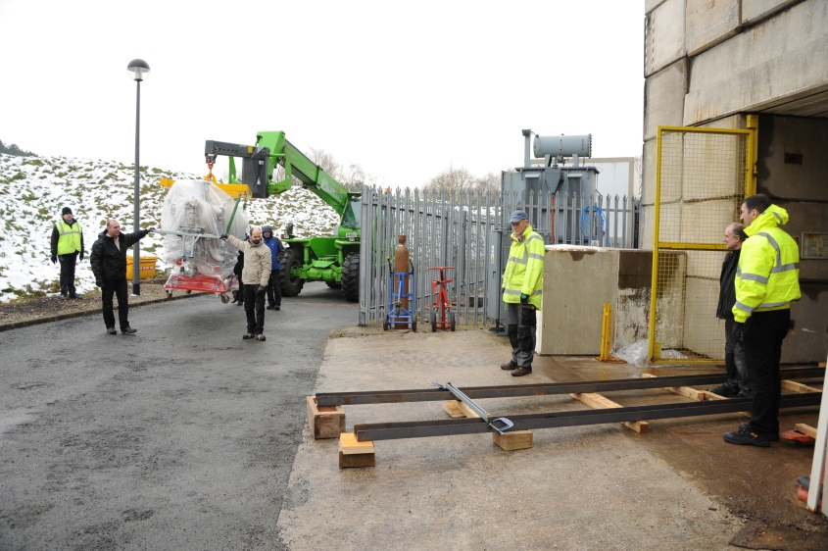
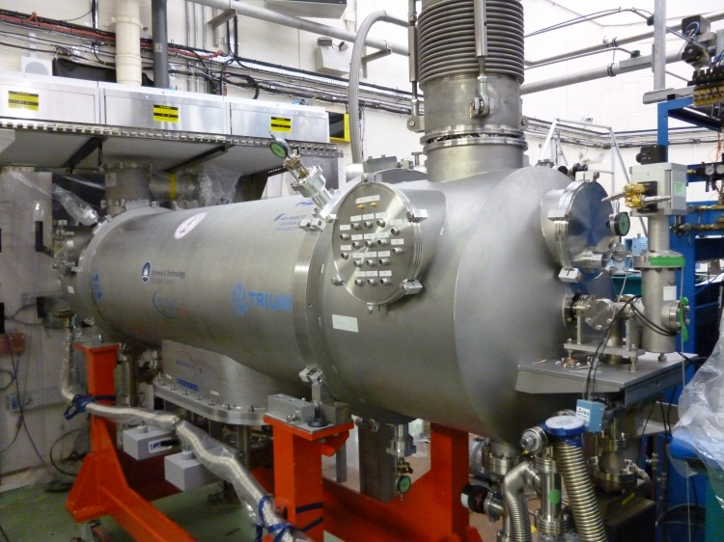
Installation on ALICE
14th June 2013
TTC Workshop A Wheelhouse

Slide 8
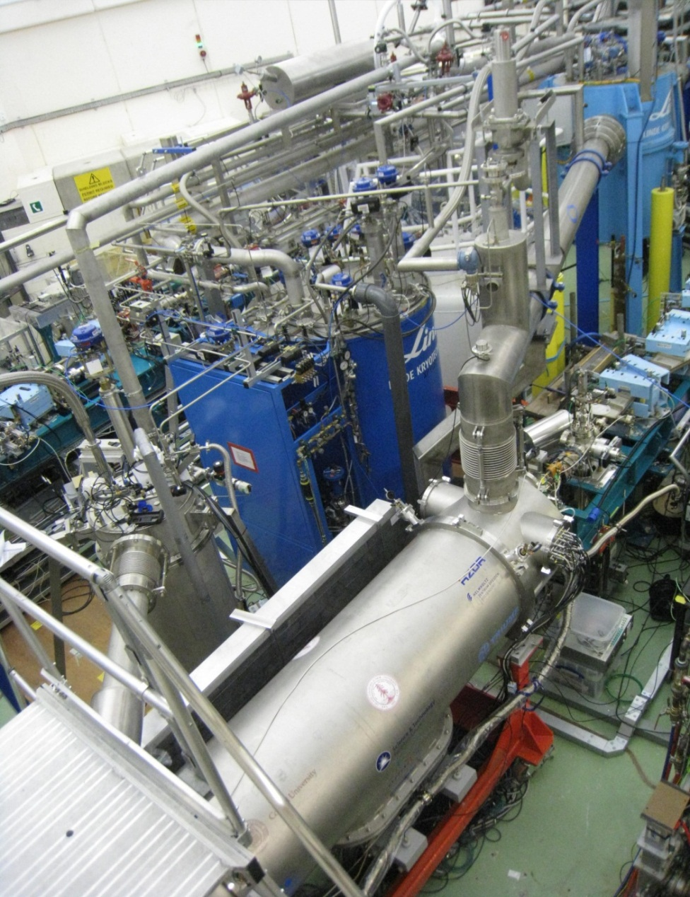
Cryogenic System
2K Box
Preliminary cool down
Cryomodule cooled to 2K
Static heat load measured at 2K~ 6W
  Similar to previous cryomodule, Spec- 15W
Base heat load measured at 2K ~ 2.5 g/s
  Similar to previous cryomodule
Intermediate Temperatures has been achieved with GHe using COOL-IT
  Gas pressure ~ 2 barA
HOMs, coupler intercepts and thermal shield are connected in series
  Circuit 1: T_{in} ~ 89K , T_{out} ~ 99K
  Circuit 2: T_{in} ~ 13.5K , T_{out} ~ 15.5K
Pressure stability at 2K (30mbar) ±0.05 mbar
Further optimisation is in progress
Dewar
TCF 50
COOL-IT
Cryomodule
14th June 2013
TTC Workshop A Wheelhouse

Slide 9
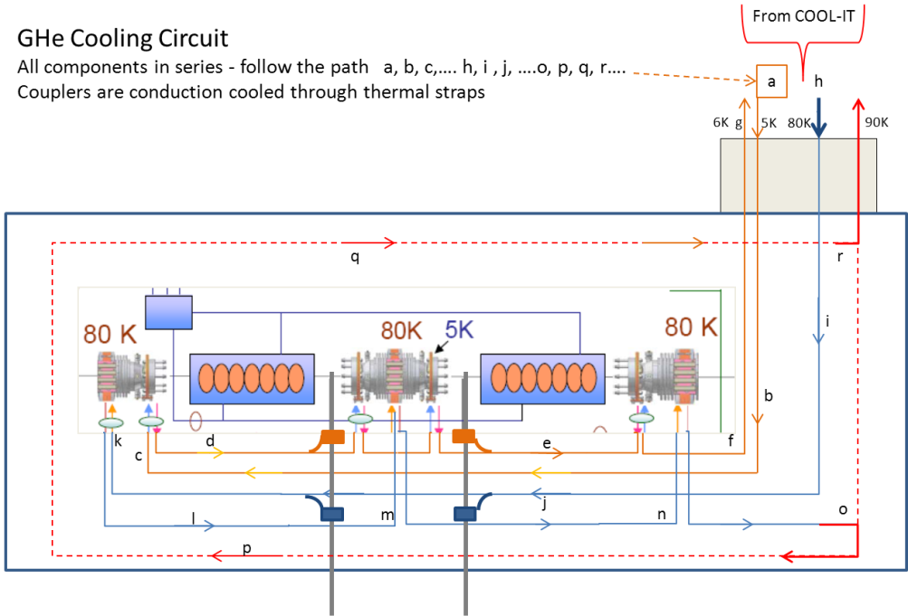
GHe Cooling Circuit
14th June 2013
TTC Workshop A Wheelhouse

Slide 10
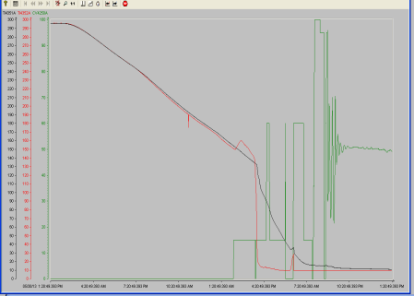
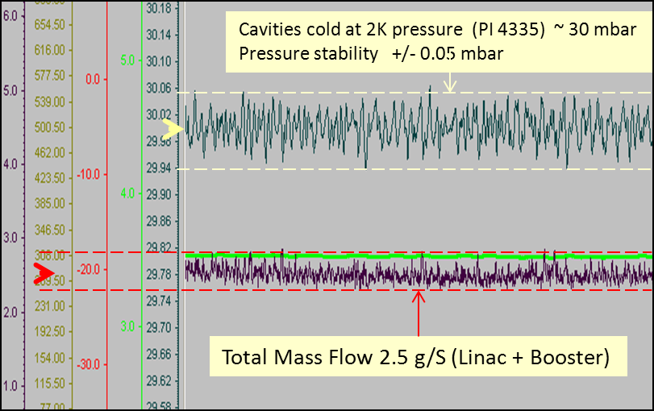
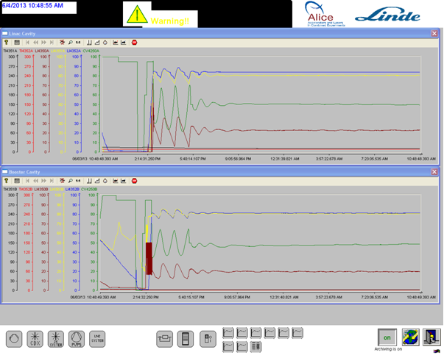
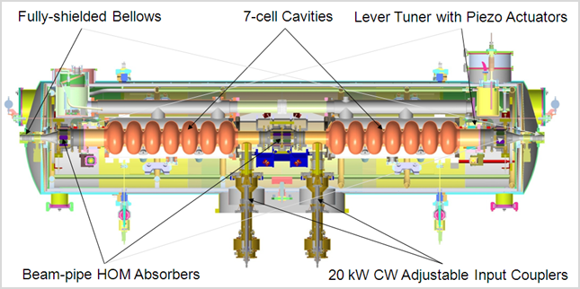
Cryogenic Performance
COOL DOWN to 2K
Cryogenic (Pressure) Stability at 2K
295 K
3K/hr (Cooling only by radiation and conduction through supports)
15 hrs
to 4K
3 hrs
to 2K
130 K
2 ½ days to 130 K
Cavity 1
Cavity 2
2.0 K
Liquid Helium levels in Reservoirs
Cavity 1
Cavity 1
Cavity 2
Cavity 2
Service Reservoir
Level Control Valve
14th June 2013
TTC Workshop A Wheelhouse

Slide 11
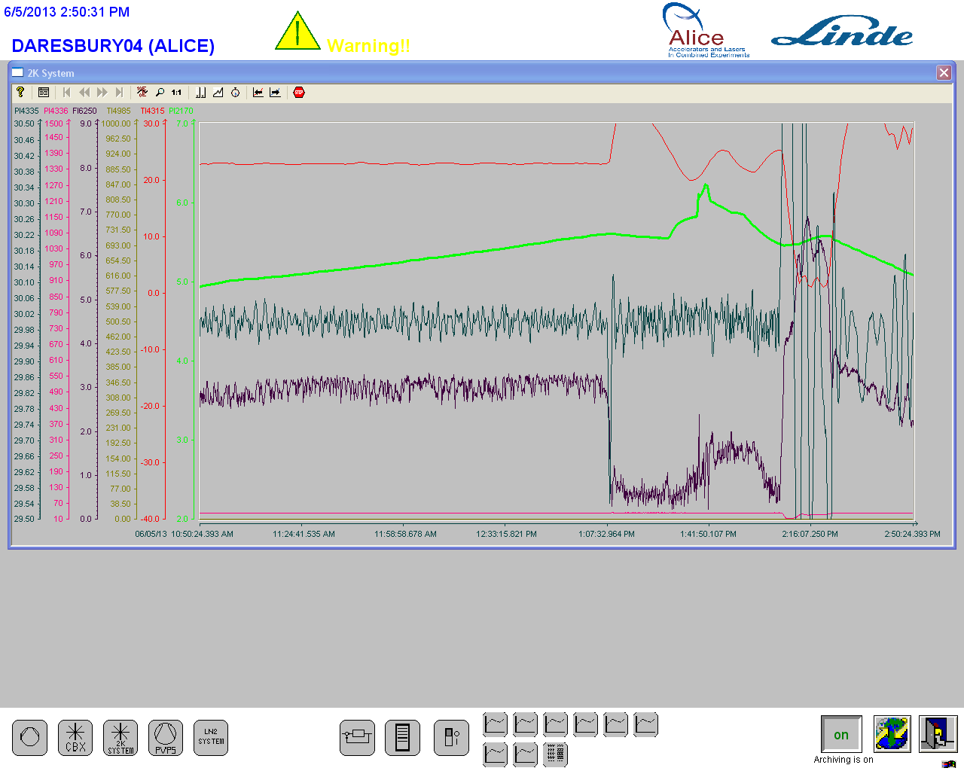
Static Heat Load at 2K
Static heat load measured with all the input valves closed to ensure that only the boil off from the cryostat is measured
0.6 g/S total mass flow Linac + Booster
0.3 g/S per module
~6.2 W per cryomodule
14th June 2013
TTC Workshop A Wheelhouse

Slide 12
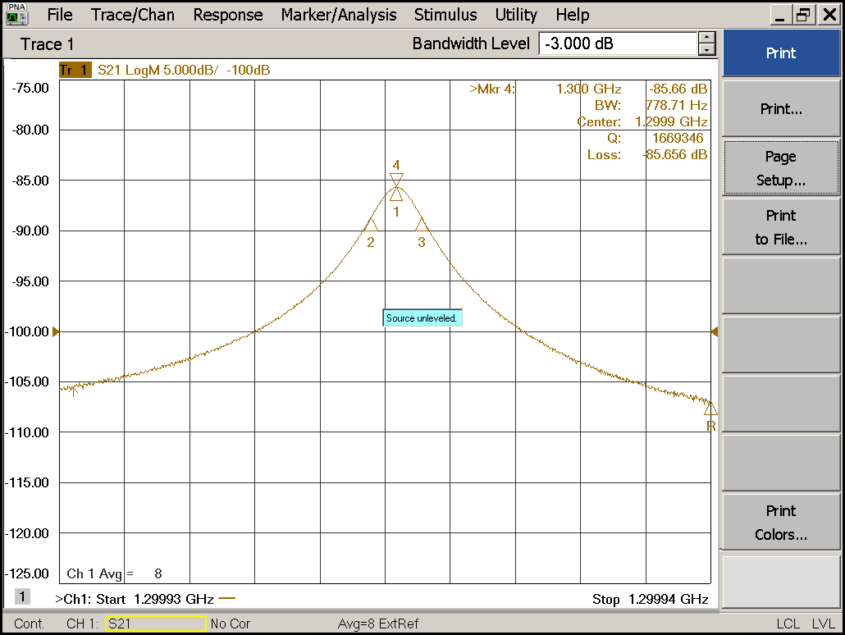
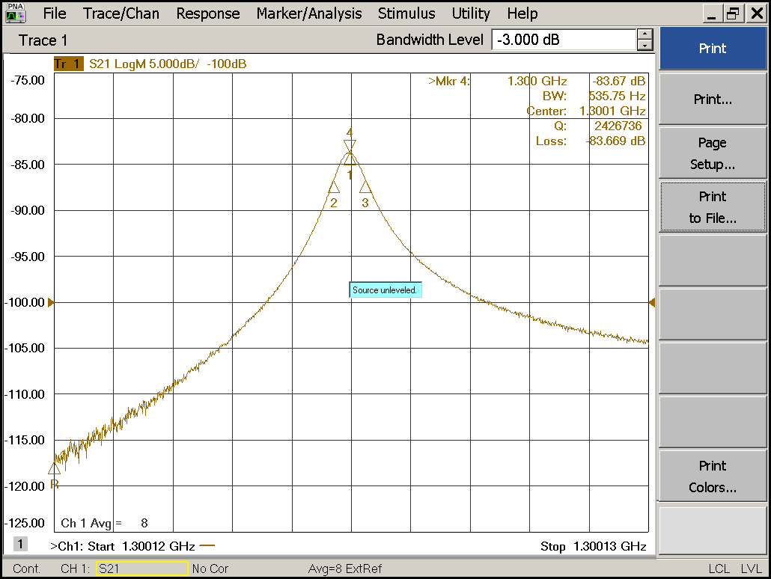
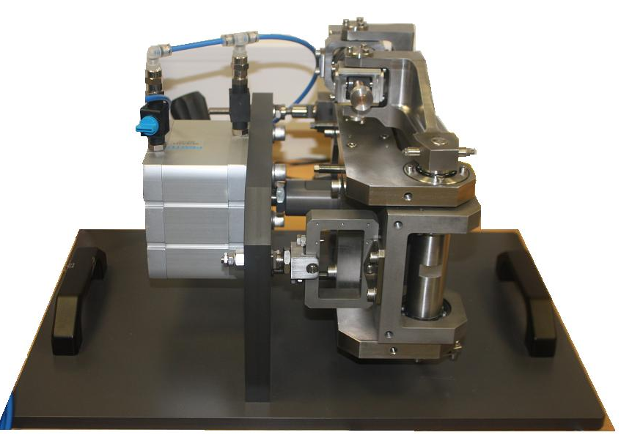
Cavity Frequency
Linac 1
Linac 2
Cavity tuner operation verified
Tuning achieved
Tuning range ±350 kHz
Q_{ext} adjusted
  Full extent of adjustment to be determined
Previous mechanical issue
14th June 2013
TTC Workshop A Wheelhouse

Slide 13
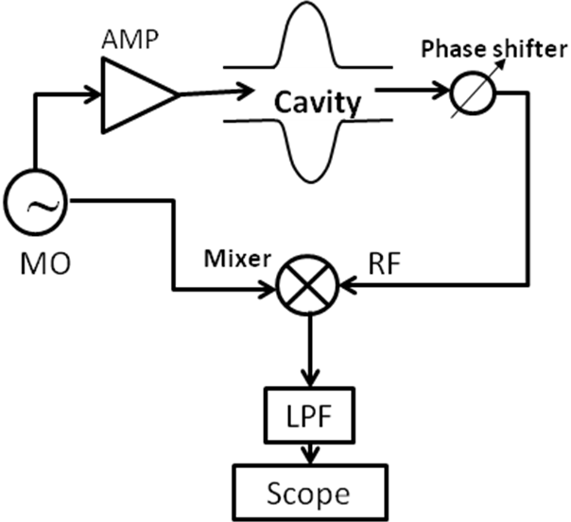
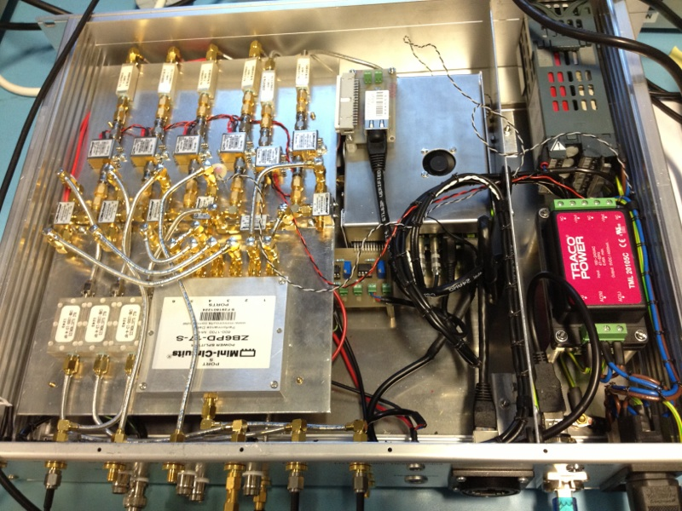
Microphonic Tests
Original Linac
New ERL Linac
The microphonics were tested in CW mode, open loop operation.
Cavity was driven by signal generator
A Hittite phase detector was used to measure the phase difference between the cavity probe signal and the system generator signal.
The new ERL cavities were driven with a CW wave from the digital LLRF system. The cavity probe signal is then mixed with the forward RF signal and filtered by a low pass filter.
The cavities have been analysed in self excited loop and open loop operations.
Based on the LLRF4 development board, designed by Larry Doolittle of LBNL
14th June 2013
TTC Workshop A Wheelhouse

Slide 14
Linac Cavity 1
Open loop measurement, strong detuning peaks at:-
1Hz, 7Hz, 24Hz, 35Hz, 38Hz, 47Hz, 78Hz, etc
Loop closed, the overall noise floor is lower and many detuning peaks removed.
50 Hz resonance and its sidebands remain on the spectrum, which is common in background environment.
Detuning peaks at 48Hz, 70Hz, 34Hz
14th June 2013
TTC Workshop A Wheelhouse

Slide 15
Linac Cavity 2
Open loop operation, strong resonances have been observed at:-
1Hz, 7Hz , 21.5Hz, 23.5Hz, 35Hz, 48Hz, 68Hz, 71Hz, 78Hz, 82Hz, 98Hz, etc.
Loop closed, resonances remain at 1Hz, 37.5Hz, 50Hz and its side bands.
Detuning peaks at 22Hz, 70Hz,63Hz,139Hz,386Hz.
14th June 2013
TTC Workshop A Wheelhouse

Slide 16
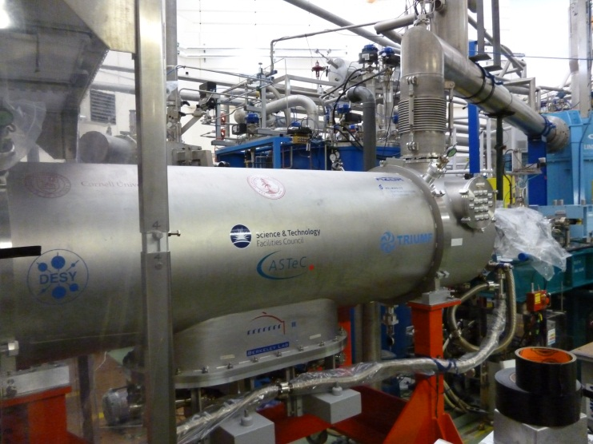
Future Plan
Evaluation Programme:-
Establish gradient and Q₀
Measure Lorentz force detuning at high gradient
Performance measurements with piezo tuners
Determine DLLRF control limitations wrt Q_{ext}
Evaluate the effect of beam loading with DLLRF, piezo control for various Q_{ext} levels under pulsed and CW conditions
Characterise cavities in CW mode at high gradient:
  Evaluate thermal transients across cavity string and 2-phase line
Cryomodule installed on ALICE
14th June 2013
TTC Workshop A Wheelhouse

