Slide 1
CW couplers;
KEK injector couplers
Eiji Kako (KEK, Japan)

Slide 2
OUTLINE
compact-ERL injector cryomodule
Specification and fabrication
Conditioning of prototype couplers
Improvement of cooling by gas-flow
Improvement of water cooling
Conditioning at test-stand and cryomodule
Beam operation of compact-ERL
Summary and next step

Slide 3
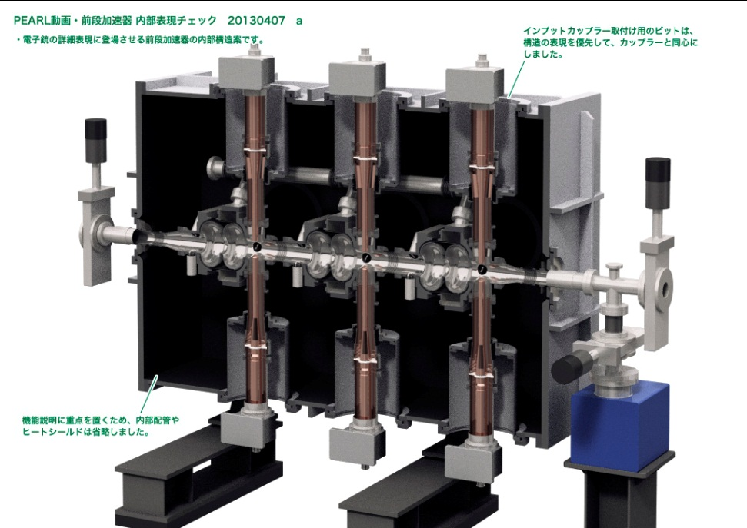
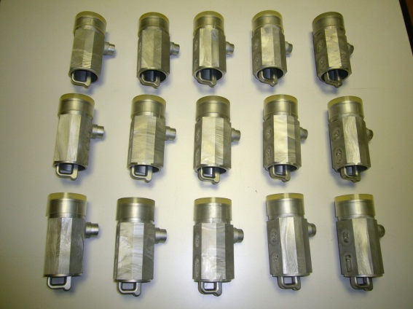
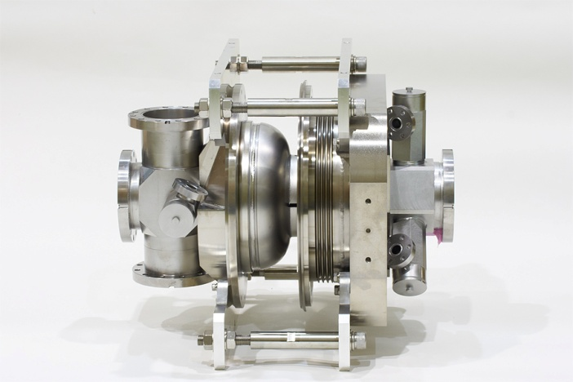
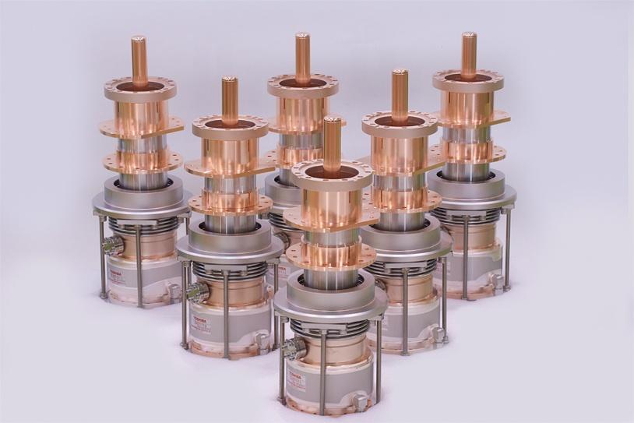
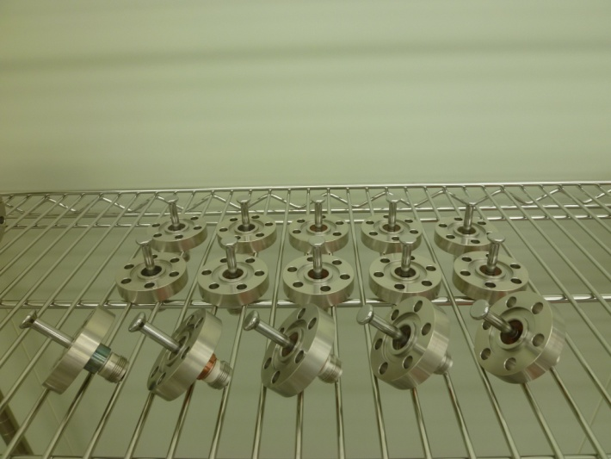
cERL Injector Cryomdule
Completed in 2012, June.
After low and high power
rf tests, beam operation
started in 2013, April.
e⁻ beam
0.5 → 5.5 MeV
10 mA
CW Input Couplers

Slide 4
Main Specification for Injector Cryomodule
(cERL injector ; I_{beam} = 10 mA, E_{beam} = 5 MeV)
 | Cavity - 1 | Cavity - 2 | Cavity - 3
Vc | 1.5 MV | 1.75 MV | 1.75 MV
Eacc | 6.5 MV/m | 7.6 MV/m | 7.6 MV/m
Q_{L} (10mA) | 7.2 x 10⁵ | 8.4 x 10⁵ | 8.4 x 10⁵
P_{RF} (10mA) | 15 kW /2 | 17.5 kW /2 | 17.5 kW /2
RF Source | Klystron – 1 30kW, CW | Klystron 300kW, | – 2 CW
I_{beam} = 100 mA, E_{beam} = 10 MeV for future 3GeV-ERL
Final target of required RF power = CW 180 kW / coupler

Slide 5
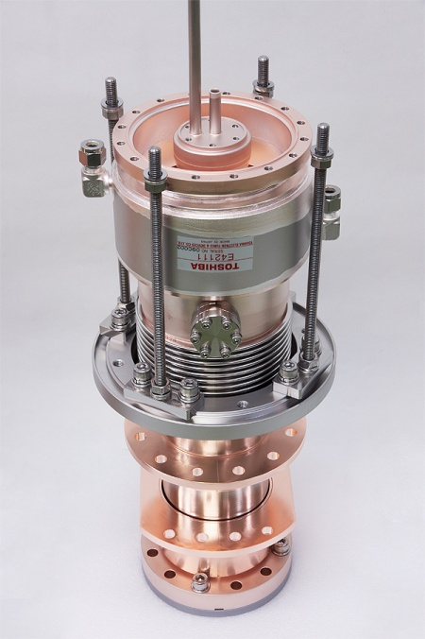
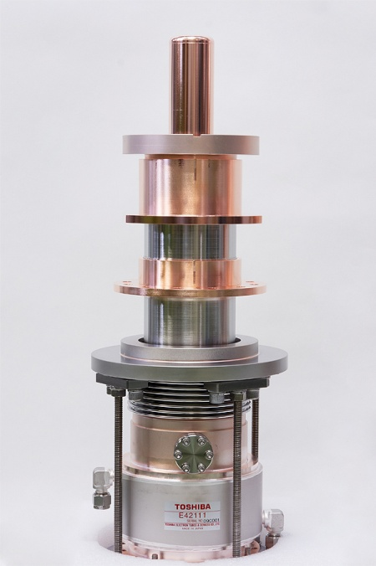

Fabrication of CW Input Couplers
Two prototype input couplers
Six input couplers for cERL injector
(completed in 2009, Oct.)
(completed in 2011, June)
(finished conditioning in 2010, Nov.)
(finished conditioning in 2012, Jan.- Apr.)
(installed in cryomodule in 2012, May)

Slide 6
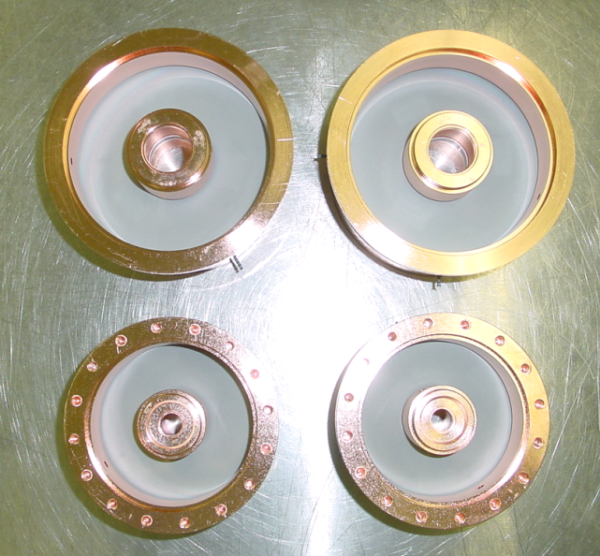
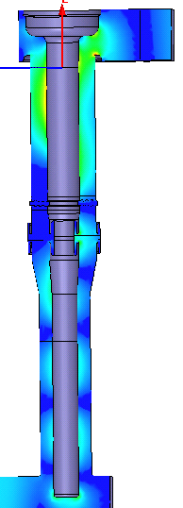
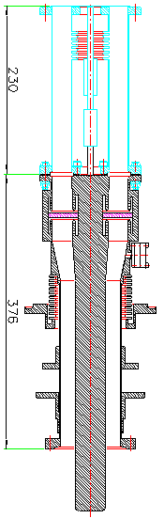
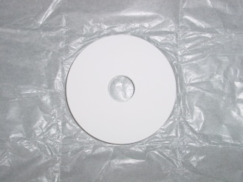
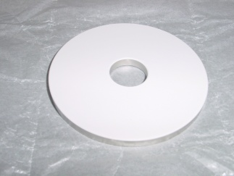
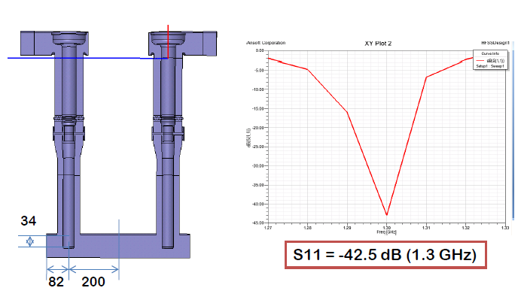
Design of Prototype Input Couplers
Water Cooling
Tristan-type
Coaxial Disk
Ceramics RF Window
Doorknob
Coaxial
line
Warm
window
300 K
80 K
Zo =
41.5 Ω
5 K

Slide 7
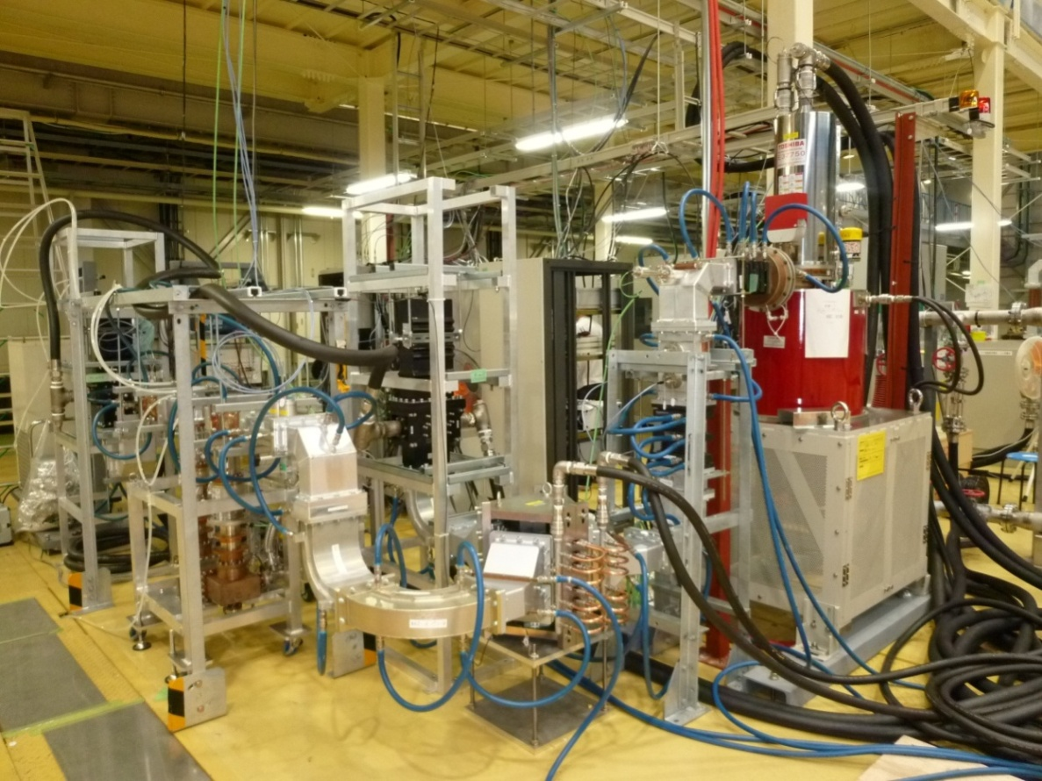
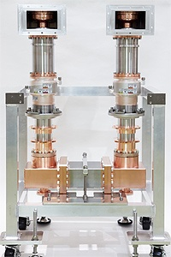
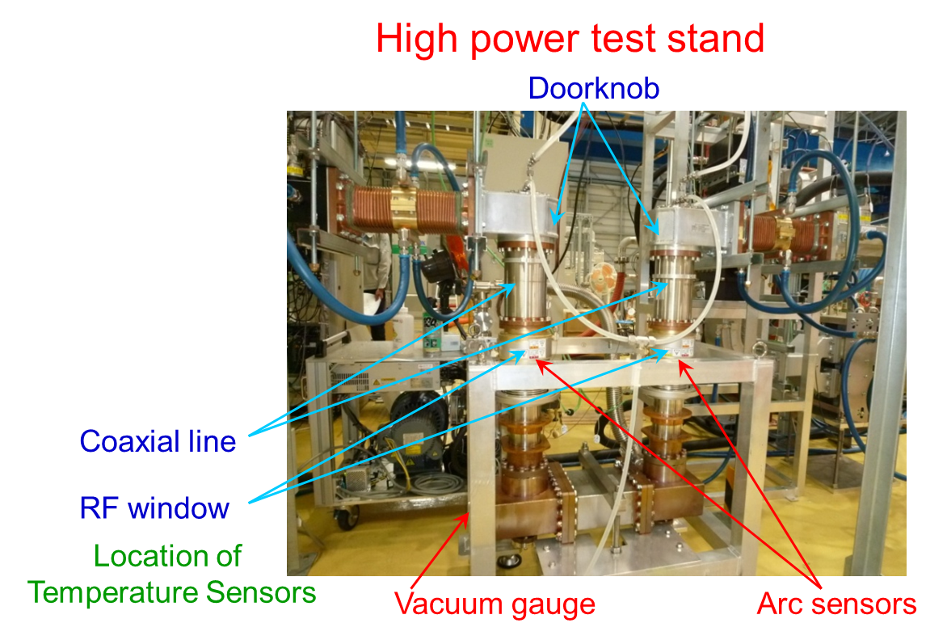
Conditioning of prototype input couplers
300kW
CW Klystron

Slide 8
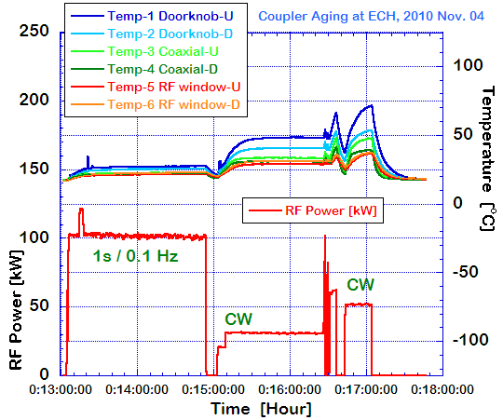
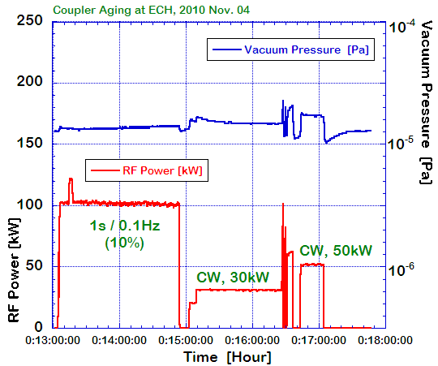
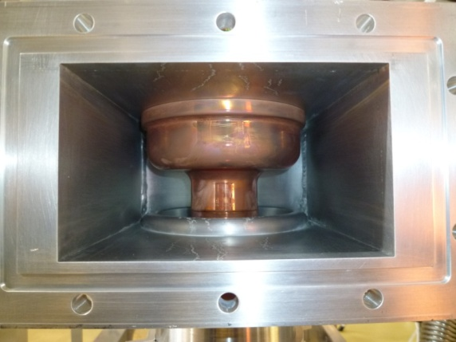
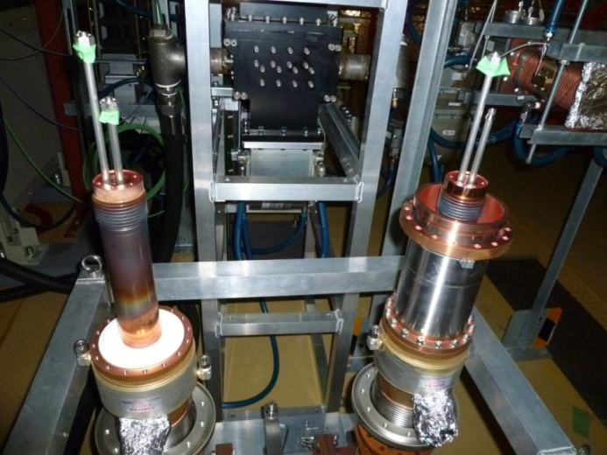
Conditioning results at Test Stand
Conditioning Results
1ms, 10Hz, (1%) 200kW for 2h
1s, 0.1Hz, (10%) 100kW for 2h
cw 30kW for 1.5h
cw 50kW for 0.5h
cw 100kW for 1 min
Fan/on
Day - 7

Slide 9
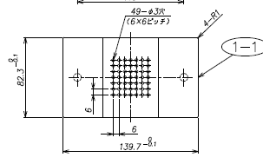
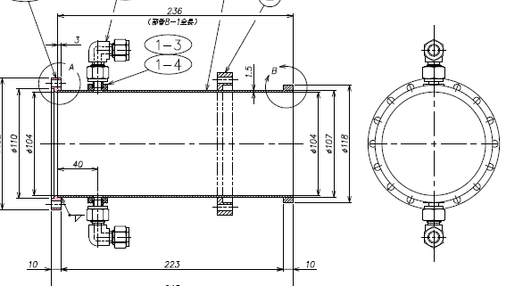
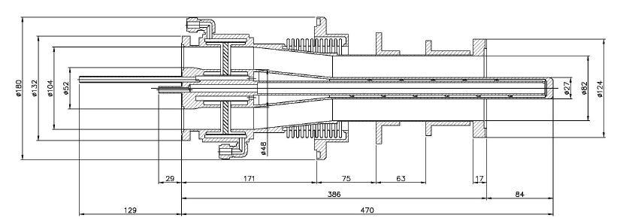
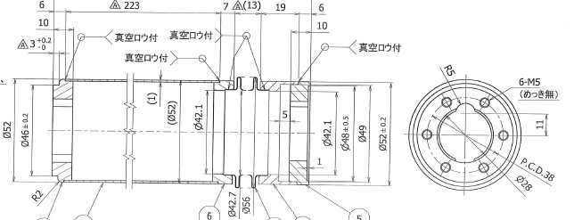
Improvement of cooling by N₂ gas-blow
Water Cooling
Material of
bellows & tube:
thin SUS with Cu plating
thick Cu tube & Cu bellows
Halls for N₂ flow
Short-end plate
of doorknob
N₂ blow
N₂ blow
N₂ blow
300 K
OD = 41 mm
27 mm
80 K
5 K
Zo = 41.5 Ω
66 Ω
1.0t, Sus
+ 10μm Cu
Inner
conductor
Outer conductor
2.0t, Cu

Slide 10
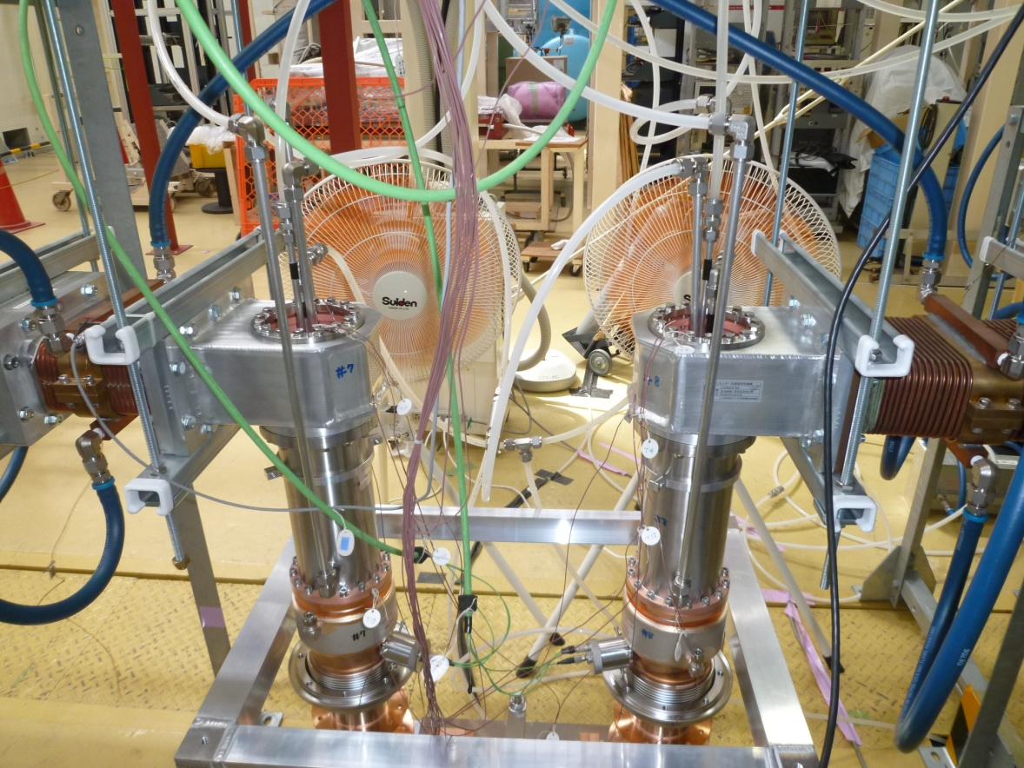
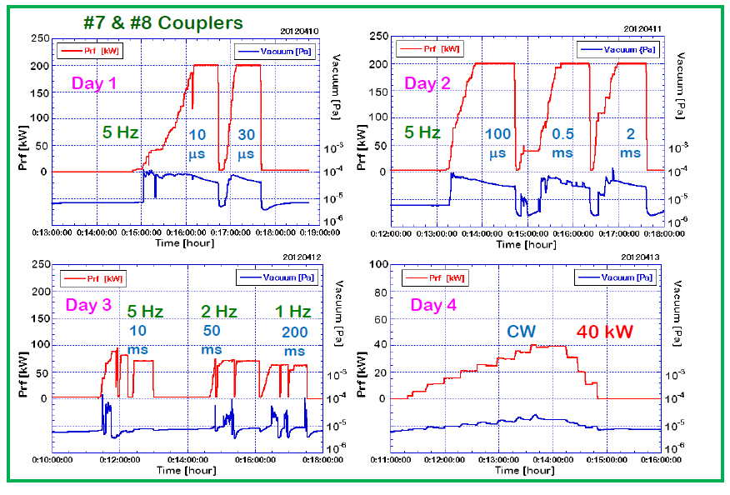
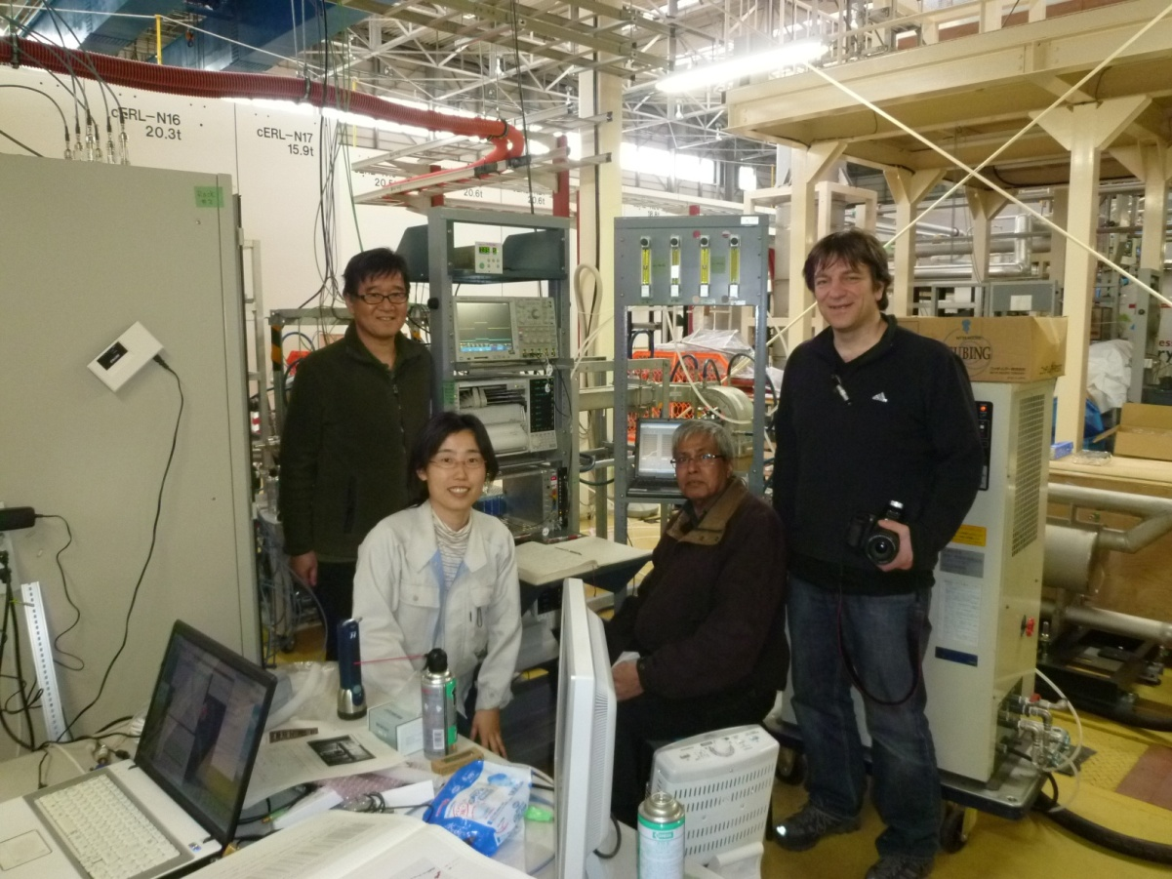
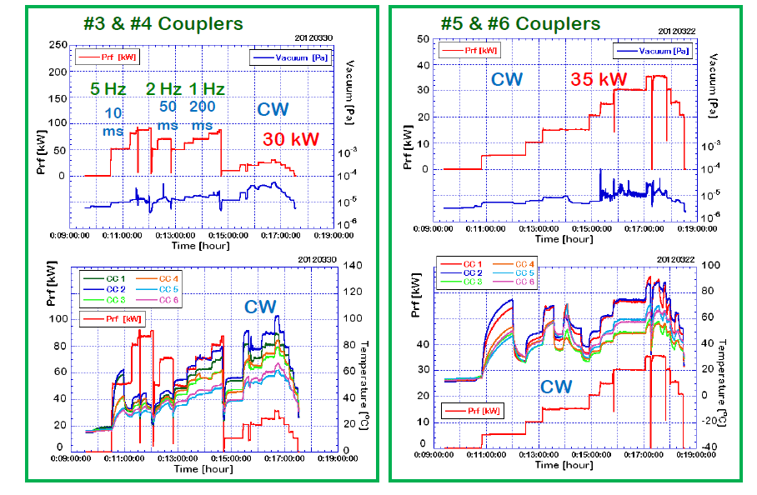
RF Conditioning of cERL Input Couplers
Collaboration with HZB/Triumf/KEK
200 kW, <2ms, 5Hz (1%)
30~40 kW, CW

Slide 11

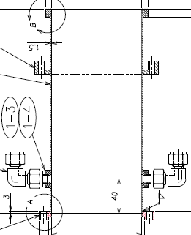
Further Improvement for efficient cooling by water
Outer conductor
Inner conductor
Water
cooling
channel
Water
cooling
jacket
N₂ gas
flow
N₂ gas
flow

Slide 12
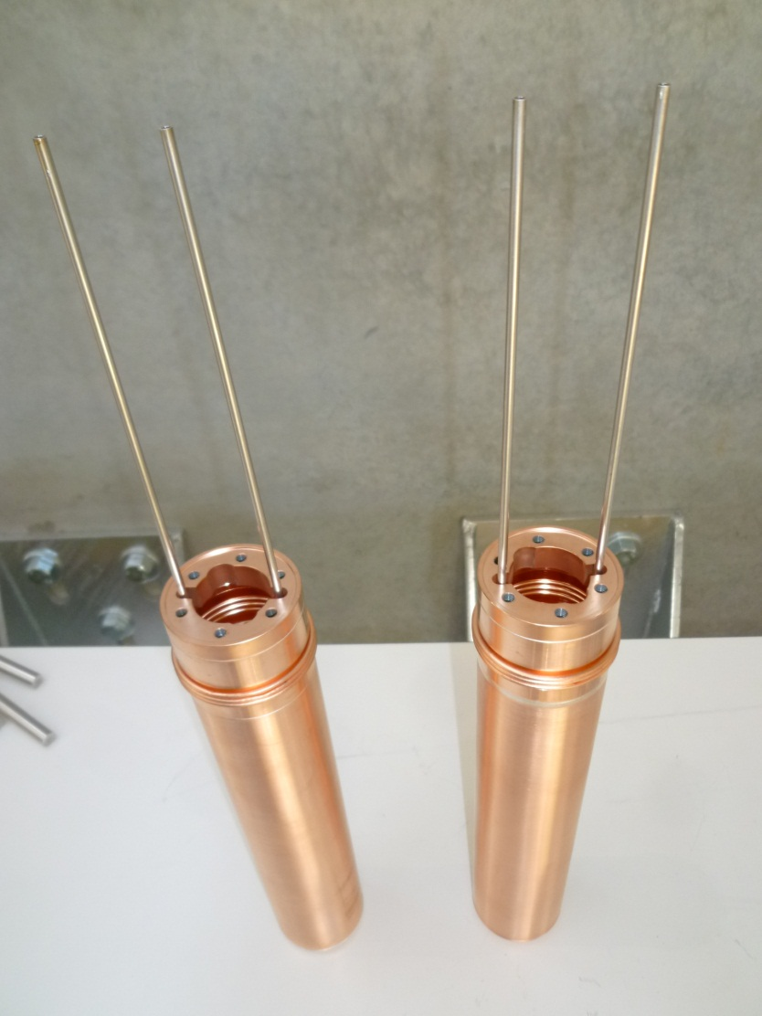
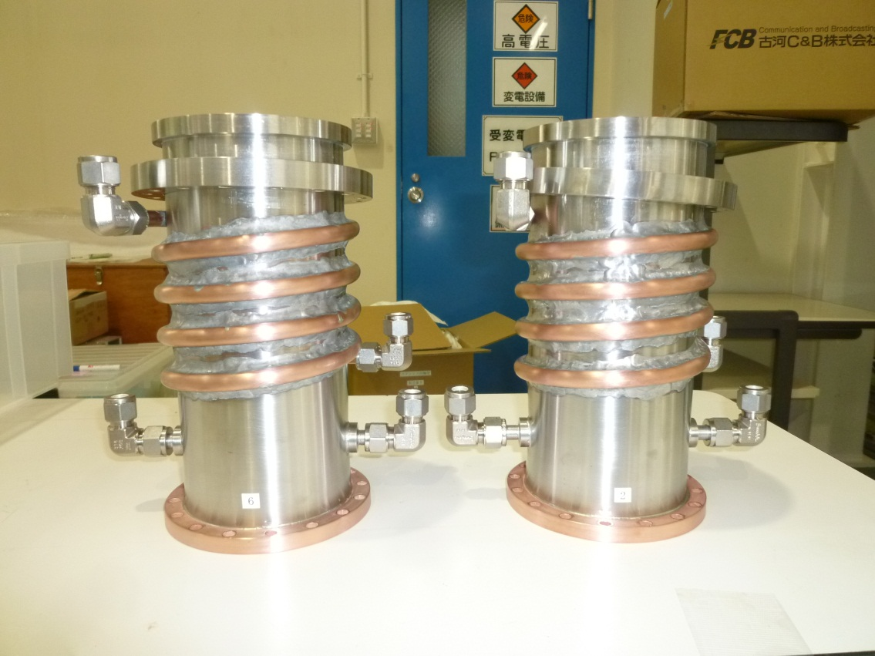
Further Improvement for efficient cooling by water
Inner conductor
Outer conductor

Slide 13
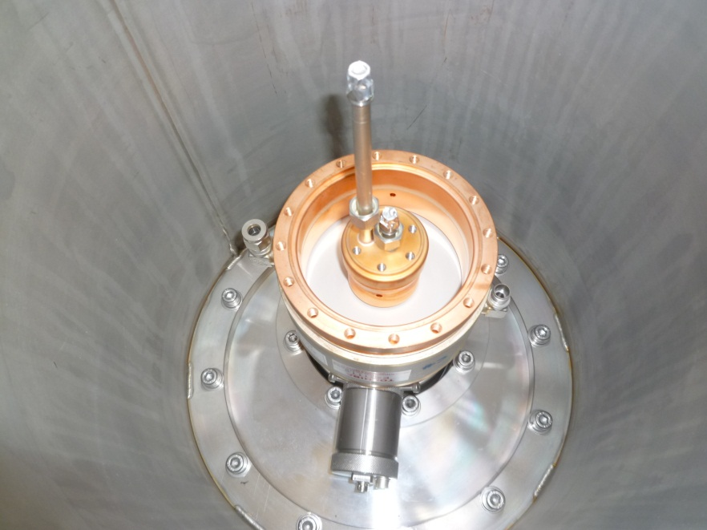
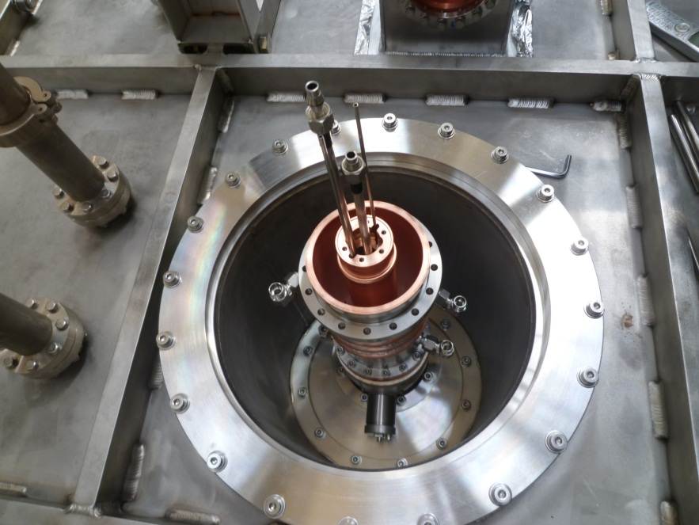
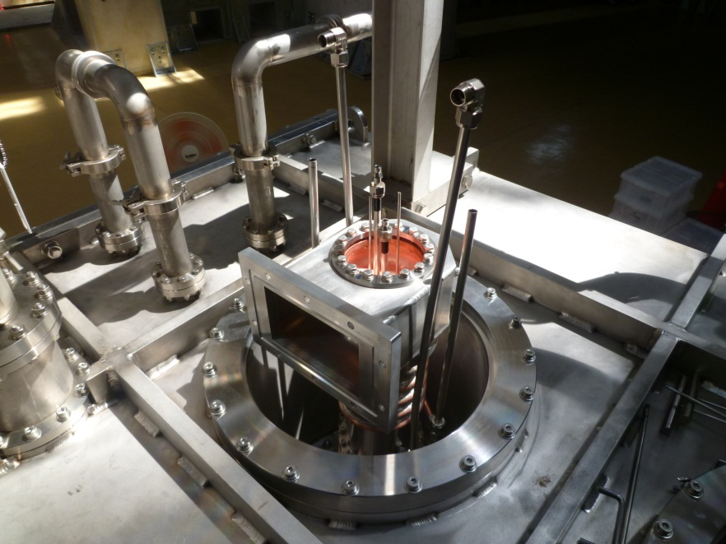
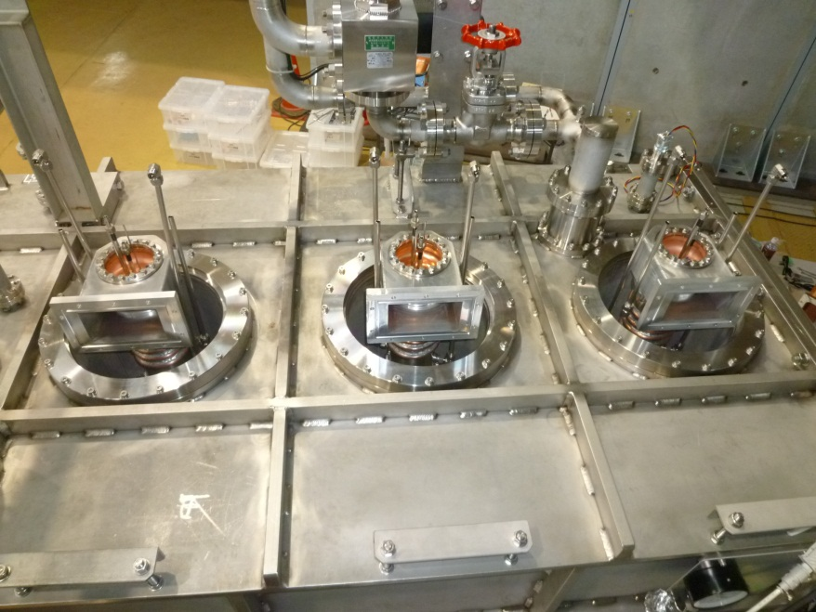
Assembly of input couplers for injector cryomodule

Slide 14
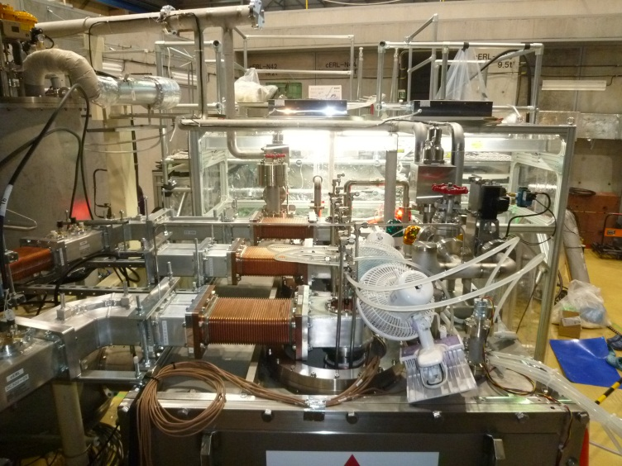
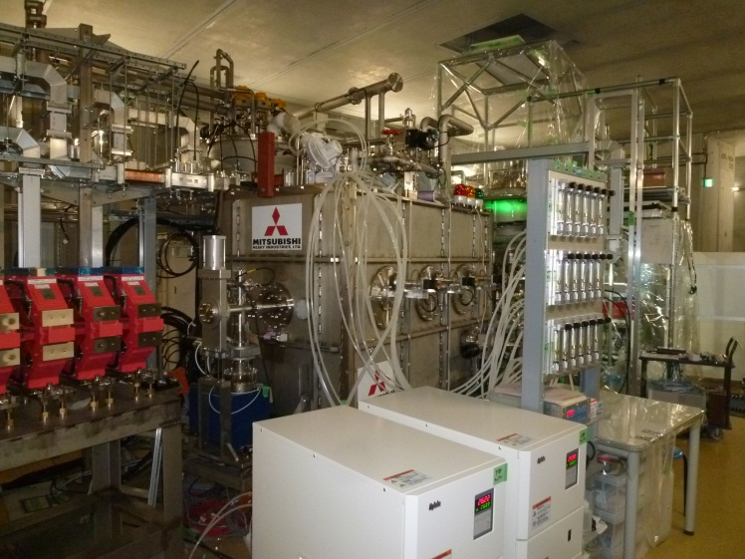
Conditioning in Cryomodule at R.T.
70 kW, <0.2s, 1Hz (20%)
20 kW, CW

Slide 15
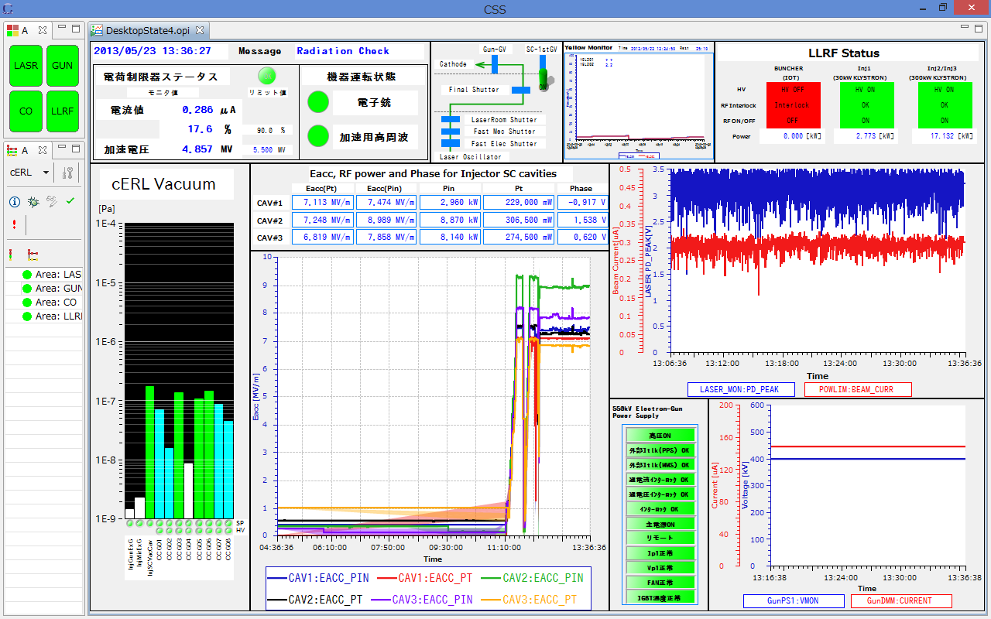
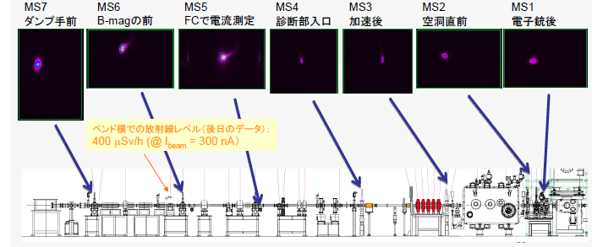
Beam Operation of cERL
e⁻ beam
5.0 MeV
0.3 μA → 10 mA
Beam operation:
Eacc = 7.2, 7.3, 6.9 MV/m
P_{RF} = 3.0, 8.9, 8.1 kW /2
Q_{L} = 12.0, 5.8, 4.8 x 10⁵

Slide 16
Summary and Next Step
KEK injector couplers were conditioned;
test stand: 200 kW (pulse, 1%), 40 kW (CW)
cryomodule: 70 kW (pulse, 20%), 20 kW (CW)
with beam: stable operation at ~ 5 kW (CW)
For the future 3-GeV ERL project;
Fabrication and conditioning at test-stand of
CW 100 kW level couplers with improved cooling
are scheduled.

Slide 17
END
Thank you for your attentions.

