Slide 1

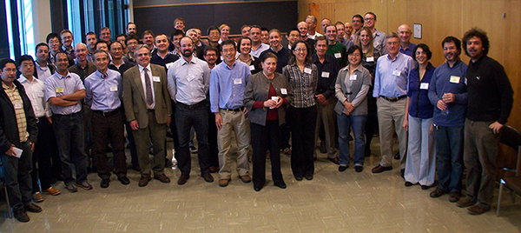
2 Year Outlook

Slide 2
Measurements in Guns

Slide 3
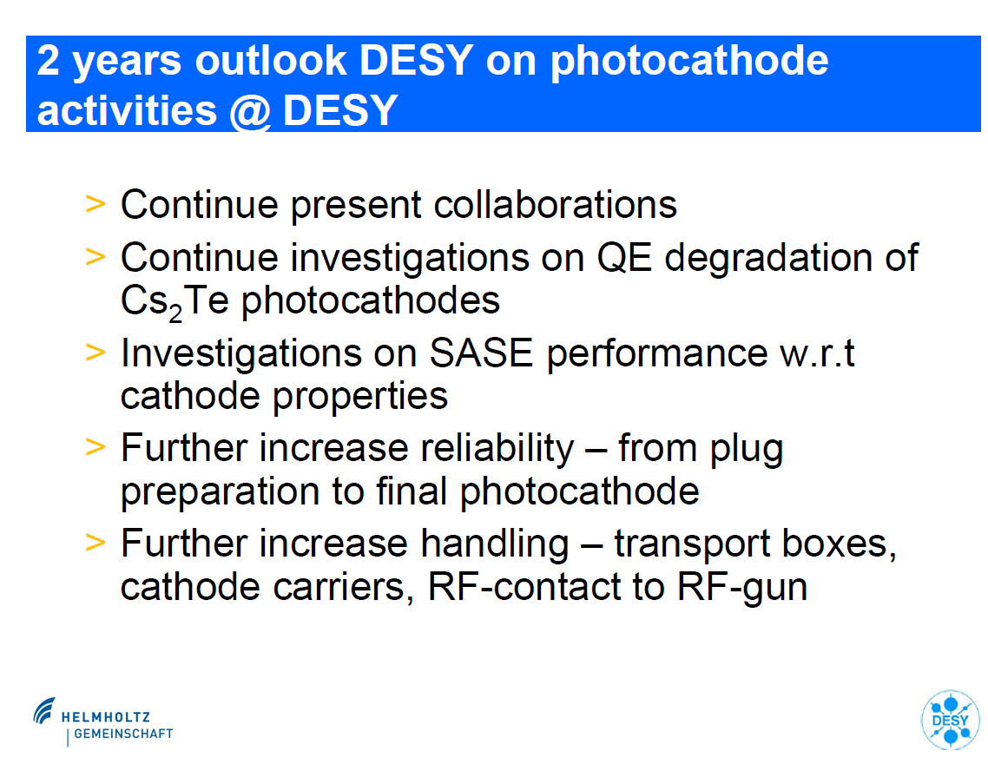

Slide 4
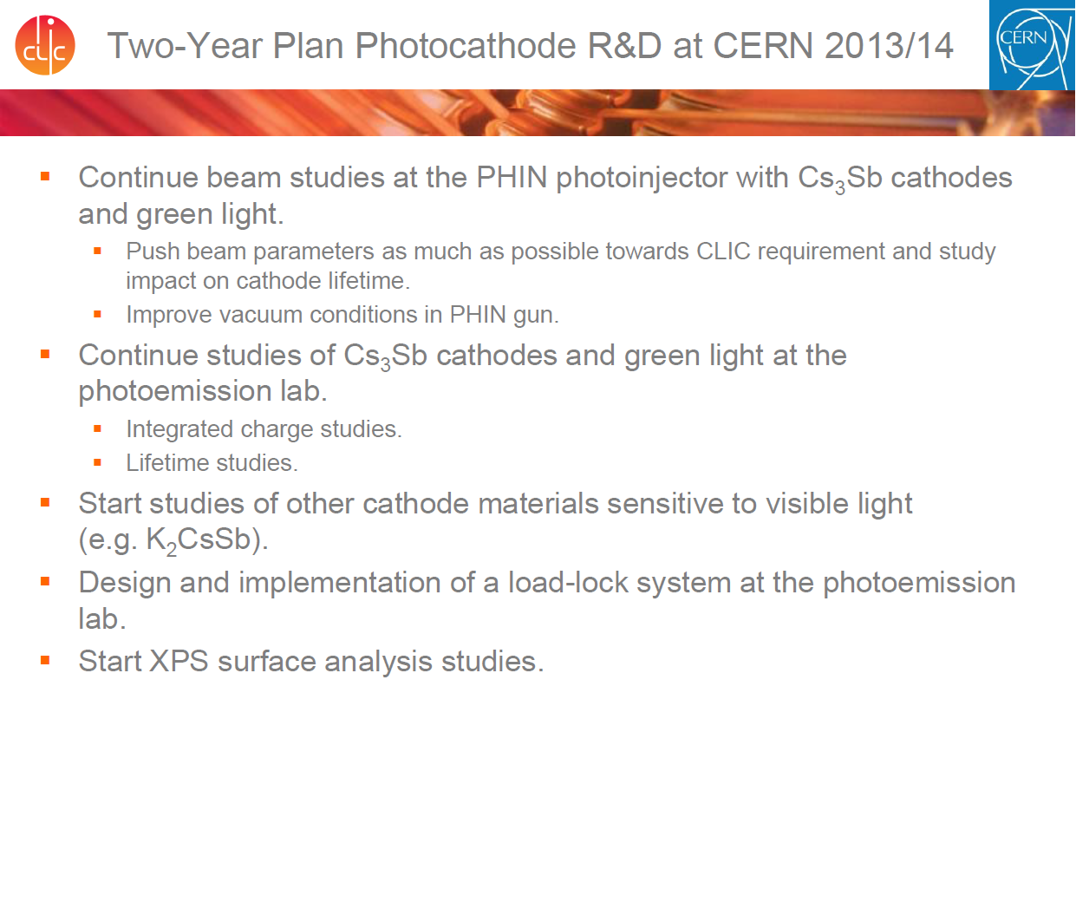
Two-Year Plan Photocathode R&D at CERN 2013/14

Slide 5
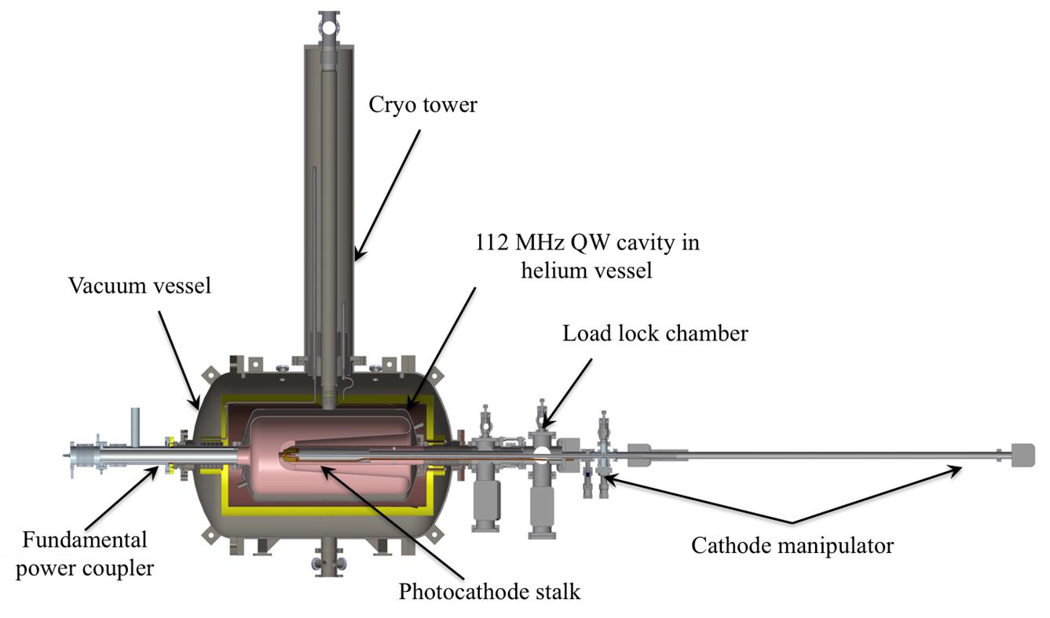
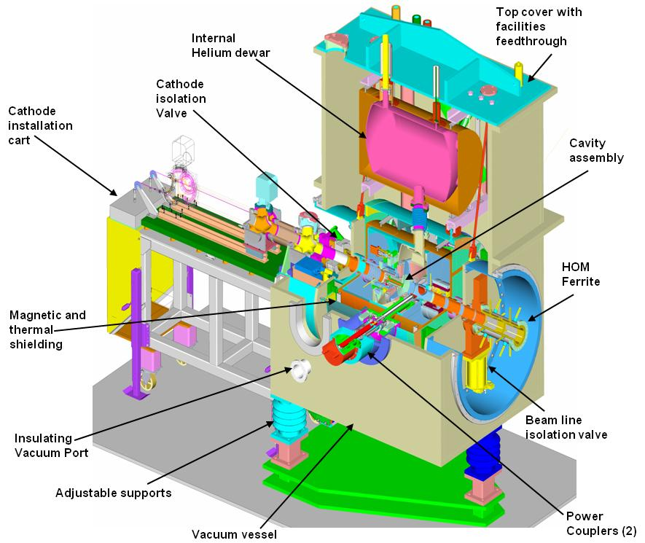
Future Programs at BNL: Gun Studies
112 MHz SRF gun tests
Fabricate cathode @ BNL
Tests at Niowave
Bialkali cathode: Dec 2012-Jan 2013
Diamond amplifier: Jan 2013
Gun transported to BNL: March 2013
700 MHz gun tests
Cu cathode: Cold emission, multipacting studies Nov. 2012
Bialkali cathode: low charge, low current, Jan 2013
Bialkali cathode: High charge, 2013
Studies continue after that
Continued Collaboration with
Jlab DC gun, bialkali cathode
LBNL-NCRF gun Diamond cathode
Deliver High current, polarized e beam from GaAs for Gatling Gun 2 years

Slide 6
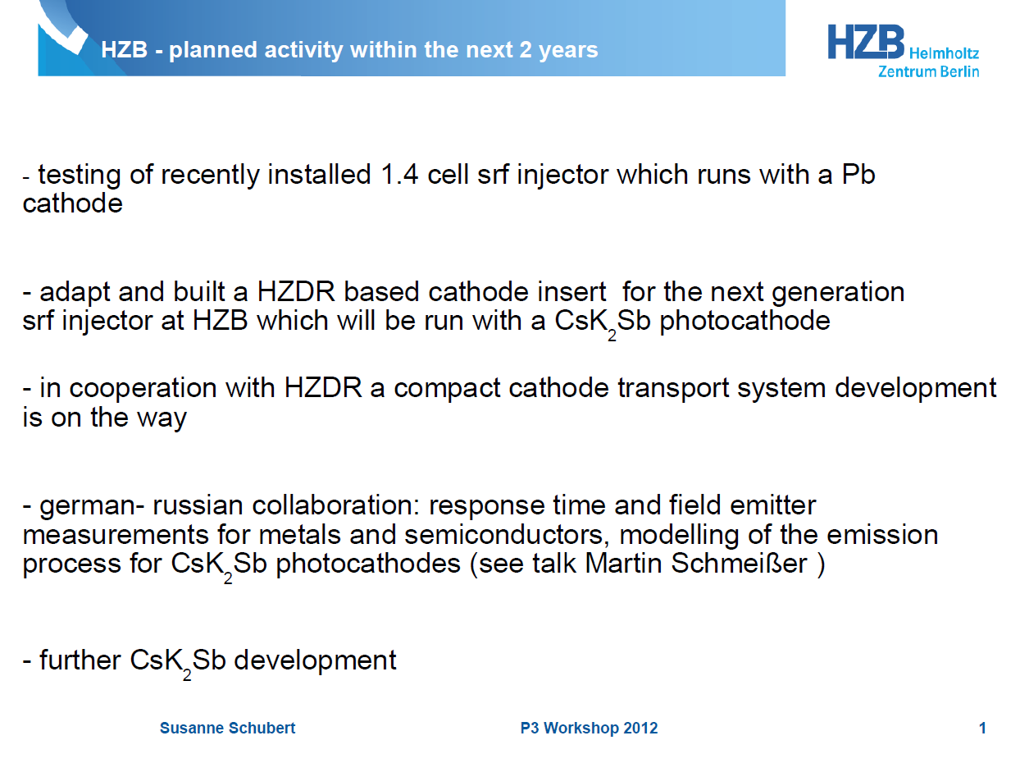

Slide 7
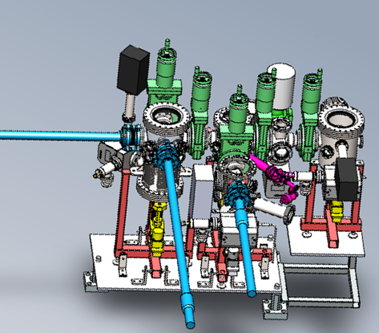
Jlab 2 year outlook
JLab FEL developing DC electron gun with segmented insulator and load-lock system, summer 2013
  Store up to 6 cathodes (GaAs first)
  Demonstrate long dark lifetime for stored Cs cathodes
  (make users happy with increased uptime)
Collaborate with Cornell on compatible photocathode puck and suitcase for transporting Cornell grown cathodes to JLab FEL
Produce CsK2Sb for testing in 200kV DC gun (have hardware)

Slide 8
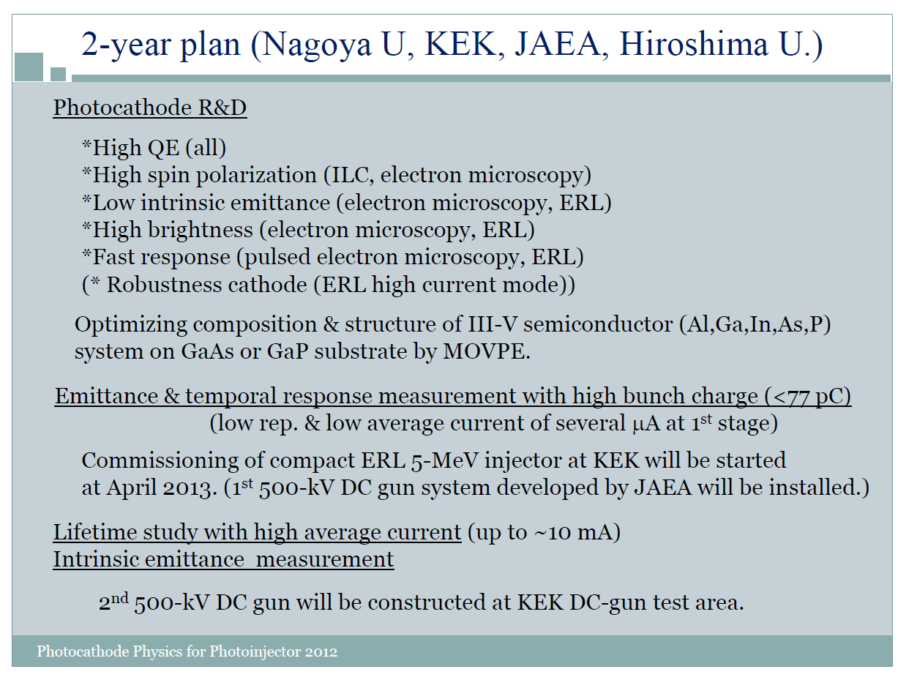

Slide 9
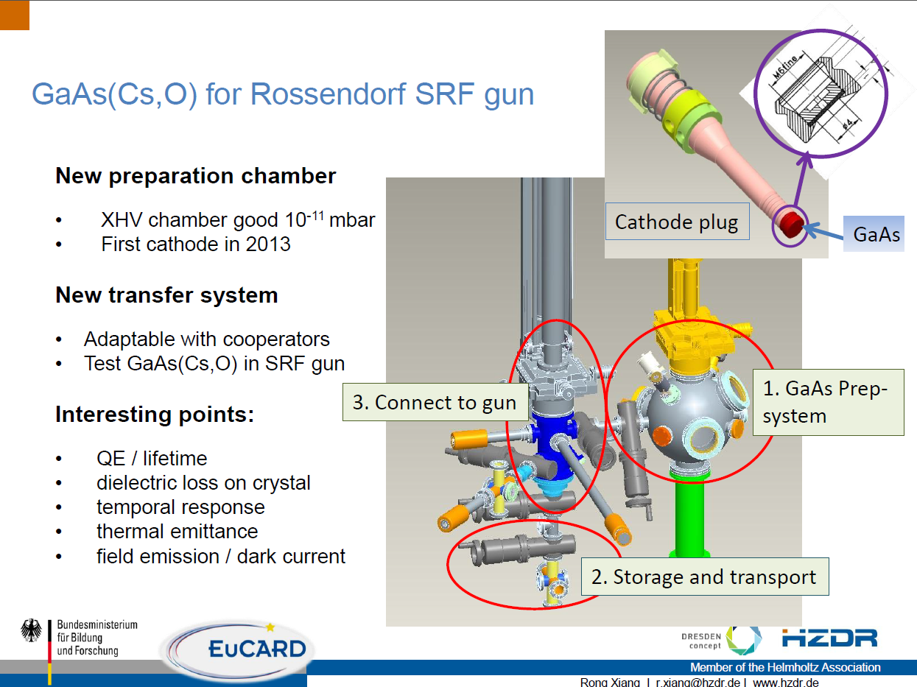

Slide 10
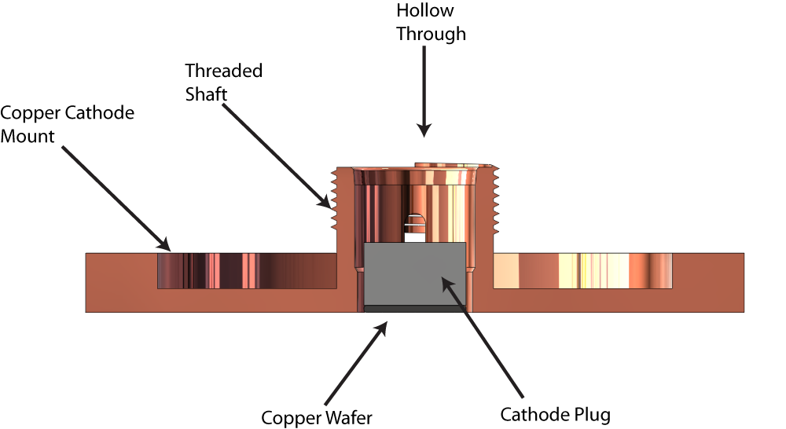
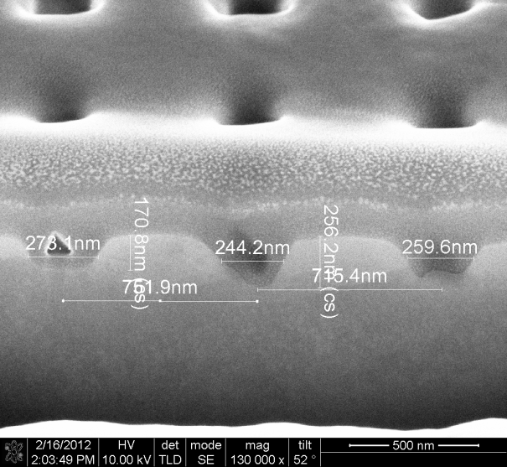
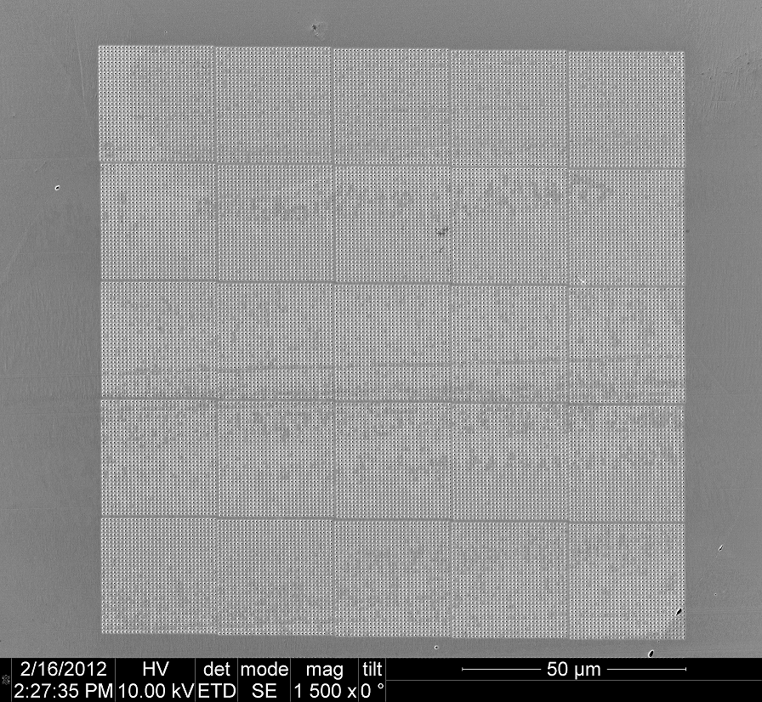

UCLA Pegasus RF photoinjector
S-band SLAC/UCLA/BNL 1.6 cell gun
3-5 MeV diagnostics beam line
Replaceable cathode. Cathode plug.
Nanopattern structures
  Optimize pattern
  Increase charge yield
  Nanostructured beams studies
Low thermal emittance cathodes for diffraction and microscopy applications.
  Require nm-emittance with 1 pC beam.
  Simulation challenge
800 nm
125 um
25 um square

Slide 11
Cathode Manufacture &
Research

Slide 12
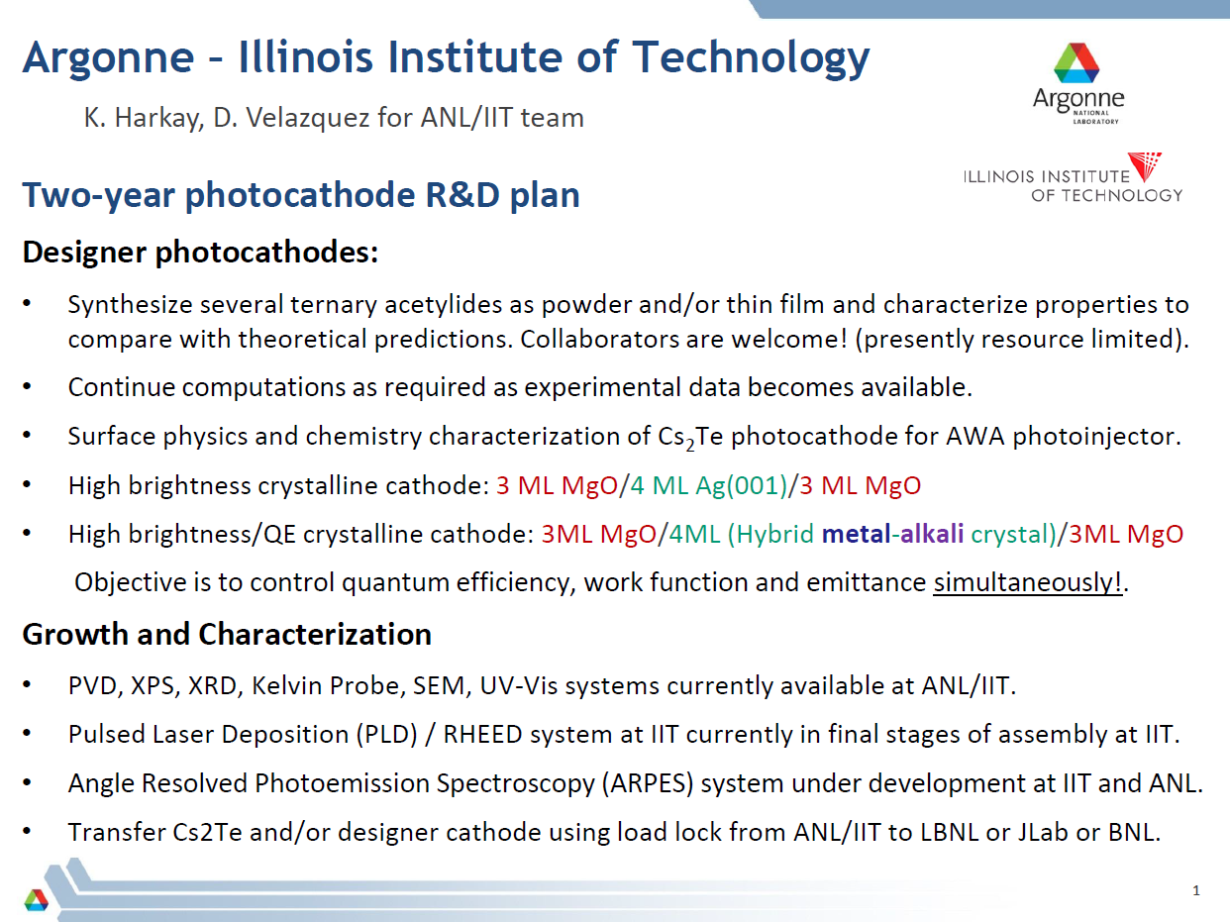

Slide 13
>2-year plan at Cornell University
Theory & modeling
  `complete’ photoemission model of III-V and related materials, including layered (quantum) structures;
  systematic verification with the experimental data;
Material engineering
  MBE growth of optimized transmission and reflection photocathodes;
  Roughness and plasmons: “messing” with the surface to one’s advantage;
Nail down the narrow cone!
  Can the crystal transverse momentum be conserved for effective mass ratios << 1; if yes, what are the prerequisites;
  `Holy grail’ of photocathodes: sub-thermal emitters with sub-ps response time and QE of more than few percent in the visible;
Alkali antimonides
  Finish the photocathode table for `new’ old materials;
  Evaluate high-current (>> 10 mA) performance and lifetime in the photoinjector for materials other than K2CsSb;
  Streamline the growth process: new and better metal sources, involve industry to grow cathodes;
Complete suite of in-situ characterization capabilities of new and existing photocathodes
  Photocathode lab on ‘steroids’: band gap and work function characterization during growth and activation, energy spectra, response time, chemical analysis all done in situ;

Slide 14
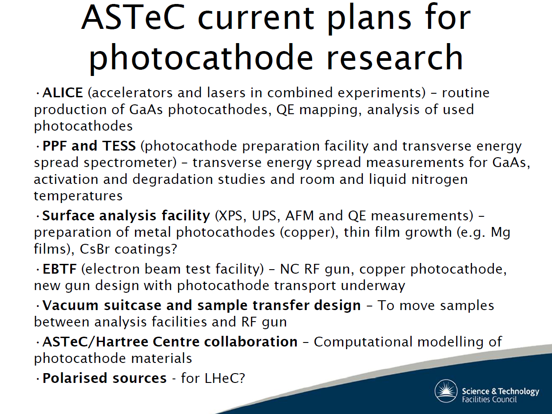
ASTeC current plans for photocathode research
ALICE (accelerators and lasers in combined experiments) – routine production of GaAs photocathodes, QE mapping, analysis of used photocathodes
PPF and TESS (photocathode preparation facility and transverse energy spread spectrometer) – transverse energy spread measurements for GaAs, activation and degradation studies and room and liquid nitrogen temperatures
Surface analysis facility (XPS, UPS, AFM and QE measurements) – preparation of metal photocathodes (copper), thin film growth (e.g. Mg films), CsBr coatings?
EBTF (electron beam test facility) – NC RF gun, copper photocathode, new gun design with photocathode transport underway
Vacuum suitcase and sample transfer design – To move samples between analysis facilities and RF gun
ASTeC/Hartree Centre collaboration – Computational modelling of photocathode materials
Polarised sources - for LHeC?

Slide 15
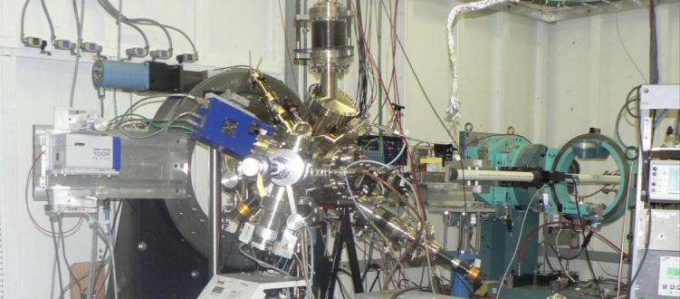
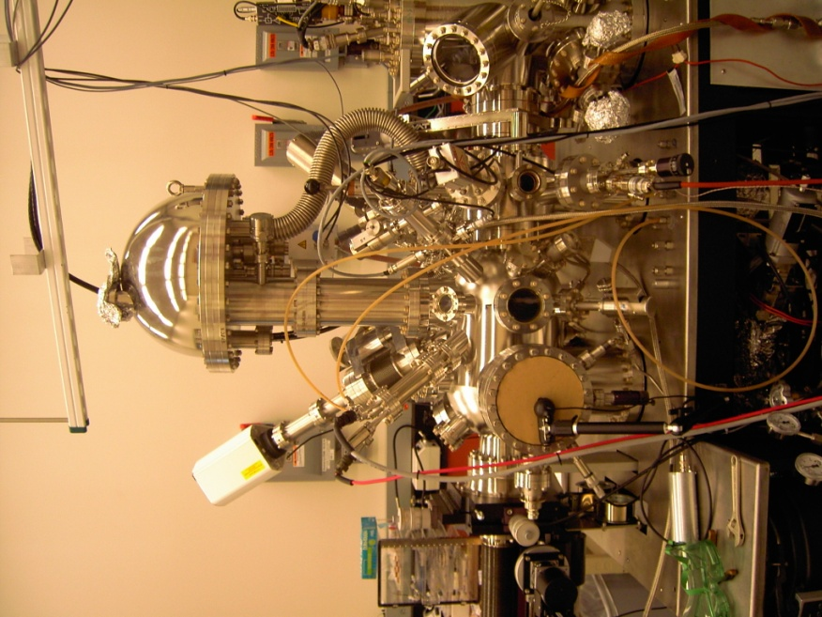
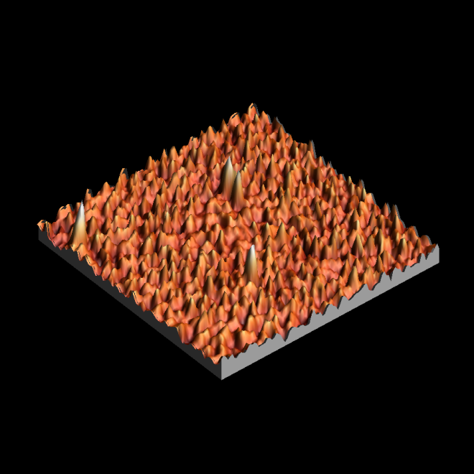
Future Programs at BNL: Cathode Studies
X-rays
Cathode materials science (2013 plans)
  Post-operation XRD analysis of cathode operated in SRF gun
  XPS of metal cathodes to observe surface contamination and correlate with laser cleaning process
  XPS of Alkali Antimonide cathodes after each stage of growth, and after oxidation
  Investigation of Alkali antimonide texture and grain size, and correlation to growth method and QE
  ARPES of Diamond emission as a function of boron doping
  Charge transport and emission from diamond with a delta-doped B surface
  Cathode preparation for RF gun tests:
  Develop GaAs photocathodes in SRF gun and in a funneling multi-cathode system
  Develop diamond amplifiers and test in RF guns

Slide 16
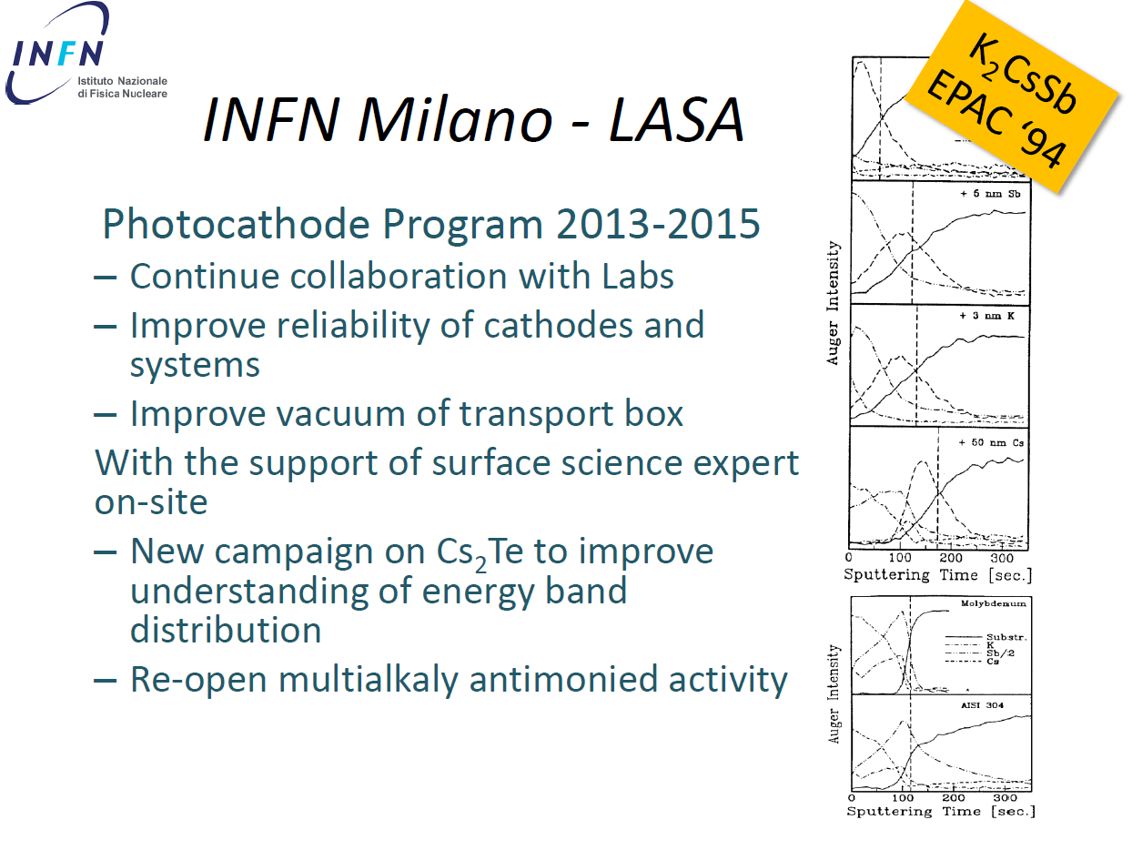

Slide 17
UIC
2+ Year Plan
Find or fabricate, and characterize, low electron effective mass (m*)
cathode materials
- Single crystal metals, semi-metals (and alloys?)
- Doped semiconductor 2-D electron gas surface quantum wells
- Excited-state thermionic emission from AlSb (m*(Γ₈) ≈ 0.15m₀)
Emittance theory with m*: transverse and longitudinal
Tunable, ultrafast (<1ps), UV laser source (250-300nm; hν = 4-5eV)
- In-situ QE(hν) and ε_{n,rms}(hν) measurements
Angle-resolved photoemission spectroscopy (ARPES)
[Future collaboration with J.-C. Campuzano at UIC]
- Determination of m* at Fermi level
- Time-resolved ARPES for emission latency and excited state dynamics

Slide 18
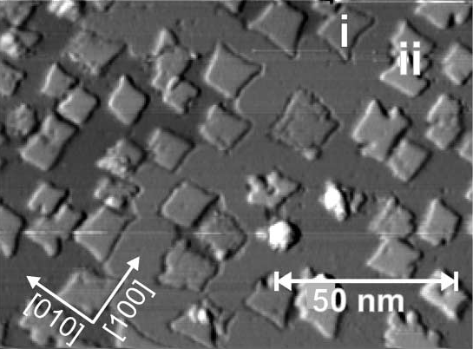
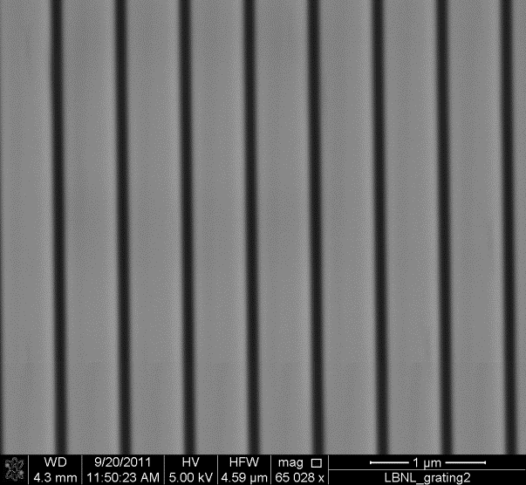
Two Year Plan PNNL
*Excited state reactions of photocathode coatings: CsBr and metals
- with Juan Maldonado
*MgO on Ag (100)
- with Kathy Harkay and Karoly Nemeth
Plasmonic Nanostructures: Gratings and hole arrays
- with Howard Padmore
NaCl on Ag(100)
MgO on Ag(100)
Pivetta et al. Phys. Rev.
B 72, 1154041 (2005)
Schintke et al. Phys. Rev.
Lett. 87, 276801 (2001)

Slide 19
Photocathode research in Berkeley 2012 - 2014
Complete cathode to VHF gun transfer system to enable measurement in the gun and post-mortem
analysis of cathodes from the gun
Continue to work with BNL / Stonybrook on cathode growth using the tools of modern materials science
Develop new methods for production of alkali antimonide cathodes with very low roughness for
very high field gradient guns. First step will be the synthesis of bulk material, probably followed by PLD
Continue to investigate use of bandstructure in ordered materials:
- finish off surface state work on metals
- investigate layered compounds and bulk band materials
- exotic materials such as BiTe3 with localized emission at the Fermi level
Continue to investigate the use of structured plasmonic materials
- use for optimum absorption of IR used in multiphoton photoemission cathodes
- use for non-stochastic emission of electrons from a cathode (cold sources)
- structured emission for super-radiance schemes
Continue to develop electronic structure calculations for prediction of cathode properties

