Slide 1
Photocathode Wiki Project – A website for the community, by the community
Siddharth Karkare

Slide 2
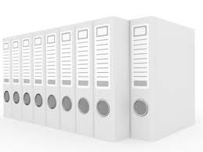
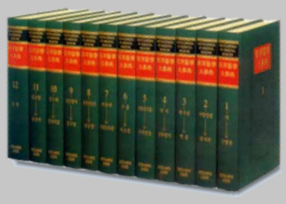
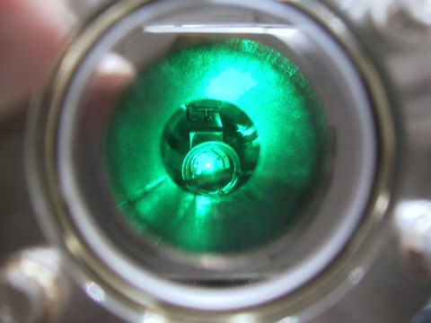
Broad Goals
Create a free online repository of photocathode info for accelerator applications
Encyclopedia for photocathode physics
Enable research collaborations easily and advancement of photocathode physics

Slide 3
A wikisite that contains
Photocathode look-up table
Photocathode preparation details
Photocathode theory
Photocathode diagnostics and surface characterization
Collaboration portal

Slide 4
Photocathode look-up table
A table giving info about
QE
Lifetimes/vacuum conditions
Emission wavelengths
Thermal Emittance
for various cathodes
Metal Cathodes | Wavelength & Energy: λ_{opt}(nm), ℏω (eV) | Quantum Efficiency (electrons per photon) | Vacuum for 1000h operation (Torr) | Work Function,φw (eV) | Thermal Emittance (microns / mm(rms)) Eq. (1) | Thermal Emittance (microns / mm(rms)) Expt.
Bare Metal
Cu | 250, 4.96 | 1.4 x 10⁻⁴ | 10⁻⁹ | 4.6 ^{[2]} | 0.5 | 1.0 ± 0.1 ^{[3]}
 |  |  |  |  |  | 1.2 ± 0.2 ^{[4]}
 |  |  |  |  |  | 0.9 ± 0.05 ^{[5]}
Mg | 266, 4.66 | 6.4 x 10⁻⁴ | 10⁻¹⁰ | 3.6 ^{[6]} | 0.8 | 0.4 ± 0.1 ^{[6]}
Pb | 250 , 4.96 | 6.9 x 10⁻⁴ | 10⁻⁹ | 4.0 ^{[2]} | 0.8 | ?
Nb | 250 , 4.96 | ~2 x 10⁻⁵ | 10⁻¹⁰ | 4.38 ^{[2]} | 0.6 | ?
Coated Metal
CsBr:Cu | 250 , 4.96 | 7 x 10⁻³ | 10⁻⁹ | ~2.5 | ? | ?
CsBr:Nb | 250 , 4.96 | 7 x 10⁻³ | 10⁻⁹ | ~2.5 | ? | ?
Dowell et al,NIMA Volume 622, Issue 3, 21 (2010)

Slide 5
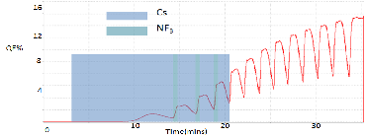
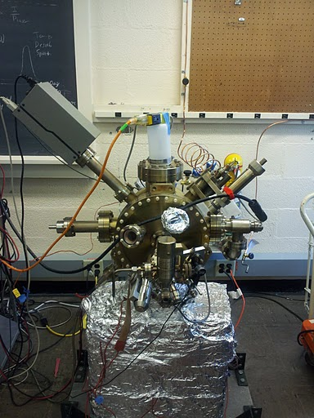
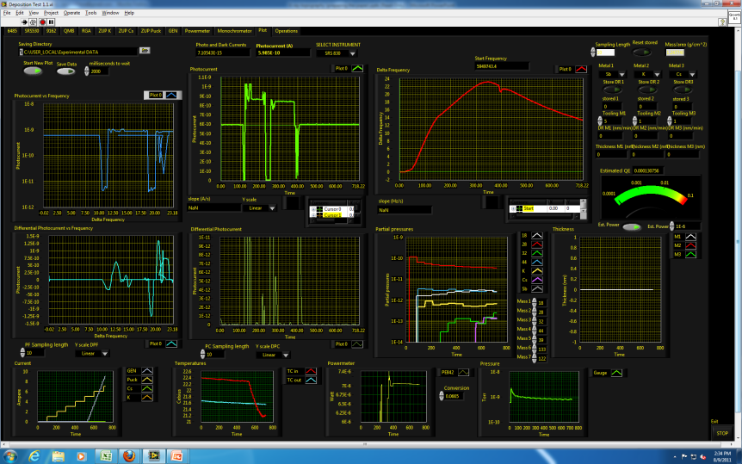
Photocathode preparation details
Designs of prep chambers
Cleaning, preparation and growth procedures from various labs along with lab specific results
Diagnostics required during preparation/growth

Slide 6
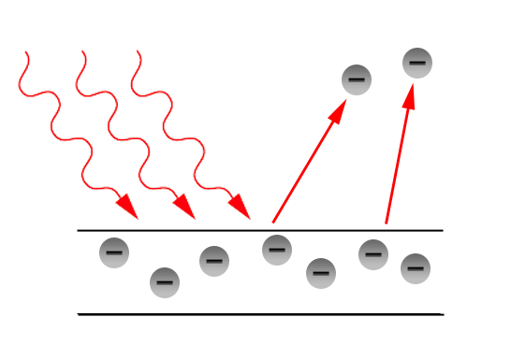
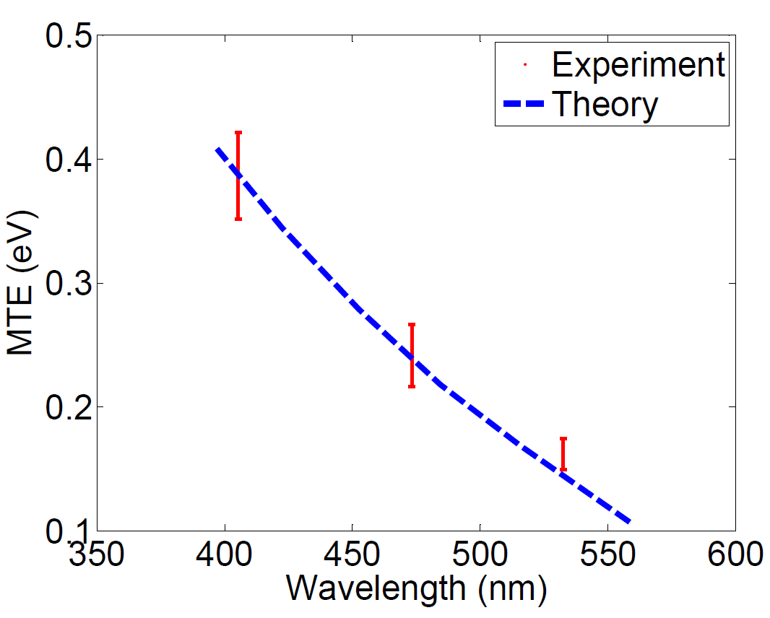
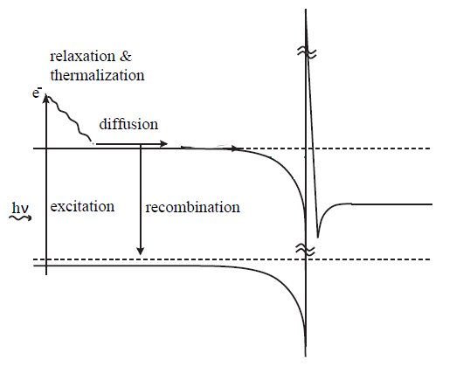
Photocathode theory
Various photoemission models
Material specific modeling
Electron transport within bulk
Surface physics
Emission physics

Slide 7
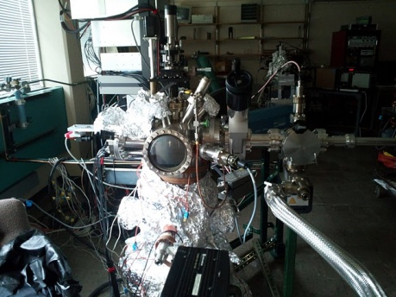
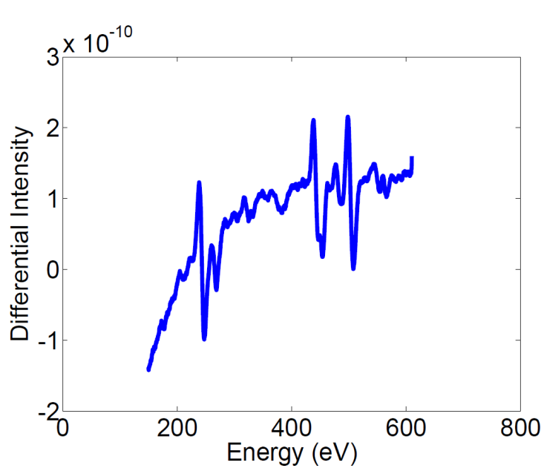
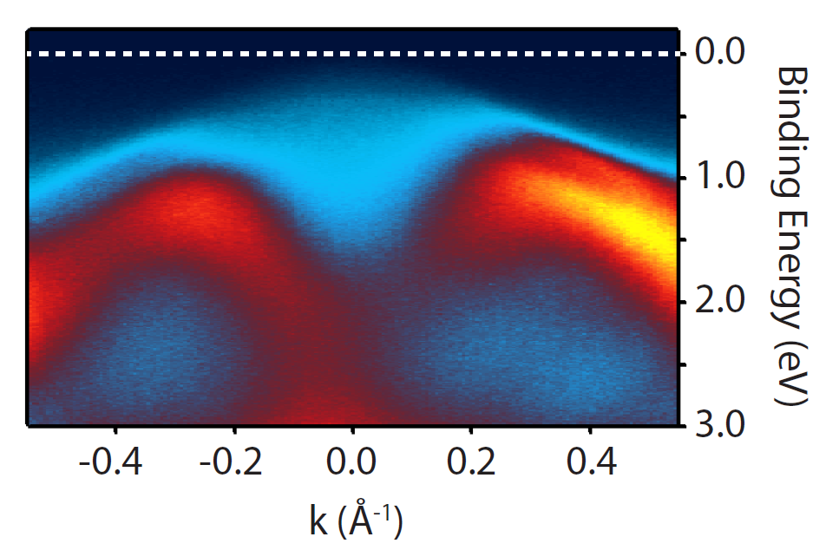
Photocathode diagnostics and characterization
Various available surface diagnostics
Beam diagnostics
Procedures for characterizing photocathodes
What to look for while characterizing cathodes

Slide 8
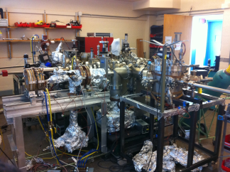
Collaboration portal
Techniques and capabilities available at various labs
Small scale and large scale facilities
Theory collaborations
List of publications and references

Slide 9
What we have so far
URL - http://photocathodes.chess.cornell.edu

Slide 10
Thanks to
Ivan Bazarov and Rick Merluzzi for setting up the website
CHESS for hosting it
All those who contributed so far…

