Slide 1
Cathode production and supply
Photocathode website
(useful things to track)
Daniele Sertore
INFN Milano – LASA

Slide 2
Introduction
In the last 15 years we have delivered
about 120 cathodes mainly to
DESY-FLASH and DESY-PITZ
We have a mean operative lifetime of the cathode (24/24h 7/7d) of about 3 months with FLASH parameter (1 nC, 800 μs, 10 Hz, 42 MV/m)
Mean QE at delivery is about 10 % (λ=254 nm)

Slide 3
Cs₂Te GROWTH and diagnostic

Slide 4
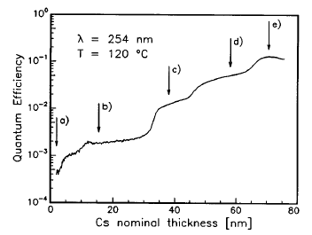
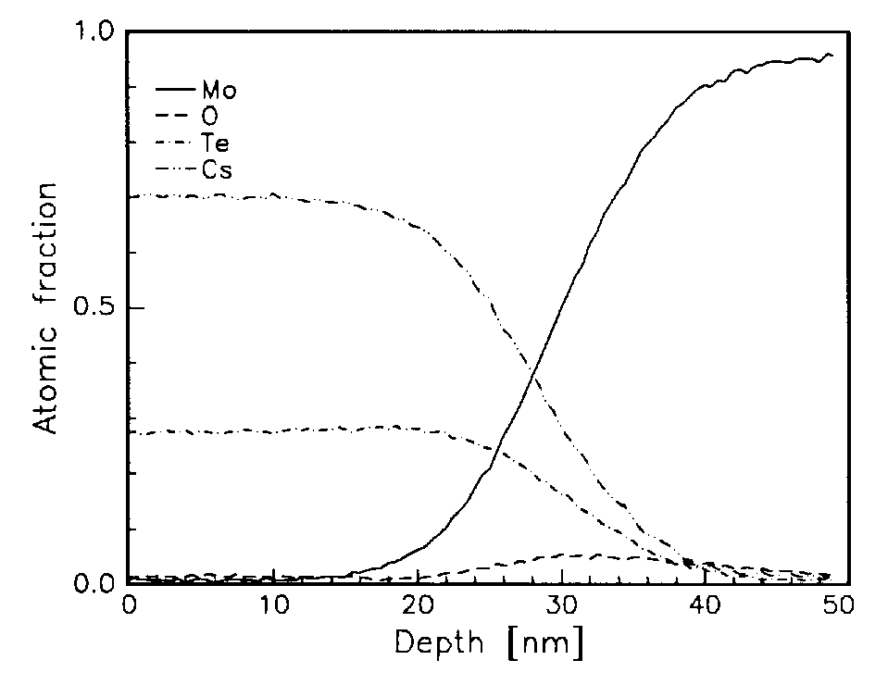
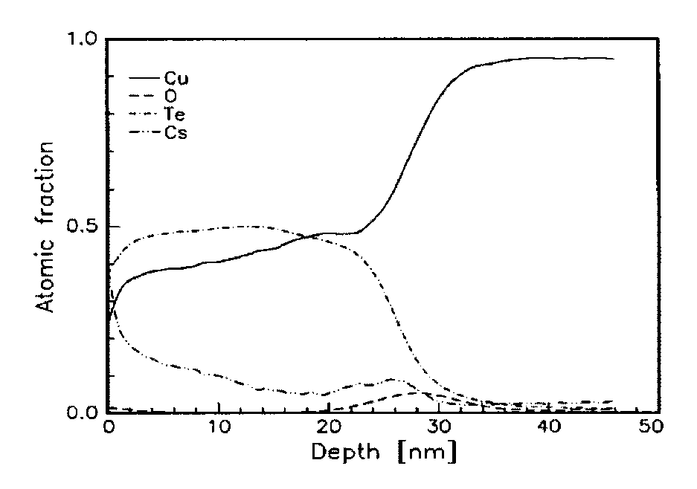
Cs₂Te Recipe
Cathode growth
The recipe was developed in Milano and as a “process” transfer to Modena for analysis.
Auger Electron Spectroscopy shows formation of different stoichiometric compounds during Cs deposition. The “correct” Cs/Te ratio is reached corresponding to the QE maximum.
Substrate contribution
The Mo plug prevents diffusion of the film (AES + Ar⁺ sputtering study). Estimated photocathode typical thickness is 20-30 nm.
 | Cs/Te
b) | 0.6
c) | 1.2
d) | 1.9
e) | 2.5
A. di Bona et al., JAP80(1996)3024
Cs₂Te
Mo
Cs₂Te
+
Cu
Cu

Slide 5
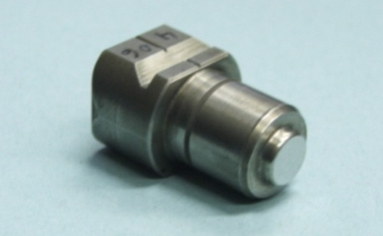
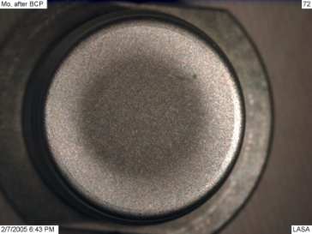
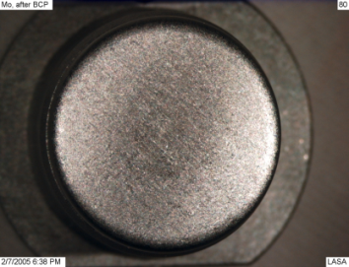
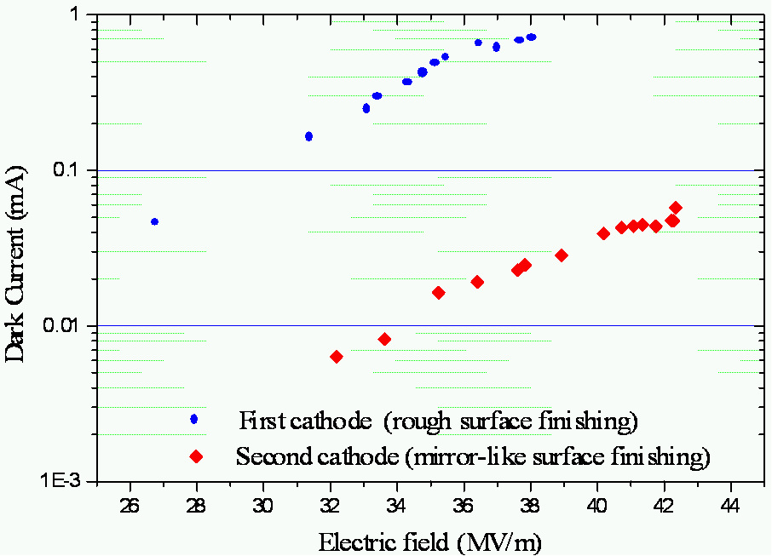
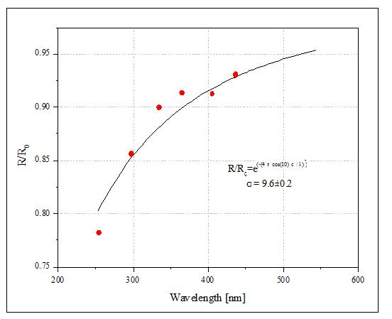

The Cs₂Te support
The recipe was then transfer to a plug compatible with gun operation
The Mo plugs, either from sintered or arc-cast material, are cleaned with a Buffered Chemical Polishing after machining.
The plugs are then polished to optical finishing to reduce dark current
The quality of the optical finishing is measured by photocathode reflectivity which
provides also
information on
surface
roughness,
typically ≈ 10 nm.
Sintered
Arc-cast
Rough Surface
Optical Finished

Slide 6
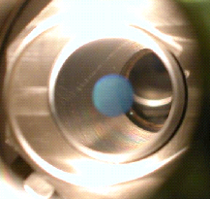
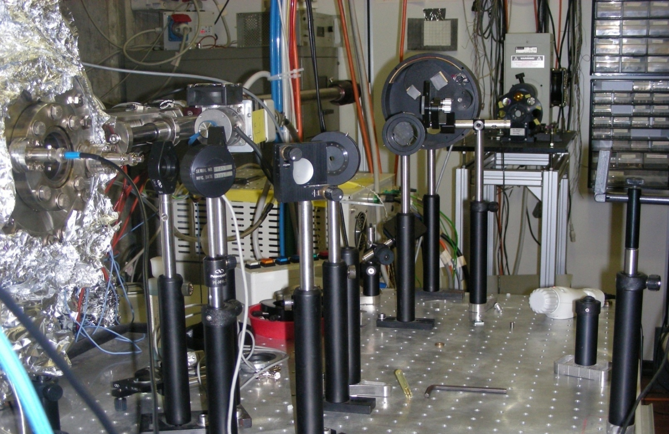
Deposition and Diagnostic
Active Area
During cathode deposition a circular masking system shapes the photoemissive layer and center it. The actual masking diameter is 5 mm
5 mm
Calibrated photodiode for reflected light power from the film
A motorized and remotely controlled filter wheel with interference filters (239 nm, 254 nm, 334 nm, 365 nm, 405 nm, 436 nm)
Picoammeter for photocurrent measurement
Hg lamp
Shutter
Prep. chamber viewport
Filter wheel
Incident power
Reflected power
Photodiode
Photocurrent signal
Remote controller

Slide 7
On-line diagnostic
Control
Te deposition on the Mo plug
Completion of the Cs₂Te (no Cs excess)
  Measure
QE & R @ λs during deposition
  Estimate
E_{g}+E_{a} threshold formation during the deposition
QE @ different λ during the Cs deposition
The “last” peak
5 nm
10 nm
15 nm
QE
Eg+Ea
Eg+Ea and QE @ 254nm vs.
Cs deposition
QE @ 254 nm vs. Cs deposition
R @ 254nm vs. Te and Cs deposition

Slide 8
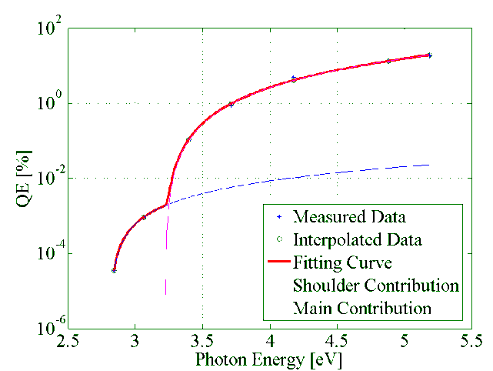
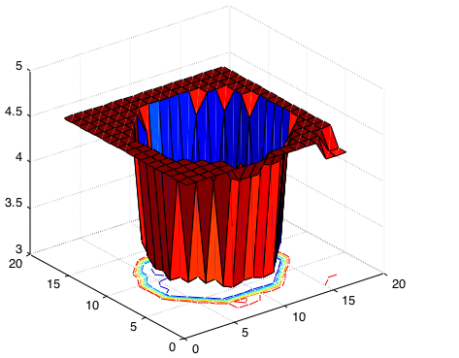
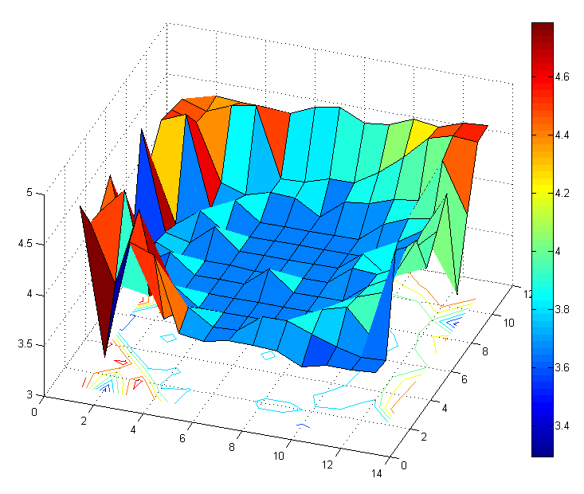
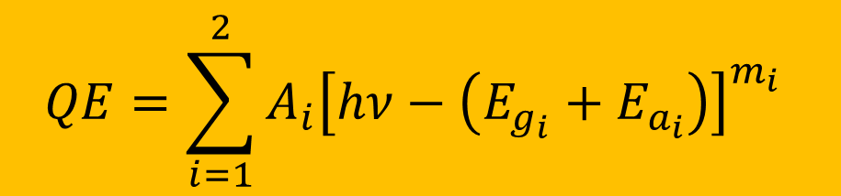
Spectral Response and QE maps
  The spectral response analysis provides the energy threshold (E_{g}+E_{a}).
  We fit data with function based on the “Kane” model
  Typical values for thresholds:
    3.3 eV (“high energy”)
      2.8 eV (“shoulder”)
$$QE=\sum_{i=1}^{2}{A_{i}{\left[hν−\left(E_{g_{i}}+E_{a_{i}}\right)\right]}_{}^{m_{i}}}$$
QE [%]
E_{g}+E_{a} mapping
Fresh Cathode
Aged Cathode
mm
mm

Slide 9
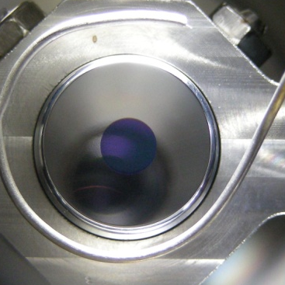
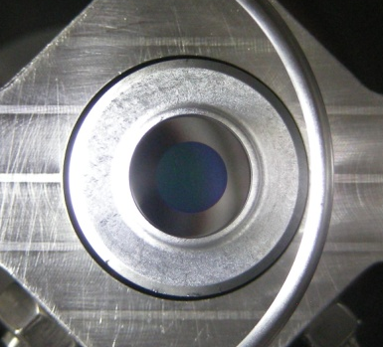
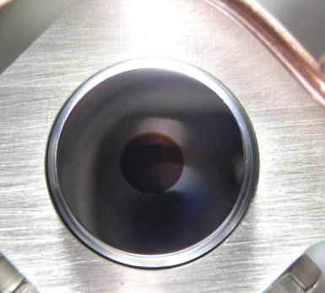
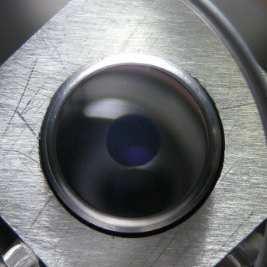
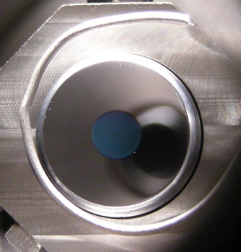
Spectral response reproducibility
The on-line diagnostic allows better control of the cathode growing.
The reproducibility of produced cathode spectral responses is largely improved.
The Cs excess is under control.
No more low energy shoulder.
104.4
417.1
107.3
77.3
123.2

Slide 10
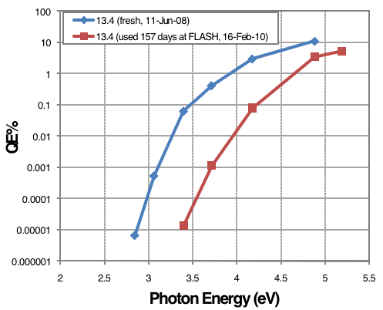
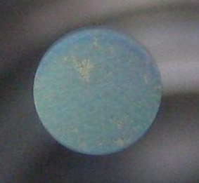
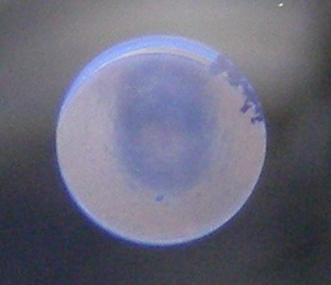
Post Usage Diagnostic
Cathode 13.4 – 157 days of operation
Measurement done at LASA
QE @ 254 nm = 3.5%
Initial QE was 11%.
Decrease of the low energy threshold as expected
After production
After usage
Cathode 77.2 – 176 days of operation
After usage, central part of the cathode has a clear darker area
Lack of coating on the right upper film area

Slide 11
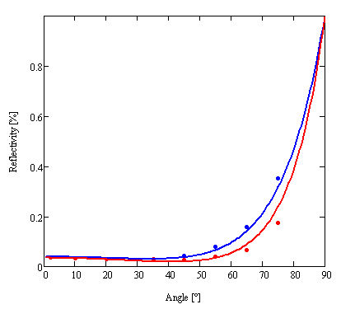
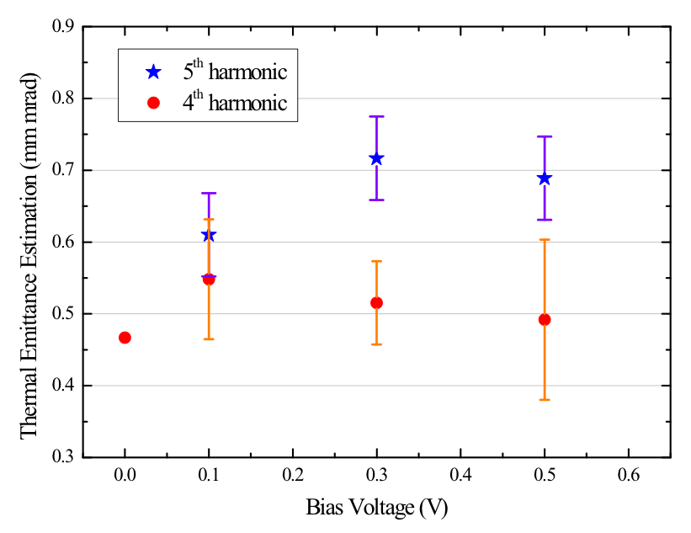
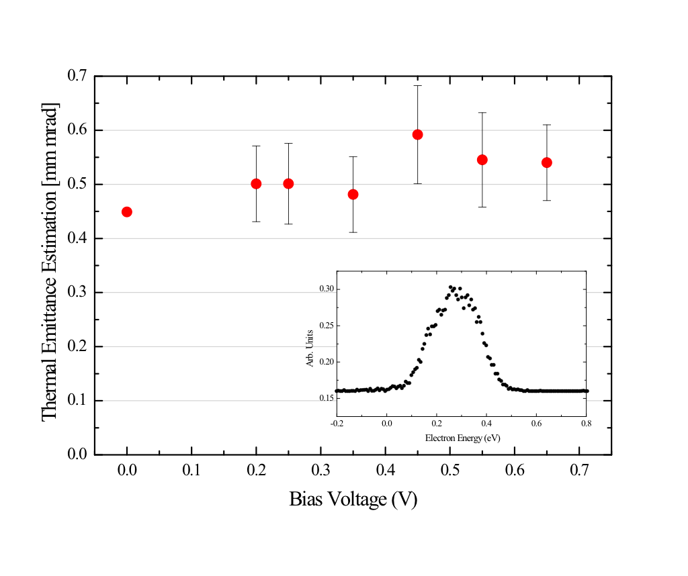
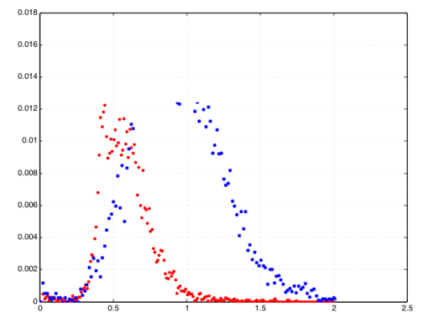
R&D activities
Optical Properties
Thermal Emittance
n | k | σ [nm] | thickness [nm]
1.75 | 0.356 | 0 | 38.5
R_{s}
R_{p}
Cs₂Te
Ag

Slide 12
PHOTOCATHODE SYSTEMS

Slide 13
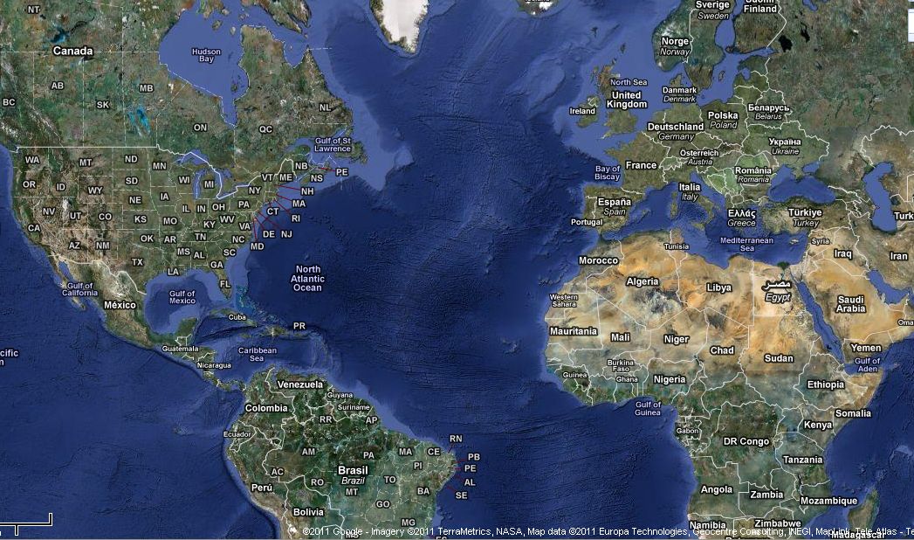
INFN Photocathode Systems
Preparation Systems | Transfer System
INFN Milano – LASA | DESY - FLASH
DESY – HH | DESY - PITZ
Fermilab – Lab7 | DESY - REGAE
Fermilab-A0 | Fermilab –NML
HZB (XPS) | LBNL

Slide 14
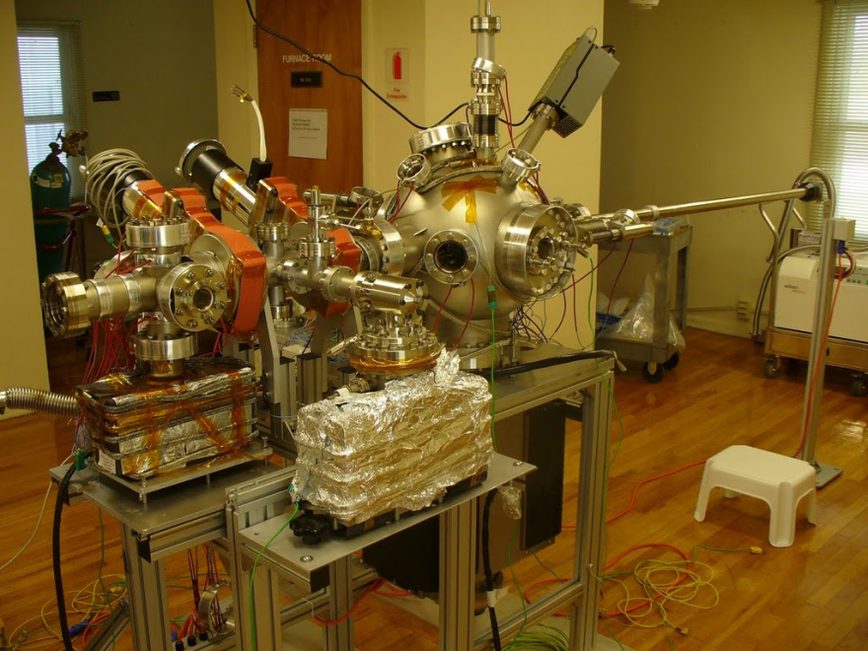
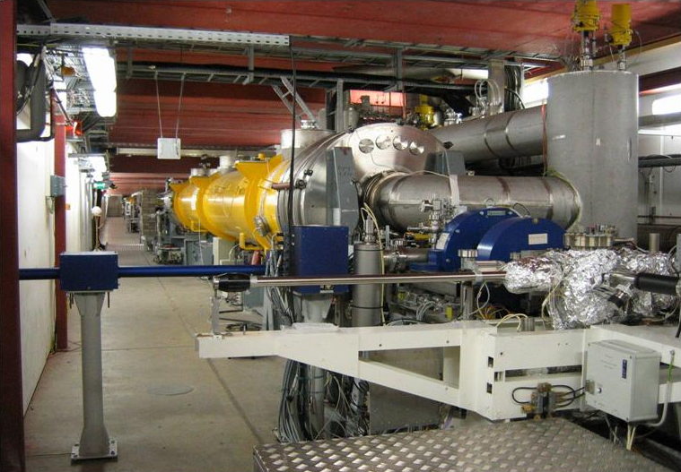
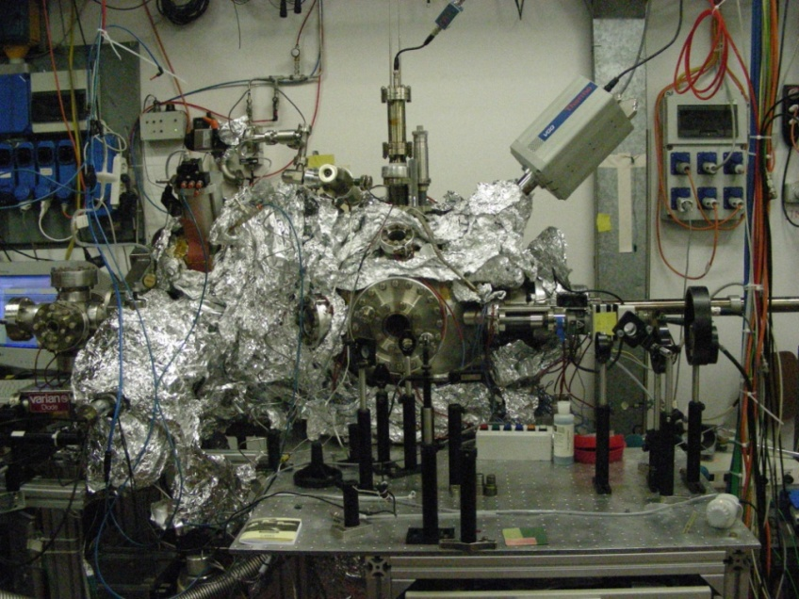
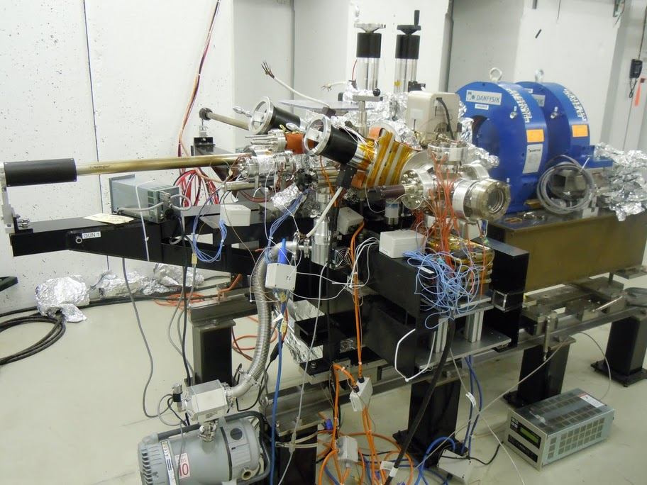
Cathode systems
RF Gun and FLASH linac
Transfer Chamber
Preparation Chamber @ FNAL
LASA preparation system
FNAL Transfer system

Slide 15
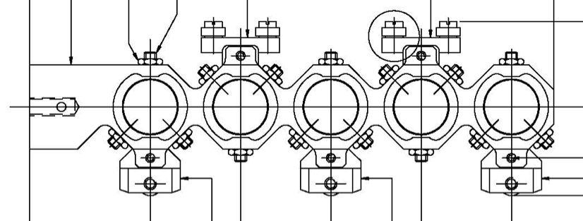
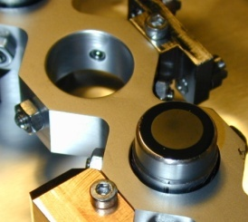
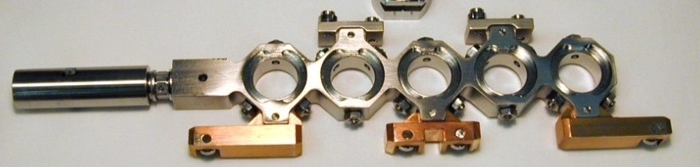
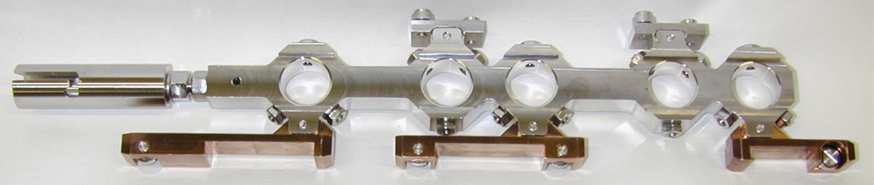
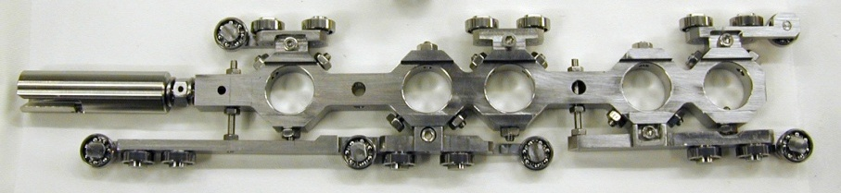
Carriage Evolution
A0 Carrier
Bajonet
2nd gen.
Increased Space
3rd gen.
4th gen.
New Sliding Blocks

Slide 16
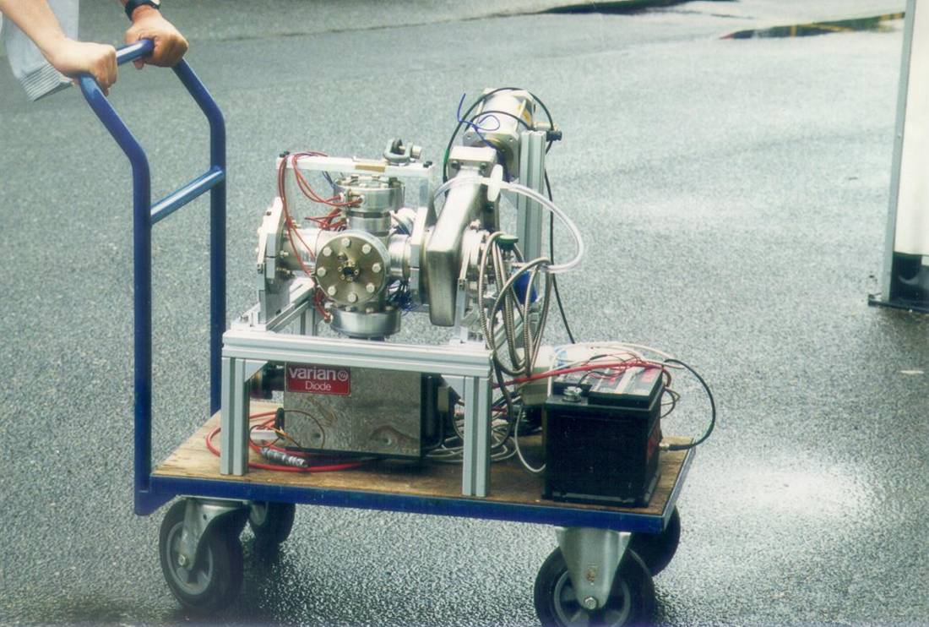
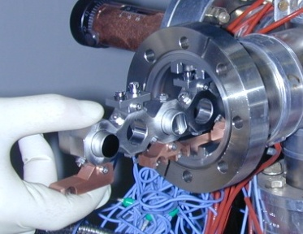
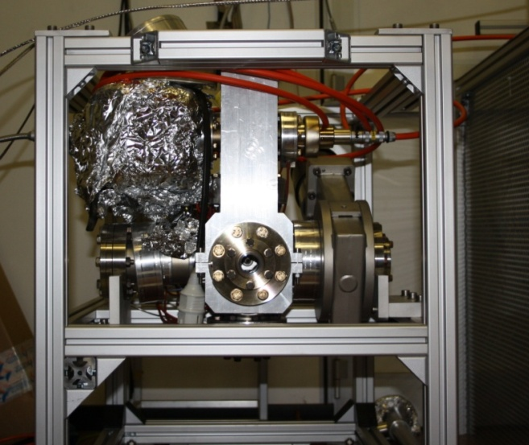
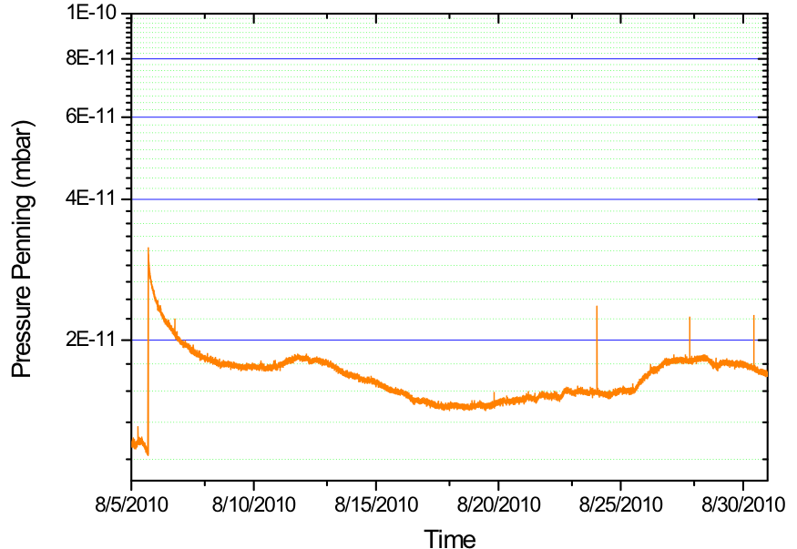
Transport System
Cathodes are transported under UHV condition from INFN Milano to the Labs.
Transport box
Cathode Loading
No power supply needed.
OK for airplane
Ion Getter Pump
Triax C.C.
SAES D100 NEG Pump

Slide 17
Cathode 409.1 in LBNL Box
1 Oct 2012
The efficiency of the new pumping system, has been tested:
switching off the ion pump (for about 3 months)
measuring the QE vs. λs
QE at 254 nm:
  Stable within few percents
  QE at 436 nm:
  Reduced by an order of magnitude
High stability of the spectral responses

Slide 18
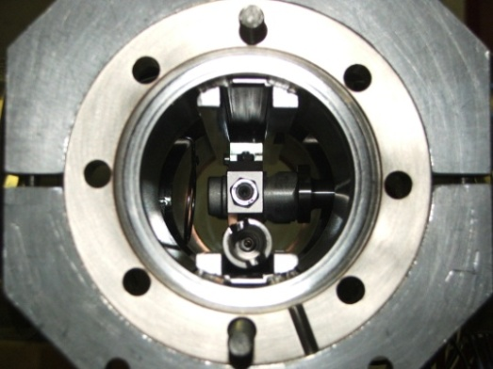
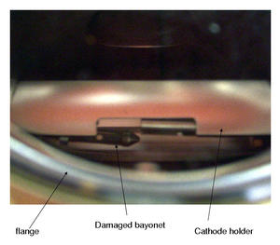
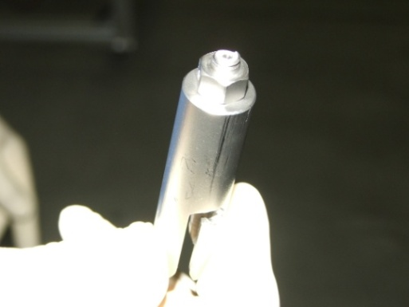
Photocathode handling system
Analysis of accident during cathode operation:
  Only three significant accidents have occurred after about 12 years of operation
Damages on the connection system:
  due to a not correct parking of the carrier in the transport box and then closing of the valve
  due to the manipulator magnet uncoupling from its vacuum counterpart
12

Slide 19
Photocathode database

Slide 20
The Photocathode Database
The database tracks photocathode performances in the different transport boxes and in the different labs as well as properties of plugs during cathode preparation.
Data from INFN Milano, DESY (FLASH, PITZ, REGAE), FNAL (NML & A0) and LBNL are included.
Plug Driven
Access to cathode properties during operation
Access to plug data and cathode related properties
Box Driven

Slide 21
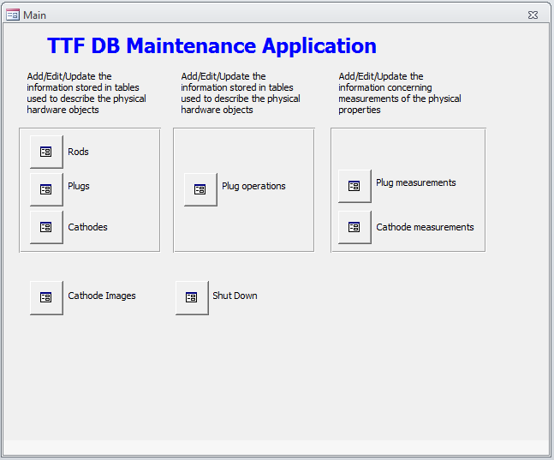
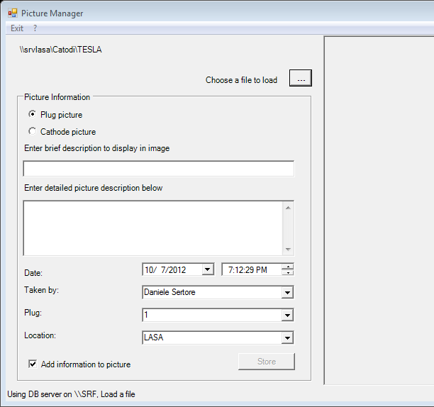
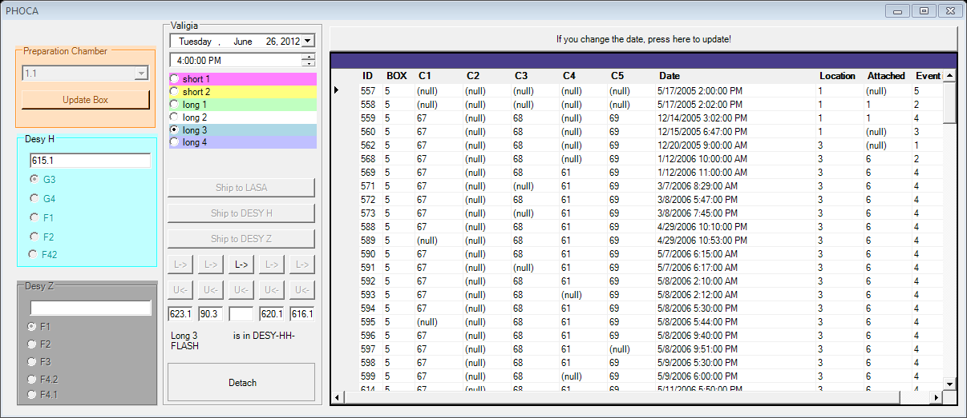
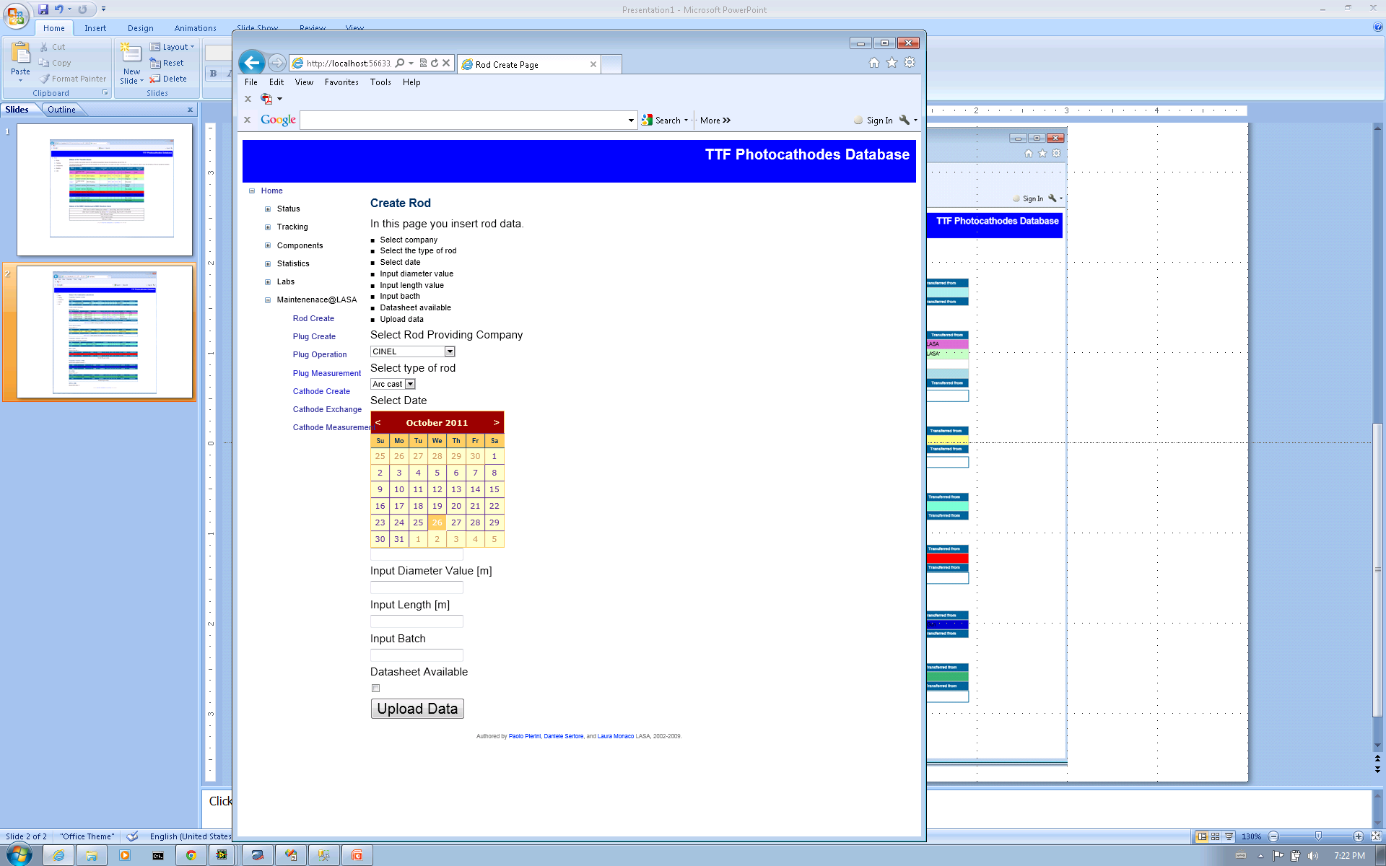
Database filling
MS Access
Forms
Dedicated
program
Web Interface

Slide 22
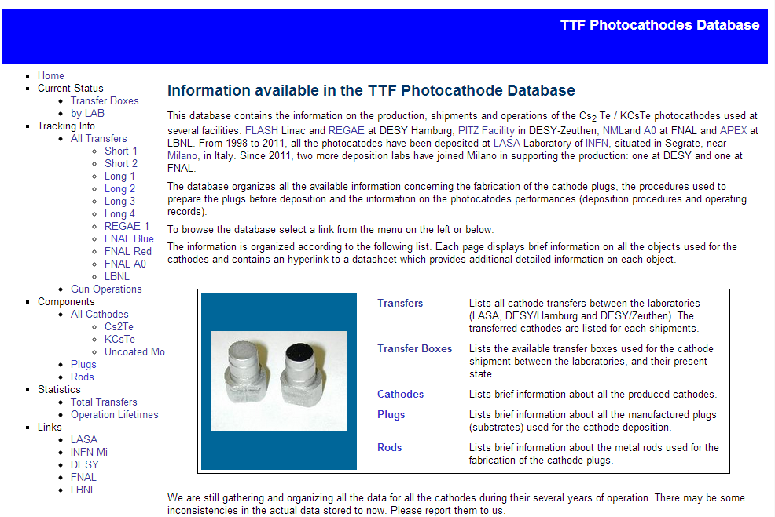
Web Interface
http://wwwlasa.mi.infn.it/ttfcathodes/

Slide 23
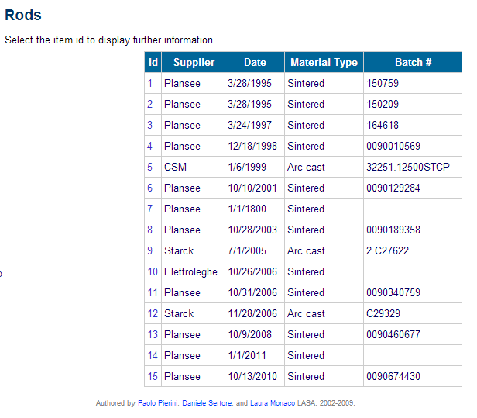
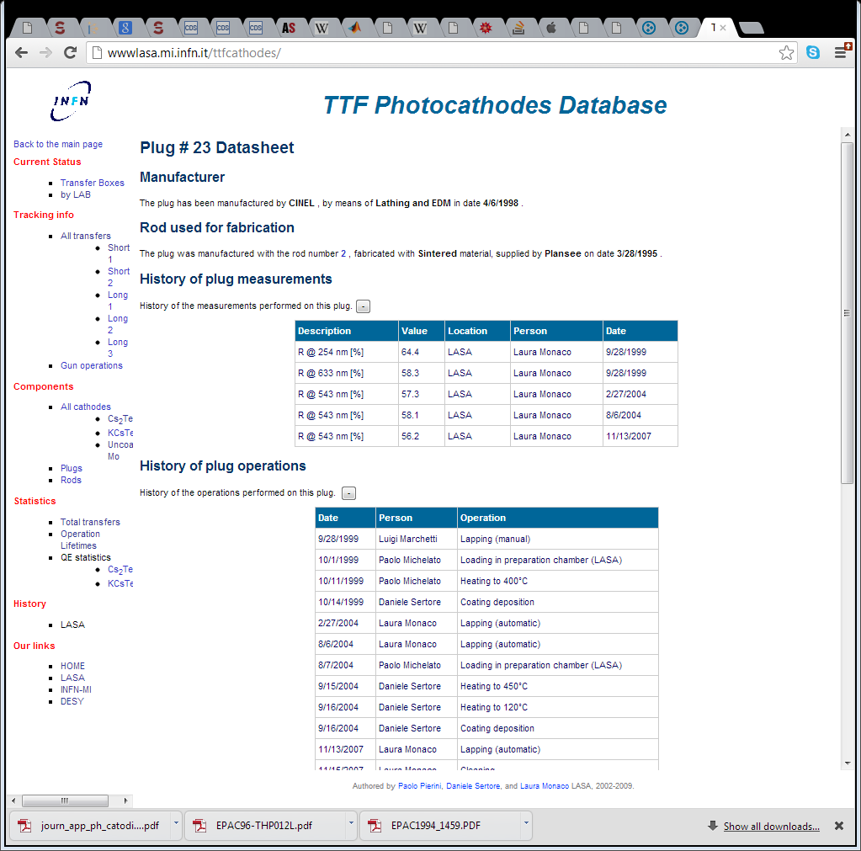


From Rod to …
Reflectivity
Lapping
BCP
Heating
Loading
Deposition

Slide 24



… Photocathode

Slide 25



Some Statistics

Slide 26
Cs₂Te QE after production
QE[%] = 10.2±2.1%

Slide 27
QE old and new diagnostic
QE[%] = 8.6±2.7%
QE[%] = 11.2±1.6%

Slide 28
QE during operation
QE during operation.
The operation last for more than 100 days of continuous operation.
The cathode is changed if:
QE < 0.5 %
dark current is limiting LINAC operation

Slide 29
Dark current and Guns
Trend of dark current for different guns.
To be notice DC decrease during operation of the gun.

Slide 30



Lab Overviews

Slide 31
Future work
Include “spectral responses” (E_{g}+E_{a})
Include “QE map” (uniformity)
Include deposition parameters:
  Te thickness (as representative of the deposition process)
Include a sort of generic “query” for retrieving data from web interface

Slide 32
THANK YOU
A special acknowledgement to
Laura Monaco and Paolo Michelato (INFN)
Sven Lederer and Siegfried Schreiber (DESY)

