Slide 1
Monte-Carlo simulations of Charge transport and photoemission from GaAs photcathodes
Siddharth Karkare

Slide 2
Outline
Motivation
3-step model for GaAs(Cs/O) photoemission
Need for a Monte-Carlo simulation
Photoemission step 1 – Excitation
Photoemission step 2 – Transport and scattering
Photoemission step 3 – emission and surface effects
Results obtained so far
Future work and direction

Slide 3
MOTIVATION
GaAs as a photocathode – activation using Cs/O or Cs/NF3.
Despite extreme vacuum requirements, still one of the coldest sources of electrons
Various associated mysteries regarding QE, response time and mean transverse energy(MTE)

Slide 4
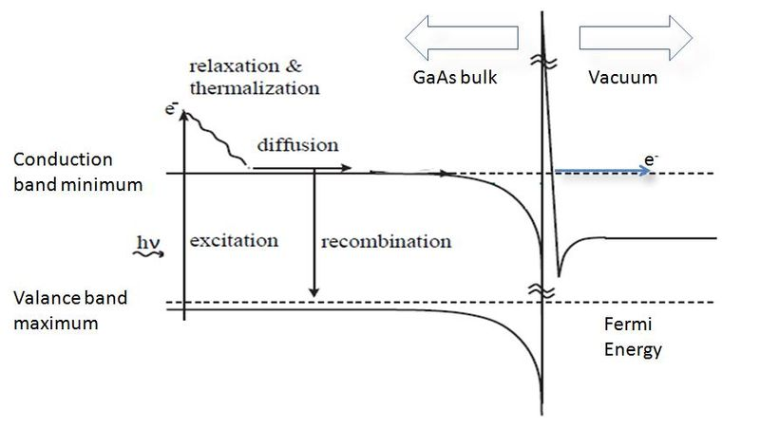
3-Step Photoemission Model for NEA-GaAs
Surface barrier
Negative electron affinity
Vacuum level

Slide 5
Need for Monte-Carlo Transport in Photoemission
Current theory based on diffusion of thermalized electrons up to surface
This is valid only for infra red excitations or for transmission cathodes.
For visible excitation on reflection cathodes significant un-thermalized electrons are emitted
Diffusion model fails for this case.
Previous attempts by Spicer et. al and Yang et.al
Spicer et. al., Surface Science 436 83 (1999)
Yang, J. Phys. D: Appl. Phys. 23 455 (1990)

Slide 6
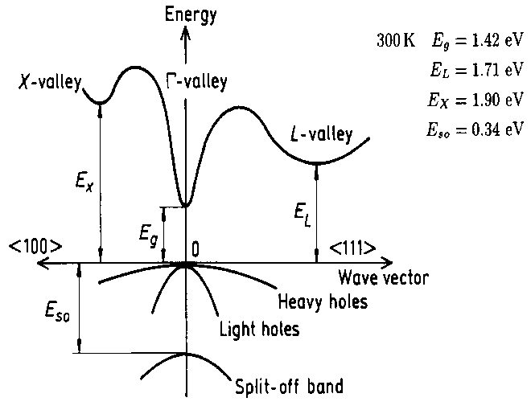
3-valley model for GaAs
http://www.ioffe.ru

Slide 7
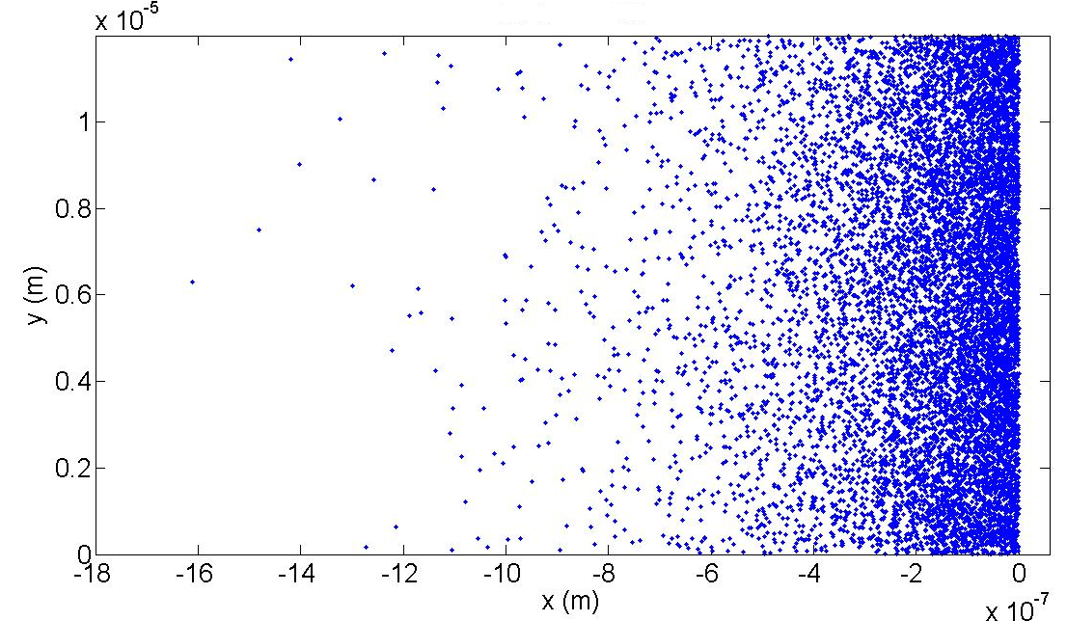
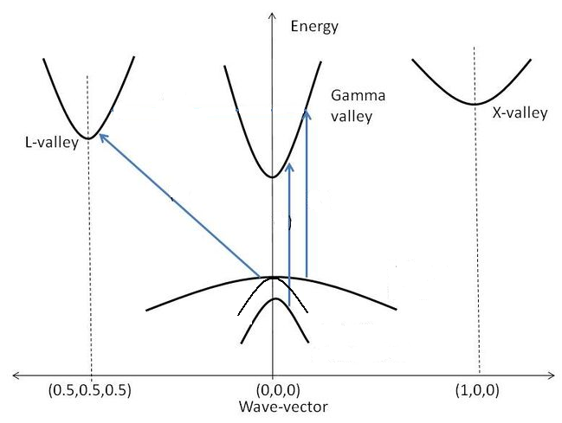
Photoemission Step 1 - Excitation
K-space
Real space
Surface
Indirect transitions
Direct transitions
Light hole band
Heavy hole band
Split-off band
Direct transitions – two body process
Indirect transitions – three body process (ignored)
All transitions are direct and hence all electrons are excited into gamma valley
Exponentially decaying distribution within surface
Semiconductors and Semimetals, Volume 39
Minority Carriers in III-V Semiconductors : Physics and Applications

Slide 8
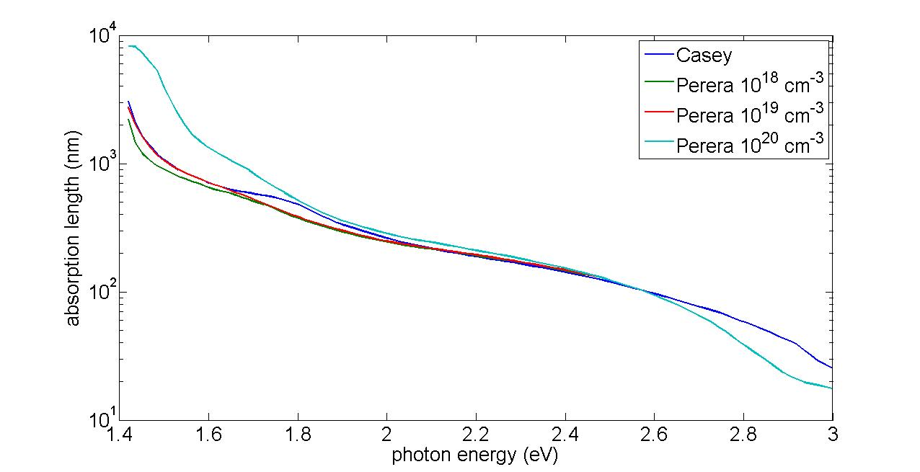
Absorption length
Perera et. al J. App Phy, 109, 103528 (2011)
Casey et. al J. Appl. Phys. 46, 1 (1975)

Slide 9
Photoemission step 2 - Transport
Calculate k-vectors
Calculate velocity vectors
Scatter
(change k and v vectors)
Calculate positions

Slide 10
Scattering Processes
Impurity Scattering
Neutral Impurities – only important at very low temperatures
Ionized Impurities – is elastic
Phonon Scattering
Acoustic – is elastic
Optical – inelastic, causes intervalley scattering
Polar Optical – inelastic
Piezoelectric – is elastic
Carrier Scattering
Electron-Electron – only important for n-doping
Electron-Hole – inelastic (still to be implemented)
Electron-Plasmon – inelastic

Slide 11
Scattering rate calculation
Based on Fermi golden rule
H’ is a perturbation to the Hamiltonian of the lattice
Then scattering matrix is given by
Scattering rate can be calculated by integrating over all possible states

Slide 12
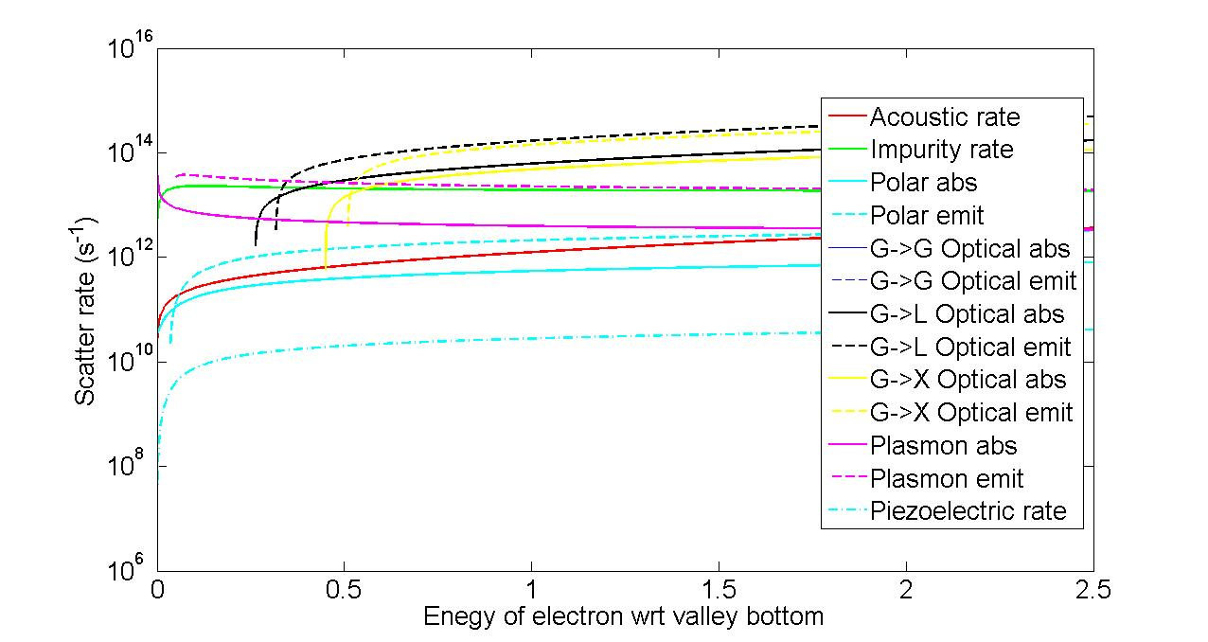
Rates for Gamma Valley

Slide 13
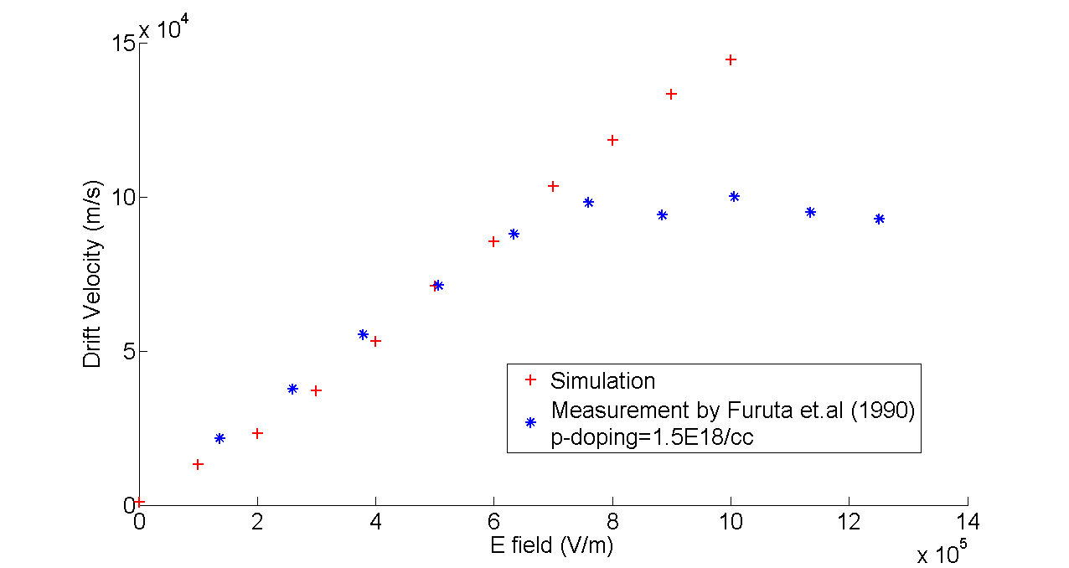
Drift Velocity Verification

Slide 14
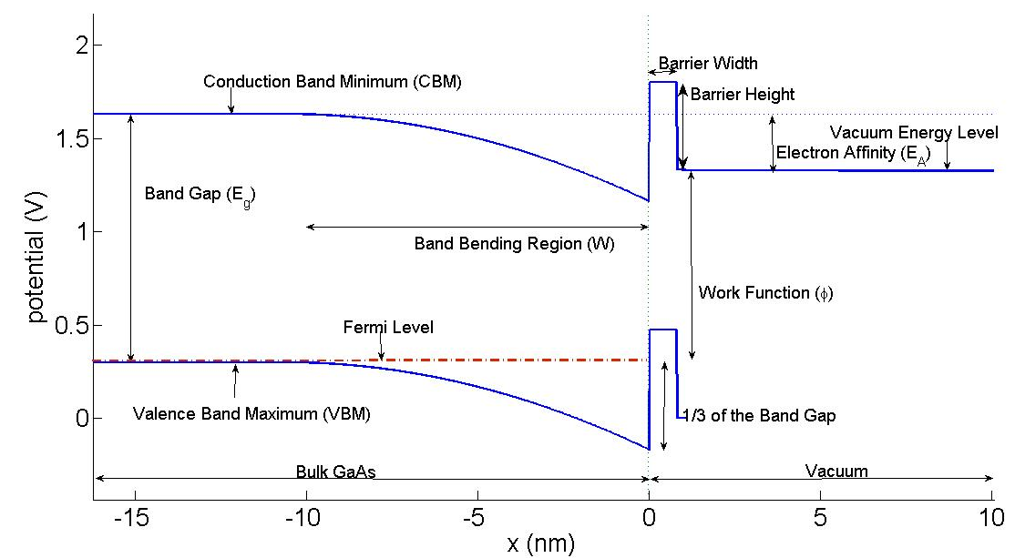
The Surface – Band Bending
Implemented using electric field
Quantum effect ignored
1N. G. Nilsson, Phys. Sta. Solidi (a), 19, K75,(1973)
2J.J. Scheer, J. van Laar, Solid St. Comm. 5, 303 (1967)

Slide 15
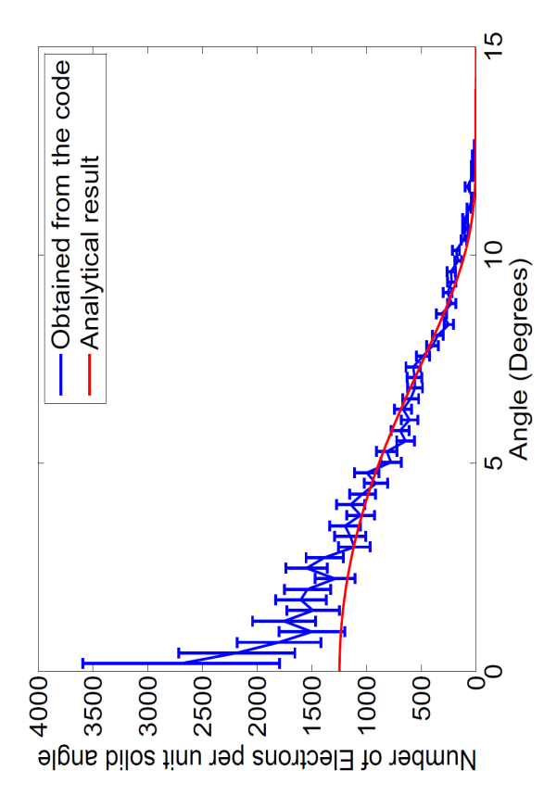
Surface - Conservation Laws during emission
Conservation of energy
Conservation of transverse momentum
CONSEQUENCES -
1.) No emission from L-valley at 100 surface
2.) Narrow cone (<15⁰) emission from G-valley
L-valley electrons have very high transverse momentum at the 100 surface. Hence cannot get out.
Analytic and simulation Results for step boundary, thermalized electrons

Slide 16
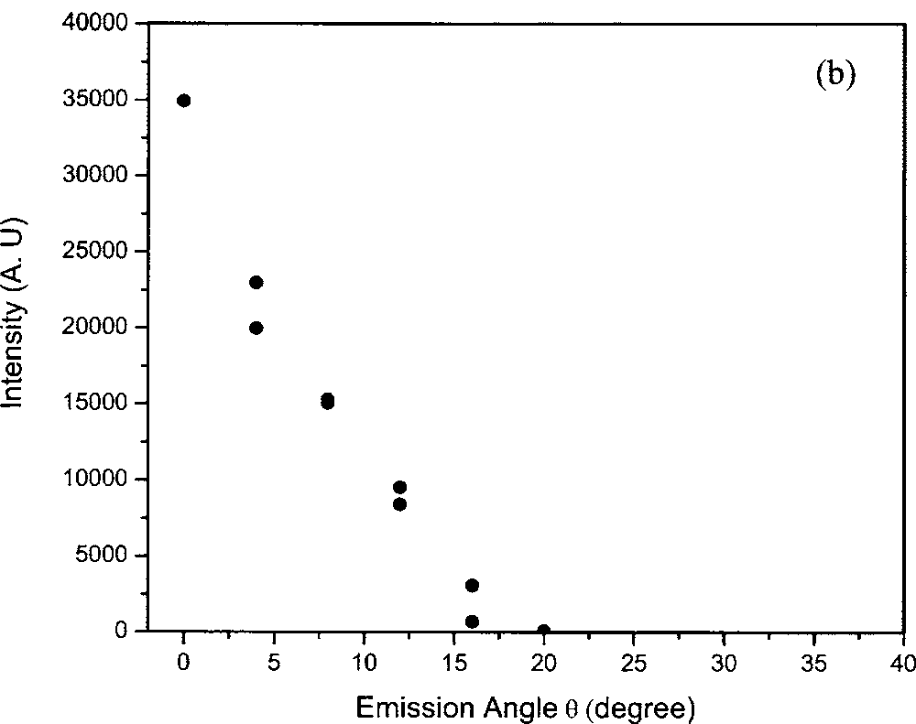
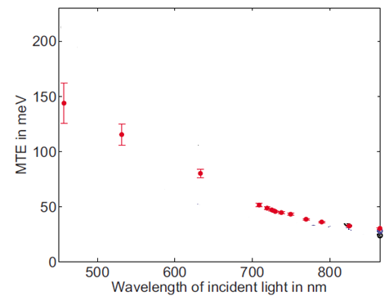
Narrow cone emission?
Implies MTE of ~5meV
but
??
Zhi Liu et.al, J. Vac. Sci. Technol. B 23(6) (2005)
Bazarov et.al, J. Appl. Phys. 103, 054901 (2008)

Slide 17
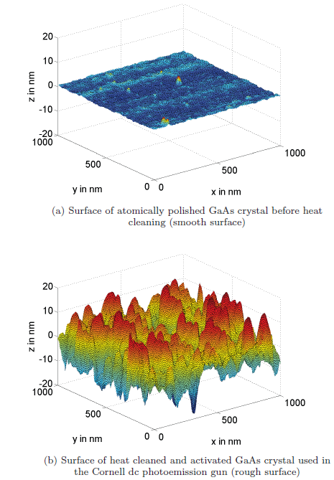
Surface Roughness/Cs scattering/Non-uniform workfunction?
Recently measured MTE from MBE grown cathodes
Cathode | QE(532nm) | MTE(635nm) | MTE(532nm)
Fully Doped | 9% | 120meV | 150mev
100nm undoped | 5% | 77meV | 105meV
S.Karkare, I.Bazarov App. Phys. Lett. 98, 094104 (2011)

Slide 18
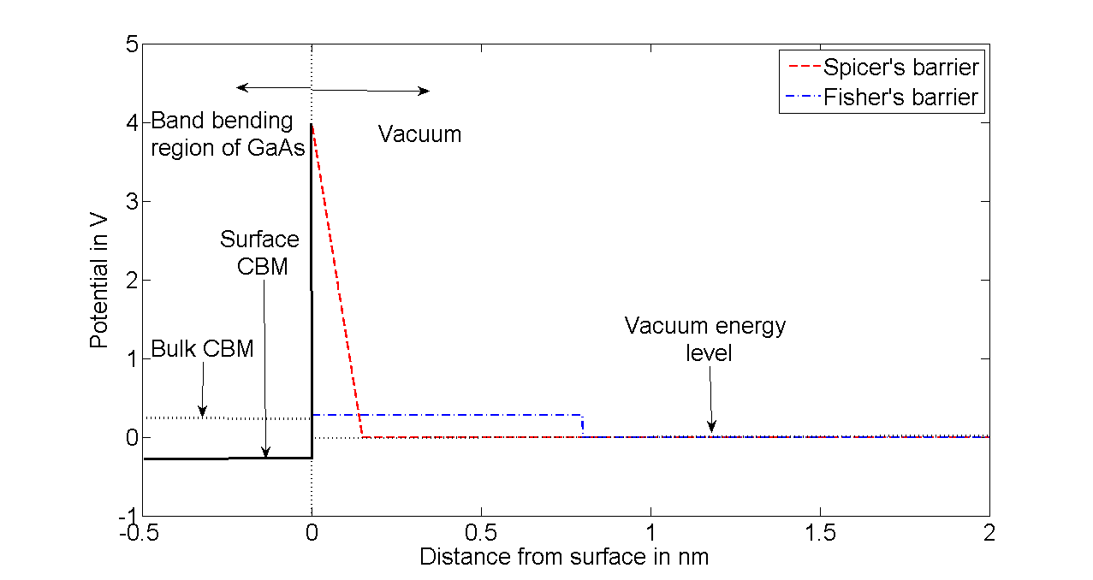
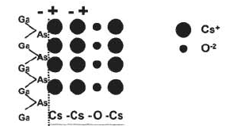
Surface Barriers
Cause – Surface double dipole effect and image charge
Montecarlo code can simulate barrier of any shape
Double-dipole proposed by Fischer (1974)
Fisher estimated barrier by fitting data to QE analytic results
Spicer estimated barrier by fitting data to simulated energy distributions
*D.G.Fisher, J. Escher et. al., J. App.Phys 43, 3815 (1972)
⁺W.E. Spicer et al Surface Science 436 83 (1999)

Slide 19
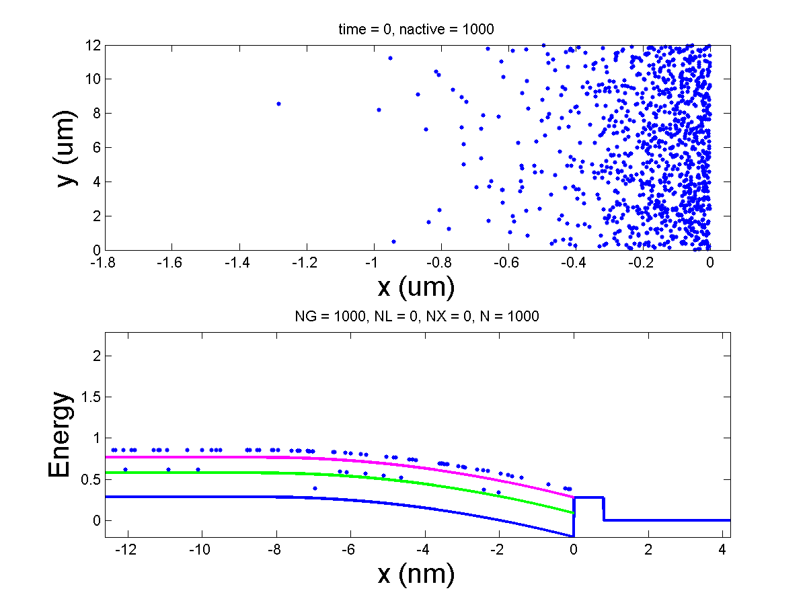
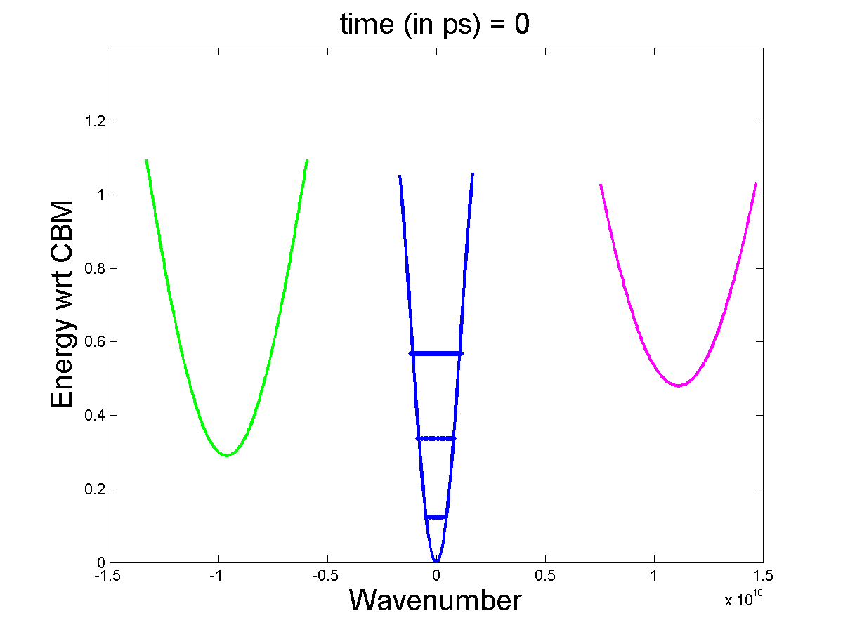
Simulation snapshots (t=0.0ps)
K-SPACE
POSITION SPACE
BLUE – Electrons in Gamma Valley
GREEN – Electrons in L Valley
PURPLE – Electrons in X Valley
RED– Emitted electrons
Excitation with 532nm photons

Slide 20
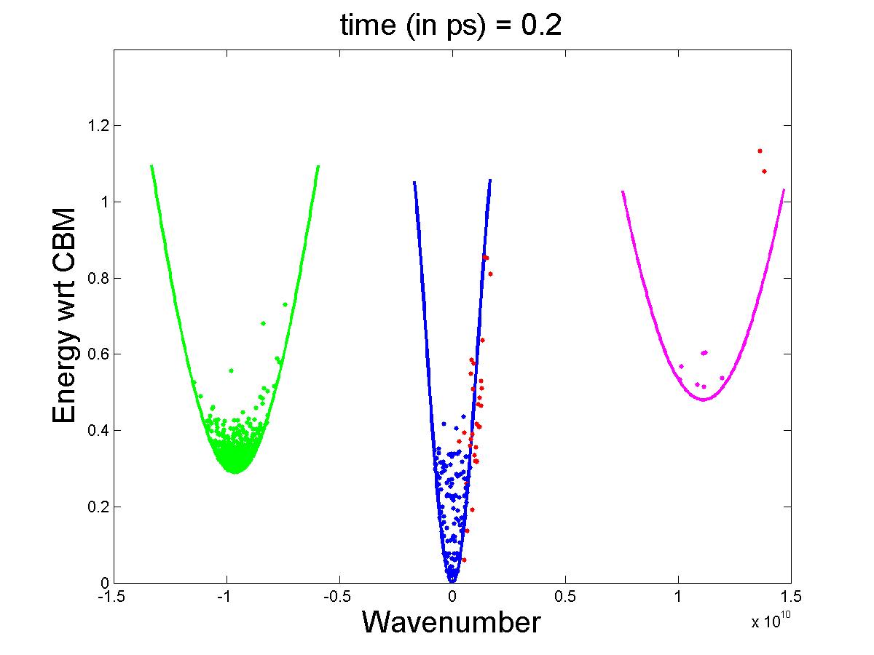
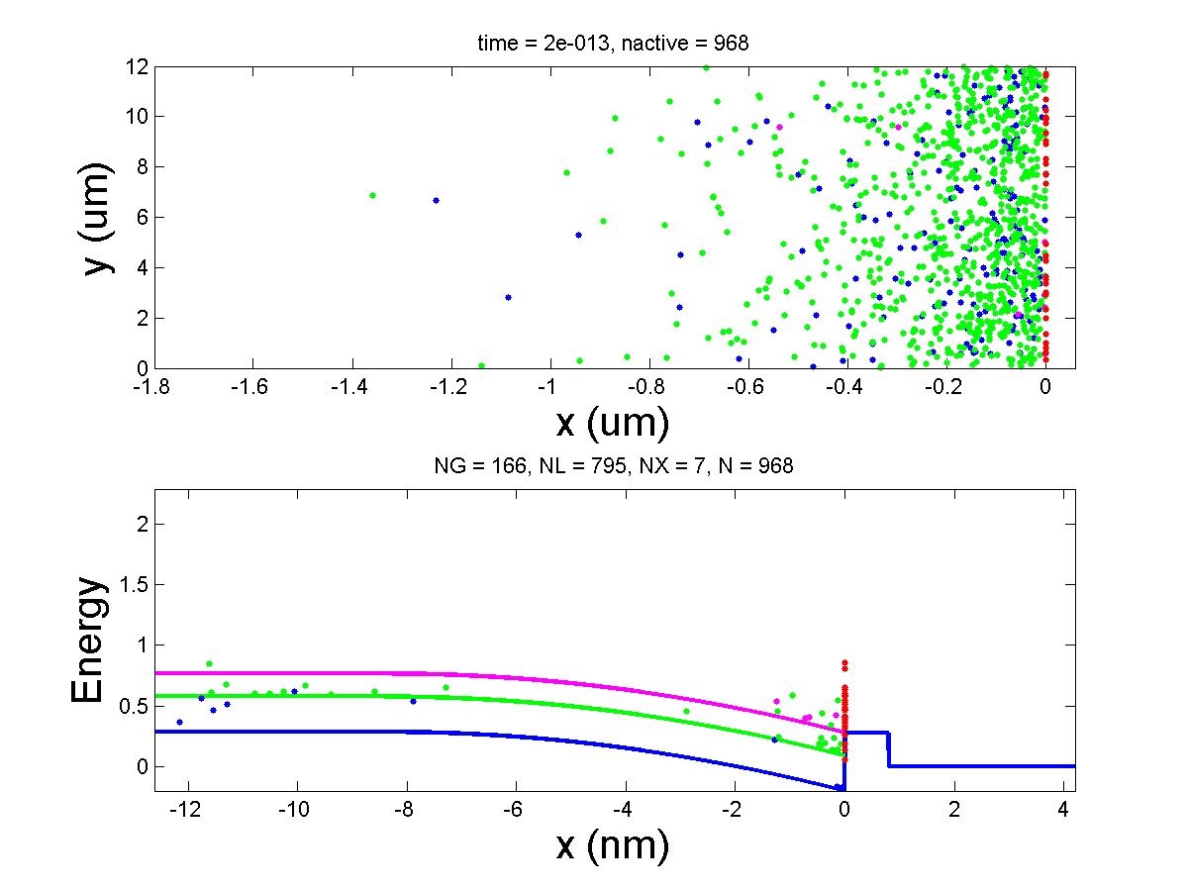
Simulation snapshots (t=0.2ps)
K-SPACE
POSITION SPACE
BLUE – Electrons in Gamma Valley
GREEN – Electrons in L Valley
PURPLE – Electrons in X Valley
RED– Emitted electrons

Slide 21
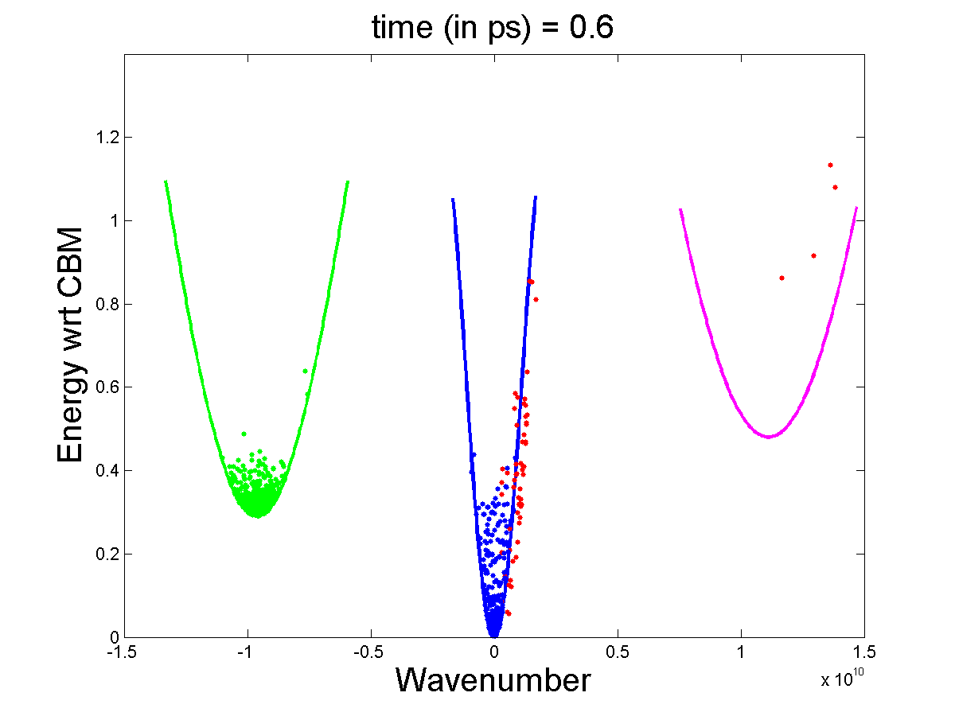
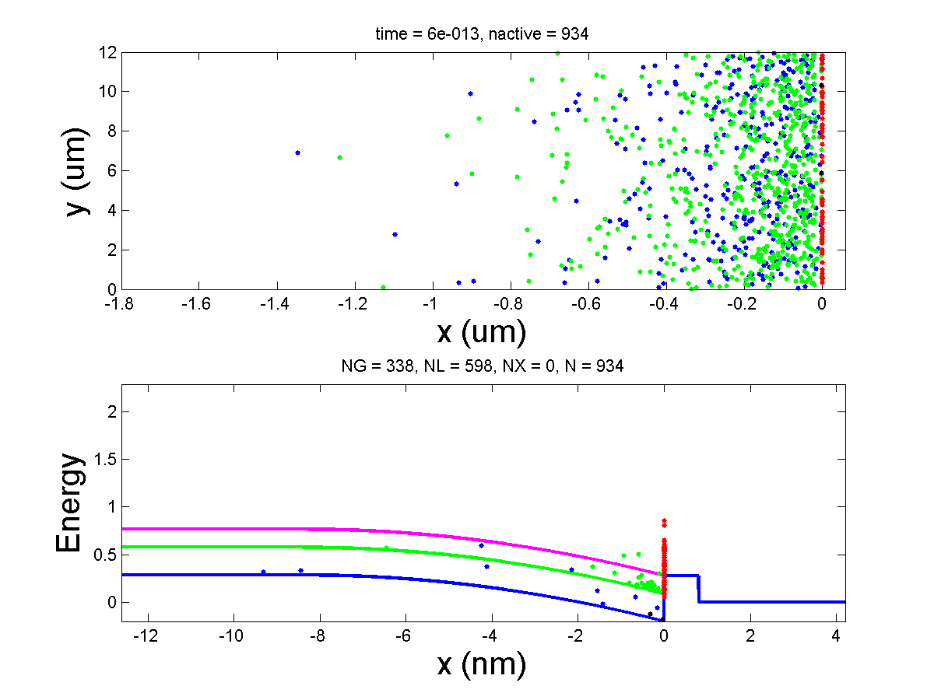
Simulation snapshots (t=0.6ps)
K-SPACE
POSITION SPACE
BLUE – Electrons in Gamma Valley
GREEN – Electrons in L Valley
PURPLE – Electrons in X Valley
RED– Emitted electrons

Slide 22
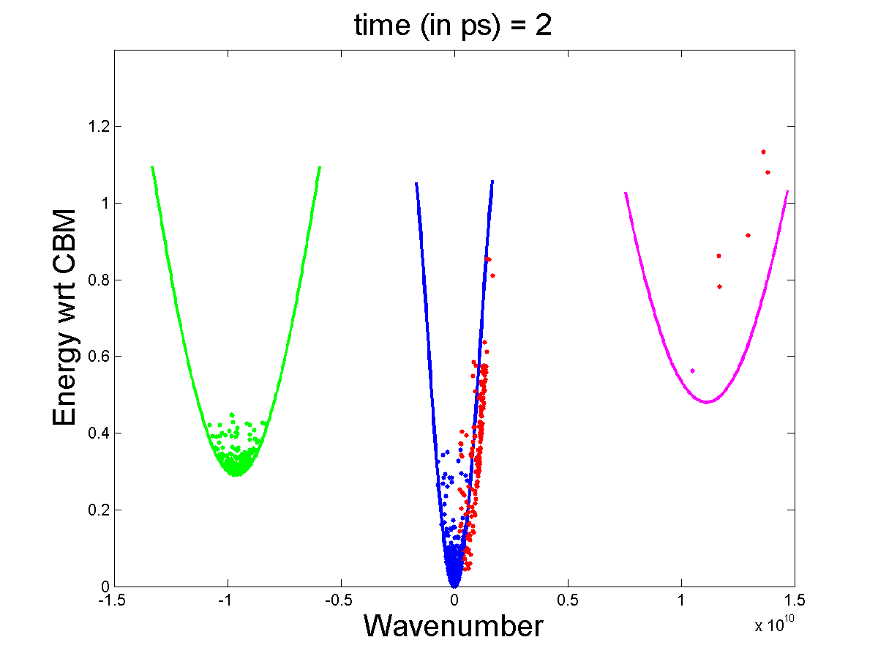
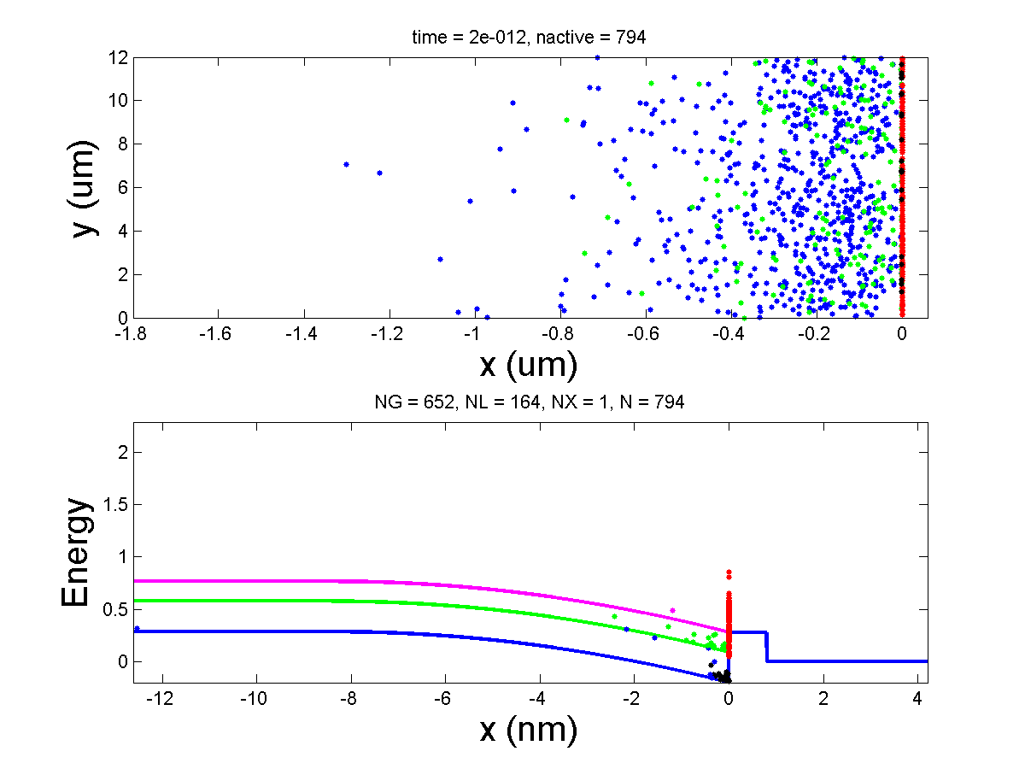
Simulation snapshots (t=2.0ps)
K-SPACE
POSITION SPACE
BLUE – Electrons in Gamma Valley
GREEN – Electrons in L Valley
PURPLE – Electrons in X Valley
RED– Emitted electrons

Slide 23
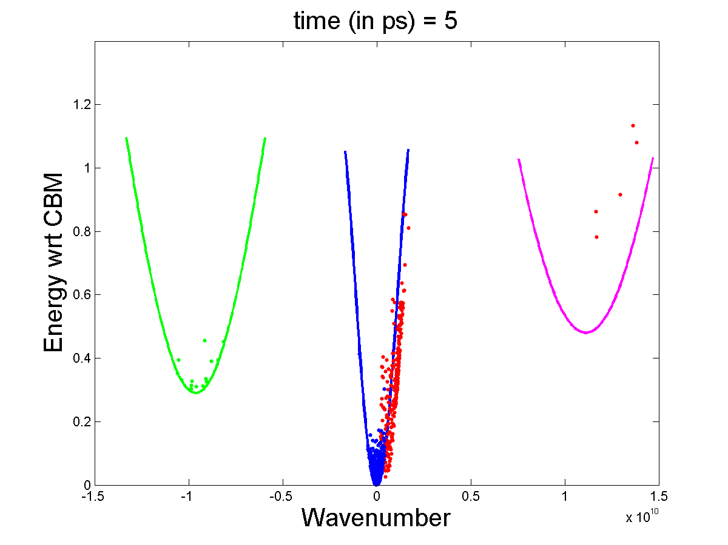
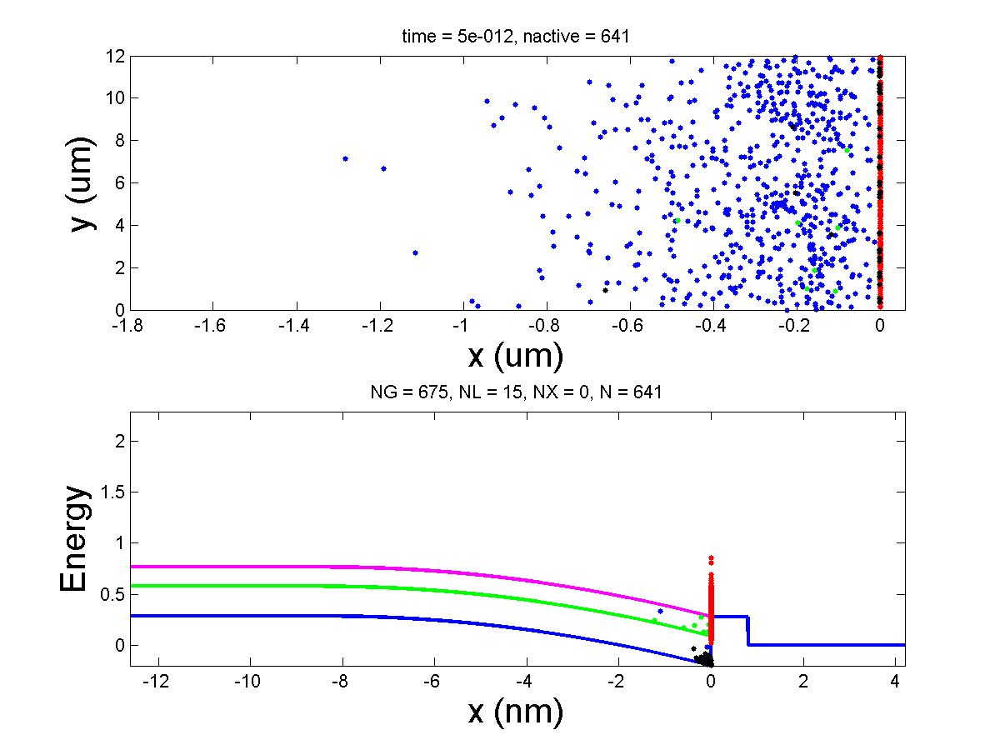
Simulation snapshots (t=5.0ps)
K-SPACE
POSITION SPACE
BLUE – Electrons in Gamma Valley
GREEN – Electrons in L Valley
PURPLE – Electrons in X Valley
RED– Emitted electrons

Slide 24
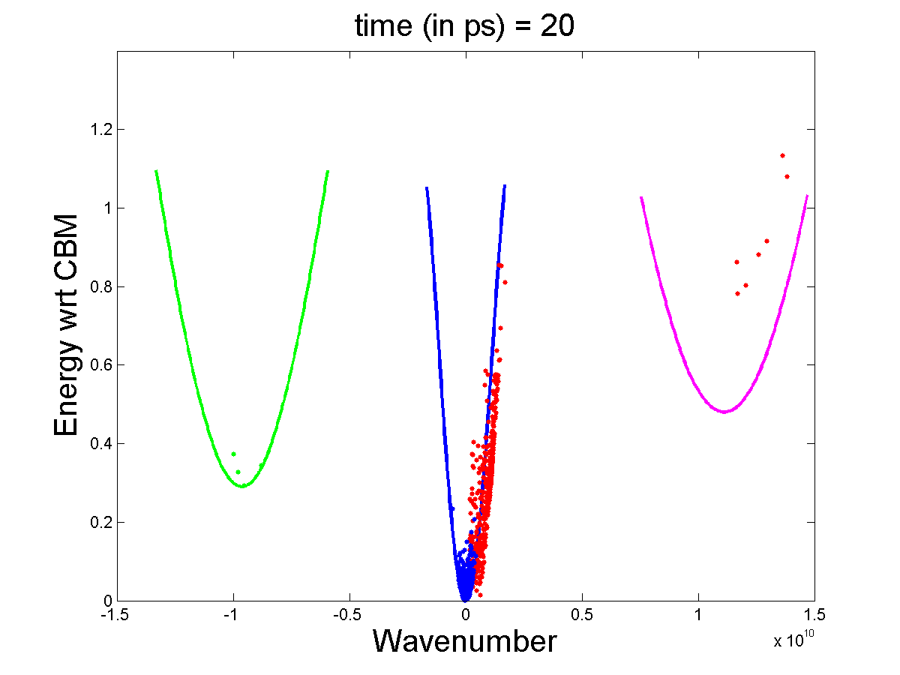
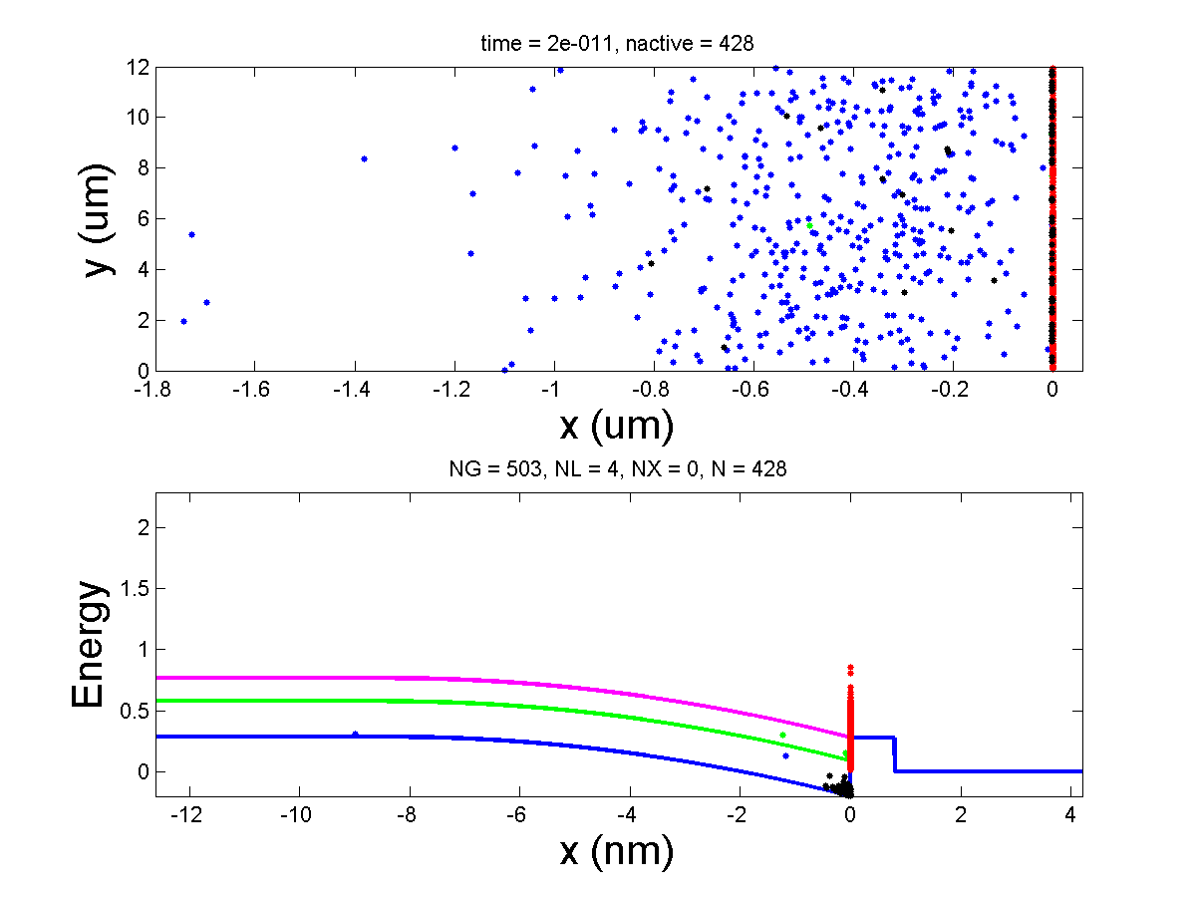
Simulation snapshots (t=20.0ps)
K-SPACE
POSITION SPACE
BLUE – Electrons in Gamma Valley
GREEN – Electrons in L Valley
PURPLE – Electrons in X Valley
RED– Emitted electrons

Slide 25
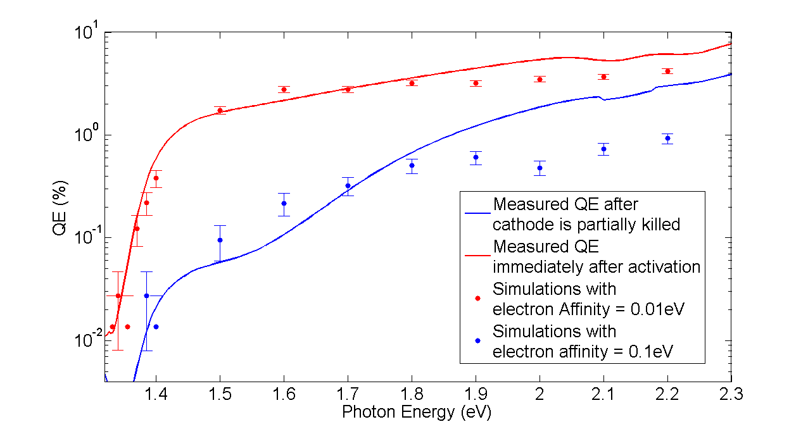
Results from code – QE dependencies

Slide 26
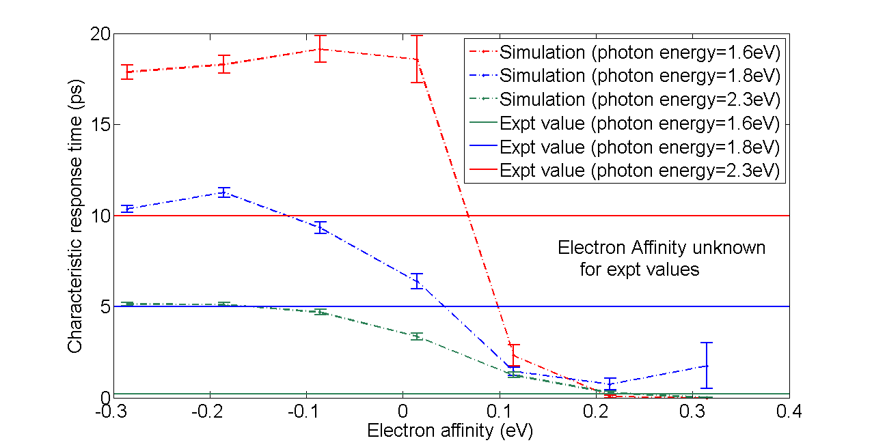
Response time*
*Time required for 50% of electrons to get out
Bazarov et.al, J. Appl. Phys. 103, 054901 (2008)

Slide 27
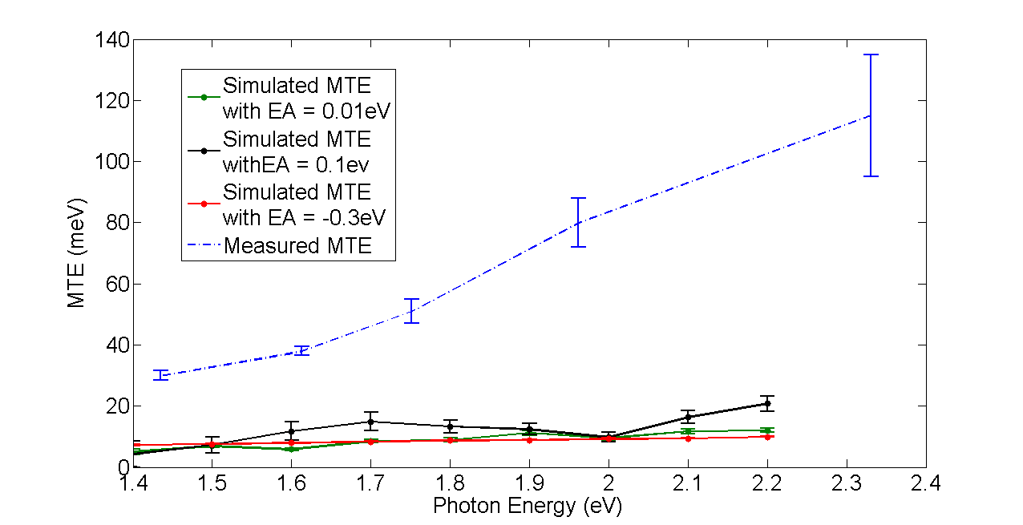
MTE vs Wavelength
Bazarov et.al, J. Appl. Phys. 103, 054901 (2008)

Slide 28
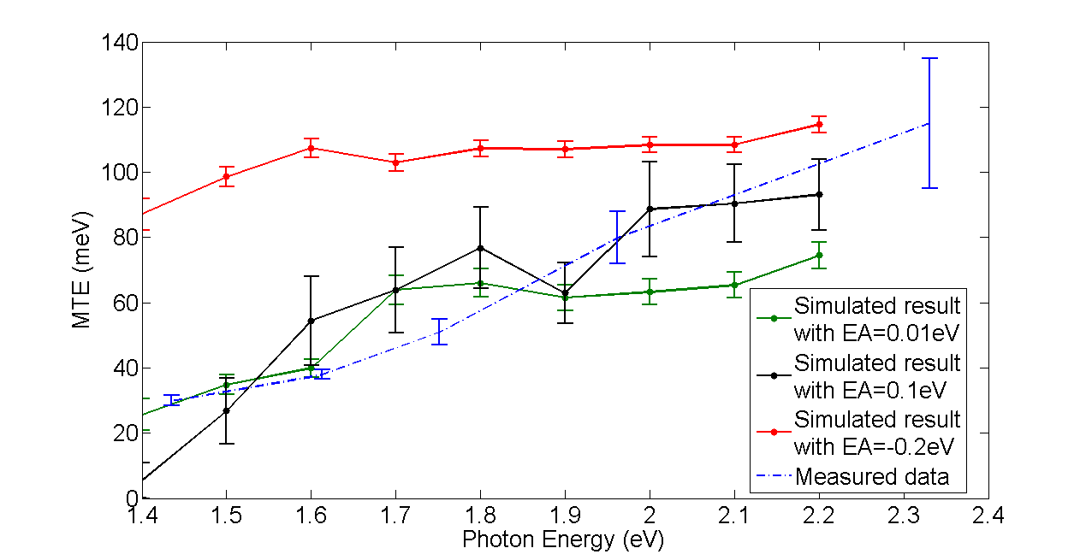
MTE vs Wavelength using cosine distribution of angles
Bazarov et.al, J. Appl. Phys. 103, 054901 (2008)

Slide 29
Future directions
Verify and reproduce GaAs results accurately
Incorporate multilayered structures with graded doping
Extend to other 3-5 semiconductors
Implement interfaces and junctions between different materials
Better approximations for the band bending quantum effects
Try to engineer multilayered structures to optimize emission parameters

Slide 30
Acknowledgements
Ivan Bazarov for his help and guidance
Dimitre Dimitrov (TechX) for useful discussions
Eric Swayer and Adam Bartnik for help in code implementation
Luca Cultrera, Xianghong Liu and Bill Schaff for growing MBE cathodes and measurements
ERL team and NSF and DOE

Slide 33
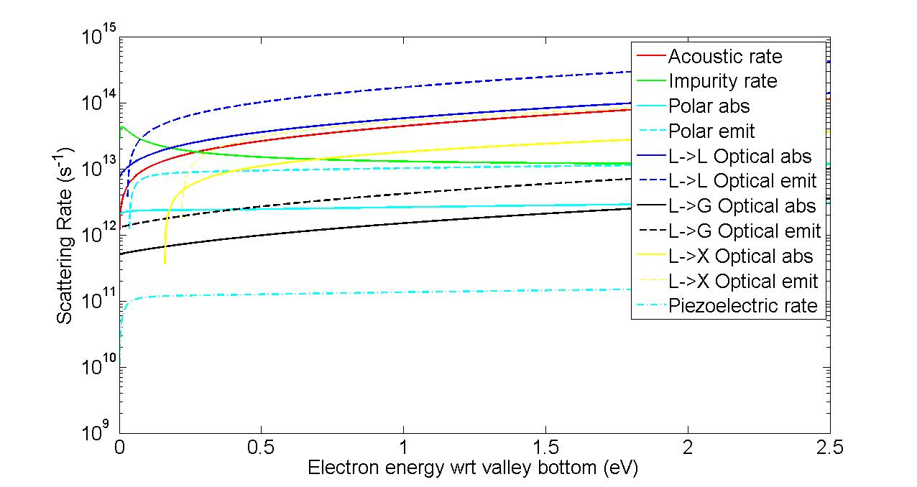
Rates for L Valley

Slide 34
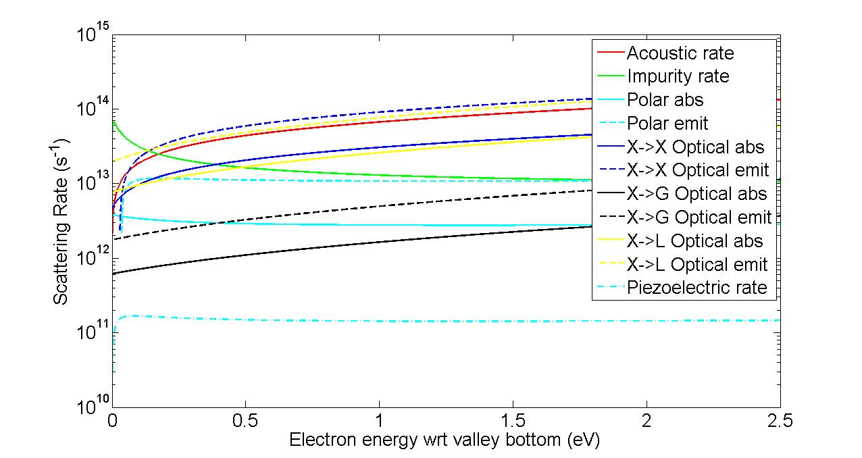
Rates for X Valley

