Slide 1
Summary of the 2nd PPP Workshop
Charlie Sinclair
Cornell University (retired)

Slide 2
This was a GREAT Workshop
I looked at essentially each slide of EVERY talk presented in the past two days, and have ~ 25 minutes to tell you about ~ 900 minutes of excellent presentations
The developments since the first PPP Workshop two years ago are dramatic in several areas
What I emphasized is based on my limited knowledge of a few areas, and VAST ignorance of many other areas……

Slide 3
Major Developments
Impressive photocathode development laboratories have been established in several laboratories
There are many new results on high average current beam delivery, low intrinsic emittance, very good cathode operational lifetimes…….
There is much broader use of surface and bulk analytical tools to analyze both cathode formation and degradation
Aggressive and detailed cathode models are being developed and improved

Slide 4
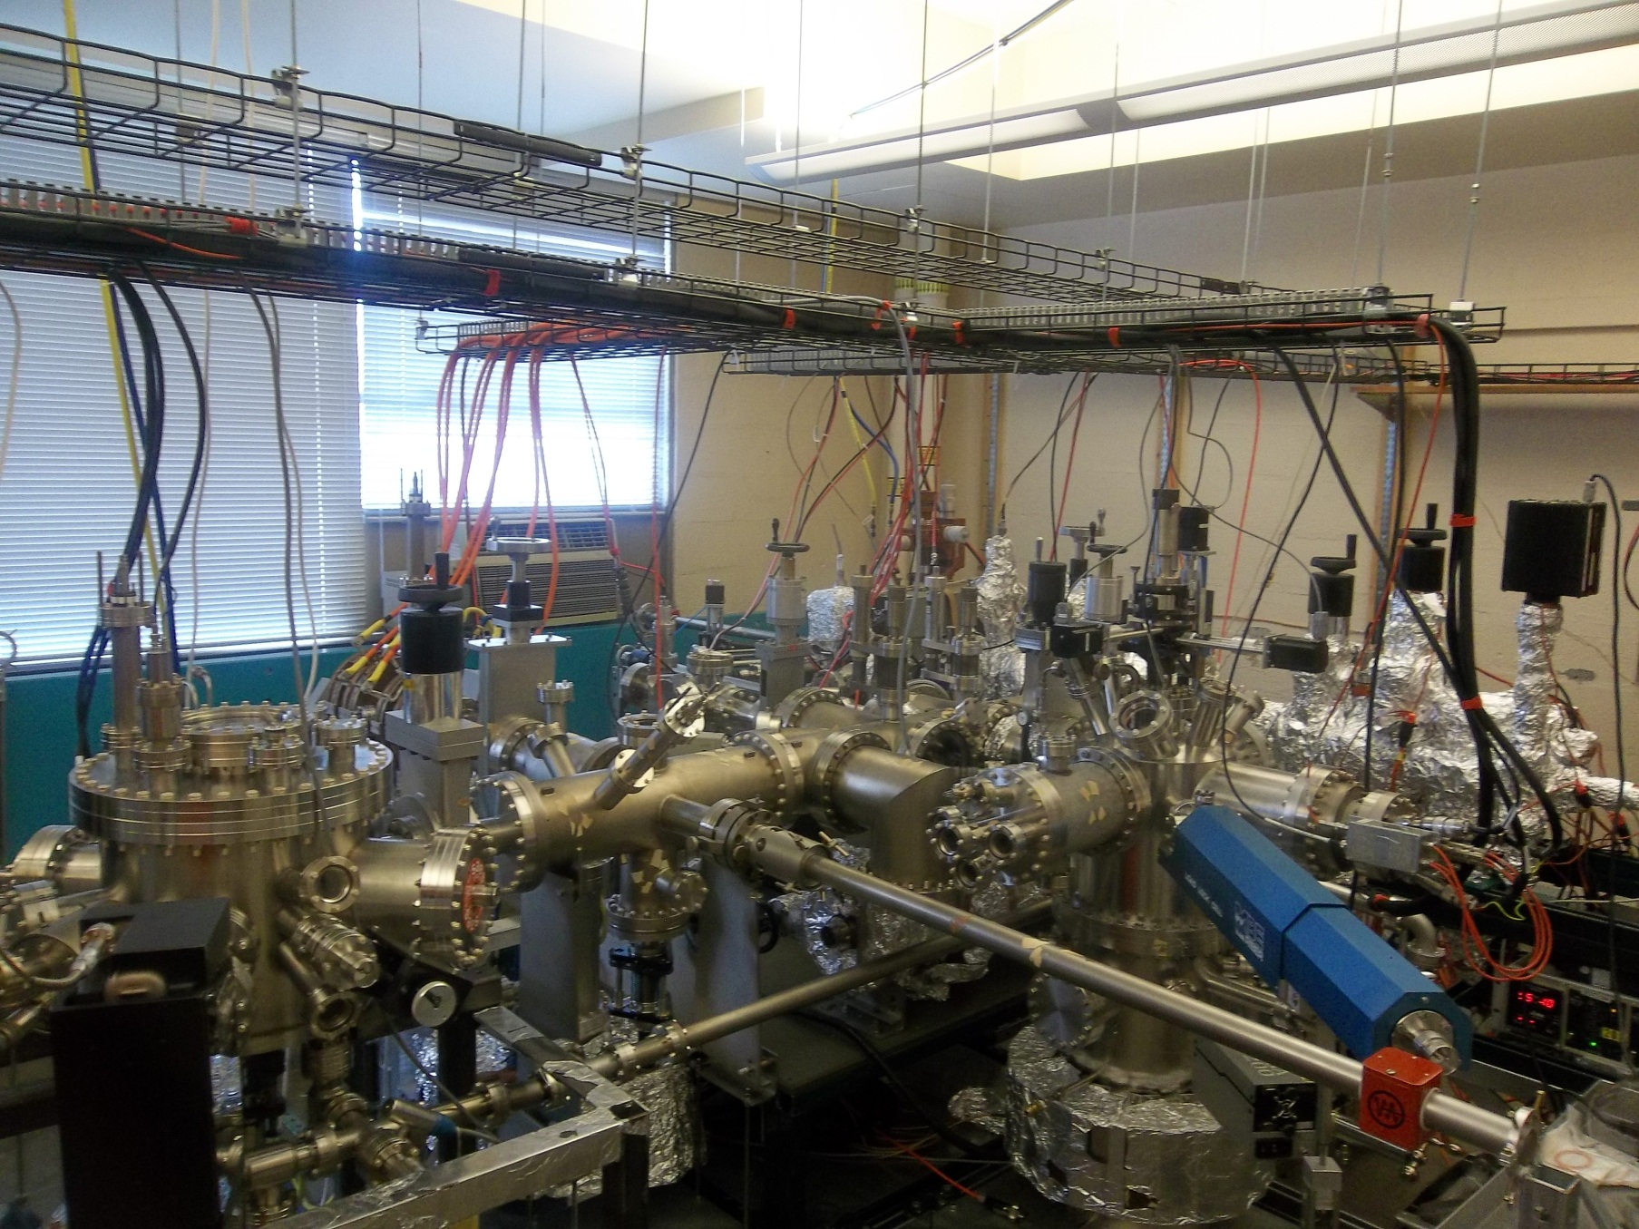
Cornell Photocathode Laboratory

Slide 5
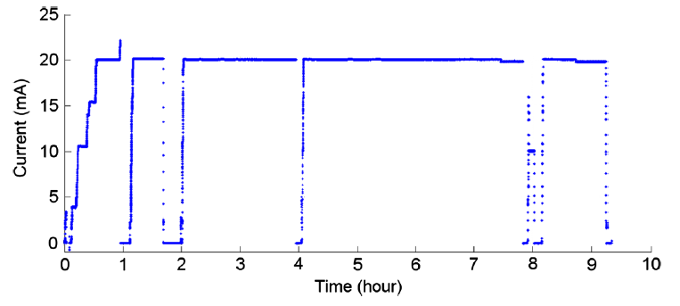
Significant Advances are Roaring In
High average currents are being achieved – Cornell reached 52 mA average current, and operated at 20 mA average for 8 hours (600 C) from K₂CsSb, stopped by boredom rather than cathode decay. QE dropped from ~11% to ~ 8% during this run. (Cultrera)

Slide 6
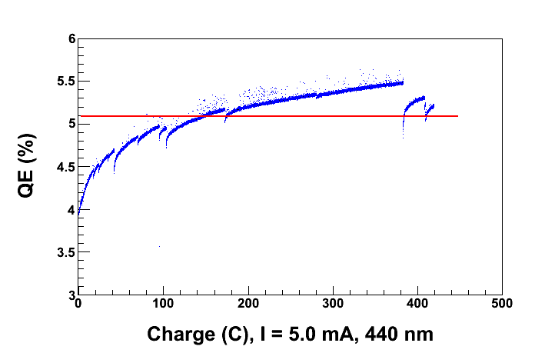
Significant Advances (Cont’d.)
BNL transported a K₂CsSb cathode to Jlab, where it delivered both high average current and total charge in a test setup, with no decay until reaching ~ 20 mA average current operation

Slide 7
Significant Advances (cont’d.)
Many laboratories report very good dark and low average current lifetimes from alkali antimonide, alkali telluride, and GaAs photocathodes
Alkali telluride cathodes are shipped all over the world, very successfully

Slide 8
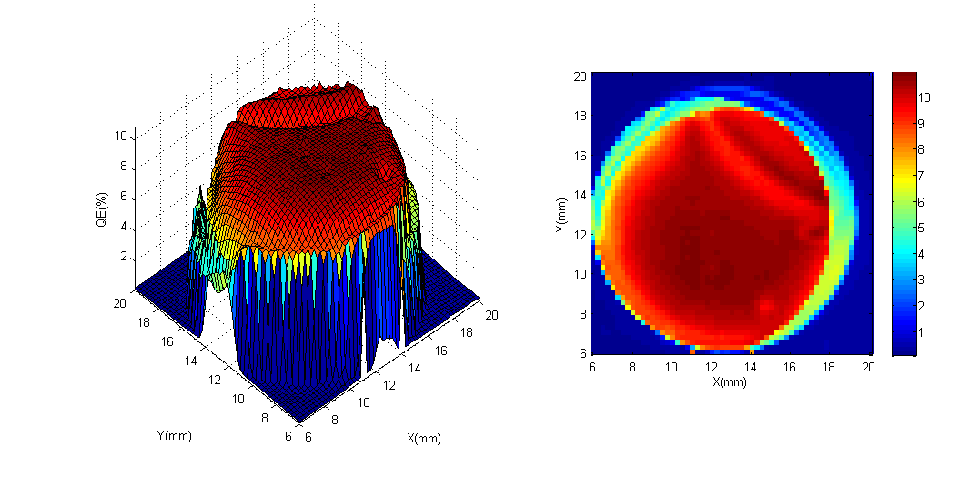
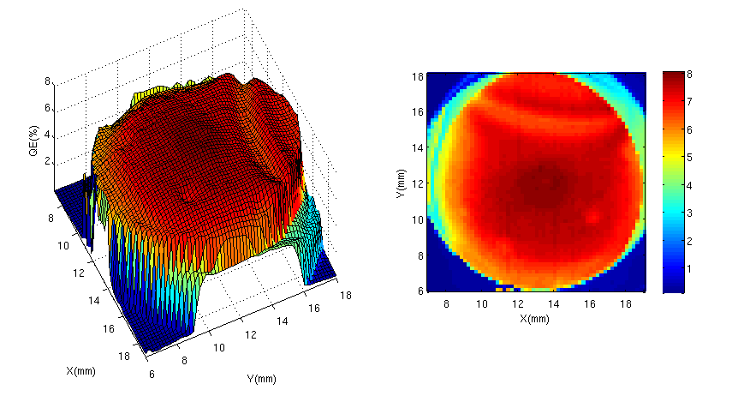
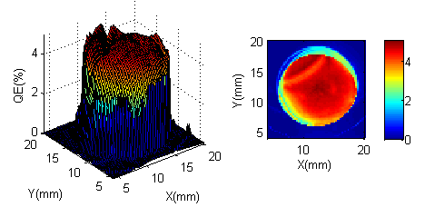
Cornell Low Average Current Life
Low average current operation
~10%
QE map on 03 Feb 2012
~8%
QE map on 03 Apr 2012
~5%
QE map on 02 Oct 2012
1/e lifetime ~13 months = 9500 hrs

Slide 9
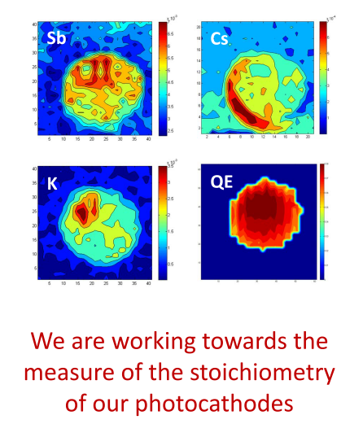
Yet Mysteries Remain……
Cornell measurement
of stoichiometry and
QE of K₂CsSb with 2D scanning Auger (Cultrera)
And: (Schubert)
“We were not successful in growing a stoichiometric CsK2Sb cathode.”

Slide 10
Quantitative Analytical Tools are Being More Widely Employed
Two Camera XRD and X-Ray reflectivity to observe formation and growth of K₃Sb and K₂CsSb cathode (Ruiz Oses)
XPS analysis of growth and stochiometry of K₂CsSb cathodes (Schubert)
AFM for observation of cathode roughness (many labs)
Study heavily used GaAs cathodes (several thousand Coulombs) from Jlab FEL (Jlab/PNNL, published)

Slide 11
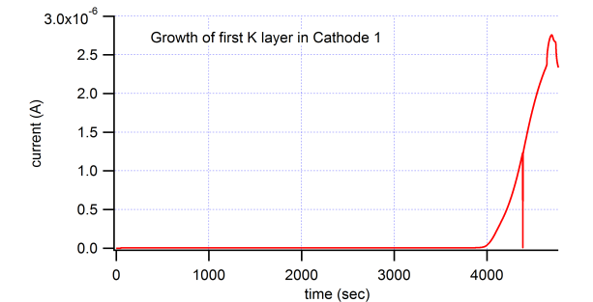
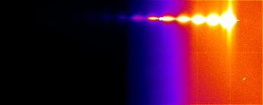
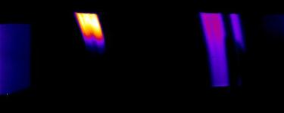
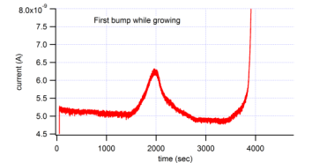
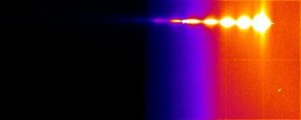

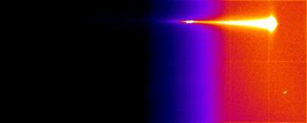

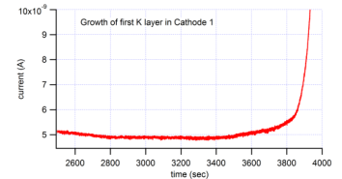
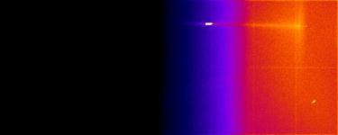

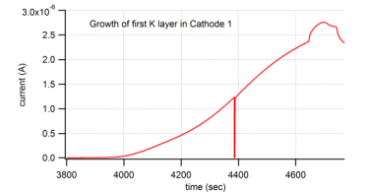
K at 140C
QE(%)=0.1%
Camera 1
Camera 2
(012)
(104)
(110)
2000 s
~10Å
Sb peaks
time
3800 s
~290Å
4645 s
~495Å
(111)
(220)
(420)
4697 s
~500Å
K3Sb peaks (K diffusion into Sb)
11

Slide 12
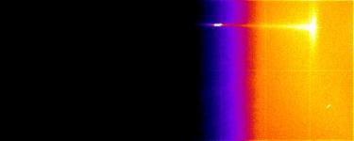
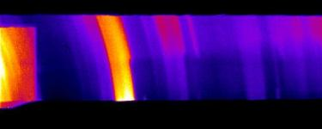
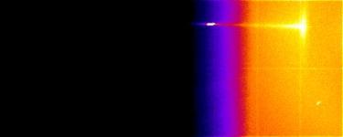
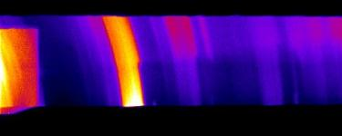
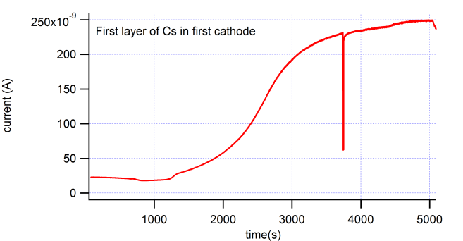
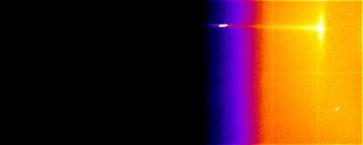
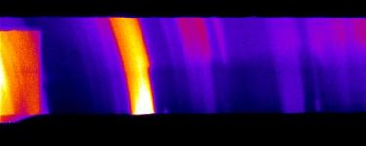
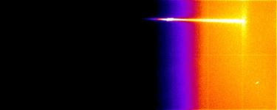
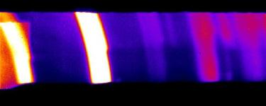
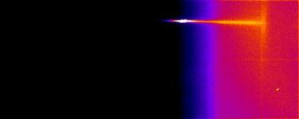
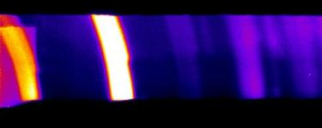
Cs at 130C
Camera 1
Camera 2
23.8˚
28˚
(111)
(220)
(420)
K3Sb peaks
0Å
QE(%)=1.4%
700 s
4400s
5000s
time
0Å
1220 s
700s
1220s
25Å
4400 s
763Å
5000 s
K2CsSb peaks
901Å
(200)
(220)
(222)
(400)
(331)
(420)
12

Slide 13
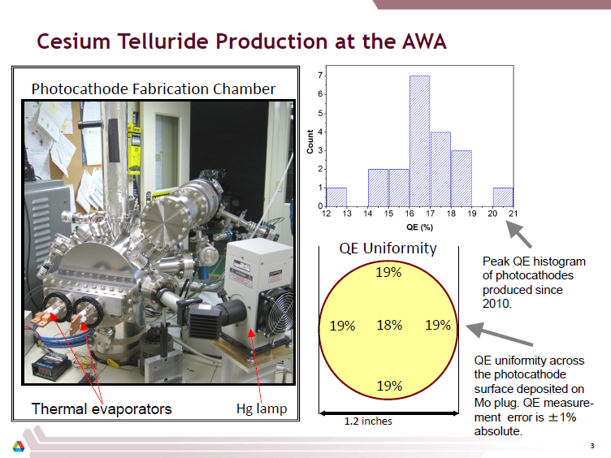

Slide 14
Significant Metal Cathode Developments
Emission from metallic surface states by p-polarized light at large incidence angle gives a very large increase in QE, and a large reduction in the mean transverse energy, compared to emission with normal incidence light (Jun Feng – LBNL)
In accord with previous observations of large QE increase from Copper at large incidence angle

Slide 15
Wavelength dependent QE measurement for Ag(111)
Normal incidence
70 degree incidence
Non-Fowler-like
Fowler-like
S polarized
  Fowler like behavior to ~ 250 nm (5 eV)
P polarized
  Large QE enhancement, particularly close to threshold
    Non-Fowler like behavior close to threshold
Jun, Mike, Wan, Dowell, Padmore
manuscript in preparation

Slide 16
Cs₃Sb and Cs₂Te Cathodes Prepared and Evaluated in the Same System for the PHIN Photoinjector (Hessler)
Photocathode planned to replace the nominal thermionic cathode for the CLIC drive beam
Conclude that Cs₃Sb is about as good as Cs₂Te for this application.
Vacuum conditions are very important for lifetime, for either photocathode

Slide 17
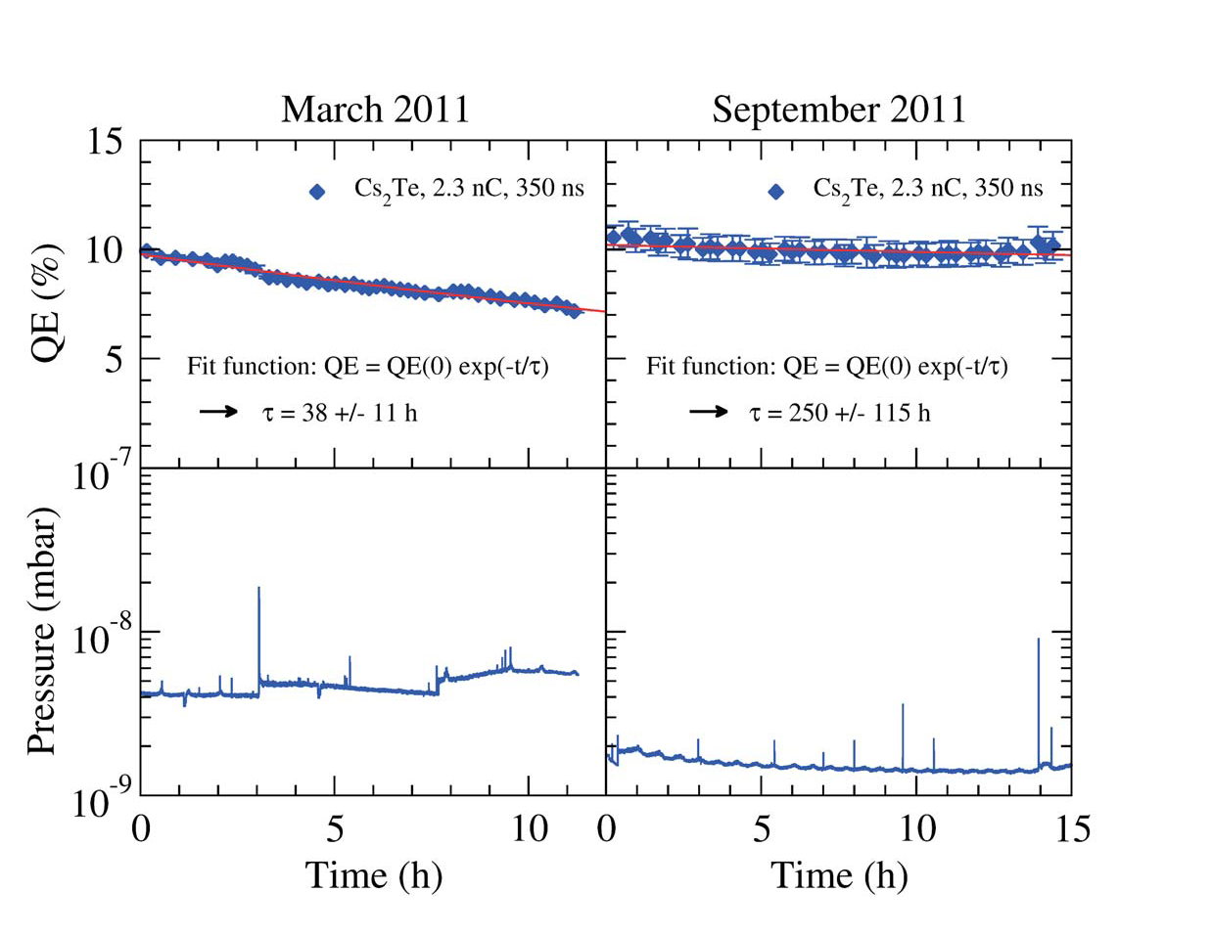
Impact of Vacuum on Cs₂Te Operating Lifetime

Slide 18
Two possibly unfamiliar K₂CsSb results
Bob Springer (LANL) reproducibly made ~ 17% QE at 532 nm in a single step taking minutes, using a liquid metal K/Cs source – no separate K or Cs sources
Alexey Lyashenko (Ph.D. thesis, Weizmann Institute) made a large number of K₂CsSb cathodes with very good QE and lifetime
Thicker cathodes gave better green response.
Very good lifetime with exceptionally small degradation in a 700 torr Ar/CH₄ mixture.

Slide 19
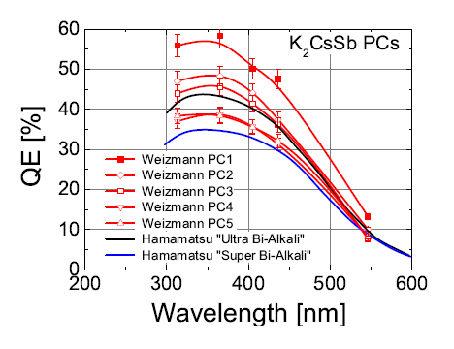
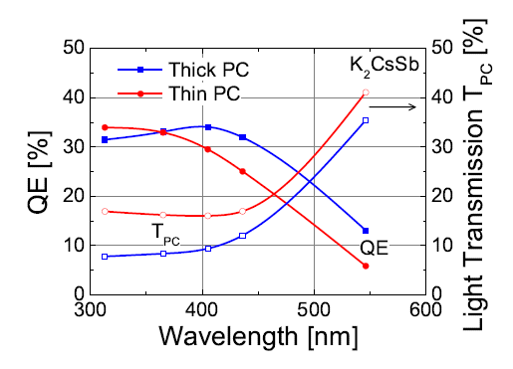
Lyashenko Cathode Results

Slide 20
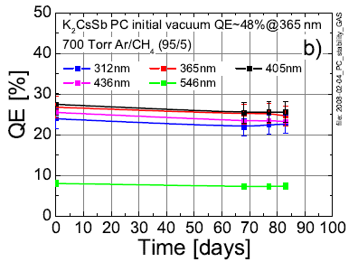
Lyashenko Cathode Results (cont’d.)

Slide 21
Innovations from Nagoya
Use GaAs/GaAsP transmission cathodes on GaP substrates to achieve small emitting area and thus higher brightness with high (~90%) beam polarization
Grow Ga_{0.52}In_{0.48}P, (1.9 eV bandgap) lattice matched to GaAs, to achieve a high QE (~ 14%), fast time response (~ 6 ps) cathode with a small mean transverse energy under 532 nm illumination

Slide 22
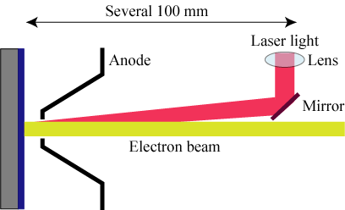
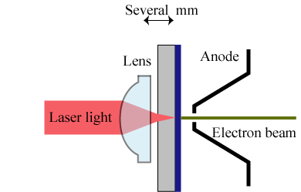
High Brightness from Transmission Geometry
Transmission geometry
allows smaller cathode spots
Conventional geometry – cathode spot
size limited by the diffraction limit

Slide 23
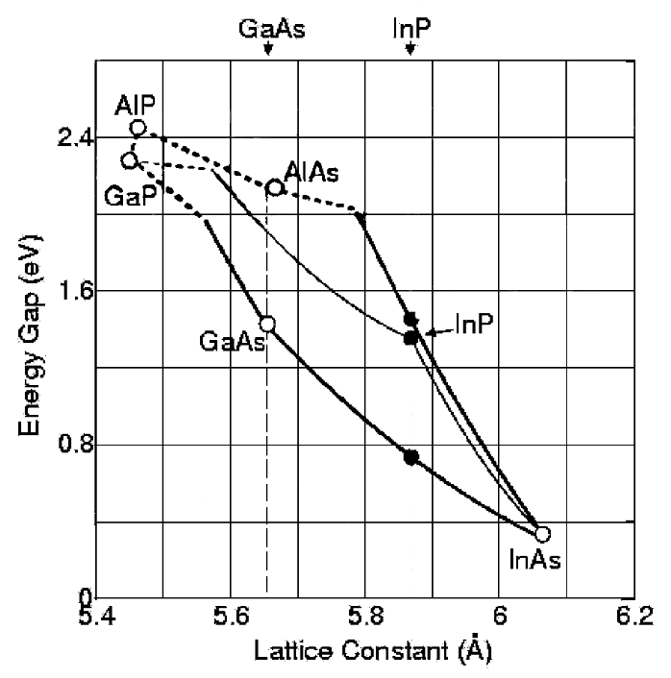
Lattice match larger bandgap material to GaAs, allowing its growth
530 nm
2.33 eV
Ga_{0.52}In_{0.48}P with a
1.9 eV bandgap,
gives:
11 to 14 % QE
52 meV MTE
~ 6.5 ps pulse

Slide 24
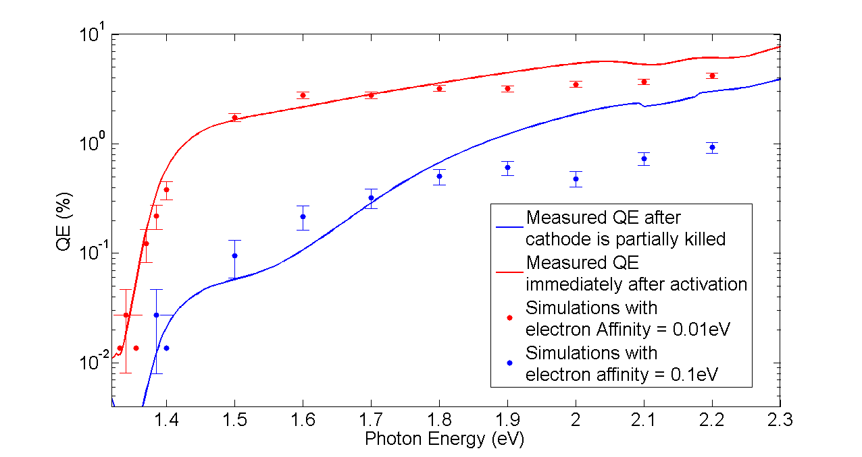
Results from code – QE dependencies
from Karkare Modeling of NEA GaAs
24

Slide 25
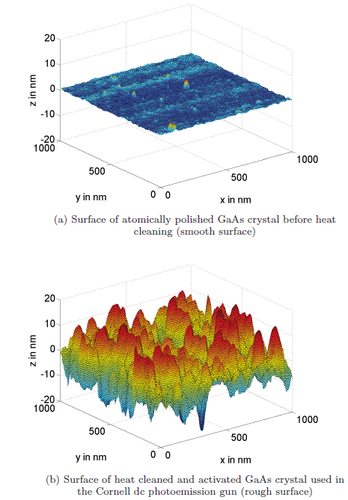
Surface Roughness/Cs scattering/Non-uniform workfunction?
from Karkare modeling of NEA GaAs
Recently measured MTE from MBE grown cathodes
Cathode | QE(532nm) | MTE(635nm) | MTE(532nm)
Fully Doped | 9% | 120meV | 150mev
100nm undoped | 5% | 77meV | 105meV
S.Karkare, I.Bazarov App. Phys. Lett. 98, 094104 (2011)
25

Slide 26
Many Other Fine Contributions, with Potential for Major Future Impact
Alternative alkali metal sources (e.g. CPD from Maryland)
Acetylation of Cs₂Te (ANL)
CsBr overlayers on Cu (PNNL, SLAC)
Nanostructured and plasmonic emitters (MIT, BNL, LBNL), including use of plasmonic cathode in real RF structure (UCLA)

Slide 27
Comments from a “Geezer”
Temperature measurements – where done w.r.t. the substrate surface? Method?
Vacuum – quoting a pressure is inadequate – must specify how measured, and provide RGA information
Duration of some measurements ~ 10⁵ sec, NOT small in terms of ~ monolayer contamination from small partial pressures

Slide 28
Unresolved Questions
What is the role of dopant(s) for NEA and PEA cathodes?
How important is band bending in NEA cathodes?
Reconcile non-uniform stiochiometry with uniform, and high, QE of antimonides
“Prescriptions” for alkali antimonide cathode formation – how do we understand the differences, and which is best?
The “payoff” from developing NEA III-V cathodes to what we believe their potential to be is ENORMOUS – a truly COLD emitter

Slide 29
I can’t wait until the next PPP Workshop.
If the progress at that time is as great as it has been in the past two years, the results will be spectacular

