Slide 1
Reduction of emittance from metals to less than thermal
Jun Feng
Lawrence Berkeley National Laboratory
Acknowledgements
Mike Greaves, W. Wan, D. Dowell, H. A. Padmore

Slide 2
Outline
Free electron metals and surface states
Experimental setup to measure QE and momentum
QE measurements on Ag(111)
Implication for other design of low emittance materials

Slide 3
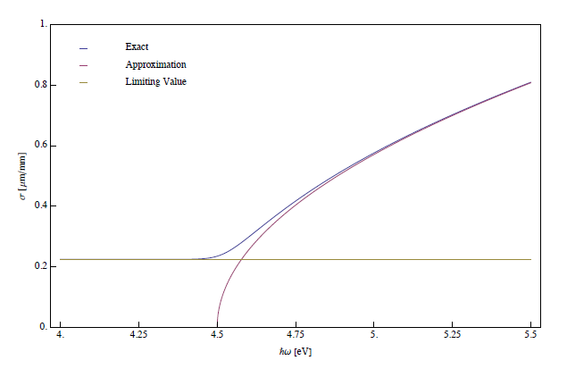
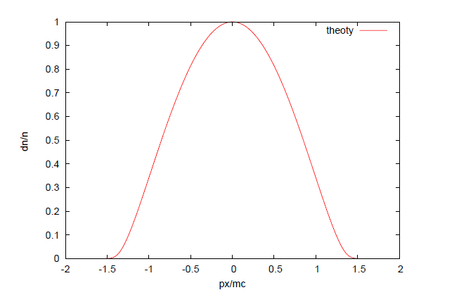
Background: emittance of a free electron metal including kT
0.5 eV excess energy
Linear dependence
+ small kT tail
Application of the 3 step model including kT
  Main Consequence: Minimum emittance with a free electron metal is 0.23 microns
  One way to decrease emittance is to limit angular emission use bandstructure
Wan, Dowell, Jun, Vecchione, Padmore
manuscript in preparation
More detail about the theory in Weishi’s talk tomorrow

Slide 4
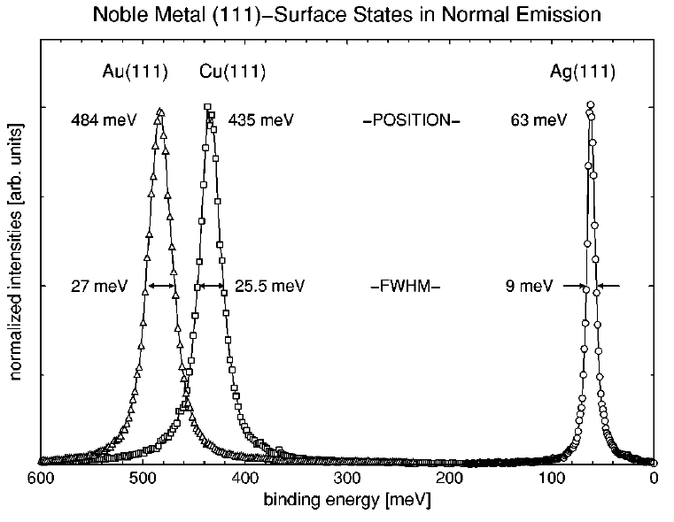
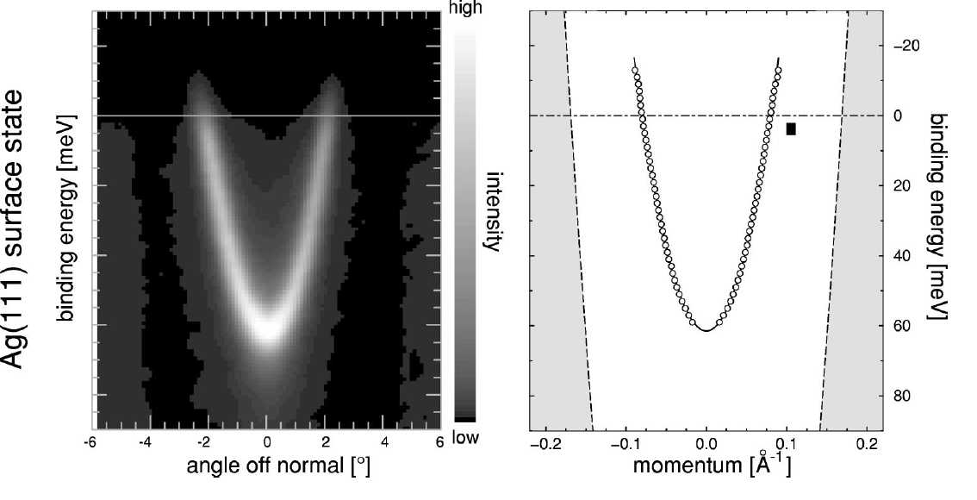
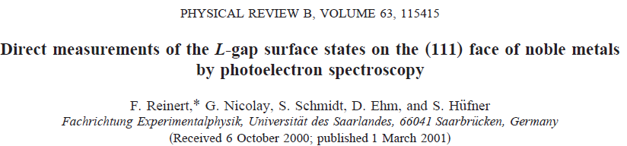
One bandstructure example: photoemitted electrons from surface states
Ag (111)
very narrow energy width (9 meV)
very close to the Fermi level (65 meV)
Small transverse momentum cutoff
Can be seen in narrow angular cone width
Fermi
level
Result is much lower emittance than normal free electron metals
eq: Ag(111) emittance ~0.078micron

Slide 5
Photoemitted electrons from surface states
We know the dispersion of surface states from previous work
  we know the emittance will be << than a free electron metal
What we don’t know is the photocurrent in the surface state channel
  Is it greater or less than would be predicted by the 3 step model?
    it would be useless to have reduced emittance if the QE is smaller than normal FE metals
Most important measurement is the spectral dependence of QE for p and s polarized light
  surface state cannot be excited in s-polarization (ie. E vector parallel to surface)

Slide 6
Setup
Fiber to spectrometer
Verdi
T₀ diode
37 mW
Pulse Picker
M1
700-1000 nm psec Laser Oscillator (MIRA, 76 MHz)
4-9 MHz
M2
M1’
1.2 W mode locked
2nd harmonic LBO
h=20%
UHV
Chamber
QE(E) measurement
7.5mW
M4
40µW, 250nm
4th harmonic BBO
Monochromator
h= 5%
ARPES
375 µW, 5-6 eV,3.8 MHz
M3
Laser Plasma Source
Techniques:
Ultra-low energy Angle Resolved Photoelectron Spectroscopy (ARPES)
Angle Resolved Electron Yield (AREY)
Low Energy Electron Diffraction (LEED)
Energy dependent yield
Full measurement of momentum distribution and yield as function of:
  Polarization, Photon energy.
  Photon incidence angle
  Surface preparation
Notes:
Change Slide to “Sources” and include Plasma Source.
1.2 W @ 856 nm, 76Mhz;
250mW 2nd Harmonic
200µW Fourth Harmonic
Pulse Picked: 30mW picked,

Slide 7
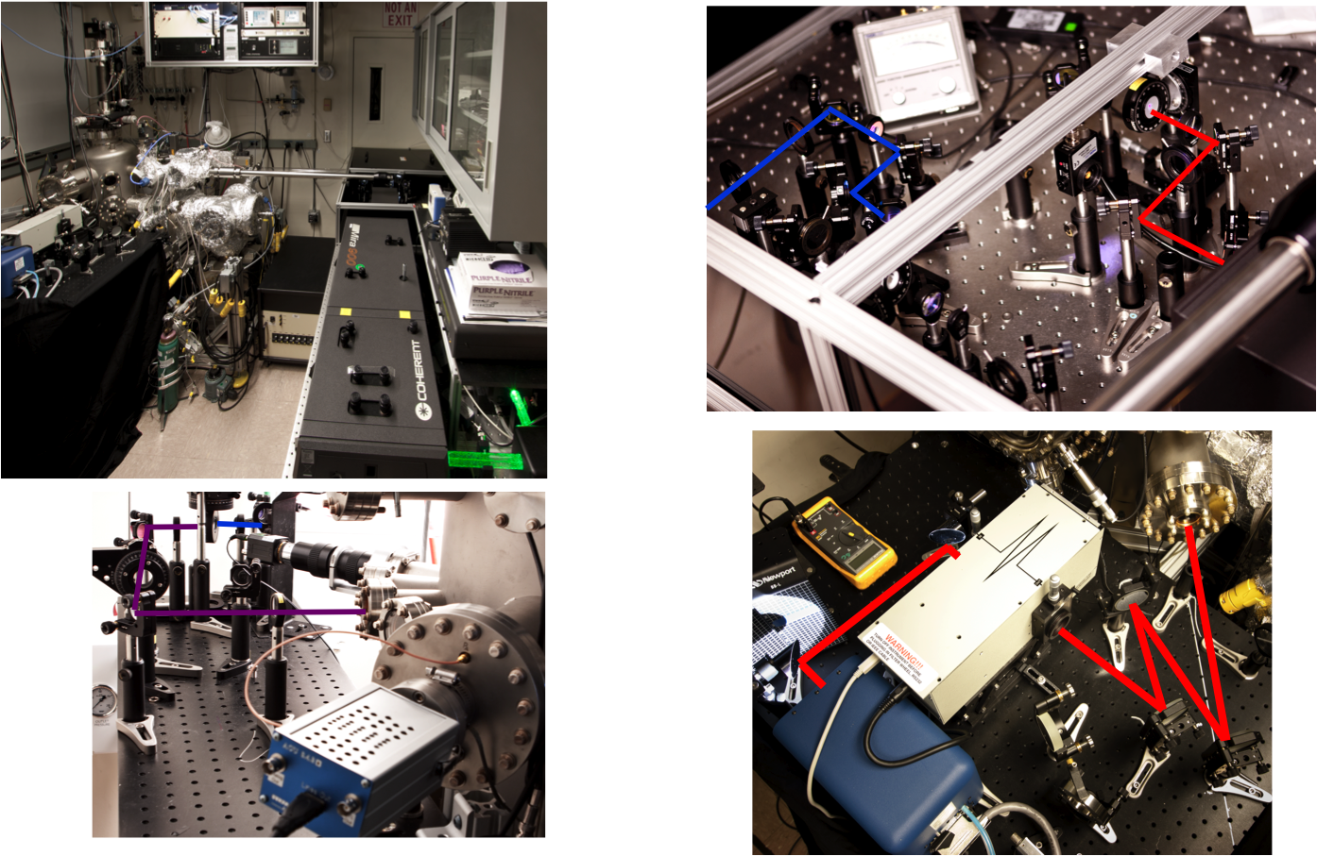
System for ARPES and yield measurements
2nd harmonic system
4th harmonic system + time of flight analyzer
Laser plasma + mono

Slide 8
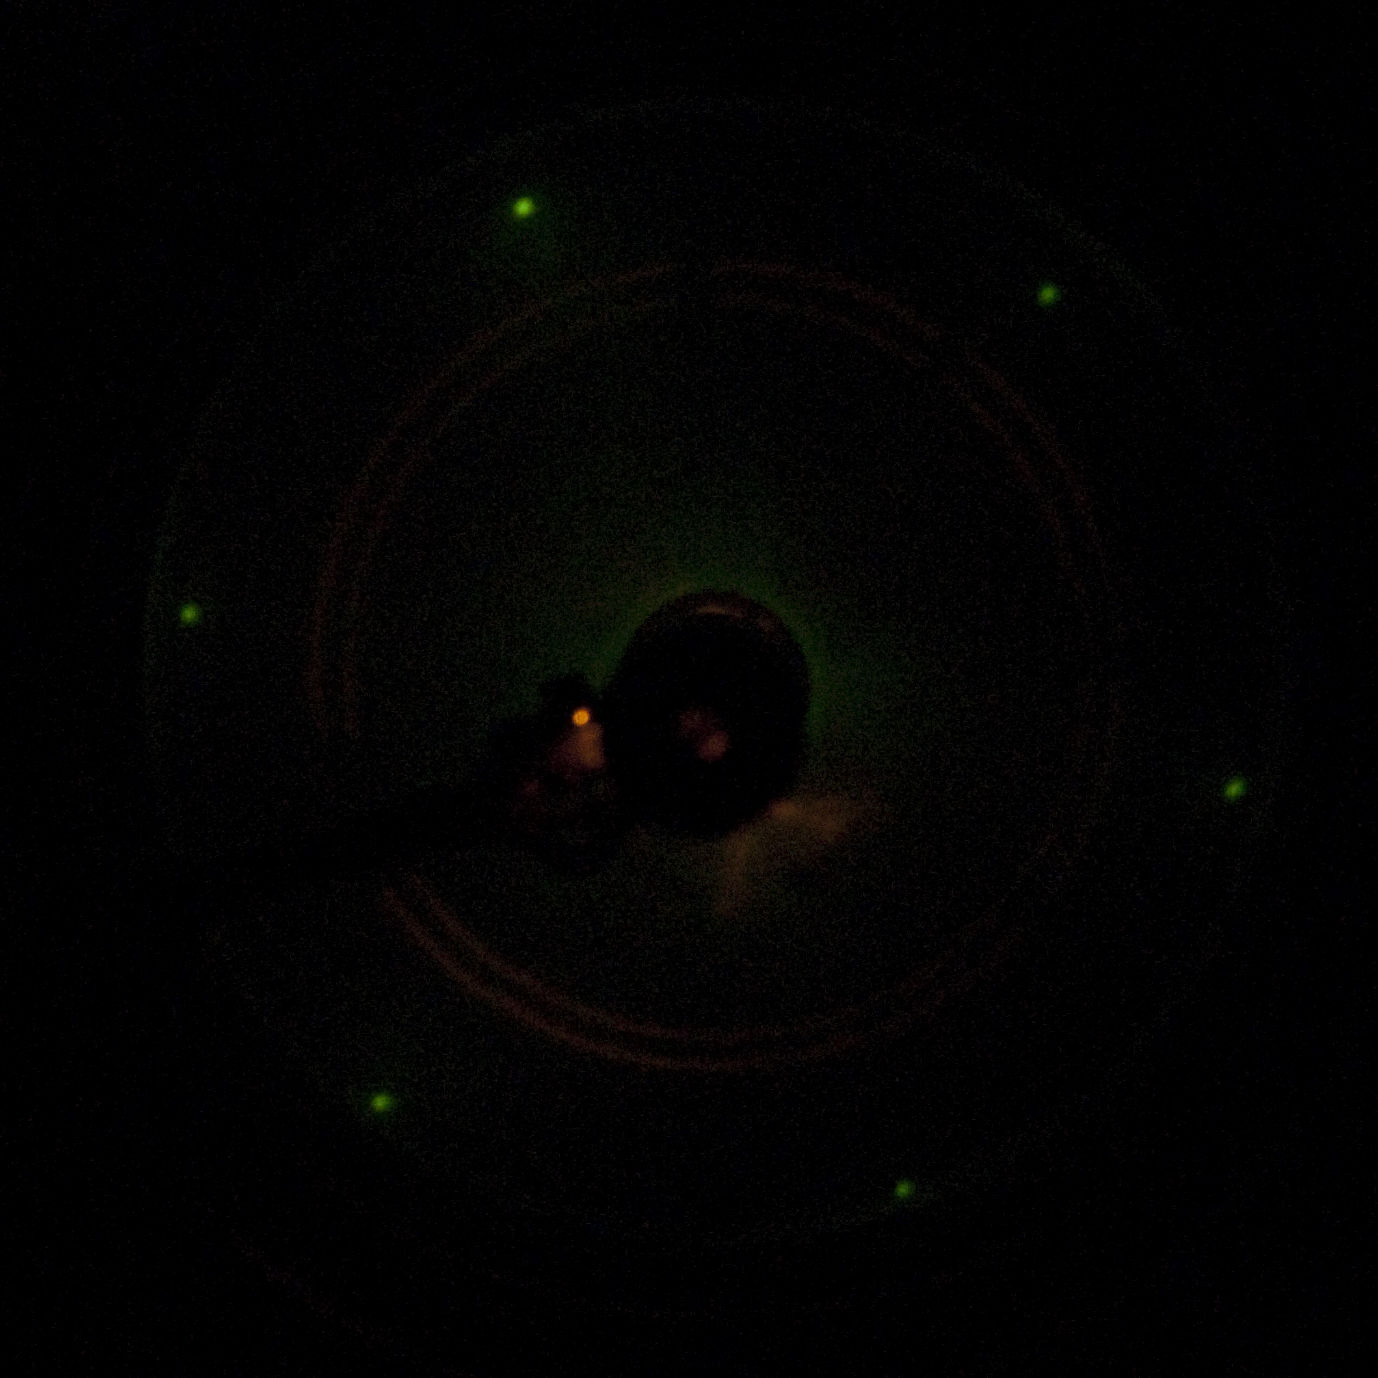
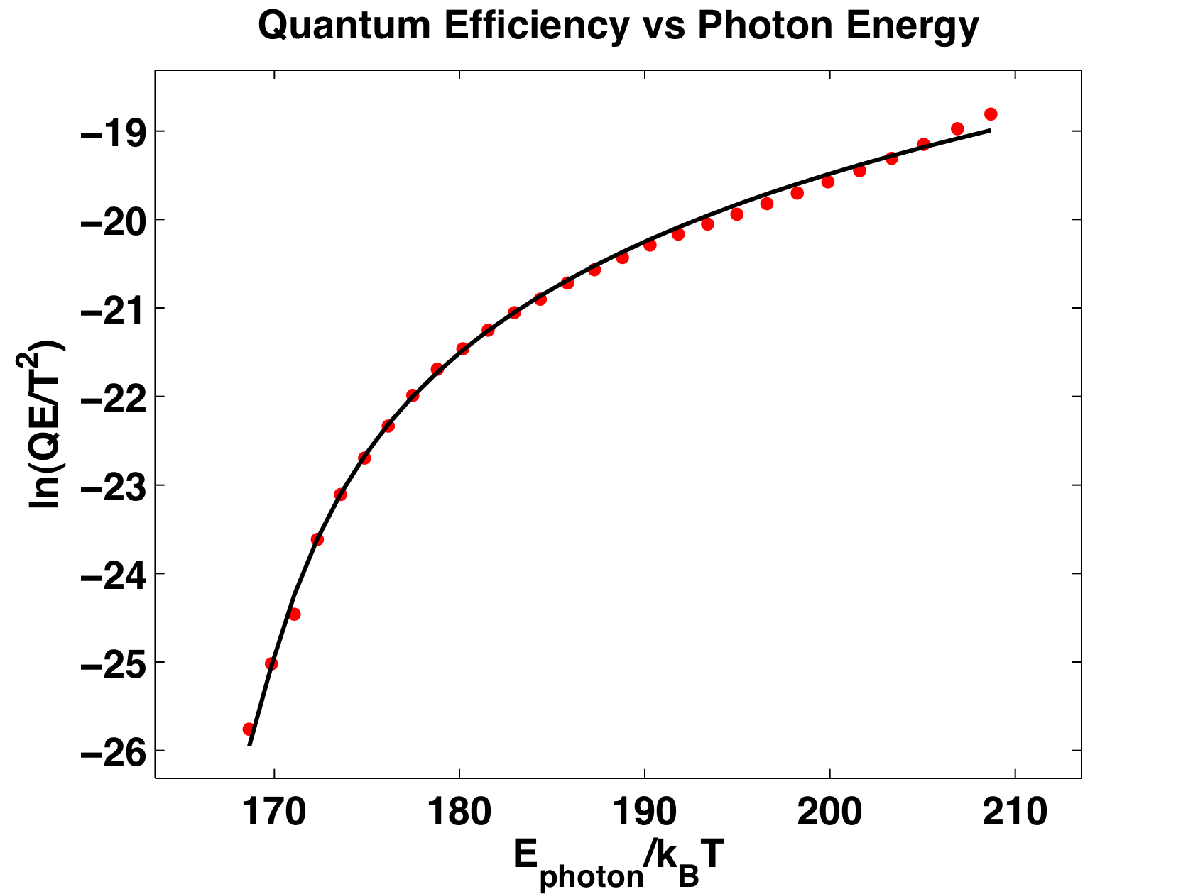
Preparation of atomically perfect single crystal surfaces
Step 1
Ion Bombard
1 kV Ar⁺ Ion
10 Å Removed
Step 2
Anneal
Ramp high temp
Dwell 10 minutes
Cool RT
Step 3
LEED
Verify Surface Order
ln(current/T²)
Work function is checked by Fowler technique

Slide 9
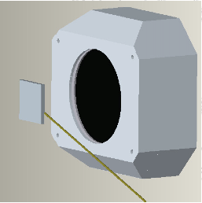
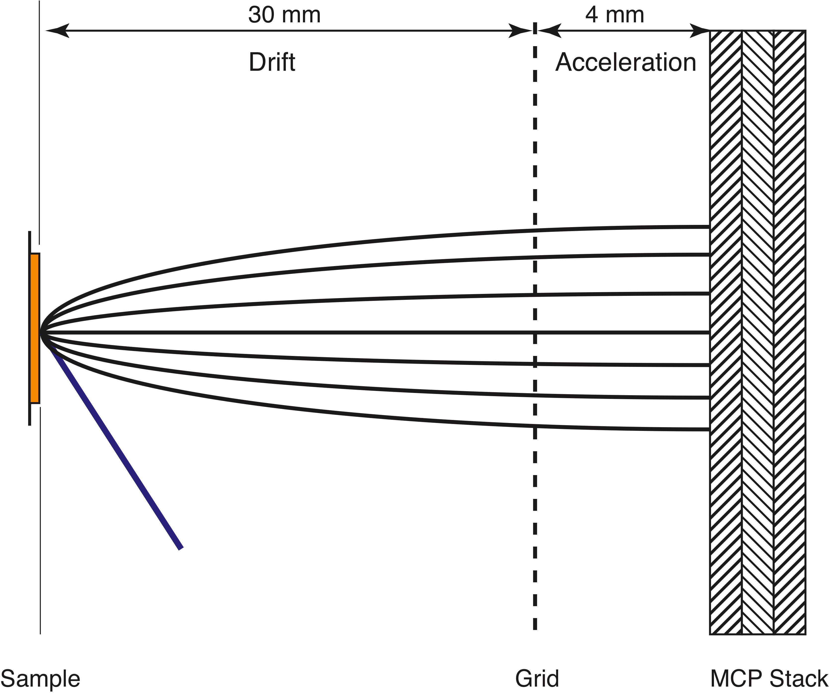
ARPES by TOF method
Measure position and time of flight of the electron in parallel plate geometry using Time of Flight (TOF).
Electrons
x,y
Sample
Light
Δt
(x,y,t) for each event
Time Resolution: 165ps
Spatial Resolution: 128µm
Maximum Count Rate: 1.5M cps
resolution: 4.8meV

Slide 10
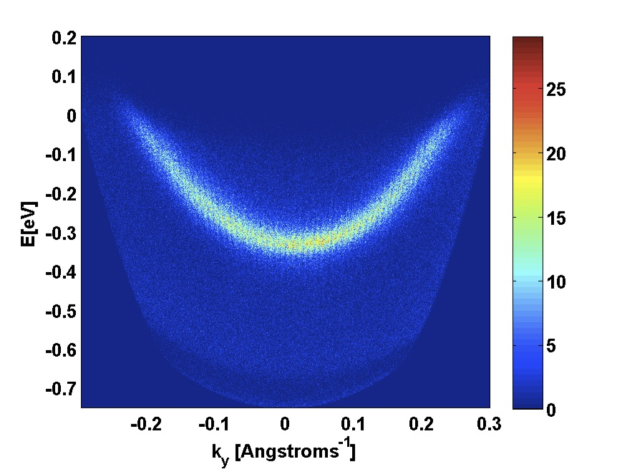
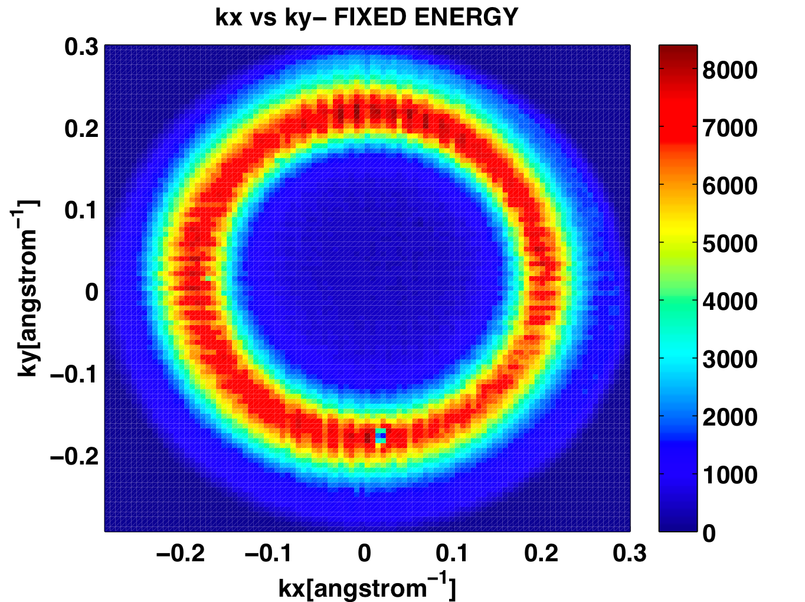
Angular distribution confirms surface state: eg. Cu(111)
I(E, k_{y}), k_{x} = 0
I(k_{x},k_{y}), E = E_{fermi}
E [eV]
Emission is not isotropic as for a free electron metal
Emission localized in energy and momentum
Maximum transverse momentum limited

Slide 11
Wavelength dependent QE measurement for Ag(111)
Normal incidence
70 degree incidence
Non-Fowler-like
Fowler-like
S polarized
  Fowler like behavior to ~ 250 nm (5 eV)
P polarized
  Large QE enhancement, particularly close to threshold
    Non-Fowler like behavior close to threshold
Jun, Mike, Wan, Dowell, Padmore
manuscript in preparation

Slide 12
Angle dependent QE measurement at 266 nm for Ag(111)
Clean surface
Sputtered surface
Photon energy 4.67 eV compared to 4.45 eV work function: 0.22 eV excess energy
QE at 70 degrees incidence ~ 100 x QE at normal incidence!
Sputtering ( ~ 10 Angstroms) mostly eliminates the enhancement
Enhancement attributed to high density of surface states 0.065 eV from the Fermi Level
More detail about the theory in Weishi’s talk tomorrow

Slide 13
Are there any better systems?
  Mo(110) higher density of surface states?
  layered compounds more than 1 contributing surface
  bulk crystals direct gap semiconductors
  exotic systems states localized at the Fermi level

Slide 14
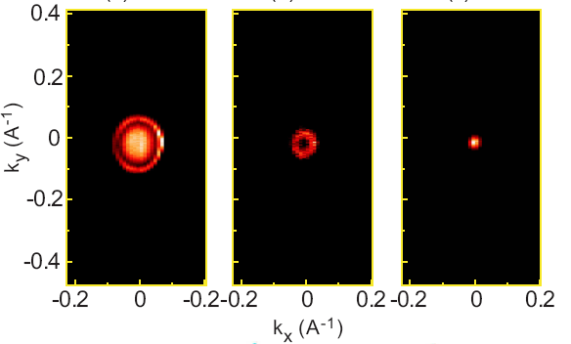
Topological insulator Bi₂Se₃
doping tuned Dirac point energy
bottom of
conduction band
(doped)
Doping brings Dirac point to Fermi level
Dotted line shows Ag(111) width at Ef
surface states
Dirac point
- note small
width in k
YuQi Xia:Princeton thesis, 2010

Slide 15
Conclusions
Surface states give the following advantages over normal metals
  Large reduction in transverse momentum
  Large increase in yield
Vacuum requirements compatible with VHF and DC photoguns
  Ag(111) relatively unreactive: surface state behavior constant at 4e-10 Torr for many days
May be much better systems
  Mo(110) higher density of surface states?
  layered compounds more than 1 contributing surface
  bulk crystals direct gap semiconductors
  exotic systems states localized at the Fermi level

