Slide 1
Operation of the High-Charge PHIN
RF Photoinjector with Cs₃Sb Cathodes
Christoph Hessler, Eric Chevallay, Steffen Doebert,
Valentin Fedosseev (CERN)
8 October 2012
Photocathode Physics for Photoinjectors Workshop 2012
Cornell University

Slide 2
Introduction
The drive beam of the CLIC test facility (CTF3) is currently being produced using a thermionic electron gun. A sub-harmonic bunching system produces the needed time structure for the beam combination scheme.
However, parasitic satellite bunches are generated with this setup, which cause beam losses and radiation issues.
To overcome these limitations the photoinjector PHIN was constructed at an off-line test stand to study its feasibility as an alternative to the CTF3 thermionic electron gun.
Satellite-free beam production at PHIN has been demonstrated in 2011.
Although PHIN was designed for CTF3 and not for CLIC, the focus of the PHIN studies has now shifted towards feasibility studies for the CLIC drive beam.

Slide 3
PHIN and CLIC Parameters
Parameter | PHIN | CLIC
Charge / bunch (nC) | 2.3 | 8.4
Macro pulse length (μs) | 1.2 | 140
Bunch spacing (ns) | 0.66 | 2.0
Bunch rep. rate (GHz) | 1.5 | 0.5
Number of bunches / macro pulse | 1800 | 70000
Macro pulse rep. rate (Hz) | 5 | 50
Charge / macro pulse (μC) | 4.1 | 590
Beam current / macro pulse (A) | 3.4 | 4.2
Bunch length (ps) | 10 | 10
Charge stability | <0.25% | <0.1%
Cathode lifetime (h) at QE > 3% (Cs₂Te) | >50 | >150
Norm. emittance (μm) | <25 | <100
Main issues: - Long cathode lifetimes with high bunch and average charges
- Laser system for CLIC parameters
(harmonics generation, 50 Hz operation)

Slide 4
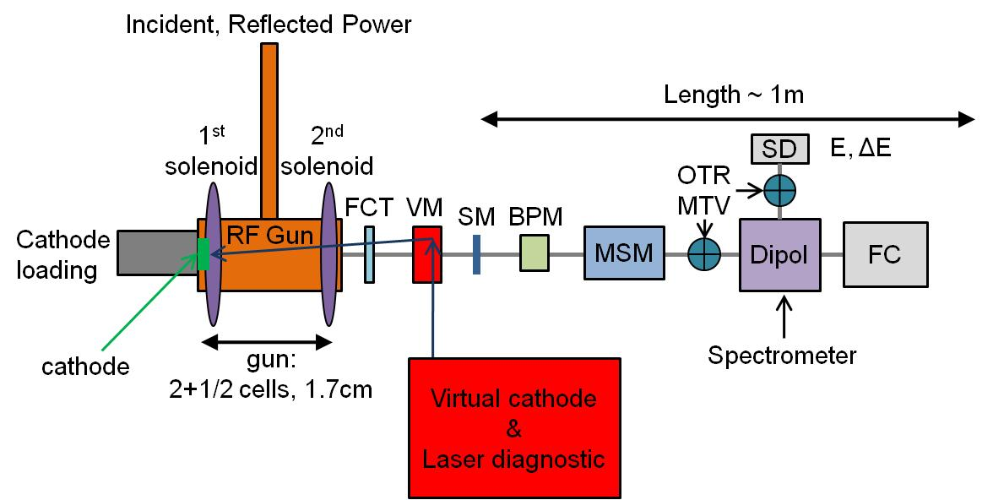
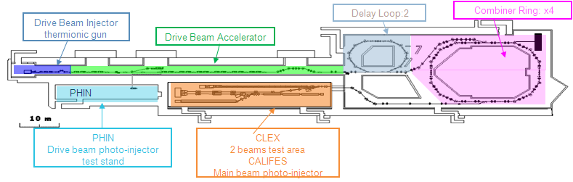
PHIN Photoinjector and CTF3
FCT: Fast current transformer
VM: Vacuum mirror
SM: Steering magnet
BPM: Beam position monitor
MSM: Multi-slit Mask
OTR: Optical transition radiation screen
MTV: Gated cameras
SD: Segmented dump
FC: Faraday cup

Slide 5
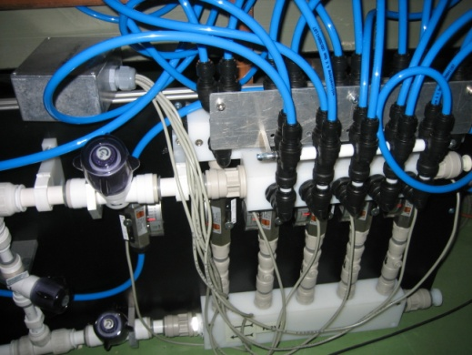
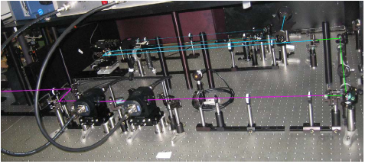

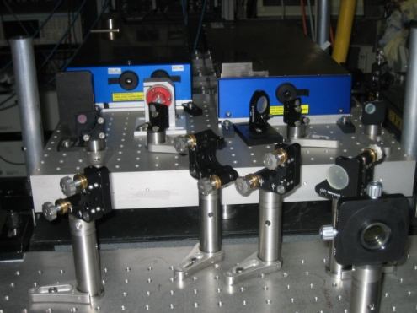
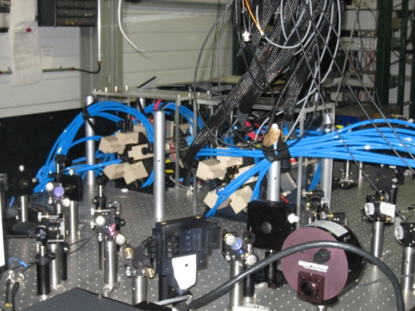


Laser System
To CALIFES
photoinjector
4ω
Harmonics
200μJ in 100ns
(=1.3μJ / laser pulse)
2ω
3-pass amplifier
Cooling
1.5 GHz
Synched oscillator
Cw
pre-amplifier
10W
Booster amplifier
320mW
3-pass amplifier
3.5kW
2-pass amplifier
8.3kW
7.8kW
14.8mJ in 1.2μs
2ω
3.6kW
4.67mJ in 1.2μs
4ω
Harmonics test stand
1.25kW
1.5mJ in 1.2μs
(=800nJ / laser pulse)
HighQ front end
AMP1 and AMP2
To PHIN
Photoinjector
M. Petrarca et al., “Study of the Powerful Nd:YLF Laser Amplifiers for the CTF3 Photoinjectors”, IEEE J. Quant. Electr. 47 (2011), p. 306.

Slide 6
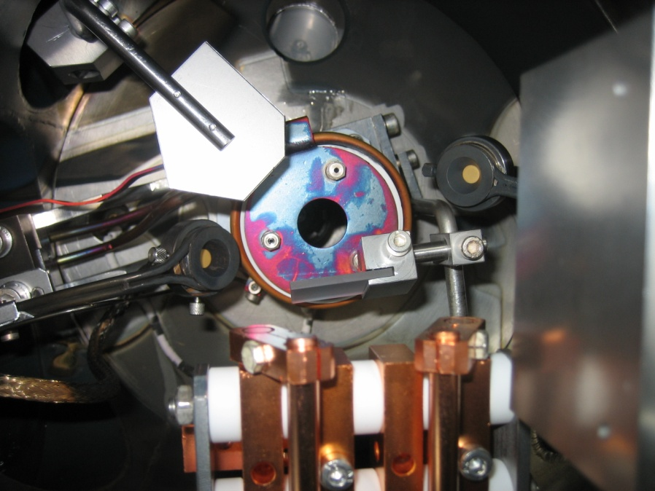
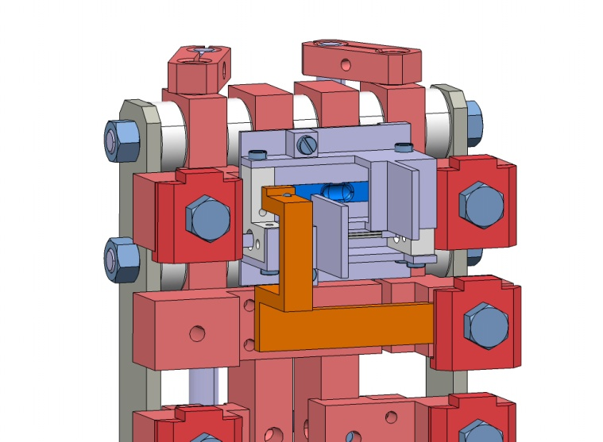
Photocathode Production
Co-evaporation of Cs and Te/Sb
Monitoring of each component by a separate microbalance (other component is shielded by a mask)
DC gun + diagnostic beam line for measuring the photocathode properties
Achieved QE: ~20% (Cs₂Te), 4.4% (Cs₃Sb)
Laser beam
Shutter
Te/Sb
microbalance
Photocathode
plug
Cs microbalance
Evaporators
Te/Sb evaporator
Masks
Cs dispenser
E. Chevallay, “Experimental Results at the CERN Photoemission Laboratory with Co-deposition Photocathodes in the Frame of the CLIC Studies”, CTF3 Note 104, submitted

Slide 7
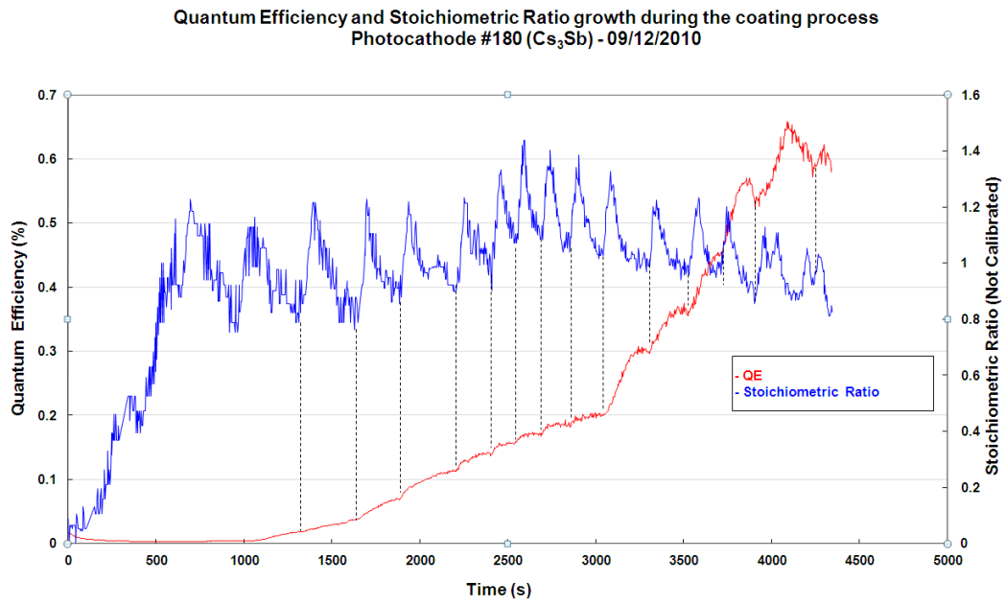
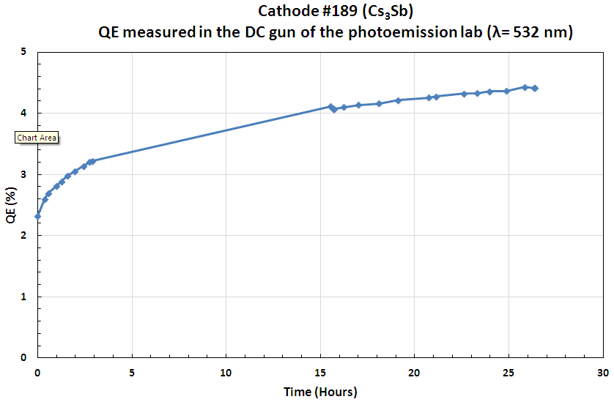
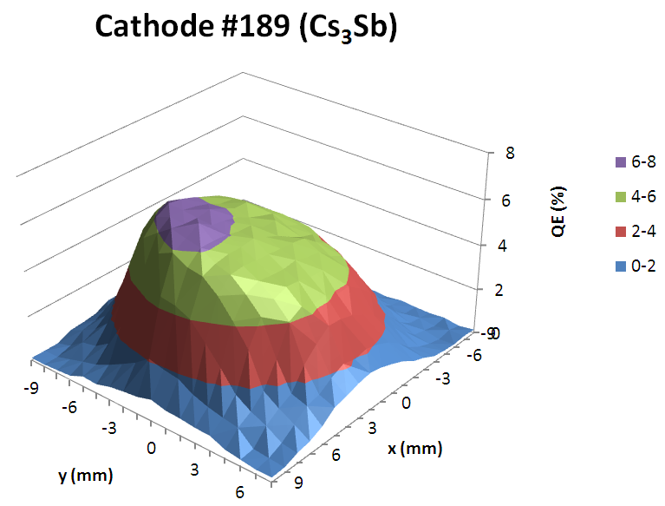
Co-deposition Cs₃Sb Photocathodes
After stopping the evaporation, the QE first continues to increase during beam production.
Reason for this behavior still unclear, maybe due to re-organization of Cs and Sb atoms.
Maximum QE achieved: 4.4%
Continuous beam operation

Slide 8
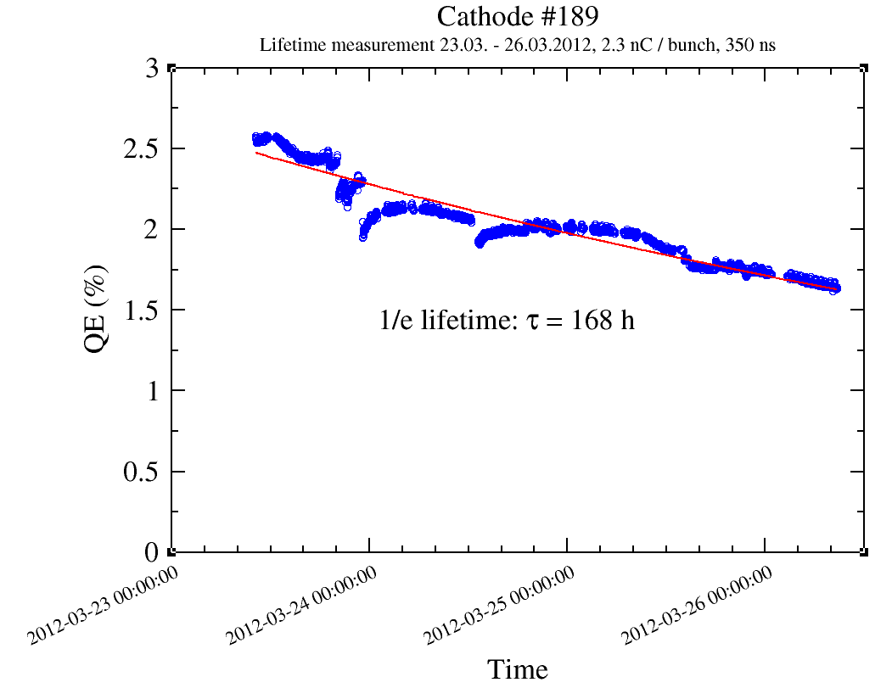
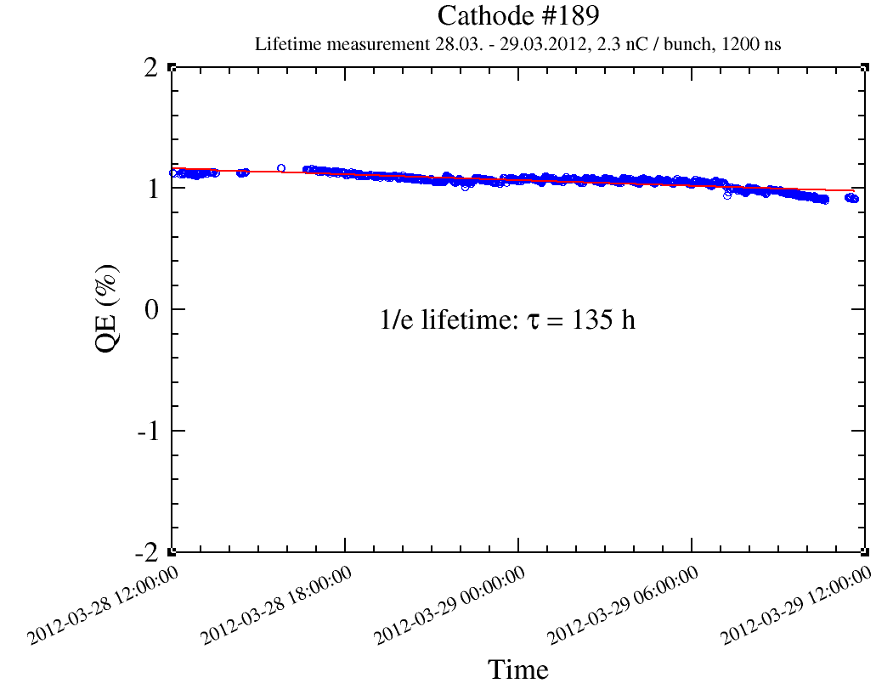
Lifetime studies of Cs₃Sb cathodes with green light
Excellent lifetimes obtained, much better than expected.
Long-time operation over 10 days with one cathode!
Operation of 1.2 µs long trains yield similar lifetime as for short trains.
2.3 nC, 350 ns
2.3 nC, 1200 ns
1/e lifetime 168 h
1/e lifetime 135 h

Slide 9
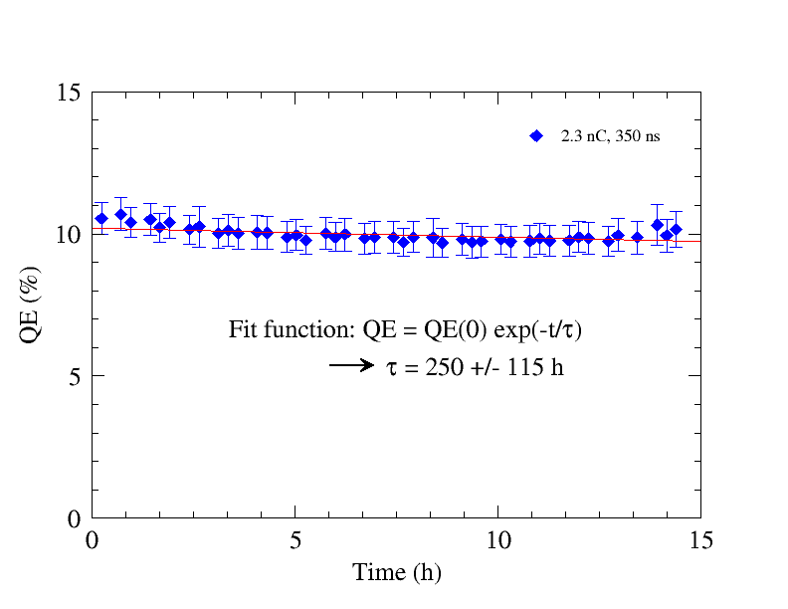
Lifetime Cs₃Sb vs. Cs₂Te Cathodes
Comparison with earlier lifetime measurements of Cs₂Te cathodes.
Lifetimes are similar and within CLIC specifications.
For Cs₃Sb a factor 6 less of QE is needed as for Cs₂Te cathodes, due to the different wavelength and the absence of 4th harmonics conversion stage
Cathode #189 (Cs₃Sb)
Cathode #185 (Cs₂Te)
2.3 nC, 350 ns
2.3 nC, 350 ns
1/e lifetime 168 h
(corresponds to 270 h
above 0.5% QE)
(corresponds to 300 h
above 3% QE)

Slide 10
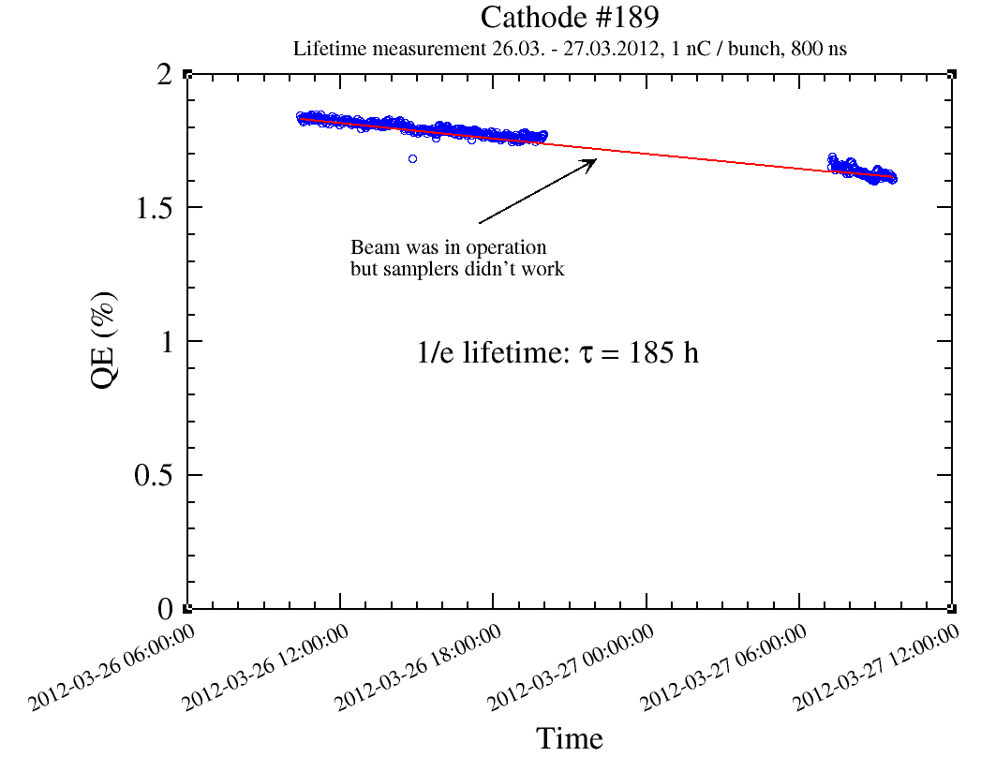
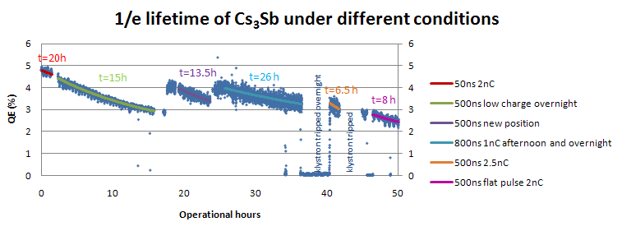
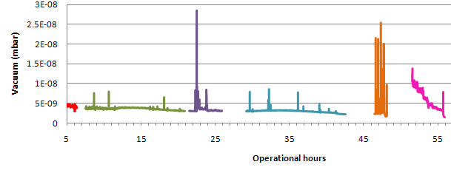
Impact of Vacuum on Cs₃Sb Cathode Lifetime
Comparison with earlier measurements of Cs₃Sb cathodes with UV light and worse vacuum conditions (same beam parameters).
Lifetime has drastically improved from 26 to 185 h.
Improved vacuum condition due to activation of NEG chamber around the gun.
March 2012
March 2011
1/e lifetime 26 h
1/e lifetime 185 h
1 nC, 800 ns
1 nC, 800 ns
4e-9 mbar
7e-10 mbar

Slide 11
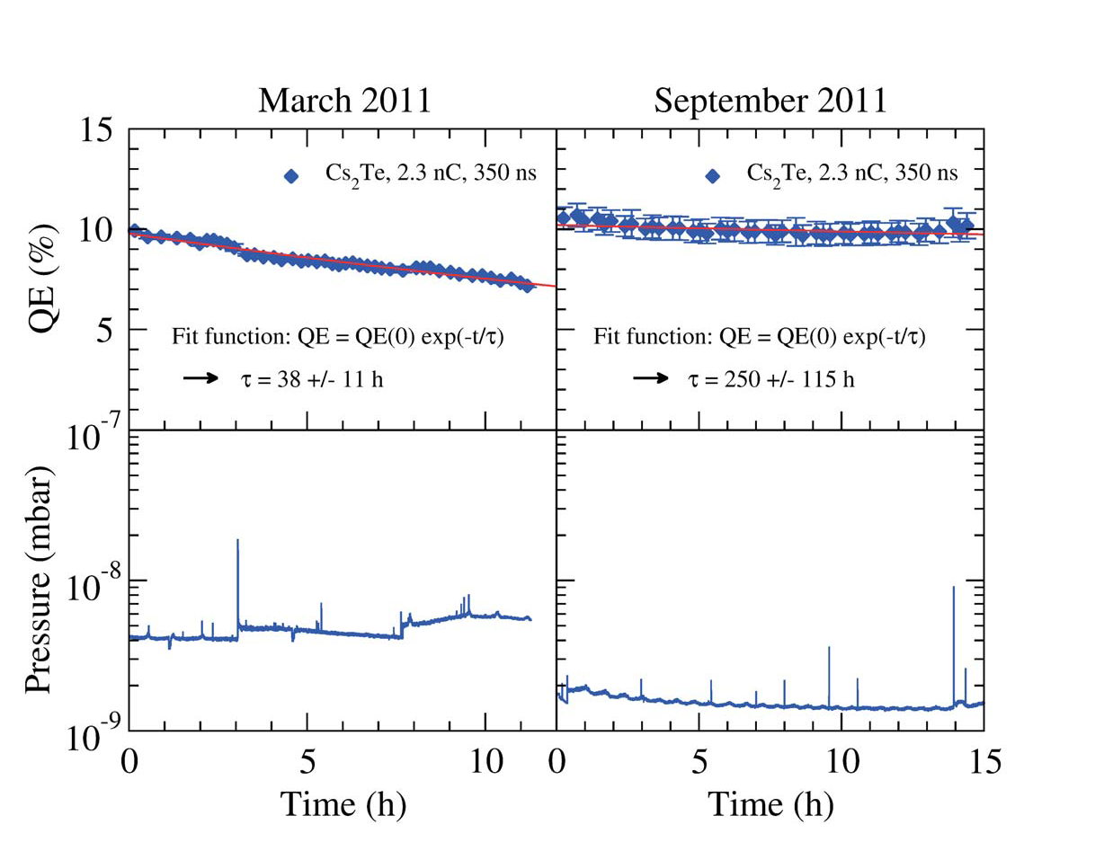
Impact of Vacuum on Cs₂Te Cathode Lifetime
Comparison of lifetime measurements with same beam properties but different vacuum conditions:
Substantial improvement of dynamic vacuum level has resulted in drastic increase of 1/e lifetime from 38 to 250 h.
Corresponds to total cathode lifetime of 300 h above 3% QE.
Cathode #185

Slide 12
Summary and Outlook
Cs₃Sb photocathodes successfully operated at PHIN RF photoinjector with green light.
Similar lifetimes obtained as for Cs₂Te cathodes.
⇒ Good candidate material for further studies
Good vacuum is mandatory for a good lifetime.
Cathode production process (co-evaporation) seems to be important for obtaining good lifetimes for Cs₃Sb cathodes .
Continue studies on Cs₃Sb cathodes with green light at PHIN.
Increase train length to maximum klystron pulse length of 5 µs
Further improvement of vacuum in PHIN planned (additional NEG pump).
Integrated charge studies with Cs₃Sb cathodes in DC gun of photoemission lab
Final proof of feasibility of a photoinjector for CLIC drive beam can only be achieved with a 1 GHz RF gun specially designed for the CLIC requirements.

Slide 14
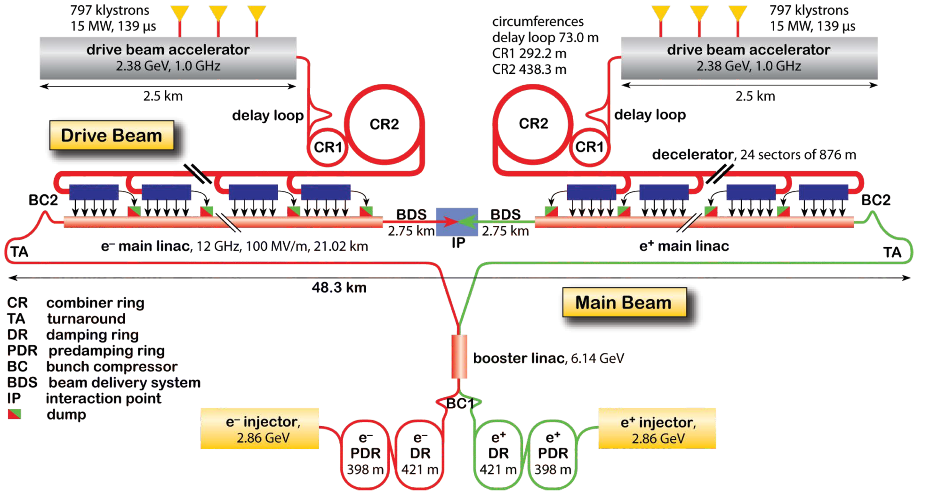
CLIC

Slide 15
PHIN and CLIC Parameters
 |  | DRIVE beam
Electrons |  | PHIN | CLIC
 | charge/bunch (nC) | 2.3 | 8.4
 | train length (ns) | 1200 | 140371
 | bunch spacing(ns) | 0.666 | 1.992
 | bunch length (ps) | 10 | 10
 | bunch rep rate (GHz) | 1.5 | 0.5
 | number of bunches | 1802 | 70467
 | machine rep rate (Hz) | 5 | 100
 | margine for the laser | 1.5 | 2.9
 | charge stability | <0.25% | <0.1%
 | Cathode lifetime (h) at QE > 3% | >50 | >150
Laser in UV | laser wavelegth (nm) | 262 | 262
 | energy/micropulse on cathode (nJ) | 363 | 1988
 | energy/micropulse laserroom (nJ) | 544 | 5765
 | energy/macrop. laserroom (uJ) | 9.8E+02 | 4.1E+05
 | mean power (kW) | 0.8 | 2.9
 | average power at cathode wavelength(W) | 0.005 | 41
 | micro/macropulse stability | 1.30% | <0.1%
Laser in IR | conversion efficiency | 0.1 | 0.1
 | energy/macropulse in IR (mJ) | 9.8 | 4062.2
 | energy/micropulse in IR (uJ) | 5.4 | 57.6
 | mean power in IR (kW) | 8.2 | 28.9
 | average power on second harmonic (W) | 0.49 | 406
 | average power in final amplifier (W) | 9 | 608

Slide 16
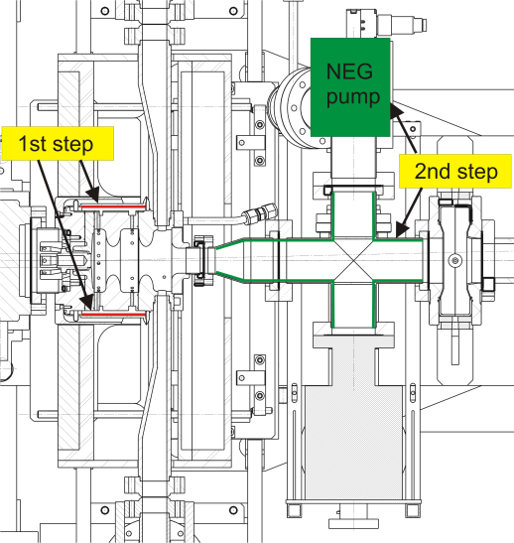
Improvement of PHIN Vacuum System
Layout PHIN gun:
Plan to improve
vacuum in two
steps:
Activation of existing NEG coated chamber around the gun
Activation of existing NEG coating in beam line and installation of additional NEG pump.
Laser
beam
Electron
beam
Photo
cathode
20 cm

Slide 17
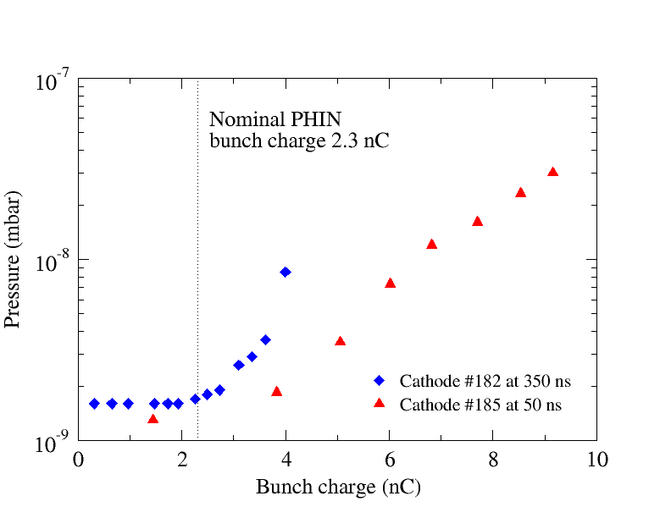
Impact of Bunch Charge on Vacuum
Vacuum vs. bunch charge
Vacuum can be maintained up to nominal bunch charge of PHIN of 2.3nC.
Pressure increase above nominal bunch charge probably due to losses inside gun.
A 1 GHz gun specially designed for CLIC might be able to maintain the vacuum up to a higher bunch charge due to larger apertures.

Slide 18
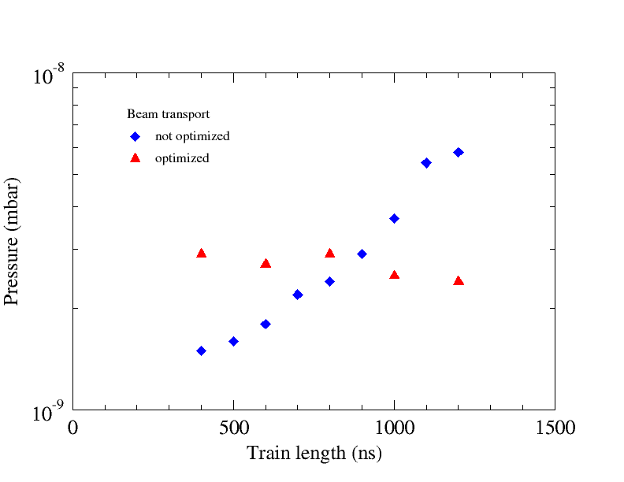
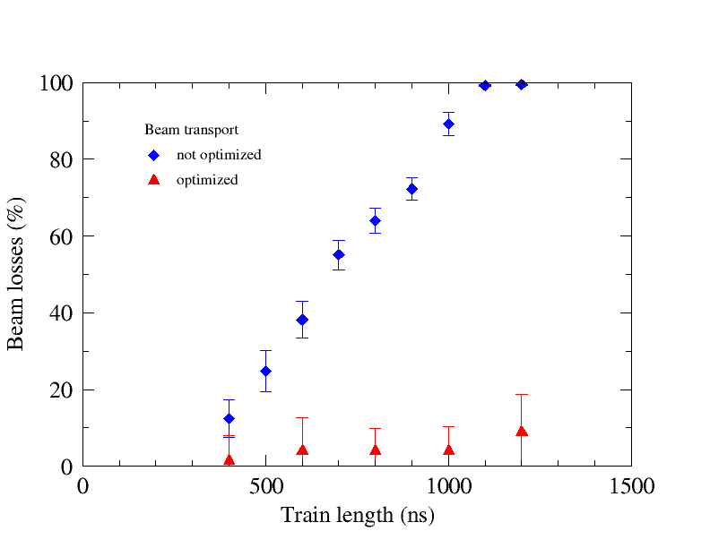
Impact of Train Length on Vacuum
Corresponding beam losses
Between FCT and Faraday cup
Vacuum vs. train-length
Bunch charge 2.3 nC
Vacuum correlated to beam losses in the beam line
When beam is optimized for good transport, the vacuum can be maintained with increasing train length

Slide 19
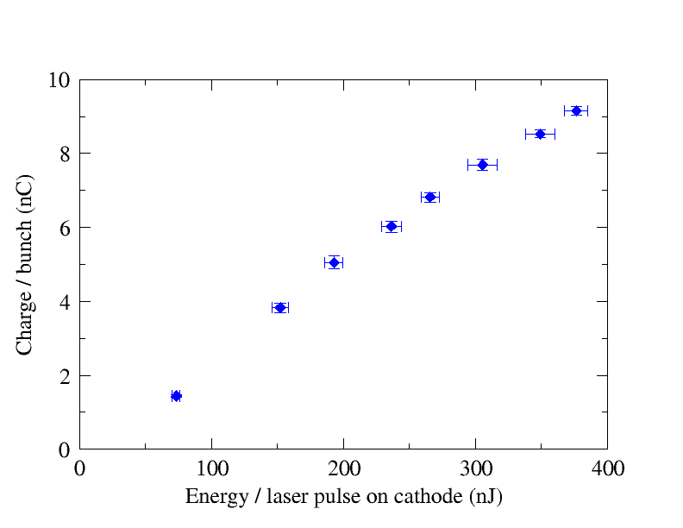
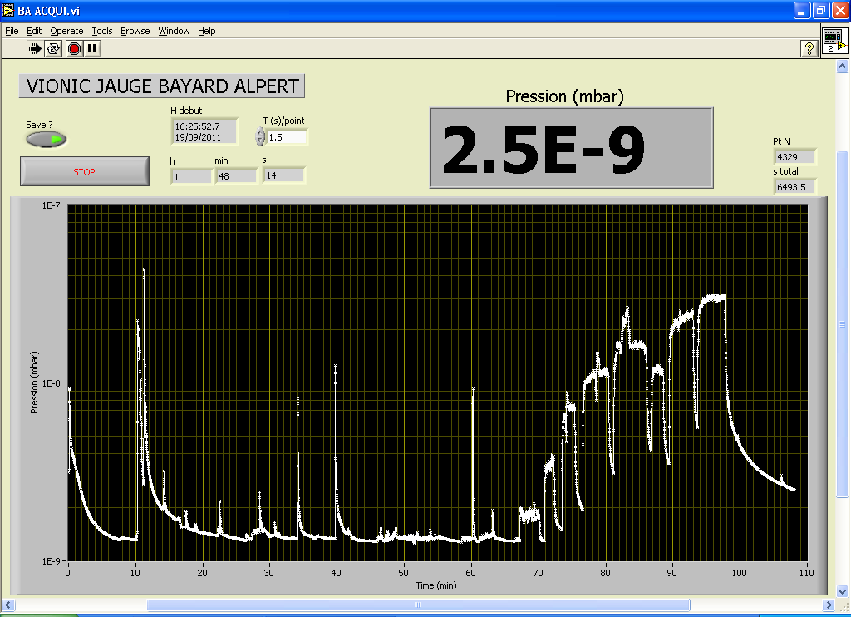
High Charge Production (Cs₂Te)
Charge vs. laser energy scan with 50 ns long trains
Linear response up to 5 nC
Record bunch charge of 9.2 nC above CLIC requirements!
Close to the theoretical limit of Q_{max}=9.47 nC for a beam size of
1.8 mm σ x 1.25 mm σ
9.2 nC!
Cathode #185 Cs₂Te

Slide 20
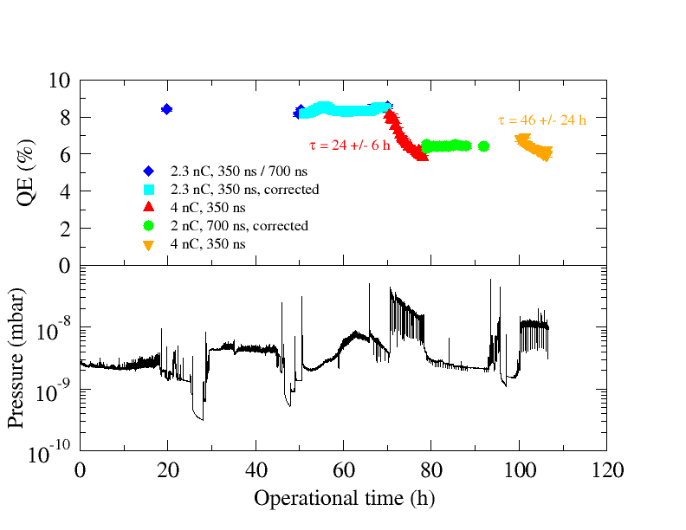
Lifetime Studies of Cs₂Te Cathodes
Cathode lifetime vs. vacuum
  Correlation between lifetime and vacuum.
  In high e-9 mbar/ low e-8 mbar
  < 50h lifetime was measured.
  When vacuum is kept at low
  e-9 mbar lifetime is within specification.
Cathode #182

Slide 21
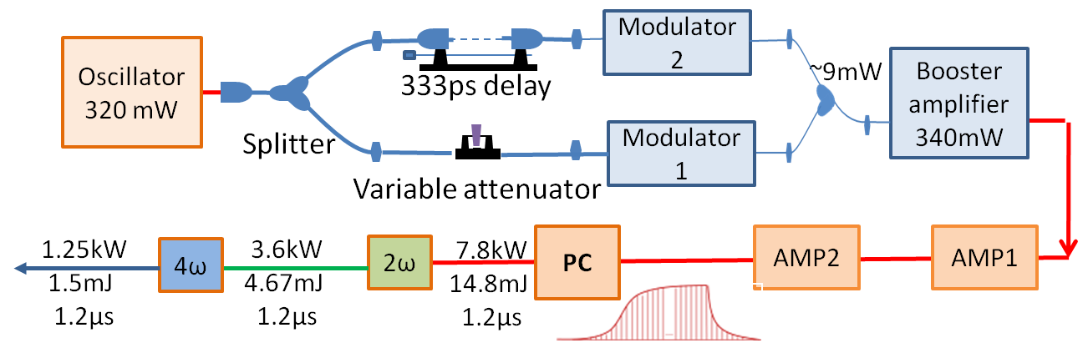
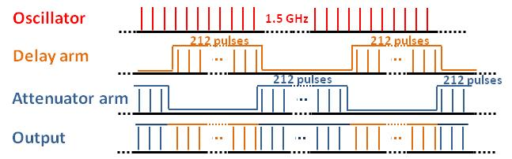
Phase Coding Demonstration
Motivation
  CTF3/CLIC drive beam requires several fast 180 degree phase-switches for beam combination.
  With currently used thermionic DC gun and sub-harmonic bunching satellites are produced, which could cause radiation problems.
Aim to provide an alternative satellite-free solution using laser phase-coding based on fiber-modulator technology and an RF photo-injector.
Setup:
M.Csatari Divall et al., “Fast phase switching within the bunch train of the PHIN photo-injector at CERN using fiber-optic modulators
on the drive laser”, Nucl. Instr. And Meth. A 659 (2011) p. 1.

Slide 22
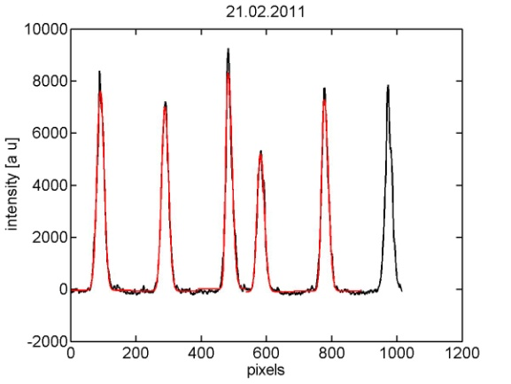
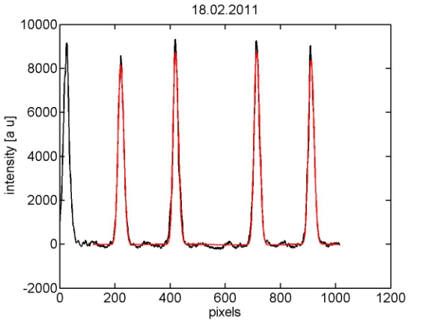
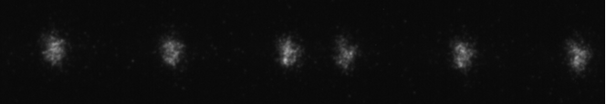

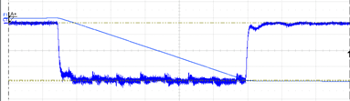
Phase Coding Demonstration
Results:
  Streak camera measurements of Cerenkov light
  Beam observation on fast current transformer:
⇒ switching time
< 300ps
⇒ Satellites <0.1%
⇒ No beam degradation
due to switching

