Slide 1

Measuring the growth of alkali antimonides using in-situ X-ray Diffraction and X-ray Reflectivity
Miguel Ruiz-Osés
Postdoc Stony Brook University
Contact: mruizoses@gmail.com
2nd Photocathode Physics for Photoinjectors workshop, Cornell 10/07/2012

Slide 2
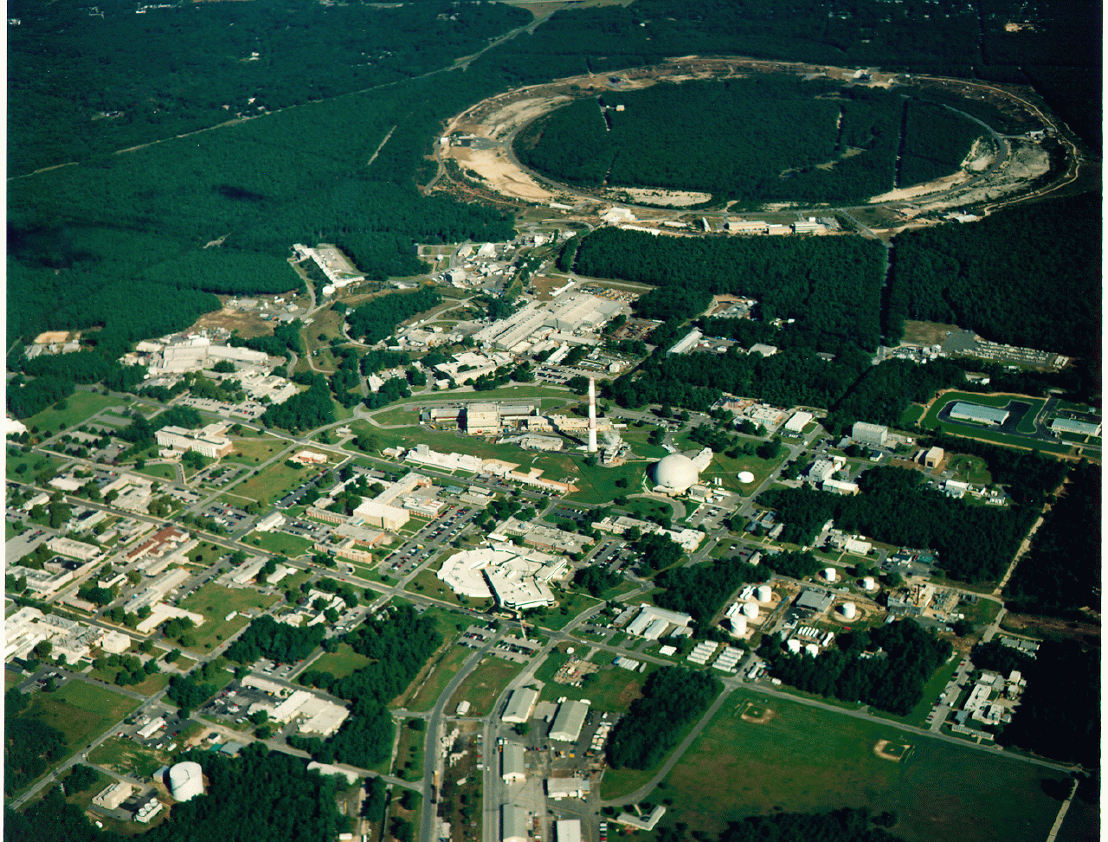
Brookhaven National Laboratory
RHIC: Relativistic Heavy Ion Collider
R&D Collider Department
NSLS: National Synchrotron Light Source

Slide 3
Introduction:
Alkali antimonide cathodes are critical both for high-average current photoinjectors and for high quantum efficiency photodetectors.
Photoinjectors performance:
  QE of 2-6% at 532 nm and >10% at 355 nm
  QE unchanged at cryogenic temperature
  > 50 mA from 7 mm radius spot
  High Uniformity
  Emittance
Problems-Challenges:
Extreme vacuum sensitivity, non-reproducibility and poor lifetime.

Slide 4
Approach:
Effort to improve the performance of alkali antimonides ( K2CsSb) based on characterization of cathode formation during growth.
Techniques:
X-Ray Diffraction in-situ growth
XPS: Chemistry of growth (Susanne’s Talk)
By means of these Techniques…
Study of the growth parameters, including both transparent and metallic substrates, sputtered and evaporated films, variation of growth time and temperatures and post-growth annealing processes. RECIPE
Goal:
Correlation Between Material Properties and Performance

Slide 5
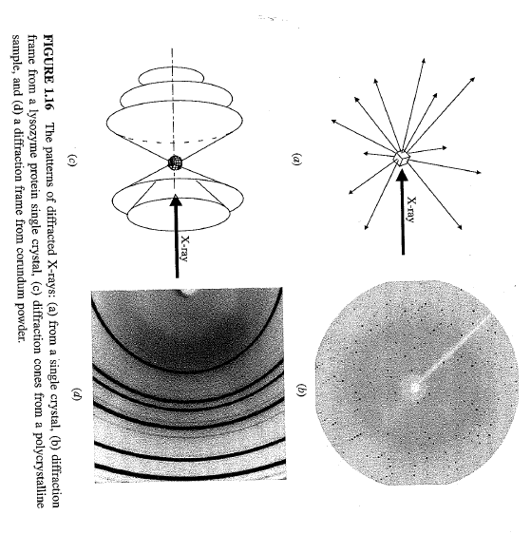
XRD Crystalline structure during growth
XRD: Atomic arrangement of materials.
Monochromatic X-Ray
Coherent X-Ray scattering = f( e- distribution in sample)
monocrystaline
polycristaline
2D area detector
“The intensity and spatial distributions of the scattered X-rays form a specific
diffraction pattern which is the “fingerprint” of the sample.

Slide 6
Experimental set up: K2CsSb cathodes growth
Horizontal evaporation of three sources:
P=1x10-10 mbar
FTM
Detector
Cs
K
X-rays
Sb
Recipe:
QE during growth (532 nm laser)
Cs
T(C)
QE(%)
140
K
K
Cs
100
Sb
25
t
t

Slide 7
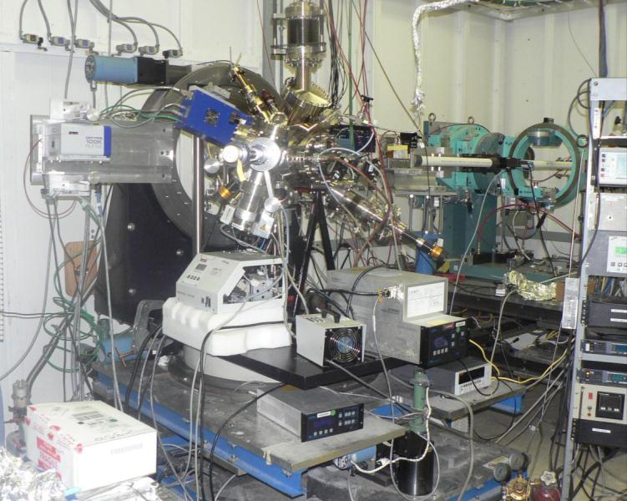
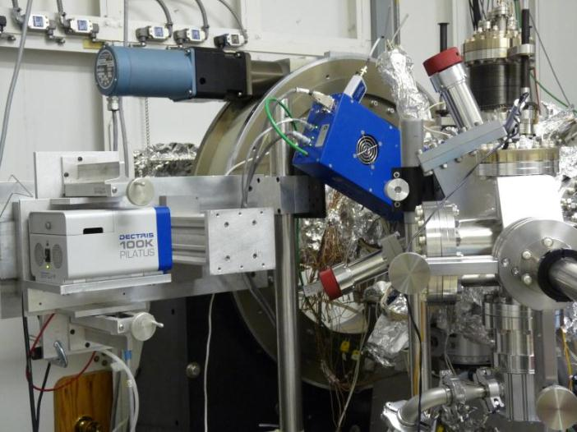
X21/NSLS Beamline
4 axis diffractometer UHV chamber
in-situ X-ray diff during deposition.
Evaporators
Beam Energy = 10 keV, λ = 1.2398 Å
Mono Resolution (ΔE/E) = ~ 2x10⁻⁴
Flux = ~ 2x10¹² ph/sec @ 300 mA
Spot Size = ~ 1 x 0.5 mm²
X-rays
UHV system (2x10-10 Torr base pressure)
Residual Gas Analyzer (RGA)
Heating/cooling substrate/cathode
Load lock (fast exchange of substrates)
Horizontal deposition of Sb, K and Cs.
zeta - θ
(sample)
nu - 2θ
(table)
Camera 2
Portable chamber!
Camera 1
Two 2D detectors (Pilatus 100K):

Slide 8
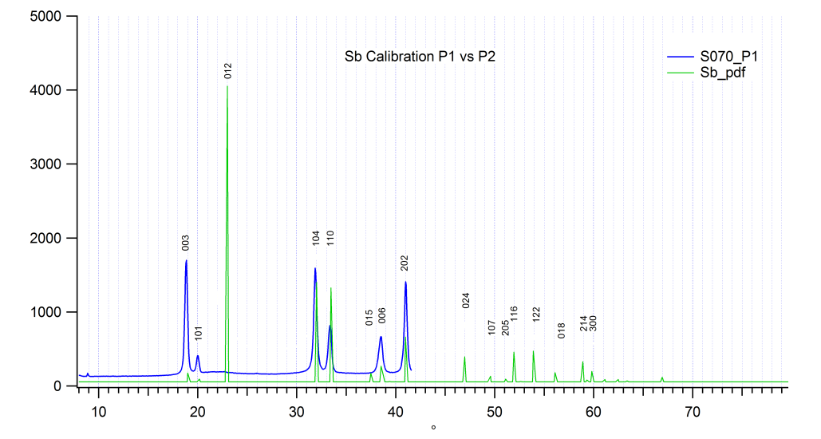
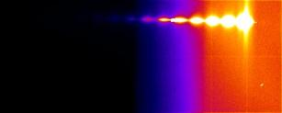
Camera 1: Scan in diff plane
  Ɵ-2Ɵ WAXS
  (after evaporation)
ZL
Diffractometer plane
Detector 1
2
1
D
X-rays
XL
α
α: Swing angle
D: Distance sample-detector
XL, YL, ZL: Lab coordinates
YL
  XRR movie while evaporation

Slide 9
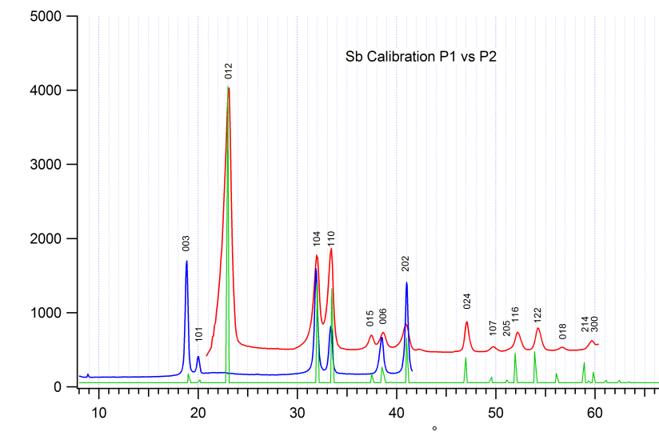
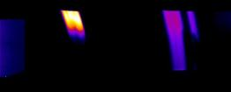
Camera 2: Scan out of diff plane
  XRD movie while evaporation
Detector 2
ZL
ZL
D’
Diffractometer plane
α’= 25˚
Detector 1
1
α’
X-rays
XL
YL

Slide 10



Set of data
Camera 1
Camera 2
X-Ray reflectivity (XRR)
Wide Angle X Ray Scattering (WAXS)
  thickness of thin film layers
  density and composition of thin film layers
  roughness of films and interfaces
FIXED ANGLE α
FIXED ANGLE α’
Wide Angle X Ray Scattering (WAXS)
  phase composition (what phases are present)
  quantitative phase analysis- (how much of each phase is present)
  unit cell lattice parameters
  crystal structure
  average crystallite size of nanocrystalline samples
  crystallite microstrain
  texture
  residual stress (really residual strain)
QE measurement during growth
Cs
QE(%)
SCAN IN ANGLE
K
t

Slide 11
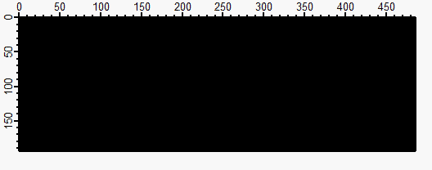

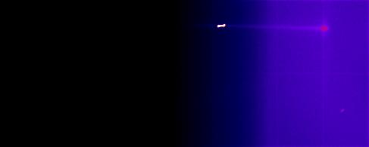
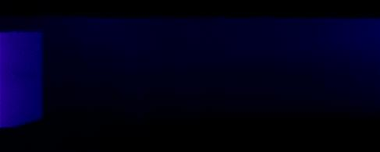
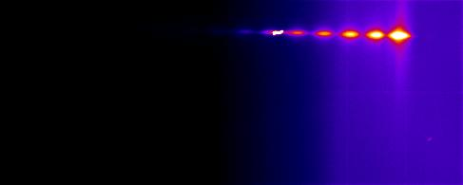
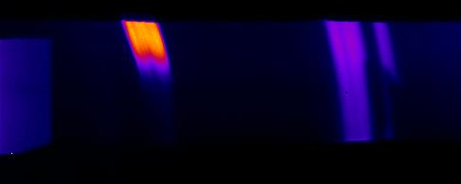
165Å Sb at RT on Si(100)
Influence of the Sb structure on the growth of the cathode:
Correlation between structure of Sb and the final structure of the cathode?
Is the substrate having an influence in the Sb growth?
Is there a correlation between reactivity, QE and roughness?
Camera 1: XRR
Camera 2: WAXS
14.9˚
39.3˚
0Å
time
165Å
(003)
(012)
(104)
(110)
Sb peaks

Slide 12
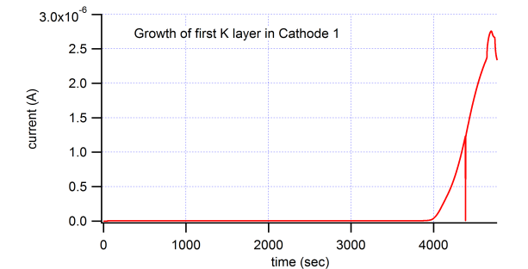
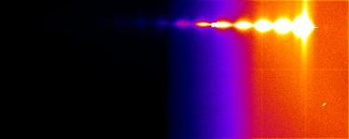
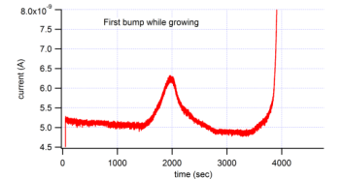
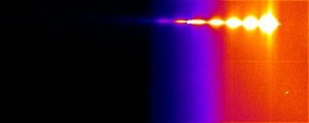

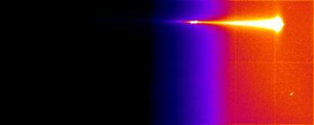

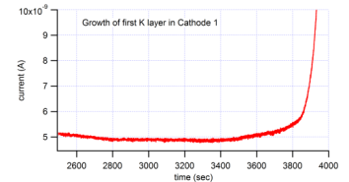
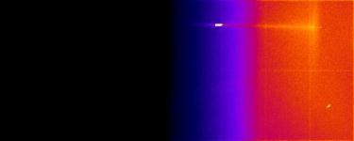

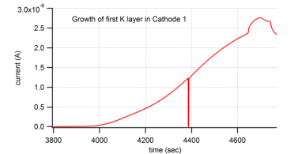
K at 140C
QE(%)=0.1%
Camera 1
Camera 2
(012)
(104)
(110)
2000 s
~10Å
Sb peaks
time
3800 s
~290Å
4645 s
~495Å
(111)
(220)
(420)
4697 s
~500Å
K3Sb peaks (K diffusion into Sb)

Slide 13
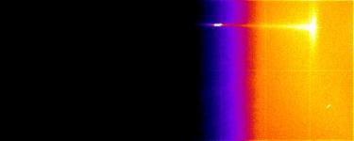
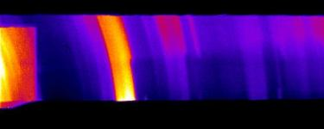
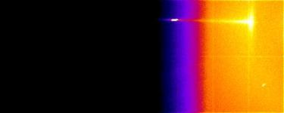
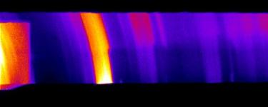
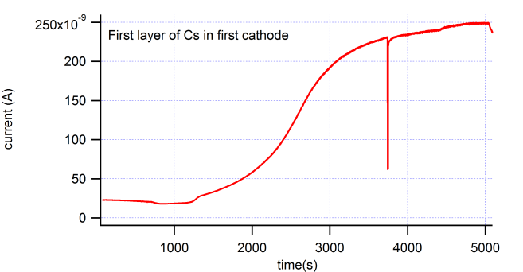
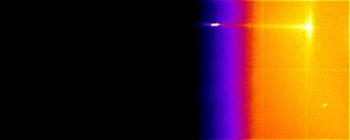
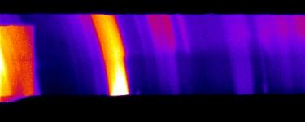
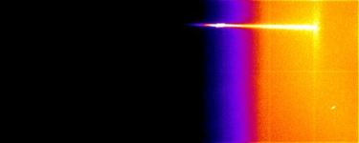
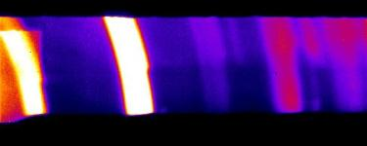
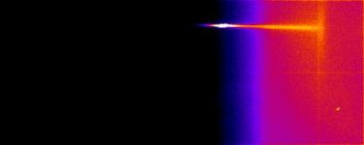
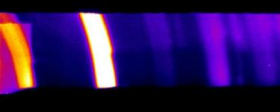
Cs at 130C
Camera 1
Camera 2
23.8˚
28˚
(111)
(220)
(420)
K3Sb peaks
0Å
QE(%)=1.4%
700 s
4400s
5000s
time
0Å
1220 s
700s
1220s
25Å
4400 s
763Å
5000 s
K2CsSb peaks
901Å
(200)
(220)
(222)
(400)
(331)
(420)

Slide 14
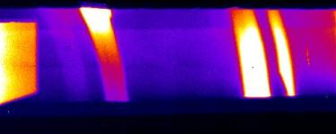
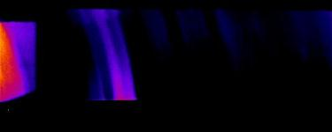
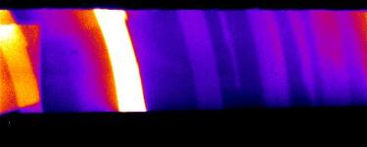
Cathodes comparison
Succesfull experiments measuring QE+XRD while growing cathodes!
Cathode 1
Cathode2
RT
100C
Sb
(003)
(012)
(104)
(110)
K3Sb
(111)
(220)
(420)
QE(%)=0.1%
QE(%)=0.4%
K2CsSb
QE(%)=1.4%
QE(%)=3.7%
RT vs 100C Sb evaporation: Starting configuration of Sb different in both cases.

Slide 15
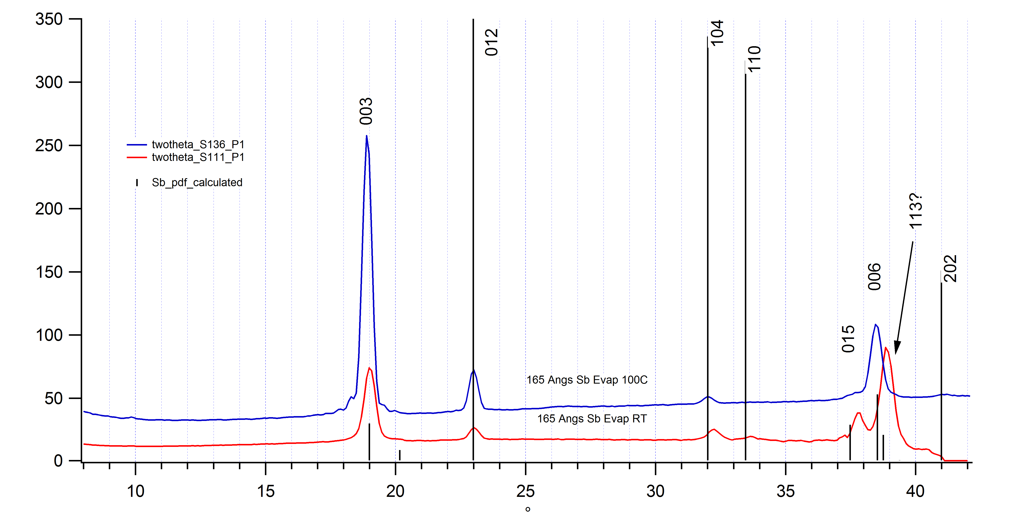
Differences between RT and 100C evaporation of Sb
RT evaporation smaller grains
100C deposition bigger grains

Slide 16

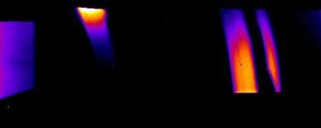

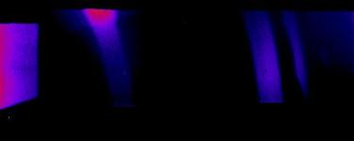

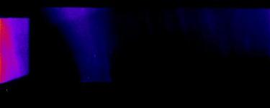

K3Sb formation:
RT
100 C
Cathode 1
Cathode2
Camera 1
Camera 2
Camera 1
Camera 2
Sb peaks
2000 s
~10Å
0s
2
1
time
3800 s
~290Å
1180s
137Å
(012)
4645 s
~495Å
1840s
205Å
K3Sb peaks
4697 s
~500Å
2820s
312Å
QE(%)=0.1%
3
QE(%)=0.4%
1. Start K reaction
2. K is not initially sticking
3. Low intensity fringes and larger background= rougher surface enhanced reaction rate

Slide 17
Comparison of Crystal structure and Final QE: K2CsSb
Cathode 1
Cathode2
249Å Cs
756Å Cs
K2CsSb
QE(%)=1.4%
QE(%)=3.7%
WAXS camera 1 after evaporation…

Slide 18
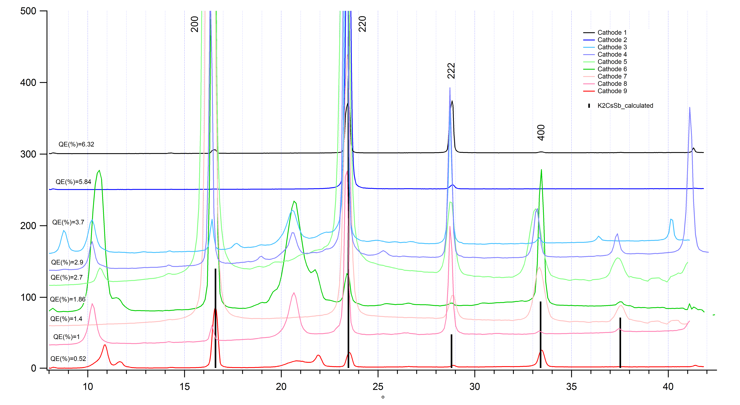
Comparison of Crystal structure and Final QE: K2CsSb cathodes
K2CsSb
Identifying phases….

Slide 19
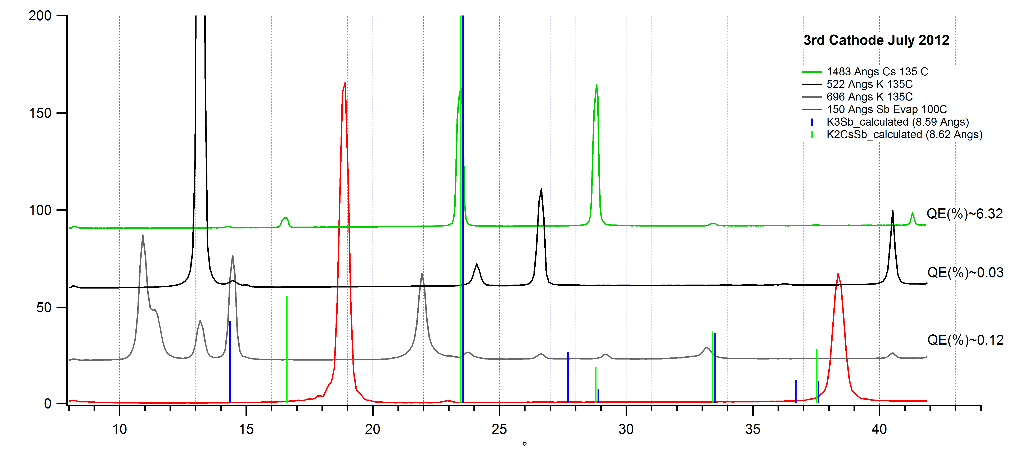
Evolution of Crystal structure during K2CsSb growth
150 nm Cs
50 nm K
70 nm K
15 nm Sb 100C

Slide 20
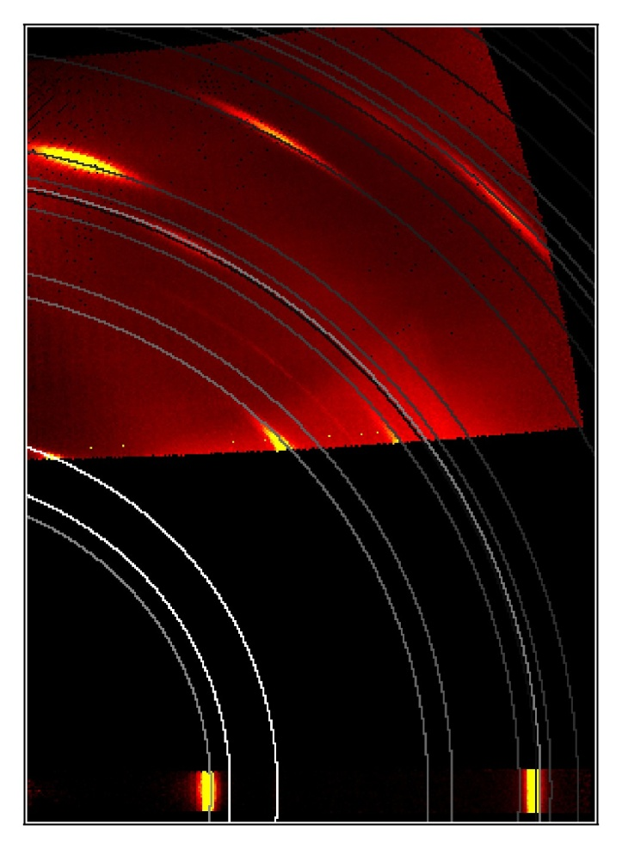
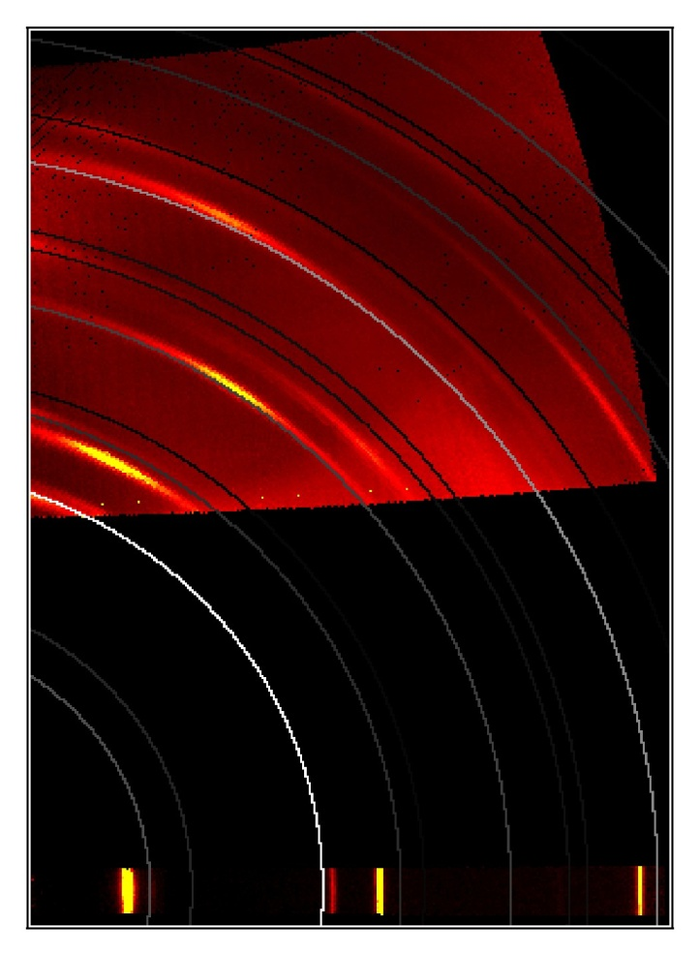
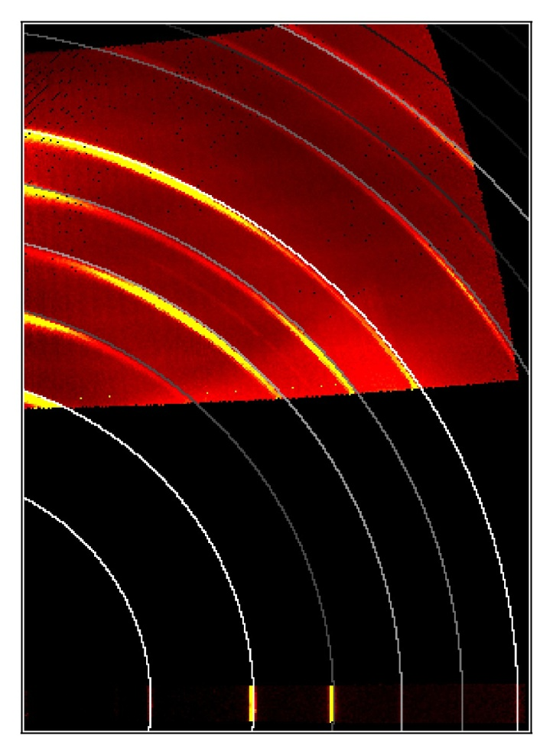
K2CsSb Cathode texture
Final QE 6.3% @ 532nm
Sb
K
Cs
Sb evaporated at 100C
Clear [003] texture
Add Potassium at 135C
Textured final film
But not K₃Sb
Add Cesium at 135C
Textured final film
Both [220] & [222]

Slide 21
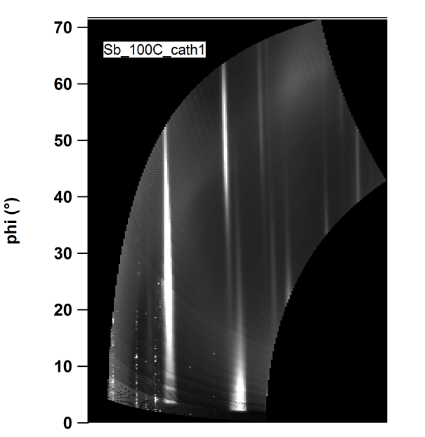
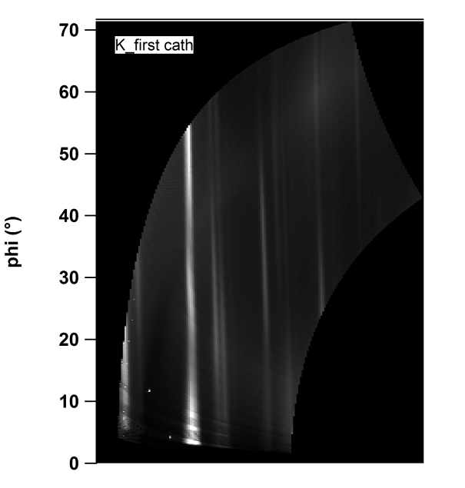
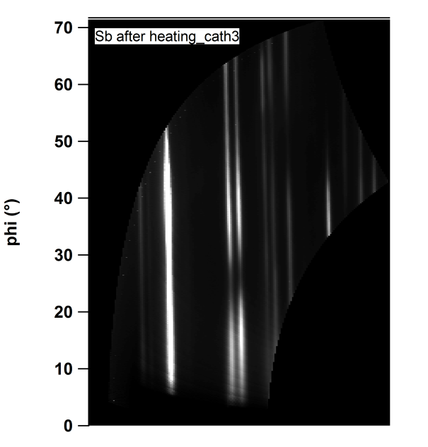
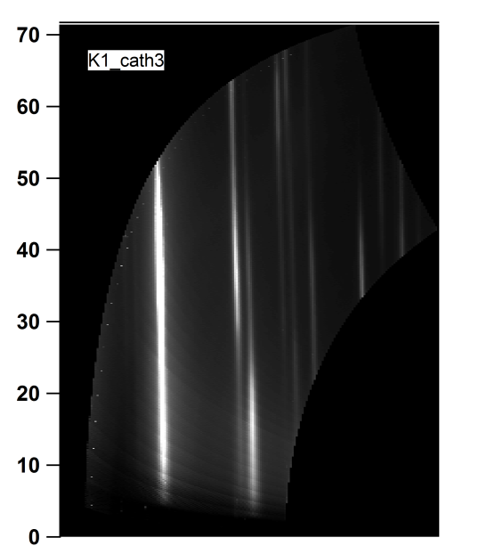
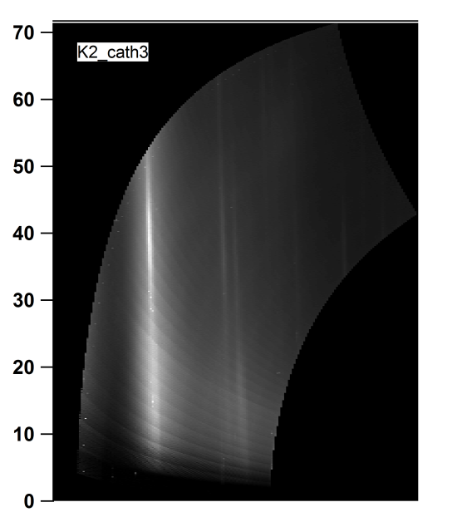
Diffusion length of K
15 nm Sb + 90 nm K
100 nm Sb + 310 nm K + 200 nm K

Slide 22
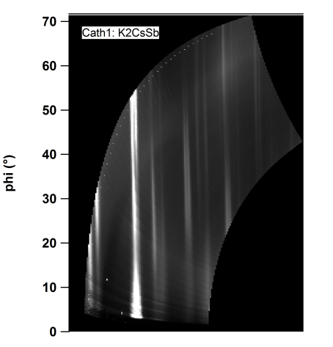




Coating of cathodes for experimental transfer
No Carbon
Carbon

Slide 23
Conclusions XRD:
Successful In-situ XRD experiment to visualize crystalline growth correlated with QE measurement.(20 cathodes in total)
Evidence of Sb effect on final QE performance.
Evidence of texturing in final “good”cathodes
Diffusion length studies of K into Sb
Capping cathodes attempt

Slide 24


Thanks to:
X. Liang, E. Muller, M. Gaowei, I. Ben-Zvi, Stony Brook University
J. Smedley, K. Attenkofer, T. Rao, Brookhaven National Lab
T. Vecchione , H. Padmore, Lawrence Berkeley Lab
S. Schubert, Helmhotlz Zentrum Berlin, Germany
DOE Office of Science, Basic Energy Sciences

Slide 25




Slide 26
Spectral response
QE(%) 062012 532 nm = 1.2
QE(%) 062112 532 nm = 1.8

Slide 27

Deposition system at Collider-Accelerator Department (CAD)
How do we transport the cathode from the deposition chamber to the gun-injector?
Antimony cell
Main chamber
Potassium cell
Cessium cell

Slide 28

Transport cart attached to depo-chamber for cathode growing and transport to gun.
Deposition chamber
Transport cart
Controllers rack

Slide 29

Attachment of transport cart into the gun for cathode installation.
SRF Gun
Transport cart
Tests with the gun….

Slide 30


Slide 31

Powder Diffraction Files

Slide 32
Calibration of two cameras

Slide 33


Slide 34


Slide 35


Slide 36



Microscopy:
SEM and EDX after brief exposure to air
UHV-AFM
K2CsSb
EDX : final Sb thickness: (36 nm cath 1, 40 nm cath 2).
In line with expected totals based on FTM values.
SEM
EDX:Energy Dispersive X-rays
QE(%)=1.1%
Segregation of K and uniform coverage of Cs and Sb:
(K forms islands during deposition or that air exposure preferentially removes K).
Sb and Cs were found in the correct stoichiometric ratio (~1:1), however a dearth of K was observed.

Slide 37


QE(%)=1.4%
No cathode
First Cathode
Full Cathode

Slide 38




K2CsSb cathodes comparison_P1
First Cath
Second Cath
First layer
First layer
QE~1.4%
QE~3.7%
S116
S143
Second layer
Second layer
QE~2.7%
QE~2.9%
S123
S154

