Slide 1
2010 P3 Workshop: Recap
Triveni Rao

Slide 2
Oct 12-14, 2010 At BNL
50 Registered Attendees:
International Participation
> 30 presentations
Short presentations ➔ Ample discussion time
Discussions: Photocathode Physics for Photoinjectors

Slide 3
Photoinjectors: The (obviously) most important Photocathode properties
Quantum efficiency
  High QE at the longest possible wavelength
  Fast response time: <100 fs
  Uniform emission
    Non-uniform emission seeds emittance growth due to transverse, space charge expansion
  Easy to fabricate, reliable, reproducible
  Low dark current, field emission.
Intrinsic emittance
  Low as possible
    Atomically flat: ~few nm p-p, to minimize emittance growth due to surface roughness and space charge
  Tunable, controllable with photon wavelength
    May need to “chase” the work function:
  Better at cryogenic temperatures?
Lifetime, survivability, robustness, operational properties
  Require >1 year of operating lifetime
    reasonable vacuum level: 10⁻¹⁰ Torr range
  Easy, reliable cathode cleaning or rejuvenation or re-activation
  Low field emission at high electric fields
  Reliable installation and replacement system (load lock)
Performance of cathode in guns in 2010 P3 Web site. Please update!

Slide 4
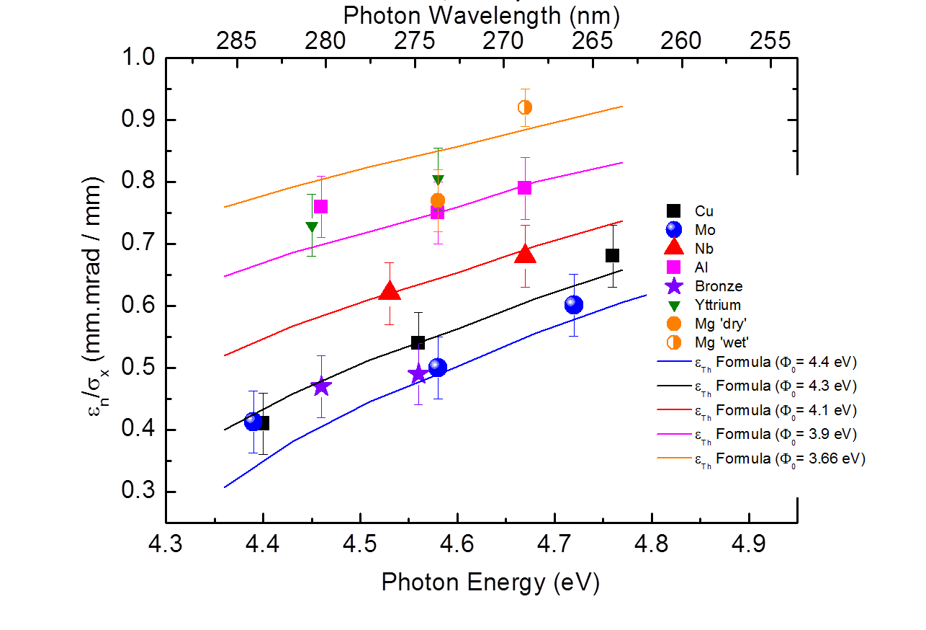
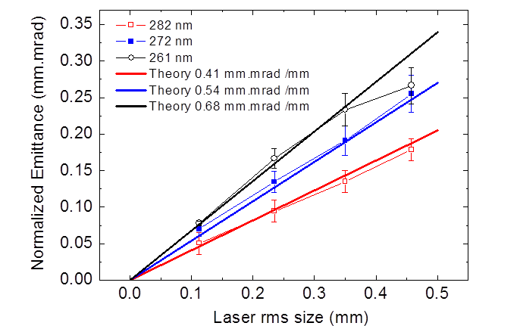
Current Status of cathodes: Metals
PSI Results
Exp. Cond.:
Q < 1 pC; 5.2 MeV
σ_{t,laser}= 4 ps rms; 25 MV/m
Copper Cu
Solenoid Scan
Systematic study of QE & ε for different metals
Good agreement between theory & experiment
Ganter

Slide 5
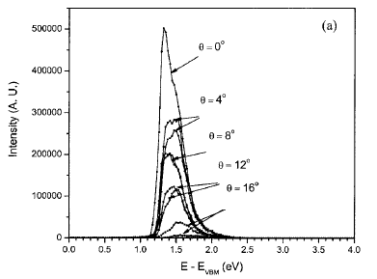
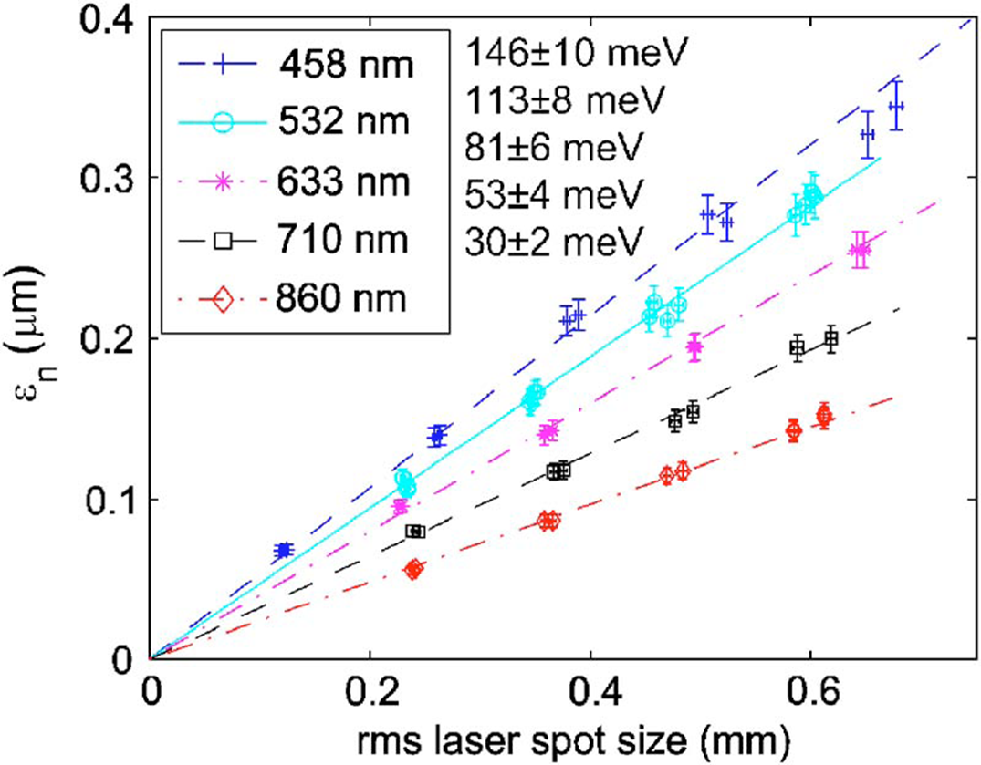
Current Status of cathodes: GaAs
Energy Distribution of e from GaAs
Emittance of e from GaAs
Liu et al., JVST B 23, 2758 (2005)
Bazarov et al.,JAP 103,154901 (2008)
Sinclair

Slide 6
Improvement:
Load-Lock chamber
Load lock chambers being built at a number of facilities
Argonne, BNL, LBNL, Cornell, HZB to name a few
Harkay

Slide 7
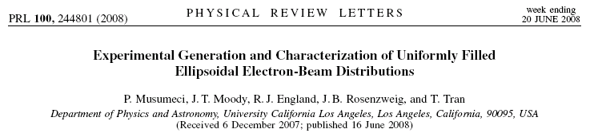
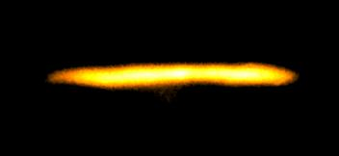
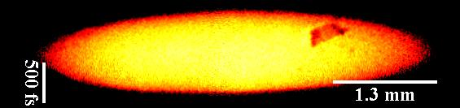
Recipe: Use very short (and intense !!!) laser pulse on the cathode.
What is really new here is:
  Shorter beams.
  More linear phase spaces (transverse and longitudinal).
  Control beam tails.
  Ease requirements on laser system !
Deflector off
Deflector on
Charge 20 pC. Laser spot size 400 μm rms (limited by asymmetry due to image charge)
rms length ~300 fs
Very sharp ellipsoidal beam boundary due to the ultrashort beam on the cathode.
Musumeci

Slide 8
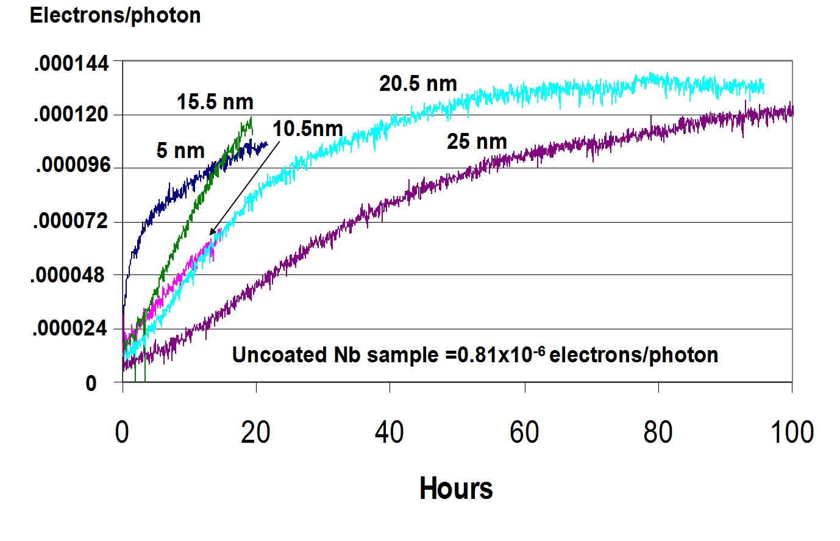
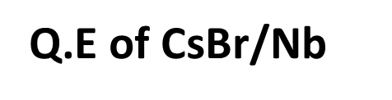
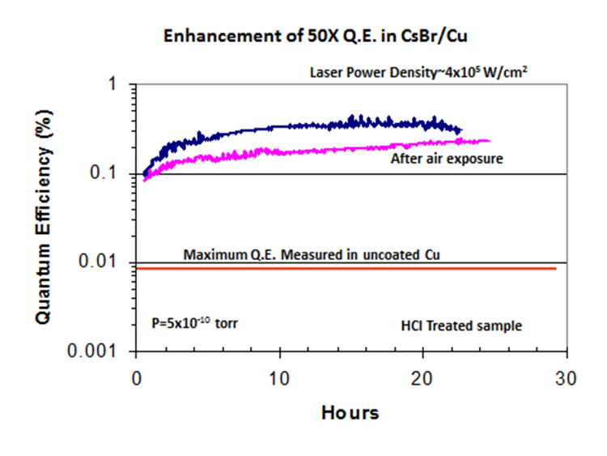
Overlayer with CsBr
Maldonado

Slide 9
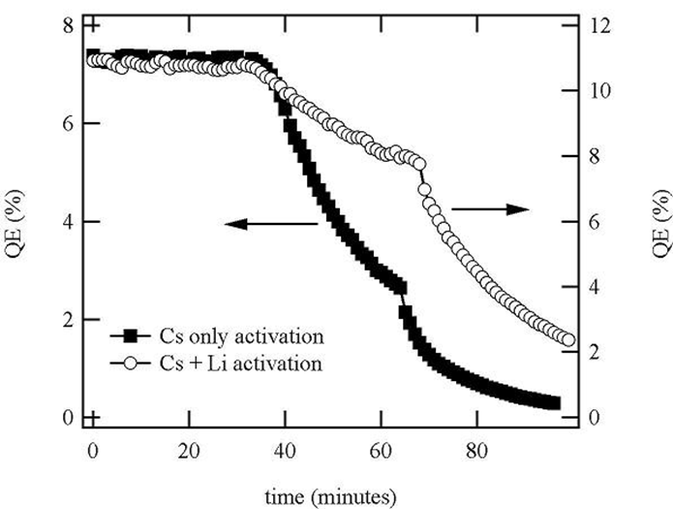
Activation of GaAs by adding Li to Cs+NF₃
Li increases immunity to CO₂ and O₂
Mulhollan

Slide 10
Cornell activated with Nitrogen!!
We clearly do NOT fully understand the surface dipole, or how to best form it
Sinclair

Slide 11
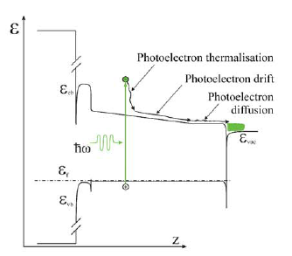
Graded Bandgap Cathode to Improve τ
Jones et al. (Spin 2009, p. 1057) reported on a graded bandgap transmission mode cathode (on sapphire) to improve the temporal response with good QE and ε.
The graded region is
Ga_{(1-x)}Al_{x}As with 0≤x≤0.1.
This creates an electric field
of ~ 4 x 10⁶ V/m, accelerating electrons into the GaAs emitting layer. They estimate a < 10 ps response time with QE ~ 20%.
Sinclair

Slide 12
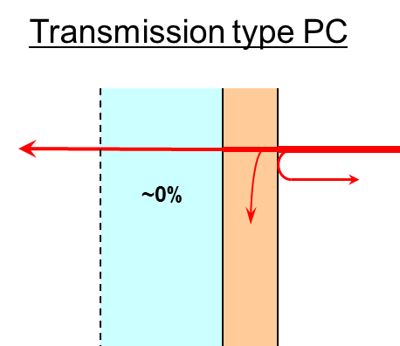
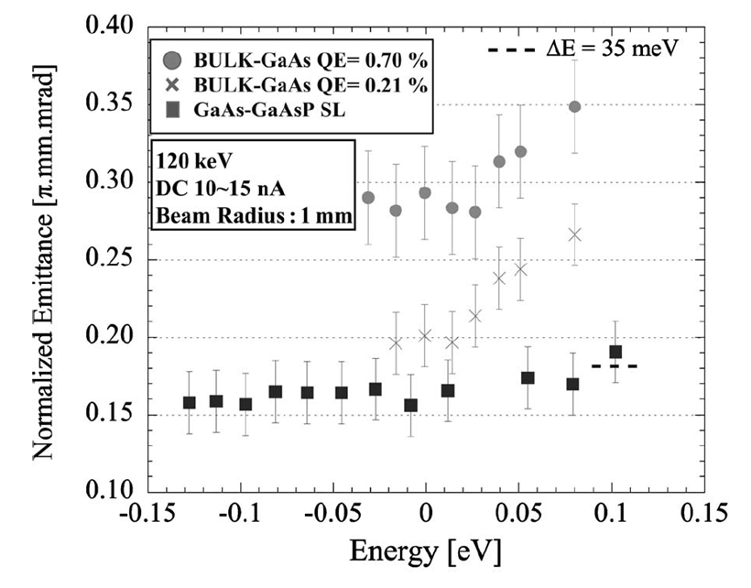
Current Status of cathodes: GaAs
Transmission type SL photocathode has been developed for high brightness
polarized electron source of Spin Polarized LEEM (SPLEEM).
Yamamoto

Slide 13
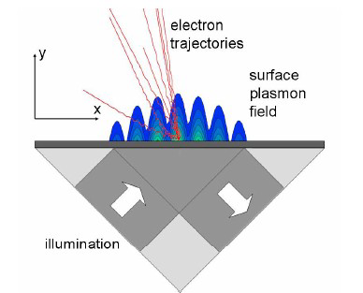
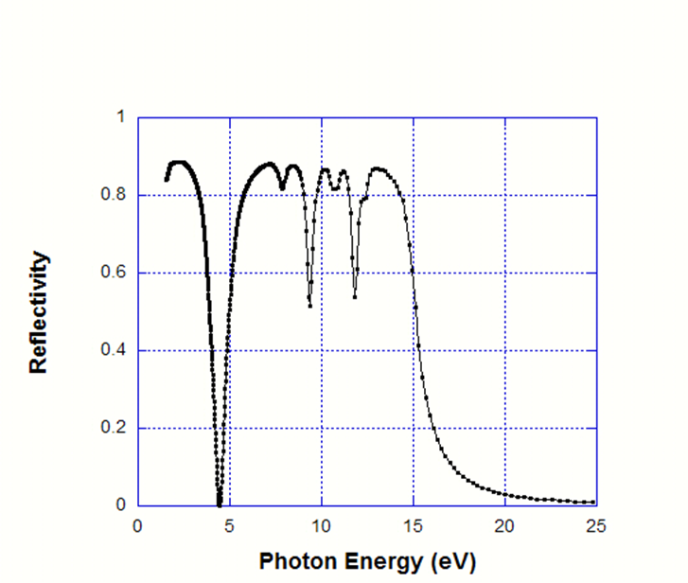
Engineered Cathode
Coupling of photon through Surface Plasmon
Mg, O, Ag
MgO(100)2L-Ag(100)4L-MgO(100)2L; DFT(PW91)
Work function reduced by ~1 eV relative to Ag(001)
Normalized emittance0.05 mm-mr/mm
Al grating, normal inc.
period g = 100 nm
groove depth h = 20 nm
groove width w= 10 nm
Nemeth

Slide 14
Physics of the cathode
Tutorials on
  Angle Resolved Photo Emission Spectroscopy
  X-Ray Diffraction
  X-Ray Absorption Fine Structure (And its relatives)
  X-Ray Photoelectron spectroscopy
  Photo Emission Electron Microscopy

Slide 15
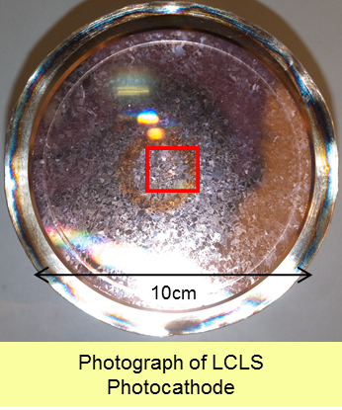
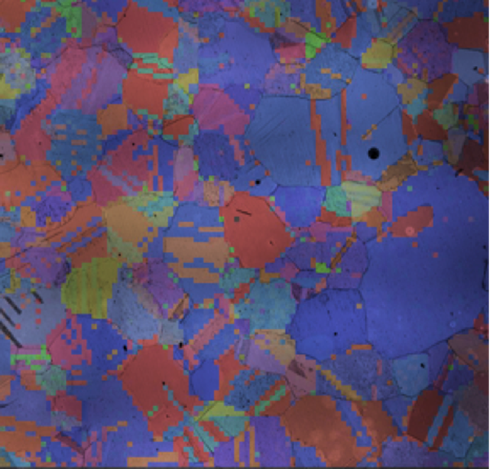
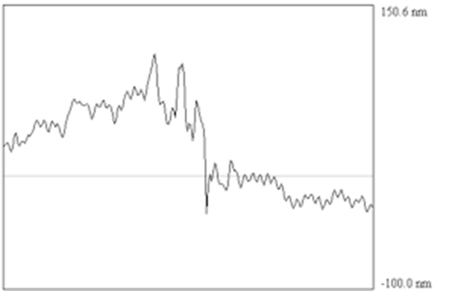
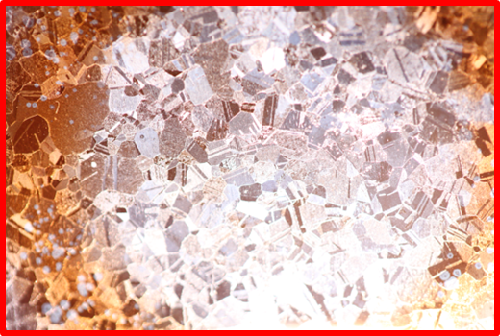
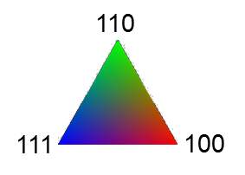
XRD studies of LCLS cathode
1 cm x 1 cm scale
Interferometric Microscope Mapping:
1-2 mm size grains
10-15 nm height variation within a grain
20- 60 nm height variation across grains
Padmore

Slide 16
Theory
Significant progress in the development of
  Theoretical model
  Simulation codes
  Validation
Comparisons with experimental results on
  Metals
  PEA semiconductors
  NEA semiconductors
  Diamond

Slide 17
Change in work function due to Crystal Plane and Coverage
Jensen

Slide 18
Future of P3
Where should money be spent first?
  What questions should we answer first?
What are the obvious collaborations?
  What do accelerator facilities lack and vice versa?
  Can solid state community help with cathode reproducibility?
  Symbiotic relationship with other applications
Cathode bazaar
  How to swap cathodes
  Universal puck? Load-lock compatibility
Hannon

Slide 19
P3 Repository
Cathode recipe and measurements repository
Links to databases, cathode group pages at labs, universities eg http://www.jlab.org/accel/inj_group/
Links to workshops, papers, reports
Glossary of common language; e.g., EDCs vs. emittance. The meaning of life…time: units of QE or charge?, dark lifetime, measurements needed to validate models
Please check and contribute to the database periodically!!!
Hannon

