Slide 2
Welcome! Ivan Bazarov Cornell University
Organizing committee & conveners:
Ivan Bazarov, Luca Cultrera, Bruce Dunham, David Dowell, Fay Hannon, Kathy Harkay, Carlos Hernandez-Garcia, Wayne Hess, Sven Lederer, Howard Padmore, Triveni Rao, Daniele Sertore, John Smedley, Dimitre Dimitrov, Kevin Jensen
Special thanks to the local organizers & helpers:
Monica Wesley, Jeanne Butler, Peggy Steenrod, Mike Roman, Devin Bougie, Siddharth Karkare, Karl Smolenski

Slide 3
Workshop charge:

Slide 4
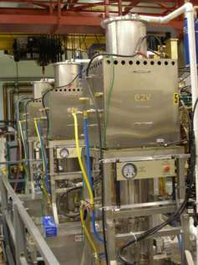
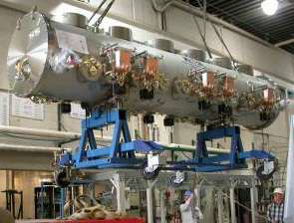
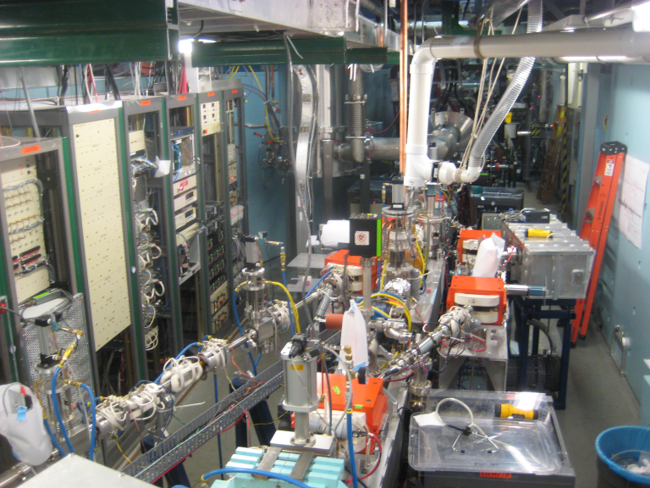
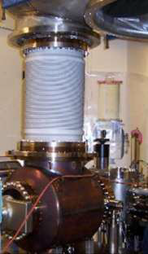
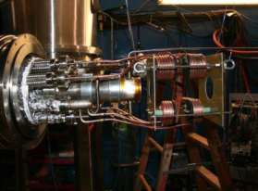
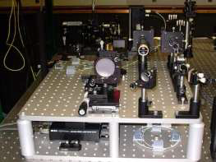
Cornell photoinjector for Energy Recovery Linac x-ray source
RF 135 kW klystrons
photocathode
DC gun
cryomodule
buncher
NSF-supported accelerator R&D test-bed, operational starting 2009
Main goals: <1 μm normalized rms emittance (to best storage rings)
average current 33mA @ 15MeV & 100mA @ 5MeV
2-3 ps bunch length
demonstrate cathode longevity, RF controls, parameter stability & reliability
SRF cryomodule
beam dump
diagnostics beam lines
5 m
world‘s highest avg brightness photoinjector!
HV DC gun
coldbox
laser system

Slide 5
Cornell photoinjector achievements (so far!)
Maximum average current of 52 mA achieved
Previous record from LANL/BOEING RF gun 32 mA (avg. over pulses), JLAB DC photoinjector 9.2 mA (CW);
Proved practicality of high current operation (~ kiloCoulomb extracted with no noticeable QE degradation from a single laser spot)
Original emittance spec. achieved:
ε_{n,90%} = 0.5 μm at 80pC/bunch (= 100mA at 1.3GHz)
ε_{n,90%} = 0.2 μm at 20pC/bunch (= 25 mA)
Would surpass best of existing storage rings in brightness today if this quality beam were to be accelerated to 5 GeV (~5 better than PETRA3!)

Slide 6
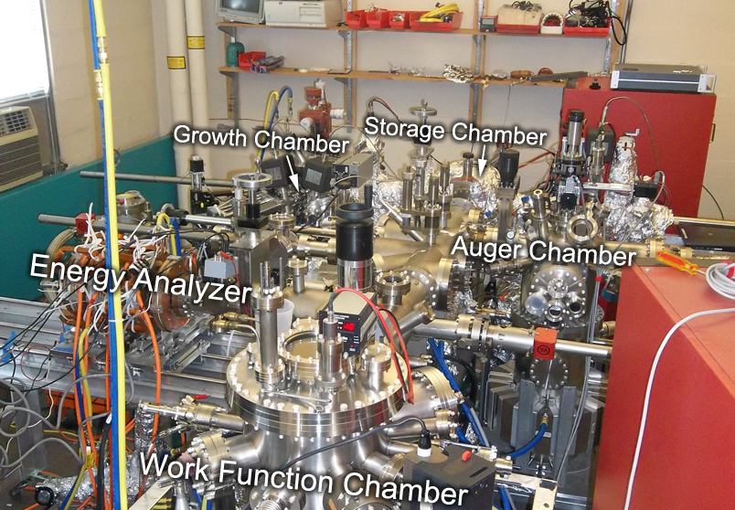
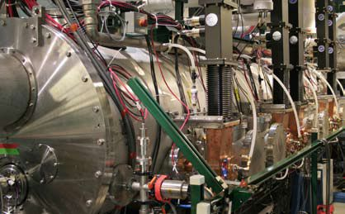
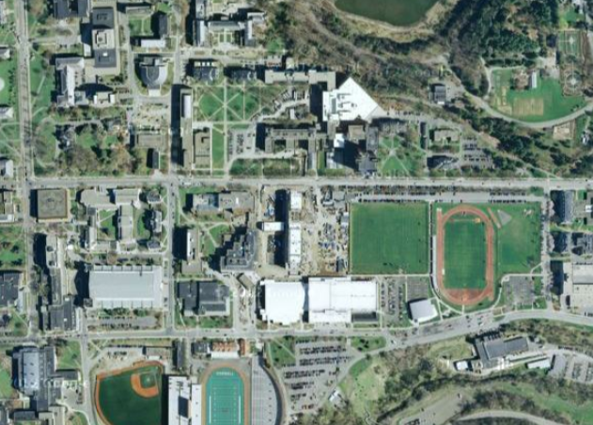
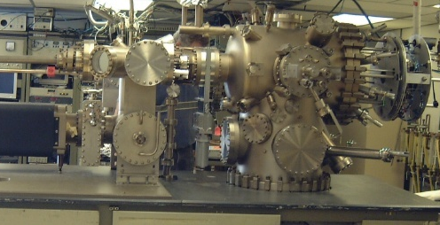
Photocathode work at Cornell
over in Newman lab
over in Wilson lab
actual accelerator
antimonide growth & analysis chamber
over in Phillips
Newman
Clark Hall
Phillips
Wilson
dedicated MBE system

Slide 7
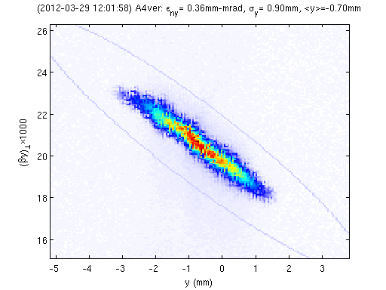
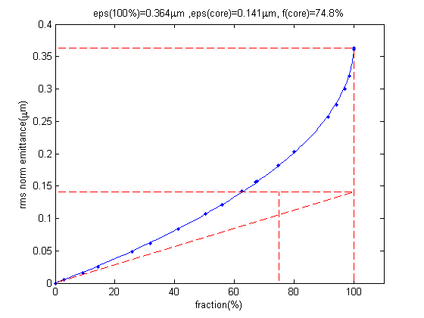
Just the beginning…
Example: x2 brightness increase after swapping a cathode with lower MTE (0.14 μm core norm. emittance at 75% core fraction for 20pC/bunch)
– enormous potential for improvement!
phase space 20 pC/bunch
emittance vs. fraction
MBE grown GaAs

Slide 8
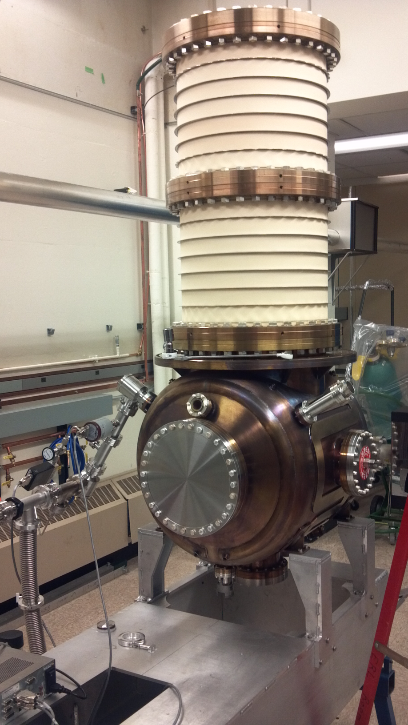
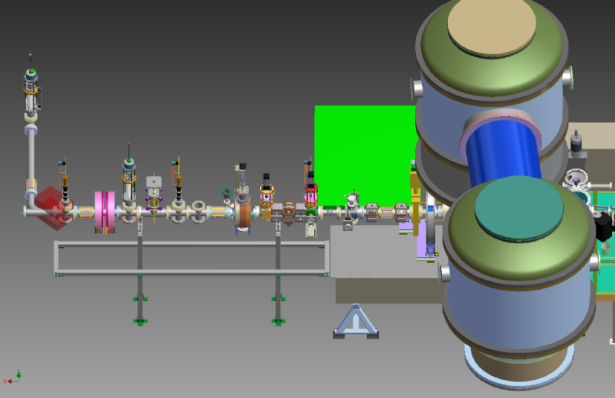
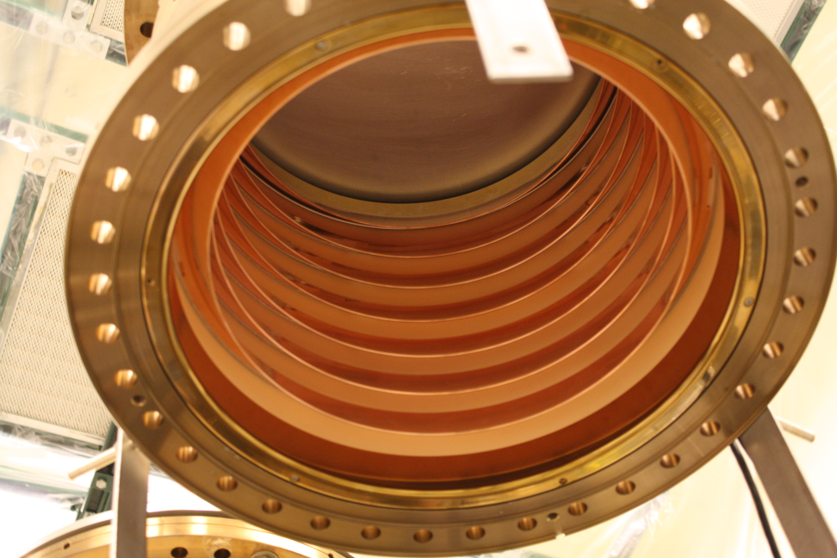
New photo-gun: ×(>5) improvement in the anticipated beam brightness
~3m
new HV DC gun with diagnostics beamline
segmented ceramic
new gun assembled

Slide 9
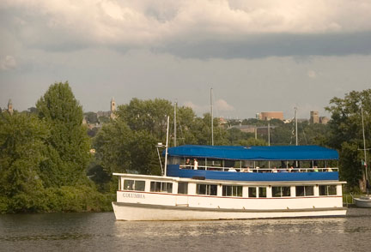
Logistics
Tuesday Cayuga lake cruise
Please upload your talk slides ahead of time!
Mike Roman, Siddharth Karkare;
All talks will be video-taped and posted online:
If you have any questions, please talk to Fay Hannon;
Tour of Cornell photocathode & photoinjector labs tonight (please sign up for a better head count);
Cayuga Lake Tour tomorrow (Tuesday): bus boarding 16:00-16:10;
Future 2-year plan discussion in Session 5:
1 slide from every lab on their plans (Fay Hannon);

Slide 10
Looking forward to a productive P3 workshop!

