Slide 1
Summary of the
2011 EuroFEL Cathode Workshop
David H. Dowell
Presented at
Photocathode Physics for Photoinjectors (P3) Workshop
Cornell University
Ithaca, NY
Oct. 2012

Slide 2

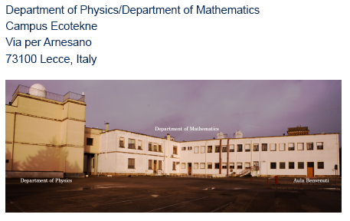
15 invited + contributed talks in 1½ days

Slide 3
Overview Talks
F. Hannon: A summary of 2010 P3 Workshop at BNL
L. Cultera: Overview of photocathodes for high brightness beams
D. Dowell: Photocathode properties for photoinjector
Metal cathode experience & experiments
G. Gatti: Cu photocathode operating experience
M. Trovo: Cu cathode experience at Fermi & ozone cleaning
X. Wang: Efficient low thermal-emittance metal cathode: a reality of pipe dream?
A. Lorusso: Thin film metallic-photocathodes grown by pulsed laser ablation.
R. Nietubyc: Pb/Nb thin film photocathodes –no talk posted
F. LePimpec: Photocathode experience and developments at PSI
Field emitter arrays
S. Tsujini: Nanofield emitter arrays at PSI –not posted
Cs₂Te cathodes
D. Sertore: High qe Cs2Te photocathode at INFN Milano-LASA
S. Lederer: Operation of Cs2Te photocathodes at FLASH and PITZ, DESY preparation system
Cathodes for ERL’s
S. Schubert: Cathode preparation for high average current ERL operation
B. Militsyn: The perspective of use GaAs (III-IV) type photocathodes in the SRF guns

Slide 4
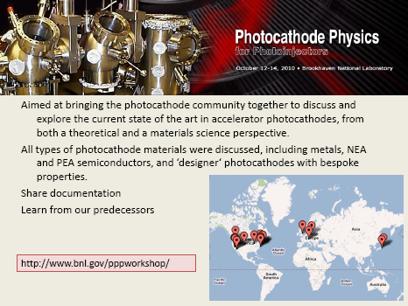
F. Hannon: A summary of 2010 P3 Workshop at BNL

Slide 5
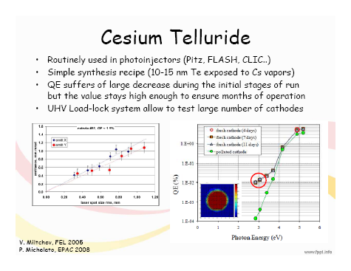
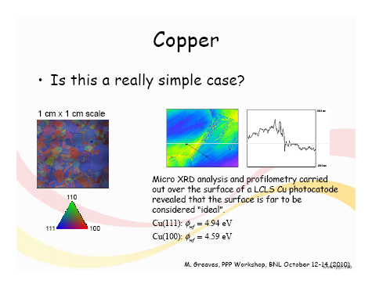
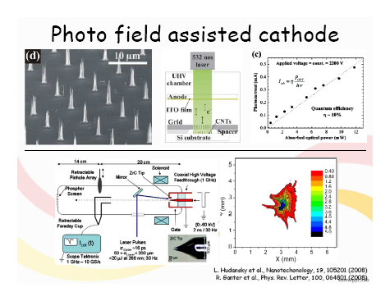
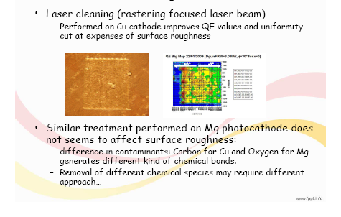
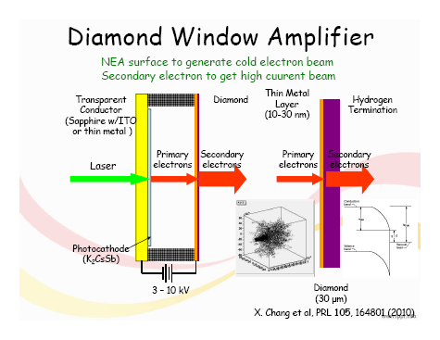
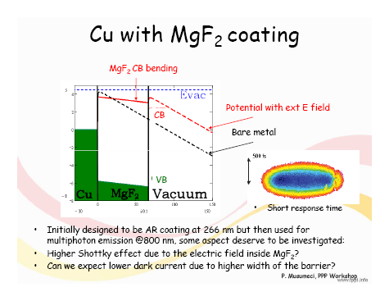
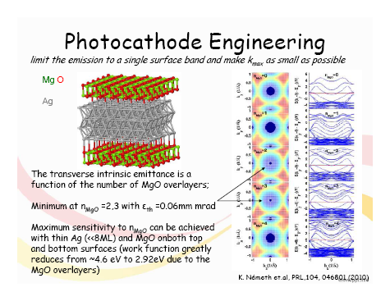
L. Cultrera: Overview of photocathodes for high brightness beams
A really complete review of the status of all cathode types
Good summaries of cathode properties and experience
Useful list of references

Slide 6
Metal cathode experience & experiments
G. Gatti: Cu photocathode operating experience at SPARC, Frascati

Slide 7
M. Trovo: Cu cathode experience at Fermi & ozone cleaning

Slide 8
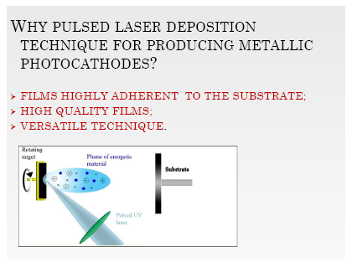
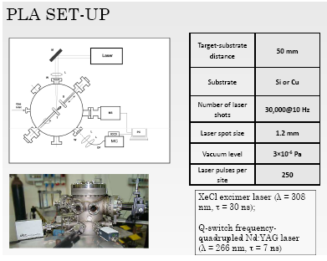
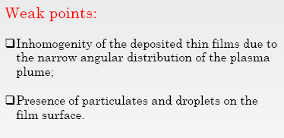
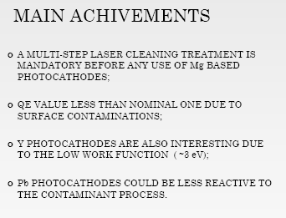
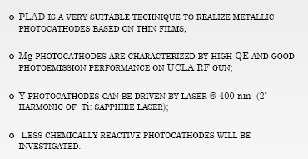
A. Lorusso: Thin film metallic-photocathodes grown by pulsed laser ablation

Slide 9
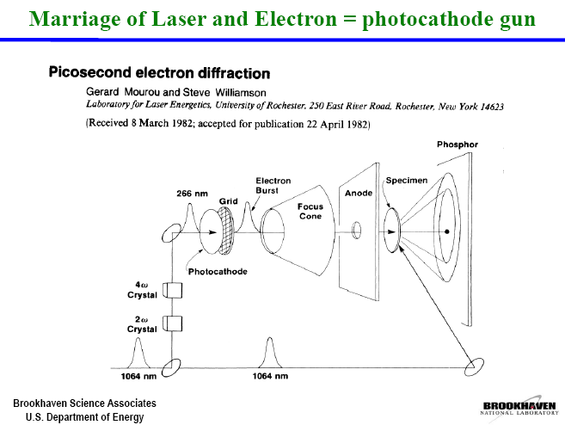
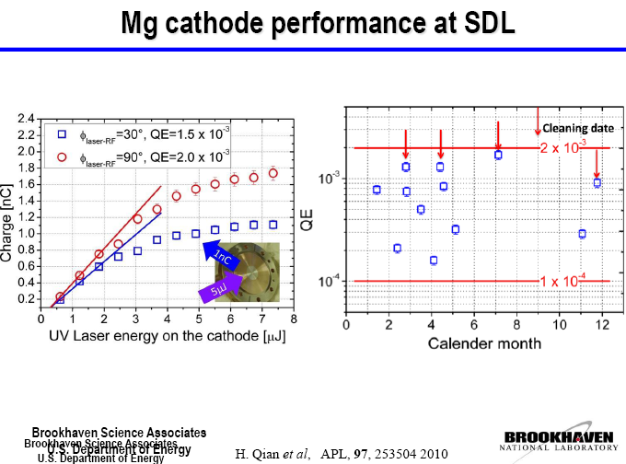
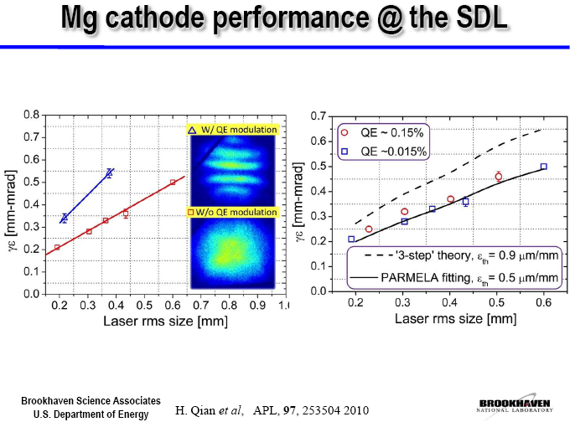
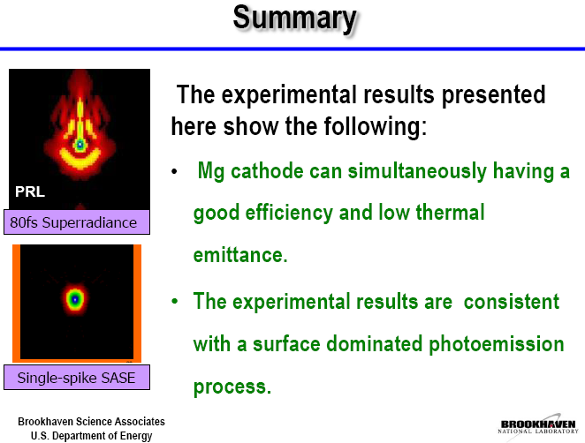
X. Wang: Efficient low thermal-emittance metal cathode:
a reality or pipe dream?

Slide 10
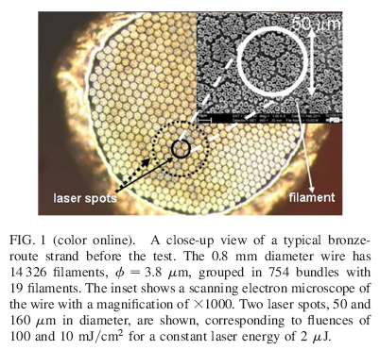
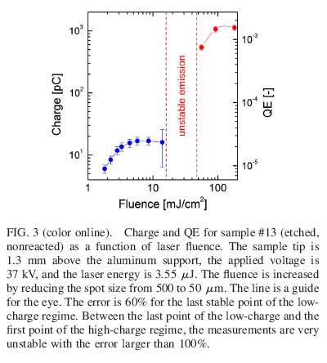
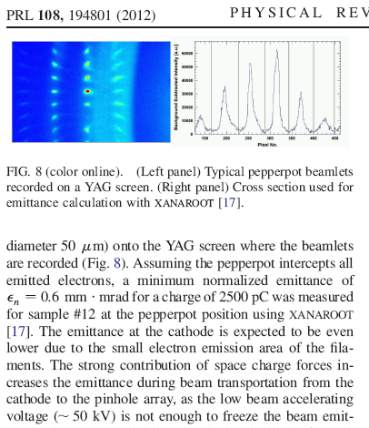
Recent publication on using multifilamentary Nb₃Sn as a cathode
[Large charge extraction from metallic multifilamentary Nb₃Sn photocathode,
A. Anghel, F. Ardana-Lamas, F. LePimpec and C.P. Hauri, PRL 108,194801(2012)]
Field emitter arrays
S. Tsujini: Nanofield emitter arrays at PSI –not posted

Slide 11
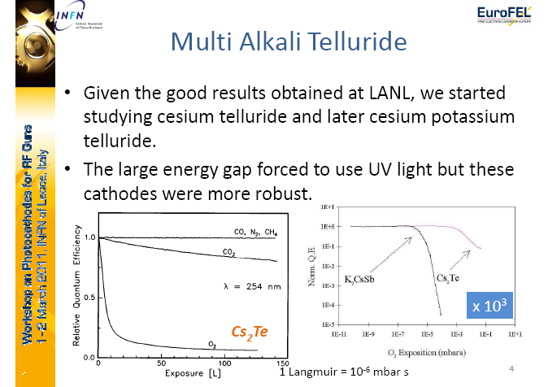
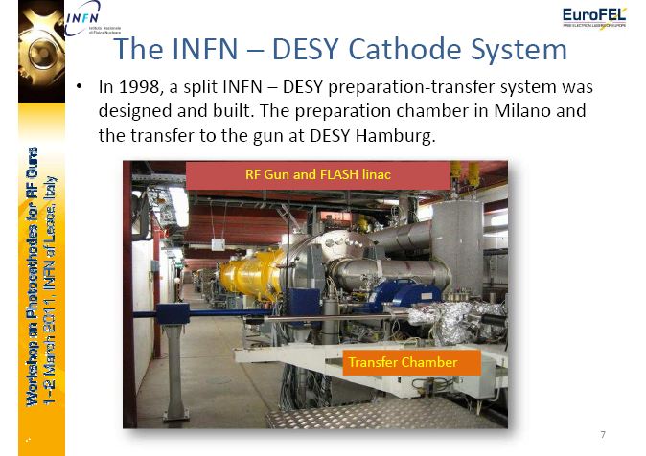
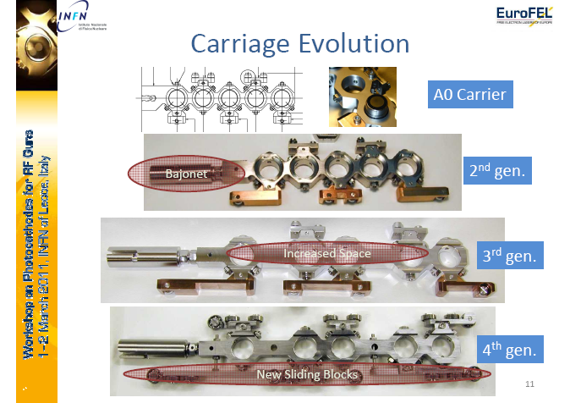
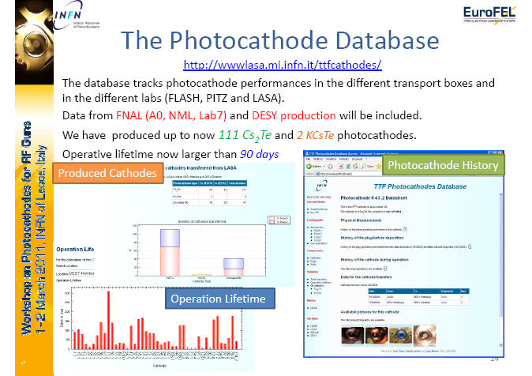
D. Sertore: High QE Cs₂Te photocathode at INFN Milano-LASA

Slide 12
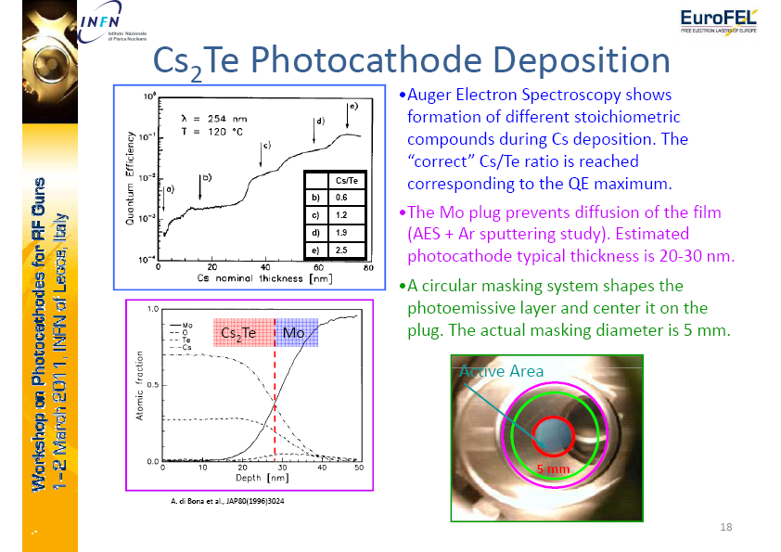
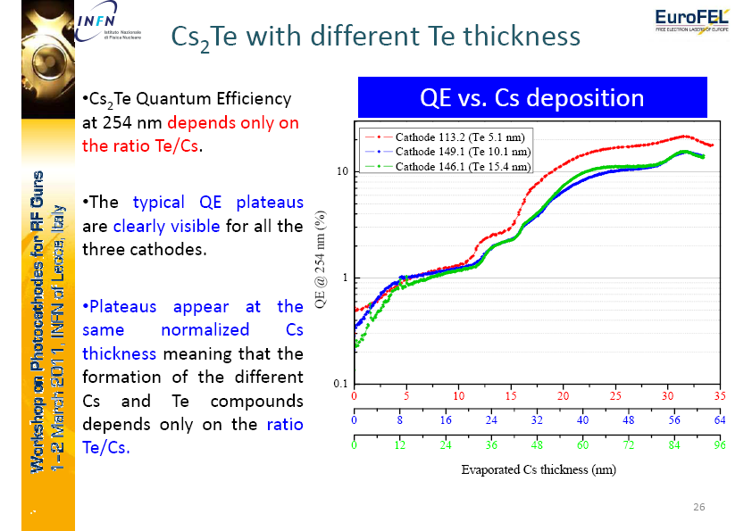
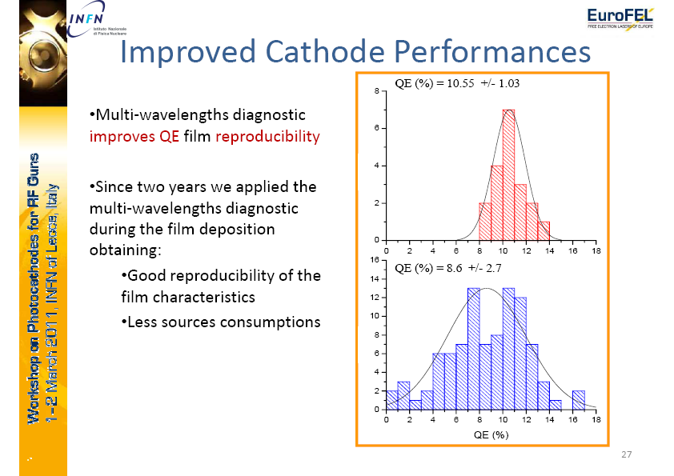
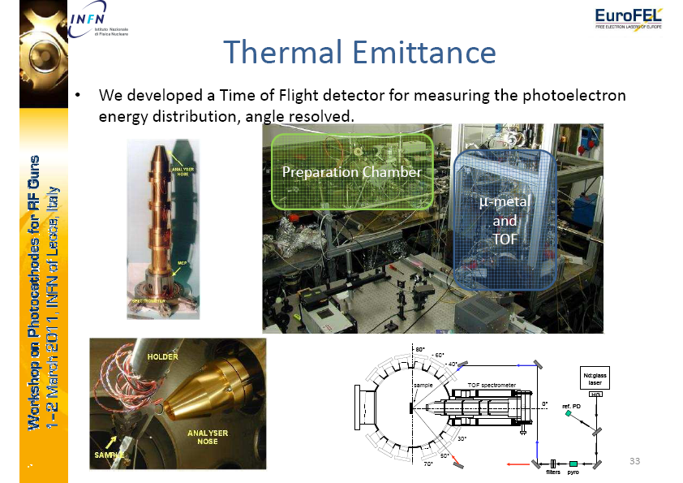

Slide 13
S. Lederer: Operation of Cs2Te photocathodes at FLASH and PITZ, DESY preparation system

Slide 14
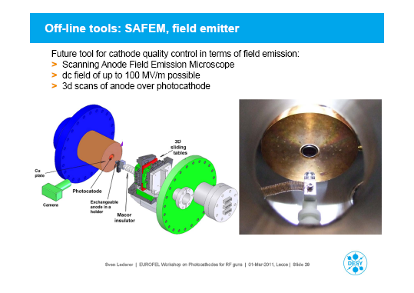

Slide 15
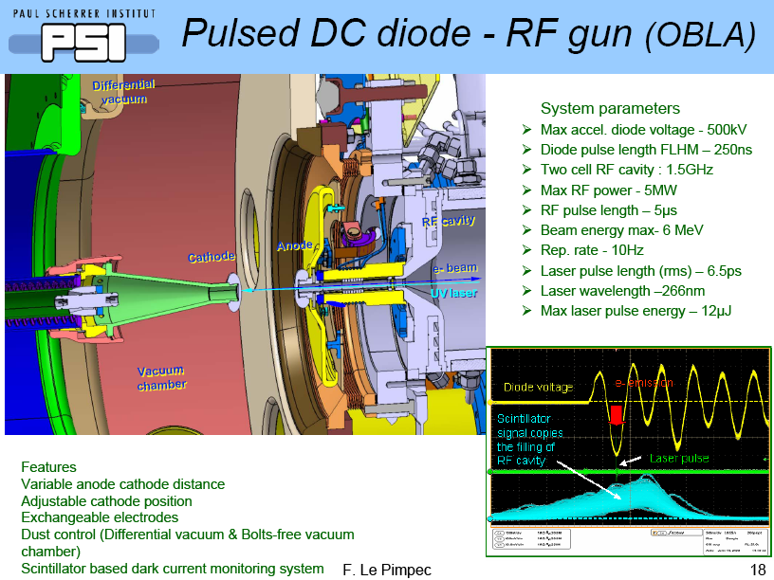
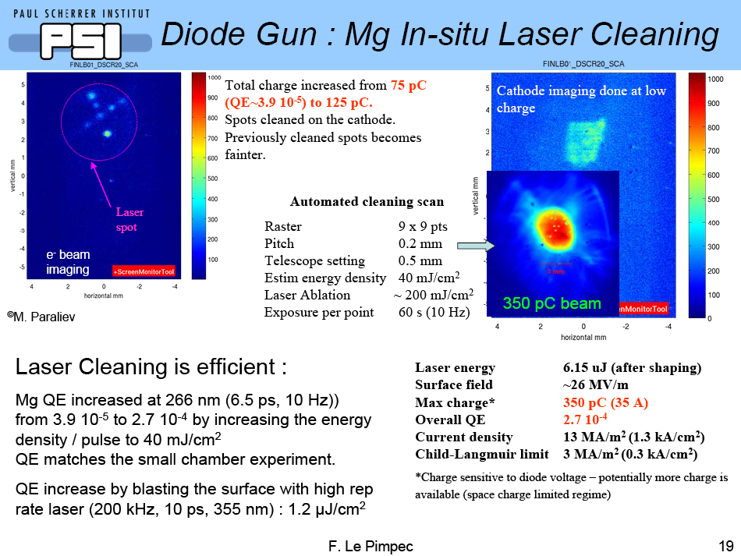
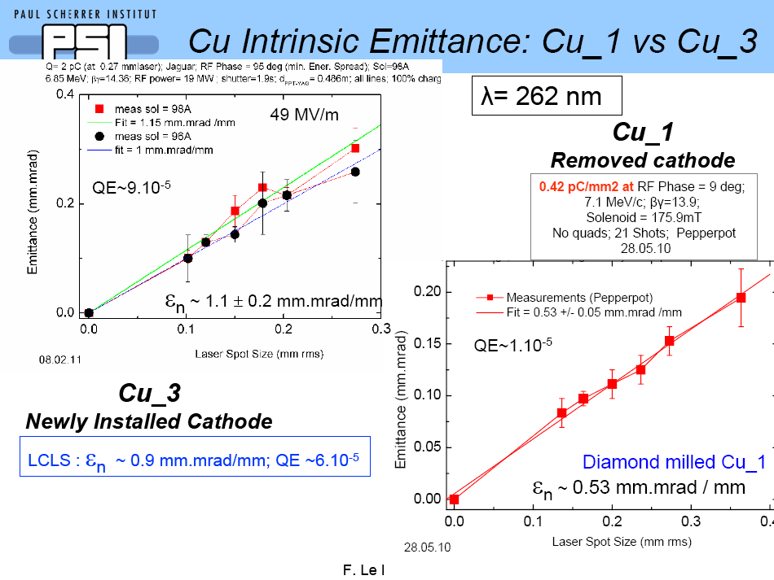
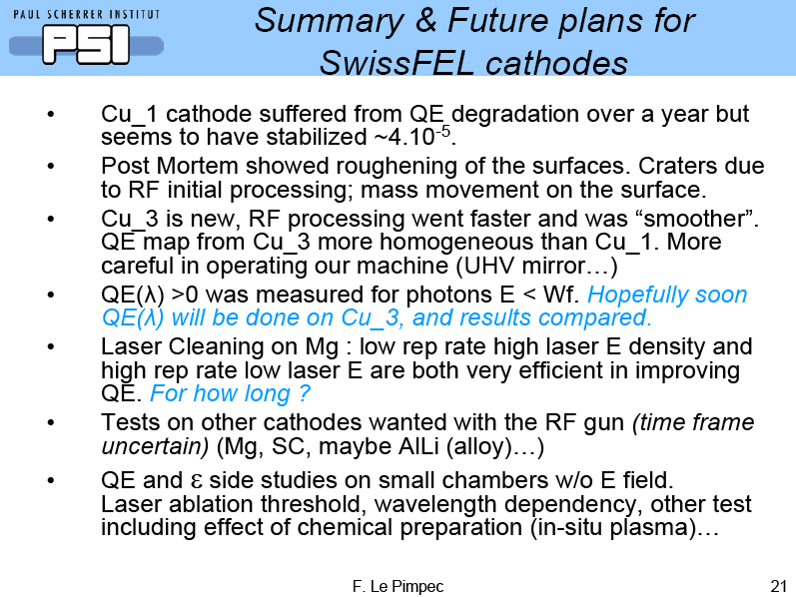
F. LePimpec: Photocathode experience and developments at PSI

Slide 16
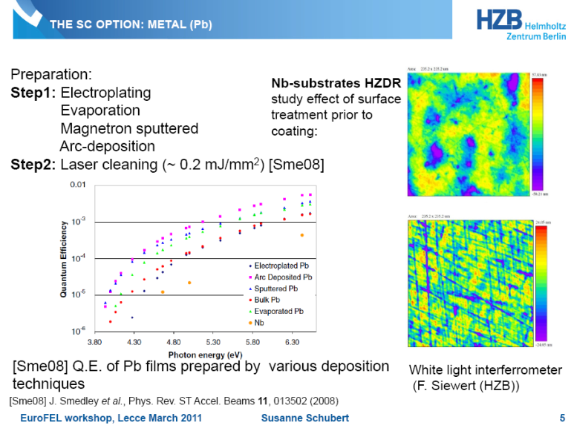
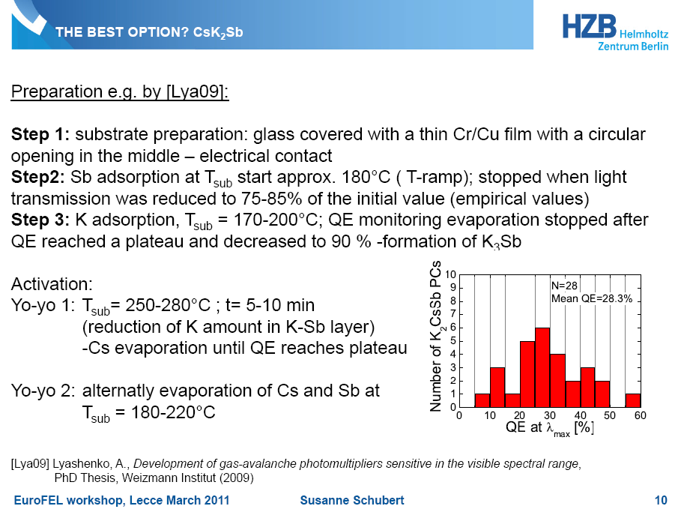
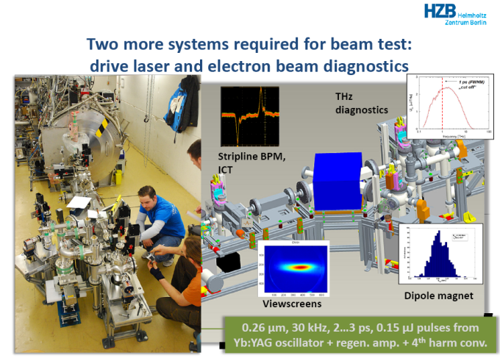
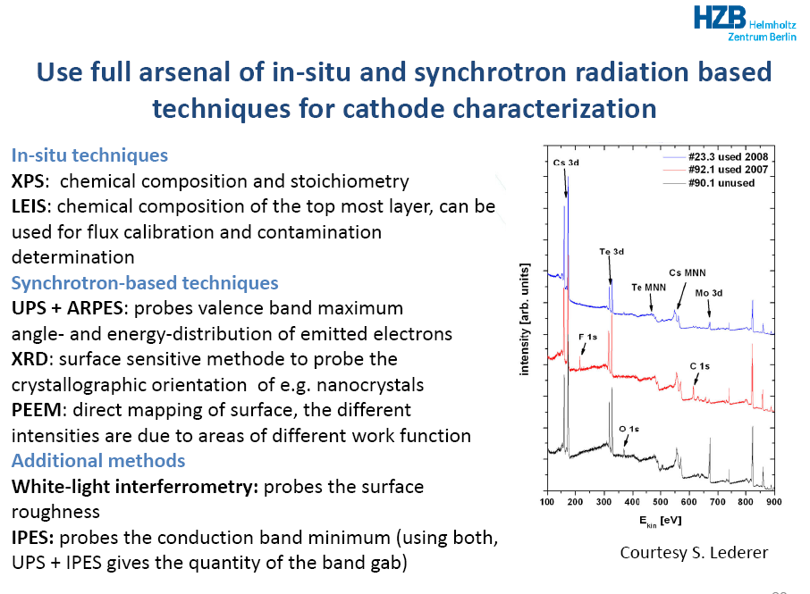
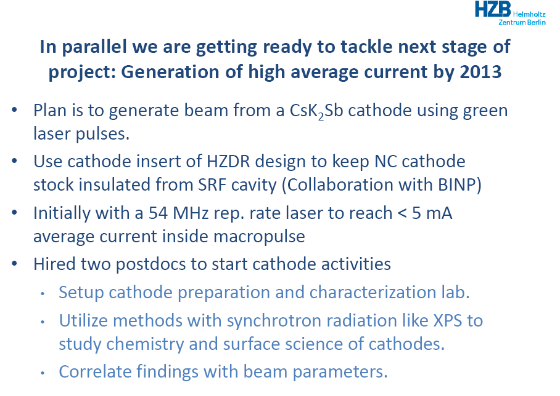
S. Schubert: Cathode preparation for high average current ERL operation

Slide 17
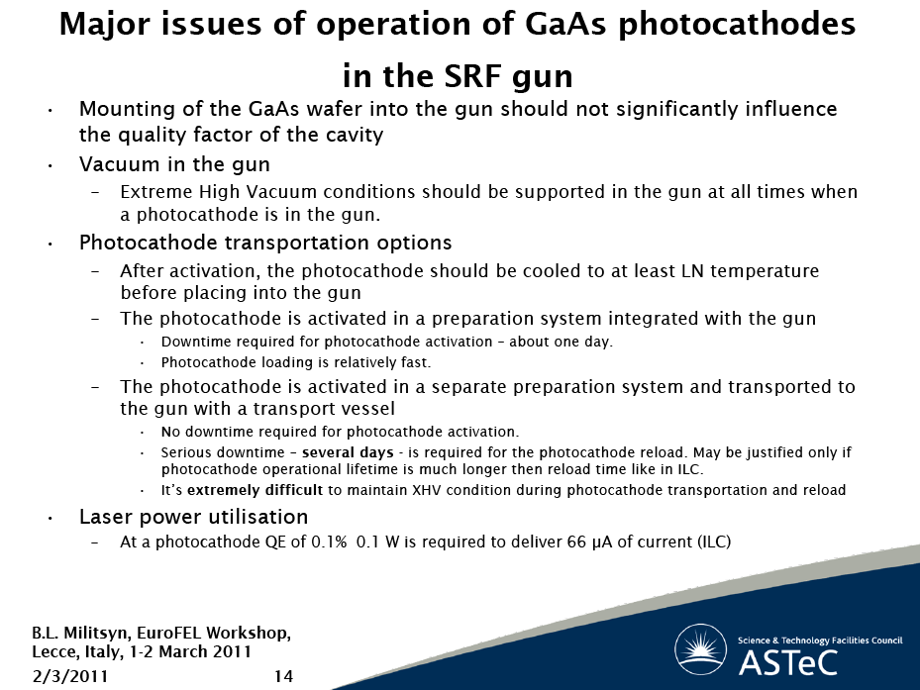
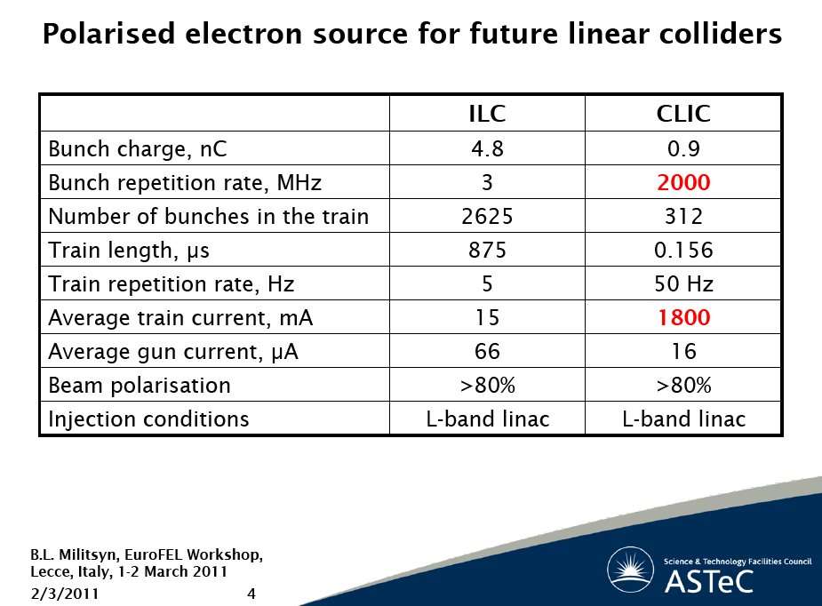
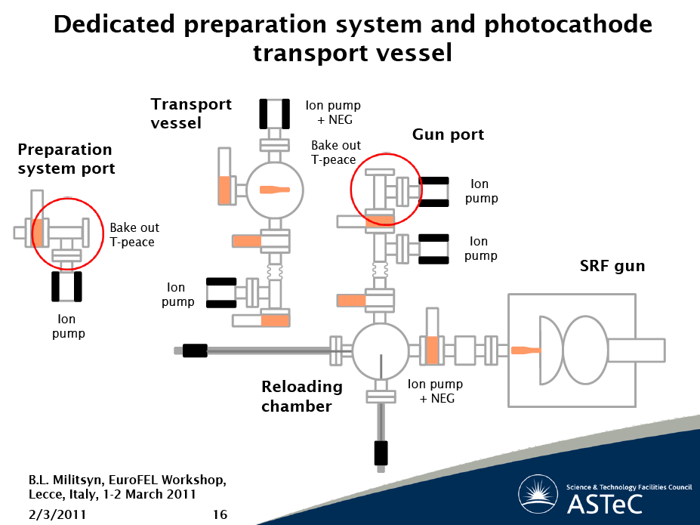
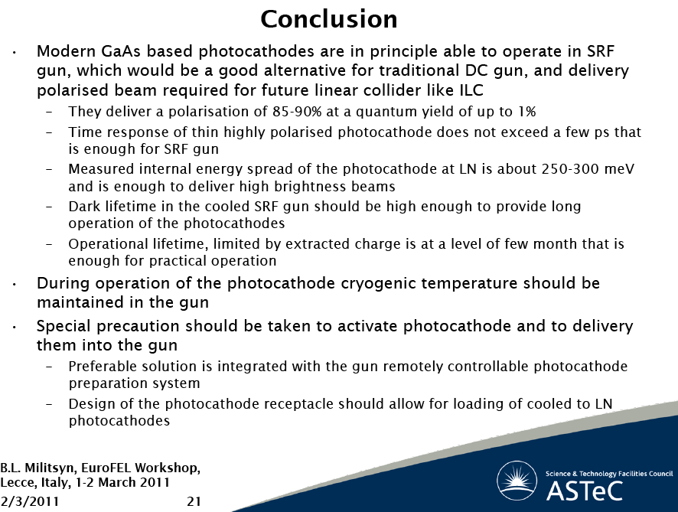
B. Militsyn: The perspective of use GaAs (III-IV) type photocathodes in the SRF guns

Slide 18
Notes on Requirements for cathodes from a SC Linac driven FEL
S. Schreiber, DESY

Slide 19
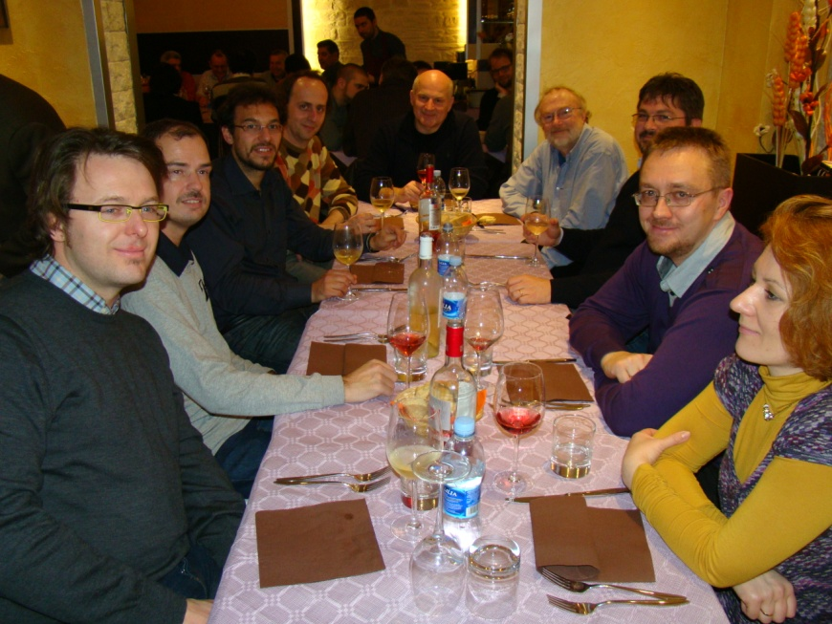
Thanks to the EuroFEL Workshop Organizers
and Attendees
http://photocathodes2011.eurofel.eu/

