Slide 1
Photocathodes for Rossendorf SRF gun
Rong Xiang

Slide 2
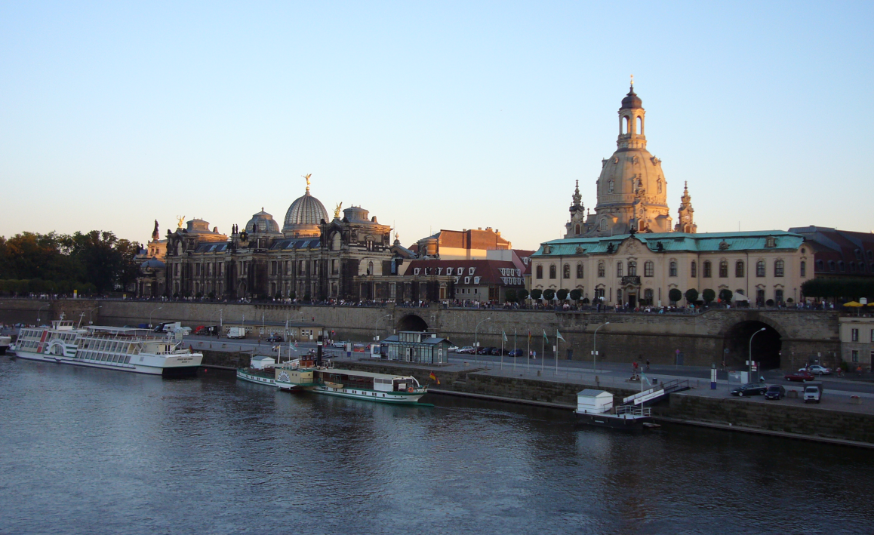
Dresden Rossendorf
Dresden
IPAC 2014, Dresden
June 15-20, 2014
http://www.ipac2014.org
ELBE

Slide 3
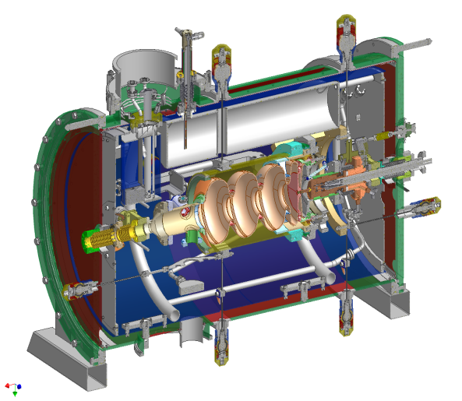
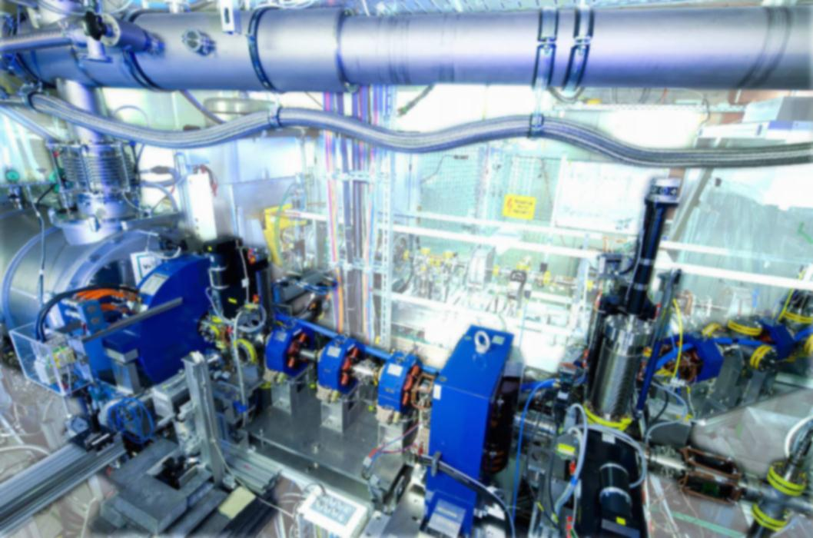
ELBE radiation source and SRF gun
Since 2007 in operation

Slide 4
OUTLINE
Cathode system for SRF gun
Running experience on Cs₂Te in SRF gun
Test on new photocathode candidates
GaAs photocathodes for the SRF gun

Slide 5
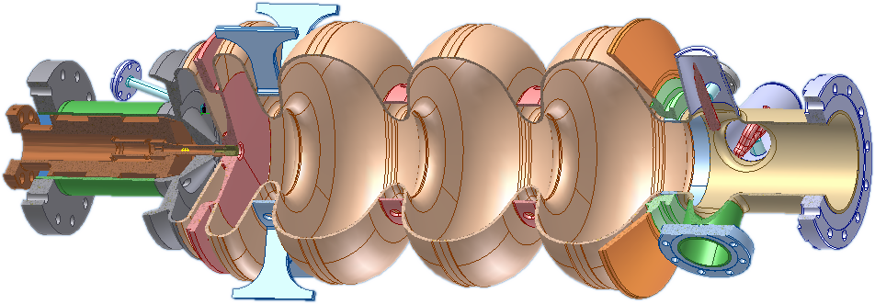
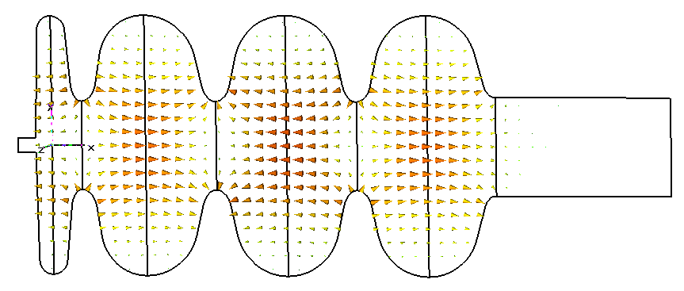
Cathode system for Rossendorf SRF gun
Choke-Filter
TESLA-Cells
HOM Coupler
Laser
1 W, 262 nm
Electron Beam
9.4 MeV, 1 mA, 9.4 kW
Cathode
Half-Cell
77 pC - 1 nC
Main Coupler
Laser and photo cathode short and highly charged bunches
RF field low emittance and high peak brightness
Superconducting cavity CW operation and high average current
More info: A.Arnold, et al., NIM A 593(2008)
J. Teichert, et al., J. Phys.: Conf. Ser. 298 012008

Slide 6
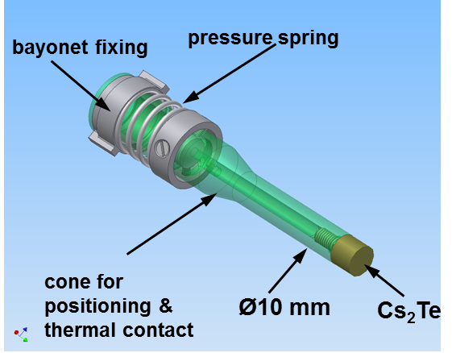
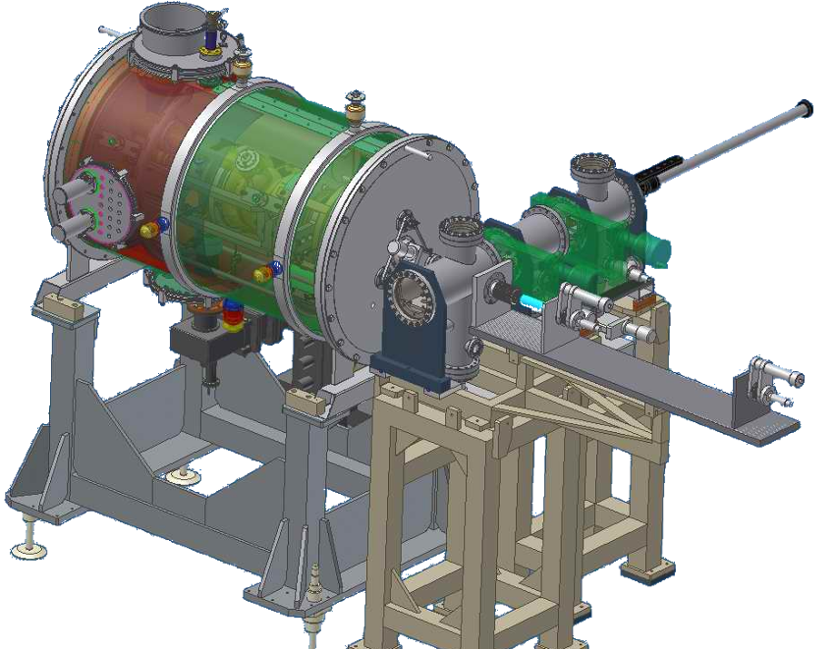
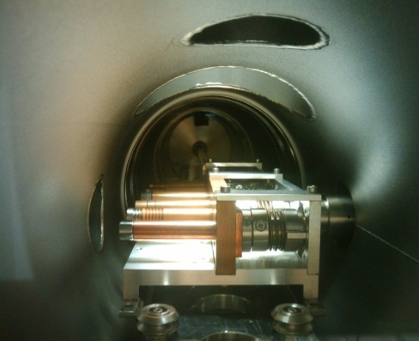
Cathode system for Rossendorf SRF gun
SRF Gun
Transport
chamber
Load-lock
Mo
Mo
Pb/Nb
GaAs
Requirements for Transfer:
Load lock system with < 10⁻⁹ mbar
Exchange w/o warm-up & in short time and low particle generation
Cs₂Te
Cs₂Te
R. Xiang, PhysRevSpecialTopics_13_043501

Slide 7
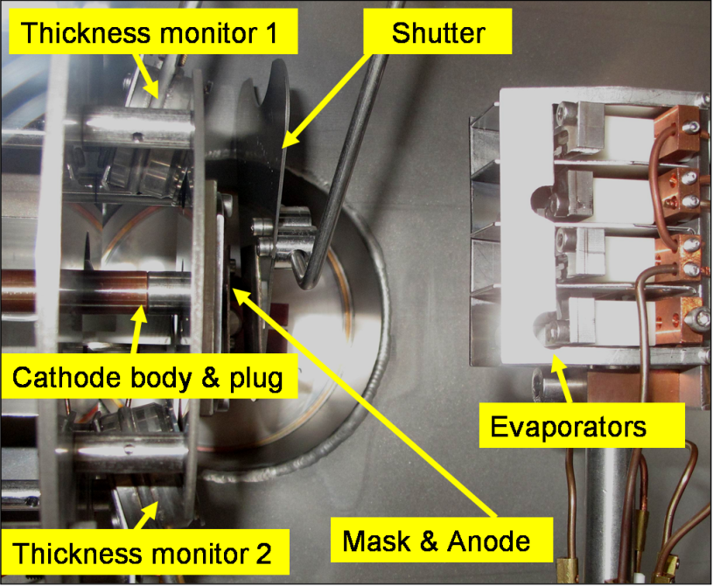
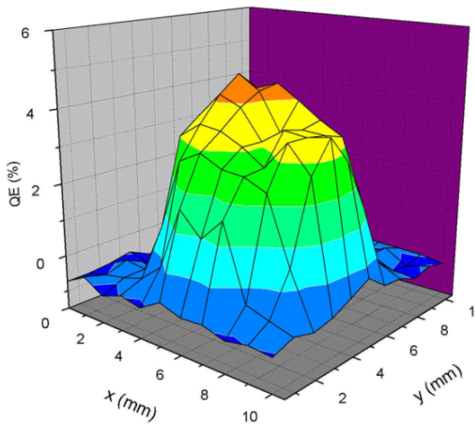
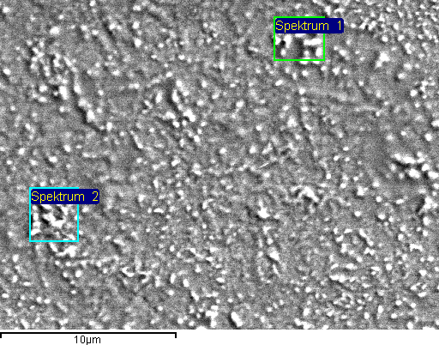
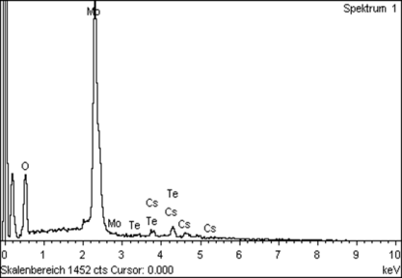
2. Cs₂Te photocathodes for SRF gun
8 cathodes tested in gun
QE ~1 % in months
I _{dark}~ 120 nA @ 15 MV/m
ɛ_{thermal} ~ 0.7 mm·mrad/r(mm)
Preparation chamber
Cathode #250310Mo
in gun from 2010.5.25 to 2011.7.26
total beam time 1013 h
extracted charge 35 C
Cs/Te=2.3
SEM / EDX for Cs₂Te on Mo
R. Xiang, et al., FEL2010, Sweden
R.Xiang, et al., IPAC2012

Slide 8
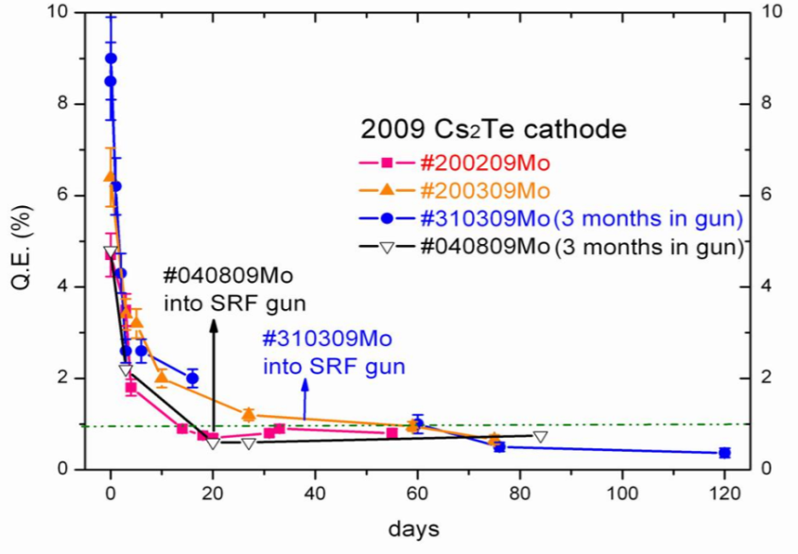
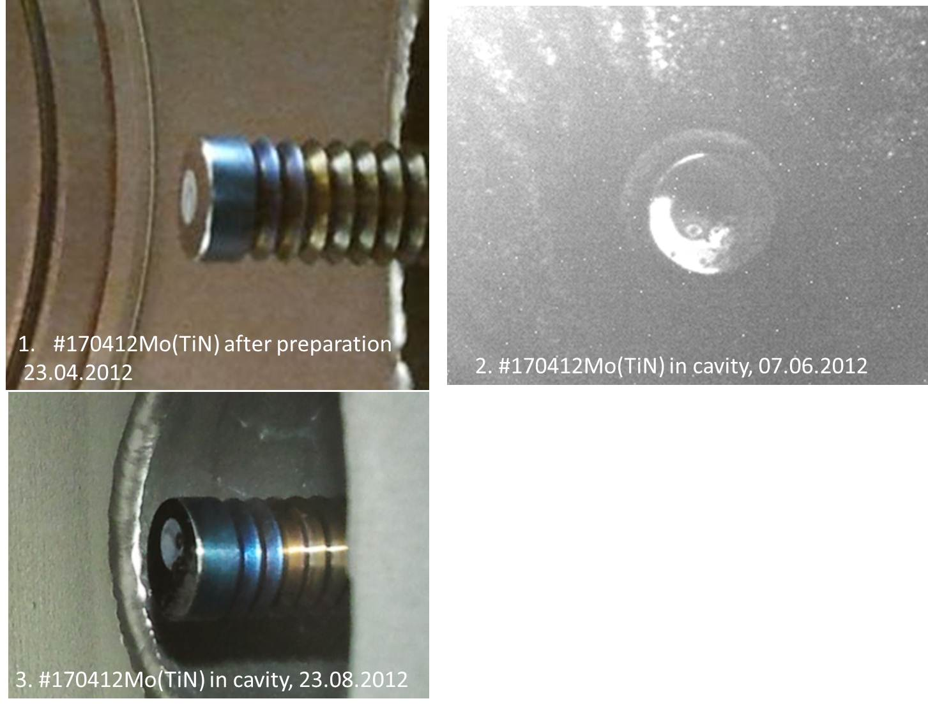
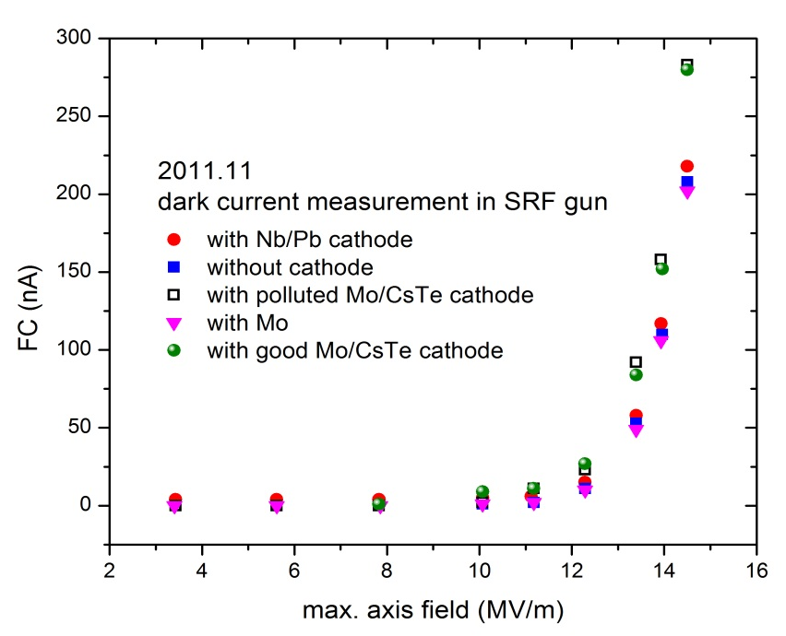
2. Cs₂Te photocathodes for SRF gun
Open questions:
QE decrease during transport
Strong multipacting around cathode plug
Dark current
layer destroyed during operation
120nA

Slide 9
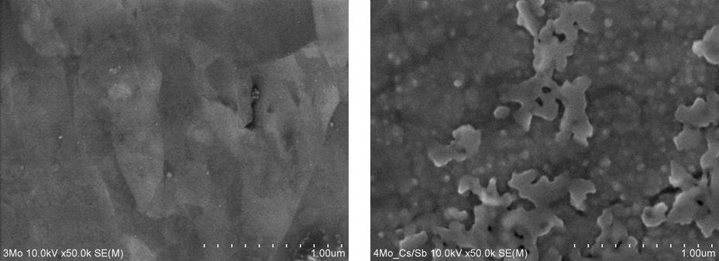
3. Test new photocathode candidates :
Cs₃Sb
Use Cs₂Te chamber, vacuum ~10⁻⁹ mbar
On Mo plug, @ 160ºC, two-cycle “Yo-yo” process
fresh QE reached 1.5 %
SEM surface morphology
Sb-source in boat
Optical-polished Mo substratum
On Mo Substrate,
Cs/Sb rate 2.7
Cs₃Sb out from chamber
R.Xiang, et al., IPAC2012

Slide 10
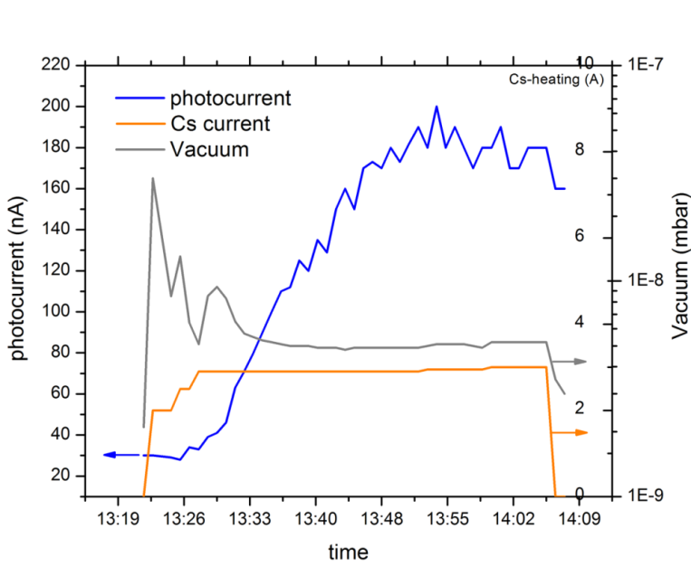
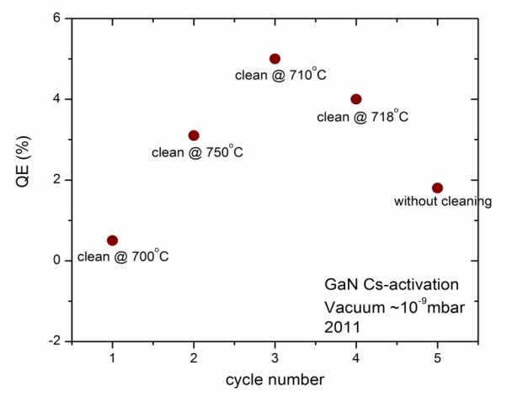
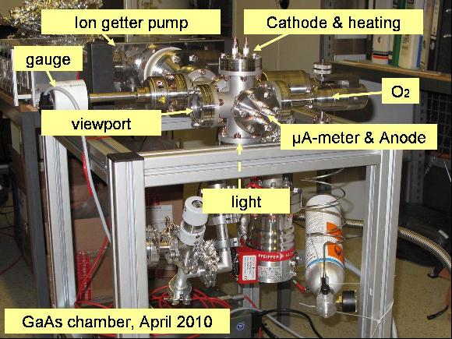
3. Test new photocathode candidates:
GaN (Cs)
wide band gap (3.4 eV)
negative electron affinity (NEA)
Robust: 10⁻⁹ mbar
GaN on sapphire with Au/Ni electrode
Only cesium
262 nm laser
~ 10⁻⁹ mbar
R.Xiang, et al., ERL 2011

Slide 11
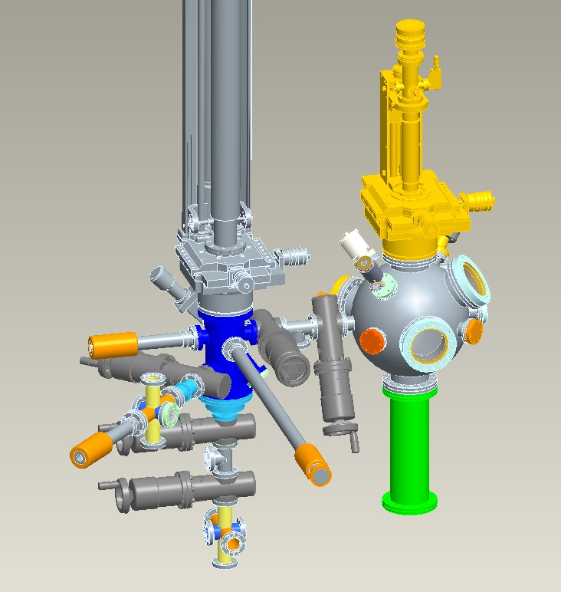
4. GaAs photocathodes for the SRF gun
preparation and transfer system for GaAs (Cs,O)
Close to SRF gun
XHV chamber 10⁻¹¹ mbar
Green light
First cathode planned in 2013
Interesting points:
QE / lifetime
dielectric loss on crystal
temporal response
thermal emittance
potential field emission
dark current
1. GaAs Prep-
system
3. Connect to gun
2. Storage and transport

Slide 12
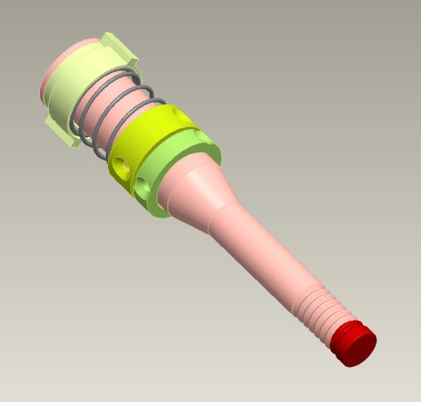
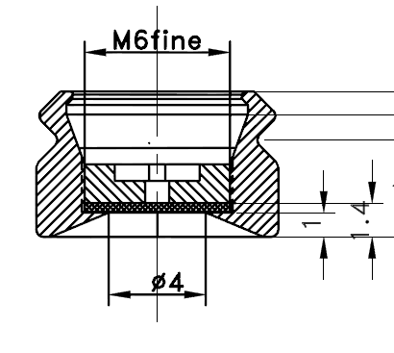
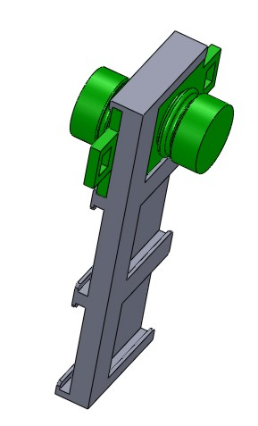
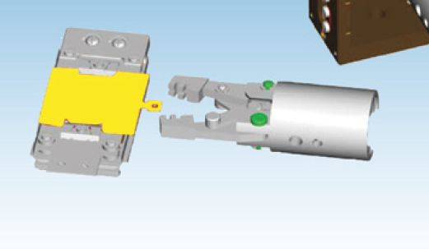
4. GaAs photocathodes for the SRF gun
Transport only small plugs (up to 6 plugs)
HZB-carrier for storage and transport
GaAs
Cathode 106 mm long
plug ɸ10mm x 6mm (modified from HZB-plug)
Easier for transport
Easier for heat-cleaning
VG Scienta sample handling

Slide 13
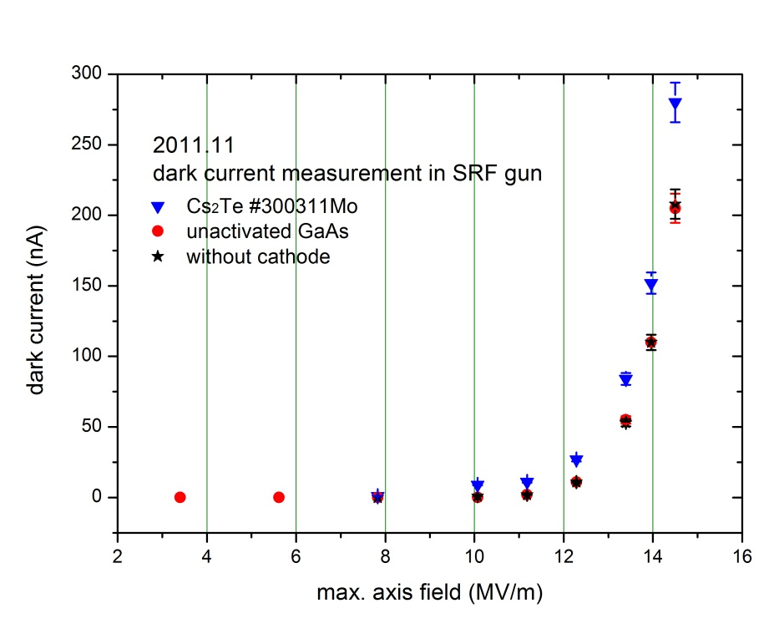
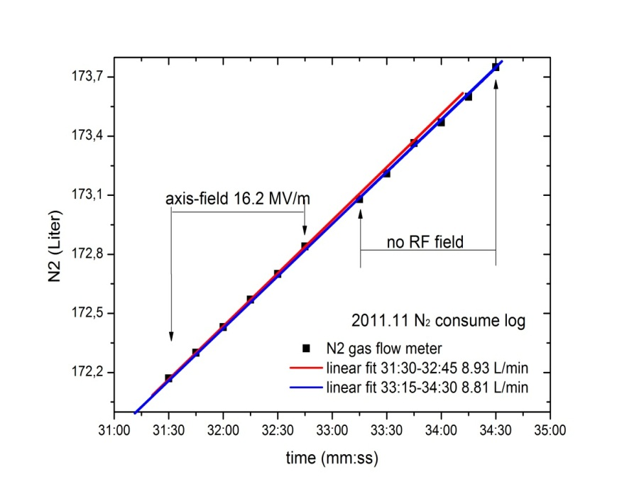
4. GaAs photocathodes for the SRF gun
time (hh:mm)
No detectable dark current from GaAs-crystal.
But after activation?
Gun with GaAs crystal (0.35mm) and holder
Without RF, P_{N2}=34.52W
With RF_{max}=5.5MV/m on surface , P_{N2}=35 W
R. Xiang, Task 10.7, EuCARD-SRF Annual Review 2012

Slide 14
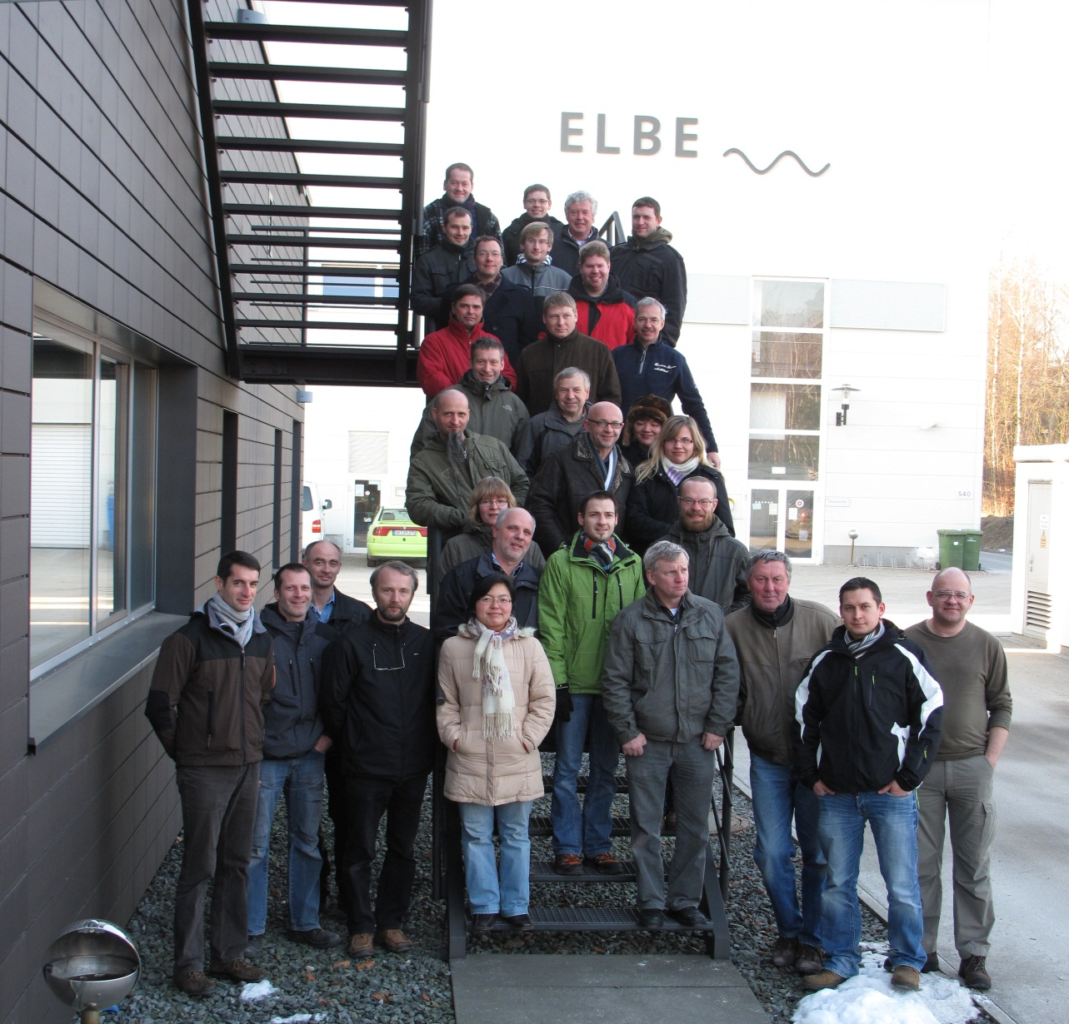
Thank you!
Acknowledgement
We acknowledge the support of the European Community-Research Infrastructure Activity under the FP7 programme since 2009 (EuCARD, contract number 227579) as well as the support of the German Federal Ministry of Education and Research grant 05 ES4BR1/8.

Slide 15
