Slide 1
K₂CsSb cathode tests at Jlab
T. Rao
Courtesy Russell Mammei

Slide 2
BNL, Jlab collaboration
JLAB: P. Adderley, J. Clark, S. Covert, J. Grames, J. Hansknecht, M. Poelker, M. Stutzman, R. Suleiman, J. McCarter, M.
Brookhaven National Lab: T. Rao, J. Smedly, J. Walsh, W. Smith

Slide 3
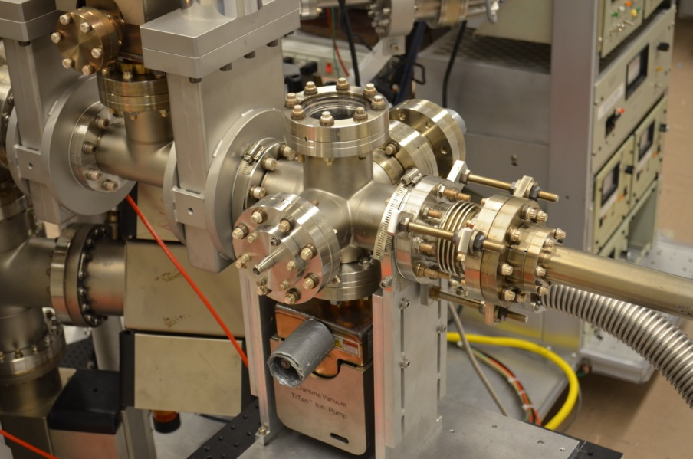
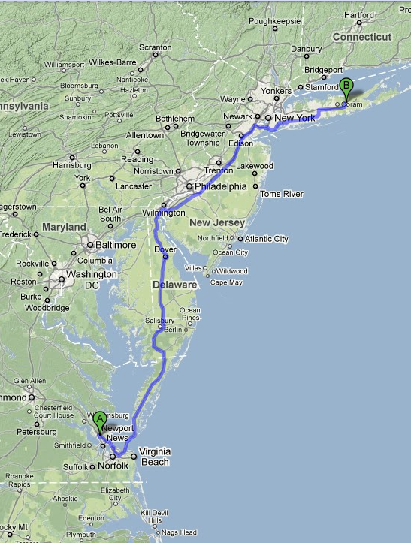
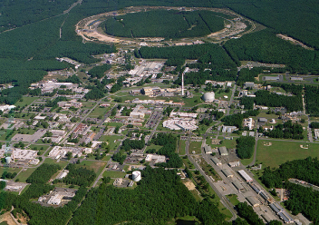
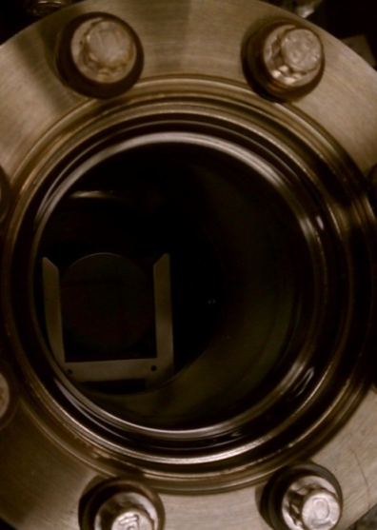
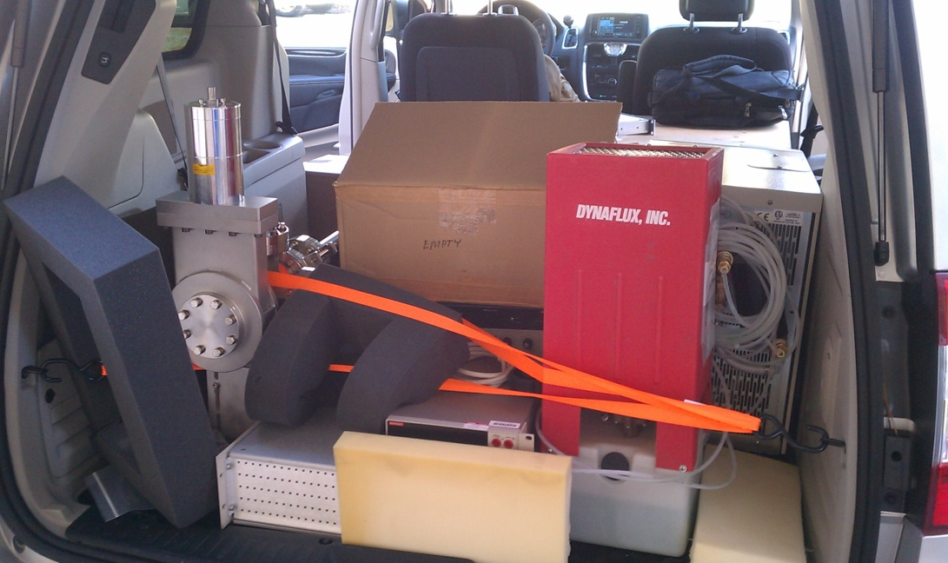
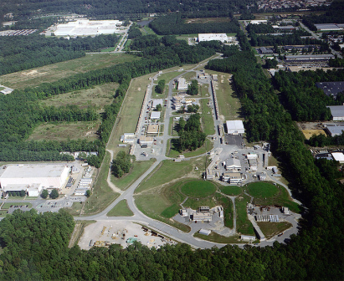
Use Vacuum Suitcase to Transport K₂CsSb Puck
600 L/s (H₂) NEG
Photocathode made at BNL
Gatevalve
Magnetic Manipulator
25 L/s (N₂) ion pump
Packed in the Minivan
Transported to JLab

Slide 4
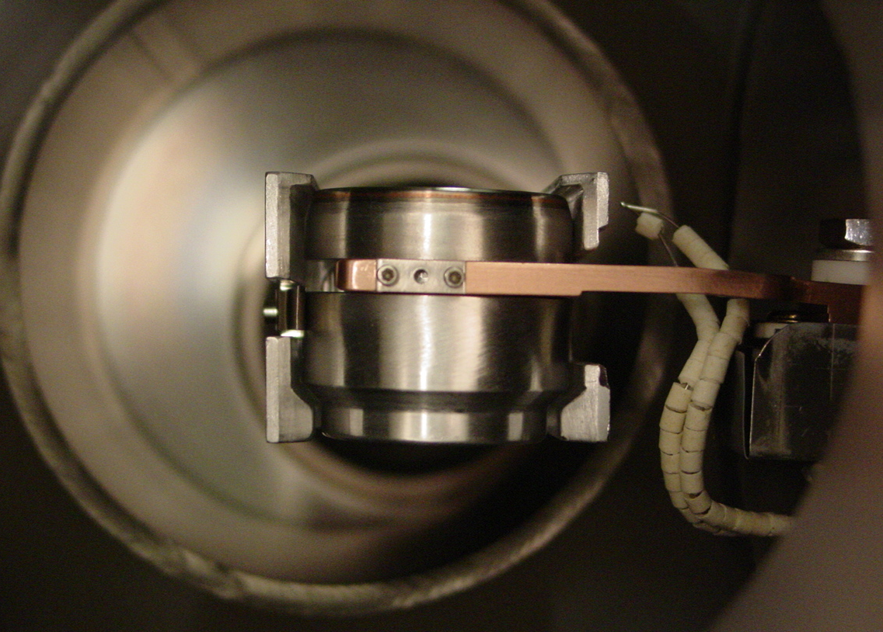
Puck design
K₂CsSb cathode transported by load lock for the first time
QE remained unchanged at ~ 1.6 % @ 532 nm before and after transport

Slide 5
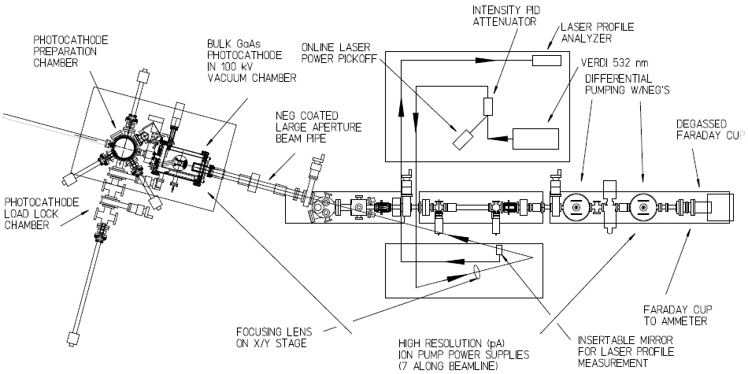
Injector Test Cave
Laser Table #1
Prep/Puck Manipulation Chamber
High Voltage Gun Chamber/cylinder
Laser Vacuum viewport
Water Cooled Beam Dump
Vacuum Suitcase
Laser Table #2
Several Correctors Magnets
Focusing Solenoids
Low Current Beam Viewers
Ion and NEG pumps

Slide 6
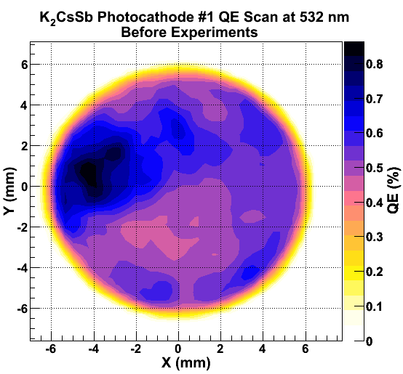
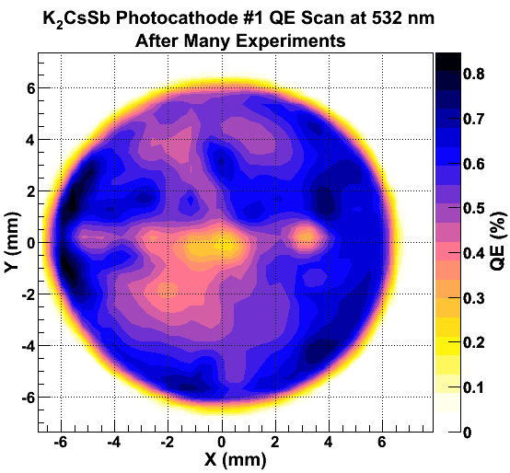
First Runs: 532nm, 500 μm spot, 100 kV Voltage
QE after transport; still good!!
QE after 6 runs at 532 nm

Slide 7
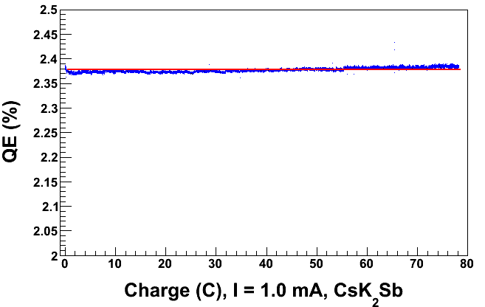
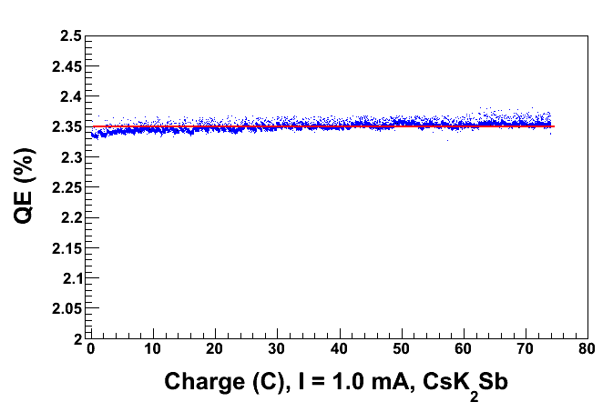
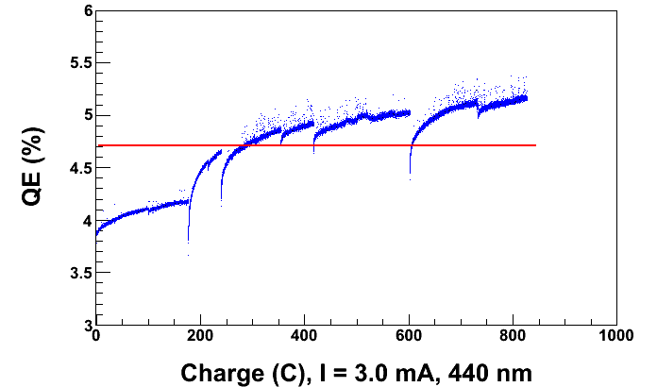
440 nm, 1050 μm, 1 mA Lifetime Runs
Typical 1 mA lifetime run with Blue at the EC!!!
100 kV Gun
200 kV Gun
QE scan after sitting for 48hours
No QE decrease in any of the runs;
actually, the QE seems to increase
QE scan after several runs

Slide 8
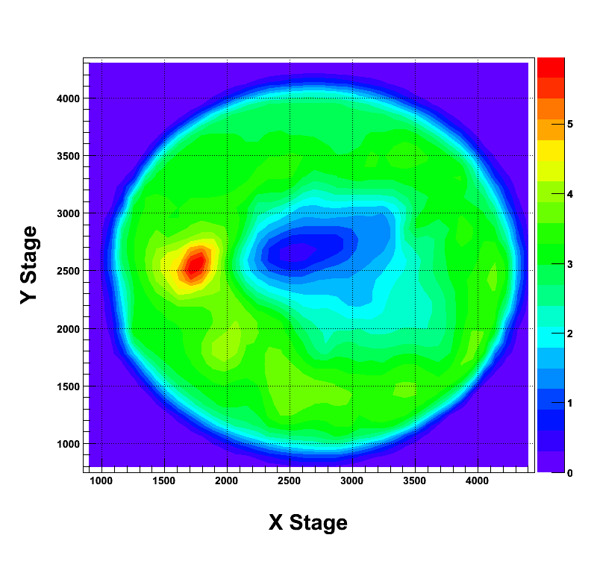
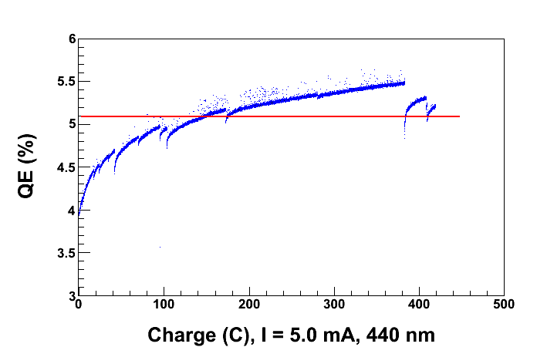
5.0 mA, 200 kV, 440 nm, 1050 μm spot
QE scan after running
Cathode is not dead after the big beam on bellows event.
In fact it seems that the rate of change (increase) of QE increases with more laser power
Is this a photochemistry effect or a heating effect?
Try this with 532nm light to see what this does, if the QE increases now with 532nm, it suggests more of a heating effect

Slide 9
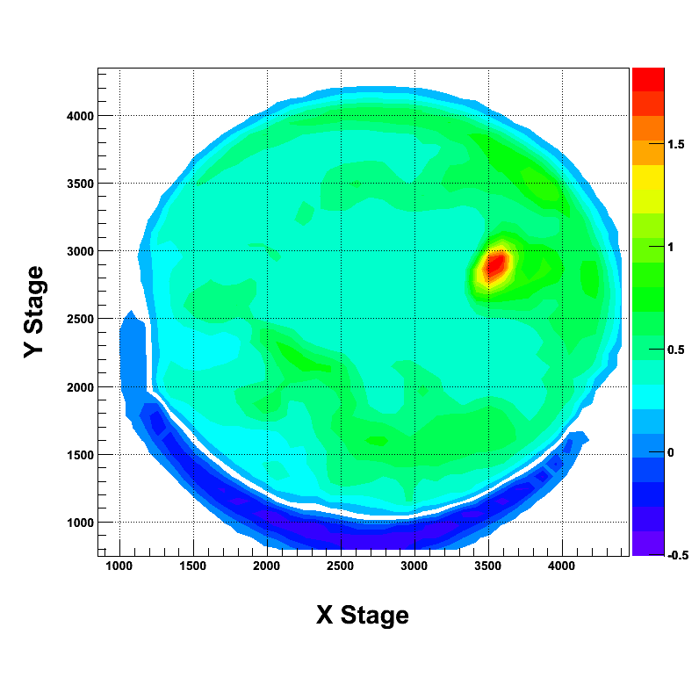
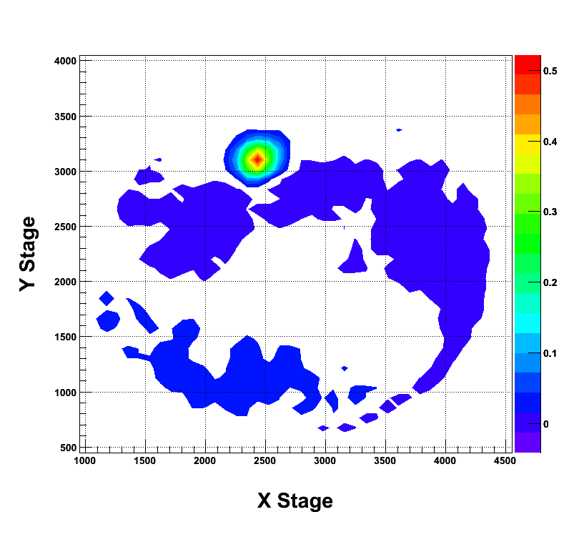
Laser Heating?
QE difference after heating for 12 hours with 440 nm and 211 mW
QE difference after heating for 2 hours with 532 nm and 672 mW
Also there is overall QE recovery from sitting in vacuum
So now the QE increases with both 440nm and 532nm light!!!
Lets do some green lifetime runs now

Slide 10
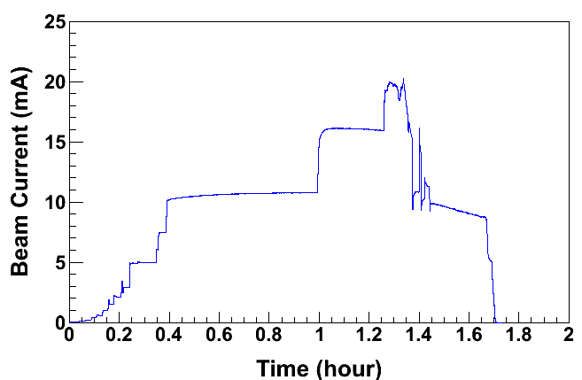
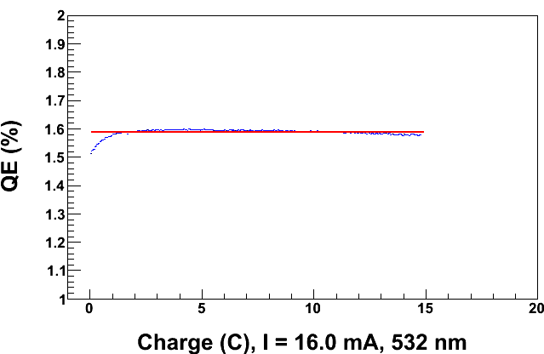
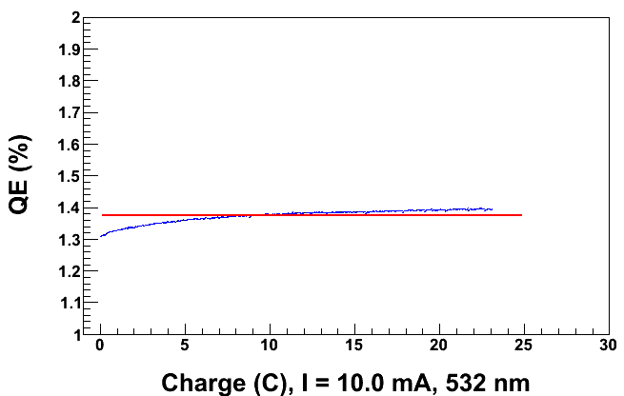
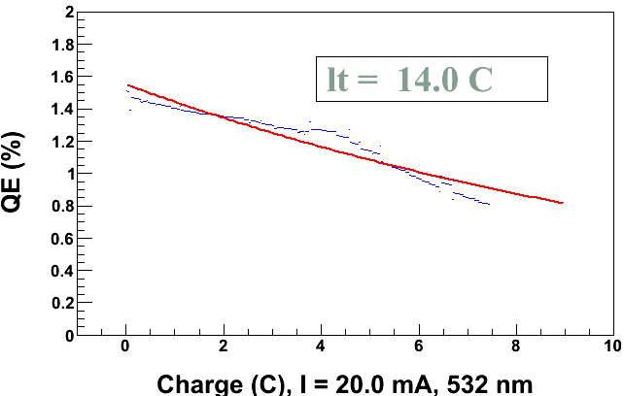
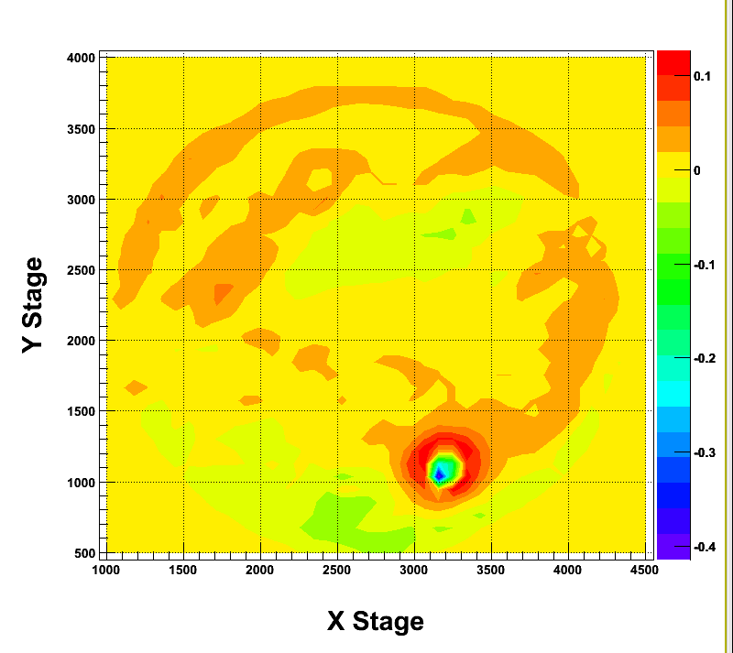
20 mA, 100 kV, 532 nm, 500 μm spot
Record current at Jlab
Then we see a slight QE decline at 16mA
Things were “normal” at 10mA
Sharp QE decline at 20mA
QE Change before and after the run
Ran with 100kV to ensure dump wouldn’t get too hot.
Dump temperature went up to about 40°C
→ Not a problem
QE change plot shows QE decline at center of the laser spot

Slide 11
Laser Heating vs. Charge Extraction
Ran beam at 100 kV, 532 nm, 500 μm spot, at indicated currents, and compared QE evolution to only illuminating with an equivalent amount of laser power. Kept laser power, not current, constant.
Qualitatively QE evolution matches for each current and equivalent.
Confirms that any QE decays is mostly due to laser illumination / heating – not ion bombardment or Joule heating.
Notes:
QE was measured at intervals by dropping laser power to ~.2mW and pulling ~1μA at a bias of 300 V to measure QE before grounding cathode and shining full laser power again. Process took under 5 min.

Slide 12
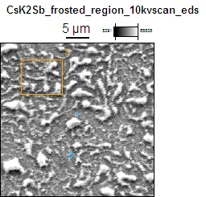
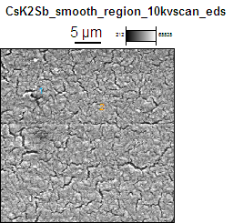
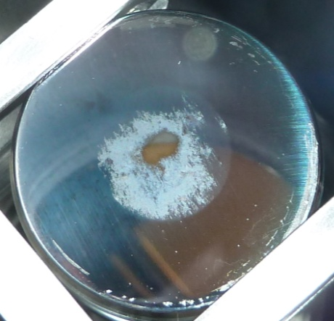
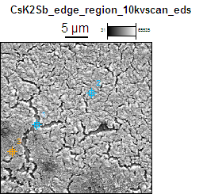
Photocathode #1 at 3000x with 10 keV Electrons
2
1
3
4
Spot 2
The “smooth” regions show cracks in the film.
We will see that the cracks are exposed SS surface.
Spot 3
Note the Frosted region two the eye has what appears to be “flakes” on top of the substrate.
We will later see that those flakes are made up of Cs, K, Sb, O, and C .
The areas between the flakes are mostly SS with some Sb.
I can imagine these cracks are negligible for our laser beam sizes of 350-800 um.
Whereas this is not the case for Spot 2’s “flakes”.
Spot 4

Slide 13
Conclusion
Cathode can be fabricated in one location and transported to another without degrading QE provided UHV conditions are maintained
Changes in QE can be attributed to heating by laser
Controlled heating due to laser improves QE
Overheating destroys the cathode

