Slide 1
GaAs Photocathode Development

Slide 2
Outline
Cathode performance and challenges
  Preparation system
  Cathode preparation procedure
  QE and lifetime (and dark lifetime)
  Cathode damage (center area, non-recoverable)
Surface roughness and thermal emittance studies (Siddharth Karkare)
Other R&D: activation using XeF₂ in He/N₂ and N₂
Future plans

Slide 3
The Preparation System
Status
SYSTEM CURRENTLY WORKS VERY WELL; NO REALLY CRYTICAL ISSUES
Load lock chamber modified to interface with vacuum suitcase, so cathodes prepared in other system can be transferred to the system without exposure to atmosphere; 1st CsK₂Sb cathode tested, very promising
Added wobble stick (w/ fork at end) in prep chamber --- A lot faster in swapping cathodes
Doubled motor speed on the two long translators
Desired features
Replacing the home-made valve between the prep chamber and the heating chamber with a gate valve, so that the two chambers are really isolated vacuum-wise, and using the heating chamber won’t affect prepared cathode or preparing new cathode in the prep chamber
More storage capacity; need to be isolated from prep chamber and in very good vacuum
Faster cathode-swapping mechanism

Slide 4
GaAs photocathode preparation procedure
Wafer cut to size and cleaning
Anodization of whole wafer
Remove anodized layer on back side by exposure to ammonium hydroxide
Indium soldered onto Mo puck in vacuum; Ta capping
Remove anodized layer of part of front side of wafer to create a desired active photocathode area immediately before loading into load lock chamber
Bakeout load lock chamber
Atomic hydrogen cleaning: 0/1 time at 350°C for 30 minutes
Heat cleaning at 500-620°C for ~ 2 hr; cool down to and hold at 150°C; then down to room temperature before activation
Cs/NF₃ activation “yo-yo”

Slide 5
Photocathode performance
Over 10% QE (at 532 nm) can be routinely obtained for newly activated cathodes
Initial QE, and dark lifetime also, tend to improve with more heating/activation cycles
Dark lifetime in prep chamber is usually only a few days while much better in the gun; so photocathodes are usually activated right before being put into the gun

Slide 6
QE Decay is a challenge for high beam current
11/16/2010
Lifetime
15 min
8 min
1 hr
2.5 hr

Slide 7
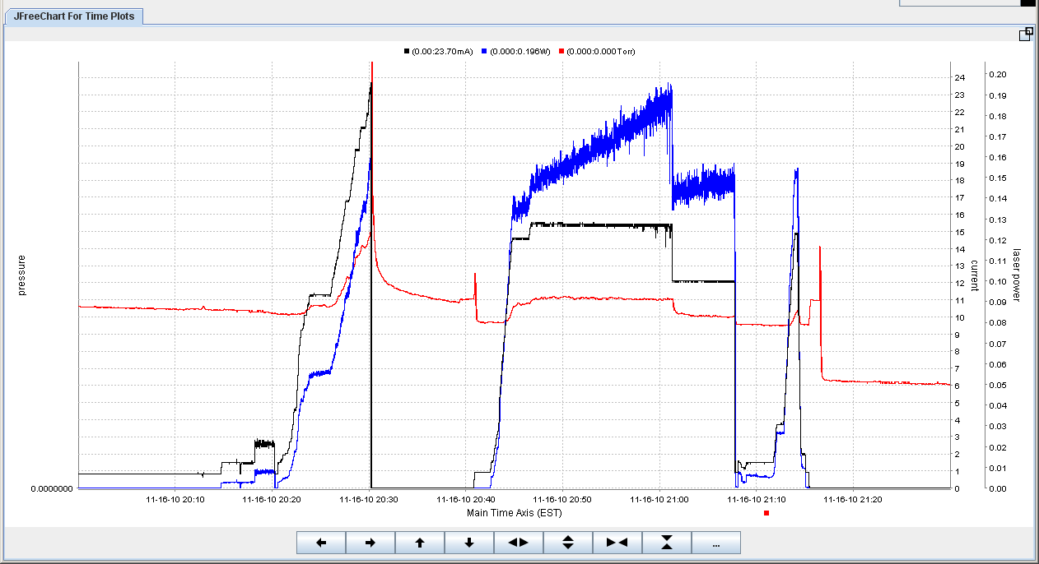
Same Run Shown with Trace of Gun Chamber Pressure
Laser Power
Beam Current
Gun Pressure
(0 – 5x10⁻¹¹ Torr)

Slide 8
Photocathode lifetime
Sudden death event
  Cathode dies with a pressure spike (discharge)
  Related with creation of visible damage on surface?

Slide 9
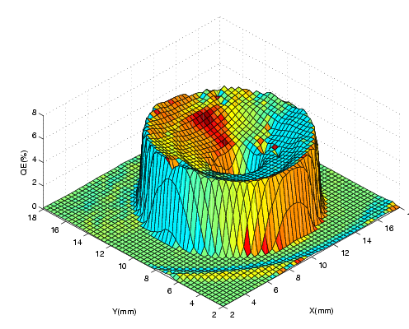
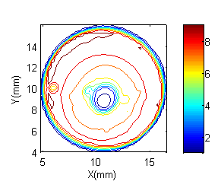
Damage #1: Non-recoverable damage of photocathode central area from high current run
The fact that the damage is always at center no matter where the laser beam strikes the cathode indicates that the damage is caused by back bombardment of ions generated near or beyond the anode.

Slide 10
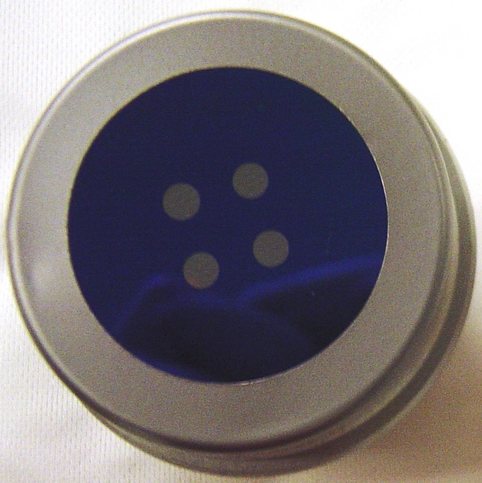
Cathode with 4 off-center active areas
Off center
Well defined active area so that
less laser profile shaping and beam pointing stability requirement

Slide 11
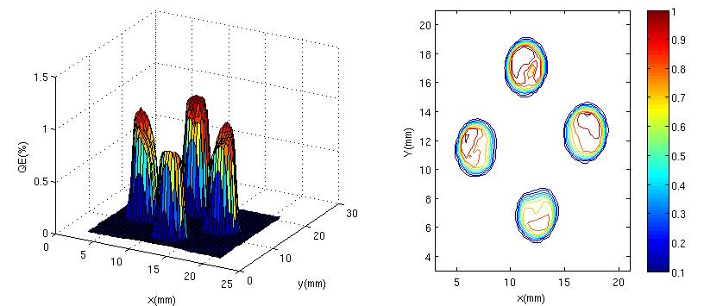
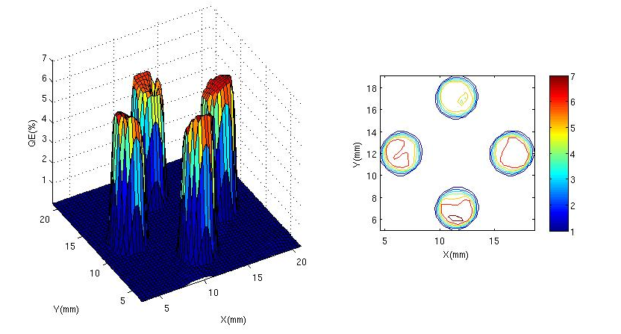
QE maps
After use
After heating and reactivation

Slide 12
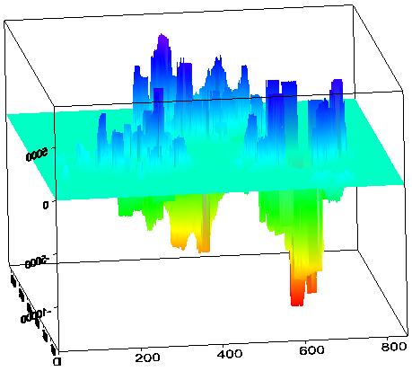
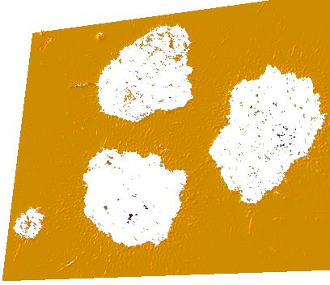
Damage #2: visible damages of cathode active area
2D image (850µm x 630µm)
3D surface (850µm x 630µm x 23µm)

Slide 13
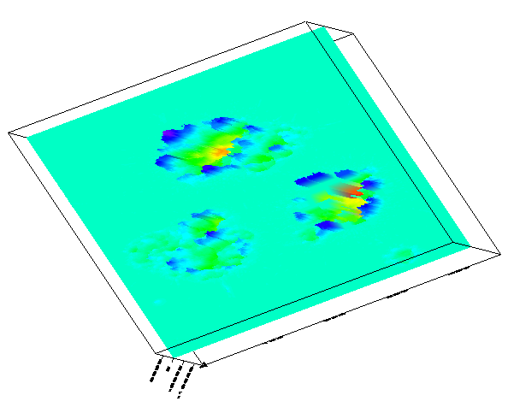
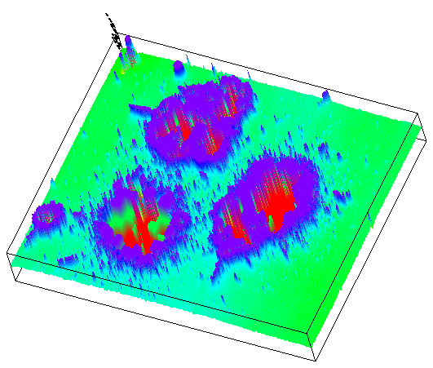
Spreads of tiny “rocks” around each “crater”
3D surface truncated to
(-100nm, 100nm)

Slide 14
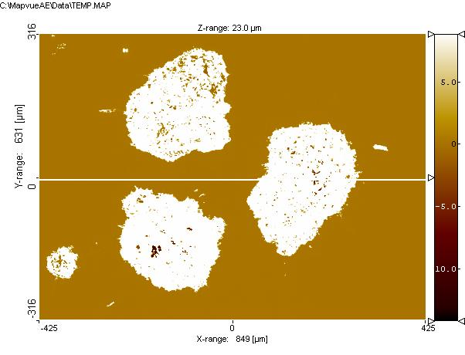
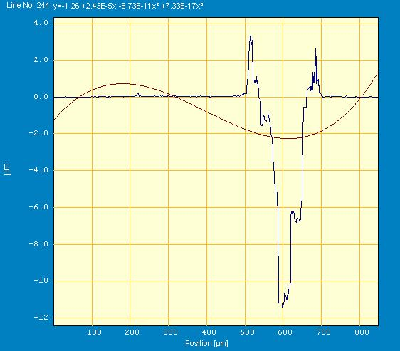
A direct look at the depth:
Profile along marked line

Slide 15
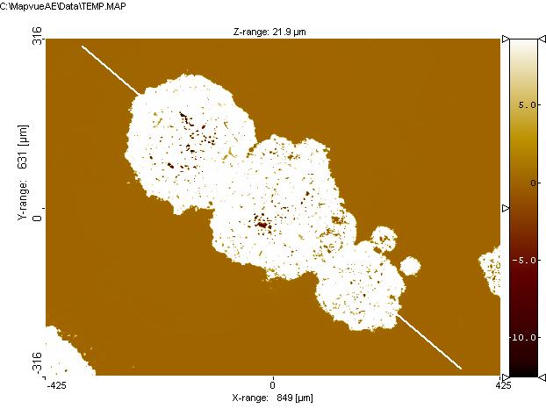
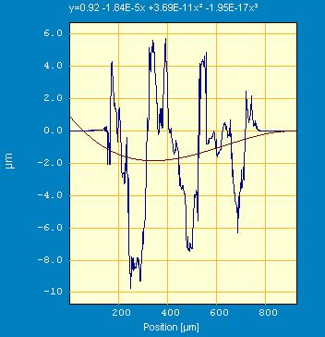
Another sample
Need chemical analysis (e.g. XPS, AES)

Slide 16
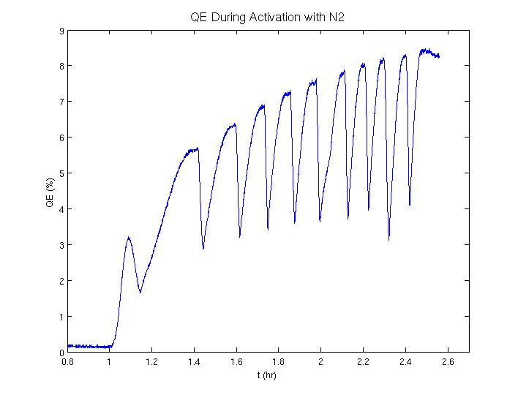
Photocathode activation with Cs/XeF₂, Cs/N₂ (on QE test system)
Synchrotron radiation photoelectron spectroscopy study by Liu et al* found the existence of significant amount of N in Cs/NF₃ activated GaAs photocathode surface layer
  N as N-F and N (5+) species
  N/F ratio: 0.3
  Only one F 1s peak; no indication of Cs-F bond
Then we decided to use XeF₂ as F delivery agent, hoping that inert Xe will be released into the vacuum and make the surface chemistry simpler.
  XeF₂: crystalline, 4 torr vapor pressure at room temperature;
  use helium (with some N₂) as carrier gas
  Does the work
  Not as superior as expected
  Still see NH₃ coming out during thermal
  desorption, even after purifying the carrier gas
Led us to try activation using N₂
  It works, too!
* Z. Liu, Y. Sun, S. Peterson, and P. Pianetta. Appl. Phys. Lett. 92, 241107 (2008)

Slide 17
Plans for near future
Dedicated beam study to better understand and improve photocathode performance
More analysis towards the cause of cathode decay and visible damages on surface
Cathode preparation without high temperature heating to preserve surface smoothness
  H-atom cleaning at medium temperature only
A new cathode test chamber with vacuum suitcase interface for AES, etc.
…

