Slide 1
New Gun HV System

Slide 2
New Insulator
Requirements:
< 10 MV/m at 750 kV on HV surfaces
< 2 MV/m at triple points
Kyocera-type braze joint
no path for electrons from HV electrodes to the insulator
5 atm SF₆ environment
arc protection, can withstand transients
XHV compatible
build in 2 sections to accommodate future plans

Slide 3
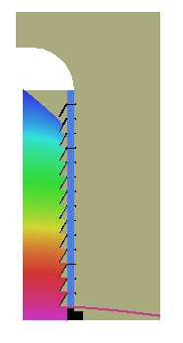
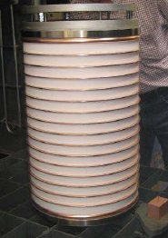
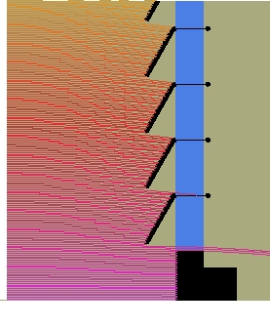
Segmented Insulator
We designed a segmented insulator with intermediate guard rings to catch any field emitted electrons before they reach the insulator material. Ready in Feb.

Slide 4
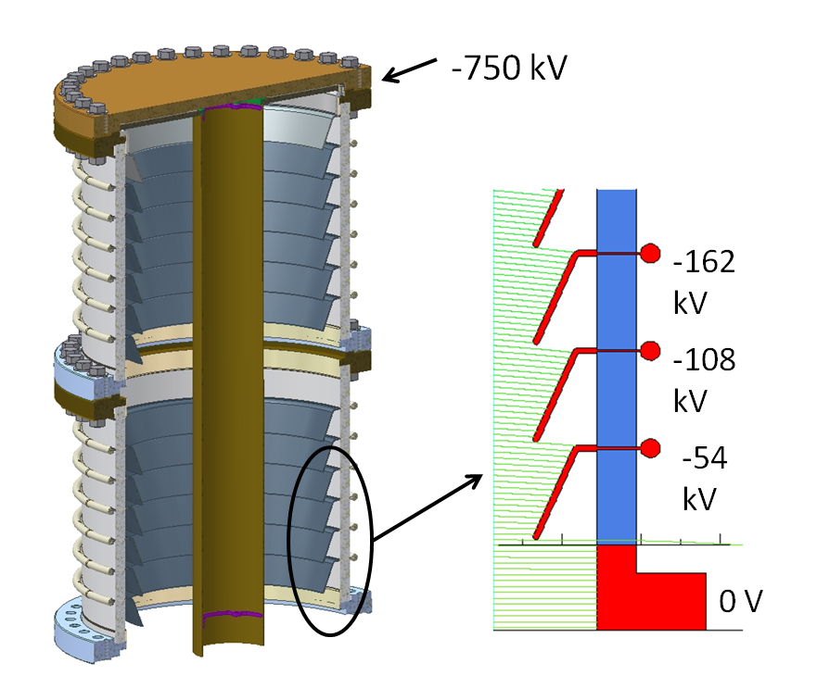
Each ceramic ring is 50 mm tall and 20 mm thick
Braze rings are kovar
The internal rings can be removed. For now, we will use copper
There is a chance for FE between the rings, but the fields are low and the energy is low (< 54 kV).

Slide 5
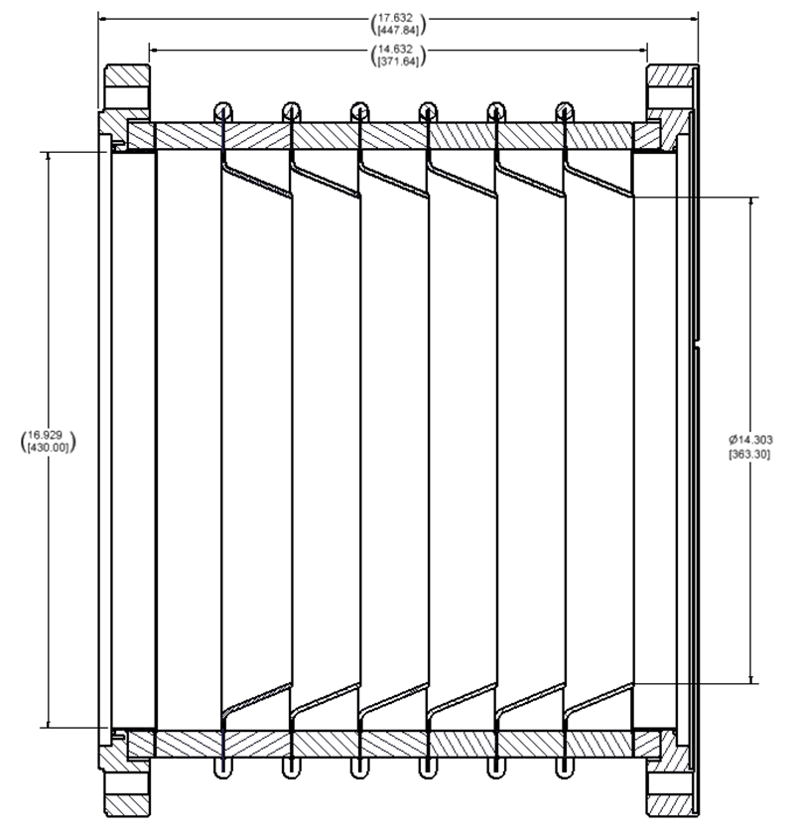
Will use wire seal flanges due to the large diameter. We have done numerous bakeout cycle tests on wire seals and have not experienced any problems

Slide 6
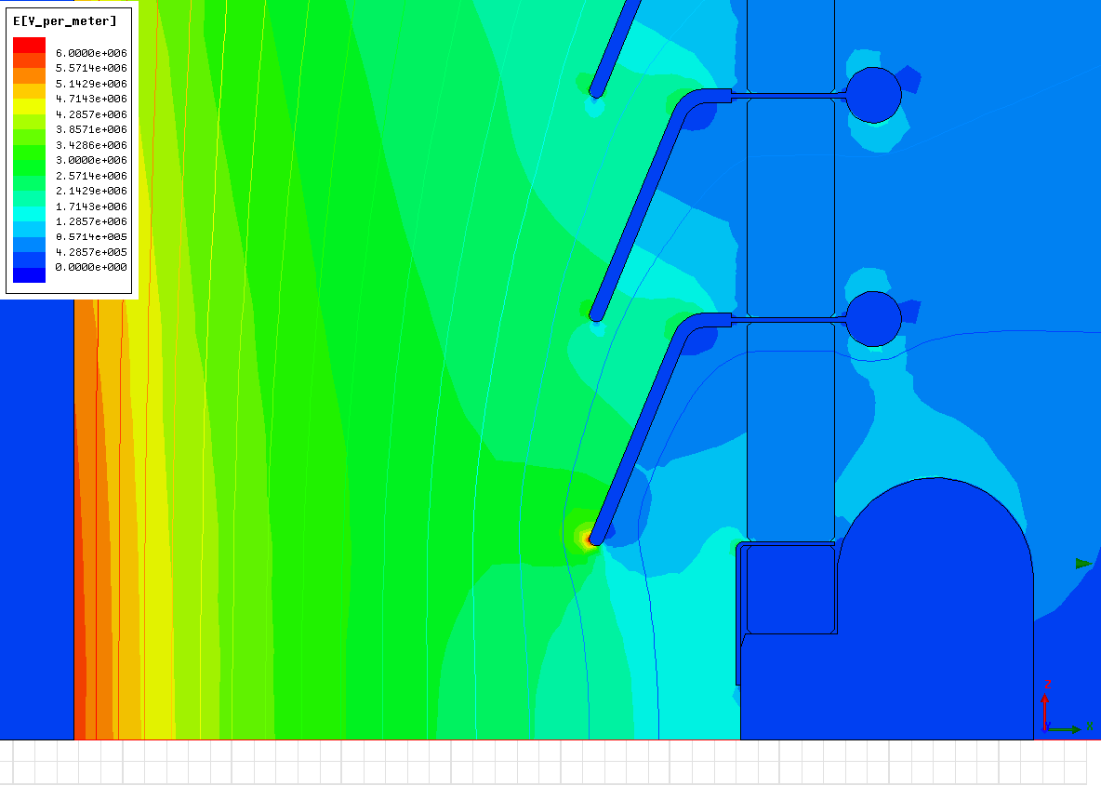
500 kV field strengths
Rings are held at a fixed potential

Slide 7
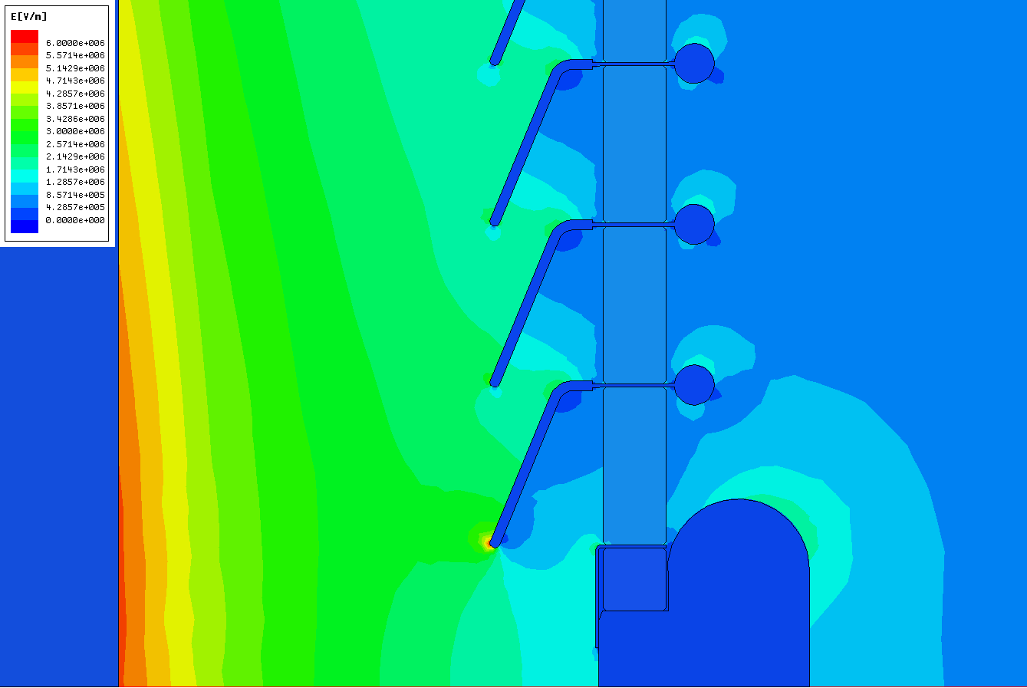
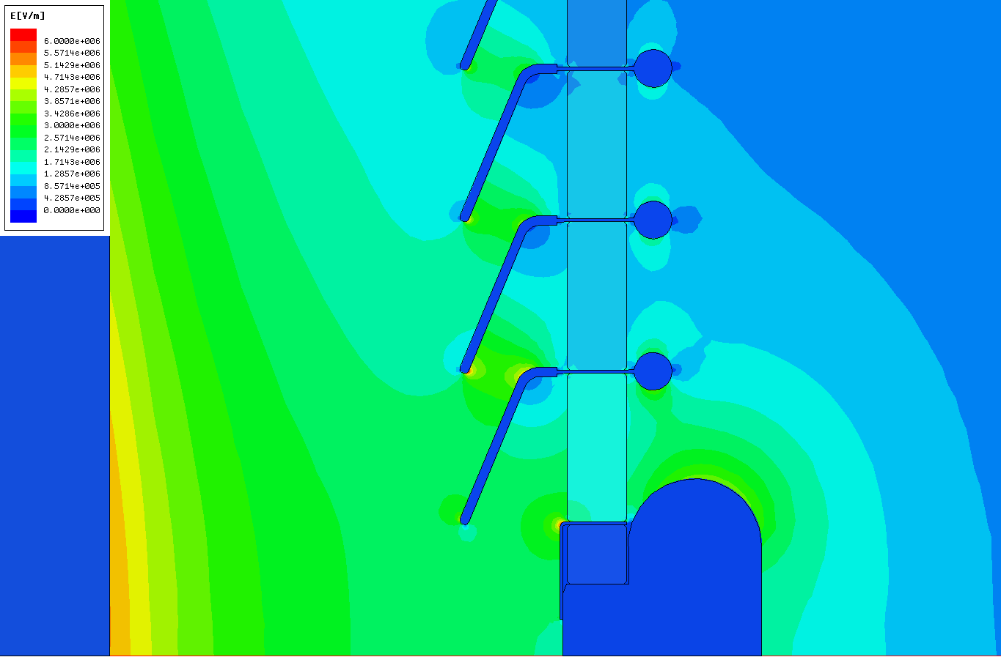
A look at possible failure modes . . .
What would happen if the resistor broke down?
A subsequent breakdown occurrs between resistor terminals
As a result, a transient (445kV with a steep front – only 10ns) re-applied across the HV insulator
Field distributed non-uniformly along the interface
E-field at the electrodes
5.1kV/mm at HV conductor
5.0~6.0kV/mm (shields from bottom three segments)
Significant FE activities between the shields(only conditioned up to 3kV/mm) or shield and HV conductor resulting in vacuum breakdowns (cascading effects may be applicable)
Prior to burst of spits
After breakdown of the opened resistor

Slide 8
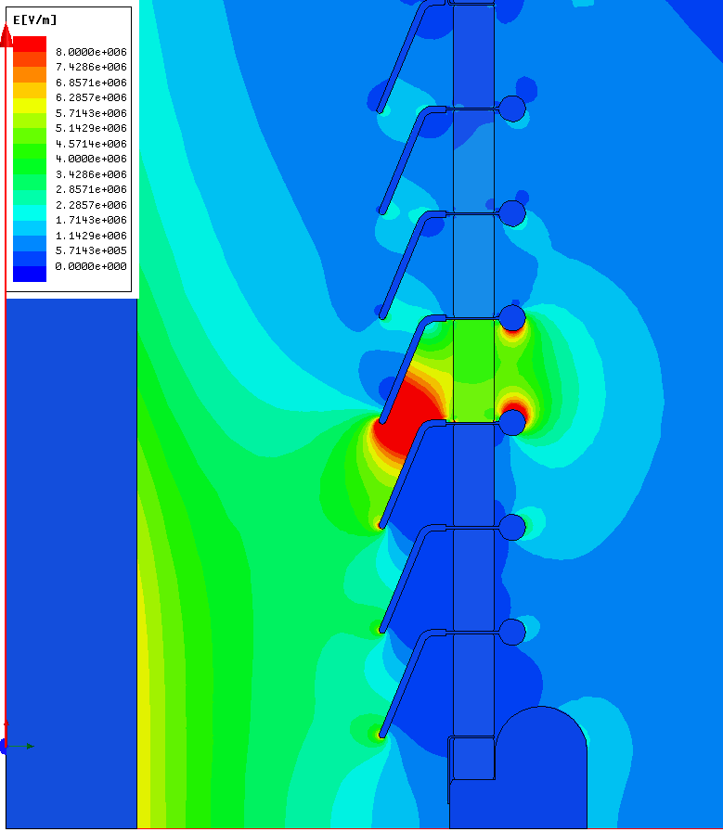
Then . . .
Flashover between shields in bottom segments or between ID conductor and shields
Sustainable arcs due to lack of current limiting surge resistor
Significant increase in E-field inside ceramic
Worm-hole puncture as a result of a series of cascading evens
Shields from bottom 4 segments shorted
Vacuum BD between HV conductor and 3rd shield

Slide 9
Each ring will have 2 sets of 2 Caddock MG815 resistors in parallel (500 Mohm each) for controlling the voltage. Could grade the voltage if desired
Will also use the resistors for HV measurements.
500 Mohm total per ring x 14 rings = 7 Gohm
At 750 kV, I_{total} = ~100uA
-> 50 uA per resistor X 27 kV = ~1 Watt per resistor

Slide 10
Ring to Ring arc protection using Littlefuse varistors
Examples from LBNL

Slide 11
SF6 Tank
Requirements:
Gun and HVPS in separate tanks
HVPS requires 5 atm (abs) SF₆ and ~ 12 inch clearances
Cylindrically symmetric
Ports for diagnostics
View ports for visual observation
Way to circulate the SF₆ (already included in the HVPS)
Method to produce power on the hot deck (optional)
Modular sections, to allow easy reconfiguration
Symmetric sections, so HVPS can be located anywhere
Interior surface finish, xx rms (in case of positive charge buildup)
Meets pressure vessel codes

Slide 12
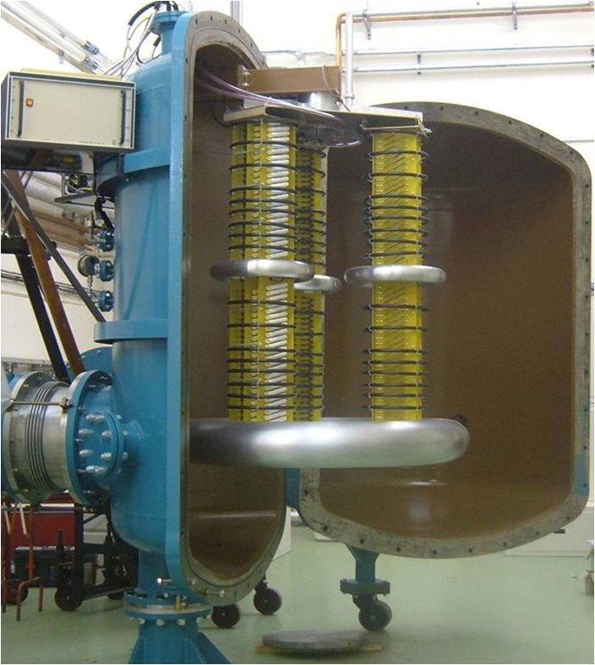
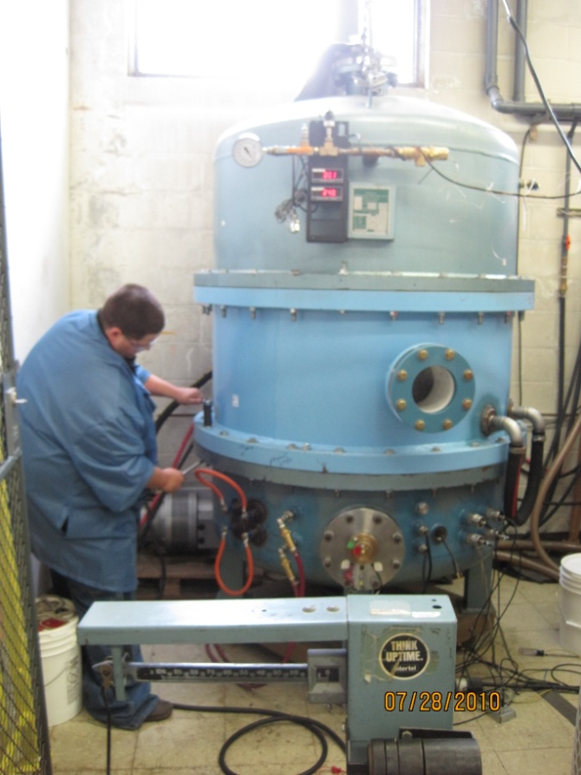
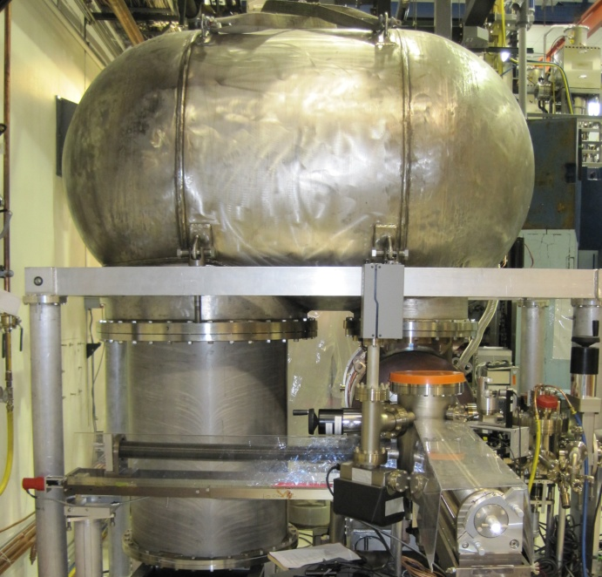
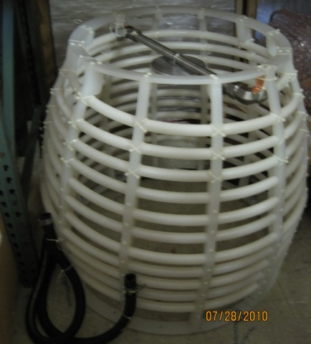

Slide 13
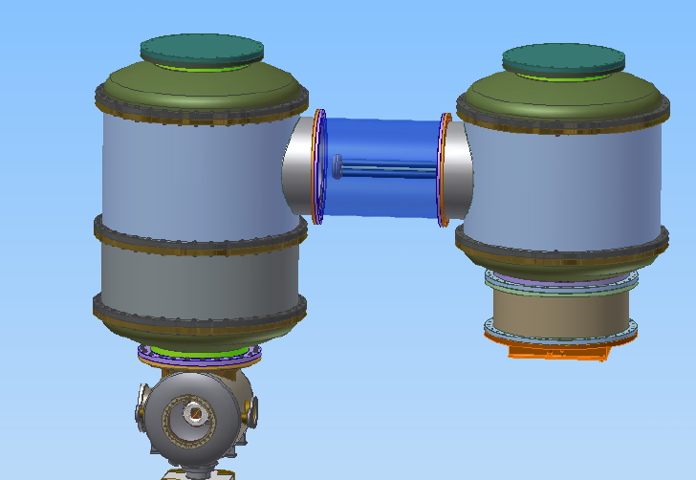
Motor/Generator
Viewport
Viewport
PMT
PMT
HV monitor
Fiber temperature sensor
Floating ammeter/fiber communication
PMT
PMT
PMT
Conceptual Design for the SF6 tanks

Slide 14
Power supply requirements
Parameter | Specification | Notes
Operating voltage | 400-600 kV
Conditioning voltage | 750 kV
Maximum current | 100 mA
Ripple | ±0.2% at 500 kV | Value depends on the gun’s voltage
Voltage reproducibility | 0.25% after 1 hour
Ramp-up time to full current | 50 – 100 msec | Depends on RF control system’s bandwidth and cavity’s fill time
Personnel safety | At least 2 independent interlocks must be satisfied before turn on
Machine safety | Should have an external signal to shut down if an accelerator trip
Arc detection | A dV/dt circuit to sense an arc and trip the supply
Temperature stability | 0.01% of V per 1 deg C | SF6 temperature can be regulated if needed
Environment | 100% SF₆ | Can use mixtures of N₂, SF₆
Current measurement | Ability to measure with < 1μA resolution for HV conditioning of electrodes | Need to separate the load current and the internal PS current draw
Calibration | 1% of full scale | Using external divider, difficult at this voltage and in SF₆
Current limit trip | Exceeding preset limit trips the supply
Line regulation | V_{out} ±0.5% for a ±10% line variation
Voltage stability | 0.25% from 10-100mA
 | DC output ±0.4% over an 8 hour period, including ripple
Capacitance/Stored Energy | 100 pF, 10 J | Not a firm number, but lower is better
External feedback port |  | Ability to apply an external signal to superimpose on control loop
We have . . .
-750kV, 100 mA Kaiser
-600kV, 100 mA Kaiser
-500kV, 1.5 mA Glassman
+/-300kv, 2 mA Glassman

Slide 15
Conditioning Parameters
max current to the gun < 100 uA
max total pressure < 1e-8 Torr (maybe 1e-9?)
max arc counts – depends on the resistor
max resistor temperature – depends on resistor (200C max, but probably want to stay well below this)
radiation – should be zero at the end . . .
PMT signals – mainly for directionality, or for fast arc counters
max voltage – trip if this level exceeded
rate of voltage increase – typically 5-10 kV/hour beyond 250 kV when things are going well, 1kV when they are not
If no progress can be made without exceeding these, time for inert gas processing?

Slide 16
Conditioning Resistors
Assume an arc dumps all the power from the HVPS
- 199J for the Glassman, 10 J for the Kaiser
Resistor rating:
(Power rating Watts)*(overload factor)*(overload time T)
-> Joules the resistor can withstand in time T
For our previous CJE Cableform resistor (40 kV)
(35 Watts) * (2.5) *(5 sec) = 438 J in 5 seconds
Kaiser: 44 arcs in 5 seconds maximum
Glassman: 2 arcs in 5 seconds maximum
Other question: what is the optimum total resistance to use? (500kV, 100 Mohm -> 5 mA max)
500 Mohm is too much, 10 Mohm is too small

Slide 17
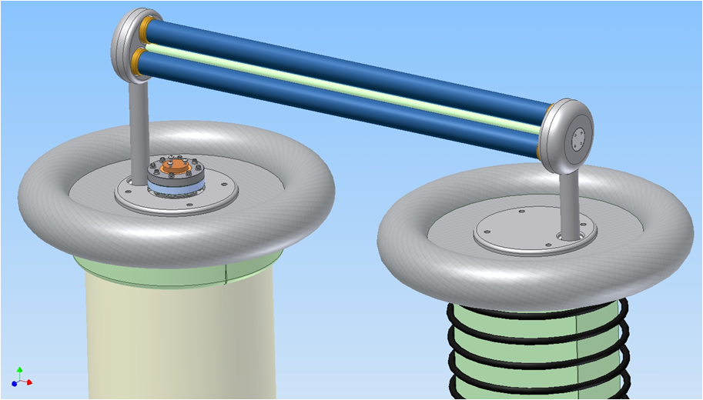
Conditioning Resistor – option #1
Nicrom resistor – single unit can hold off 400 kV in air
Rating:
(250 Watts) * (2.5) * ( 5 sec) = 3125 Joules in 5 sec
Stack 3 in parallel for redundancy
These are the best option: Nicrom makes good products, but delivery is extremely slow (6 months min)
Fiber temperature sensor

Slide 18
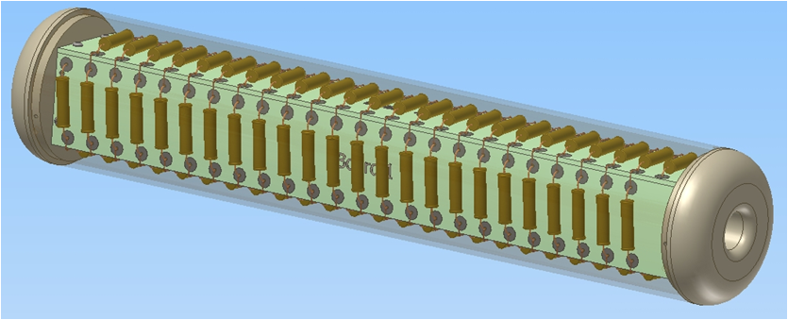
Conditioning Resistor – option #2
Homemade resistor chain – Caddock MS310 – 100x1 M-Ohm
Rating:
(10W*100units)*(5)*(5 sec) = 25000 Joules in 5 sec, or 250 Joules in 5 sec per resistor

Slide 19
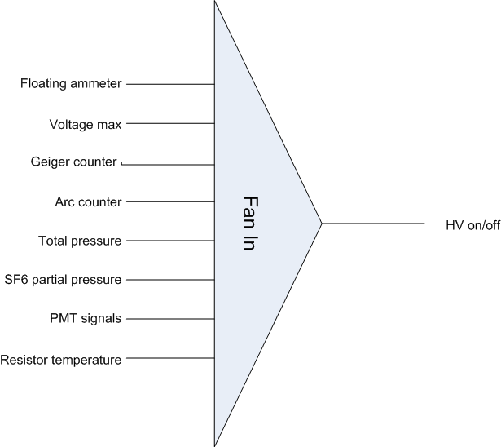
Protection during Conditioning
Use multiple inputs AND’d together to trip the supply if any limits are exceeded

Slide 20
Summary
Insulator should be delivered in Feb/March
Need to do more work on failure modes
Need to model corona rings/triple point protection
Material for rings – copper? (also need to look at copper for hydrogen outgassing)
SF6 tank design still preliminary
Processing resistors in hand or awaiting delivery
Varistors in hand (need circuit boards, mounting hardware)
Ring-Ring resistor in hand ( need circuit boards, mounting hardware)
Process control electronics for HV conditioning almost ready for testing
Kaiser supply problems have been fixed
Cathode dark-current problems may limit our ultimate voltage . . .

