Slide 1
Cornell ERL Prototype Injector
DC Photocathode Gun Design Review
Vacuum Systems
Yulin Li, January 5th– 6th, 2011

Slide 2
Outline
Vacuum Requirements – In general
Present vacuum system and performance
Vacuum system Issues
Possible improvements

Slide 3
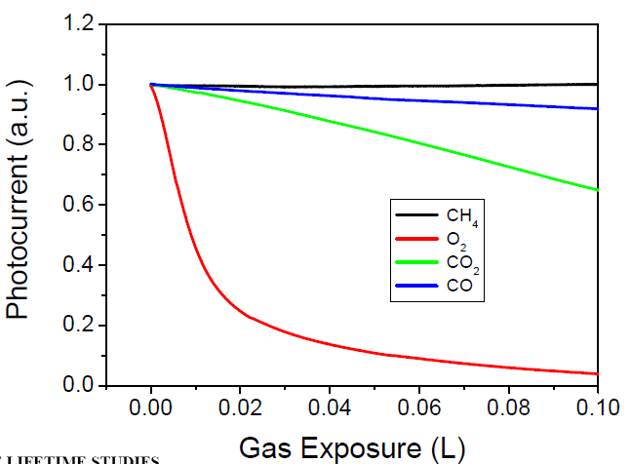
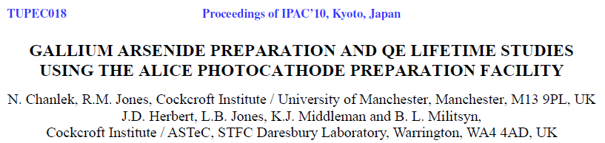
Photocathode Gun Vacuum Requirements (I)
(GaAs Cathode Dark Lifetime)
Dominated by photocathode lifetime – dark and beam operation
Base pressure –
keep reactive residual gas
pressure sufficiently low,
dark lifetime > days
 | H₂ | O₂ | CO | CO₂
D_{max} (L) | ? | ~ 10⁻² | ~ 1 | ~ 0.5
P_{max} (torr) | ? | ~ 10⁻¹⁴ | ~ 10⁻¹² | ~ 10⁻¹³
*) for dark time of 10⁶ sec

Slide 4
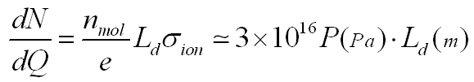

Photocathode Gun Vacuum Requirements (II)
(GaAs Cathode Beam Lifetime)
“Sudden” death – HV arcing ?
Ion back-bombardment
→ Ions originated from cathode-anode gap
→ Ions originated from trapped ions beyond anode !
Estimate ion flux to the cathode beyond anode (σ_{ion} ≈ 2x10⁻²³ m⁻²):
(Ref. 1)
For pressure of 10⁻⁸ Pa in the drift , and laser spot of Ф0.2cm, and L_{d} = 0.25m
(ions/sec·cm² @ 100mA)
The ion flux seems not very high. But what is the mechanism of the QE damage ?
Ref.1 Pozdeyev, Phys. Rev. ST Accel. Beams 10, 083501 (2007)

Slide 5
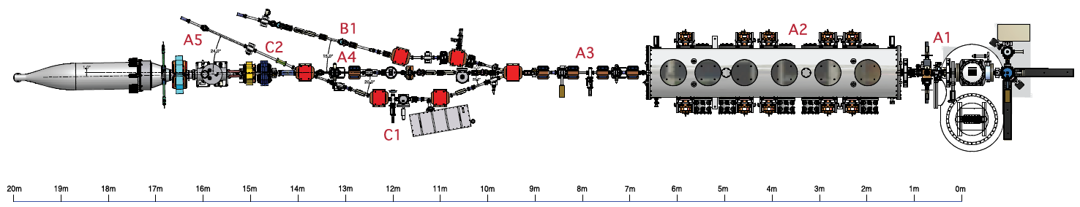
ERL Prototype Injector Layout
4
1
5
3
2
1
DC Photo-cathode gun
3
2
keV Beamline (A1)
SC RF cavity Cryo-module
4
MeV Beamlines w/ full suite of beam instrumentation
5
600 kW Beam Dump
Conductance limited beampipes (Ф35mm typical) and cryo-pumping in the ICM effectively separated diagnostic beamlines and beam dump from the photocathode fun
A small (2°) angle in the dump beamline shield the photocathode from radiation originated in the dump, if any

Slide 6
Achieving XHV in Photocathode Gun
Ultra-Low Outgassing in Stainless Steels by Mild Heat Treatment
The heat-treated (400°C bake in air for a duration of up to 100 hr) all stainless steel materials for the gun chamber.
SST outgassing rates below 10⁻¹³ torr·l/s·cm² achieved with F₀>3, a dimensionless time scale, F_{0.}
t – heating time; d –thickness
D=D₀ exp(-E_{d} /kT) – Hydrogen diffusion constant
Ref. C. D. Park, et al, J. Vac. Sci. Technol. A 26 1166 (2008)

Slide 7
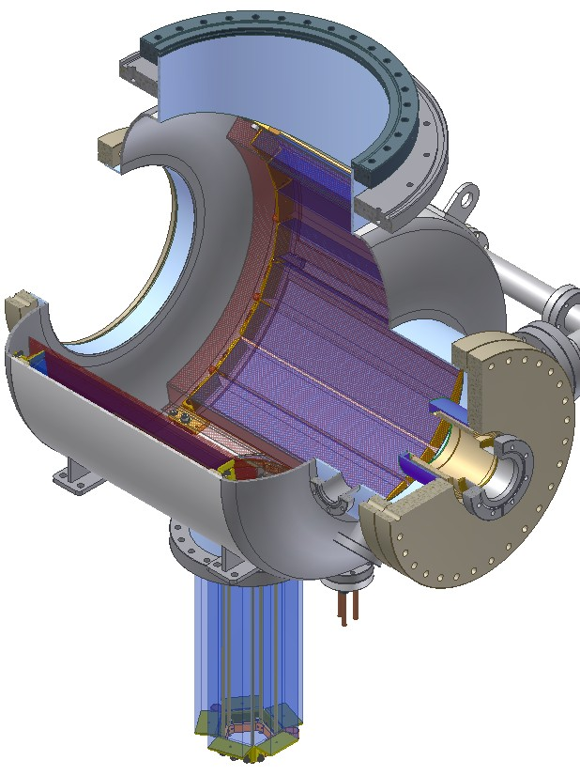
Pumping in the Photocathode Gun
The gun chamber is lined with 16 SAES WR 1650 st707 NEG modules
4 SAES WR 950 st707 NEG modules inserted into a 400-l/s noble diode ion pump
Total H₂ pumping speed exceeding 10,000 l/s !!
However:
Base pressure ~ 5x10⁻¹² torr
Outgassing from thick flanges, ceramics, cathode structures, cathode support stock ??
Limited by equilibrium H₂ pressure of the NEGs and ion pump ??
NEG Modules
400 l/s Ion Pump

Slide 8
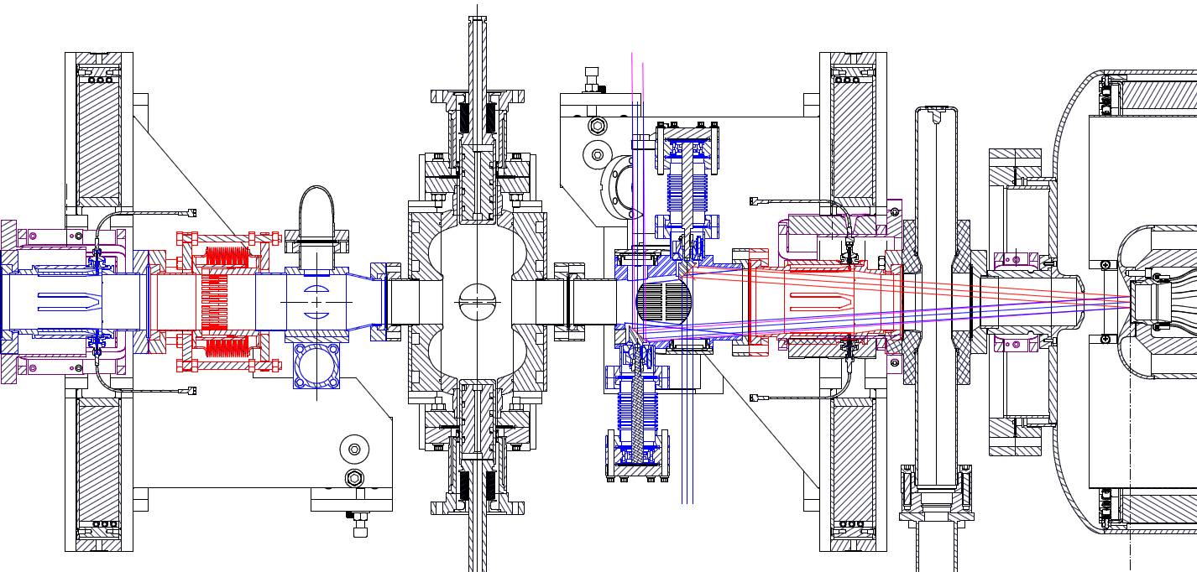
A1 Section – KeV Beamline
Pumps (ion pumps and NEG)
4
2
2
5
3
1
1 Meter
1
DC Photo-cathode gun
2
BPM/Corrector/Solenoid
3
Laser Entrance with adjustable in-vacuum mirrors
4
RF Buncher
5
RF Shielded Sliding Joint and Beam Profile Viewer
Very limited installed vacuum pumping due to lack of space
Very difficult for a thorough/good bakeout, due to many temperature sensitive hardware

Slide 9
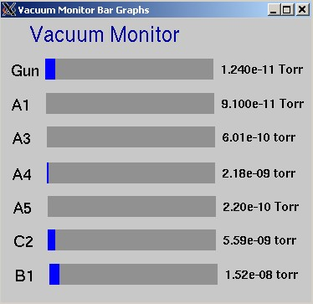
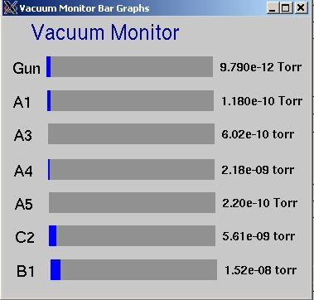
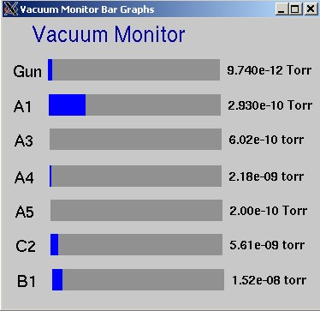
Vacuum Base Pressures in Gun & A1
1. A1 Connected to the Gun and ICM
2. A1 isolated from the Gun
3. A1 isolated from the Gun & the ICM
For sufficiently low base pressure to ensure adequate GaAs cathode lifetime, improvements are needed for the A1 section
Many ‘trapped or hidden’ surfaces (viewer, SLDJT, BPM, buncher tuner, etc.)
Part of ICM warm beampipe that is not bakeable may be a major source of outgassing

Slide 10
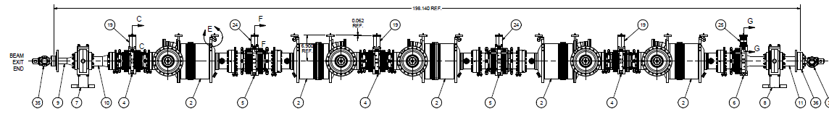
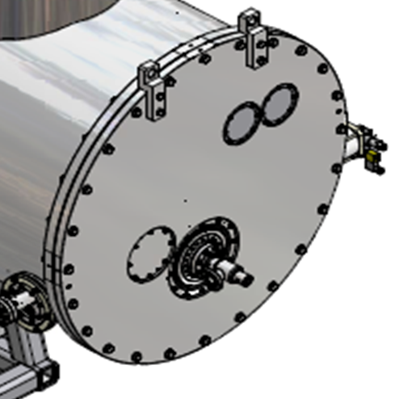
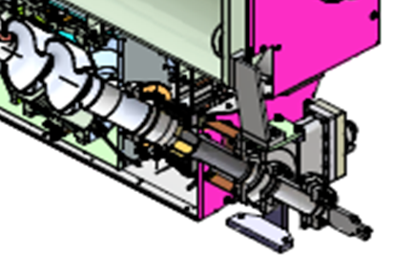
ICM Warm Pipe as a Part of A1
Unbakeable surfaces exposed
to A1 during A1 bakeout

Slide 11
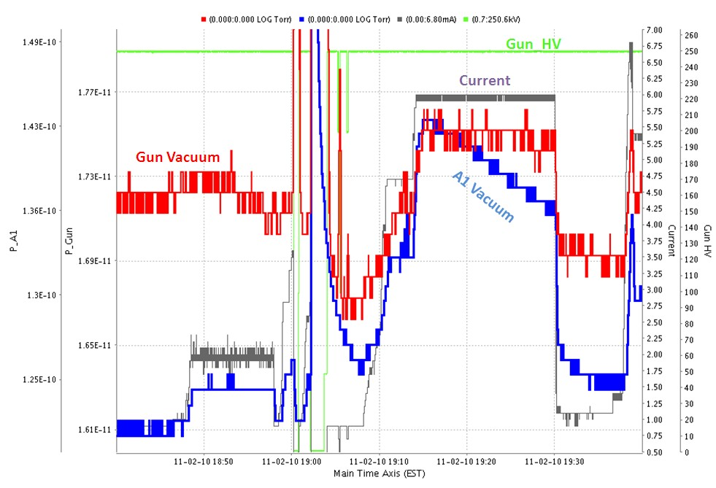
Gun/A1 Vacuum in Beam Runs – I

Slide 12
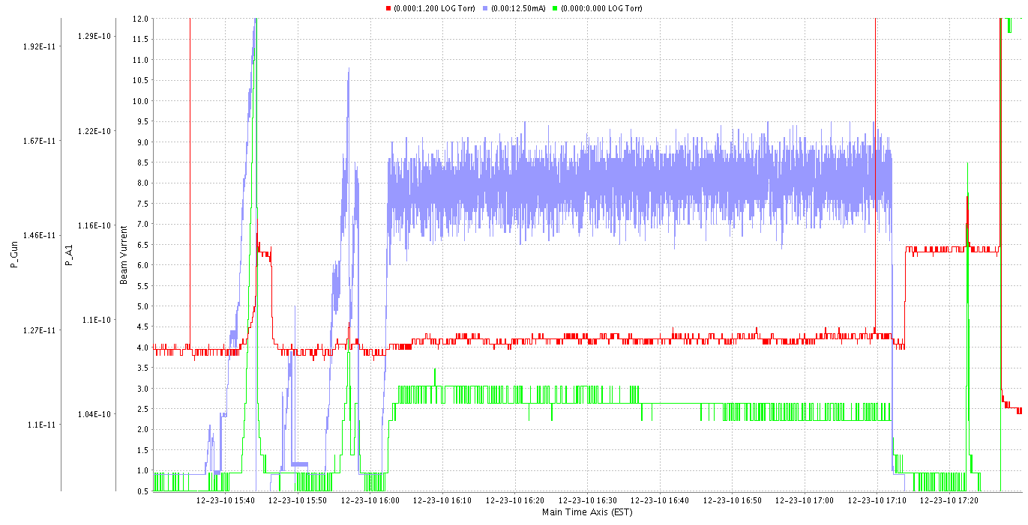
Gun/A1 Vacuum in Beam Runs – II
Beam Current
Clear showing beam induced pressure rises in A1 (and the Gun). Causes :
→ Beam halo ? → RF-induced in the buncher ?

Slide 13
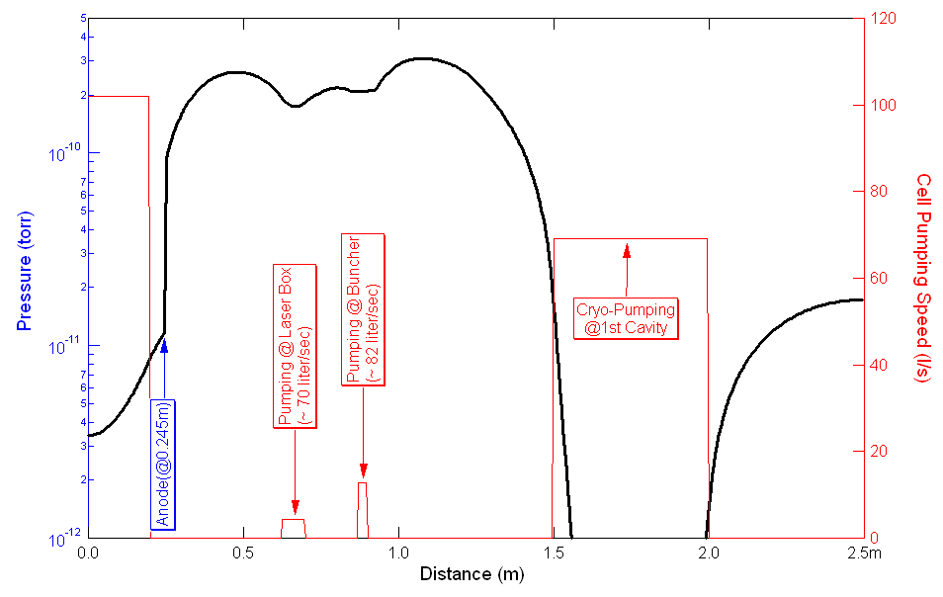
Calculated Pressure Profiles
Calculated using one-dimensional finite-element method, to fit measured data, assuming ONLY thermal gas-loads

Slide 14
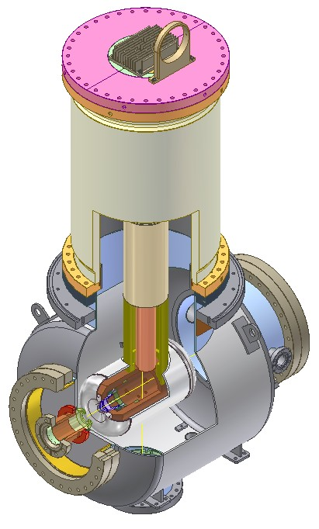
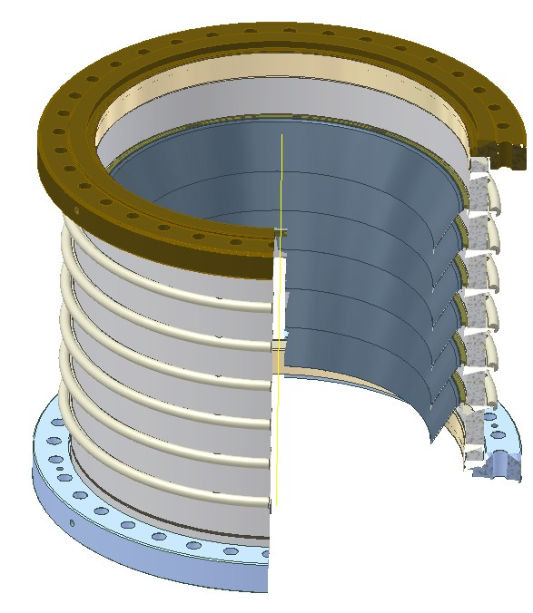
Improving Vacuum in the Gun
Understand outgassing from other components in the gun, such as the segmented ceramics, copper parts for the cathodes, etc.
Explored other pumping methods (better
combination of NEGs and SIP, cryo-pumps)
NEG coating (gun chamber, gun components,
ceramic guard rings, a NEG coated liner, etc.)
Double-walled thin SST chamber ?
Improving gun bakebility

Slide 15
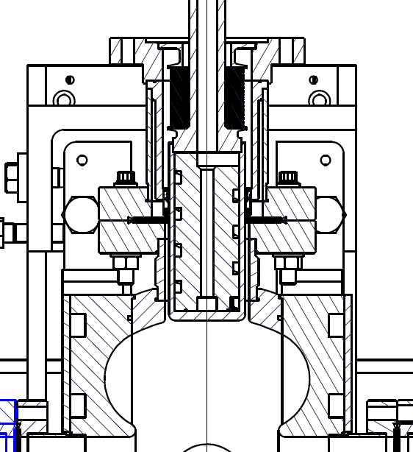
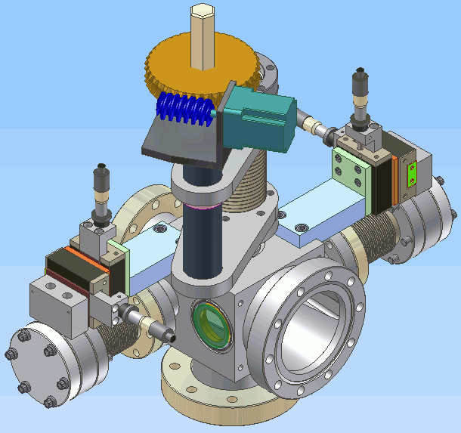
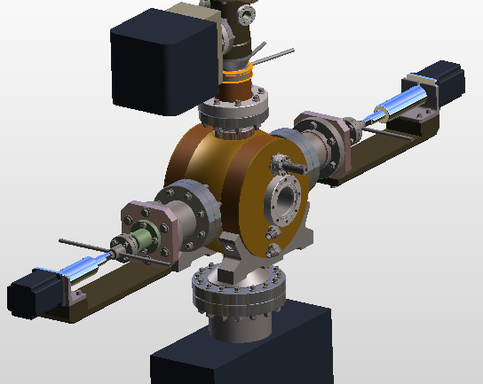
Improving Vacuum in “A1” Section
Increase installed pumping (adding pumps, increase conductance to the pumps, etc.)
Reducing ‘trapped’ surfaces, as much as possible
Enhance bakebility of the A1 section
Apply NEG thin film coating to the A1 section beam pipes and components.
NEG ?

Slide 16
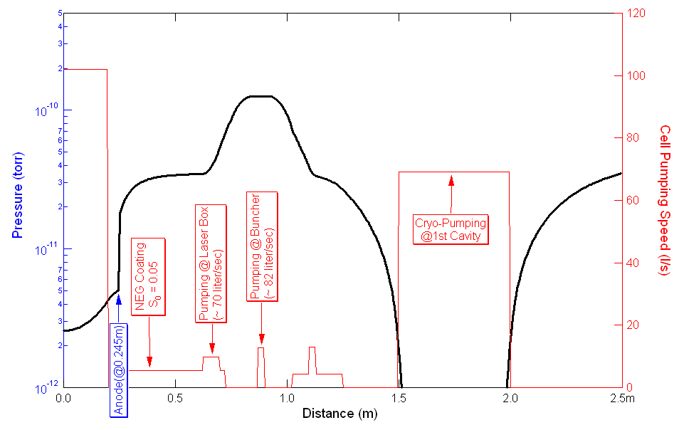
Calculated Pressure Profiles w/ NEG Coating

Slide 17
Brief Summary
Present gun vacuum seem sufficiently good to maintain adequate GaAs cathode dark lifetime
However, base pressure in the preparation chamber needing improvement if multiple cathodes to be stored
Vacuum levels in both the gun and the A1 section needing improvement to achieve acceptable GaAs cathode beam-lifetime
However, significant improvement won’t be trivial
Reduce ion back-scattering using ion-rejecting biased anode/ring(s)
OR, alternative photocathodes, such as multi-alkali

