Slide 1
Review of Gun Performance

Slide 2
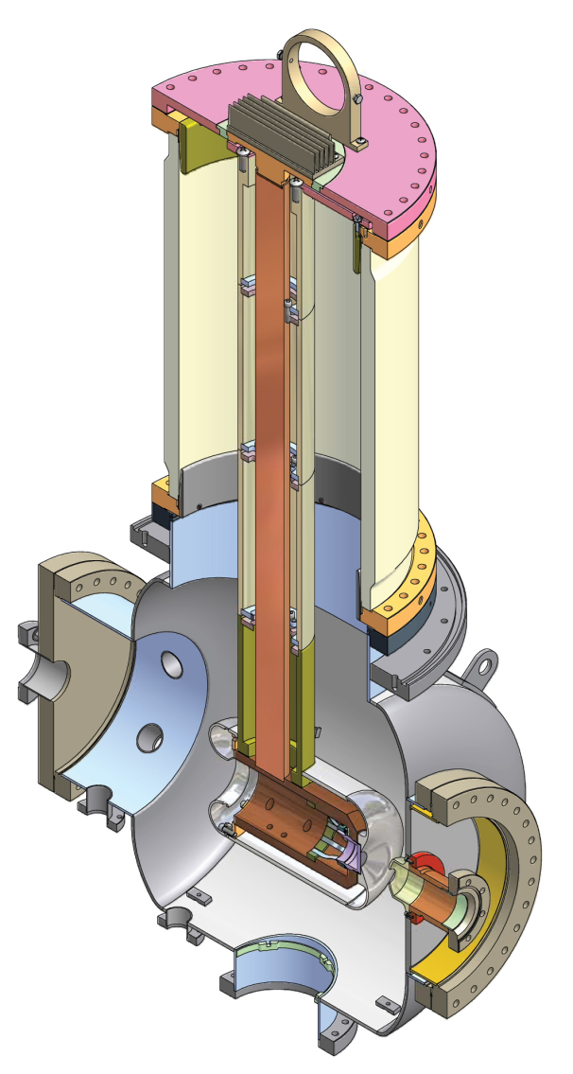

Slide 3
Outline
1. Beam Results
2. Laser Results
3. Cathode
4. HVPS
5. Vacuum
6. Insulator
7. Gun rebuild
8. HV Conditioning
9. Summary

Slide 4
Beam Results – increasing average power
Previously, we could not make it past 8 mA CW. Mostly due to HV power supply instability.
Gun can operate at 350 kV with Morgan/Kyocera insulator
Repaired power supply, reinstalled late summer.
Started increasing current after that. Experienced ‘current surges’ that caused beam loss, vacuum spikes, cathode degradation, thus limiting operation time.
Found problem with HVPS assembly – fixed it, fewer problems, but still occur
Still looking for root cause – likely to be x-rays or light reaching the cathode
Reduced gun voltage to 250 kV, and the rate of events dropped considerably
Reached ~15 mA, limited by radiation, beam loss

Slide 5
Beam Results continued . . .
Found that the beam was inducing a field in the deflection cavity, and kicking the beam, which caused the radiation to go up. Detuned deflector
Reached 25 mA for a short time (limited by laser power, cathode QE)
Ran at 20 mA for ~1 hour
Other issues: above 10 mA, fast laser power fluctuations-> fast current fluctuations, which seem to bother the RF controls. Added fast current feedback using a Pockels cell, need to work on RF controls
Other issues: inadequate shielding, buncher controls (?), ‘poor’ vacuum between the gun and cryomodule. Ramping up the laser power.
At high QE (with a fresh cathode), we see higher radiation levels after the ICM. After an event which reduces the QE, the radiation is lower for the same beam current – halo?
At the end of the 2010, switched to CsK₂Sb cathode – ran 8 mA for 1 hour, no degradation

Slide 6
Laser Results
50 MHz system: enough for full bunch charge operation, used for emittance measurements, low average power beam studies
1300 MHz system: 13 Watts max at 520 nm
Above that, experience fiber damage. working on new fiber holders, thermal engineering . . .
Lose a lot on the way to the cathode, including laser shaping. Lucky if we get 2 Watts to the cathode
Longitudinal shaping – 3 birefringent crystals
Transverse shaping – image an aperture to the cathode
Lack of laser power to the cathode + poor QE (lifetime) are limiting us at the moment.

Slide 7
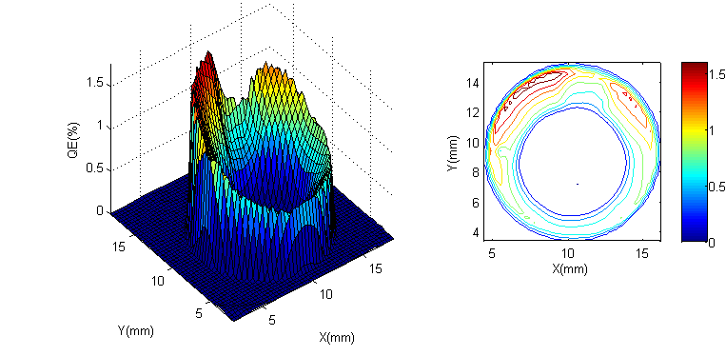
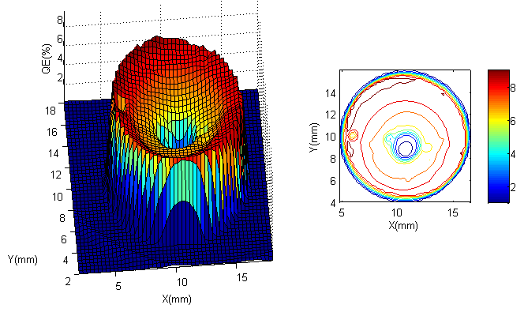
GaAs Cathode – lifetime issues
After 25 mA run
After heat clean and activation

Slide 8
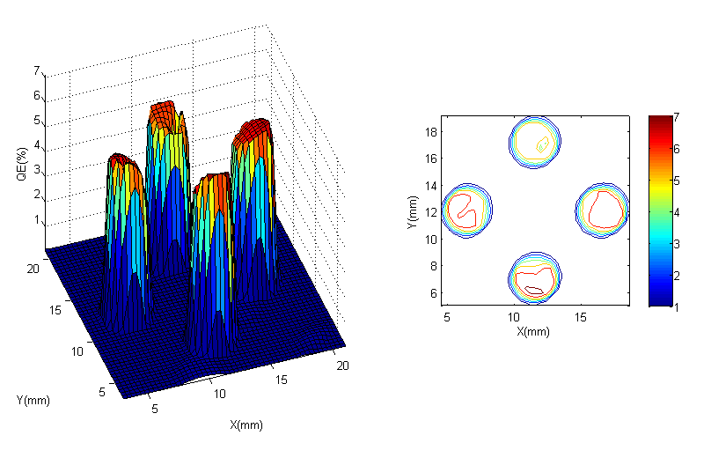
Activate 4 areas away from the center –
- avoids ‘halo’ generation from stray light
- defines a sharp edge for the beam (‘laser shaping’)
- reduces effects of laser position jitter

Slide 9
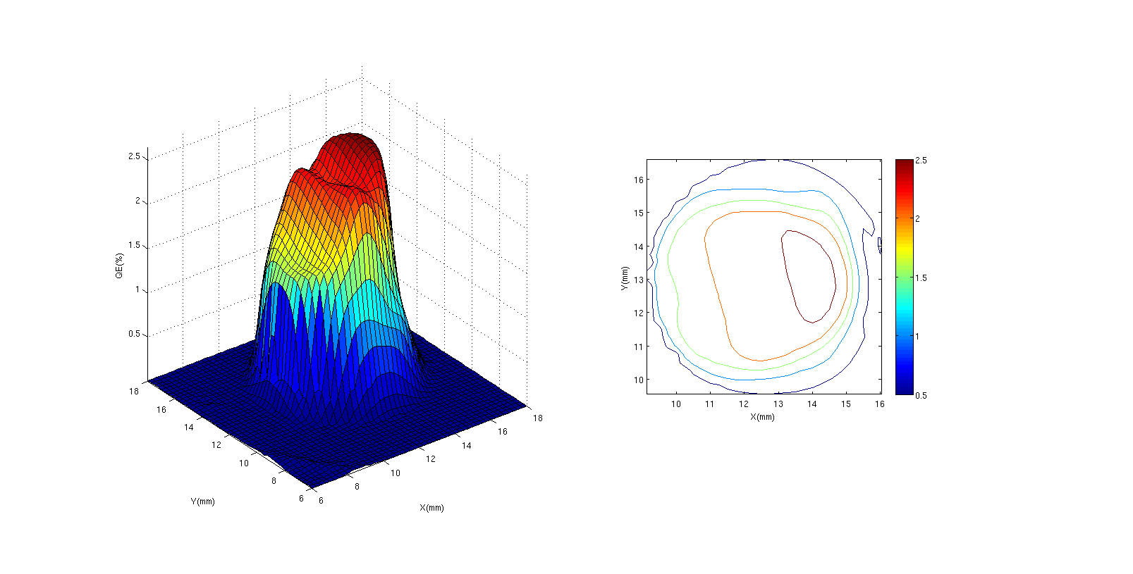
First CsK₂Sb cathode – no QE degradation seen after running 1 hour at 8 mA (2.66% at 532 nm)

Slide 10
GaAs Cathode Surface Damage
Noticed small, visible dots on the cathode surface
Later, pictures show them to be field emission locations
Also, see surface roughening over time, most likely due to heat cleaning
Were able to observe DC field emission from the cathode on a viewer after the cryomodule (nA level), at 350 kV
At 250 kV, do not see any field emission from the cathode

Slide 11
Kaiser HVPS issues
We see line harmonics (output ripple) on the electron beam arrival time signals, can this be reduced?
Overvoltage trip not working right (Vfdbk 1 & 2 comparison trip).
One of the feedback resistor chains may have a problem. Only one of the chains worked when attached to the Vfdbk chain, when we tried the other chain the system did not work.
loop instabilities, what does the VLOOP light really mean
lots of vibrations from blower in SF6 tank. Can we find a different fan, or a variable speed drive so we can tune it away from the tank resonance, which is close to 30 Hz?
output voltage droop when large currents turned on quickly. Can we measure the voltage versus rate of current increase somehow to determine a reasonable rate of rise?
radiated/ conducted emissions from supply affect many other systems
resonance in the ripple between 3mA and 7mA (worst frequency component at 1.6 kHz). What is the cause and can it happen at others current/voltage ranges?
During HV processing, we experienced many trips, particularly OV. Is there a way to change some of the trip parameters during processing to reduce the # of trips (assuming the safety of the supply is not compromised)?
We would like to have a way to use an external feedback signal for fine tuning the HV output (level and ripple). With this, we can compensate for slow thermal drifts in the output voltage and ripple the the control circuitry might not pick up.
The output signals (on the front panel) for voltage and current are very noisy. We don’t know if the ‘noise’ we see is a real voltage fluctuation or just noise. We have already mentioned that the supply radiates a lot of EMI, could this be getting into the control board and control signals?
The water flow/ SF6 temperature interlock circuit trips a few times a week
Any better ways we can monitor the ripple?
Based on all of these issues, we sent the entire supply back to Kaiser for upgrades

Slide 12
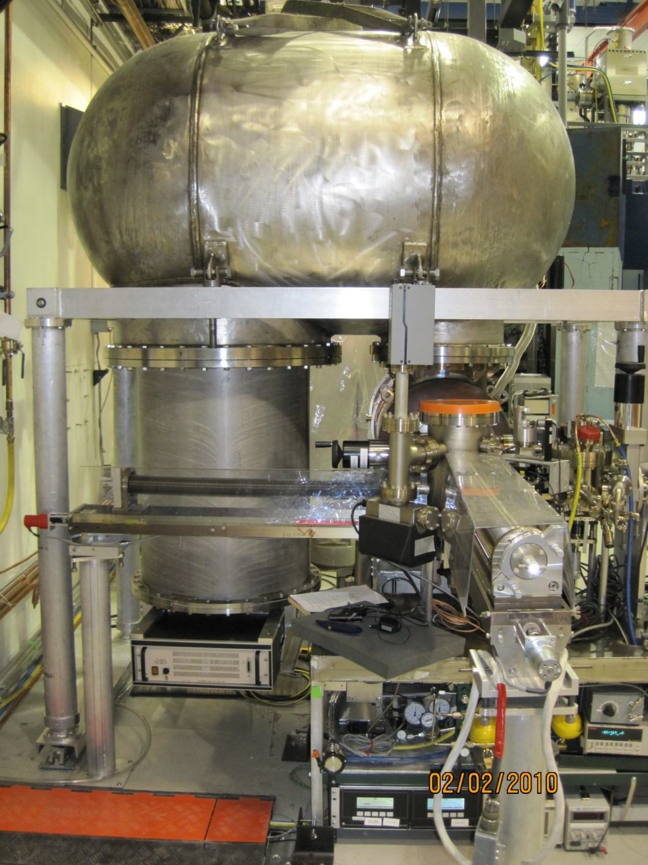
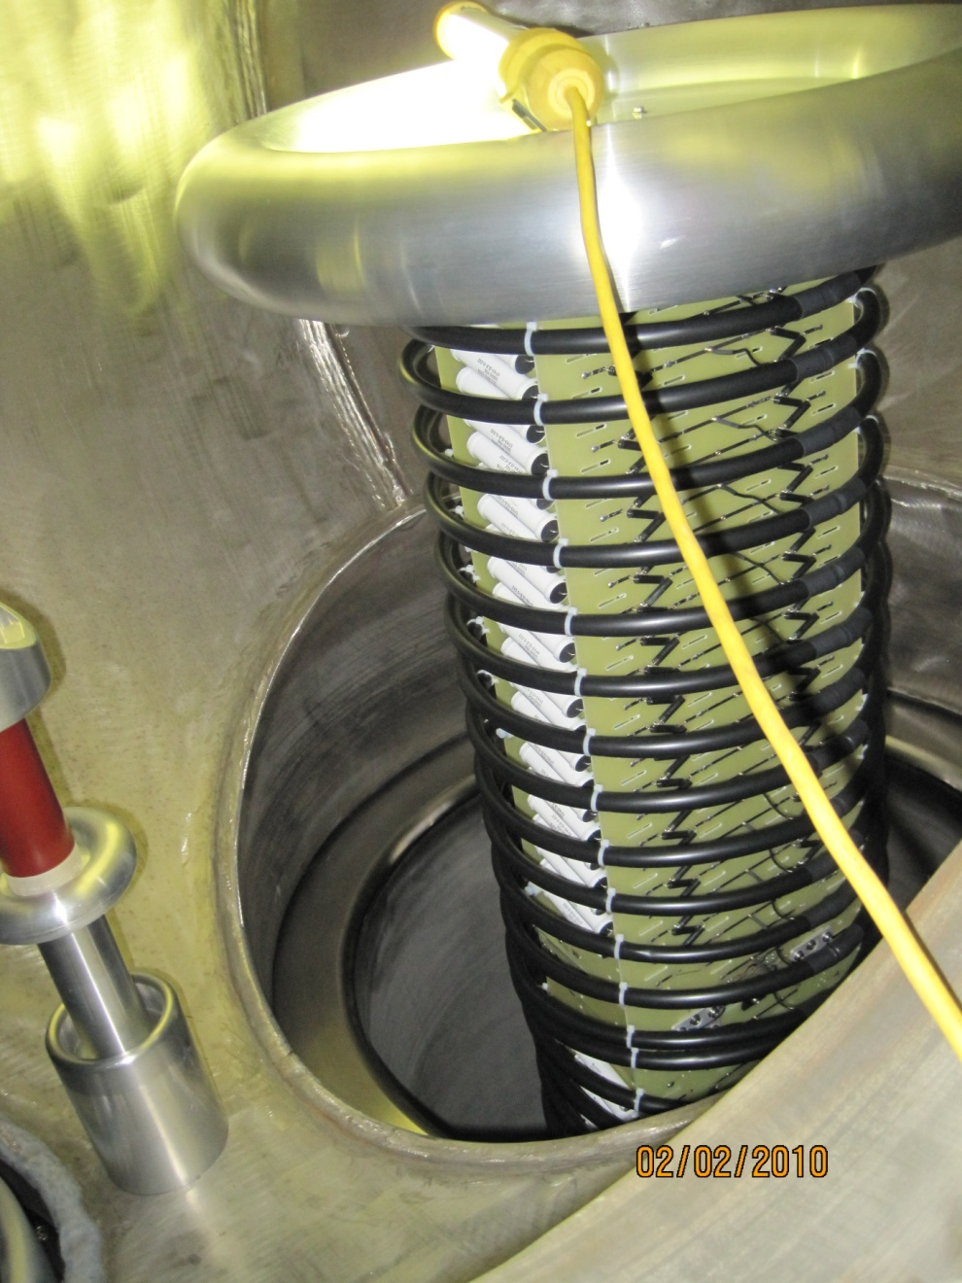
While the Kaiser supply was out for repair, we used a -500kV, 1.5 mA Glassman supply for gun processing and low current operations

Slide 13
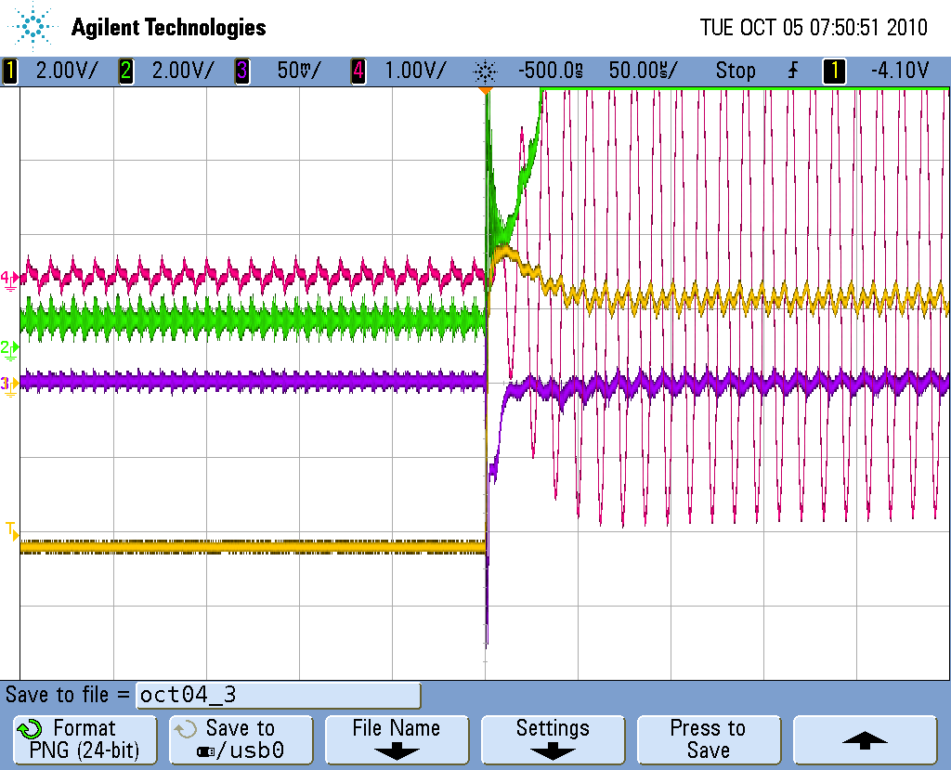
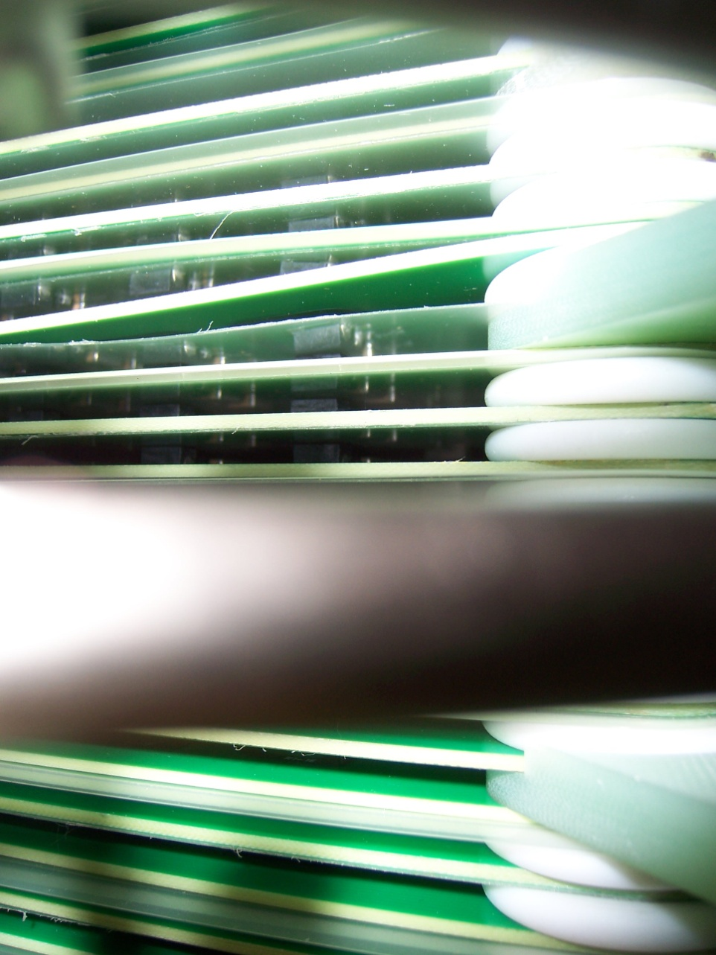
Kaiser HVPS problems after it was returned
Pinched boards
current
PMT
Inverter current
voltage
Arcing down the corner to gnd
Rebuilt the stack, adjusted some control board parameters, fixed HV divider compensation. Has been working well since

Slide 14
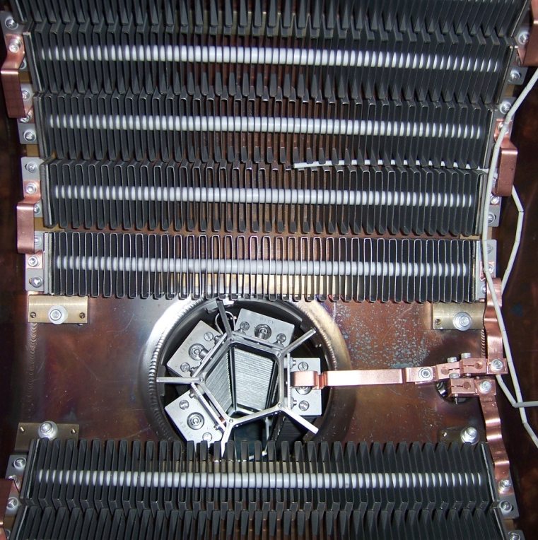
Vacuum
Air-baked stainless steel, arrays of NEG’s, plus one large ion pump
The vacuum (measured with an extractor gauge) is ~7e-12 Torr with the gate valves closed.
One of the NEG arrays is not fully activated (shorted)
With the gate valve opened, the gun vacuum increases to 1e-11 Torr.
Between the gun and the ICM, the pressure is ~3e-10 Torr (valves closed)
During normal beam ops, the gun vacuum does not increase
During ‘events’ it increases momentarily to the 1e-10 to 1e-9 range

Slide 15
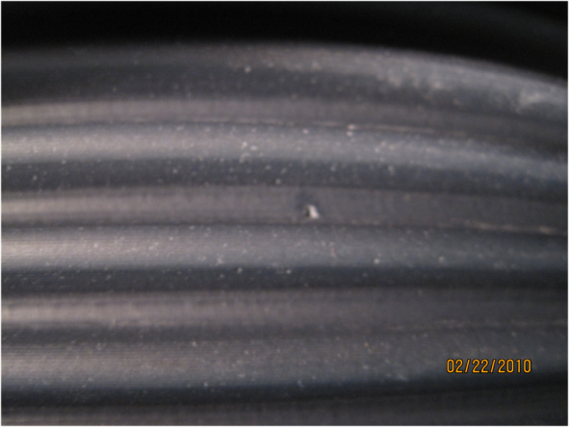
HV Insulator
We have all had problems with insulator braze joint reliability and with insulator punch-thru around 450 kV
We believe the braze joint problem has been solved (see next page).
With the assumption that having a slightly conductive insulator material will bleed away field emitted electrons that reach the insulator, we procured an insulator made with AL970CD (from Morgan, since discontinued).
Unfortunately, had a punch-thru at 450kV, so it appears to be no better than plain alumina
Now, can run beam at 350kV, and probably higher with further processing

Slide 16
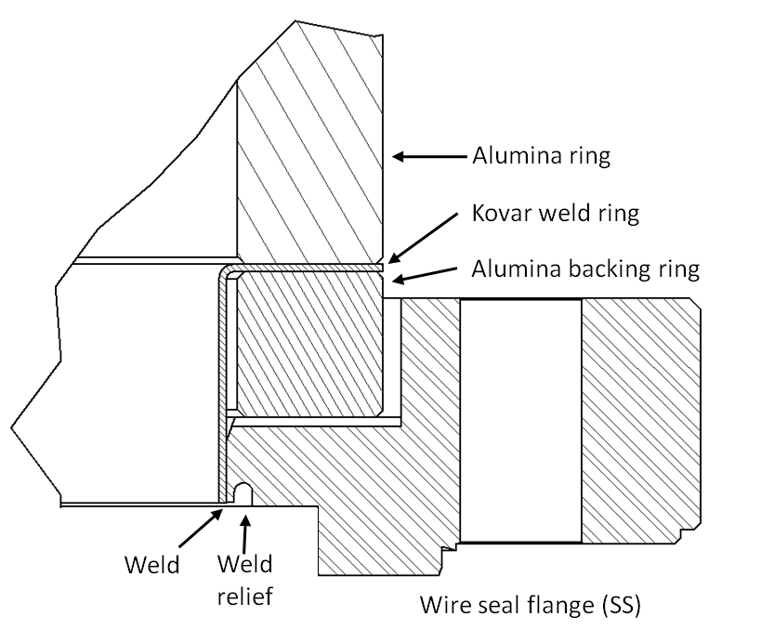
New braze design, first implemented by Kyocera. Has performed great so far.
Now have a number of reliable vendors for brazing (not CPI . . .)

Slide 17
Gun Rebuild
For the last build, we went to extreme lengths to keep dust and particles out of the gun
Used SRF techniques
High pressure rinsed most components
Thoroughly rinsed others (NEG’s for example, had many particles)
All parts cleaned in a clean room (bolts, gaskets, flanges too)
Assembly was all in a clean room
Used .003 um filtered N2 + a particle counter to blow off parts and quantitatively measure when the particles were removed
Did not use silver plated screws (instead used screws of different materials) – have found silver shards in the past
Slow, controlled pump down methods
Was it all worth it?

Slide 18
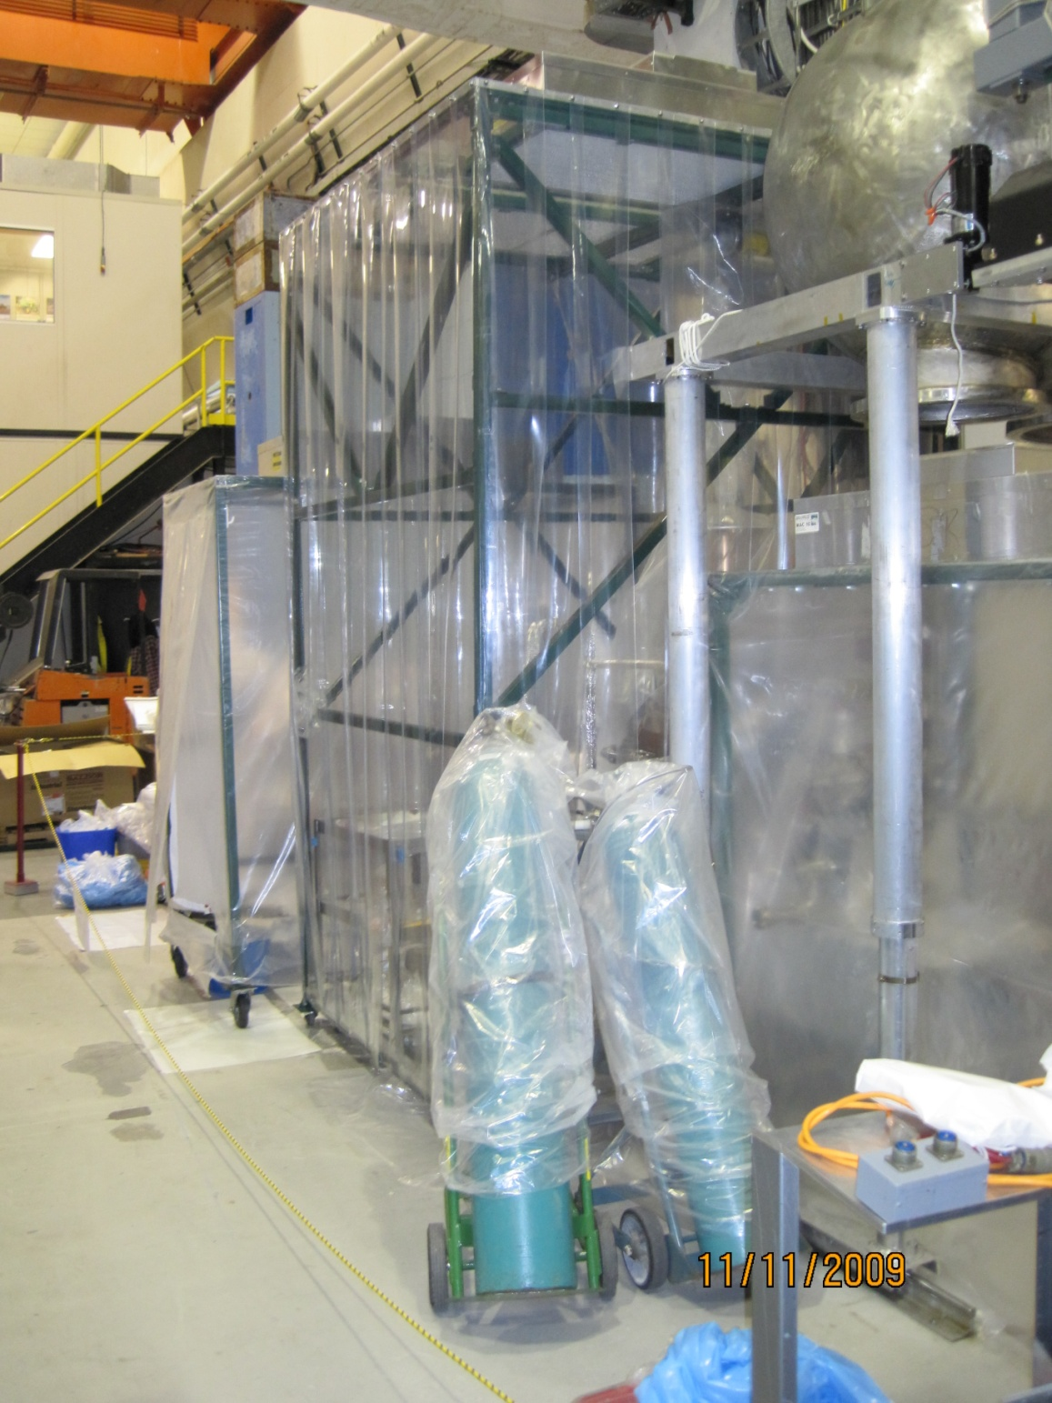

Slide 19
HV Conditioning
All of our insulators have failed at ~445 kV
Jlab and Daresbury devices also fail in this range
The Cornell insulators are larger diameter, but still fail at the same voltage

Slide 20
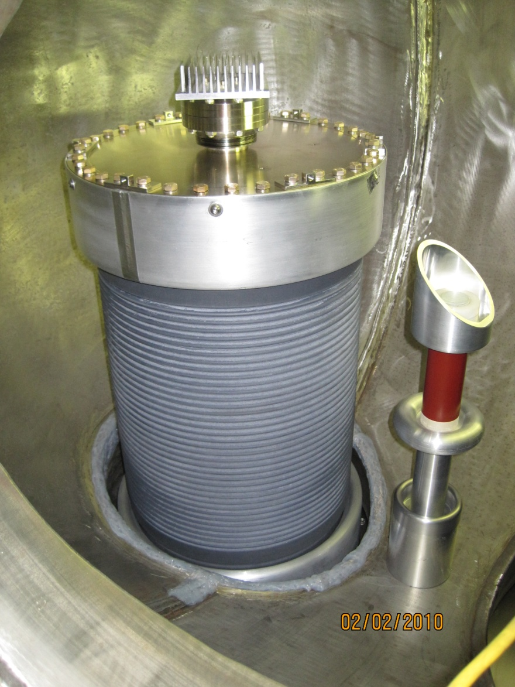
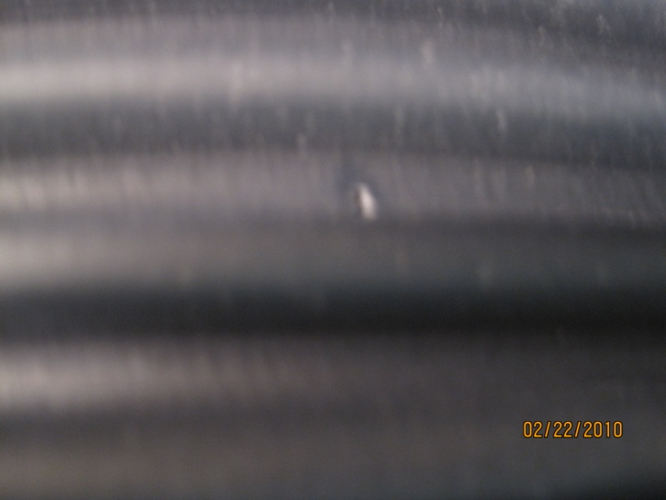
Interior of SF6 tank, insulator side (round dome is missing)
Location of punch-thru

Slide 21
Glassman HVPS, much higher stored energy than the Kaiser supply

Slide 22
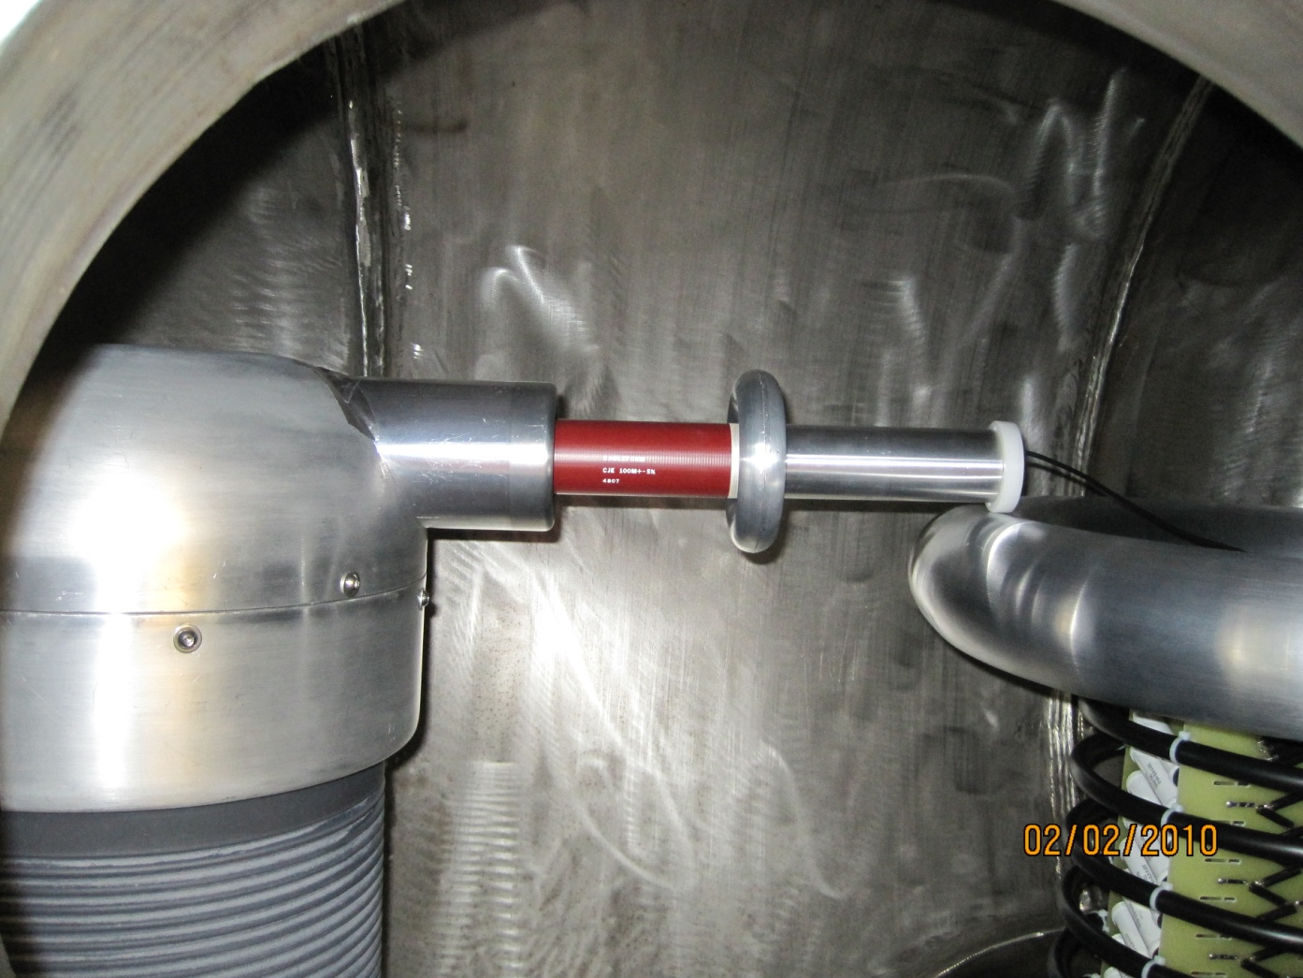
Processing resistor. The resistor is 100 Mohm. We usually put a second resistor on the right side where the tube is, but I ran out of resistors. Pressurized to 1 atm (abs).

Slide 23
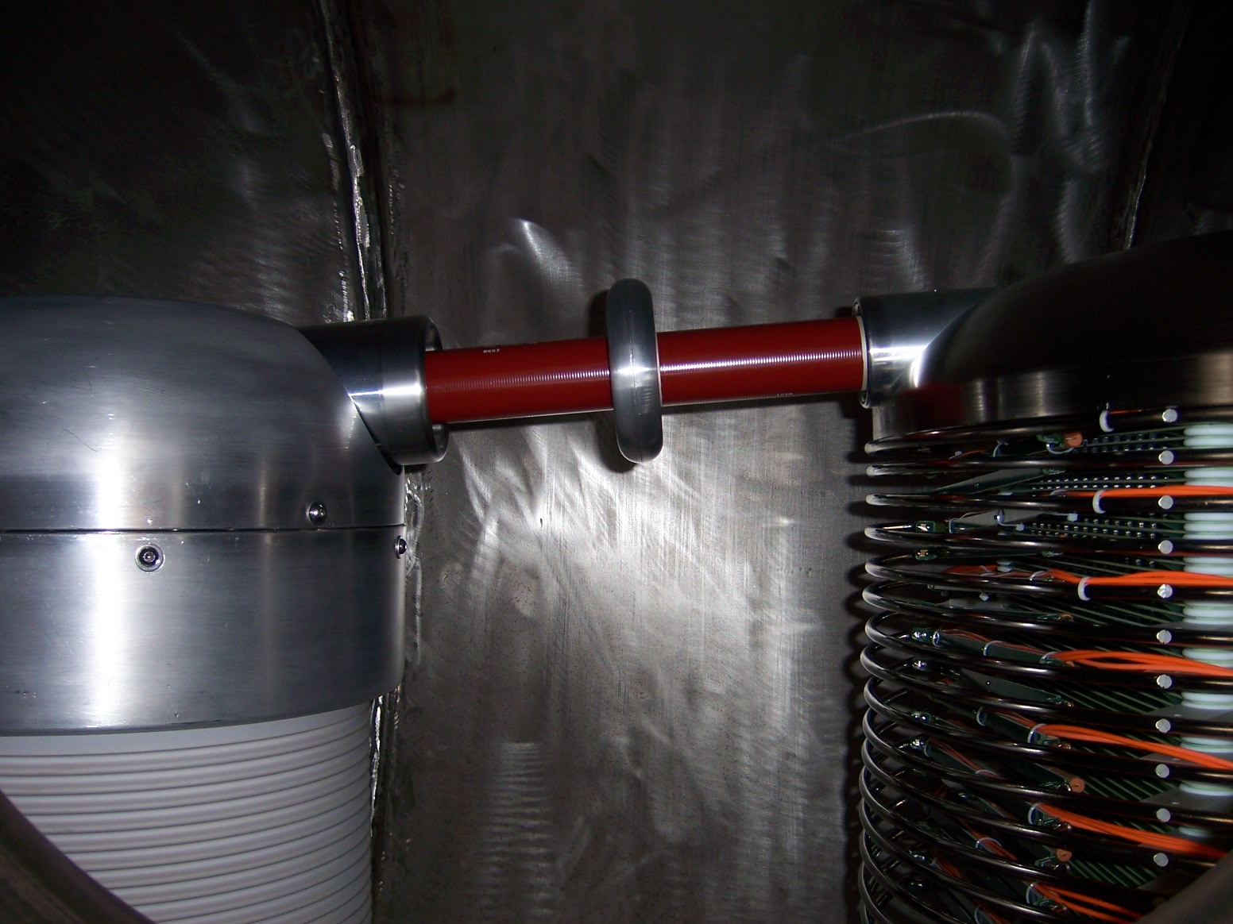
Here is the older configuration when we use the Kaiser Supply

Slide 24
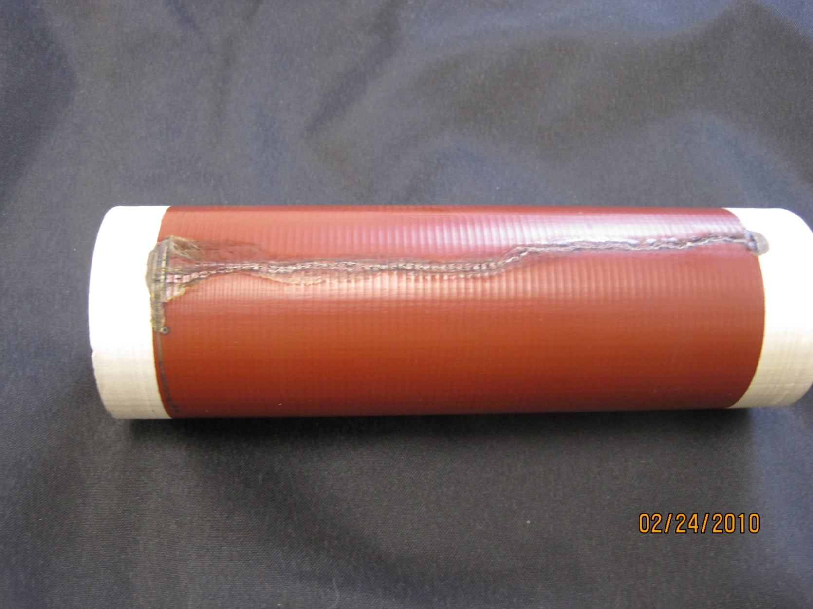
Damaged resistor - open

Slide 25
30 mm diameter
10 MV/m
165 mm
-400kV
125 mm
50 mm diameter – 100MOhm resistor
0 V
If one side drops to ground and the other side of the resistor is at -400kV, I calculated a max field of 10 MV/m

Slide 26
My Theory – maybe you can come up with a better one!
100 M-Ohm resistor, SF6 pressure 1 atm. We normally use 2-3 atm for our Kaiser HVPS, but the Glassman supply does not need so much pressure as the spacings are much larger.
Processing was going pretty well, with a rate of 5 to 10 kV/hour up to 445 kV. Never had to resort to inert gas processing.
At 445 kV, had a large field emission event (vacuum increased a lot, and a burst of radiation). Right after this the vacuum pressure rose and we had burned a hole thru the insulator
We opened up the SF6 tank and found the leak, then sealed it with vacseal. The resistor had a large track mark down its length and measured infinite resistance.
My guess: during the ‘event’, the gun side instantaneously dropped to ground. Then, there was 445 kV across the resistor, and the > 10MV/m field was enough to breakdown thru the SF6 (at 1 atm), as evidenced by the scorched resistor. Then, all of the stored energy in the HVPS was able to dump into the field emitter for long enough to melt a hole in the insulator.

Slide 27
This same thing has happened to me on 3 different insulators now, at almost exactly the same voltage. On the last insulator, we went to extreme lengths to clean the electrodes and keep them dust free during installation – this was quite successful as the processing went quickly up to 445kV.
The previous times, I did have more sf6 pressure in the tank, more like 2 to 3 atm.
My colleagues at Jefferson lab and at Daresbury lab have reached slightly higher voltages (~480-500kV), even though their ceramic has a smaller diameter, thus higher fields on the central tube. This leads me to believe that my geometry should be good for well over 600kV if theirs reaches 500. Both labs did have punch-thrus at the 480kV levels., though. Their processing resistor chains are about 2X longer than mine.
All this evidence points me towards believing that the resistor is the weak link, not necessarily the insulator

Slide 28
Summary
Overall, the gun itself has been very reliable, at lower than desired voltages.
Cathode lifetime is poor for high average currents, with heavy ion damage
Field emission from the cathode surface cause DC dark current
Cathode surface roughening a potential problem
Processing resistor design is poor and a potential cause of insulator failures
Processing techniques and procedures need improvement
Need more laser power and/or better cathode QE (with better lifetime) to make progress much past 25 mA.
Need to find the source of the anomalous events at high average current.
Gun vacuum is ok, need to improve the pressure between the gun and ICM.

