Slide 1
PHOTOCATHODE STUDIES
Electron Energy Analyzer
NEA Cathodes (GaAs)
Multi-alkali Cathodes

Slide 2
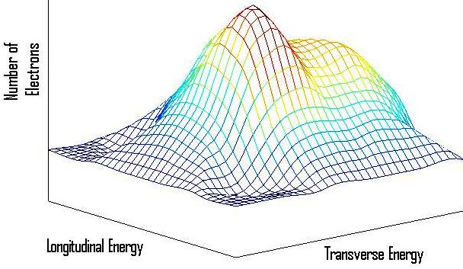
2D ENERGY ANALYZER FOR ELECTRON BEAMS
e
e
e
e
e
e
e
e
e
e
e
Purpose - Measuring the transverse and longitudinal energy distribution of electrons

Slide 3
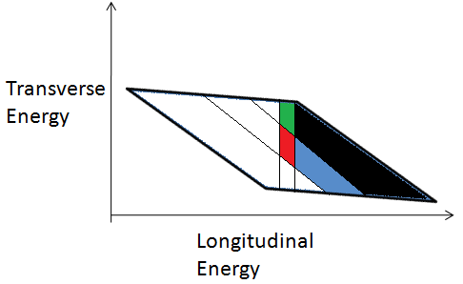
Principle of operation
First Marking Electrode
Varying Magnetic Field
Second Marking Electrode
Beam Current Detector
Transverse
Energy
Longitudinal Energy

Slide 4
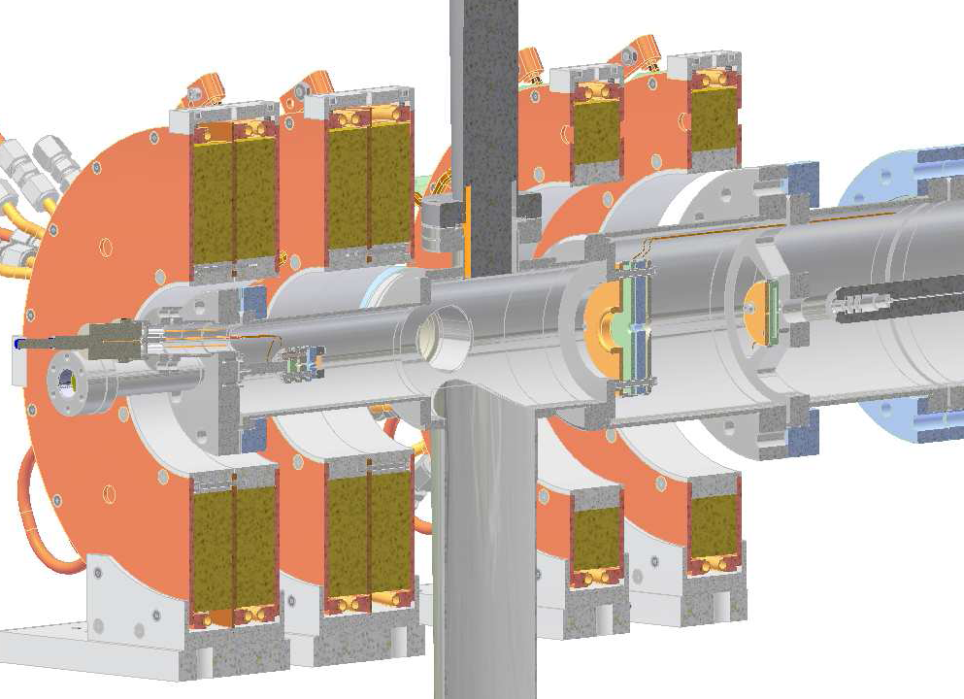
Electron Energy Analyzer
Magnet Coils
Electron source
(Thermionic gun with energy shaping assembly)
RFA
(2nd marking electrode)
Gun
( 1st marking electrode)

Slide 5
Features
Improved version of the Energy analyzer originally developed at Max Planck Institute by Orlov
Use of double lock-in technique and better electrode design.
Can be used at 1nA/mm² and hence with lower intensity tunable wavelength light sources.
Can obtain better energy resolution (<10meV).

Slide 6
NEA Semiconductor Cathodes
Focused on GaAs
Study of surface roughness on emittance
Surface preparation/activation techniques

Slide 7
Surface roughness of GaAs
Surfaces were imaged to a resolution of less than 1 nm using Atomic Force Microscopy
Found more than 10 times rise in rms roughness after activation and use in gun.
Major cause thought to be repetitive heat cleaning for prolonged periods.
Roughness not detectable under optical microscope and wafer doesn’t loose mirror like look

Slide 8
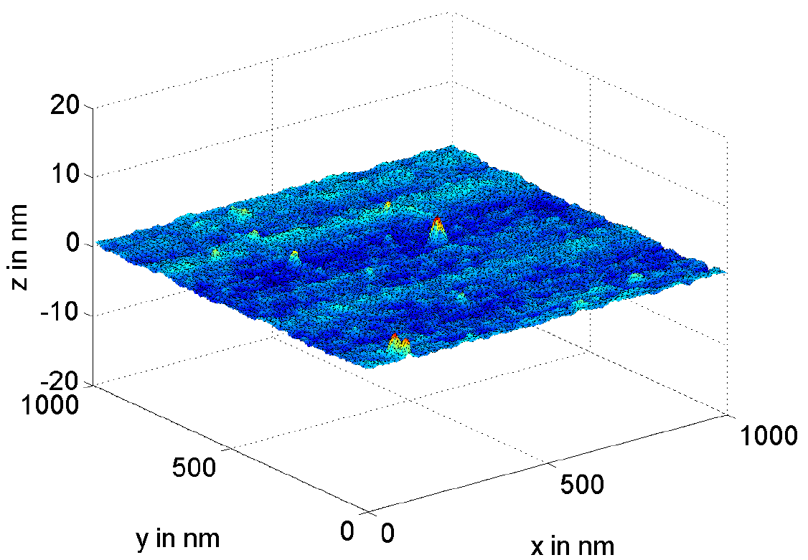
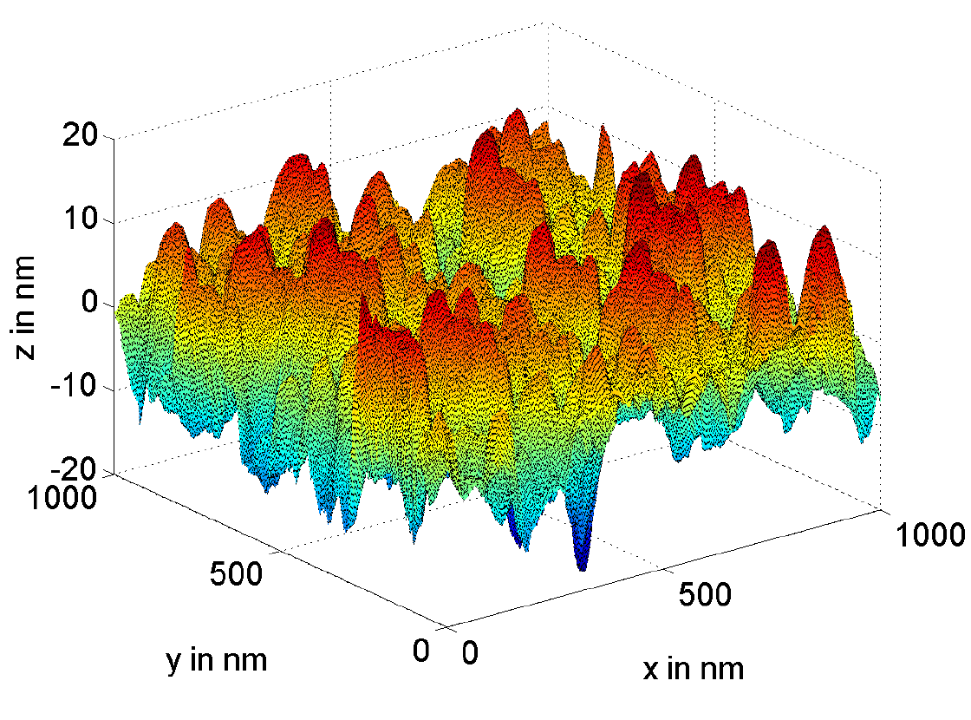
Surface Roughness of GaAs
Atomically polished surface
Activated surface removed from gun
Roughness = 0.5nm(rms)
Roughness = 6nm(rms)

Slide 9
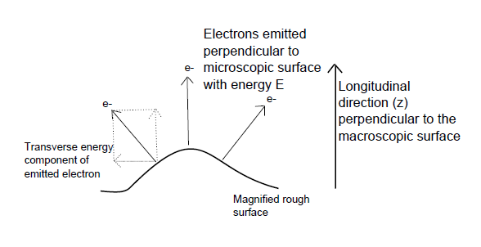
Effect on transverse energy

Slide 10
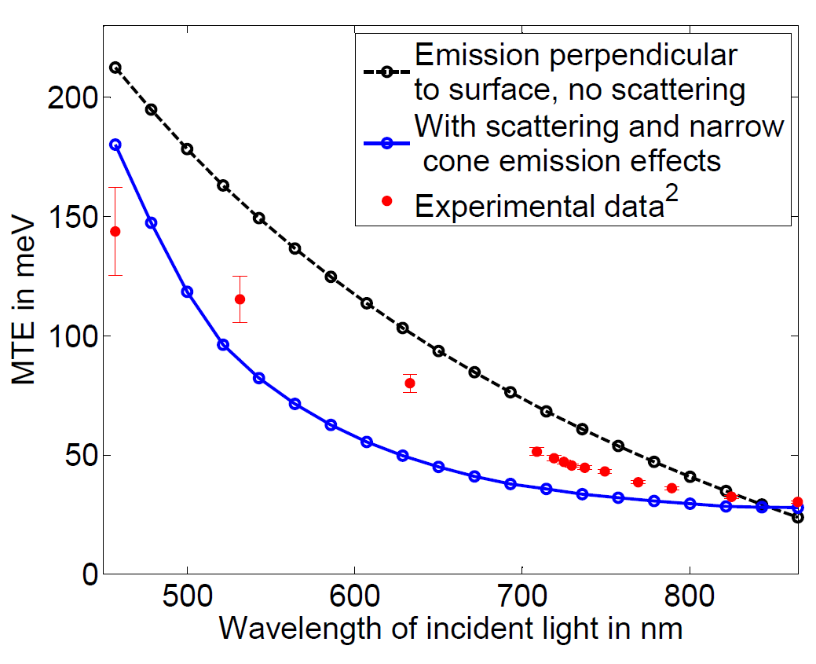
Effect on transverse energy

Slide 11
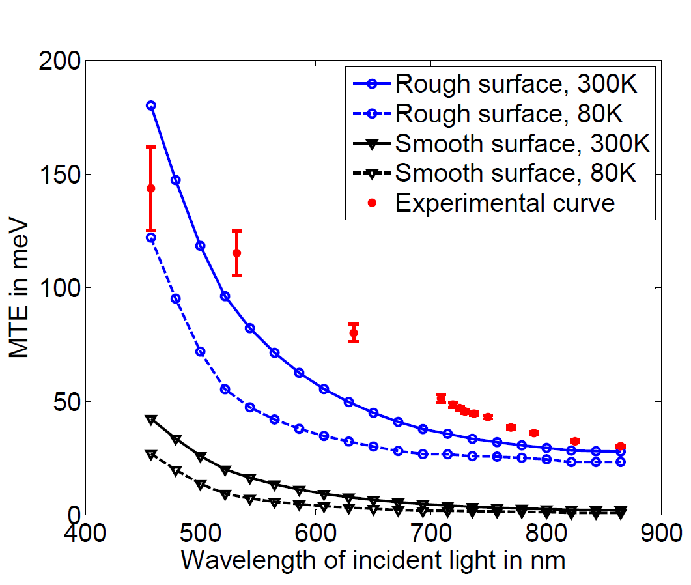
Effect on transverse energy

Slide 12
Future Work
Look at energy distributions/emittance from flat and rough surface
Look into effect of low temperature
Techniques for activation that maintain the surface quality – Cleaving in vacuum, MBE
Energy distributions of multi-alkali cathodes

